Slide 1
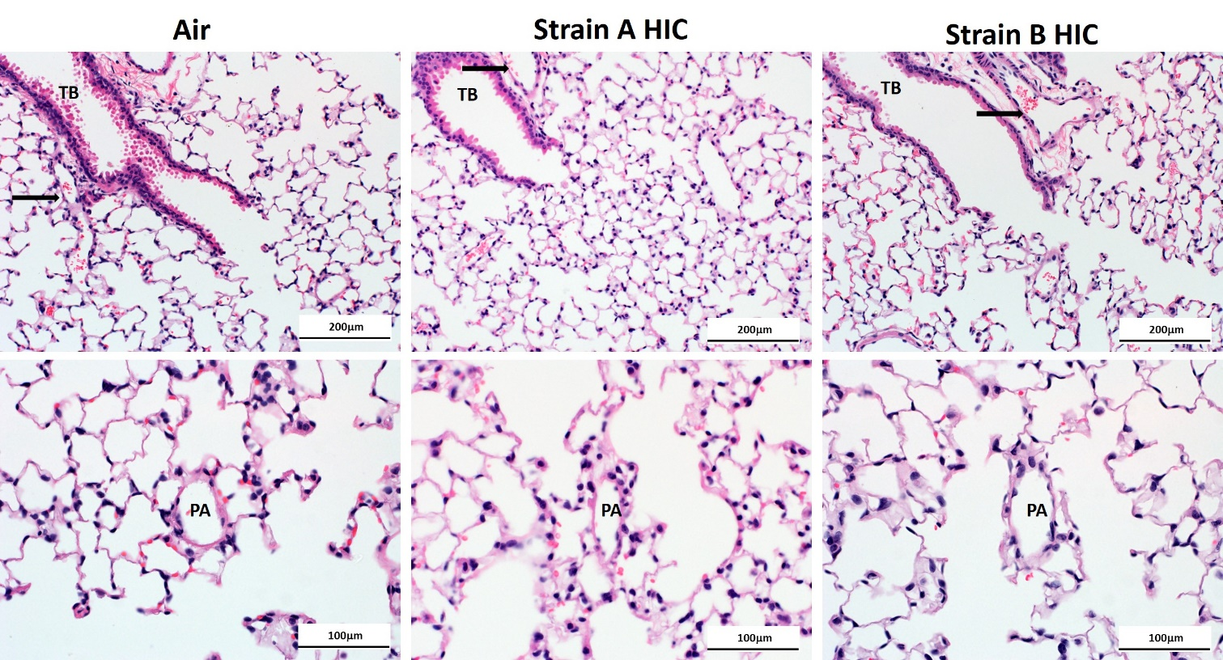
Figure E2
Notes:
Figure E2. Lung tissue following heat-inactivated conidia exposure. Representative photomicrographs of H&E stained sections of lung from mice exposed to either Strain A HIC or Strain B HIC, and sacrificed at 24 hours after 13 weeks of exposure. Lung from an air exposed mouse is shown for reference. Pulmonary arteries (PA, arrows) near the terminal bronchiole (TB).

