Slide 1
Original Article Outbreak of Listeriosis in South Africa Associated with Processed Meat
Juno Thomas, M.D., Nevashan Govender, M.Sc., M.P.H., Kerrigan M. McCarthy, M.D., Linda K. Erasmus, M.D., Timothy J. Doyle, Ph.D., Mushal Allam, Ph.D., Arshad Ismail, Ph.D., Ntsieni Ramalwa, M.P.H., Phuti Sekwadi, M.P.H., Genevie Ntshoe, M.P.H., Andronica Shonhiwa, M.P.H., Vivien Essel, M.D., Nomsa Tau, M.S., Shannon Smouse, M.S., Hlengiwe M. Ngomane, M.T., Bolele Disenyeng, M.T., Nicola A. Page, Ph.D., Nelesh P. Govender, M.D., Adriano G. Duse, M.D., Rob Stewart, M.T., Teena Thomas, M.D., Deon Mahoney, M.S., Mathieu Tourdjman, M.D., Olivier Disson, Ph.D., Pierre Thouvenot, B.S., Mylène M. Maury, Ph.D., Alexandre Leclercq, M.S., Marc Lecuit, M.D., Ph.D., Anthony M. Smith, Ph.D., and Lucille H. Blumberg, M.D.
N Engl J Med
Volume 382(7):632-643
February 13, 2020

Slide 2
Study Overview
A total of 937 cases of listeriosis associated with consumption of the processed meat polony were identified in South Africa.
Pregnant girls and women, neonates, and persons infected with HIV-1 were disproportionately affected.
Molecular techniques identified cases associated with this event and the source of the contamination.

Slide 3
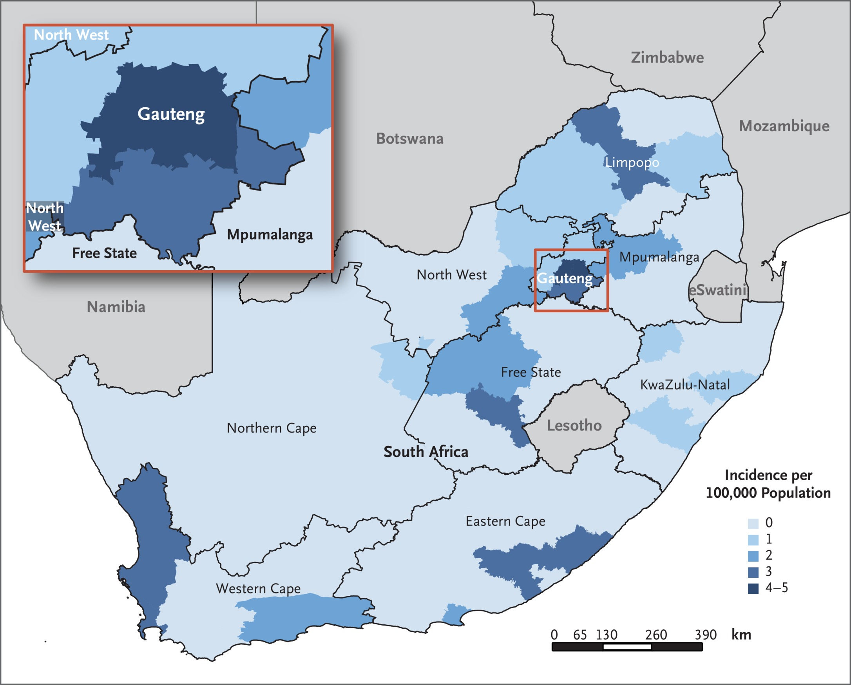
Incidence of Laboratory-Confirmed Cases of Listeriosis in South Africa during the Outbreak Period, According to District.
Thomas J et al. N Engl J Med 2020;382:632-643
Notes:
Figure 1 Incidence of Laboratory-Confirmed Cases of Listeriosis in South Africa during the Outbreak Period, According to District. A total of 937 cases were detected during the outbreak period (June 11, 2017, to April 7, 2018). Incidence was calculated with the use of mid-year population data from 2017.

Slide 4
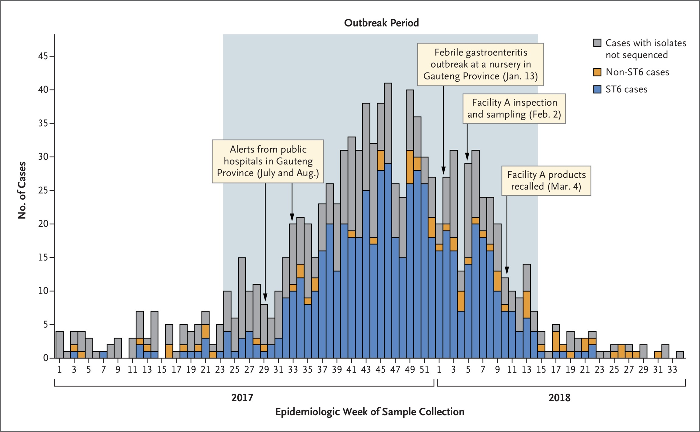
Number of Laboratory-Confirmed Cases of Listeriosis, According to Epidemiologic Week and Major Events (January 1, 2017, to August 21, 2018).
Thomas J et al. N Engl J Med 2020;382:632-643
Notes:
Figure 2 Number of Laboratory-Confirmed Cases of Listeriosis, According to Epidemiologic Week and Major Events (January 1, 2017, to August 21, 2018). Shown are the whole-genome sequence types of 1055 isolates from the patients. The outbreak period was defined as the interval during which the case numbers exceeded and remained above a weekly threshold of five cases per epidemiologic week (June 11, 2017, to April 7, 2018). ST6 denotes sequence type 6.

Slide 5
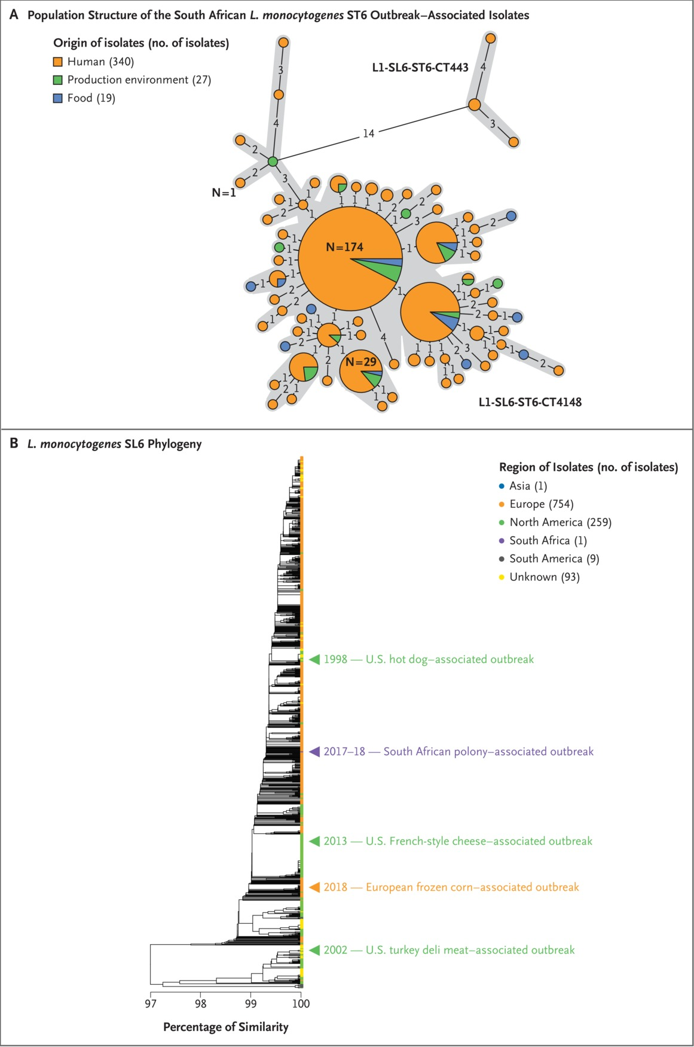
Population Structure of the South African Listeria monocytogenes ST6 Outbreak–Associated Isolates and of L. monocytogenes ST6 Isolates Collected Worldwide.
Thomas J et al. N Engl J Med 2020;382:632-643
Notes:
Figure 3 Population Structure of the South African Listeria monocytogenes ST6 Outbreak–Associated Isolates and of L. monocytogenes ST6 Isolates Collected Worldwide. Panel A shows the diversity of the South African ST6 outbreak isolates based on core-genome multilocus sequence typing profiles. A total of 386 South African isolates are represented. The minimum spanning tree was constructed with the use of the minimum-spanning-tree algorithm available in the software tool BioNumerics, version 7.6.2 (bioMérieux). Each circle represents isolates that have a single core-genome multilocus sequence typing profile. Gray zones surround the isolates that have no more than 7 allelic differences (out of 1748 L. monocytogenes core genes), thus delineating the core-genome multilocus sequence types. The genotypes of the isolates are indicated next to the corresponding gray zone and provide information on the phylogenetic lineage (L), sublineage (SL), sequence type (ST), and core-genome multilocus sequence type (CT). The numbers shown on the black lines linking the circles correspond to the numbers of allelic differences between the isolates. These links are only indicative, because alternative links with equal weight might exist. The size of the circle reflects the number of isolates having similar core-genome multilocus sequence typing profiles; the number on or next to the circles indicates the number of isolates they contain. Panel B shows the genotypic relatedness of the South African ST6 outbreak isolates to the global ST6 population. The position of one isolate representative of the South African outbreak (HM00108598, CT4148, food origin) is indicated by the purple arrowhead. The positions of isolates representative of past outbreaks involving ST6 are also shown. Single-linkage–based cluster analysis was performed with the use of the core-genome multilocus sequence typing allelic profiles of isolates, as described previously. The scale bar indicates the percentage of allelic similarity among the core-genome multilocus sequence typing profiles of the isolates.

Slide 6
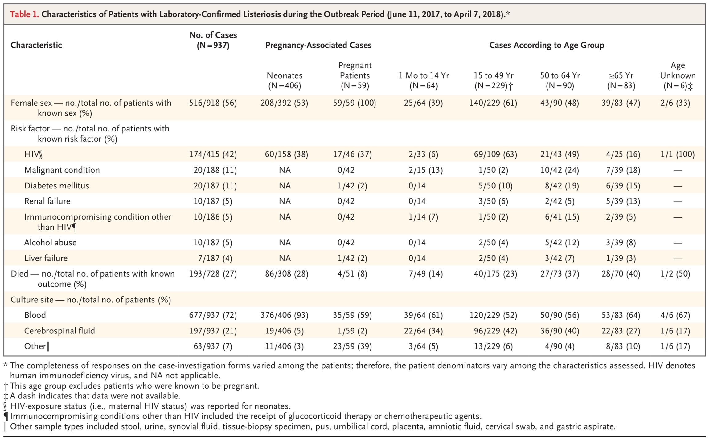
Characteristics of Patients with Laboratory-Confirmed Listeriosis during the Outbreak Period (June 11, 2017, to April 7, 2018).
Thomas J et al. N Engl J Med 2020;382:632-643
Notes:
Table 1 Characteristics of Patients with Laboratory-Confirmed Listeriosis during the Outbreak Period (June 11, 2017, to April 7, 2018).

Slide 7
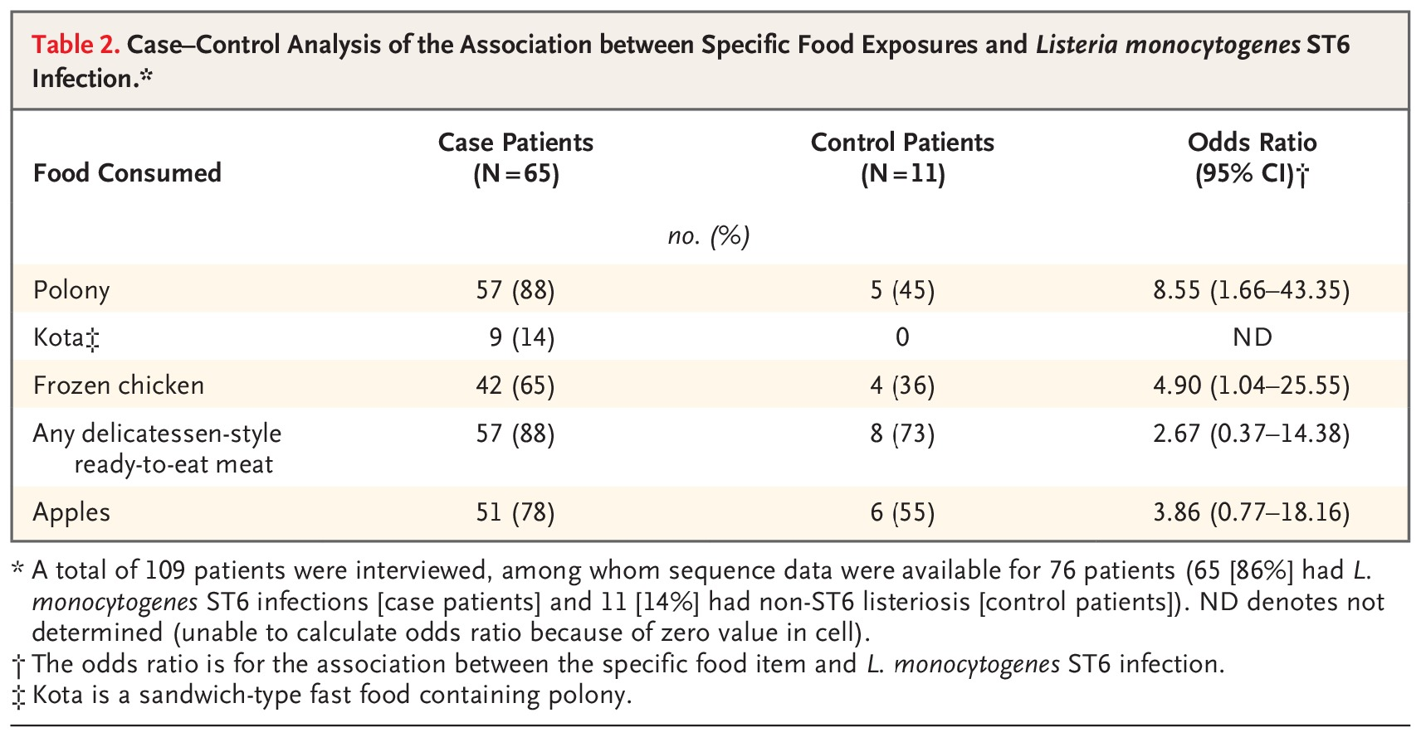
Case–Control Analysis of the Association between Specific Food Exposures and Listeria monocytogenes ST6 Infection.
Thomas J et al. N Engl J Med 2020;382:632-643
Notes:
Table 2 Case–Control Analysis of the Association between Specific Food Exposures and Listeria monocytogenes ST6 Infection.

Slide 8
Conclusions
This investigation showed that in a middle-income country with a high prevalence of HIV infection, L. monocytogenes caused disproportionate illness among pregnant girls and women and HIV-infected persons.
Whole-genome sequencing facilitated the detection of the outbreak and guided the trace-back investigations that led to the identification of the source.

