Slide 1
Supplemental Figures

Slide 2
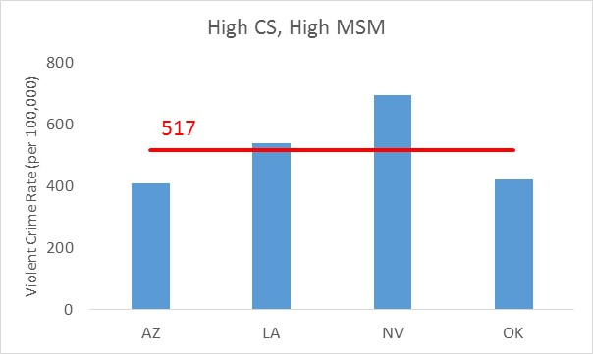
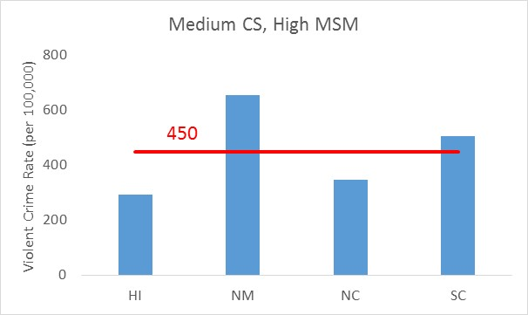
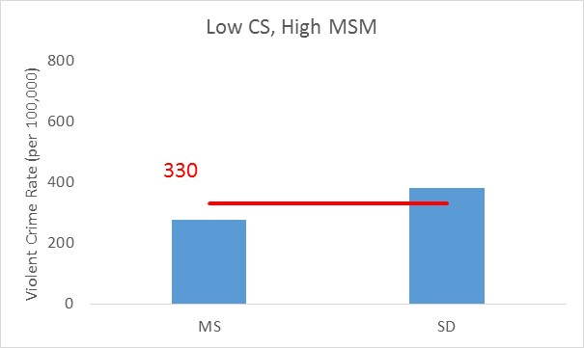
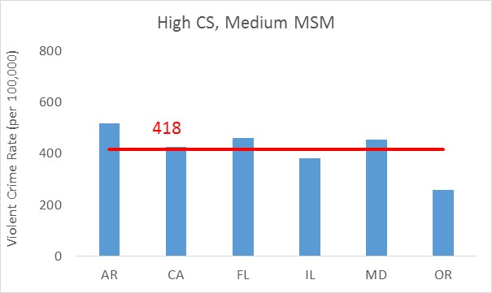
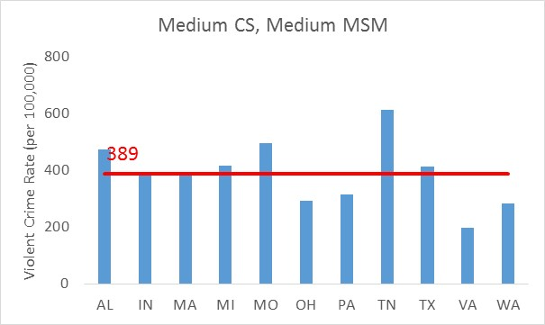
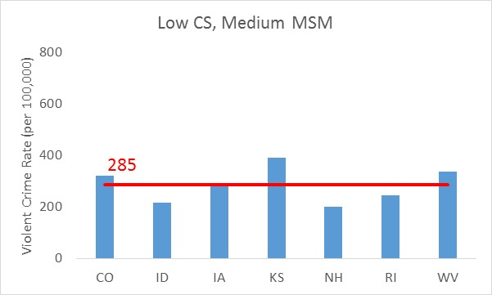
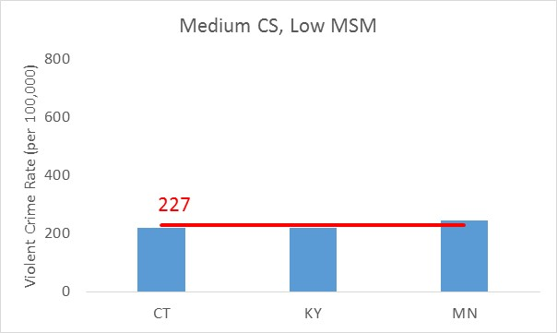
CS Rate
High (Top 10)
Medium (Middle 19)
Low (Bottom 15)
High (Top 10)
Medium (Middle 24)
MSM P&S Rate
Low (Bottom 10)
Supplemental Figure 1

Slide 3
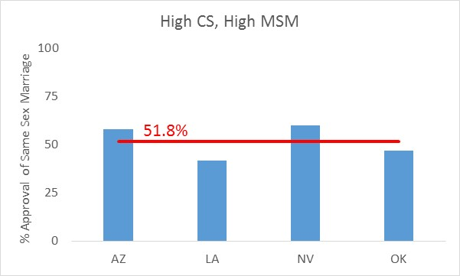
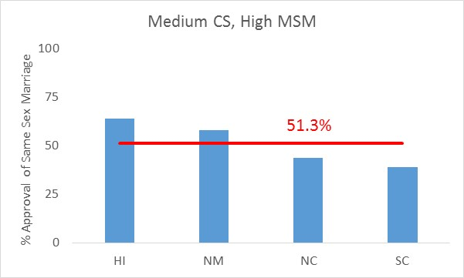
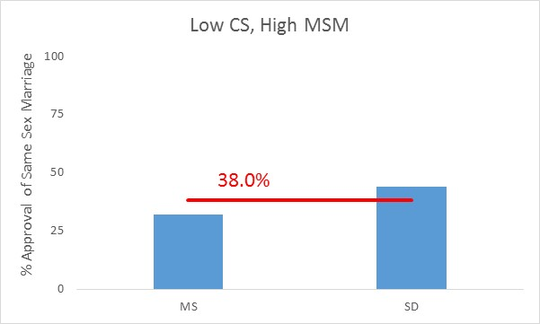
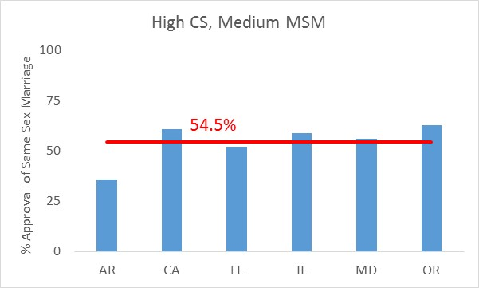
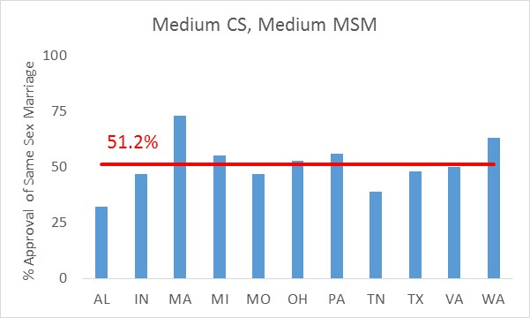
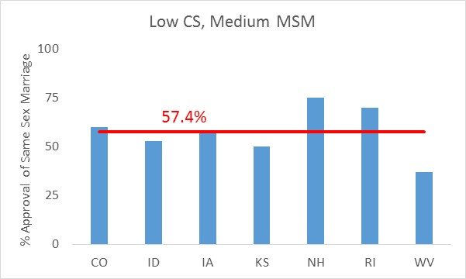
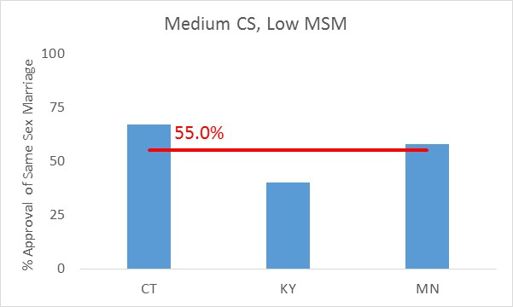
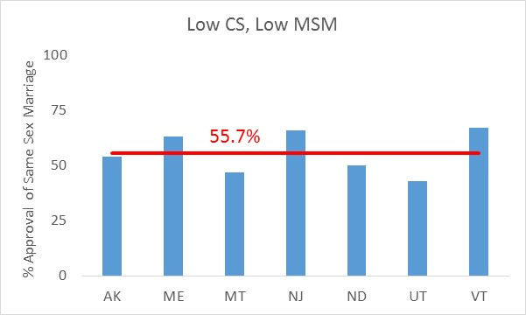
CS Rate
High (Top 10)
Medium (Middle 19)
Low (Bottom 15)
High (Top 10)
Medium (Middle 24)
MSM P&S Syphilis Rate
Low (Bottom 10)
Supplemental Figure 2

Slide 4
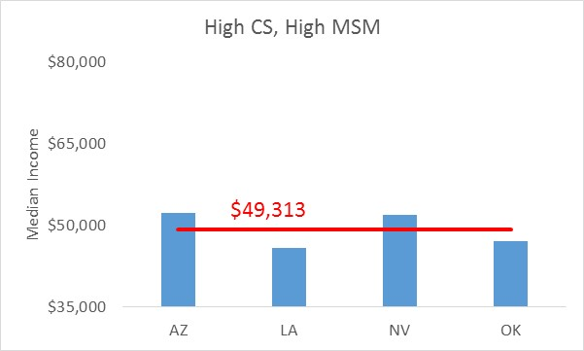
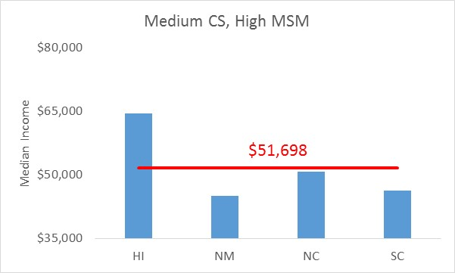
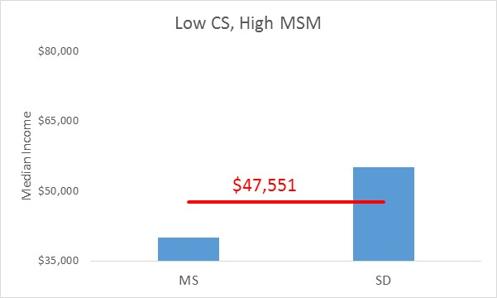
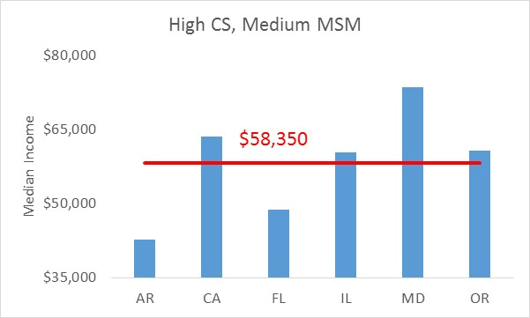
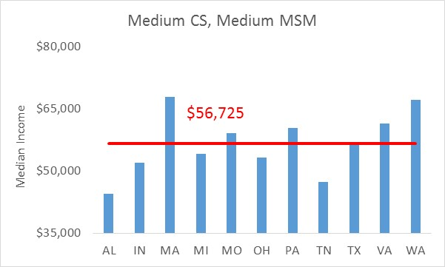
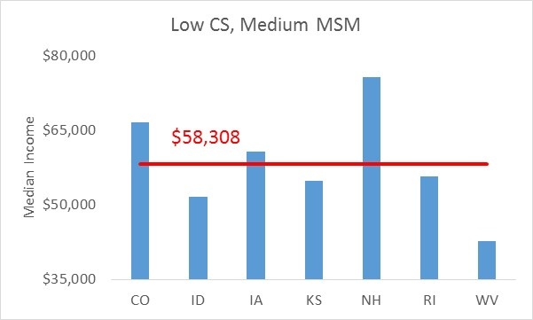
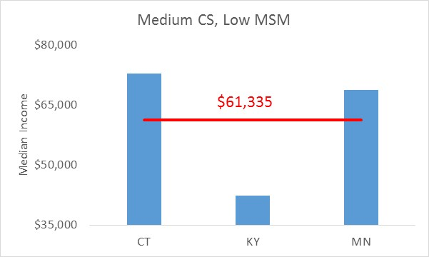
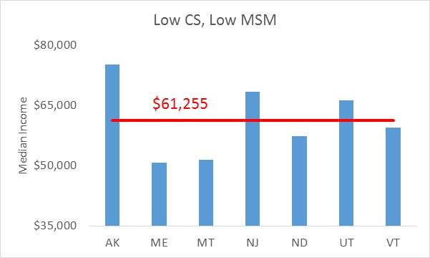
CS Rate
High (Top 10)
Medium (Middle 19)
Low (Bottom 15)
High (Top 10)
Medium (Middle 24)
MSM P&S Syphilis Rate
Low (Bottom 10)
Supplemental Figure 3

Slide 5
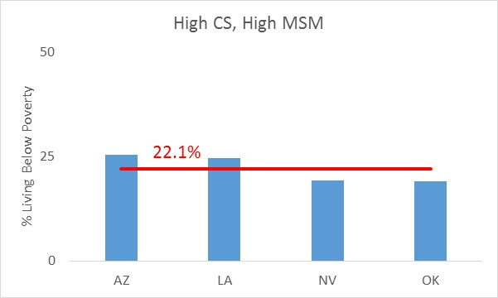
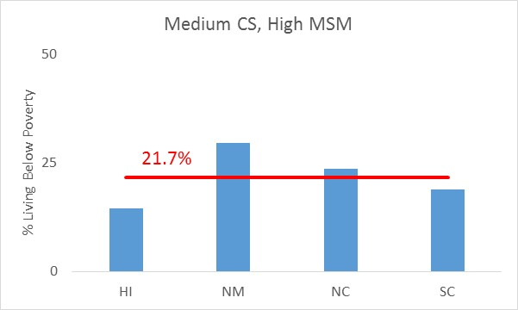
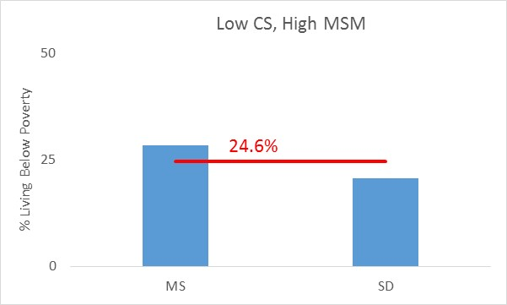
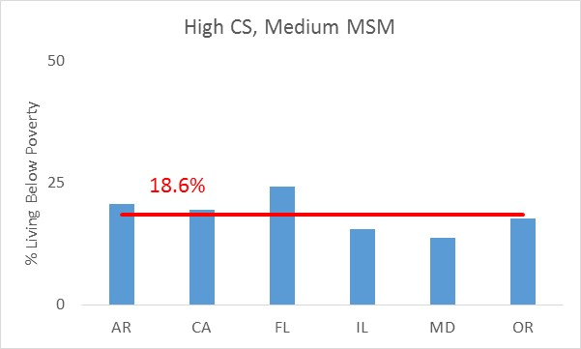
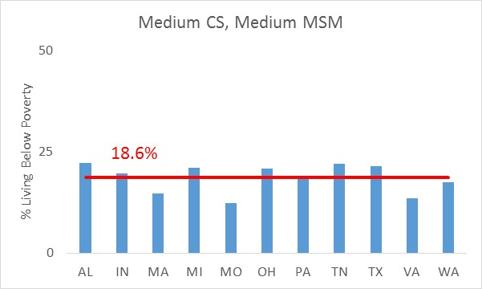
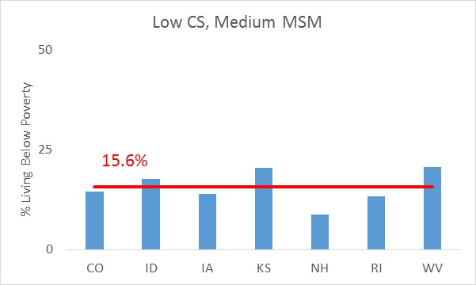
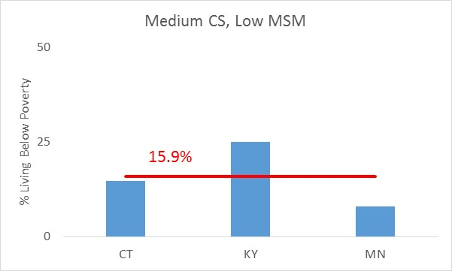
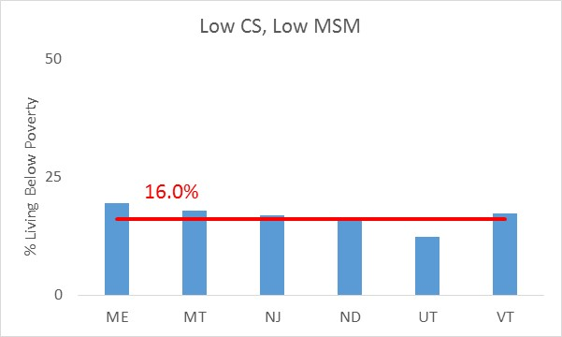
CS Rate
High (Top 10)
Medium (Middle 19)
Low (Bottom 15)
High (Top 10)
Medium (Middle 24)
MSM P&S Syphilis Rate
Low (Bottom 10)
Supplemental Figure 4

Slide 6
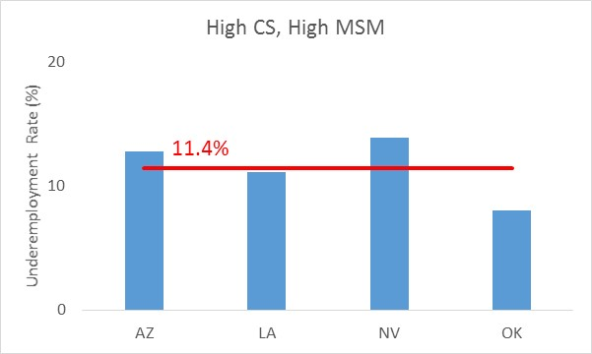
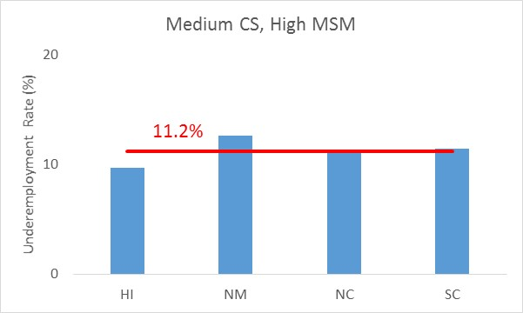
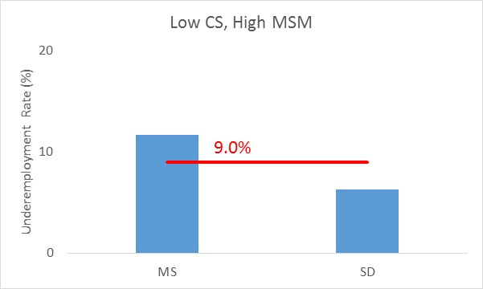
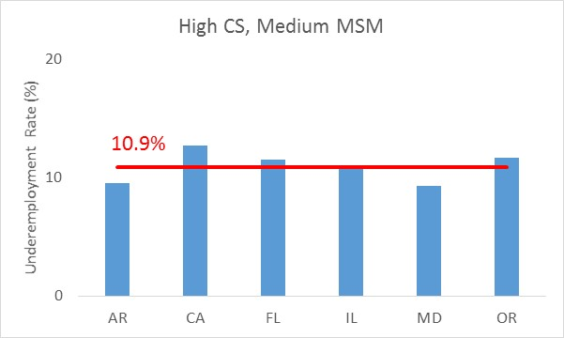
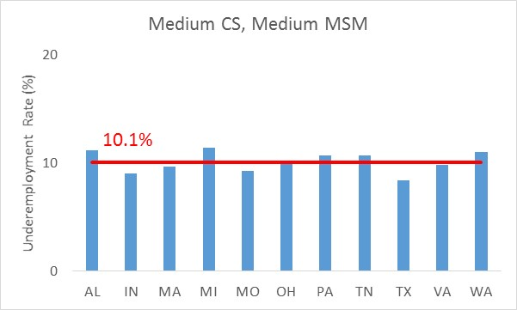
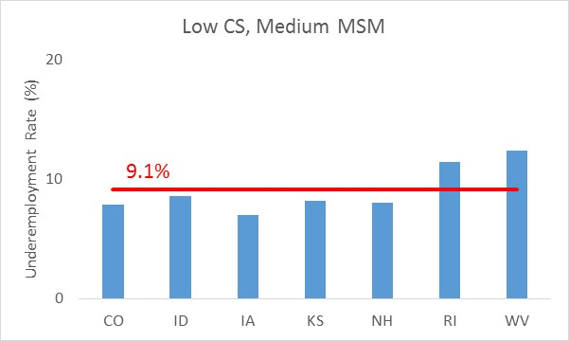
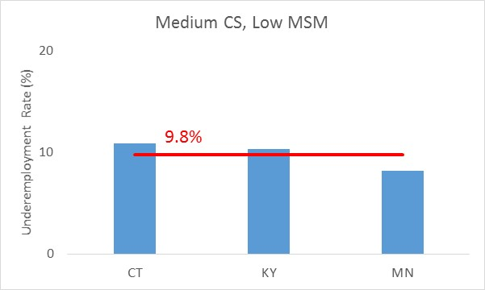
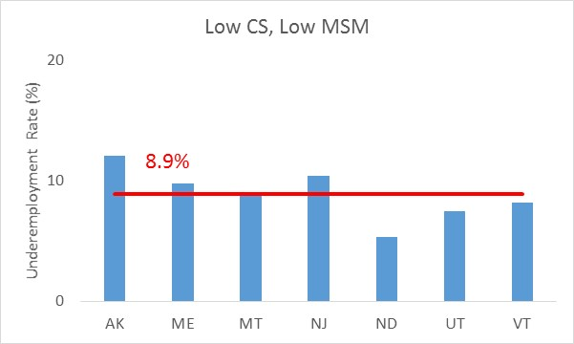
CS Rate
High (Top 10)
Medium (Middle 19)
Low (Bottom 15)
High (Top 10)
Medium (Middle 24)
MSM P&S Syphilis Rate
Low (Bottom 10)
Supplemental Figure 5

Slide 7
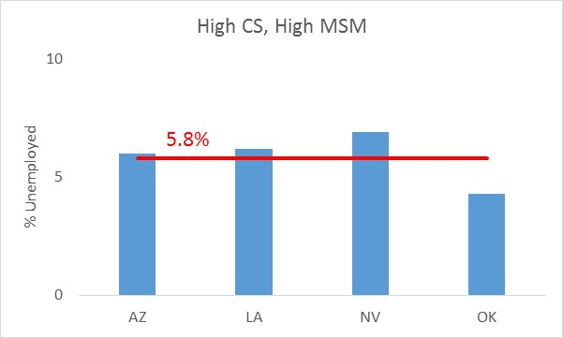
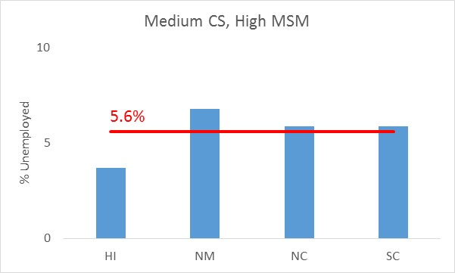
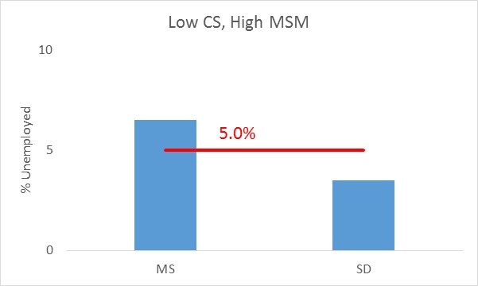
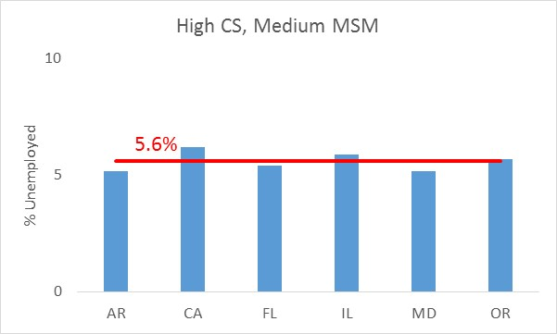
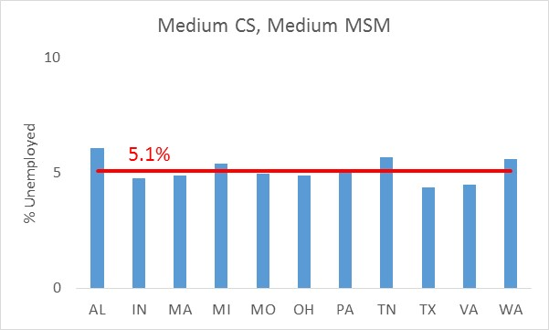
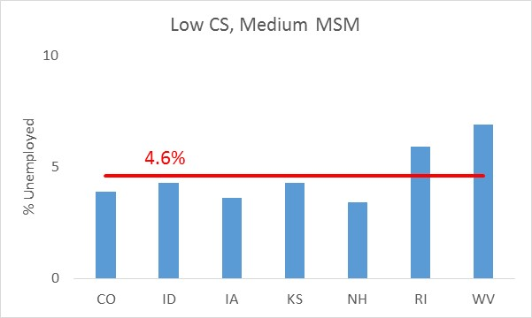
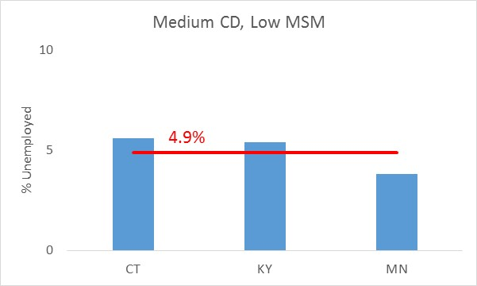
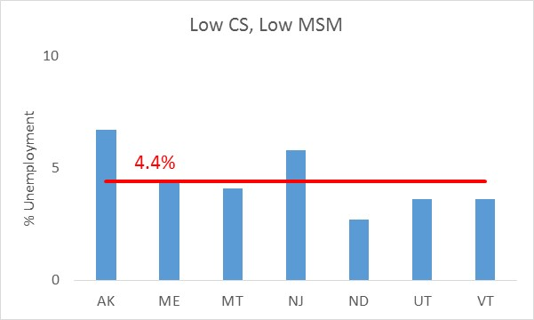
CS Rate
High (Top 10)
Medium (Middle 19)
Low (Bottom 15)
High (Top 10)
Medium (Middle 24)
MSM P&S Syphilis Rate
Low (Bottom 10)
Supplemental Figure 6

Slide 8
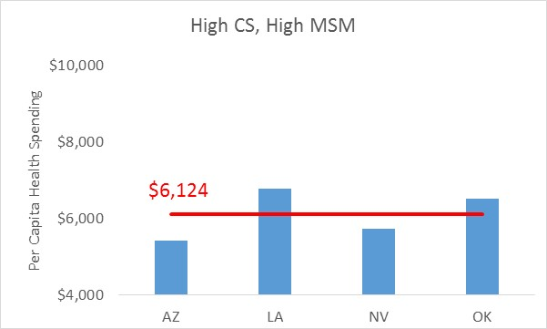
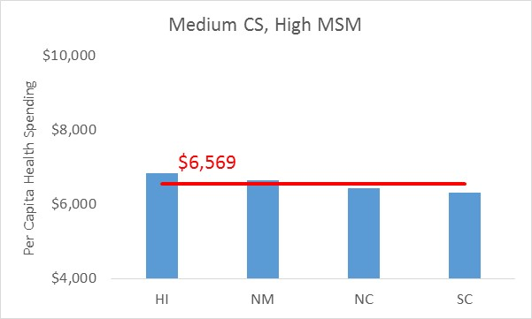
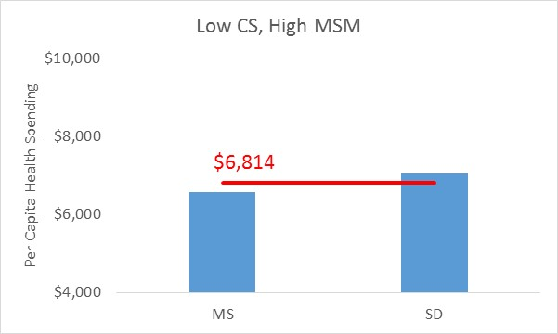
CS Rate
High (Top 10)
Medium (Middle 19)
Low (Bottom 15)
High (Top 10)
Medium (Middle 24)
MSM P&S Syphilis Rate
Low (Bottom 10)
Supplemental Figure 7

Slide 9
CS Rate
High (Top 10)
Medium (Middle 19)
Low (Bottom 15)
High (Top 10)
Medium (Middle 24)
MSM P&S Syphilis Rate
Low (Bottom 10)
Supplemental Figure 8

Slide 10
CS Rate
High (Top 10)
Medium (Middle 19)
Low (Bottom 15)
High (Top 10)
Medium (Middle 24)
MSM P&S Syphilis Rate
Low (Bottom 10)
Supplemental Figure 9

Slide 11
CS Rate
High (Top 10)
Medium (Middle 19)
Low (Bottom 15)
High (Top 10)
Medium (Middle 24)
MSM P&S Syphilis Rate
Low (Bottom 10)
Supplemental Figure 10

Slide 12
CS Rate
High (Top 10)
Medium (Middle 19)
Low (Bottom 15)
High (Top 10)
Medium (Middle 24)
MSM P&S Syphilis Rate
Low (Bottom 10)
Supplemental Figure 11

Slide 13
CS Rate
High (Top 10)
Medium (Middle 19)
Low (Bottom 15)
High (Top 10)
Medium (Middle 24)
MSM P&S Syphilis Rate
Low (Bottom 10)
Supplemental Figure 12

