Slide 2
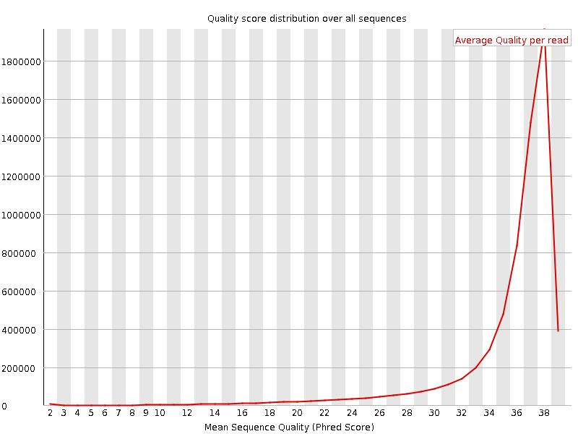
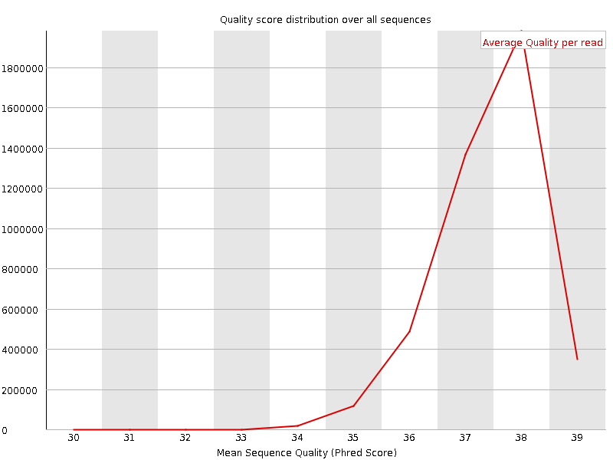
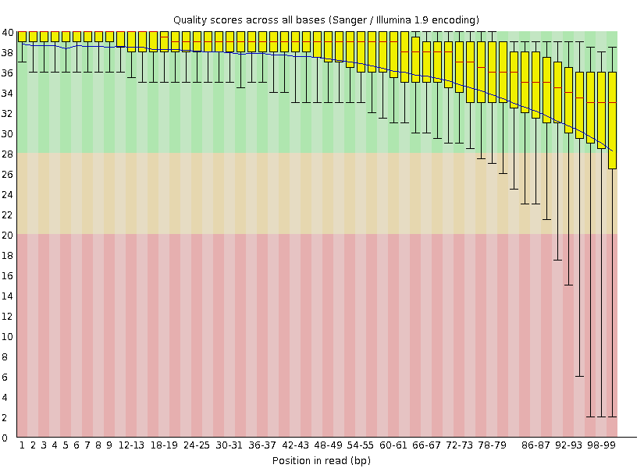
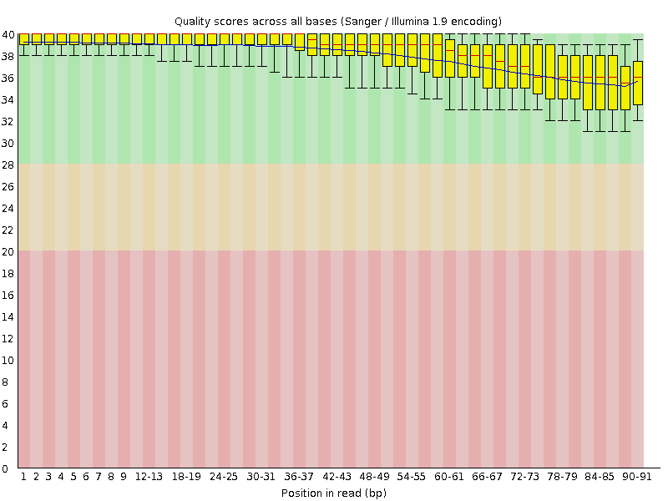
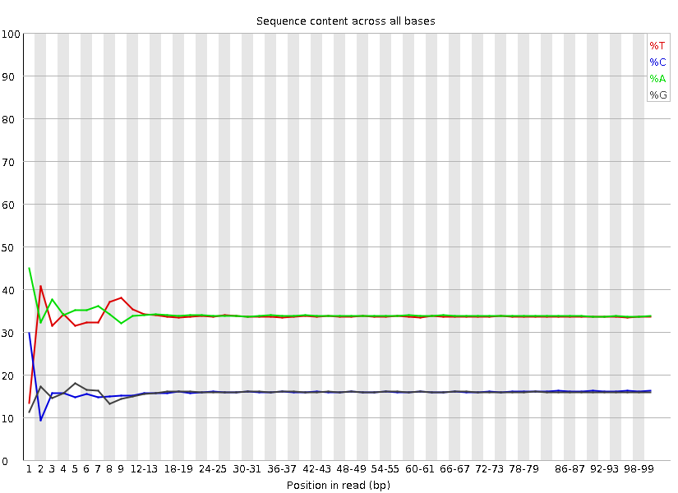
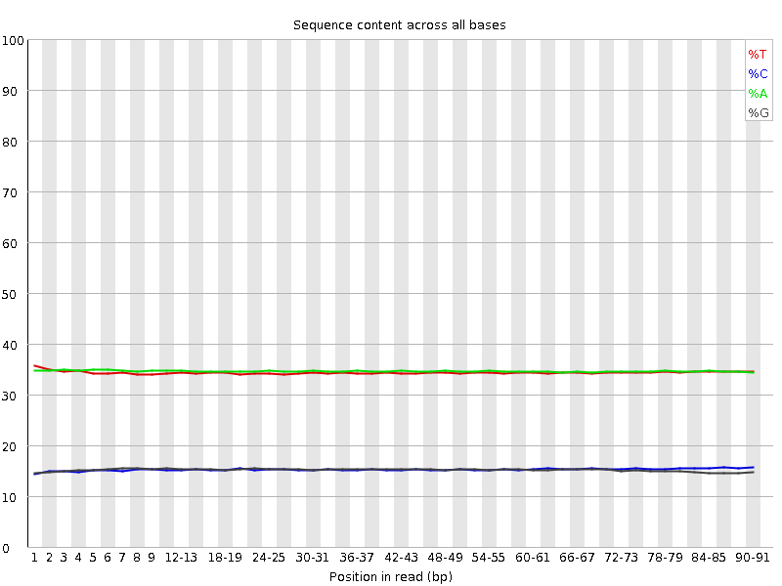
A
B
C
Supplementary S2

Slide 3
A
cgd3_4340
cgd3_4350
cgd3_4360
cgd4_10
IOWA
4135-bp insertion after cgd3_4360, encoding a cgd3_10 ortholog
35090
B
cgd6_5470
cgd6_5480
cgd6_5500
34902
5,273-bp insertion between cgd6_5480 and cgd6_5500, encoding a cgd3_4260 ortholog
31727
Supplementary Fig S3

Slide 4
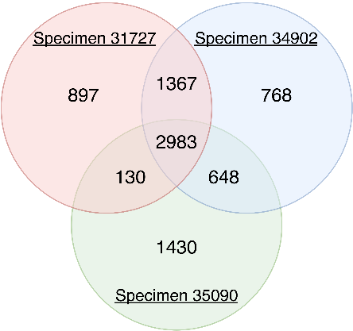
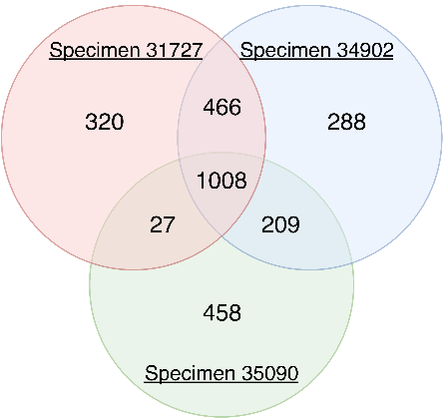
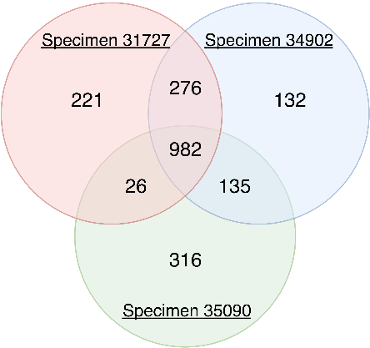
A
B
C
Supplementary Fig S4

Slide 5
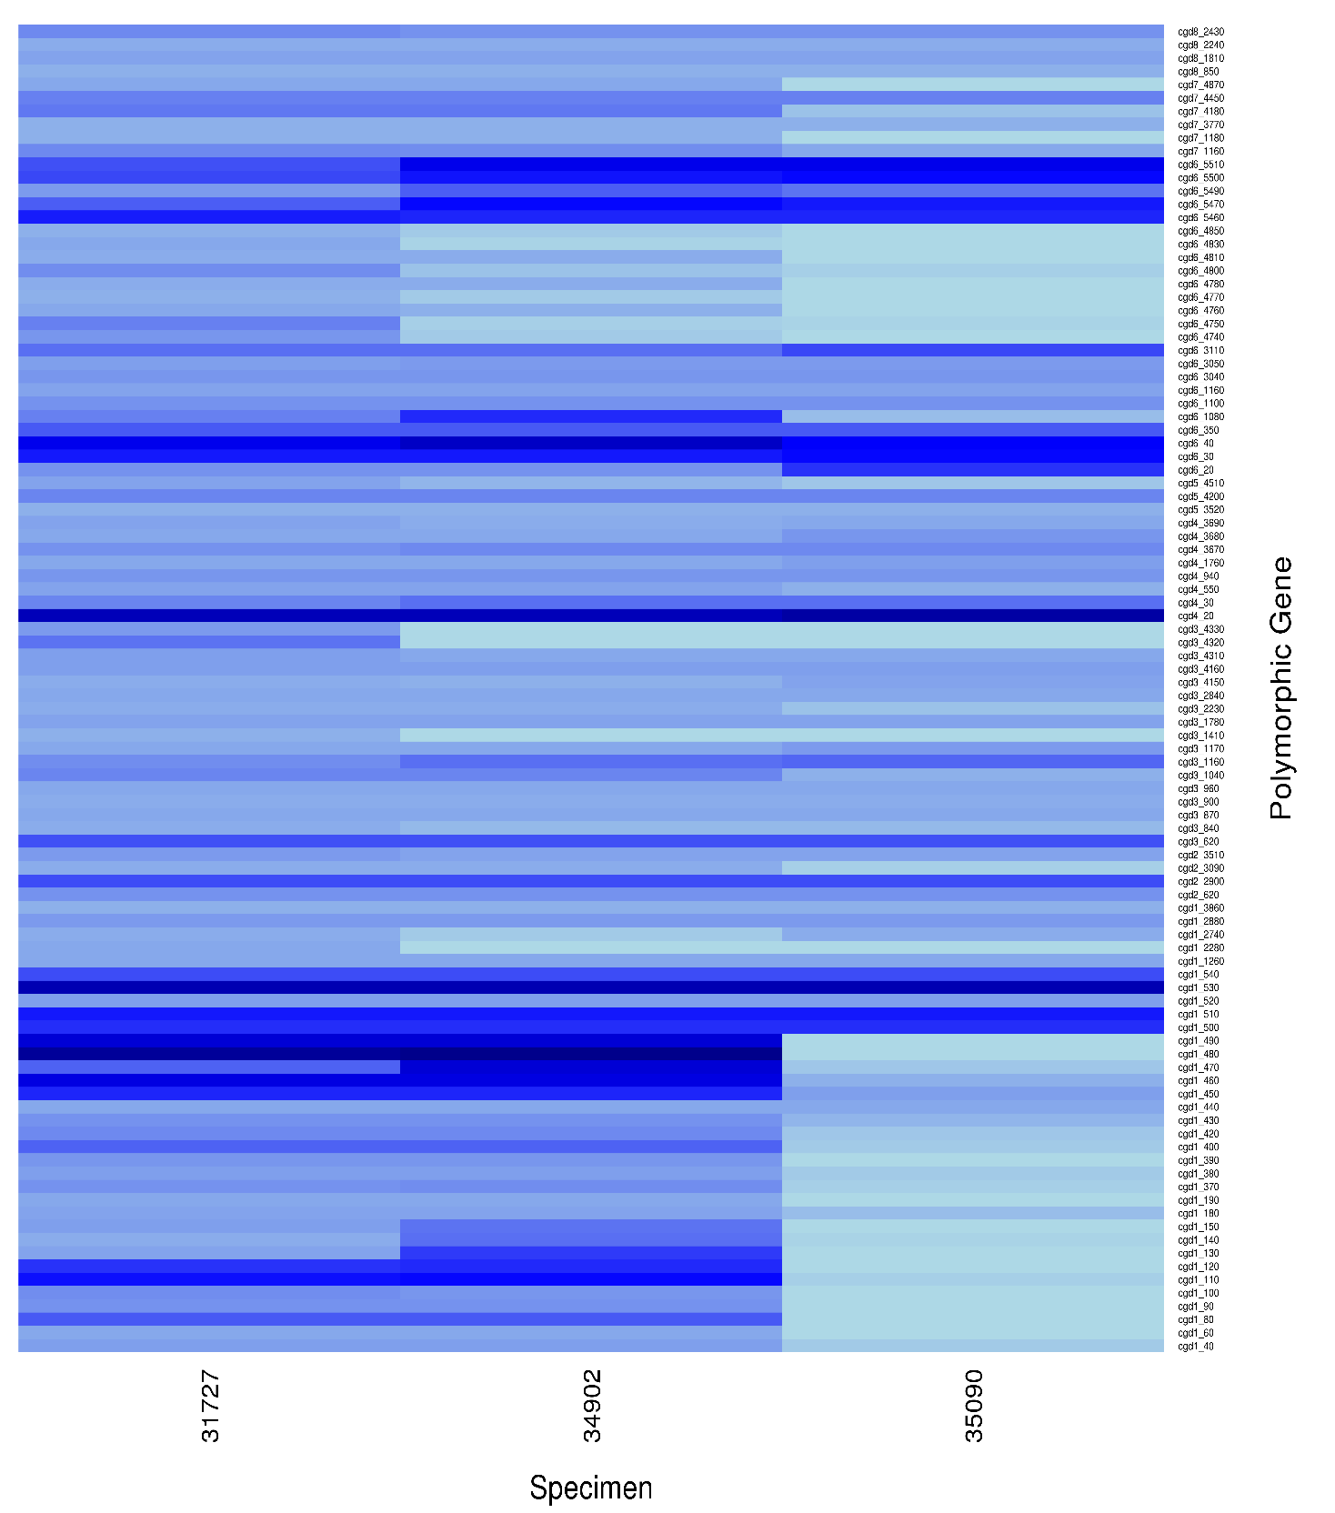
Supplementary Fig 5

