Slide 1
User Resources for the:
One Health Harmful Algal Bloom System (OHHABS) and
National Outbreak Reporting System (NORS)
Updated: 07/08/2016

Slide 2
Purpose of the OHHABS and NORS Informational Resources
The information presented in these slides is intended to serve as a resource for local, state, and territorial public health authorities.
These slides are intended to provide technical information about reporting to the One Health Harmful Algal Bloom System (OHHABS) and the National Outbreak Reporting System (NORS).

Slide 3
Content
One Health Harmful Algal Bloom System (OHHABS)
National Outbreak Reporting System (NORS)
Linked Systems: OHHABS and NORS
  Permission Models
  User Types

Slide 4
One Health Harmful Algal Bloom System (OHHABS)

Slide 5
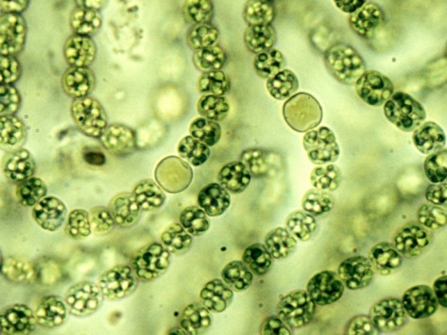
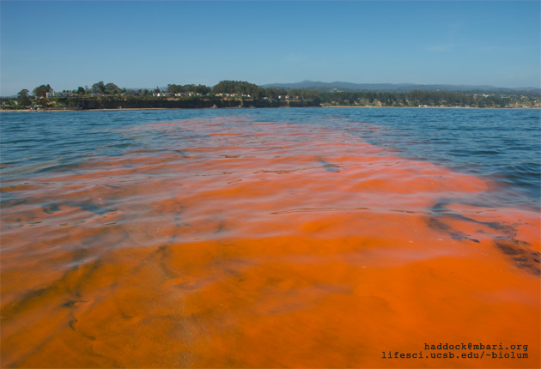
Harmful Algal Blooms (HABs)
Harmful algal bloom (HAB) – overgrowth of phytoplankton (cyanobacteria or microalgae) that can cause harm to animals, people, or the local ecology
  Occur in warm, nutrient rich fresh or marine waters
Adverse effects:
  Economic (e.g., beach closures, shellfish harvest closures)
  Ecologic (e.g., oxygen depletion, sunlight deprivation)
  Health (e.g., human and animal illnesses)
Source: CA Water Boards - Cyanobacteria
Source: UCSB Biolum - Dinoflagellate

Slide 6
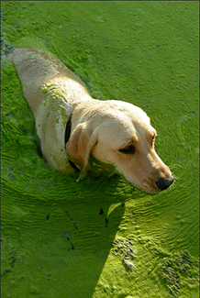
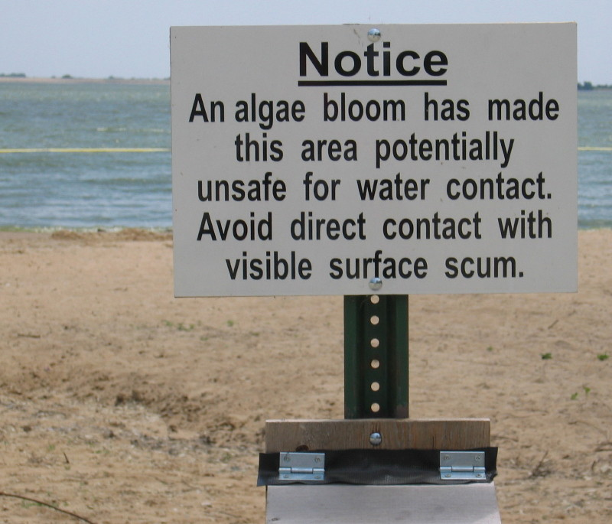
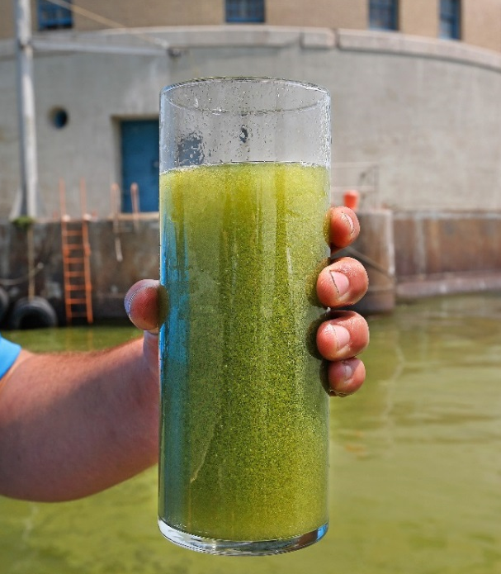
HABs and Public Health
Exposure pathways: ingestion (water or food), inhalation, dermal contact
One Health issue – humans, animals, and the environment
Emerging public health issue
  Warming climate, nutrient pollution
Challenges: identifying and characterizing HAB-associated illnesses
To learn more about HAB-associated illnesses, visit www.cdc.gov/habs
Source: Jill Siegrist
Source: USGS
Source: David Zapotosky

Slide 7

One Health
The health of humans is connected to the health of animals and the environment.
Animals share susceptibility to some diseases and environmental hazards such as harmful algal blooms (HABs); animal illnesses may serve as early warnings for potential human illness.
Successful public health interventions require the cooperation of the human health, veterinary health, and environmental health communities.
Adapted from: http://www.cdc.gov/onehealth/

Slide 8
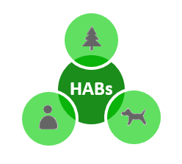
One Health Harmful Algal Bloom System (OHHABS)
Electronic reporting system launched in 2016
  Web-based, password-protected system
  Not a real-time notification or case investigation system
  Event-based, not for routine water monitoring
Used by local, state, and territorial public health partners for voluntary reporting of HAB events or HAB-associated human and animal illnesses to the Centers for Disease Control and Prevention (CDC)
Collects data on foodborne or waterborne HAB events in fresh and marine water settings:
  HAB events (environmental data)
  HAB-associated human cases of illness
  HAB-associated animal cases of illness
OHHABS fills a gap in health surveillance, and will inform understanding of HAB occurrences and HAB-associated illnesses
For more information, visit the OHHABS website www.cdc.gov/habs/ohhabs

Slide 9
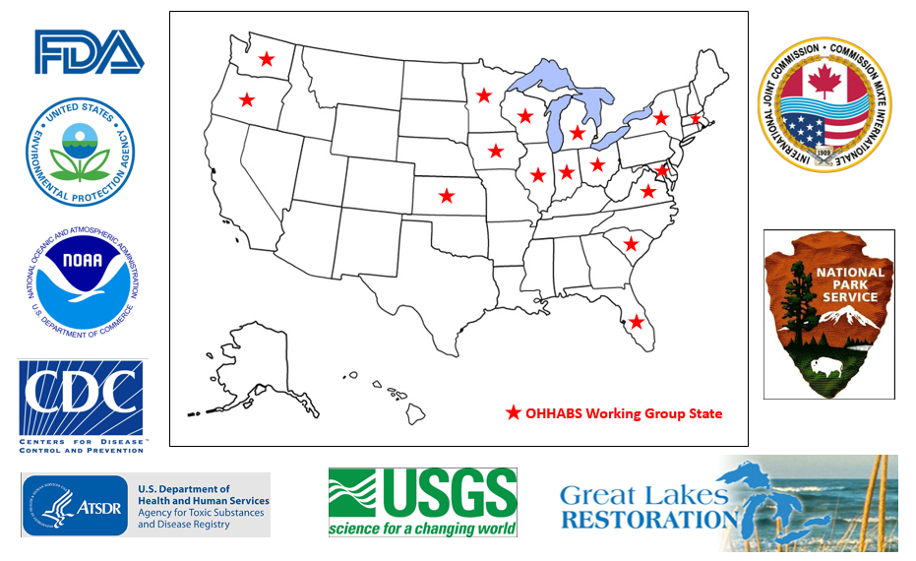
Acknowledgments
A special thanks to the OHHABS working group of state and federal partners for contributing to the development and success of OHHABS!

Slide 10
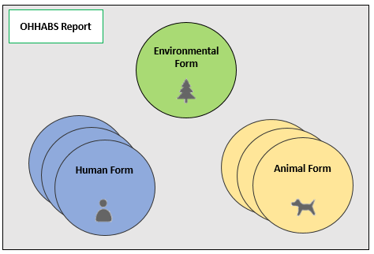
OHHABS Reports
OHHABS reports contain forms
  Environmental form (only one form per report)
  Human form (one or multiple forms per report)
  Animal form (one or multiple forms per report)

Slide 11
Types of Data Collected in an OHHABS Report*
Form Type | Types of Data Collected
Environmental Form | Location of the HAB event Observed water body characteristics Advisories and health warnings Laboratory testing – event sample testing Pathogens or toxins detected Other data systems that contain associated information Seafood catch or harvest location for HAB-associated foodborne illnesses
Human Form | General case information (e.g., sex, age in years) Exposures (e.g., activities, duration) Signs and symptoms of illness Medical and health history Clinical testing Pathogens or toxins detected in clinical samples
Animal Form | General case information (e.g., type of animal, single/group of animals) Exposures (e.g. activities, duration) Signs of illness Health information (e.g., veterinary treatment) Clinical testing Pathogen or toxins detected in clinical samples
*Not all data are required in OHHABS

Slide 12
HAB Event and Case Definitions
HAB event and case definitions standardize how OHHABS report data will be classified by CDC
  Assessments of the level of evidence that a HAB event or associated illness occurred
  Developed through discussions with state and federal partners
Definitions for:
  HAB Event (Suspect, Confirmed)
  Human Case (Suspect, Probable, Confirmed)
  Animal Case (Suspect, Probable, Confirmed)
Definitions can be found at www.cdc.gov/habs/ohhabs

Slide 13
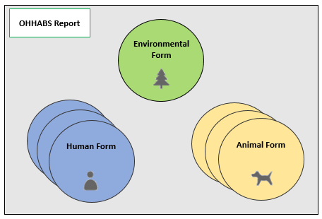
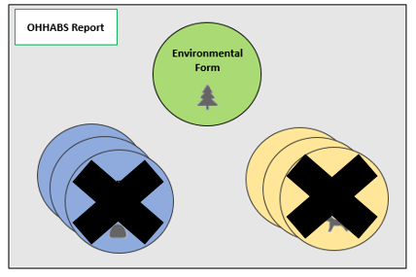
Ways to Create a Report in OHHABS
  Report environmental data, human case data, and animal case data
  2. Report only environmental data

Slide 14
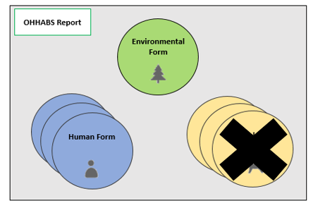
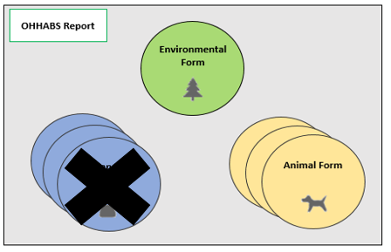
Ways to Create a Report in OHHABS (continued)
  3. Report human case data with environmental data
  4. Report animal case data with environmental data

Slide 15
OHHABS Resources
OHHABS resources are available at www.cdc.gov/habs/ohhabs
  Guidance materials
    Getting Started and Technical Features Guidance
    Environmental Form Guidance
    Human Form Guidance
    Animal Form Guidance
    Foodborne Illness Guidance
    Multistate Reporting Guidance
  Event and case definitions
  Paper & fillable PDF forms
  Data dictionary
For more information about HAB events and HAB associated illnesses, please visit www.cdc.gov/habs/

Slide 16
National Outbreak Reporting System (NORS)

Slide 17
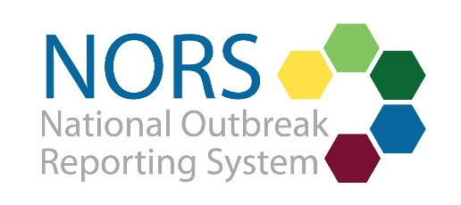
National Outbreak Reporting System (NORS)
Electronic reporting system launched in 2009
  Web-based, password-protected system
  Not a real-time notification or outbreak investigation system
Used by local, state, and territorial public health partners for voluntary outbreak reporting to the Centers for Disease Control and Prevention (CDC)
Outbreaks: two or more human cases of illness epidemiologically linked by time, exposure and illness characteristics
Collects aggregate data on:
  Waterborne disease outbreaks
  Foodborne disease outbreaks
  Enteric disease outbreaks transmitted by other transmission modes including animal contact, person-to-person contact, environmental contamination, and unknown modes of transmission
Outbreak data provide information about national outbreak trends and learning lessons for preventing future outbreaks.
For more information, visit the NORS website
  www.cdc.gov/NORS

Slide 18
Linked systems:
OHHABS and NORS

Slide 19
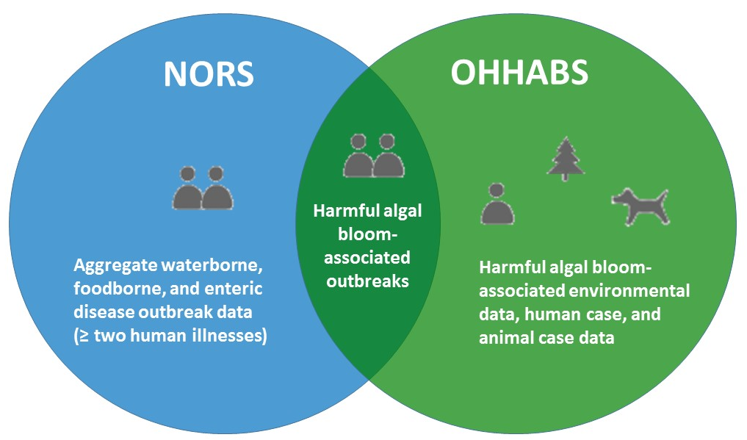
How are OHHABS and NORS Linked?
OHHABS and NORS are linked in two ways:
  Can both collect different types data for HAB-associated outbreaks that together will inform public health understanding and prevention efforts
    NORS collects aggregate outbreak data (≥ two human cases of illness)
    OHHABS collects environmental data, human case data, and animal case data
  Share technical reporting features
HAB-associated outbreaks may be reported to both OHHABS and NORS
  Data about the outbreak are collected differently in each system

Slide 20
Shared Technical Reporting Features for OHHABS and NORS

Slide 21
Technical Definitions
Reporting structure – describes the organization of state, territorial, or local public health agencies or users in OHHABS or NORS
Reporting site – refers any state or territory that reports in OHHABS or NORS
  Agency – refers to a reporting group geographically or functionally organized within a reporting site (e.g., state county, state region)
User type – describes the functions a user can have in OHHABS or NORS (e.g., managing other user accounts, editing reports, viewing reports)
Permissions – describes the way that a reporting site manages and views reports and users
  Permissions model – refers to the way report and user management are organized in a reporting site.
  The permissions model allows reporting sites to have the flexibility to centralize or share the reporting burden across agencies and at the local, state, or territory levels.
  Each reporting site set up its permissions model in 2009 based on administrative needs.

Slide 22
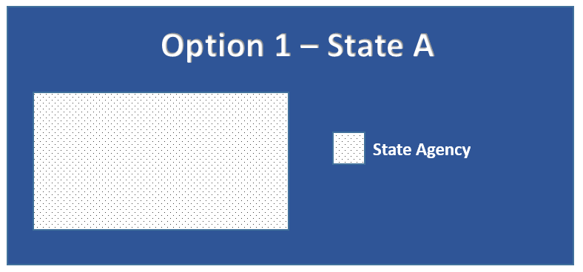
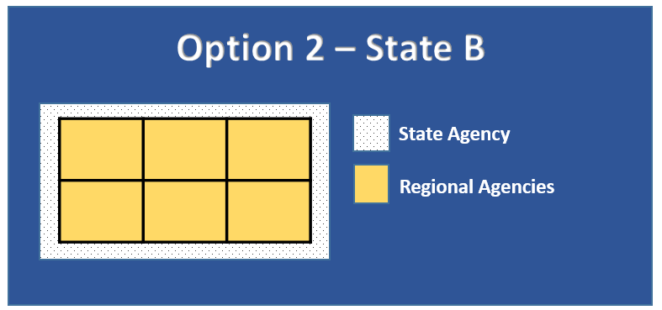
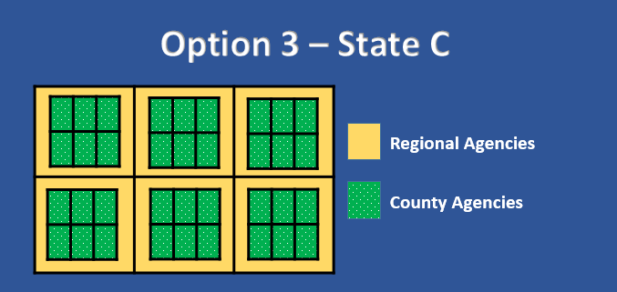
Permission Models
There are three different types of permissions models for reporting sites
The type of permissions model affects how users manage and view reports in their reporting site
A reporting site can have
  Single agency (Option 1)
  Multiple agencies (Options 2 and 3)
Only two levels of agencies are allowed in a reporting site
For more information about your state’s permission model, contact your state’s NORS or OHHABS administrator or the CDC NORS Team at NORSAdmin@cdc.gov

Slide 23
Option 1 Permission Model
State A is the example for the Option 1 Permission Model
State A is organized with one State Agency that reports to OHHABS or NORS
In State A, all users in the State Agency can:
  View all reports in the State Agency

Slide 24
Option 2 Permission Model
State B is the example for the Option 2 Permission Model
State B is organized with several Regional Agencies within a State Agency
  All Regional Agencies and the State Agency report to OHHABS and NORS
In State B, users in the State Agency can:
  View all reports in the State Agency
  View all reports in the Regional Agencies
In State B, users in the Regional Agency can:
  View all reports in their Regional Agency but not reports created by State Agency users or users in other Regional Agencies

Slide 25
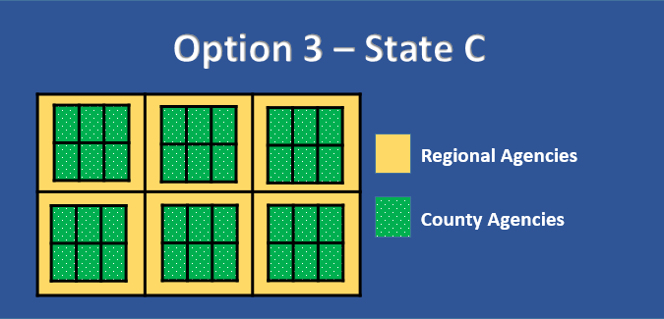
Option 3 Permission Model
State C is the example for the Option 3 Permission Model
State C is organized with several Regional Agencies and County Agencies
  There is no State Agency
  The County Agencies are within a Regional Agency
In State C, users in the Regional Agency can:
  View only their Regional Agency’s reports
  View the all County Agencies’ reports within their Regional Agency
In State C, users in the County Agency can:
  View only their County Agency’s reports

Slide 26
OHHABS and NORS User Types
There are three different user options for OHHABS and NORS:
  OHHABS and NORS user – user can access both systems
  OHHABS only user – user can access only OHHABS
  NORS only user – user can access only NORS
User types in OHHABS and NORS can perform different functions (e.g., managing other user accounts, editing reports, viewing reports)
  Reports a user can view and manage depends on the site’s permissions model, user agency, and user type
There are four different User Types that can perform different functions:
  Reporting Site Administrator (RSA)
  Agency Administrator (AA)
  Read-Write (RW)
  Read-Only (RO)
An OHHABS and NORS user can have different user types in each system (e.g., a user can be an OHHABS RSA and a NORS RW)

Slide 27
Overview of User Type Functions
Permissions | Reporting Site Administrator (RSA) | Agency Administrator (AA) | Read-Write (RW) | Read-Only (RO)
User Management
Manage Users Across Their Reporting Site | ü | û | û | û
Manage Users Across Their Agency | ü | ü | û | û
Report Management
Create a New Report | ü | ü | ü | û
Delete Their Report | ü | ü | û | û
View Reports Across Their Agency | ü | ü | ü | ü
Manage Reports Across Their Reporting Site | ü | û | û | û
Manage Reports Across Their Agency | ü | ü | û | û
Manage Their Own Reports | ü | ü | ü | û

Slide 28
OHHABS and NORS User Support
To gain access to OHHABS or NORS, please contact your OHHABS Reporting Site Administrator (RSA) or NORS Reporting Site Administrator (RSA)
  For states or territories that have not yet assigned an OHHABS RSA, the NORS RSA will be automatically assigned as an OHHABS RSA
For assistance identifying your state’s NORS or OHHABS RSA, please contact NORSWater@cdc.gov
For additional questions about OHHABS, please visit www.cdc.gov/habs/ohhabs or contact NORSWater@cdc.gov

