Slide 1
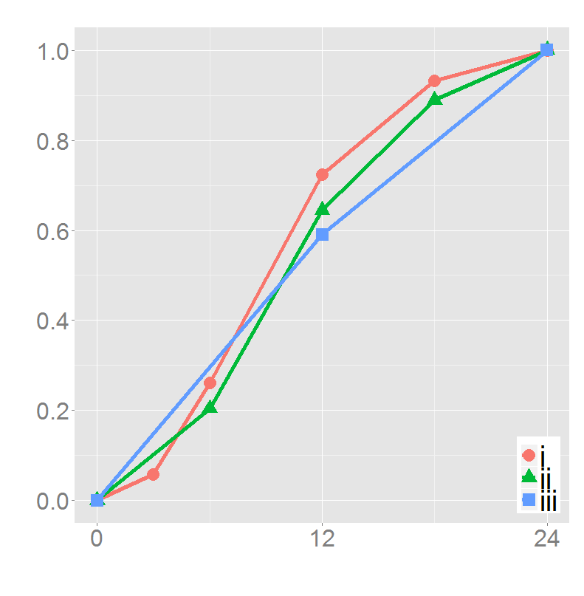
Cumulative proportion of
pediatric norovirus cases
Age (months)

