Slide 1
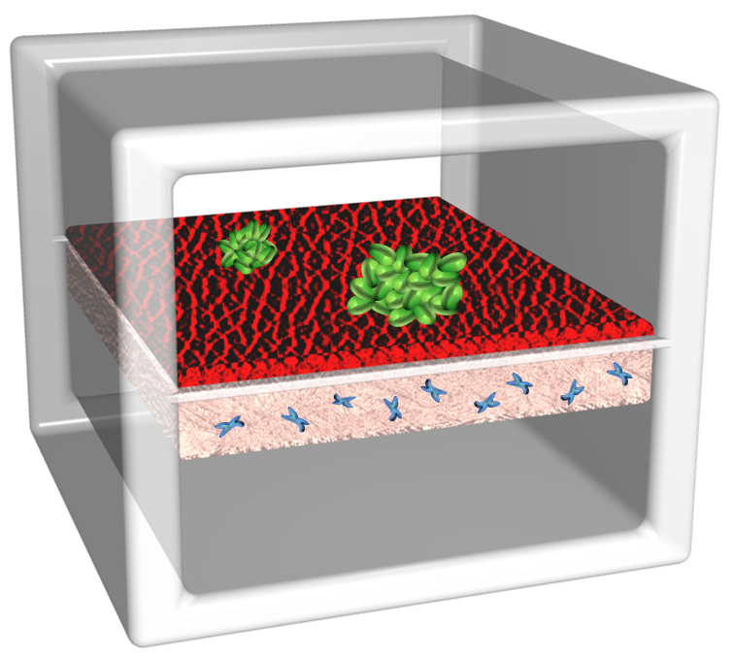
We report a microengineered cell culture platform that reconstitutes the 3D architecture and microenvironment of early-stage breast cancer.

