Slide 1
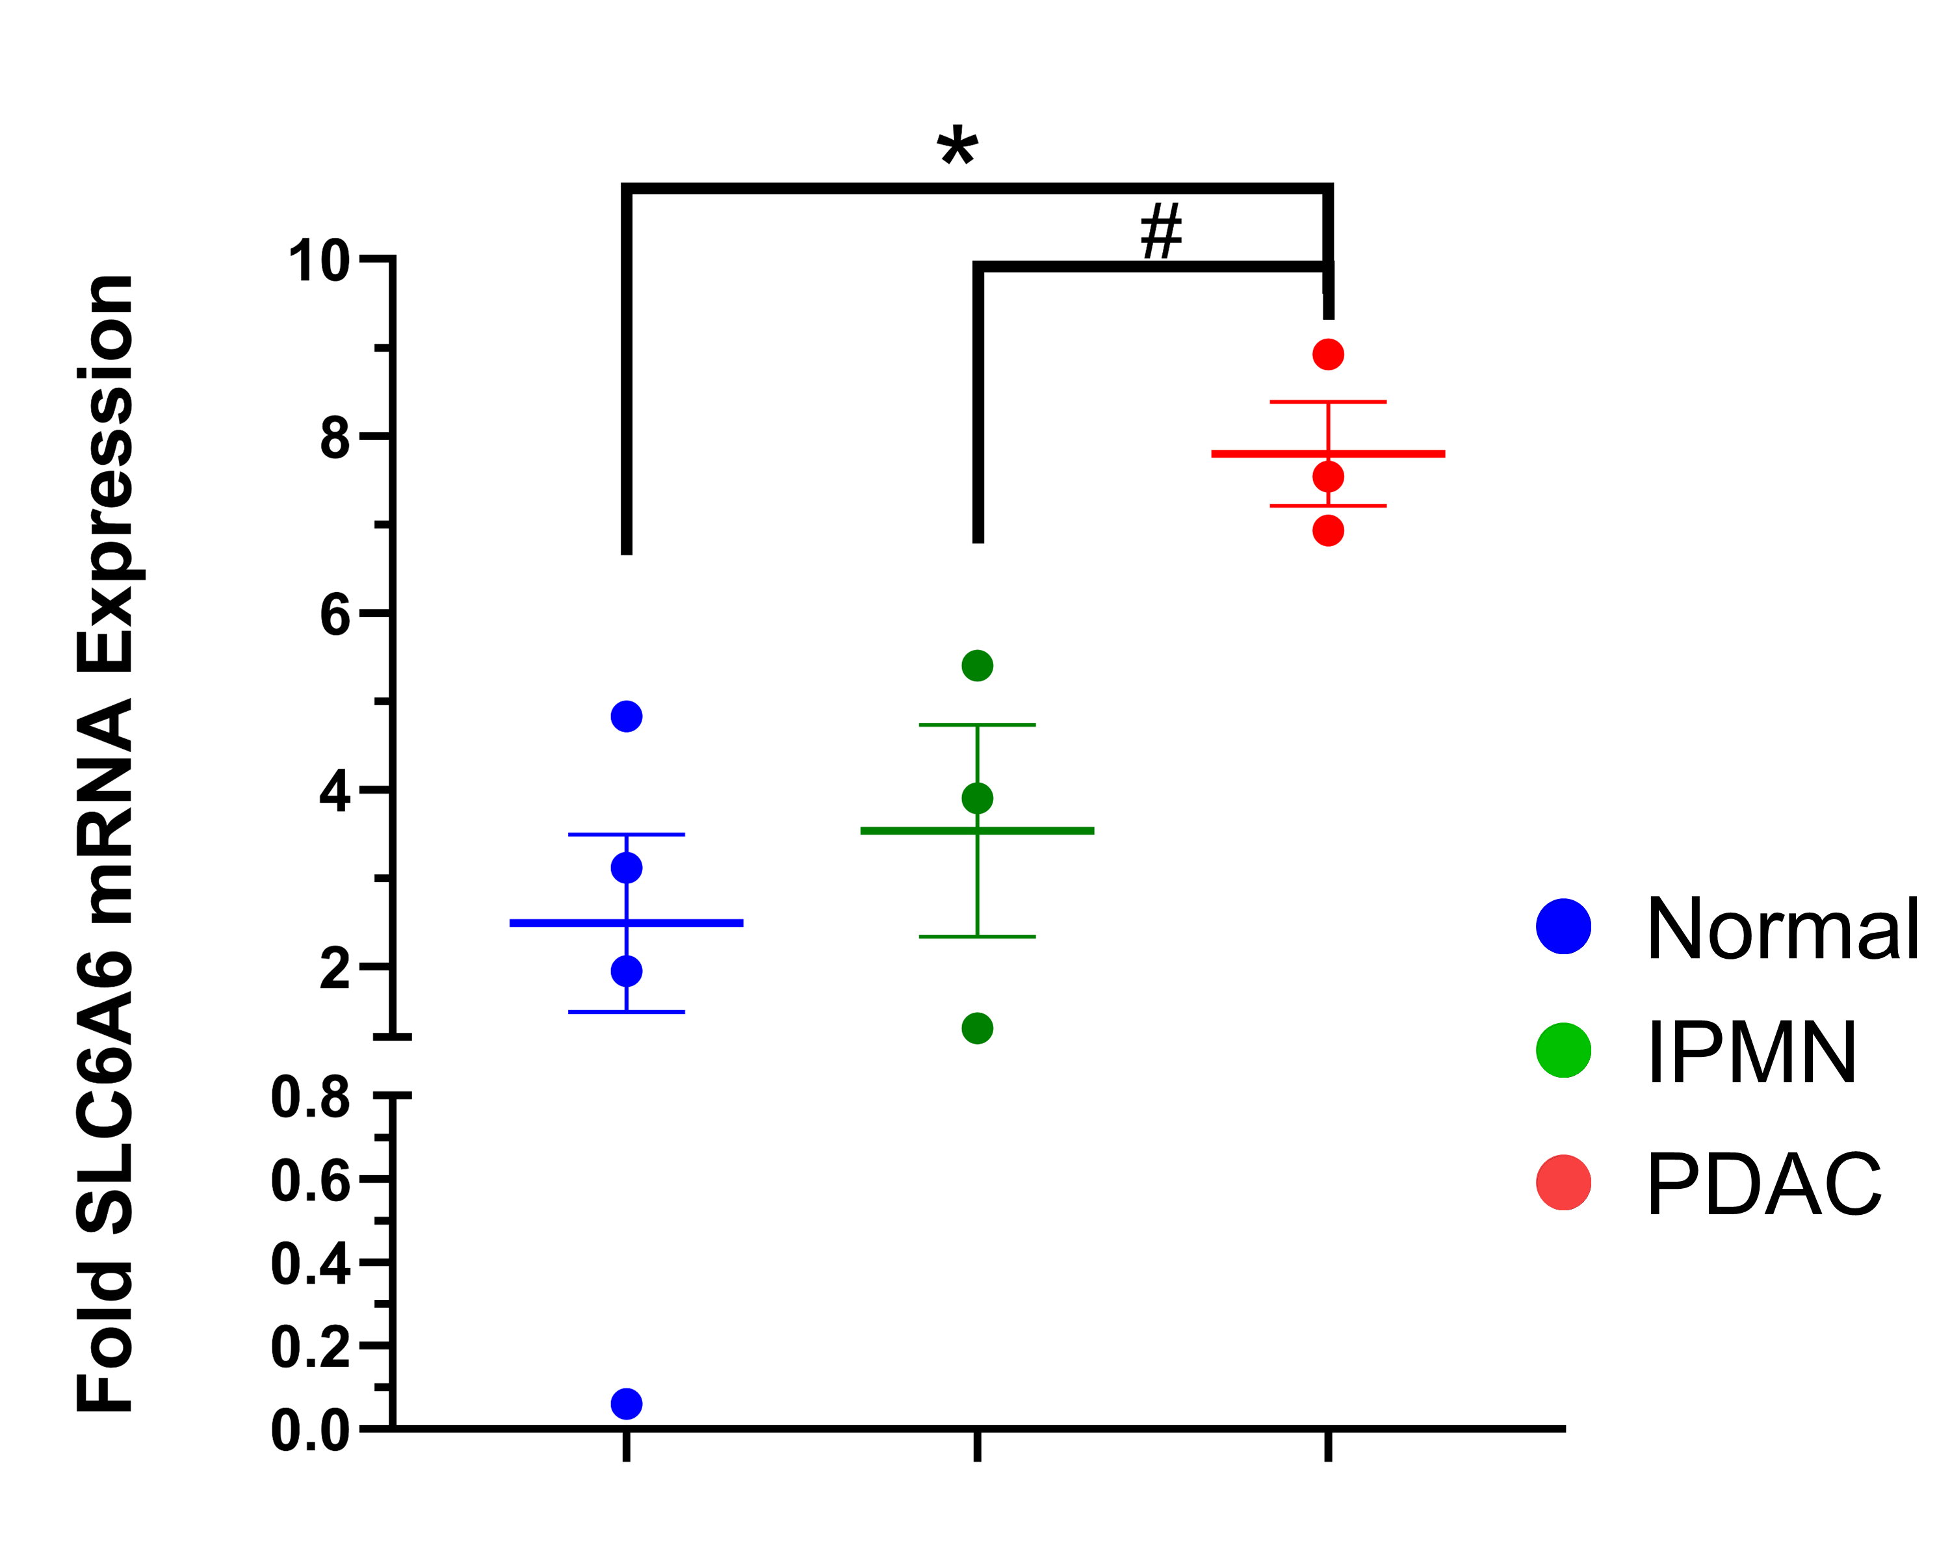
Supplementary Figure S7: Fold SLC6A6 mRNA expression in normal/non-neoplastic pancreas tissue (blue dots, n=4), IPMN (green dots, n= 3) and PDAC samples (red dots, n=3). Values represent the mean ± SEM. Statistical significance is denoted by an asterisk (*), indicating p-values less than 0.05; # represents p-value = 0.067.

