Slide 1
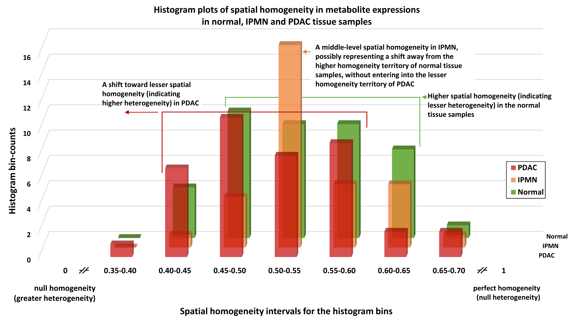
Supplementary Figure S4: Histogram plots showing spatial homogeneity in normal/non-neoplastic pancreas tissue (green), IPMN (orange), and PDAC (red) tissue samples. Homogeneity was calculated using Haralick texture features from MALDI-MSI ion images for eight metabolites: taurine, acetylcarnitine, creatine, malate, ascorbic acid, m/z 835.64 (tentatively identified as sphingomyelin SM 42:2;O2), PC 34:3, and PC 32:0 across all (n = 5) tissue samples in each group (One IPMN sample MGT10 was excluded due to bad tissue quality). For trend interpretation, the top four histogram bins were analyzed in each group. The top four bin counts for normal samples (green) indicate higher spatial homogeneity (i.e., lower heterogeneity). The IPMN samples (orange) show intermediate spatial homogeneity, suggesting a shift away from the higher homogeneity seen in normal tissues but not yet reaching the lower homogeneity typical of PDAC. The PDAC samples (red) show a shift toward lower spatial homogeneity, indicating increased heterogeneity.

