Slide 1
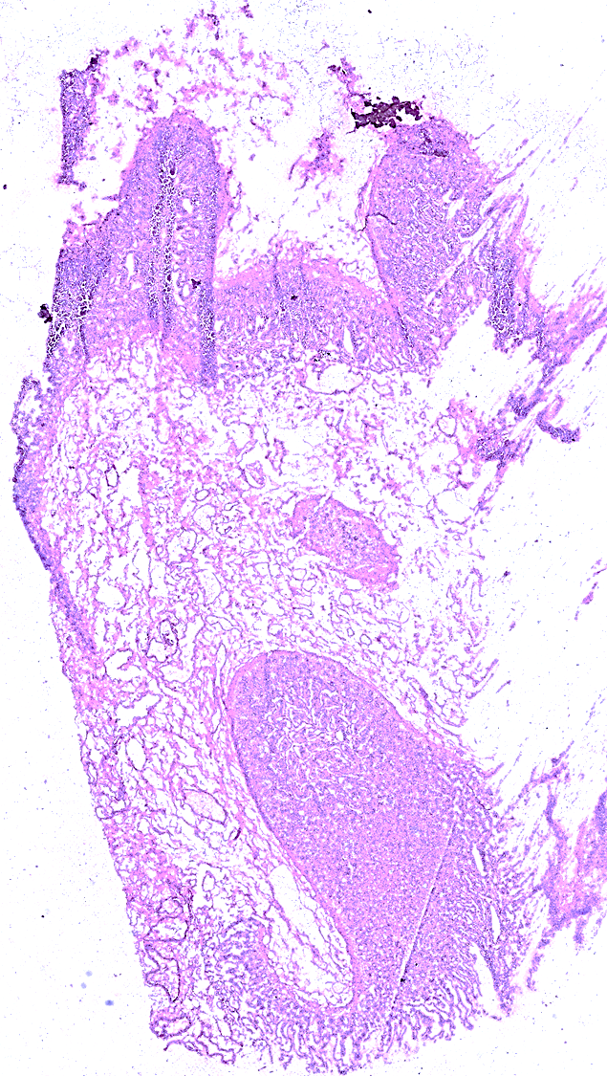
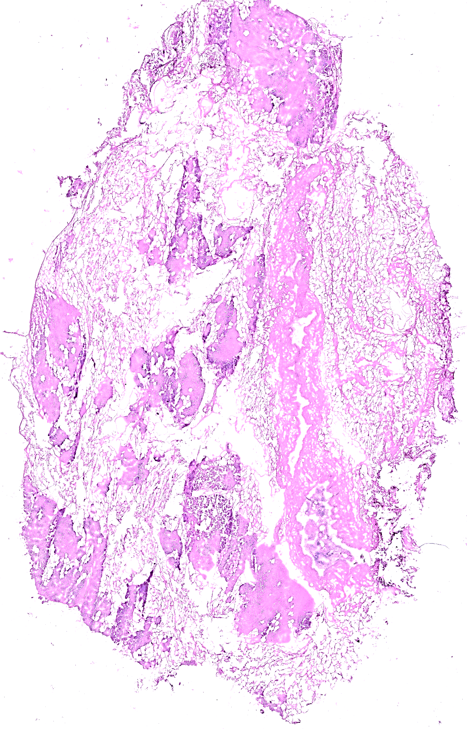
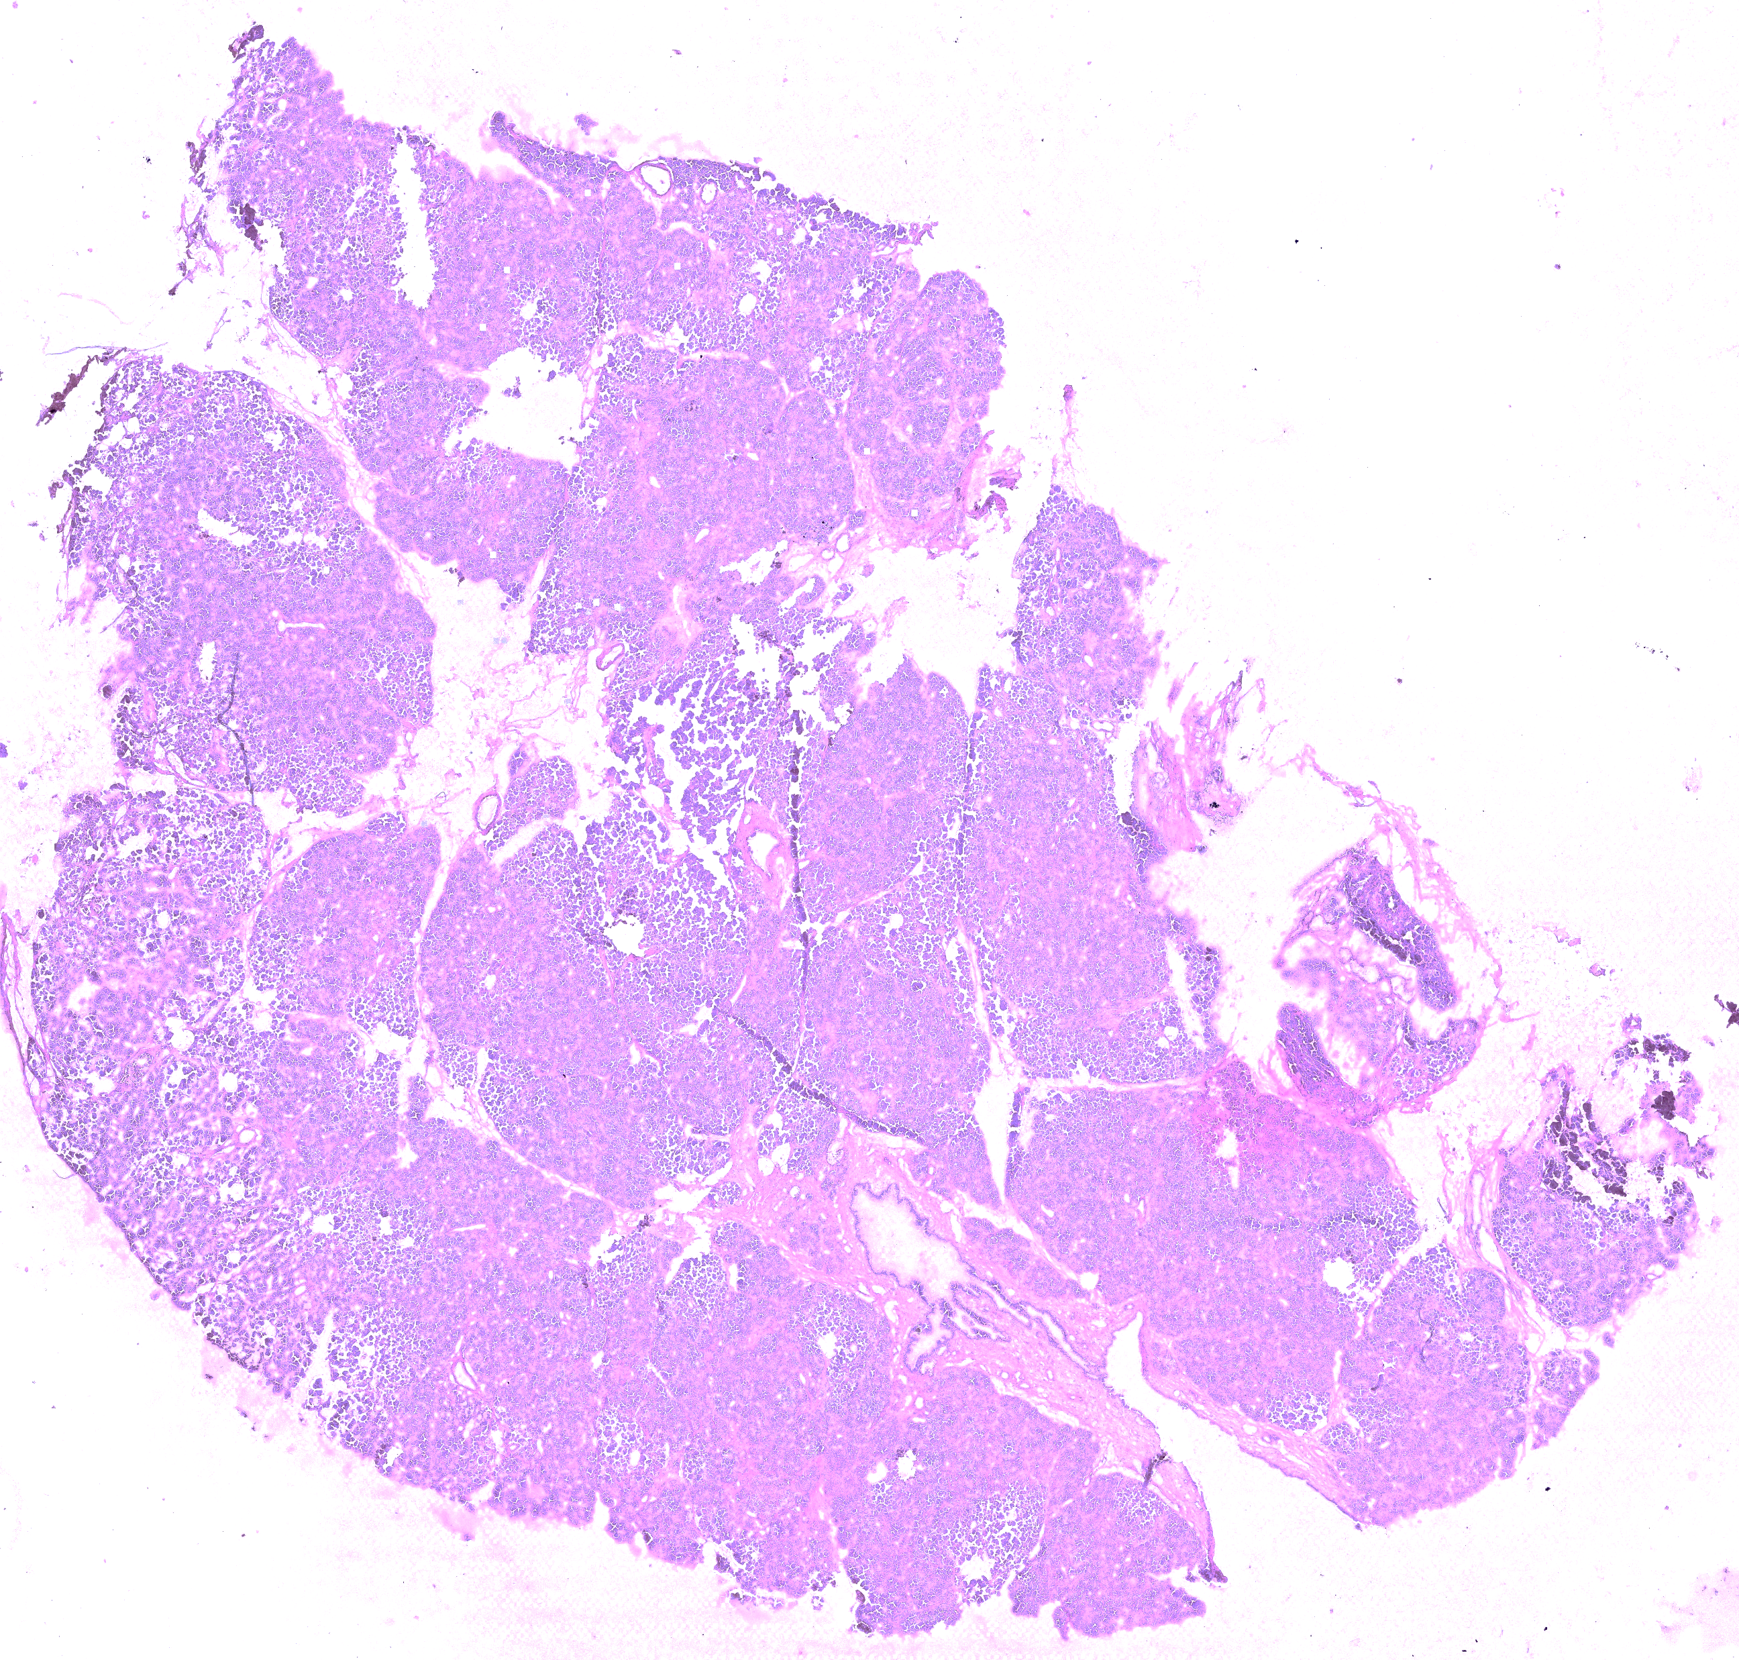
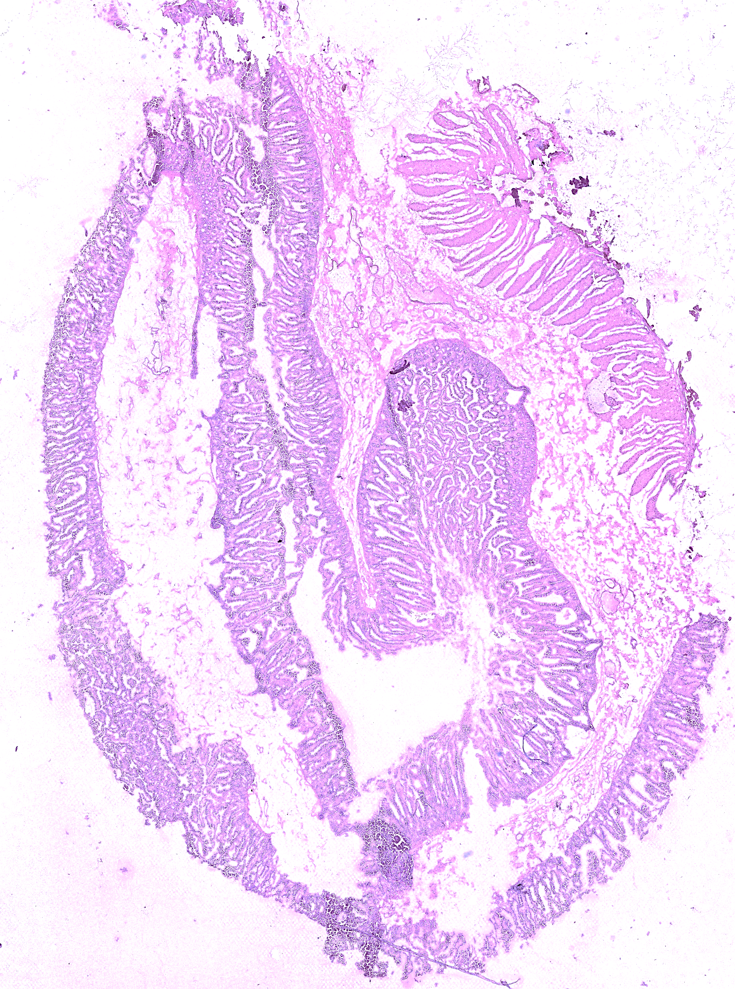
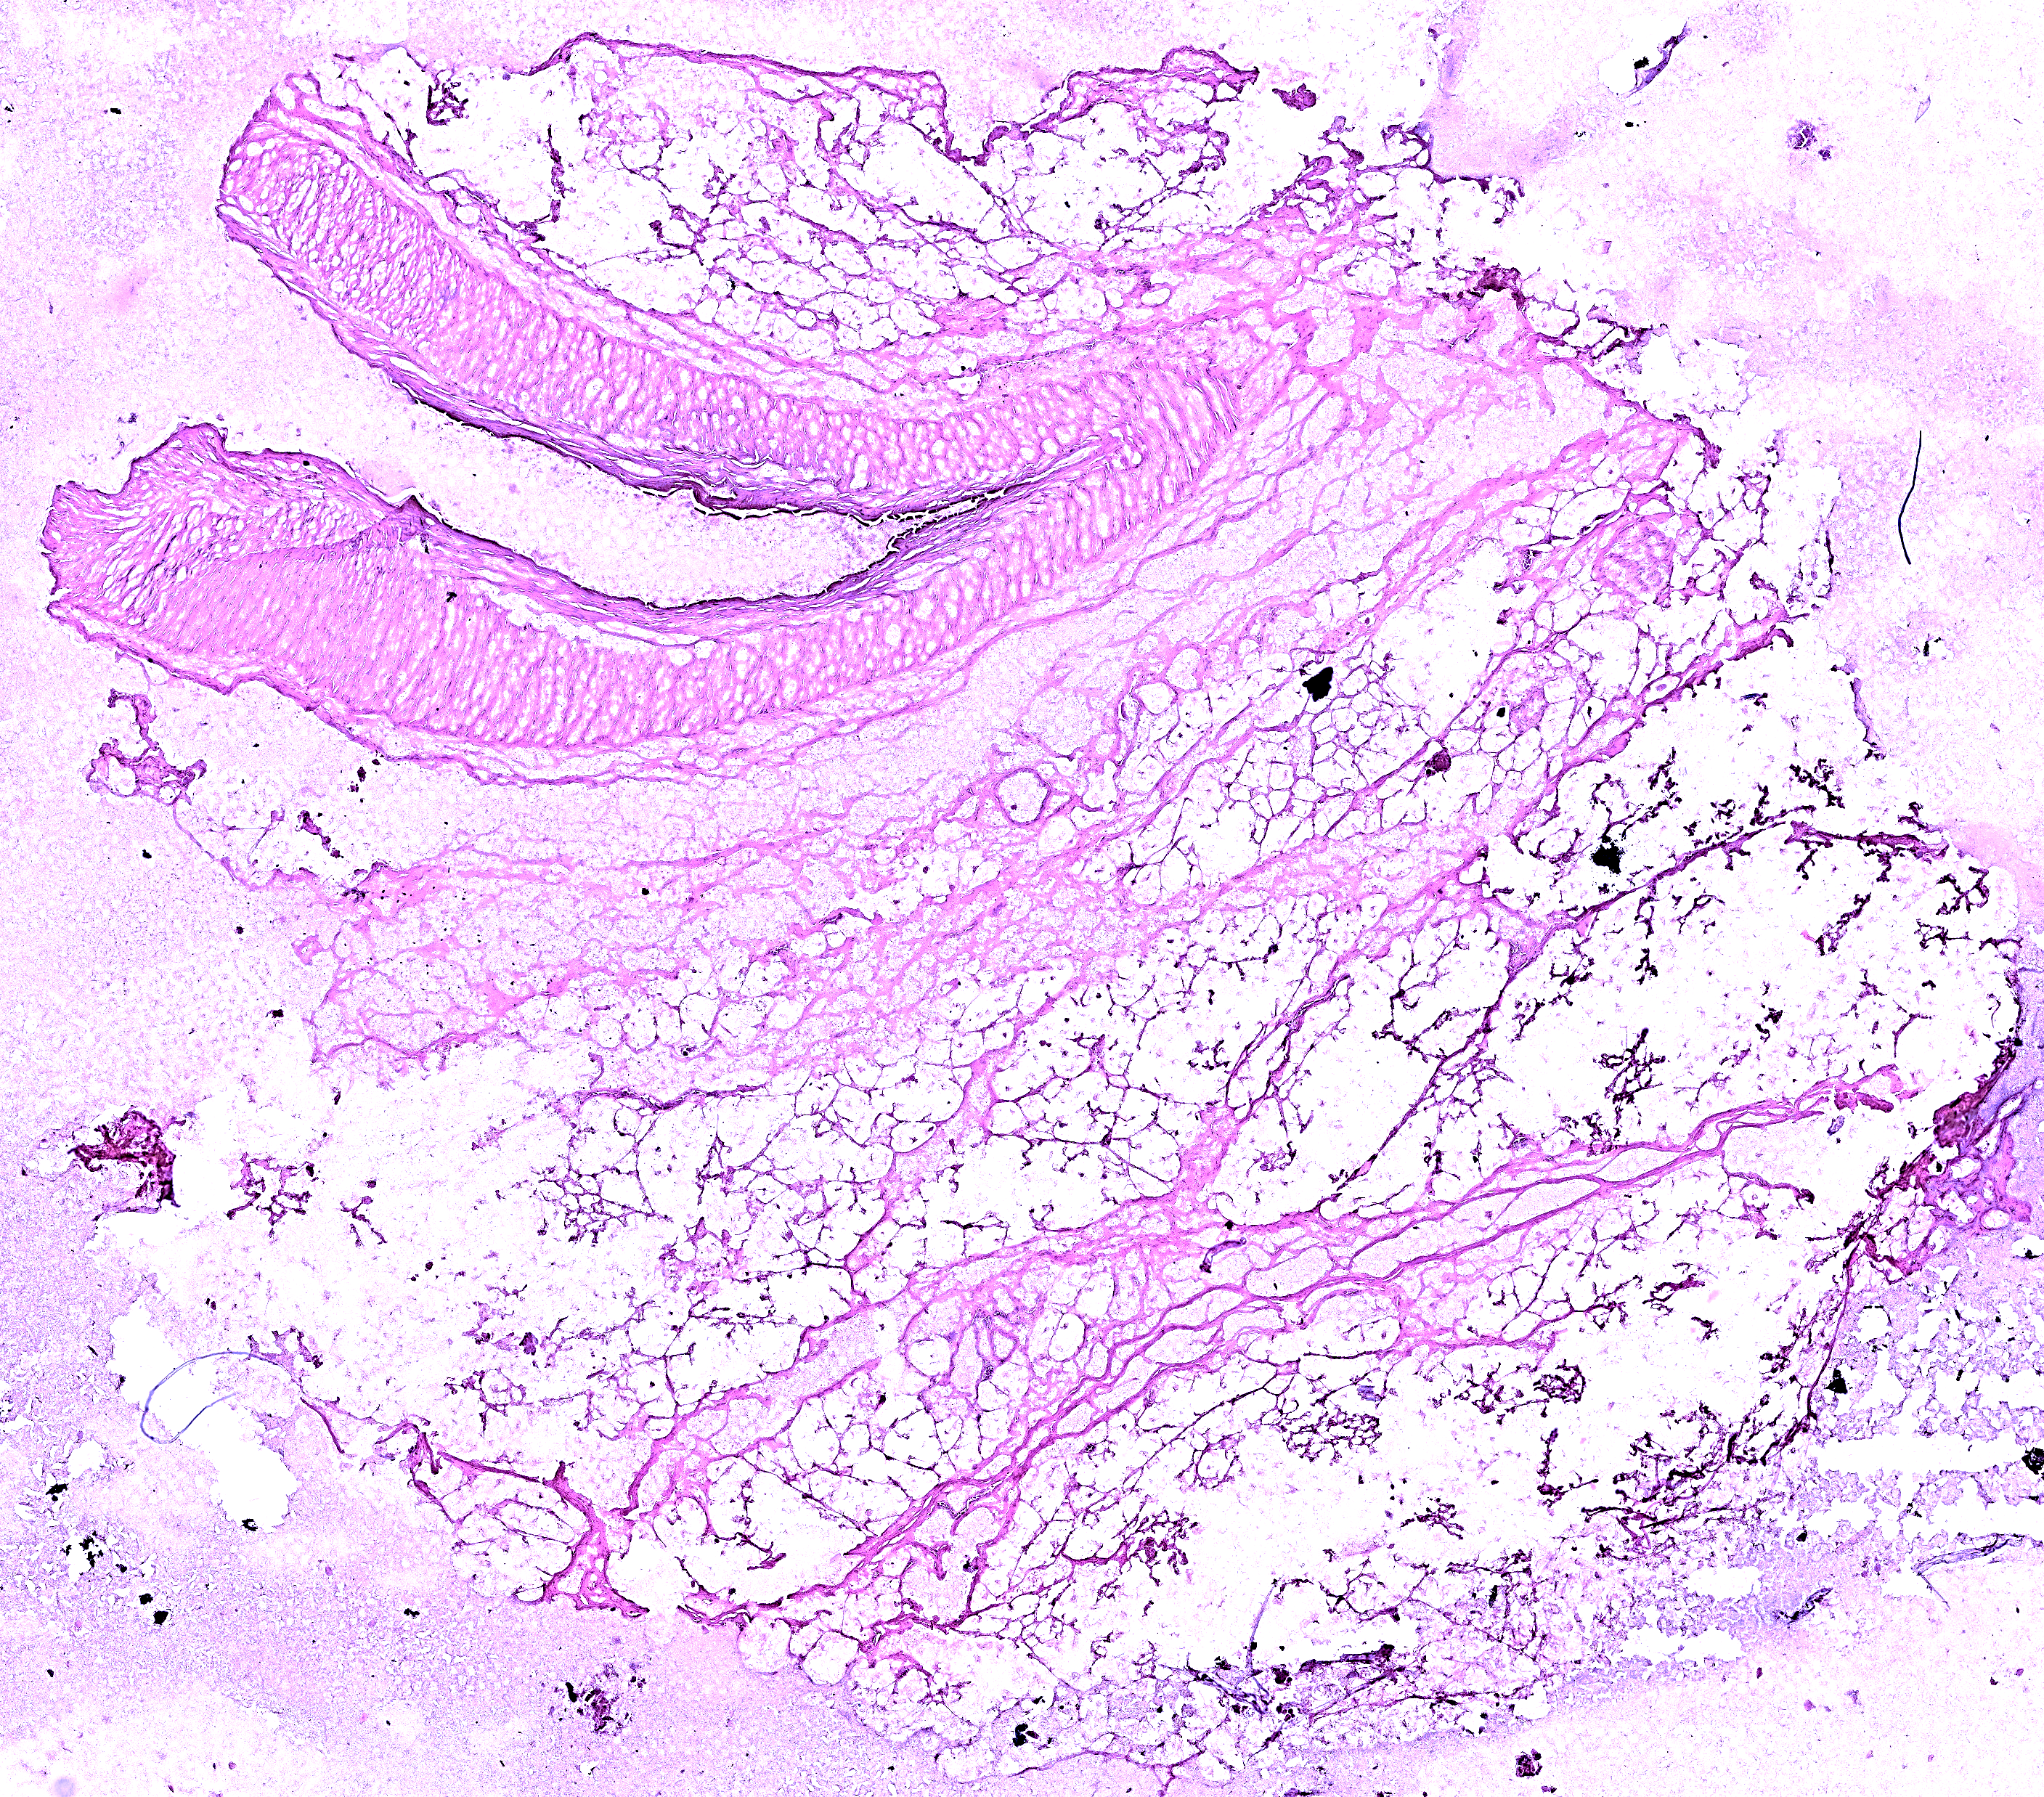
Supplementary Figure S3. Hematoxylin and eosin-stained images of normal/non-neoplastic pancreatic tissue samples.
MGT-1
MGT-2
MGT-3
MGT-5
MGT-4

