Slide 1
Architecting Federal Public Health with the CDC Technical Reference Architecture (TRA)
Session 170 – March 12, 2026
Ryan M Harrison, PhD
Chief Enterprise Architect (Acting)
Centers for Disease Control and Prevention
DISCLAIMER: The views and opinions expressed in this presentation are solely those of the author/presenter and do not necessarily represent any policy or position of HIMSS or Informa.

Slide 2

Meet Our Speakers
Ryan M Harrison, PhD
Chief Enterprise Architect (Acting)
Centers for Disease Control and Prevention
Notes:
Hello everyone. Thank you so much for joining.
Welcome to Architecting Federal Public Health with the CDC Technical Reference Architecture (TRA)
I am Ryan Harrison, Acting Chief Enterprise Architect with the Centers for Disease Control and Prevention and I am happy to be presenting to you today.

Slide 3
Conflict of Interest
Ryan M Harrison, PhD
Has no real or apparent conflicts of interest to report.
Notes:
Use this slide ONLY if there is no conflict of interest. If there is a conflict of interest, delete this slide and use the next slide.

Slide 4
Agenda
  What is Enterprise Architecture, with CDC examples
  Federal Enterprise Architecture
  Building the CDC Technical Reference Architecture (CDC TRA)
  Incorporating the CDC TRA into Governance
  Continuous Improvement

Slide 5
Learning Objectives
After attending this session, participants will be able to:
  Recognize how Enterprise Architecture advances digital transformation
  Recognize the Federal agencies take different approaches to codifying technical standards
  Evaluate your organization's enterprise architecture maturity
Notes:
Learning objectives must match those that appear for your session on the conference website.
Exactly match the learning objectives on the talk agenda page: https://app.himssconference.com/event/himss-2026/planning/UGxhbm5pbmdfMzMwMzUyNg==

Slide 6
What is Enterprise Architecture?

Slide 7
What is Enterprise Architecture?
The Open Group Architecture Framework (TOGAF)
EA is a strategic tool that presents an approach to identify and address gaps between aspirations and reality, whatever drives the gaps. It accelerates the ability of an Enterprise to achieve its stated objectives.
Federated Enterprise Architecture Certification (FEAC) [Zachman]
ENTERPRISE ARCHITECTURE is the total set of intersections between the Abstractions and the Perspectives that constitute the total set of descriptive representations relevant for describing an Enterprise.
The Open Group. (2025). TOGAF Series Guide: A Practitioners’ Approach to Developing Enterprise Architecture Following the TOGAF® ADM. Retrieved February 9, 2026, from https://digital-portfolio.opengroup.org/togaf-series-guide-practitioners-approach/latest/01-doc/chap03.html
Zachman, J. A. (2022). Architecture is architecture is architecture. Zachman International – FEAC Institute. Retrieved February 9, 2026, from https://zachman-feac.com/resources/ea-articles-reference/153-architecture-is-architecture-is-architecture

Slide 8
What is Enterprise Architecture?
(4) "enterprise architecture"-
(A) means-
(i) a strategic information asset base, which defines the mission;
(ii) the information necessary to perform the mission;
(iii) the technologies necessary to perform the mission; and
(iv) the transitional processes for implementing new technologies in response to changing mission needs; and
(B) includes-
(i) a baseline architecture;
(ii) a target architecture; and
(iii) a sequencing plan;
44 U.S.C. § 3601

Slide 9
What is Enterprise Architecture?
1. Make lists
2. Articulate state
3. Apply through governance

Slide 10
What is Enterprise Architecture?
1. Make lists
  Preferred Solutions
  IT Systems
  Software
    Repositories
    Licenses
  Stakeholders
2. Articulate state
  Baseline, Target, Transition
  Architecture diagrams
  Architecture principles
  IT Standards
3. Apply through governance
  Local governance
  Enterprise governance

Slide 11





Enterprise Architecture (EA) at CDC
1
Establish CDC Technical Reference Architecture (CDC TRA)
2
Create CDC Technology Roadmaps
3
Establish EA Ops
4
Re-launch Architecture Community of Practice (CoP)
5
Integrate EA within Governance Review Processes
These objectives form the foundation of our EA strategy, promoting standardization and collaboration.

Slide 12
Authority for Enterprise Architecture
Law (Statute)
Executive Order (EO)
Policy
OMB (Office of Management and Budget)
HHS (Department of Health and Human Services)
CDC (Centers for Disease Control and Prevention)
FITARA (Federal Information Technology Acquisition Reform Act)
MEGABYTE Act (Making Electronic Government Accountable By Yielding Tangible Efficiencies Act of 2016)
SHARE IT Act (Source code Harmonization And Reuse in Information Technology Act)

Slide 13
Authority for Enterprise Architecture
HHS Chief Information Officer (CIO)
Delegation of Authority
CDC Chief Information Officer (CIO)
Delegation of Authority
CDC Chief Enterprise Architect (CEA)

Slide 14
Example: Share IT Act
SHARE IT ACT
SEC. 4. Software reuse.
(a) Sharing.—Not later than 210 days after the date of enactment of this Act, the head of each agency shall ensure that—
U.S. Congress. (2023–2024). SHARE IT Act, S. 3594, 118th Cong. (introduced 2024). Congress.gov. https://www.congress.gov/bill/118th-congress/senate-bill/3594/text/is
Law
HHS Chief Information Officer (CIO)
Delegate
CDC Chief Information Officer (CIO)
Delegate
CDC Chief Enterprise Architect (CEA)

Slide 15
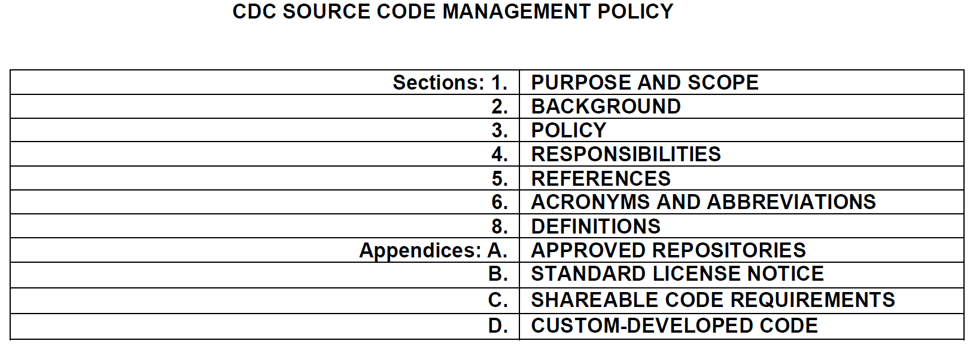
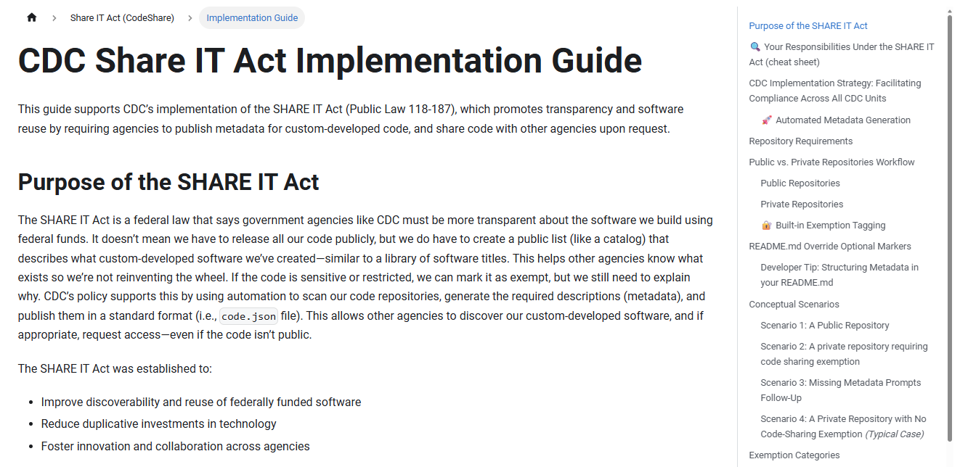
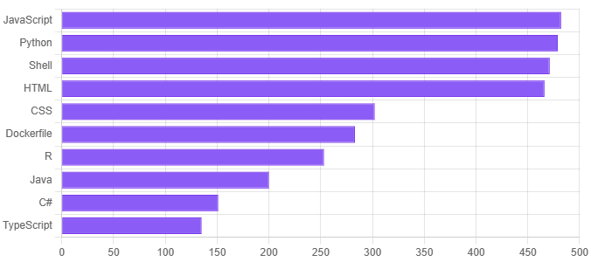
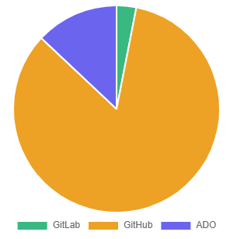
Example: Share IT Act
Law: Share IT Act
CDC Chief Enterprise Architect (CEA)
Policy
Implementation
cdc.gov/code.json
{
"agency": "CDC",
"measurementType": {
"method": "projects"
},
"projects": [{
"name": "hl7-pet",
"name": "data-exchange-fhir",
"name": “prime-fhir-converter",
...
Guidance
Dashboards
15
Notes:
Public-facing machine-readable metadata is available at: https://www.cdc.gov/code.json

Slide 16
Example: Cloud Tagging
Cloud Business Office
Data Management
Cloud Tagging
Supports transparency, accountability, and better decision-making through centralized financial data and forecasting insights.
Improves data quality, cost reporting, and cloud accountability through consistent cloud resource tags.
Cost Optimization
Adoption
Delivers actionable insights that reduce waste, improve efficiency, and align cloud usage with strategic and financial goals.
Creates a CDC-wide environment that is cloud-aware, cost-conscious, and confident—regardless of technical background or readiness level.

Slide 17
Example: Cloud Tagging
Cloud Tagging
Enterprise Architecture
Principles
Standard
(metadata)
FinOps
Federal Cloud Computing Strategy
CDC-specific metadata standard for Azure and AWS
Cloud Financial Dashboard
General Services Administration (GSA) Cloud Tagging Strategy Guide
Cloud Business Office

Slide 18
Example: Advancing AI Across Public Health
Support Public Health to Accelerate AI Adoption
Strengthen Governance and Public Trust
Advance AI Capabilities Across CDC Enterprise Data Platforms
Empower an AI – Ready Workforce and Foster Innovation
1
2
3
4
Notes:
CDC’s AI strategy is built on four pillars detailing how the agency will harness AI internally and collaborate with external partners to improve public health protection and response efforts locally and nationally:
Support Public Health with Responsible AI
Strengthen AI Governance and Public Trust
Advance AI Capabilities Across CDC’s Enterprise Data Platforms
Empower an AI-Ready Workforce and Foster Innovation
CDC’s AI Strategy is aligned with the Administration’s AI goals and directives (AI Action Plan, Executive Order 14179, the Office of Management and Budget’s memorandums M-25-21 and M-25-22) and the U.S. Department of Health and Human Services (HHS)’s AI Strategy.

Slide 19
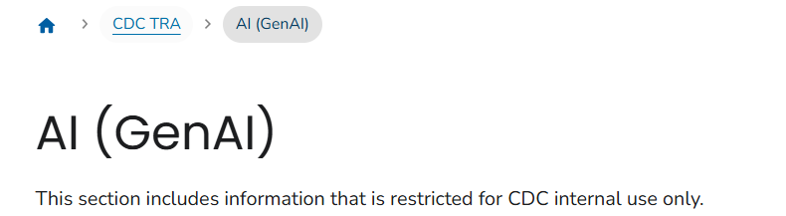
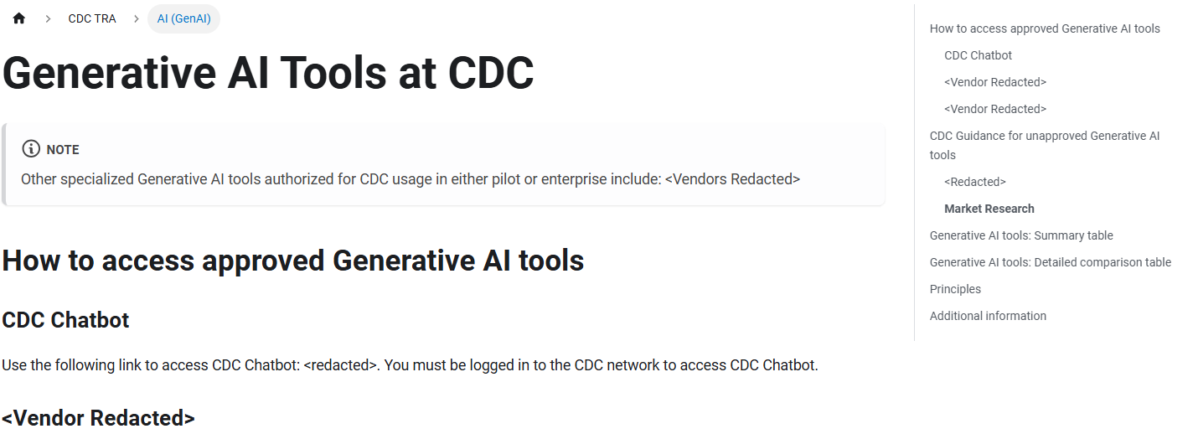
Example: Advancing AI Across Public Health
Public CDC TRA
Internal CDC TRA

Slide 20
Example: Advancing AI Across Public Health
Practical resources to safely and effectively leverage Generative AI and Deep Research in public health.
Considerations for Enabling Generative AI in Public Health
Considerations for Enabling Deep Research in Public Health
Foundational steps for STLT GenAI adoption
Real-world use cases from STLT agencies
Responsible use principles aligned with NIST AI Risk Management Framework
Overview of agentic AI tools for multi-step research tasks
Best practices for effective prompting
Use case examples from CDC
20
Notes:
STLT Resources (State, Tribal, Local, Territorial)
CDC is committed to supporting our State, Tribal, Local, and Territorial public health agencies in enabling responsible AI adoption. Along with the release of our Agency AI strategy, we are releasing two informational resources focused on considerations for our public health partners on enabling GenAI and agentic scientific research based upon CDC’s experiences with both technologies.

Slide 21

Informational Resources
Available Now!
cdc.gov/ai
Notes:
On 12 March 2026, CDC releases AI informational resources for STLTs (State, Tribal, Local, Territorial) public health agencies, available at https://cdc.gov/ai

Slide 22
Federal Enterprise Architecture (FEA)

Slide 23
A Brief History
Era | Time period | Key Events
3rd Era: Clinger-Cohen 1996 – Present | 2006 | [Useable] Federal Enterprise Architecture Framework (FEAF)
 | 2003 | DOD Architecture Framework (DODAF)
 | 1996 | Clinger-Cohen Act
2nd Era: Zachman 1980s – 1990s | 1995 | The Open Group Architecture Framework (TOGAF)
 | 1987 | Zachman Framework
1st Era: Business Systems Planning 1960s – 1980s | 1982 | IBM publishes their internal planning approach
 | Mid-1960s | Corporate Models
Kotusev, S. (2016). The history of enterprise architecture: An evidence-based review. Journal of Enterprise Architecture–Volume, 12(1), 29.

Slide 24
A Brief History
Era | Generation | Time period | Key Events
3rd Era: Clinger-Cohen | 4th generation | 2025 – Present | Delegated Chief Enterprise Architect (CEA) CDC Technical Reference Architecture (TRA) CDC Source Code Management (policy, code.json)
 | 2nd interregnum | 2020 – Present 2020 – 2024 | Vacant Chief Technology Officer Vacant Chief Enterprise Architect
 | 3rd generation MISO Center of Excellence in Architecture | 2017 – 2019 | CDC Enterprise Architecture Policy v3, drafted but never ratified.
 | 1st interregnum | 2015 – 2016
 | 2nd generation EA Community of Practice | 2007 – 2014 | CDC Enterprise Architecture Policy v2 [2013] CDC Enterprise Architecture Policy v1 [2007]
 | 1st generation Pre-CDC EA policy | 1996 – 2007 | Clinger-Cohen Act OMB M-97-16

Slide 25
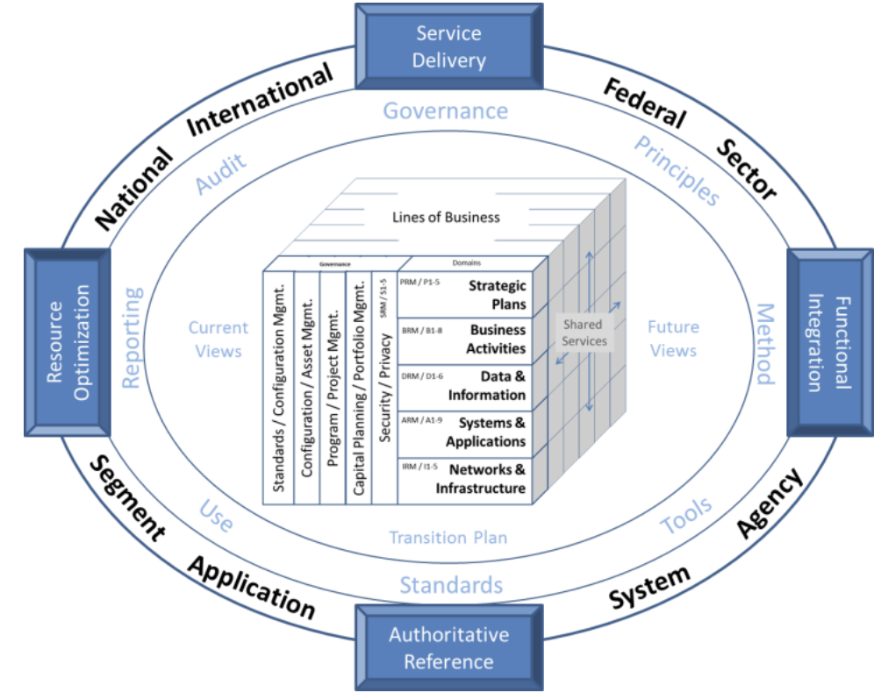
Federal Enterprise Architecture
Levels of Scope
  International
  National
  Federal
  Sector
  Agency
  Segment
  System
  Application
Office of Management and Budget. (2012, May 2). A common approach to federal enterprise architecture (PDF). U.S. Government. https://obamawhitehouse.archives.gov/sites/default/files/omb/assets/egov_docs/common_approach_to_federal_ea.pdf
Notes:
Concept of…
Scope
Sub-architectures
Segments

Slide 26
Segment vs Sub-Architecture
[Public Health] Segment
“Line of Business”
  Behavioral Health
  Case [Surveillance]
  Genomics
  Laboratory
  Vital Statistics
  …
Sub-architecture [Domain]
  Reference Model
  Performance
  Business
  Data
  Application
  Infrastructure
  Security

Slide 27
Segment vs Sub-Architecture
[Public Health] Segment
“Line of Business”
Genomics
Definition | Genomic information used to help characterize high-priority pathogens
Mission | Monitor and analyze genomic trends to predict, manage, and prevent outbreaks of infectious diseases; understand how people are exposed to pathogens and how pathogens are geographically distributed; help trace the source and transmission of outbreaks; learn about pathogen evolution, such as the development of drug resistance
Example data types | Whole genome sequences
Example Systems | - PulseNet 2.0 - CaliciNet - CryptoNet - National Antimicrobial Resistance Monitoring System (NARMS) - Strep Lab

Slide 28
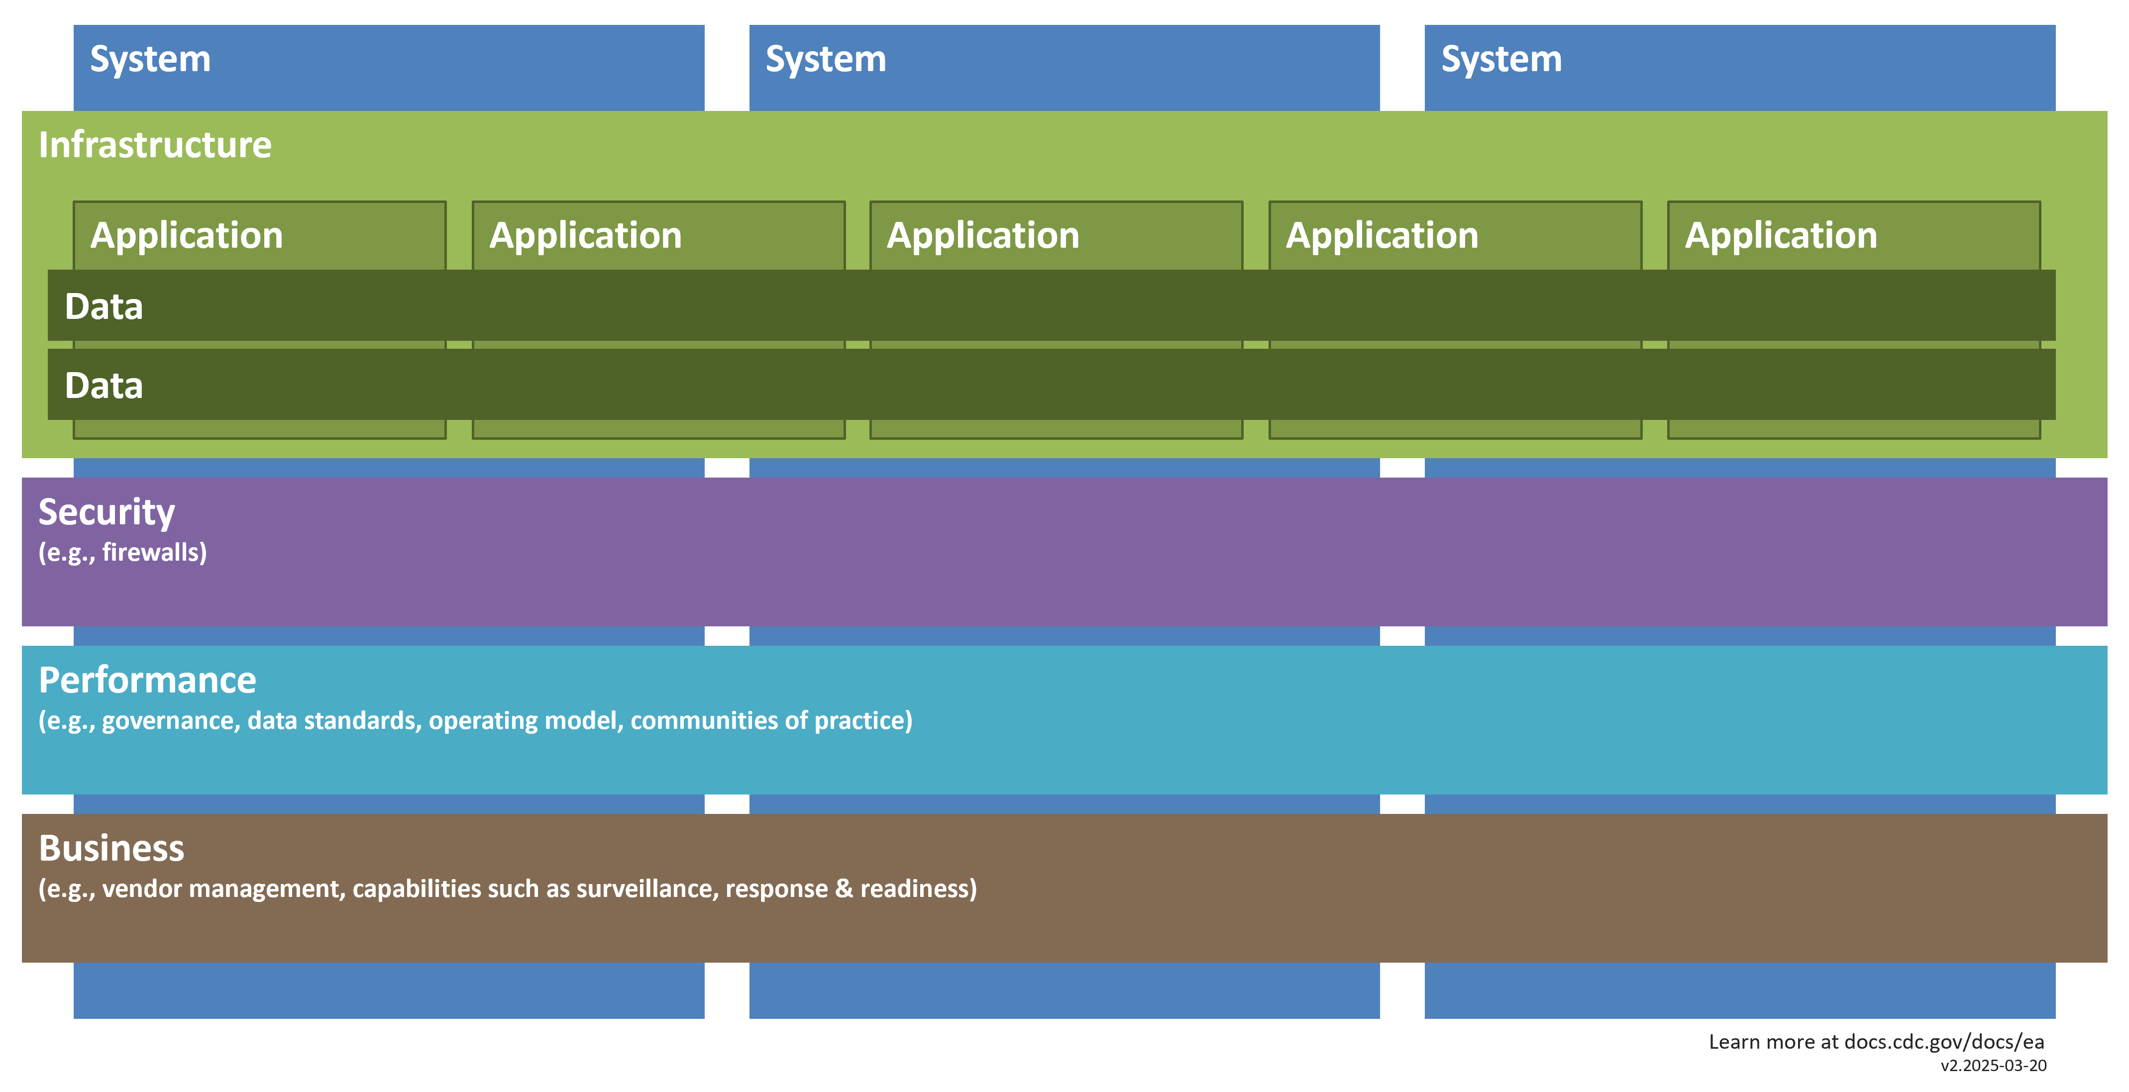
Segment vs Sub-Architecture
Sub-architecture [Domain]
  Reference Model
Notes:
Alt-text: Diagram showing how sub architectures fit together. There are several systems that share infrastructures. Applications sit inside the infrastructure with shared data. There are also layers for Security (e.g., firewalls), Performance (e.g, governance, data standards, operating model, communities of practice), Business (e.g., vendor management, capabilities such as surveillance, response and readiness).

Slide 29
Business Architecture
CDC Mission
Partnership
Collaboration
Data Acquisition
Data Management
Guidance & Insights
Advice & Response
PUBLIC HEALTH OBSERVATIONS & EVENTS
Healthcare Systems
Modeling, Analysis, & Visualizations
PUBLIC HEALTH OUTCOMES
Intermediaries
State, Tribal, Local, & Territorial
Data Integration & Organization
Communications;
Logistics & Response
Data Platforms
Policies, Standards, & Guidelines
Aligning core capabilities
Promoting adaptive, shared enterprise solutions
Utilizing robust data platforms
Notes:
Aligning core capabilities to address public health challenges from the point that a public health “event” occurs to the point that CDC engages in a response effort.
Promoting adaptive, shared enterprise solutions for CDC and its partners to enable efficient data sharing and clear decision-making.
Utilizing robust data platforms with enterprise governance and guidelines to ensure high-quality data flow to help inform public health response.

Slide 30
Building the CDC Technical Reference Architecture (TRA)

Slide 31
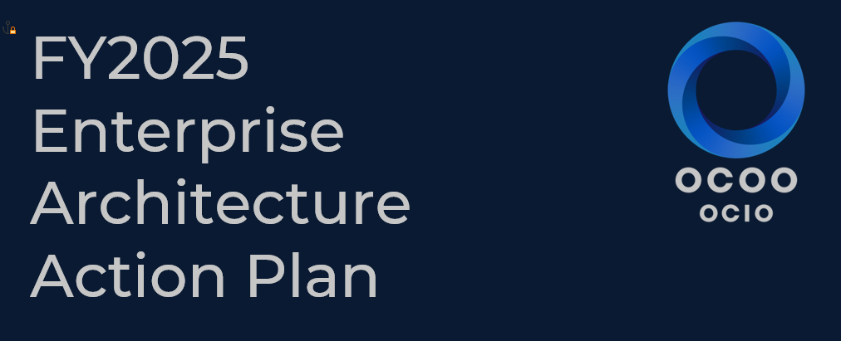
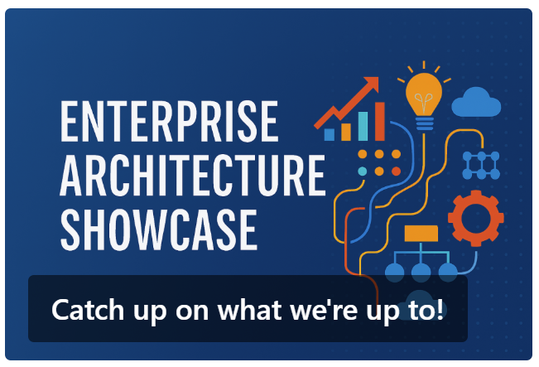
Timeline
CY2024 Q1
Enterprise Architecture Action Plan
CY2025 Q1
Internal TRA pages published
CY2024 Q2
Endorsement by CIO
CY2025 Q2
CoP re-starts
CY2025 Q2
Public TRA pages

Slide 32
Authority
HHS Policy for Enterprise Architecture (EA)
7.10 Operating Division (OpDiv) Chief Enterprise Architect (CEA)
    a. Develop and disseminate the OpDiv’s EA strategies, policies, standards, and governance requirements that are no less restrictive than those within this policy and the HHS EA Framework;
    d. Adapt the HHS EA Framework to produce an OpDiv-specific enterprise architecture vision, standards, and review process to meet the requirements of their OpDiv;
U.S. Department of Health & Human Services, Office of the Chief Information Officer. (2024, October). HHS policy for enterprise architecture (EA). HHS.gov. https://www.hhs.gov/web/governance/digital-strategy/it-policy-archive/hhs-policy-for-enterprise-architecture.html#7.10

Slide 33
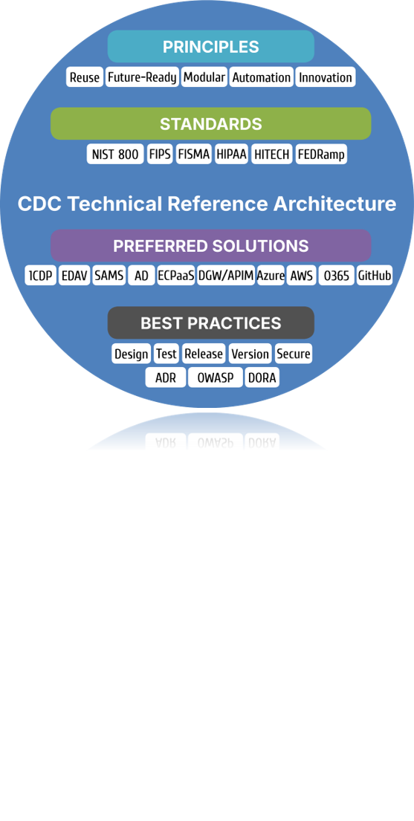
What is the CDC TRA?
Guides the development of the CDC technology ecosystem.
Defines standards that operationalize guiding principles.
Prescribes preferred solutions that implement Federal, HHS and CDC standards.
Supports systems and applications implementation with best practices and checklists that distill industry and CDC best practices.

Slide 34
What is the CDC TRA?
Baseline in Dec 2024
  May use: List of IT Systems
  Should use: Not codified
  Gap: What should an architect, developer, or system designer use?
Baseline in Dec 2025
  Codified as Preferred Solutions by
  Sub-architecture
    Data
    Applications
    Security
  Public Health Segment
    Genomics
    Laboratory

Slide 35
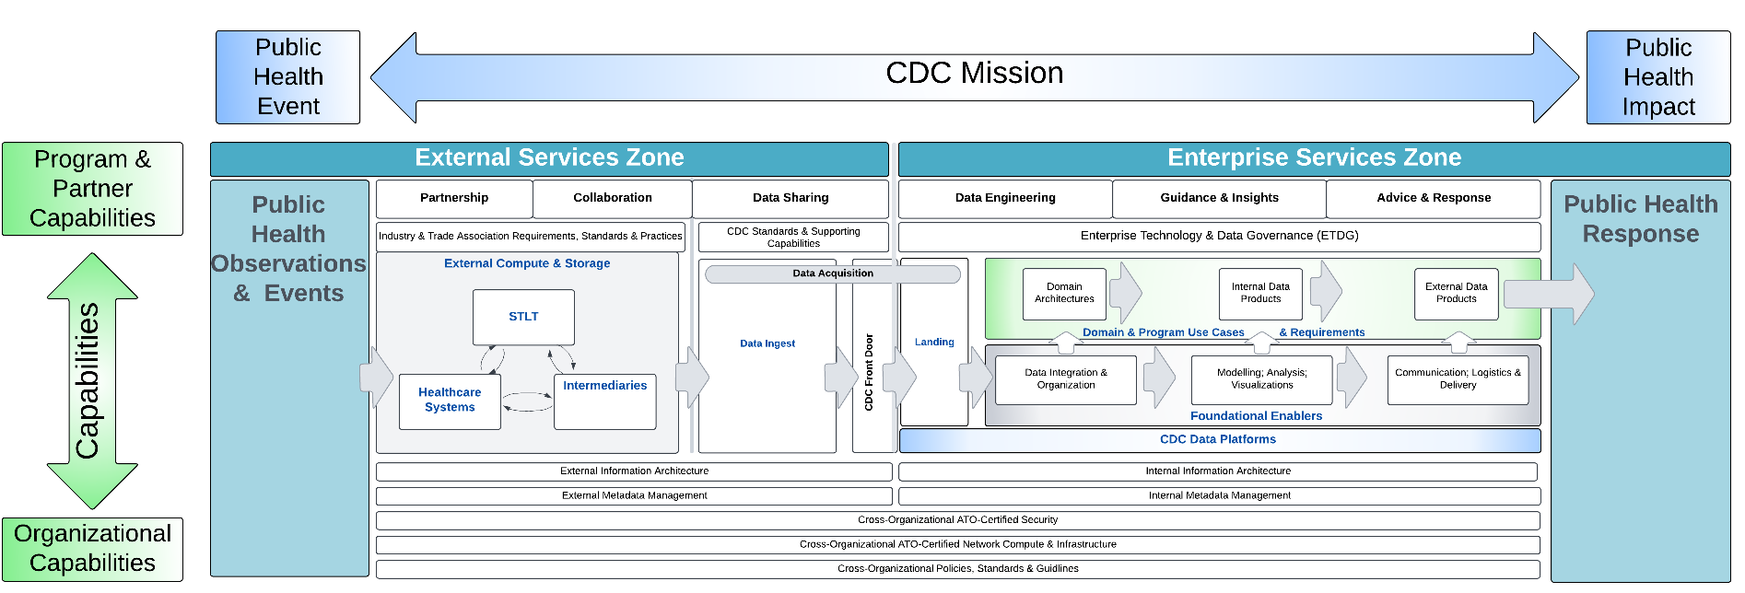
Example: Data Platforms

Slide 36
Existing Platforms
Many different systems with “platform” in name
System ID | System Name ∋ “Platform” | System Acronym
1 | National Center A Data Platform
2 | Vendor A Data Platform
3 | CDC Vendor B Security Platform
4 | Disease A Surveillance Cloud-based Computing Platform
5 | Disease B Analysis Platform
…
N

Slide 37
Define a “Platform”
A Platform refers to any system whose primary purpose is to host other systems or applications, providing services that support the build, deployment, and operation of those systems or applications.
Within CDC, platforms can be categorized into two categories: functional and data platforms.
Functional platform is to support operations activities related to the mission functions of CDC.
Data Platform is to drive analytics and insights for decision-making by supporting core functions required to manage data across the data lifecycle.

Slide 38
Attributes of a Data Platform
Data Ingestion: Best practices for data integration
Data Storage: Best storage principles
Data Processing: Tools and technologies for data transformation
Data Product Dissemination: Data distribution
Data Governance: Ensuring data quality and compliance

Slide 39



Codify Preferred Solutions
Preferred Data Platforms
Sub-Architecture: Data
Segment: Genomics
One CDC Data Platform (1CDP)
Advanced Molecular Detection (AMD) Platform
Enterprise Data Analytics & Visualization (EDAV) Platform

Slide 40
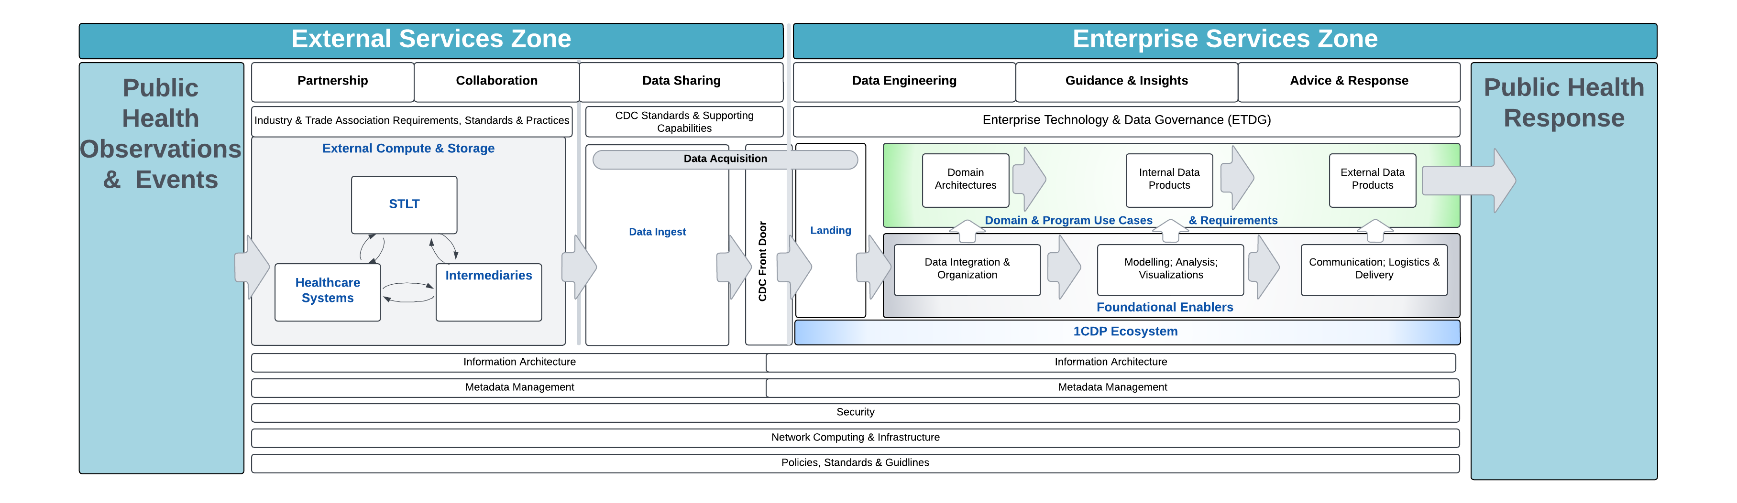
Detail by Persona
As Management, are we doing the “right” things, and are we doing them right?
As a Scientist, how do I build the pipeline? Am I getting the right data in the right format at the right time?
As a Solution Architect, does the TRA identify major components AND provide direction to support my IT system?
As Operations, are we adhering to pre-approved design patterns that ensure an efficient, managed and controlled foundation?

Slide 41
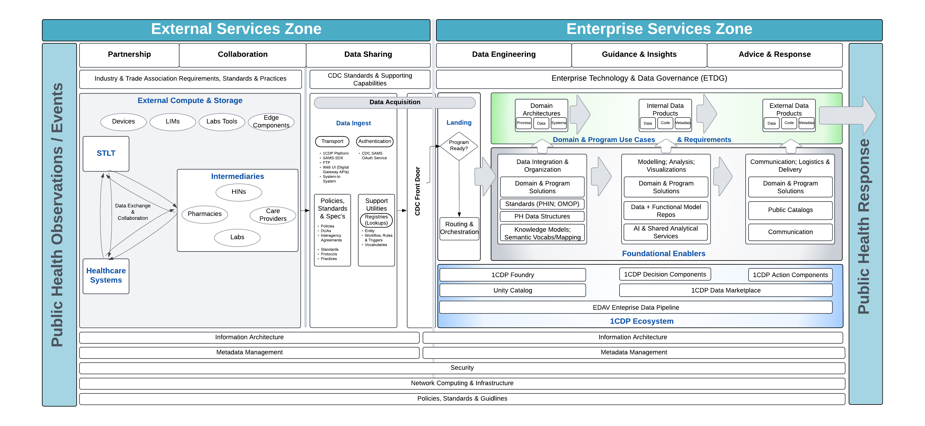
Management
Preferred Solutions
Data Ingest
1CDP
SAMS-SDX
FTP Data Exchange
Custom APIs (with registration in Digital Gateway)
Management seeks to ensure that preferred solutions and design patterns are applied related to ingestion and authentication

Slide 42

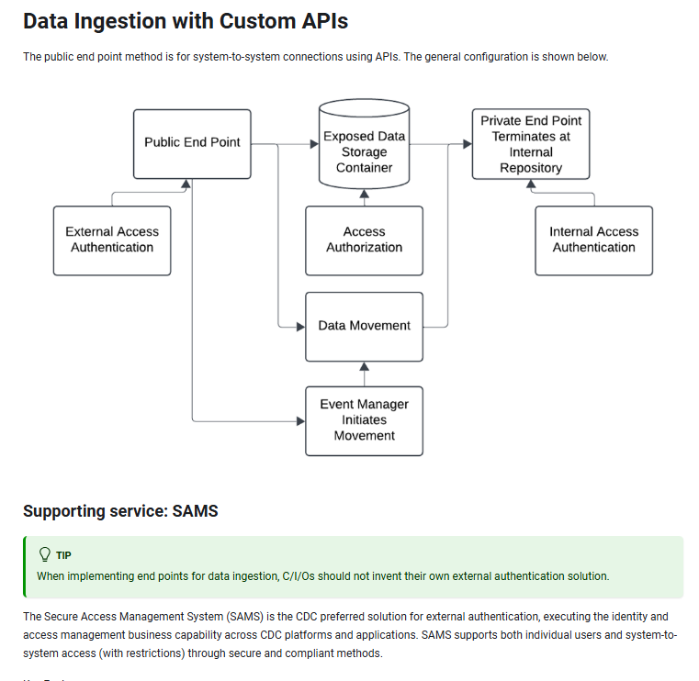
Solution Architect
Solution architect needs additional detail.

Slide 43
Governance

Slide 44
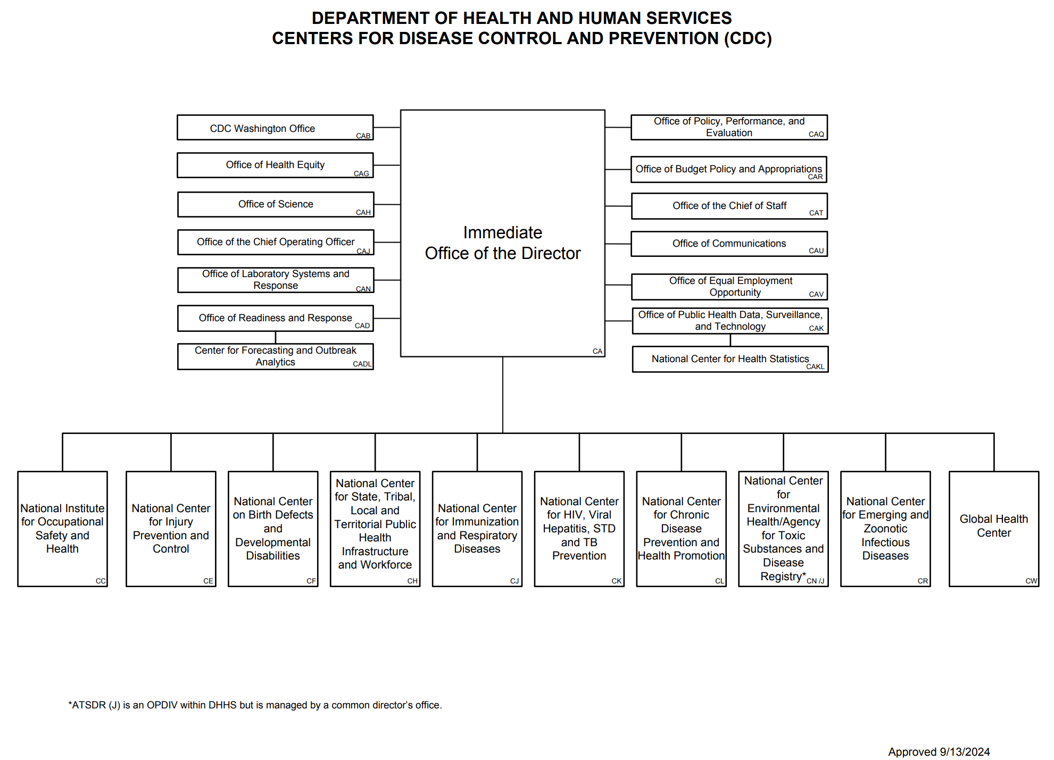
CDC Organization
Enterprise Governance
Enterprise technology providers
Local Governance
Centers for Disease Control and Prevention. (2024). Centers for Disease Control and Prevention organizational chart (PDF). U.S. Department of Health and Human Services. https://www.cdc.gov/about/media/pdfs/cdc-org-chart.pdf

Slide 45
CDC Organization
Enterprise Architecture Team
OCIO TMO
Chief Enterprise Architect (Acting)
Enterprise Architect
Enterprise Architect
National Center
National Center
National Center
National Center
EA Critical
Partner
Solutions
Architect
EA Critical
Partner
Solutions
Architect
EA Critical
Partner
Solutions
Architect
EA Critical
Partner
Solutions
Architect
ADI
Solutions
Architect
ADI
Solutions
Architect
ADI
Solutions
Architect
ADI
Solutions
Architect
Information
Architect
Security
Architect
Information
Architect
Security
Architect
Information
Architect
Security
Architect
Information
Architect
Application
Architect
Application
Architect
Application
Architect
Security
Architect
Technical
Architect
Technical
Architect
Technical
Architect
Technical
Architect
Application
Architect
ADI : Associate Director of Informatics | EA CP : [EPLC] Enterprise Architecture Critical Partner | OCIO TMO : OCIO Technology Modernization Office

Slide 46
Enterprise Technology & Data Governance
Executive Committee
Technology Governance Committee
Data Governance Committee
Local Governance

Slide 47
Enterprise Technology & Data Governance
Executive Committee
Technology Governance Committee
Data Governance Committee
CDC Technical Reference Architecture (TRA)
Local Governance

Slide 48
Enterprise Technology & Data Governance
Executive Committee
Technology Governance Committee
Data Governance Committee
1CDP Governance Committee
Technical Reference Architecture
Disclosure Review
AI Consultation Workgroup
Data Policy Workforce Upskilling
HL7 - FHIR
Local Governance

Slide 49
Enterprise Technology & Data Governance
Exception
Guidance
Executive Committee
Technology Governance Committee
Data Governance Committee
Investment Review Process
1CDP Governance Committee
Technical Reference Architecture
Disclosure Review
AI Consultation Workgroup
Data Policy Workforce Upskilling
HL7 - FHIR
Local Governance
Guidance informs criteria for escalation and investment review
Notes:
Keep decision making closer to the problem
More freedom to operate for local governance
Reduced workload for enterprise governance

Slide 50
Continuous Improvement

Slide 51
ADKAR Change Management Model
Awareness
Desire
Knowledge
Ability
Reinforcement
Announce the change to employees well ahead of time.
Explain your reasoning behind the change, including current pain points and potential ROI of the new solution.
Give employees an opportunity to ask questions and make suggestions.
Gauge employees’ reactions to the change.
Identify champions.
If employees are resistant or indifferent, address their concerns or show them how the change benefits them personally.
Provide training or coaching to show what employees need to do after the change takes place.
Address any skill gaps.
Offer resources, such as process flowcharts, that employees can reference later on.
Schedule practice runs before the change is fully implemented.
Monitor performance immediately following the change and provide constructive feedback.
Set reasonable goals and metrics at the start.
Adjust processes as necessary.
Monitor the change over time to ensure it fulfills your desired outcome.
Use positive feedback, rewards, and recognition to encourage employees to keep following the new process.
Hiatt, J. (2006). ADKAR: a model for change in business, government, and our community. Prosci.

Slide 52
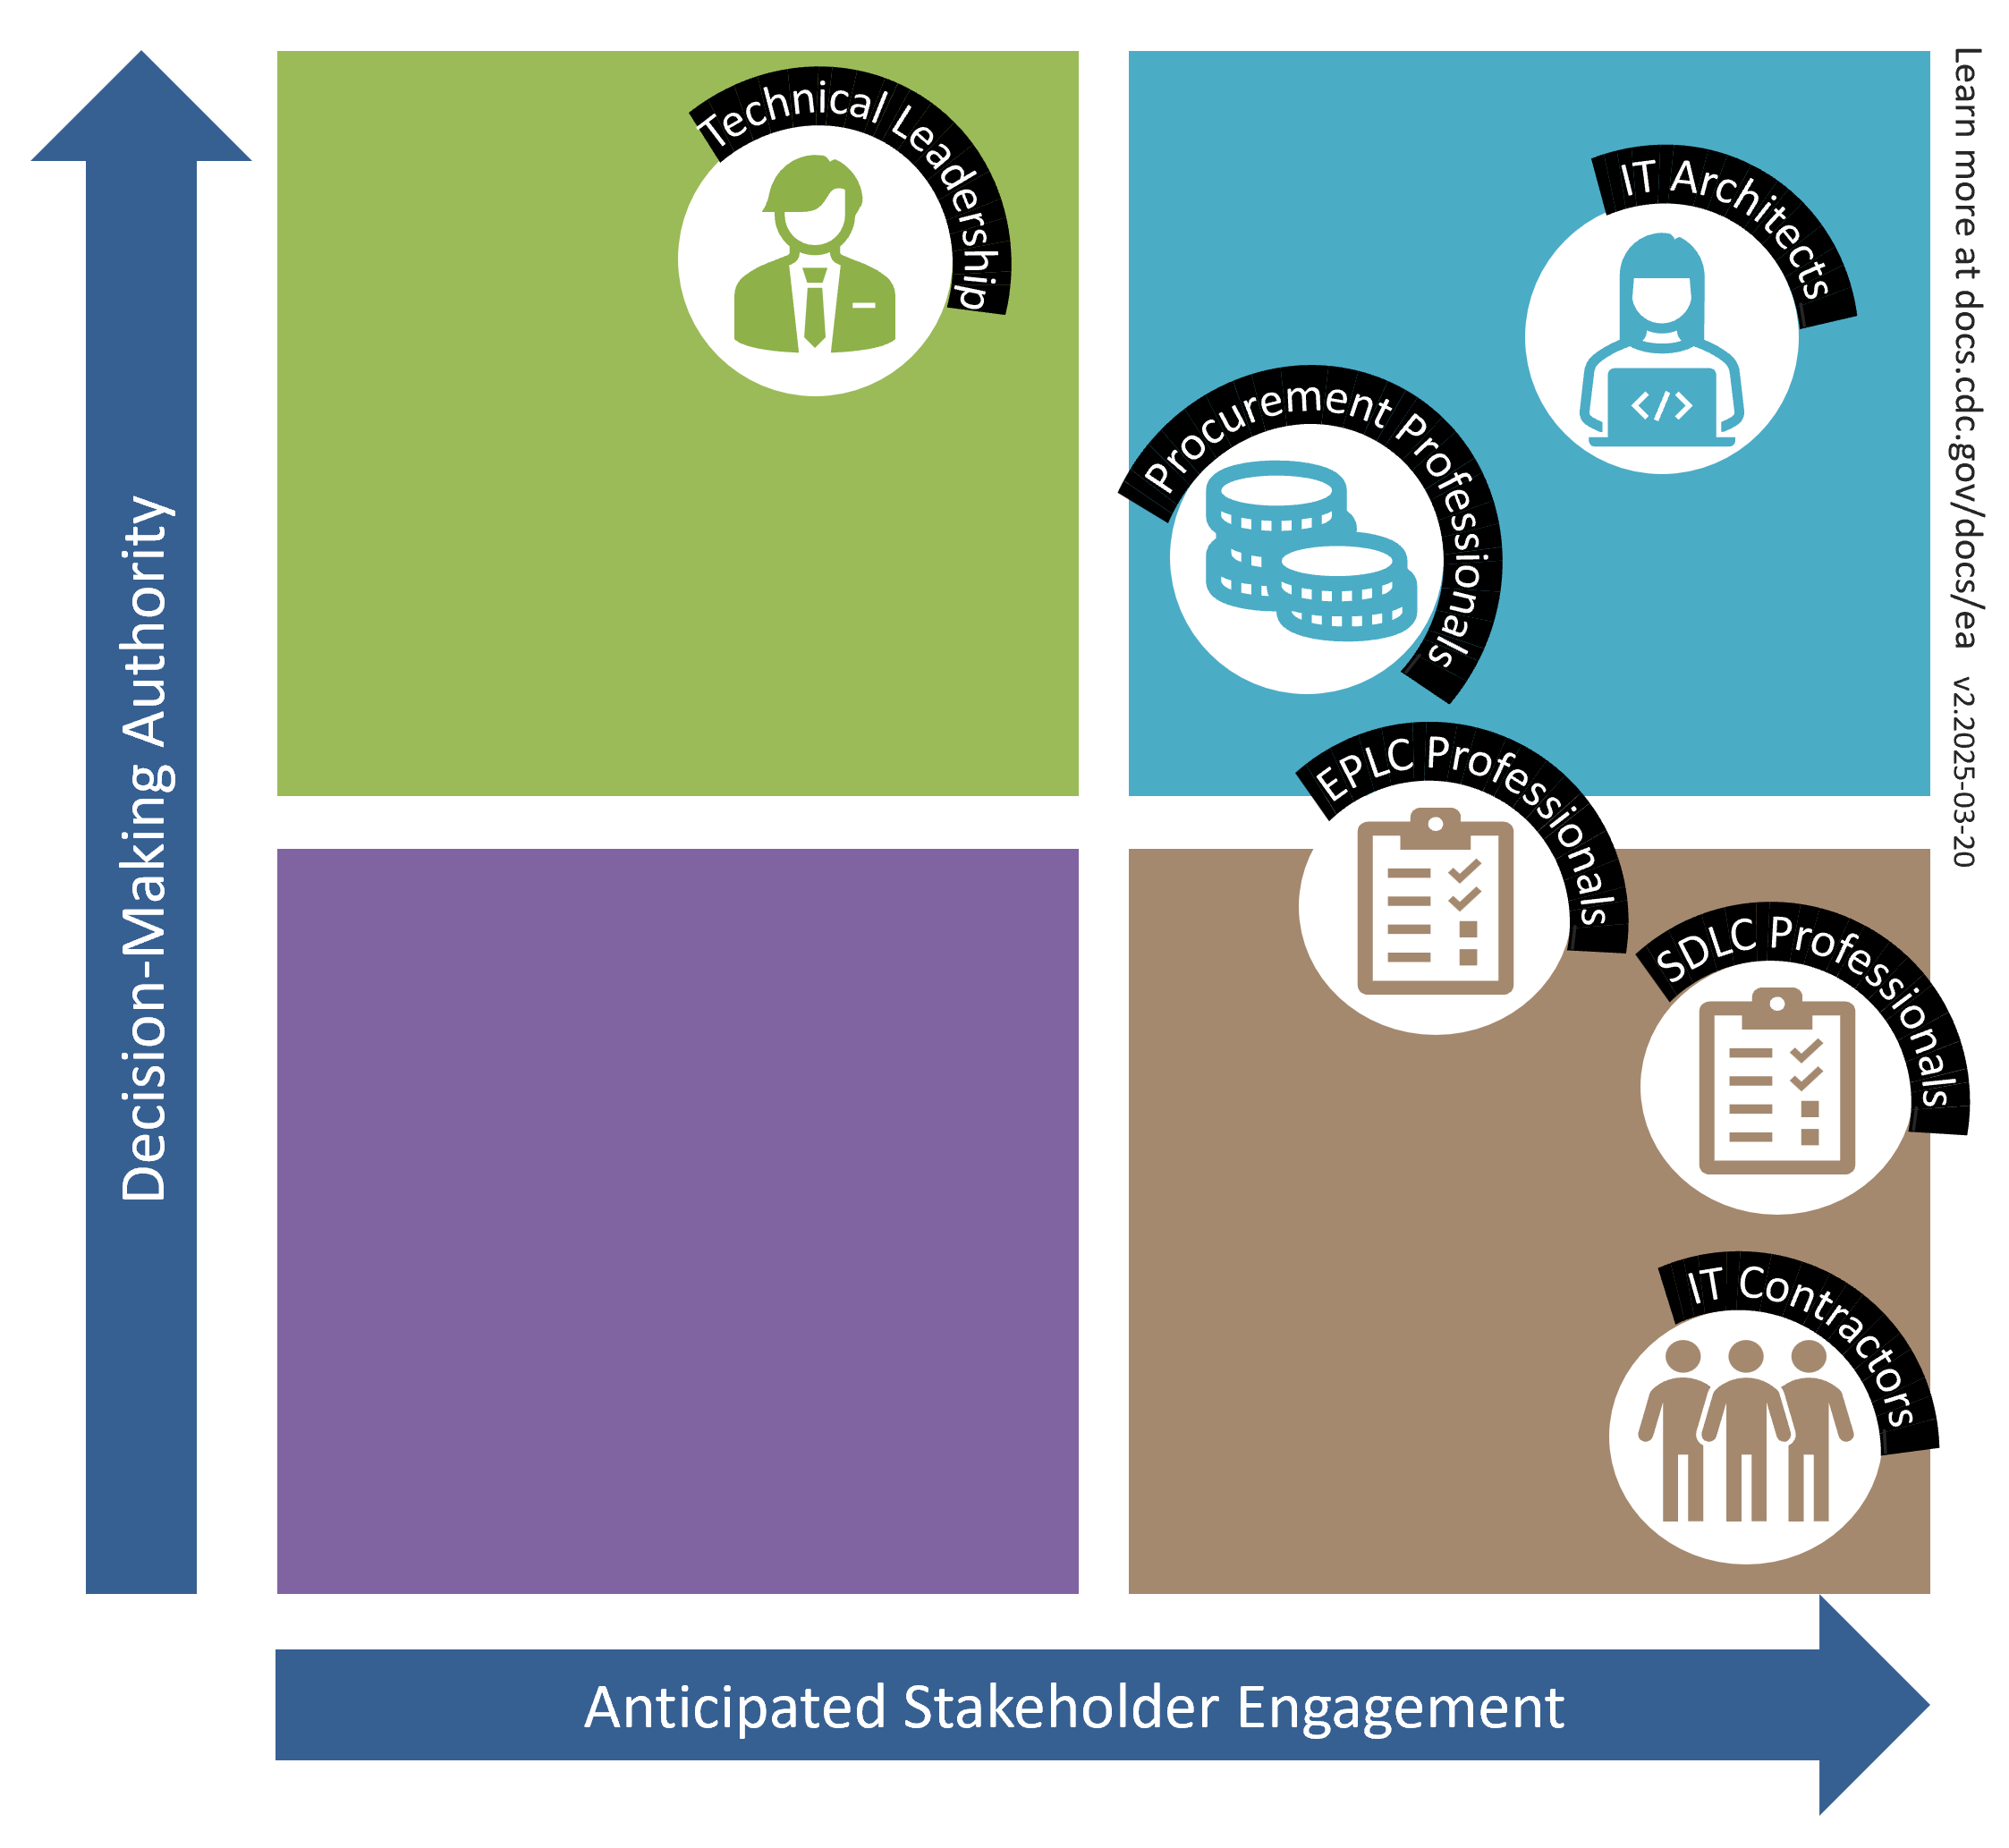
Personas and Engagement Mapping
Persona Type | Interviewed
EPLC / SDLC Professionals | 6
IT Contractor | 2
IT Architect | 1
Grand Total | 9
To inform our EA approach, we interviewed a range of stakeholder types, including contractors, architects and process leads, to understand their roles, how familiar they are with EA and how EA affects their daily work at the agency.

Slide 53
Personas Pain Points
Pain Point | EA Charter Goal | Objective | Quote
Leadership & Communication Gaps | Ensure that the IT landscape is strategically aligned with, and capable of supporting, current and future business needs. | Ensure programs are aware of agency's future strategy and incorporating in their roadmap | "You're not getting any communication and then all of a sudden you're out of compliance and someone's pinging you" - SDLC Professional (Project Manager)
Lack of Visibility & Alignment | Foster an environment where business and mission areas can collaborate and communicate on common IT projects and outcomes. | Ensure cross program communication and collaboration | "I feel like it's communication is where it's lacking, so it's like, ‘oh, we're going to roll out this or you know, we're going to roll out 1CDP, or we're going to roll out this new security process’ but like the tactical how do you do that? Or what are the next steps?" - SDLC Professional (Project Manager)
Inconsistent Processes | Promote the use of common IT solution patterns, standards, best practices, and the adoption of enterprise-wide IT services. | Expand common IT patterns, standards, and best practices usage across programs | "So the issue with having consistency is you have some people who are allowed to come to work and just make their own workflow." - SDLC Professional (Security Steward)
 | Identify IT redundancies and streamline processes to enhance overall efficiency, including IT system and software license rationalization. | Decrease redundancy of IT tools, services, and processes
 | Improve decision making by ensuring that decisions are not made in isolation or solely based on project-specific needs but instead reflect broader enterprise priorities, thus avoiding costly one-off solutions and promoting more sustainable, integrated investments. | Decrease costly one-off solutions across agency
Compliance & Security Concerns | Promote the use of common IT solution patterns, standards, best practices, and the adoption of enterprise-wide IT services. | Expand common IT patterns, standards, and best practices usage across programs | "What would make my job easier is if there's more of a compliance mechanism to say, 'hey, you must follow this,' a lot of times we don't necessarily have that guidance" - IT Architect
Notes:
Purpose
1. We did user research
2. I will read one quote (not all of them), to give a concrete example of the feedback we’ve received.

Slide 54
Surveys
Strong Organizational Consensus
78% of respondents rate EA as very to extremely important, demonstrating clear organizational alignment for implementation
Mission-Critical Priority
Half of all respondents view EA as "critical for our success," indicating current CDC capabilities are significantly constrained without it
Minimal Resistance
Only 6% see EA as slightly important, showing widespread recognition of its strategic value across the organization

Slide 55
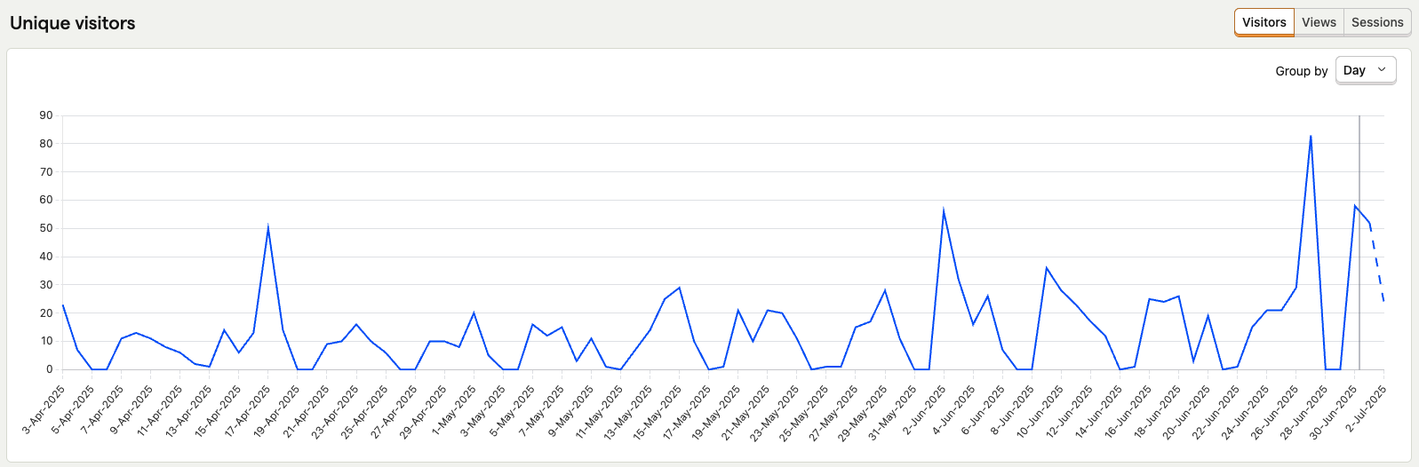
Usage tracking (CY2025 Q2)
Persona interviews, 1CDP meeting, survey sent
June 2
June 27
EA Showcase April 17

Slide 56
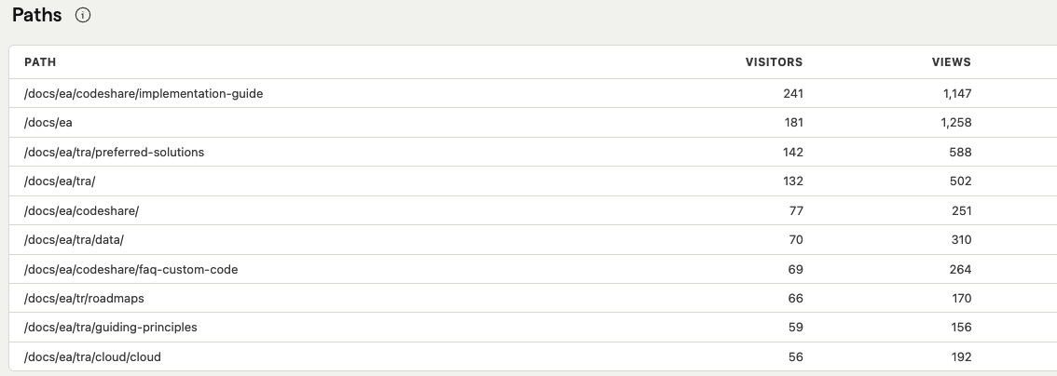
Usage tracking (CY2025 Q3)

Slide 57
Outcome Measures
Measure | July 2025
Awareness (Stakeholders being very familiar with Enterprise Architecture) | 28%
Desire (Stakeholders view EA as important to strengthening CDC’s technology capabilities) | 50%
Knowledge (7-day trailing average of unique visitors to TRA) | 28
Ability (EA standards and principles application) | 0%
Reinforcement (Average weekly TRA user retention) | 16.2%

Slide 58
Takeaways
Notes:
EA: Making lists, articulating state, and applying through governance
By codifying these standards, we’ll be able to better support public health

Slide 59











Acknowledgements
FF
Federal Staff
Former Federal Staff
Ryan Harrison
Chief Enterprise
Architect (Acting)
Arezoo Risman
Data Modernization
Initiative (DMI), Operations Lead
Ben Rogers
Deputy Chief
AI Officer (Acting)
Rishi Tarar
Former Chief
Enterprise Architect
Ricky Freyre
Former Enterprise Architect
Vamsee Kovelamudi
Former Security Engineering
and Architecture Lead
Contract Staff
KaNisa Williams
Ed Brailovsky
Jonathan Adams
Nihar Dave
Dorris Wong

Slide 60
Q&A
Feel free to ask questions!
Contact Information
Ryan Harrison: rharrison@cdc.gov
Session Feedback
Please take a moment to complete the session evaluation.
Notes:
Include speaker(s) contact information – email and/or social media
Organization logos may be placed on this slide
Remind attendees to complete online evaluation

