Slide 1
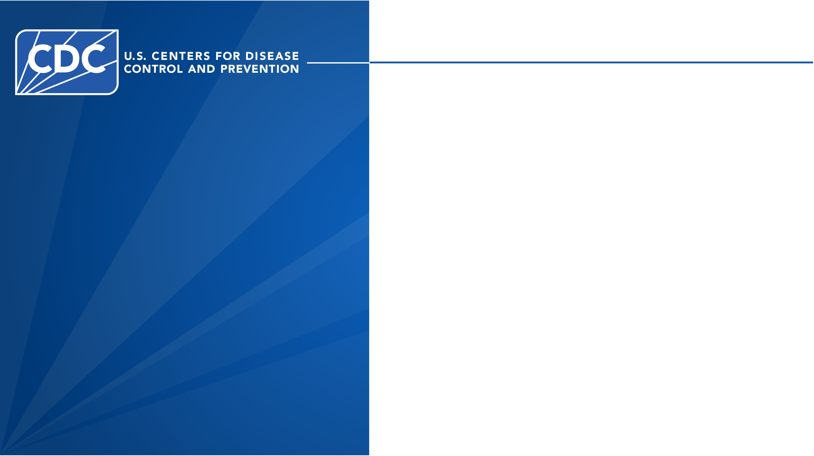
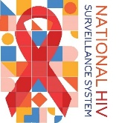

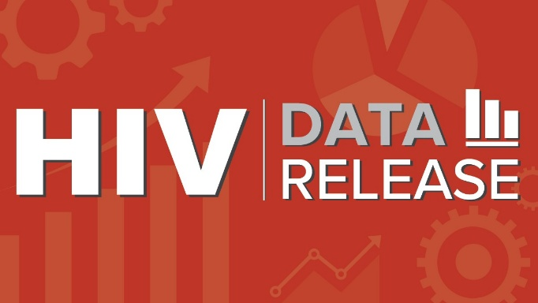
Monitoring Selected National HIV Prevention and Care Objectives by Using HIV Surveillance Data—United States and 7 Territories and Freely Associated States, 2024
Notes:
These slides were prepared by the Division of HIV Prevention, National Center for HIV, Viral Hepatitis, STD, and TB Prevention (NCHHSTP), Centers for Disease Control and Prevention (CDC). These slides present data on persons with HIV in the United States based on cases of HIV infection reported to CDC’s National HIV Surveillance System through December 2025.
Data are based on case reports from 50 states, the District of Columbia, and the U.S. territories and freely associated states. Confidential, name-based reporting is required by law or regulation.
Note. This slide set is in the public domain. You may reproduce these slides without permission; however, citation as to source is appreciated.
Centers for Disease Control and Prevention. Monitoring Selected National HIV Prevention and Care Objectives by Using HIV Surveillance Data —
United States and 7 Territories and Freely Associated States, 2024. Atlanta: U.S. Department of Health and Human Services; 2026.
You are also free to adapt and revise these slides; however, you must remove the CDC name and logo if changes are made.

Slide 2


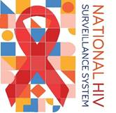


Data Sources and Technical Notes
Project Logo
For more information on data sources, data collection and reporting practices, and case definitions, see the National HIV Surveillance System (NHSS) Technical Notes.
Data for all figures are available in the 2024 Monitoring HIV Prevention and Care Objectives Data Release tables or NCHHSTP AtlasPlus.
Additional data, stratifications, and years are available in NCHHSTP AtlasPlus.
Notes:
For more information on data sources, data collection and reporting practices, and case definitions, see the National HIV Surveillance System (NHSS) Technical Notes, available at https://www.cdc.gov/hiv-data/nhss/index.html.
Data for all figures are available in the 2024 Monitoring HIV Prevention and Care Objectives Data Release tables or NCHHSTP AtlasPlus, available at https://www.cdc.gov/nchhstp/about/atlasplus.html.
Additional data, stratifications, and years are available via NCHHSTP AtlasPlus, available at https://www.cdc.gov/nchhstp/about/atlasplus.html.

Slide 3
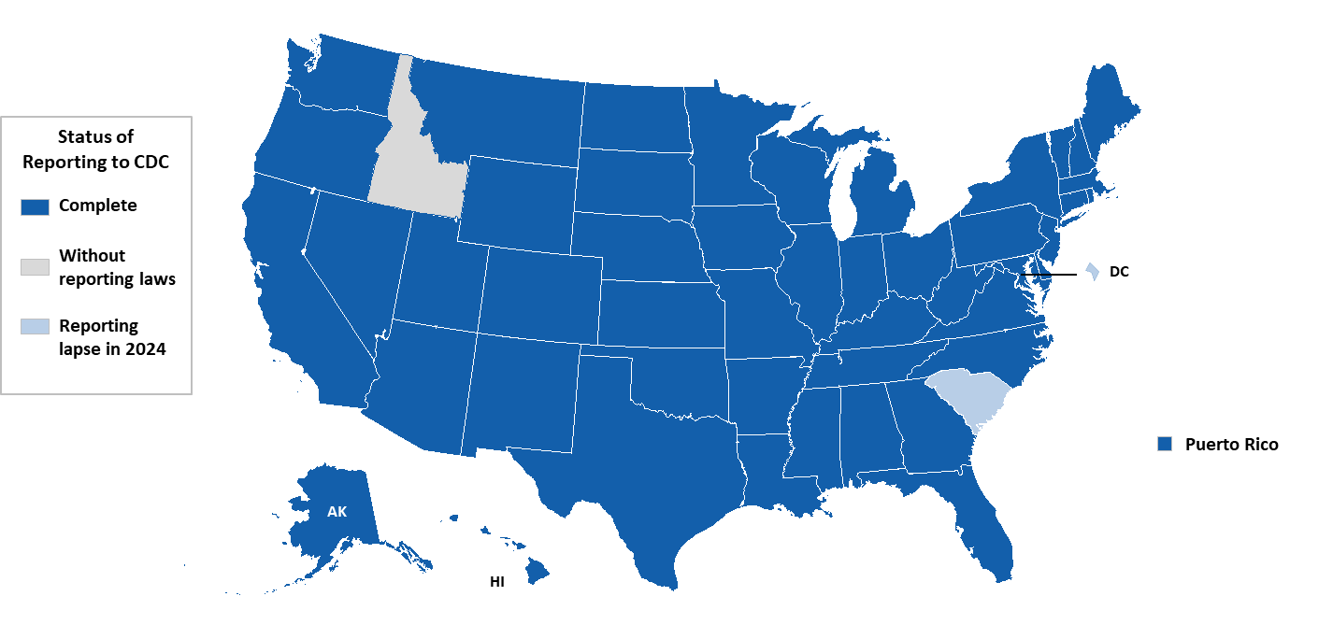


Status of CD4 and viral load reporting by HIV surveillance reporting area, December 2025—United States and Puerto Rico
AK
Notes:
Key findings
All states (except Idaho), the District of Columbia, and Puerto Rico meet CDC’s criteria for the collection and reporting of CD4 and viral load test results. Idaho does not require mandatory reporting of all CD4 and viral load test results; therefore, its data are included in national and regional analyses but are not presented in jurisdiction-level tables. Data for District of Columbia and South Carolina are included in all analyses; however, they should be interpreted with caution because of a lapse in laboratory reporting during 2024.
Data notes and sources
Use caution when interpreting data for the West, as it includes Idaho, which does not have laws and regulations requiring the reporting of all CD4 and viral load results.
For more information on data sources, data collection and reporting practices, and case definitions, see the National HIV Surveillance System (NHSS) Technical Notes, available at https://www.cdc.gov/hiv-data/nhss/index.html.
A list of jurisdictions with complete lab reporting by year is available on the NCHHSTP AtlasPlus (Table 1.8) technical notes located at https://www.cdc.gov/nchhstp/about/atlasplus.html.

Slide 4

Stage of disease at HIV diagnosis
Notes:
Stages of HIV infection are defined according to the 2014 HIV surveillance case definition and are based on age-specific CD4 lymphocyte counts or percentages of total lymphocytes. The 2014 HIV surveillance case definition describing stages of disease is available at https://www.cdc.gov/mmwr/preview/mmwrhtml/rr6303a1.htm.
Because complete assessment of stage of disease at time of HIV diagnosis relies on complete laboratory data (all CD4 values) to assess earlier stages of disease (stage 0 or 1), stage of disease at time of diagnosis was calculated only for jurisdictions that reported complete laboratory data.
Information on stage 3 (AIDS) is available for all 50 states, the District of Columbia, and 7 U.S. territories and freely associated states, even when not all CD4 values are reportable; therefore, stage 3 (AIDS) at time of HIV diagnosis was calculated for persons in all jurisdictions.
Data on persons with diagnosed HIV, stage 3 (AIDS) include persons whose stage of disease has ever been classified as stage 3 (AIDS). These data do not necessarily reflect a person’s current stage of disease.
Stage of disease at time of diagnosis (i.e., HIV infection, stage 0, 1, 2, 3 [AIDS], or unknown) was determined by using the first CD4 test result or documentation of an AIDS-defining condition within 3 months of HIV diagnosis date (including diagnosis on the same day as the CD4 test) during the most recent year, unless documentation indicated stage 0. If ≥ 2 events occurred during the same month and could qualify as the “first” event, the following hierarchy was applied:
If an AIDS-defining condition was documented, it was used, regardless of whether a CD4 count or CD4 percentage was also reported.
If an AIDS-defining condition was not documented and both a CD4 count and CD4 percentage were reported, the CD4 count was used.
If an AIDS-defining condition was not documented and >1 CD4 count was reported, the lowest CD4 count (indicative of the most severe disease state) was used.
If an AIDS-defining condition was not documented and no CD4 count was reported but a CD4 percentage was reported, the CD4 percentage was used. If > 1 CD4 percentage was reported, the lowest CD4 percentage (indicative of the most severe disease state) was used.
For stage of disease at time of diagnosis, HIV was classified as “stage unknown” if the month of HIV diagnosis was missing or if, > 3 months after diagnosis, neither a CD4 count nor CD4 percentage was reported and no AIDS-defining condition was documented.

Slide 5
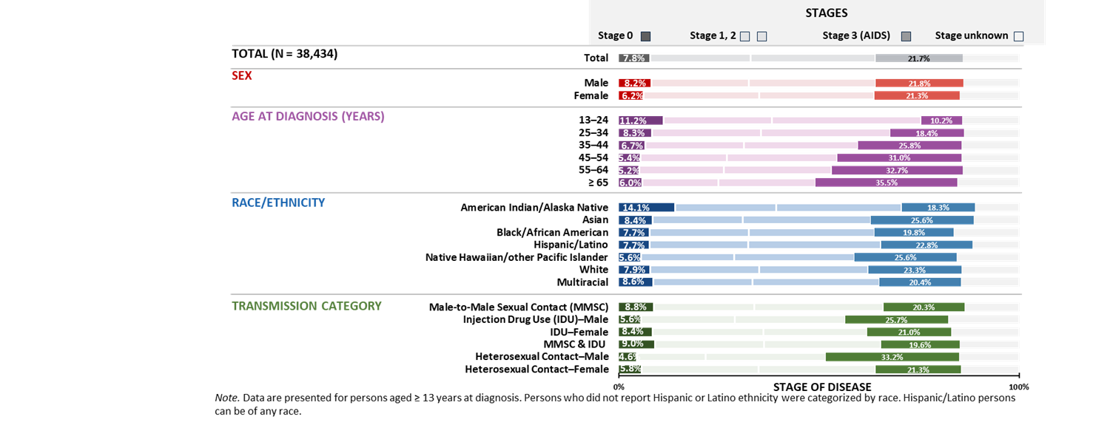
Stage of disease at HIV diagnosis, by selected characteristics, 2024—United States
Notes:
Key findings
In 2024 in the United States, among 38,434 persons aged ≥ 13 years diagnosed with HIV, the stage of disease at time of diagnosis was classified as follows: stage 0 (7.8%), stage 1 (25.2%), stage 2 (31.1%), stage 3 (AIDS) (21.7%), and stage unknown (14.2%).
Overall, a higher percentage (21.7%) received a late stage (stage 3 [AIDS]) classification than an early (stage 0) diagnosis (7.8%).
Highest percentages of early (stage 0) diagnoses—males (8.2%), persons aged 13–24 years (11.2%), American Indian/Alaska Native persons (14.1%), and males with HIV attributed to male-to-male sexual contact and injection drug use (9.0%) and male-to-male sexual contact (8.8%).
Highest percentages of late (stage 3 [AIDS]) diagnoses—persons aged ≥65 years (35.5%), Asian (25.6%) and Native Hawaiian/other Pacific Islander persons (25.6%), males with HIV attributed to heterosexual contact (33.2%).
Data notes and sources
For additional data, see Table 1a in the 2024 HIV Monitoring Data Release.
Data have been statistically adjusted to account for missing transmission category. Use caution when interpreting data for American Indian/Alaska Native and Native Hawaiian/other Pacific Islander persons due to small numbers
For more information on data sources, data collection and reporting practices, and case definitions, see the National HIV Surveillance System (NHSS) Technical Notes, available at https://www.cdc.gov/hiv-data/nhss/index.html.
Data for all figures are available in 2024 HIV Monitoring Data Release or NCHHSTP AtlasPlus.

Slide 6
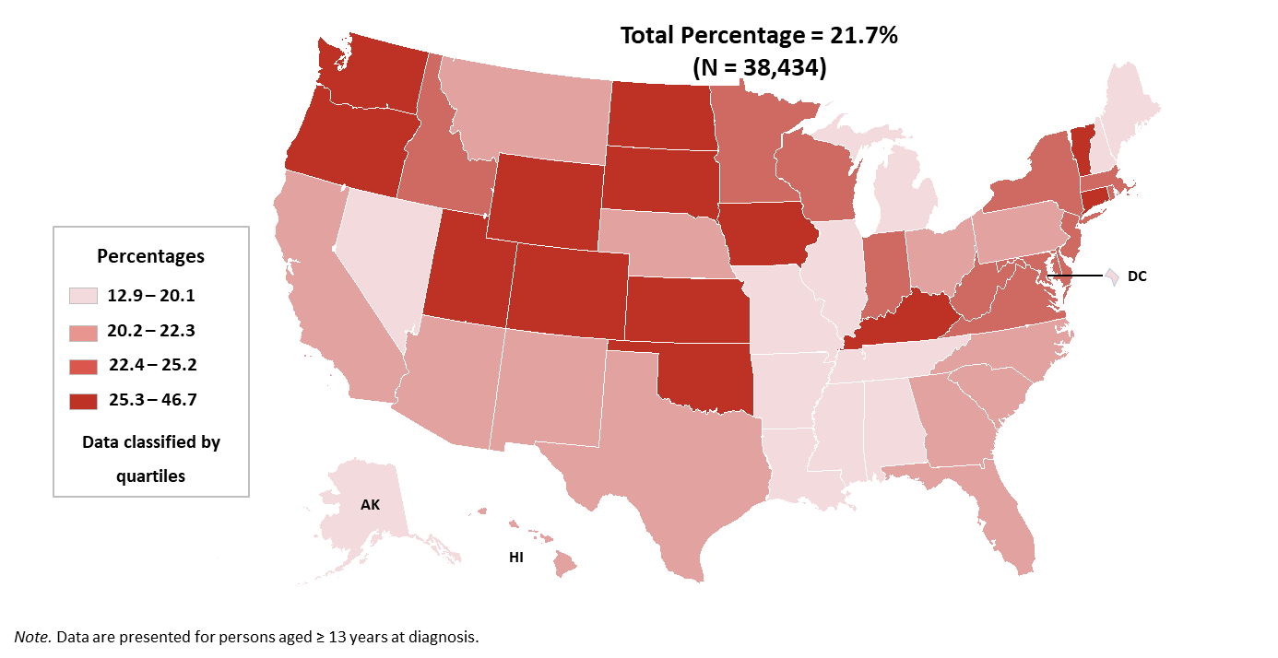
Stage 3 (AIDS) at HIV diagnosis, 2024—United States
Notes:
Key findings
Among the 38,434 persons aged ≥ 13 years who received an HIV diagnosis during 2024 in the United States, more than 1 in 5 persons (21.7%) received a late-stage diagnosis (stage 3 [AIDS]).
Jurisdictions in the highest quartile (Colorado, Connecticut, Iowa, Kansas, Kentucky, North Dakota, Oklahoma, Oregon, South Dakota, Utah, Vermont, Washington, and Wyoming) had ≥ 25.3% of persons who received a late-stage classification.
Data notes and sources
For additional data, see Table 5c in the 2024 HIV Monitoring Data Release.
For more information on data sources, data collection and reporting practices, and case definitions, see the National HIV Surveillance System (NHSS) Technical Notes, available at https://www.cdc.gov/hiv-data/nhss/index.html.
Data for all figures are available in the 2024 HIV Monitoring Data Release.

Slide 7
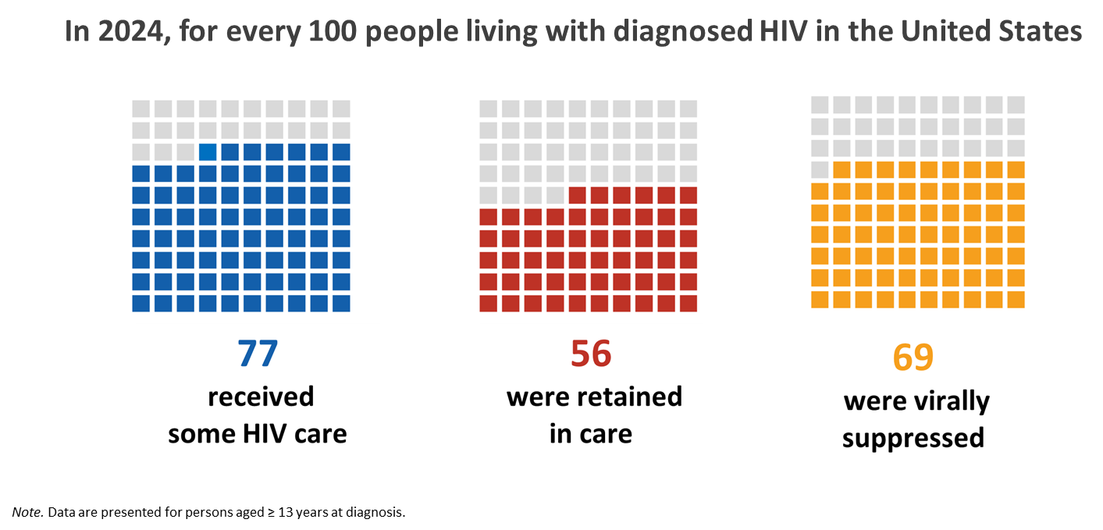
HIV care continuum, 2024—United States
Notes:
Key findings
In 2024, of the 1,103,895 persons aged ≥ 13 years living with diagnosed HIV in the United States:
• 77% received HIV medical care
• 56% were retained in HIV medical care
• 69% were virally suppressed
Data notes and sources
For additional data, see Table 3a in the 2024 HIV Monitoring Data Release.
For more information on data sources, data collection and reporting practices, and case definitions, see the National HIV Surveillance System (NHSS) Technical Notes, available at https://www.cdc.gov/hiv-data/nhss/index.html.
Data for all figures are available in 2024 HIV Monitoring Data Release or NCHHSTP AtlasPlus.

Slide 8
Linkage to HIV medical care within 1 month
Notes:
Data on linkage to HIV medical care were based on persons with HIV diagnosed during the specified year. Linkage to HIV medical care within 1 month of HIV diagnosis was measured by documentation of ≥ 1 CD4 (count or percentage) or viral load test performed within 1 month of HIV diagnosis, including tests performed on the same date as the date of diagnosis.
For analyses of linkage to, and retention in, care, the month and year of the earliest HIV-positive test result reported to the surveillance system were used to determine the diagnosis date. Test results were excluded if the month of the specimen collection was missing. For linkage to care, data were excluded if the month of diagnosis was missing.

Slide 9
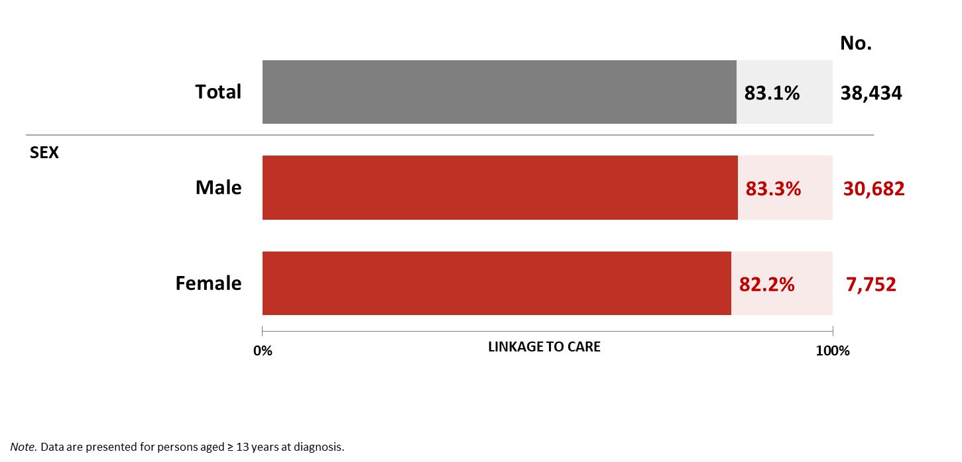
Linkage to HIV medical care within 1 month of HIV diagnosis, by sex, 2024—United States
Notes:
Key findings
Among the 38,434 persons aged ≥ 13 years who received an HIV diagnosis during 2024 in the United States, 83.1% were linked to care within one month. By sex, 83.3% of males and 82.2% of females who received an HIV diagnosis during 2024 were linked to care within one month.
Data notes and sources
For additional data, see Table 2a in the 2024 HIV Monitoring Data Release.
For more information on data sources, data collection and reporting practices, and case definitions, see the National HIV Surveillance System (NHSS) Technical Notes, available at https://www.cdc.gov/hiv-data/nhss/index.html.
Data for all figures are available in 2024 HIV Monitoring Data Release or NCHHSTP AtlasPlus.

Slide 10
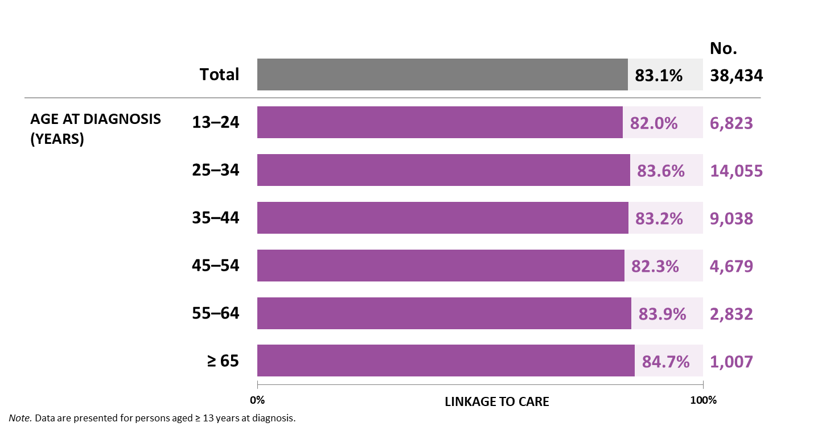
Linkage to HIV medical care within 1 month of HIV diagnosis, by age, 2024—United States
Notes:
Key findings
Among the 38,434 persons aged ≥ 13 years who received an HIV diagnosis during 2024 in the United States, 83.1% were linked to care within one month. By age group, linkage to care was lowest among persons aged 13–24 years (82.0%) and persons aged 45–54 years (82.3%).
Data notes and sources
For additional data, see Table 2a in the 2024 HIV Monitoring Data Release.
For more information on data sources, data collection and reporting practices, and case definitions, see the National HIV Surveillance System (NHSS) Technical Notes, available at https://www.cdc.gov/hiv-data/nhss/index.html.
Data for all figures are available in 2024 HIV Monitoring Data Release or NCHHSTP AtlasPlus.

Slide 11
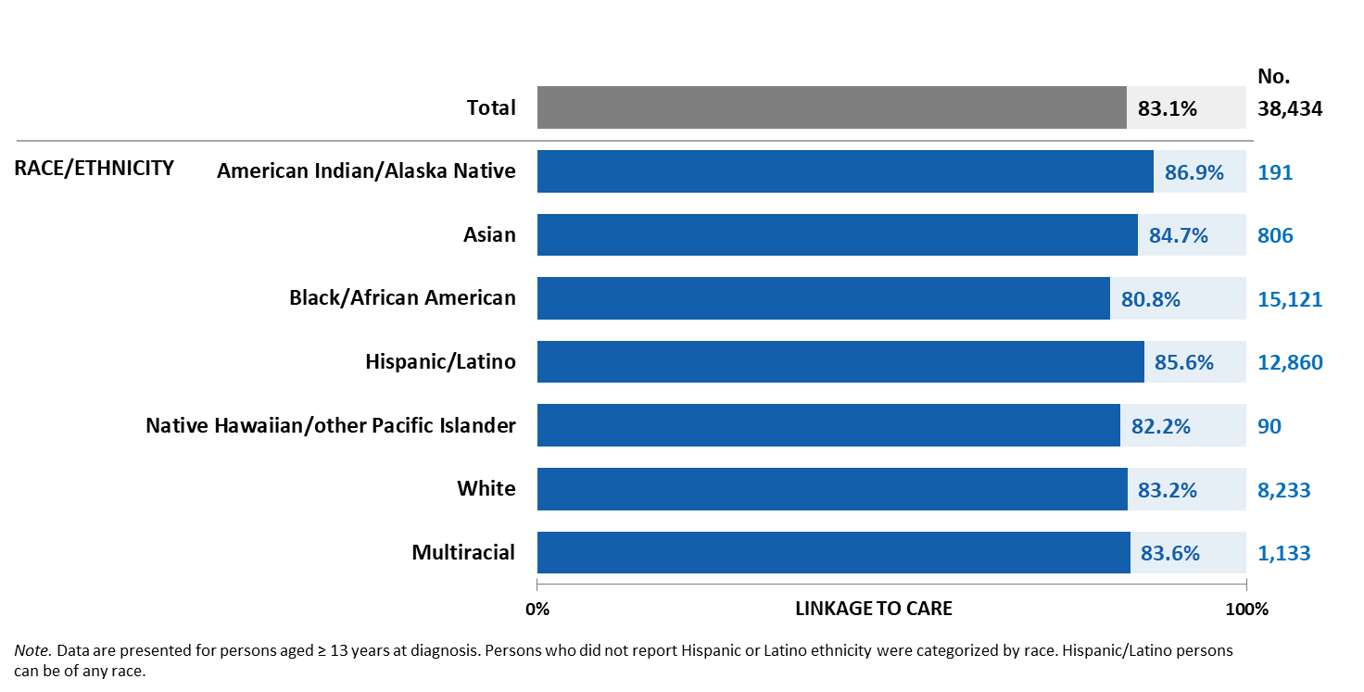
Linkage to HIV medical care within 1 month of HIV diagnosis, by race/ethnicity, 2024—United States
Notes:
Key findings
Among the 38,434 persons aged ≥ 13 years who received an HIV diagnosis during 2024 in the United States, 83.1% were linked to care within one month. By race/ethnicity, linkage to care was lowest among Black/African American persons (80.8%).
Data notes and sources
For additional data, see Table 2a in the 2024 HIV Monitoring Data Release.
Use caution when interpreting data for American Indian/Alaska Native and Native Hawaiian/other Pacific Islander persons due to small numbers.
For more information on data sources, data collection and reporting practices, and case definitions, see the National HIV Surveillance System (NHSS) Technical Notes, available at https://www.cdc.gov/hiv-data/nhss/index.html.
Data for all figures are available in 2024 HIV Monitoring Data Release or NCHHSTP AtlasPlus.

Slide 12
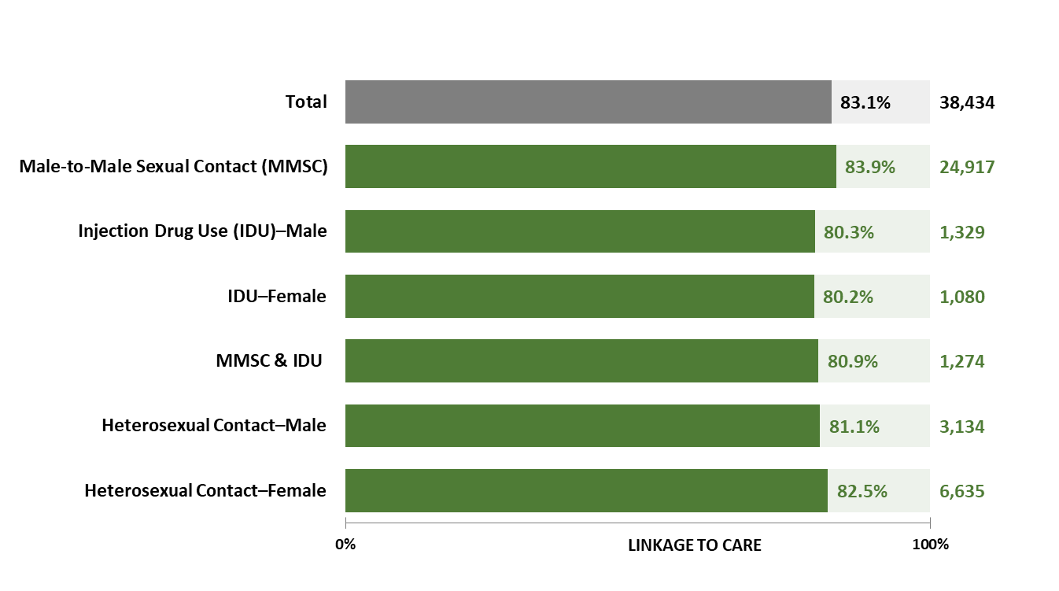
Linkage to HIV medical care within 1 month of HIV diagnosis, by transmission category and sex, 2024—United States
Notes:
Key findings
Among the 38,434 persons aged ≥ 13 years who received an HIV diagnosis during 2024 in the United States, 83.1% were linked to care within one month. By transmission category and sex, linkage to care was lowest among persons with HIV attributed to injection drug use (males, 80.3%; females, 80.2%) and male-to-male sexual contact and injection drug use (80.9%).
Data notes and sources
For additional data, see Table 2a in the 2024 HIV Monitoring Data Release.
Data have been statistically adjusted to account for missing transmission category.
For more information on data sources, data collection and reporting practices, and case definitions, see the National HIV Surveillance System (NHSS) Technical Notes, available at https://www.cdc.gov/hiv-data/nhss/index.html.
Data for all figures are available in 2024 HIV Monitoring Data Release or NCHHSTP AtlasPlus.

Slide 13
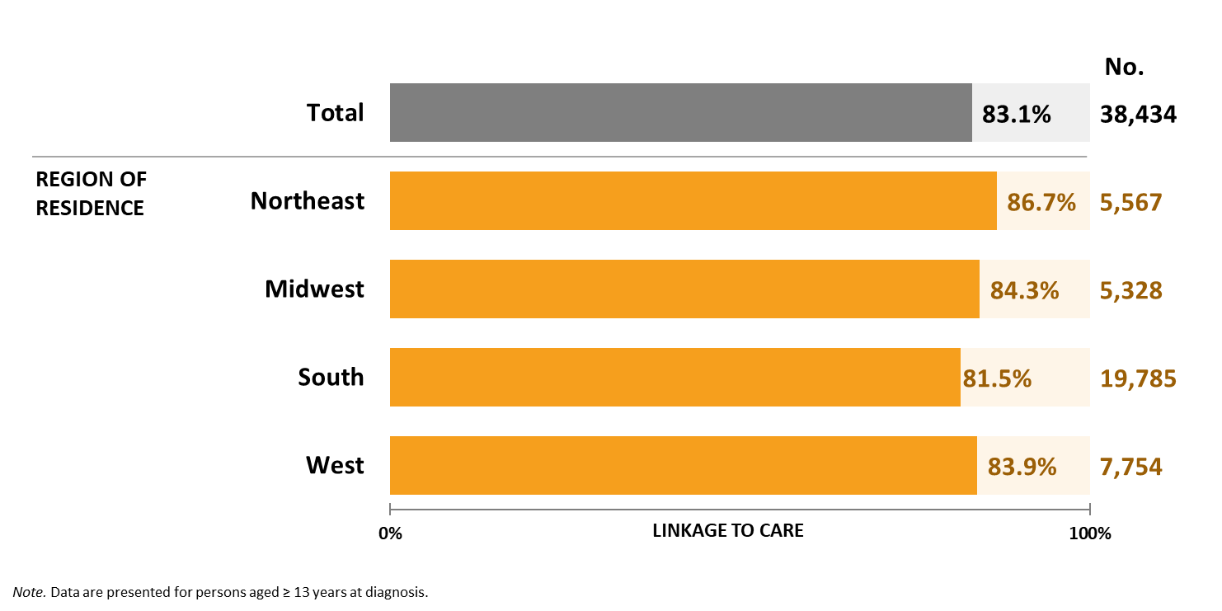
Linkage to HIV medical care within 1 month of HIV diagnosis, by region of residence, 2024—United States
Notes:
Key findings
Among the 38,434 persons aged ≥ 13 years who received an HIV diagnosis during 2024 in the United States, 83.1% were linked to care within one month. By region of residence, linkage to care was lowest among persons residing in the South at the time of diagnosis (81.5%).
Data notes and sources
For additional data, see Table 2a in the 2024 HIV Monitoring Data Release.
For more information on data sources, data collection and reporting practices, and case definitions, see the National HIV Surveillance System (NHSS) Technical Notes, available at https://www.cdc.gov/hiv-data/nhss/index.html.
Data for all figures are available in 2024 HIV Monitoring Data Release or NCHHSTP AtlasPlus.

Slide 14
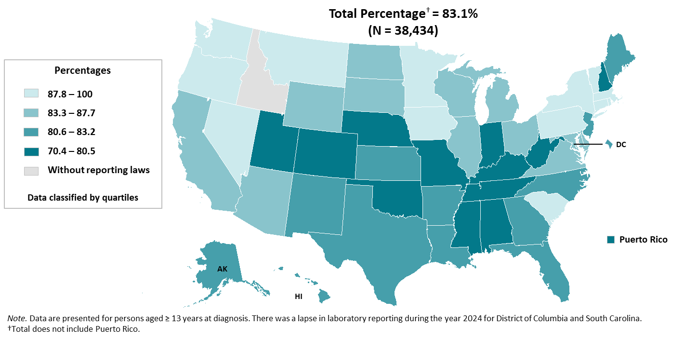
Linkage to HIV medical care within 1 month of diagnosis, 2024—United States and Puerto Rico
Notes:
Key findings
Among the 38,434 persons aged ≥ 13 years who received an HIV diagnosis during 2024 in the United States, 83.1% were linked to care within one month.
Jurisdictions in the lowest quartile (Alabama, Colorado, Indiana, Kentucky, Mississippi, Missouri, Nebraska, New Hampshire, Oklahoma, Puerto Rico, Tennessee, Utah, and West Virginia) had ≤ 80.5% of persons linked to HIV medical care.
Data notes and sources
For additional data, see Table 2b in the 2024 HIV Monitoring Data Release.
For more information on data sources, data collection and reporting practices, and case definitions, see the National HIV Surveillance System (NHSS) Technical Notes, available at https://www.cdc.gov/hiv-data/nhss/index.html.
Data for all figures are available in 2024 HIV Monitoring Data Release or NCHHSTP AtlasPlus.

Slide 15
Viral suppression within 6 months of HIV ﻿﻿diagnosis
Notes:
Viral suppression within 6 months of diagnosis was measured among persons with HIV diagnosed during the specified year. Viral suppression was defined as a viral load result of < 200 copies/mL at any viral load test performed within 6 months of an HIV diagnosis made during the specified year. The cutoff value of < 200 copies/mL was based on the definition of virologic failure as a viral load of ≥ 200 copies/mL. Virologic failure may indicate lack of adherence to antiretroviral therapy (ART).

Slide 16
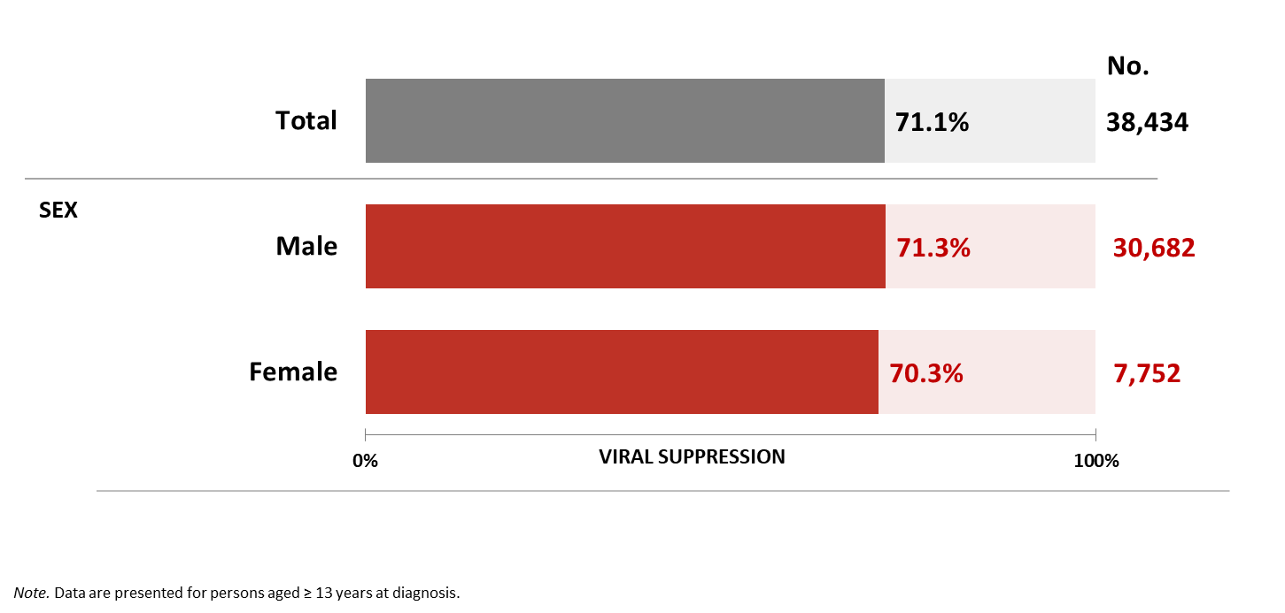
Viral suppression within 6 months of diagnosis, by sex, 2024—United States
Notes:
Key findings
Among the 38,434 persons aged ≥ 13 years who received an HIV diagnosis during 2024 in the United States, 71.1% of persons were virally suppressed within 6 months of diagnosis.
By sex, 71.3% of males and 70.3% of females who received an HIV diagnosis during 2024 were virally suppressed within 6 months of diagnosis.
Data notes and sources
For additional data, see Table 2a in the 2024 HIV Monitoring Data Release.
For more information on data sources, data collection and reporting practices, and case definitions, see the National HIV Surveillance System (NHSS) Technical Notes, available at https://www.cdc.gov/hiv-data/nhss/index.html.
Data for all figures are available in 2024 HIV Monitoring Data Release or NCHHSTP AtlasPlus.

Slide 17
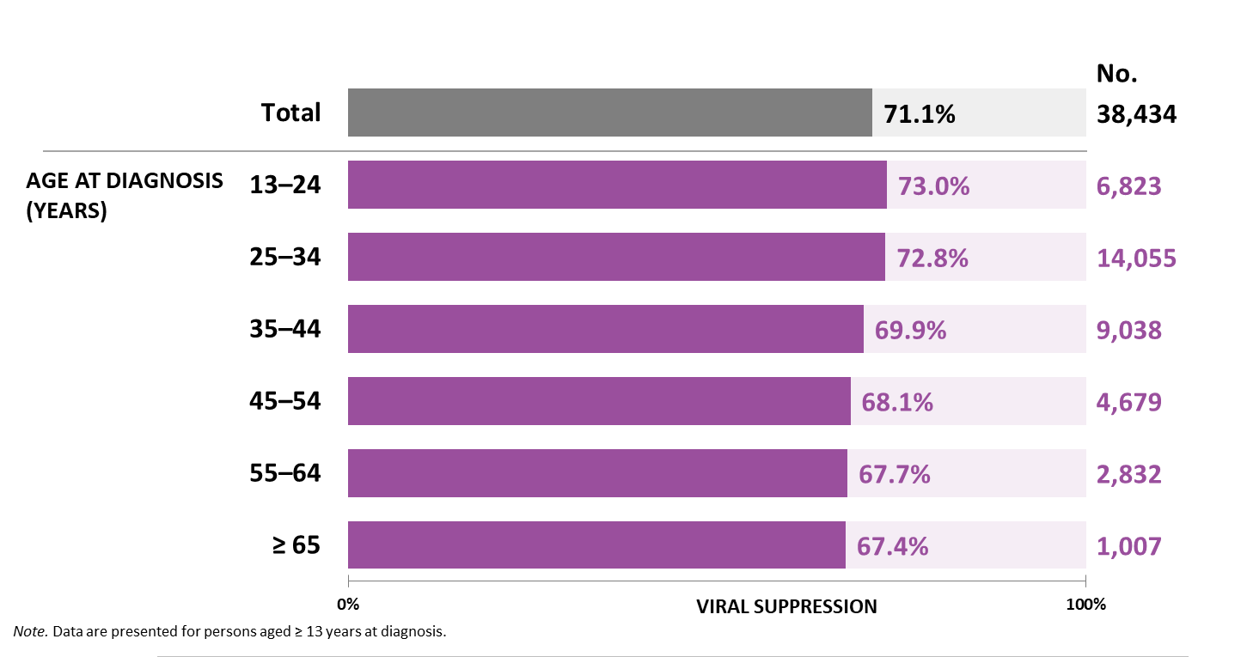
Viral suppression within 6 months of diagnosis, by age, 2024—United States
Notes:
Key findings
Among the 38,434 persons aged ≥ 13 years who received an HIV diagnosis during 2024 in the United States, 71.1% of persons were virally suppressed within 6 months of diagnosis. By age group, viral suppression within 6 months of diagnosis was lowest among persons aged ≥ 65 years (67.4%).
Data notes and sources
For additional data, see Table 2a in the 2024 HIV Monitoring Data Release.
For more information on data sources, data collection and reporting practices, and case definitions, see the National HIV Surveillance System (NHSS) Technical Notes, available at https://www.cdc.gov/hiv-data/nhss/index.html.
Data for all figures are available in 2024 HIV Monitoring Data Release or NCHHSTP AtlasPlus.

Slide 18
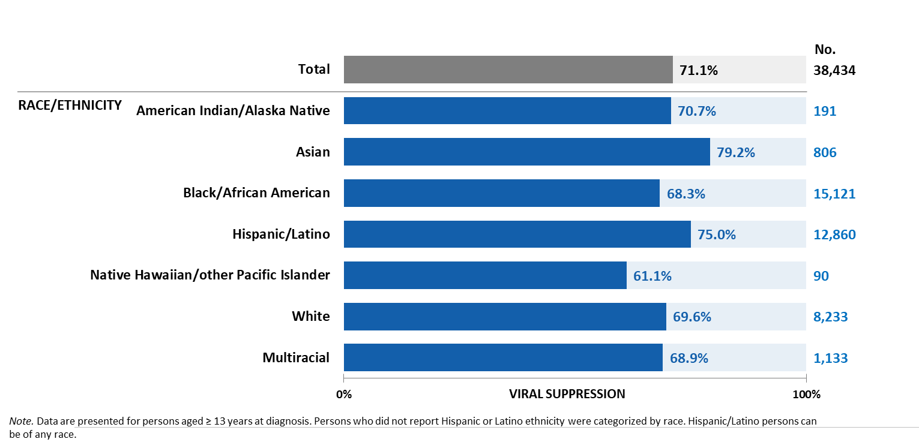
Viral suppression within 6 months of diagnosis, by race/ethnicity, 2024—United States
Notes:
Key findings
Among the 38,434 persons aged ≥ 13 years who received an HIV diagnosis during 2024 in the United States, 71.1% of persons were virally suppressed within 6 months of diagnosis. By race/ethnicity, viral suppression within 6 months of diagnosis was lowest among Native Hawaiian/other Pacific Islander persons (61.1%).
Data notes and sources
For additional data, see Table 2a in the 2024 HIV Monitoring Data Release.
Use caution when interpreting data for American Indian/Alaska Native and Native Hawaiian/other Pacific Islander persons due to small numbers.
For more information on data sources, data collection and reporting practices, and case definitions, see the National HIV Surveillance System (NHSS) Technical Notes, available at https://www.cdc.gov/hiv-data/nhss/index.html.
Data for all figures are available in 2024 HIV Monitoring Data Release or NCHHSTP AtlasPlus.

Slide 19
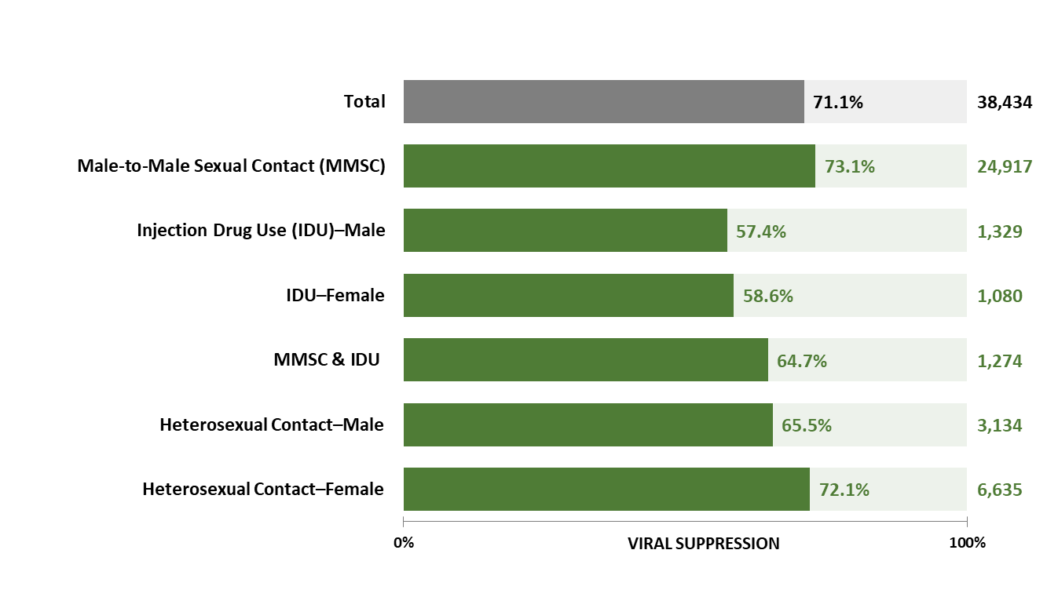
Viral suppression within 6 months of diagnosis, by transmission category and sex, 2024—United States
Notes:
Key findings
Among the 38,434 persons aged ≥ 13 years who received an HIV diagnosis during 2024 in the United States, 71.1% of persons were virally suppressed within 6 months of diagnosis. By transmission category and sex, viral suppression within 6 months of diagnosis was lowest among persons with HIV attributed to injection drug use (males: 57.4%, females: 58.6%).
Data notes and sources
For additional data, see Table 2a in the 2024 HIV Monitoring Data Release.
Data have been statistically adjusted to account for missing transmission category.
For more information on data sources, data collection and reporting practices, and case definitions, see the National HIV Surveillance System (NHSS) Technical Notes, available at https://www.cdc.gov/hiv-data/nhss/index.html.
Data for all figures are available in 2024 HIV Monitoring Data Release or NCHHSTP AtlasPlus.

Slide 20
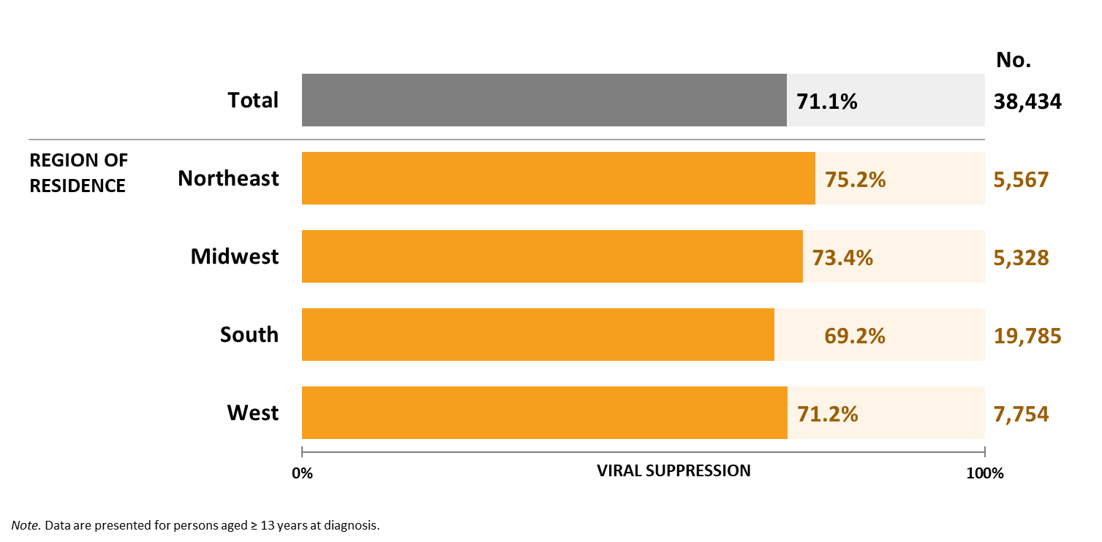
Viral suppression within 6 months of diagnosis, by region of residence, 2024—United States
Notes:
Key findings
Among the 38,434 persons aged ≥ 13 years who received an HIV diagnosis during 2024 in the United States, 71.1% of persons were virally suppressed within 6 months of diagnosis. By region of residence, viral suppression within 6 months of diagnosis was lowest among persons residing in the South at the time of diagnosis (69.2%).
Data notes and sources
For additional data, see Table 2a in the 2024 HIV Monitoring Data Release.
For more information on data sources, data collection and reporting practices, and case definitions, see the National HIV Surveillance System (NHSS) Technical Notes, available at https://www.cdc.gov/hiv-data/nhss/index.html.
Data for all figures are available in 2024 HIV Monitoring Data Release or NCHHSTP AtlasPlus.

Slide 21
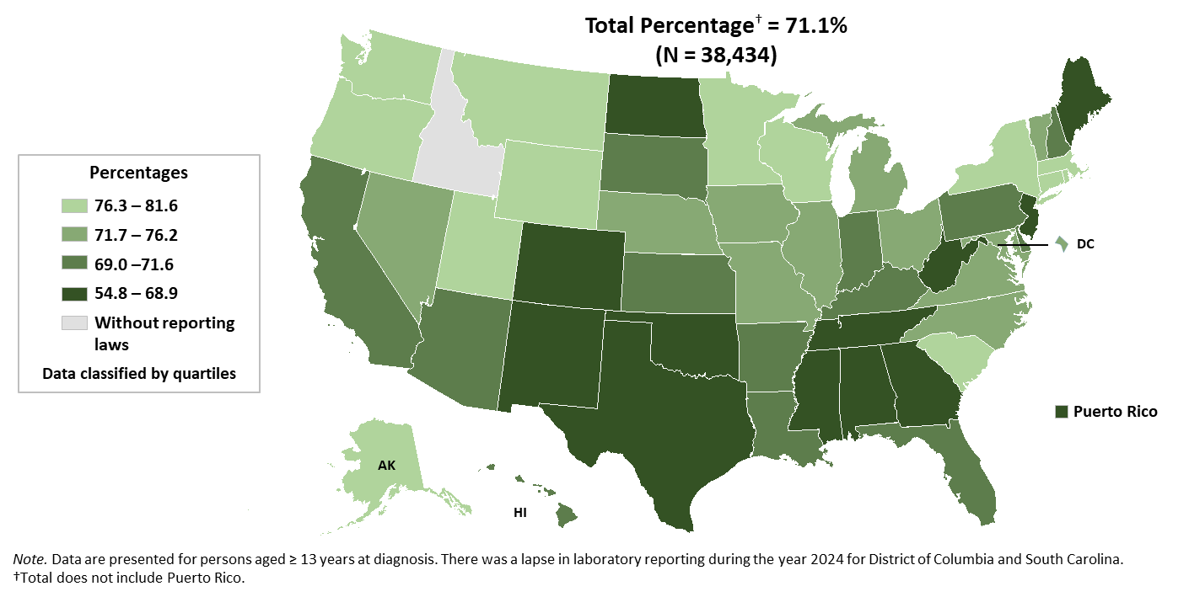
Viral suppression within 6 months of diagnosis, 2024—United States and Puerto Rico
Notes:
Key findings
Among the 38,434 persons aged ≥ 13 years who received an HIV diagnosis during 2024 in the United States, 71.1% of persons were virally suppressed within 6 months of diagnosis. Jurisdictions in the lowest quartile (Alabama, Colorado, Georgia, Maine, Mississippi, New Jersey, New Mexico, North Dakota, Oklahoma, Puerto Rico, Tennessee, Texas, and West Virginia) had ≤ 68.9% of persons were virally suppressed within 6 months of diagnosis.
Data notes and sources
For additional data, see Table 2b in the 2024 HIV Monitoring Data Release.
For more information on data sources, data collection and reporting practices, and case definitions, see the National HIV Surveillance System (NHSS) Technical Notes, available at https://www.cdc.gov/hiv-data/nhss/index.html.
Data for all figures are available in 2024 HIV Monitoring Data Release or NCHHSTP AtlasPlus.

Slide 22
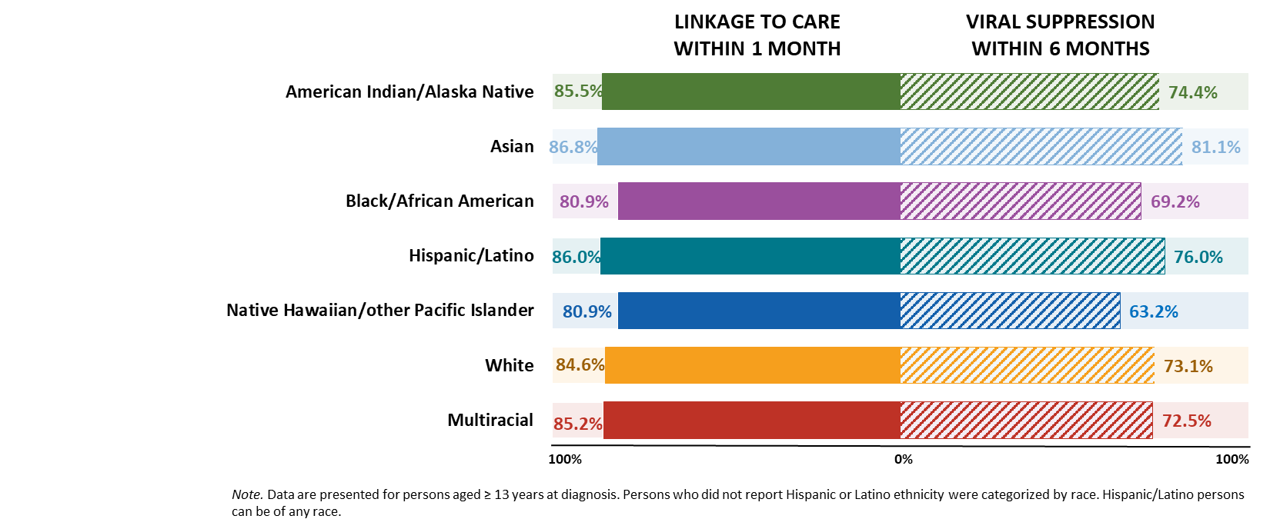
Linkage to HIV medical care and viral suppression among males with HIV attributed to male-to-male sexual contact, by race/ethnicity, 2024—United States
Notes:
Key findings
In the United States in 2024, of 24,917 males aged ≥ 13 years with HIV attributed to male-to-male sexual contact, 83.9% were linked to care within 1 month of diagnosis, and 73.1% were virally suppressed within 6 months of diagnosis.
By race/ethnicity, among males with HIV attributed to male-to-male sexual contact, lowest percentages:
• Linkage to HIV medical care within 1 month of diagnosis—Black/African American (80.9%) and Native Hawaiian/other Pacific Islander (80.9%) persons
• Viral suppression within 6 months of diagnosis—Native Hawaiian/other Pacific Islander persons (63.2%)
Data notes and sources
For additional data, see Table 2d in the 2024 HIV Monitoring Data Release.
Data have been statistically adjusted to account for missing transmission category. Use caution when interpreting data for American Indian/Alaska Native and Native Hawaiian/other Pacific Islander persons due to small numbers.
For more information on data sources, data collection and reporting practices, and case definitions, see the National HIV Surveillance System (NHSS) Technical Notes, available at https://www.cdc.gov/hiv-data/nhss/index.html.
Data for all figures are available in 2024 HIV Monitoring Data Release or NCHHSTP AtlasPlus.

Slide 23
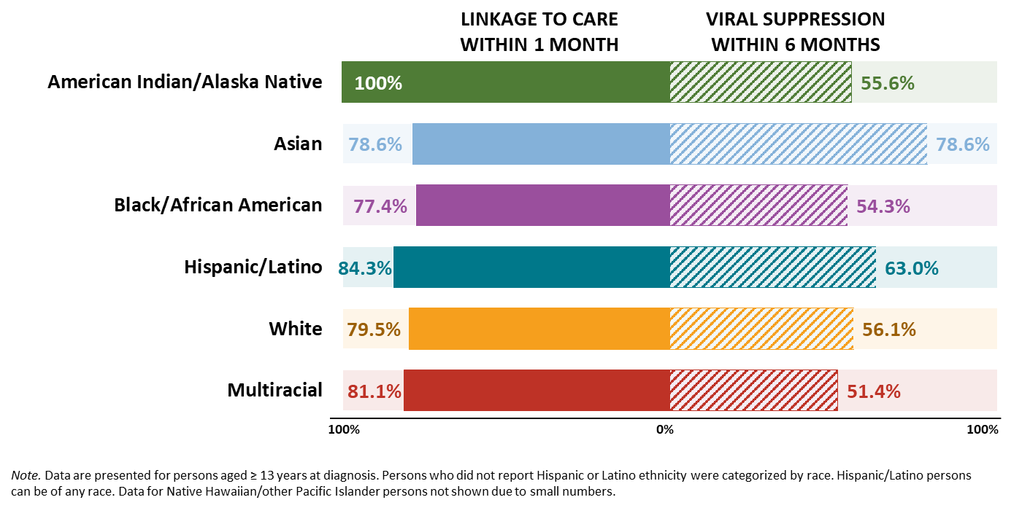
Linkage to HIV medical care and viral suppression among males with HIV attributed to injection drug use, by race/ethnicity, 2024—United States
Notes:
Key findings
In the United States in 2024, among 1,329 males aged ≥ 13 years with HIV attributed to injection drug use, 80.3% were linked to care within 1 month of diagnosis, and 57.4% were virally suppressed within 6 months of diagnosis.
By race/ethnicity, among males with HIV attributed to injection drug use, lowest percentages:
• Linkage to HIV medical care within 1 month of diagnosis—Black/African American persons (77.4%)
• Viral suppression within 6 months of diagnosis—multiracial persons (51.4%)
Data notes and sources
For additional data, see Table 2c in the 2024 HIV Monitoring Data Release.
Data have been statistically adjusted to account for missing transmission category. Use caution when interpreting data for American Indian/Alaska Native and Native Hawaiian/other Pacific Islander persons due to small numbers.
For more information on data sources, data collection and reporting practices, and case definitions, see the National HIV Surveillance System (NHSS) Technical Notes, available at https://www.cdc.gov/hiv-data/nhss/index.html.
Data for all figures are available in 2024 HIV Monitoring Data Release or NCHHSTP AtlasPlus.

Slide 24
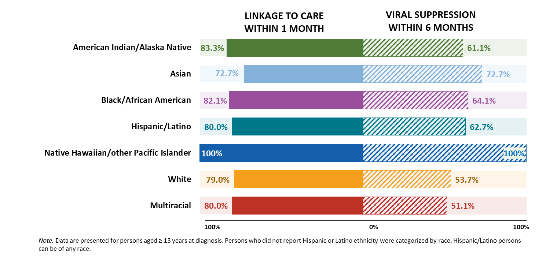
Linkage to HIV medical care and viral suppression among females with HIV attributed to injection drug use, by race/ethnicity, 2024—United States
Notes:
Key findings
In the United States in 2024, among 1,080 females aged ≥ 13 years with HIV attributed to injection drug use, 80.2% were linked to care within 1 month of diagnosis, and 58.6% were virally suppressed within 6 months of diagnosis.
By race/ethnicity, among females with HIV attributed to injection drug use, lowest percentages:
• Linkage to HIV medical care within 1 month of diagnosis—Asian persons (72.7%)
• Viral suppression within 6 months of diagnosis—multiracial persons (51.1%)
Data notes and sources
For additional data, see Table 2c in the 2024 HIV Monitoring Data Release.
Data have been statistically adjusted to account for missing transmission category. Use caution when interpreting data for American Indian/Alaska Native and Native Hawaiian/other Pacific Islander persons due to small numbers.
For more information on data sources, data collection and reporting practices, and case definitions, see the National HIV Surveillance System (NHSS) Technical Notes, available at https://www.cdc.gov/hiv-data/nhss/index.html.
Data for all figures are available in 2024 HIV Monitoring Data Release or NCHHSTP AtlasPlus.

Slide 25
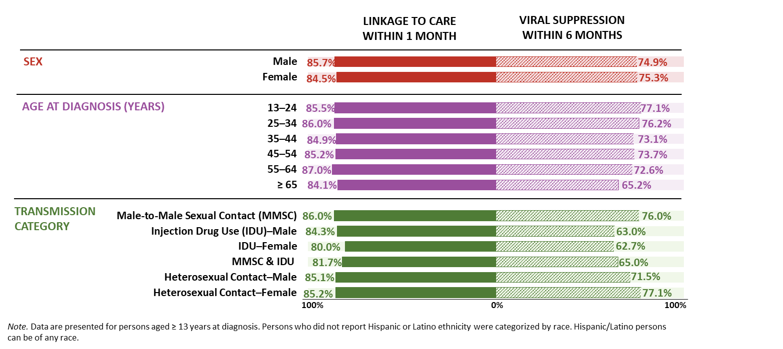
Linkage to HIV medical care and viral suppression among Hispanic/Latino persons, by selected characteristics, 2024—United States
Notes:
Key findings
In the United States in 2024, among 12,860 Hispanic/Latino persons aged ≥ 13 years diagnosed with HIV, 85.6% were linked to HIV medical care within 1 month of diagnosis of HIV, and 75.0% were virally suppressed within 6 months of HIV diagnosis.
The lowest percentages among Hispanic/Latino persons were as follows:
By sex:
• Linkage to HIV medical care within 1 month of diagnosis—Hispanic/Latino males (85.7%) and females (84.5%)
• Viral suppression within 6 months of diagnosis—Hispanic/Latino males (74.9%) and females (75.3%)
By age at diagnosis:
• Linkage to HIV medical care within 1 month of diagnosis—persons aged ≥ 65 years (84.1%)
• Viral suppression within 6 months of diagnosis—persons aged ≥ 65 years (65.2%)
By transmission category and sex:
• Linkage to HIV medical care within 1 month of diagnosis—females with HIV attributed to injection drug use (80.0%) and males with HIV attributed male-to-male sexual contact and injection drug use (81.7%)
• Viral suppression within 6 months of diagnosis—persons with HIV attributed to injection drug use (males: 63.0%, females: 62.7%)
Data notes and sources
For additional data, see Table 2c in the 2024 HIV Monitoring Data Release.
Data have been statistically adjusted to account for missing transmission category. Use caution when interpreting data for American Indian/Alaska Native and Native Hawaiian/other Pacific Islander persons due to small numbers.
For more information on data sources, data collection and reporting practices, and case definitions, see the National HIV Surveillance System (NHSS) Technical Notes, available at https://www.cdc.gov/hiv-data/nhss/index.html.
Data for all figures are available in 2024 HIV Monitoring Data Release or NCHHSTP AtlasPlus.

Slide 26
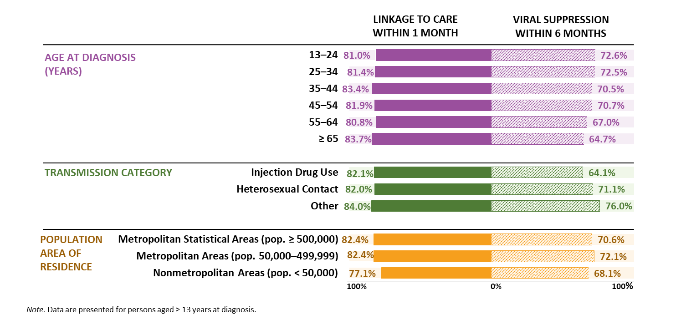
Linkage to HIV medical care and viral suppression among Black/African American females, by selected characteristics, 2024—United States
Notes:
Key findings
In the United States in 2024, among 4,068 Black/African American females aged ≥ 13 years with diagnosed HIV, 82.0% were linked to HIV medical care within 1 month of diagnosis of HIV, and 70.6% were virally suppressed within 6 months of HIV diagnosis.
The lowest percentages among Black/African American females were as follows:
By age at diagnosis:
• Linkage to HIV medical care within 1 month of diagnosis— persons aged 13–24 years (81.0%), persons aged 25–34 years (81.4%), and persons aged 55–64 years (80.8%)
• Viral suppression within 6 months of diagnosis—persons aged ≥ 65 years (64.7%)
By transmission category:
• Linkage to HIV medical care within 1 month of diagnosis— persons with HIV attributed to injection drug use (82.1%) and persons with HIV attributed to heterosexual contact (82.0%)
• Viral suppression within 6 months of diagnosis—persons with HIV attributed to injection drug use (64.1%)
By population area of residence:
• Linkage to HIV medical care within 1 month of diagnosis—persons who resided in nonmetropolitan areas of population < 50,000 (77.1%)
• Viral suppression within 6 months of diagnosis—persons who resided in nonmetropolitan areas of population < 50,000 (68.1%)
Data notes and sources
For additional data, see Table 2c in the 2024 HIV Monitoring Data Release.
Data have been statistically adjusted to account for missing transmission category.
For more information on data sources, data collection and reporting practices, and case definitions, see the National HIV Surveillance System (NHSS) Technical Notes, available at https://www.cdc.gov/hiv-data/nhss/index.html.
Data for all figures are available in 2024 HIV Monitoring Data Release or NCHHSTP AtlasPlus.

Slide 27
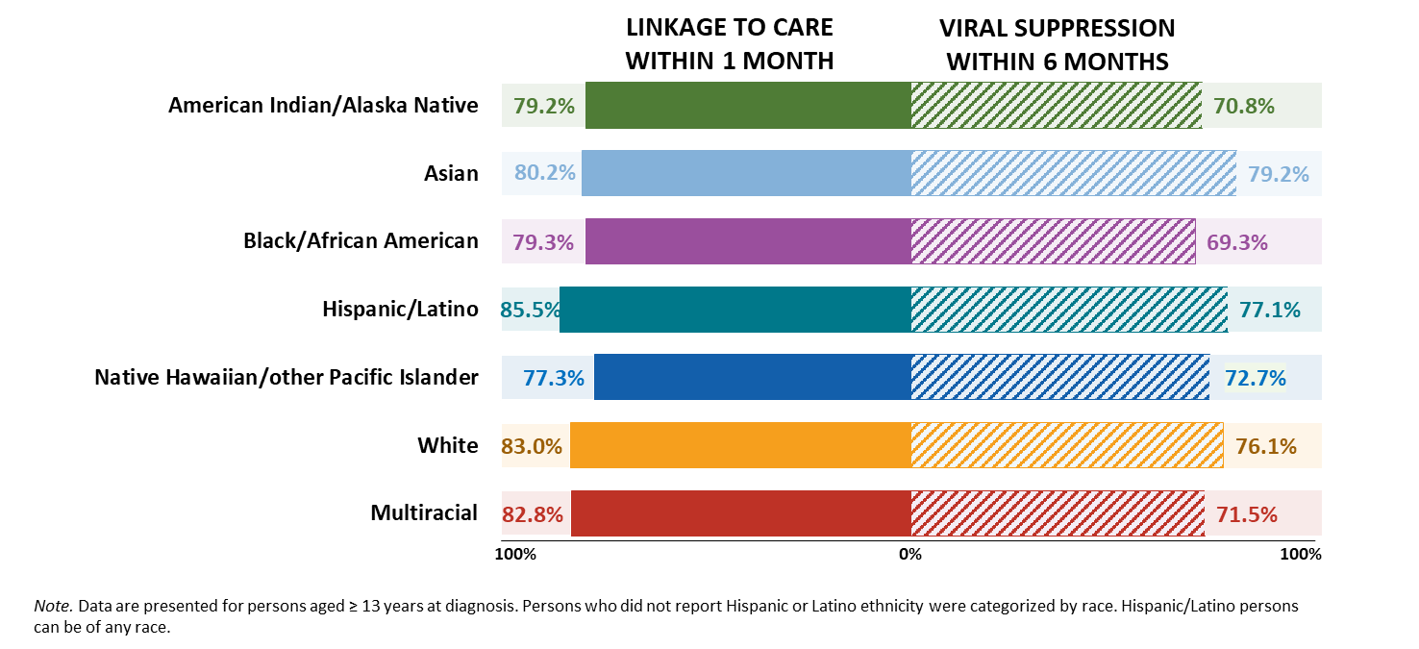
Linkage to HIV medical care and viral suppression among persons aged 13–24 years, by race/ethnicity, 2024—United States
Notes:
Key findings
Of 6,823 persons aged 13–24 years with HIV diagnosed in 2024 in the United States, 82.0% were linked to HIV medical care within 1 month of diagnosis of HIV, and 73.0% were virally suppressed within 6 months of HIV diagnosis.
Lowest percentages among persons aged 13–24 years by race/ethnicity were as follows:
• Linkage to HIV medical care within 1 month of diagnosis—Native Hawaiian/other Pacific Islander persons (77.3%)
• Viral suppression within 6 months of diagnosis—American Indian/Alaska Native (70.8%), Black/African American (69.3%), and multiracial (71.5%) persons
Data notes and sources
For additional data, see Table 2c in the 2024 HIV Monitoring Data Release.
Use caution when interpreting data for American Indian/Alaska Native and Native Hawaiian/other Pacific Islander persons due to small numbers.
For more information on data sources, data collection and reporting practices, and case definitions, see the National HIV Surveillance System (NHSS) Technical Notes, available at https://www.cdc.gov/hiv-data/nhss/index.html.
Data for all figures are available in 2024 HIV Monitoring Data Release or NCHHSTP AtlasPlus.

Slide 28
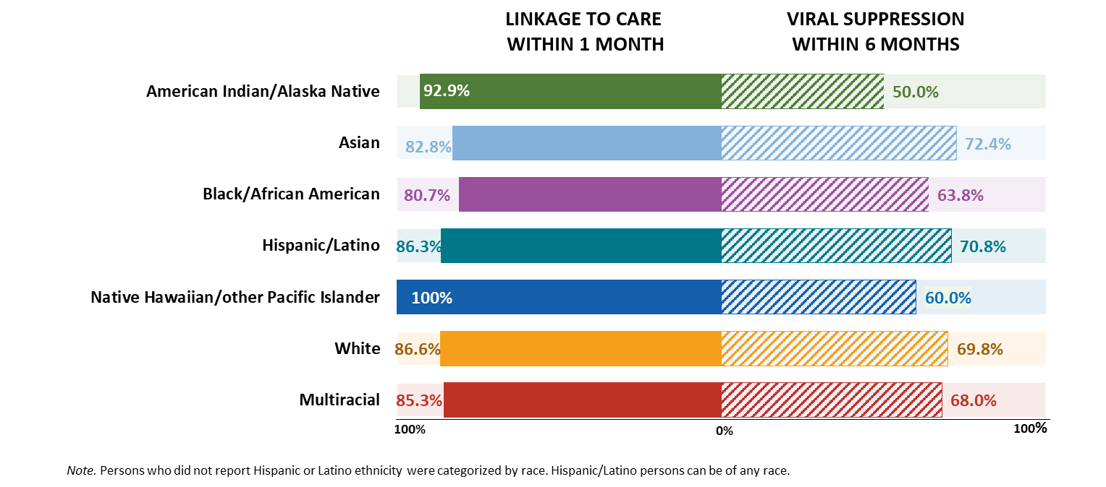
Linkage to HIV medical care and viral suppression among persons aged ≥ 55 years, by race/ethnicity, 2024—United States
Notes:
Key findings
Of 3,839 persons aged ≥ 55 years with HIV diagnosed during 2024 in the United States, 84.1% were linked to HIV medical care within 1 month of diagnosis of HIV, and 67.6% were virally suppressed within 6 months of HIV diagnosis.
Lowest percentages among persons aged ≥ 55 years by race/ethnicity were as follows:
• Linkage to HIV medical care within 1 month of diagnosis—African American/Black persons (80.7%)
• Viral suppression within 6 months of diagnosis—American Indian/Alaska Native persons (50.0%)
Data notes and sources
For additional data, see Table 2c in the 2024 HIV Monitoring Data Release.
Use caution when interpreting data for American Indian/Alaska Native and Native Hawaiian/other Pacific Islander persons due to small numbers.
For more information on data sources, data collection and reporting practices, and case definitions, see the National HIV Surveillance System (NHSS) Technical Notes, available at https://www.cdc.gov/hiv-data/nhss/index.html.
Data for all figures are available in 2024 HIV Monitoring Data Release or NCHHSTP AtlasPlus.

Slide 29
Receipt of HIV medical care
Notes:
Data on receipt of HIV medical care were based on persons with HIV diagnosed by the end of the calendar year prior to the specified year who were alive at the end of that specified year. Receipt of any HIV medical care was measured by documentation of ≥ 1 CD4 or viral load tests performed during the specified year. Retention in care (receipt of continuous HIV medical care) was measured by documentation of ≥ 2 CD4 or viral load tests performed ≥ 3 months apart during the specified year.

Slide 30
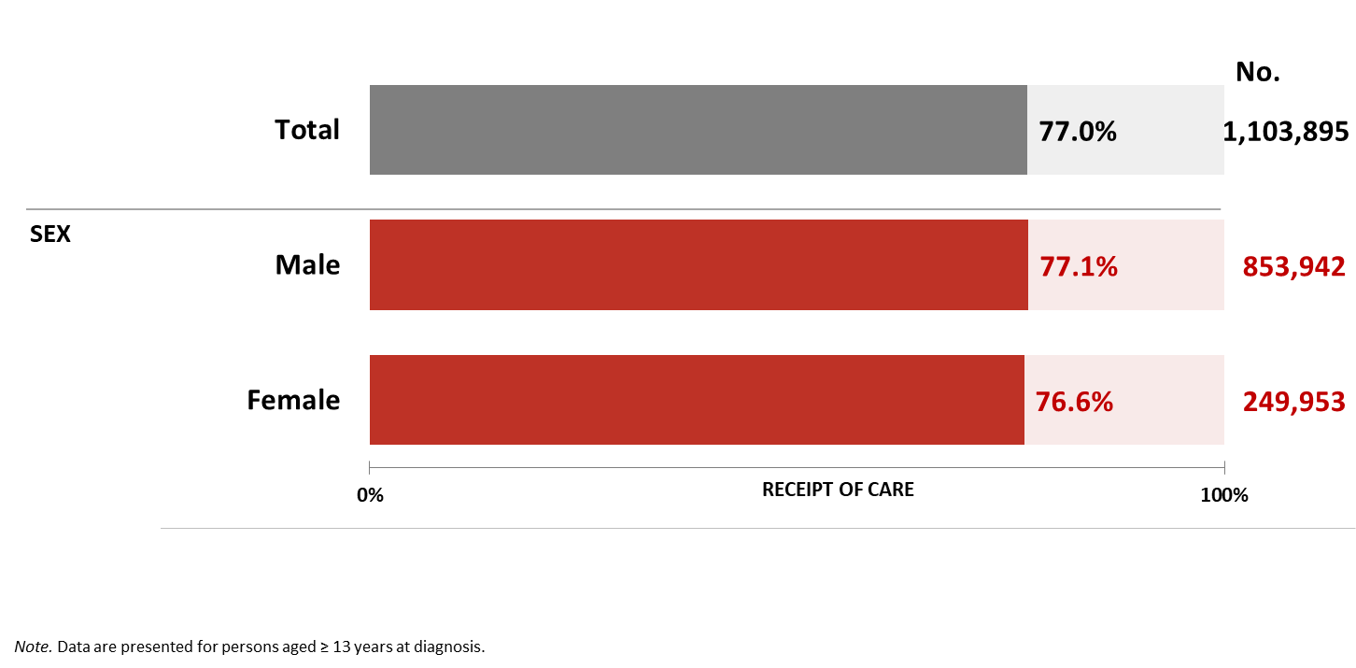
Receipt of HIV medical care among persons living with diagnosed HIV, by sex, 2024—United States
Notes:
Key findings
During 2024 in the United States, 77.0% of 1,103,895 persons aged ≥ 13 years living with diagnosed HIV and alive at year-end 2024 received any HIV medical care (at least 1 CD4 or viral load test).
By sex, 76.6% of females and 77.1% of males received HIV medical care during 2024.
Data notes and sources
For additional data, see Table 3a in the 2024 HIV Monitoring Data Release.
For more information on data sources, data collection and reporting practices, and case definitions, see the National HIV Surveillance System (NHSS) Technical Notes, available at https://www.cdc.gov/hiv-data/nhss/index.html.
Data for all figures are available in 2024 HIV Monitoring Data Release or NCHHSTP AtlasPlus.

Slide 31
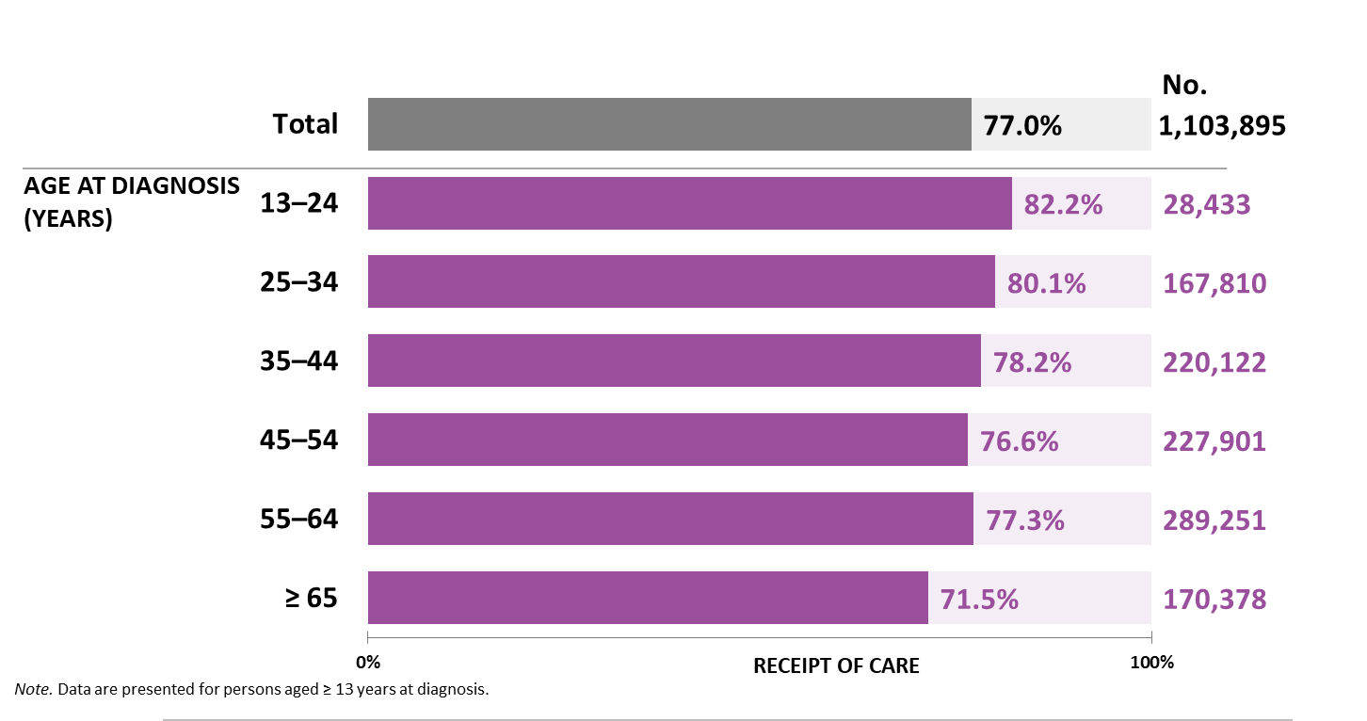
Receipt of HIV medical care among persons living with diagnosed HIV, by age, 2024—United States
Notes:
Key findings
During 2024 in the United States, 77.0% of 1,103,895 persons aged ≥ 13 years alive at year-end 2024 received any HIV medical care (at least 1 CD4 or viral load test). By age group at year-end 2023, the lowest percentage of receipt of HIV medical care was among persons aged ≥ 65 years (71.5%).
Data notes and sources
For additional data, see Table 3a in the 2024 HIV Monitoring Data Release.
For more information on data sources, data collection and reporting practices, and case definitions, see the National HIV Surveillance System (NHSS) Technical Notes, available at https://www.cdc.gov/hiv-data/nhss/index.html.
Data for all figures are available in 2024 HIV Monitoring Data Release or NCHHSTP AtlasPlus.

Slide 32
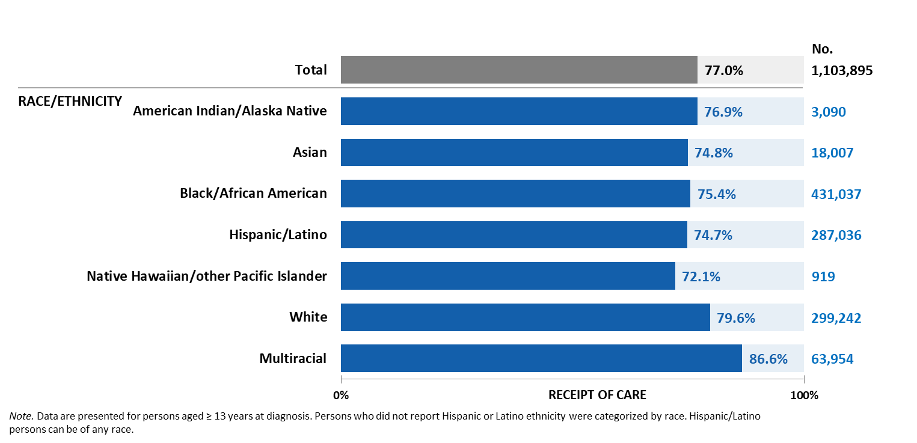
Receipt of HIV medical care among persons living with diagnosed HIV, by race/ethnicity, 2024—United States
Notes:
Key findings
During 2024 in the United States, 77.0% of 1,103,895 persons aged ≥ 13 years living with diagnosed HIV and alive at year-end 2024 received any HIV medical care (at least 1 CD4 or viral load test). By race/ethnicity, the lowest percentage of receipt of HIV medical care was among Native Hawaiian/other Pacific Islander persons (72.1%).
Data notes and sources
For additional data, see Table 3a in the 2024 HIV Monitoring Data Release.
Use caution when interpreting data for American Indian/Alaska Native and Native Hawaiian/other Pacific Islander persons due to small numbers.
For more information on data sources, data collection and reporting practices, and case definitions, see the National HIV Surveillance System (NHSS) Technical Notes, available at https://www.cdc.gov/hiv-data/nhss/index.html.
Data for all figures are available in 2024 HIV Monitoring Data Release or NCHHSTP AtlasPlus.

Slide 33
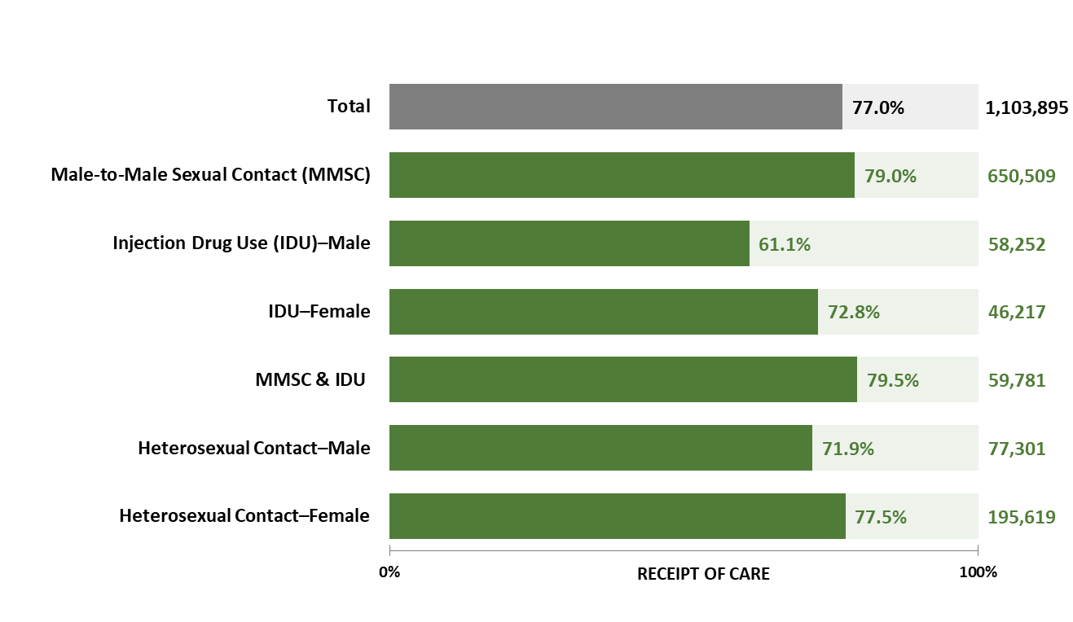
Receipt of HIV medical care among persons living with diagnosed HIV, by transmission category and sex, 2024—United States
Notes:
Key findings
During 2024 in the United States, 77.0% of 1,103,895 persons aged ≥ 13 years living with diagnosed HIV and alive at year-end 2024 received any HIV medical care (at least 1 CD4 or viral load test). By transmission category, the lowest percentage of receipt of HIV medical care was among males with HIV attributed to injection drug use (61.1%).
Data notes and sources
For additional data, see Table 3a in the 2024 HIV Monitoring Data Release.
Data have been statistically adjusted to account for missing transmission category.
For more information on data sources, data collection and reporting practices, and case definitions, see the National HIV Surveillance System (NHSS) Technical Notes, available at https://www.cdc.gov/hiv-data/nhss/index.html.
Data for all figures are available in 2024 HIV Monitoring Data Release or NCHHSTP AtlasPlus.

Slide 34
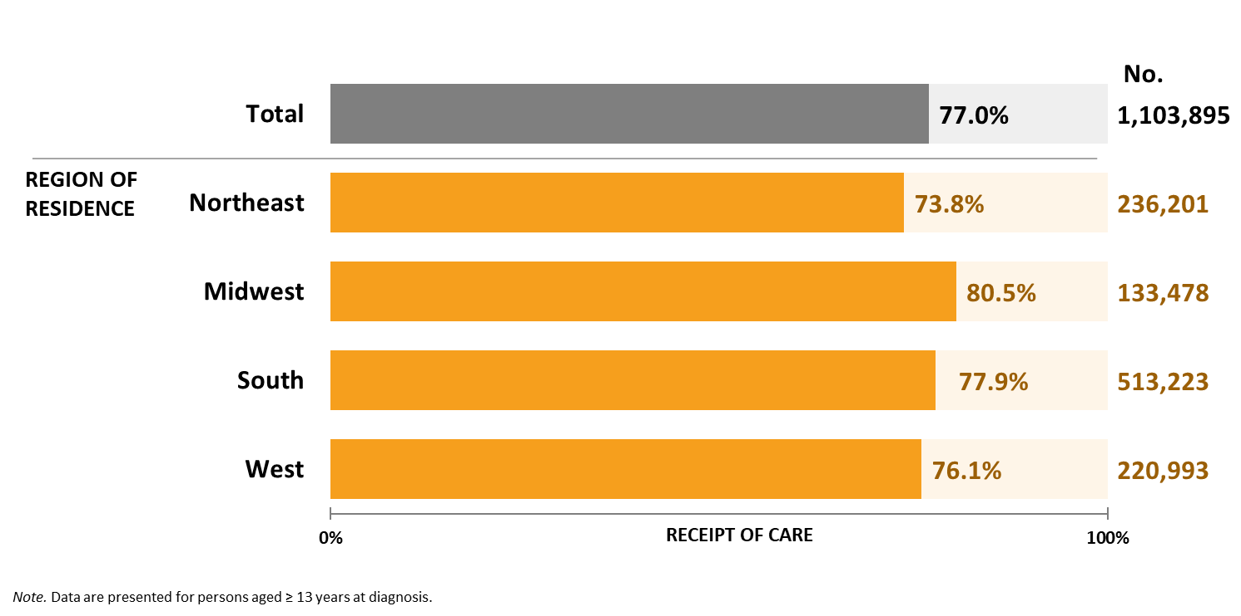
Receipt of HIV medical care among persons living with diagnosed HIV, by region of residence, 2024—United States
Notes:
Key findings
During 2024 in the United States, 77.0% of 1,103,895 persons aged ≥ 13 years living with diagnosed HIV and alive at year-end 2024 received any HIV medical care (at least 1 CD4 or viral load test). By region of residence, the lowest percentage of receipt of HIV medical care was among persons who resided in the Northeast (73.8%).
Data notes and sources
For additional data, see Table 3a in the 2024 HIV Monitoring Data Release.
For more information on data sources, data collection and reporting practices, and case definitions, see the National HIV Surveillance System (NHSS) Technical Notes, available at https://www.cdc.gov/hiv-data/nhss/index.html.
Data for all figures are available in 2024 HIV Monitoring Data Release or NCHHSTP AtlasPlus.

Slide 35
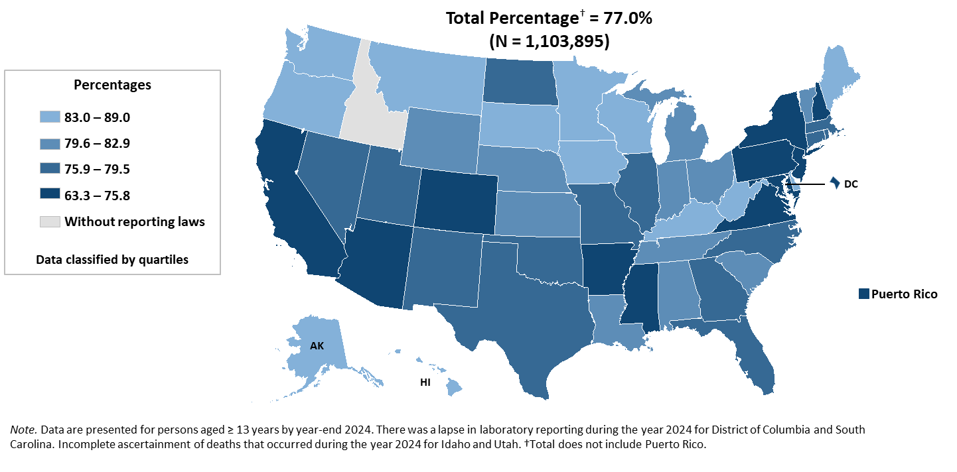
Receipt of HIV medical care among persons living with diagnosed HIV, 2024—United States and Puerto Rico
Notes:
Key findings
During 2024 in the United States, 77.0% of 1,103,895 persons aged ≥ 13 years living with diagnosed HIV and alive at year-end 2024 received any HIV medical care (at least 1 CD4 or viral load test).
Jurisdictions in the lowest quartile (Arizona, Arkansas, California, Colorado, District of Columbia, Maryland, Mississippi, New Hampshire, New Jersey, New York, Pennsylvania, Puerto Rico, and Virginia) had ≤75.8% of persons who received any HIV medical care.
Data notes and sources
For additional data, see Table 3a in the 2024 HIV Monitoring Data Release.
For more information on data sources, data collection and reporting practices, and case definitions, see the National HIV Surveillance System (NHSS) Technical Notes, available at https://www.cdc.gov/hiv-data/nhss/index.html.
Data for all figures are available in 2024 HIV Monitoring Data Release or NCHHSTP AtlasPlus.

Slide 36
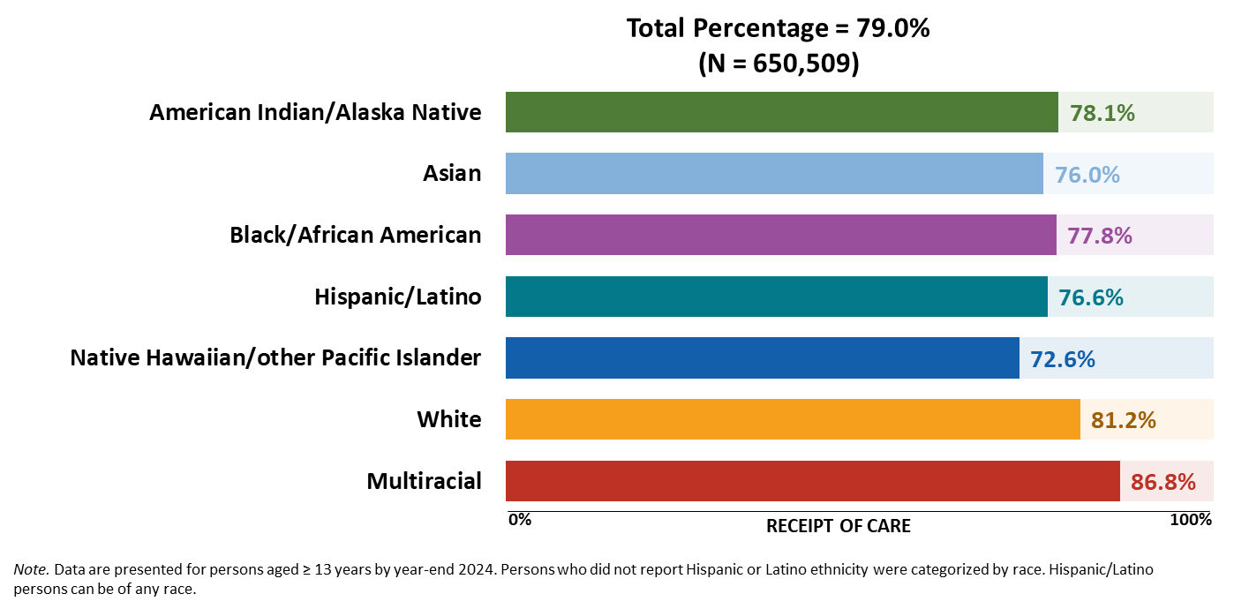
Receipt of HIV medical care among males living with diagnosed HIV attributed to male-to-male sexual contact, by race/ethnicity, 2024—United States
Notes:
Key findings
Of 650,509 males aged ≥ 13 years living with diagnosed HIV attributed to male-to-male sexual contact at year-end 2024 in the United States, 79.0% received HIV medical care. By race/ethnicity, among males with HIV attributed to male-to-male sexual contact, the lowest percentage was among Native Hawaiian/other Pacific Islander (72.6%) persons.
Data notes and sources
For additional data, see Table 3d in the 2024 HIV Monitoring Data Release.
Data have been statistically adjusted to account for missing transmission category. Use caution when interpreting data for American Indian/Alaska Native and Native Hawaiian/other Pacific Islander persons due to small numbers.
For more information on data sources, data collection and reporting practices, and case definitions, see the National HIV Surveillance System (NHSS) Technical Notes, available at https://www.cdc.gov/hiv-data/nhss/index.html.
Data for all figures are available in 2024 HIV Monitoring Data Release or NCHHSTP AtlasPlus.

Slide 37
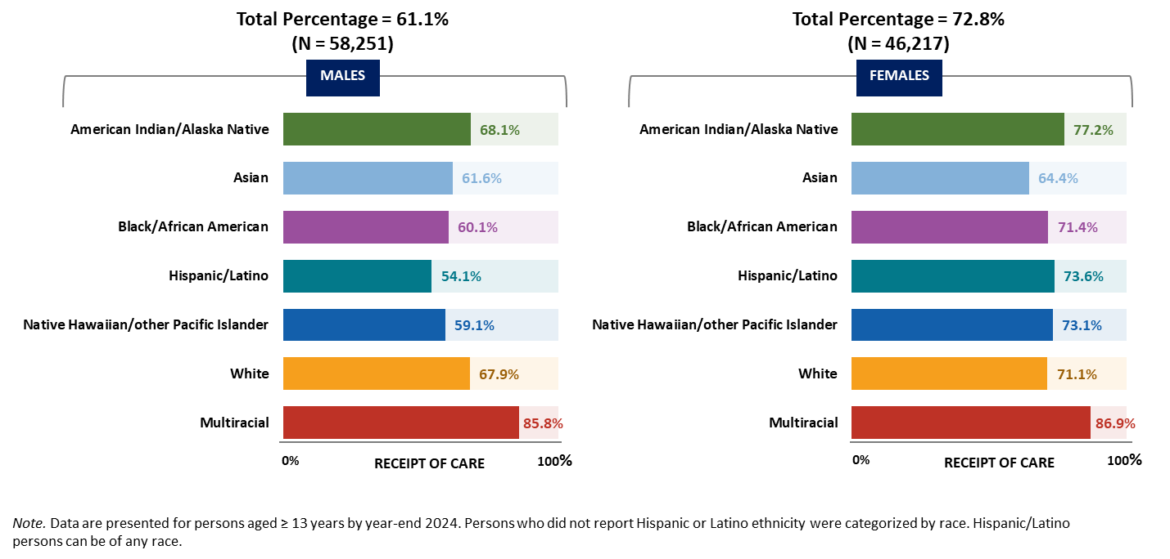
Receipt of HIV medical care among persons living with diagnosed HIV attributed to injection drug use, by race/ethnicity and sex, 2024—United States
Notes:
Key findings
Of 58,252 males aged ≥ 13 years living with diagnosed HIV attributed to injection drug use at year-end 2024 in the United States, 61.1% received HIV medical care in 2024. Of 46,217 females aged ≥ 13 years living with diagnosed HIV attributed to injection drug use at year-end 2024 in the United States, 72.8% received HIV medical care.
Lowest percentages of receipt of care among persons with HIV attributed to injection drug use, by sex and race/ethnicity, were as follows:
• Male—Hispanic/Latino persons (54.1%)
• Female—Asian persons (64.4%)
Data notes and sources
For additional data, see Tables 3a and 3c in the 2024 HIV Monitoring Data Release.
Data have been statistically adjusted to account for missing transmission category. Use caution when interpreting data for American Indian/Alaska Native and Native Hawaiian/other Pacific Islander persons due to small numbers.
For more information on data sources, data collection and reporting practices, and case definitions, see the National HIV Surveillance System (NHSS) Technical Notes, available at https://www.cdc.gov/hiv-data/nhss/index.html.
Data for all figures are available in 2024 HIV Monitoring Data Release or NCHHSTP AtlasPlus.

Slide 38
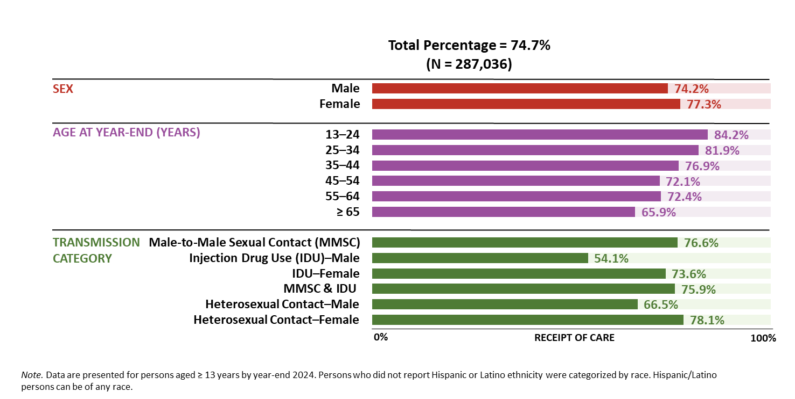
Receipt of HIV medical care among Hispanic/Latino persons living with diagnosed HIV, by selected characteristics, 2024—United States
Notes:
Key findings
In the United States in 2024, among 287,036 Hispanic/Latino persons aged ≥ 13 years living with diagnosed HIV at year-end 2024, 74.7% received HIV medical care.
For receipt of HIV medical care, lowest percentages among Hispanic/Latino persons:
• By sex—males (74.2%)
• By age at year-end 2023—persons aged ≥ 65 years (65.9%)
• By transmission category and sex—males with HIV attributed to injection drug use (54.1%)
Data notes and sources
For additional data, see Table 3c in the 2024 HIV Monitoring Data Release.
Data have been statistically adjusted to account for missing transmission category.
For more information on data sources, data collection and reporting practices, and case definitions, see the National HIV Surveillance System (NHSS) Technical Notes, available at https://www.cdc.gov/hiv-data/nhss/index.html.
Data for all figures are available in 2024 HIV Monitoring Data Release or NCHHSTP AtlasPlus.

Slide 39
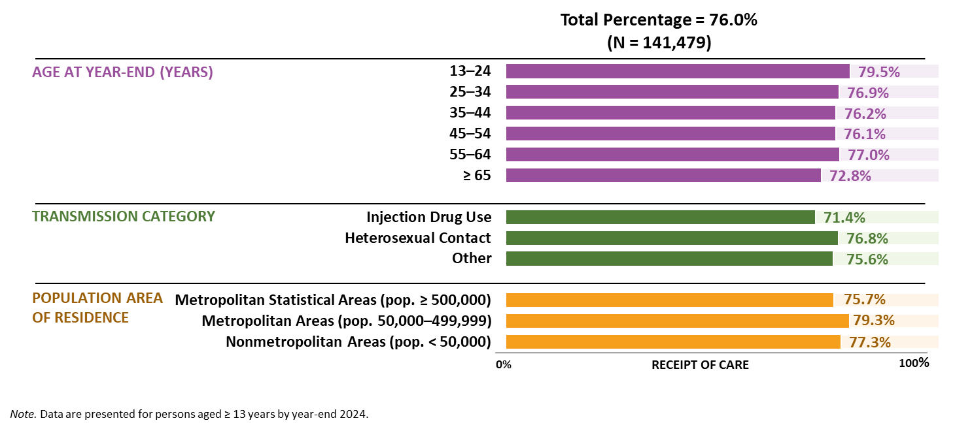
Receipt of HIV medical care among Black/African American females living with diagnosed HIV, by selected characteristics, 2024—United States
Notes:
Key findings
In the United States in 2024, among 141,479 Black/African American females aged ≥ 13 years living with diagnosed HIV at year-end 2024, 76.0% received HIV medical care.
For receipt of HIV medical care, lowest percentages among Black/African American females:
• By age at year-end 2023—persons aged ≥ 65 years (72.8%)
• By transmission category—persons with HIV attributed to injection drug use (71.4%)
• By population area of residence—persons who resided in metropolitan areas of population ≥ 500,000 (75.7%)
Data notes and sources
For additional data, see Table 3c in the 2024 HIV Monitoring Data Release.
Data have been statistically adjusted to account for missing transmission category. Use caution when interpreting data for American Indian/Alaska Native and Native Hawaiian/other Pacific Islander persons due to small numbers.
For more information on data sources, data collection and reporting practices, and case definitions, see the National HIV Surveillance System (NHSS) Technical Notes, available at https://www.cdc.gov/hiv-data/nhss/index.html.
Data for all figures are available in 2024 HIV Monitoring Data Release or NCHHSTP AtlasPlus.

Slide 40
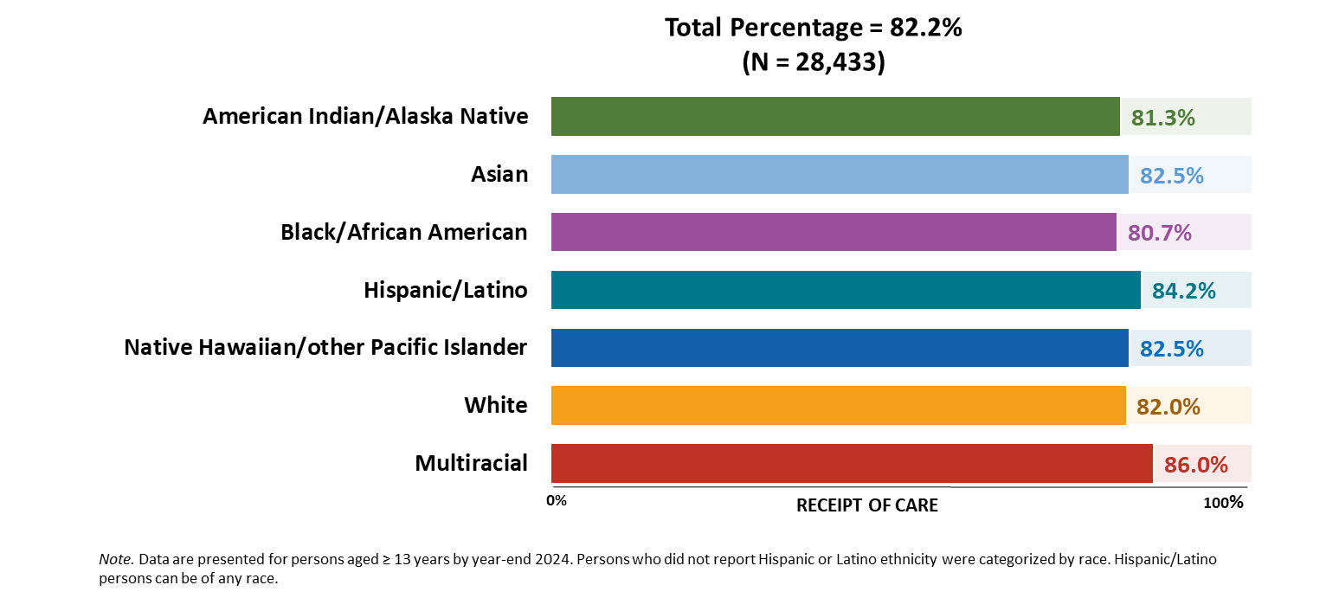
Receipt of HIV medical care among persons aged 13–24 years living with diagnosed HIV, by race/ethnicity, 2024—United States
Notes:
Key findings
Of 28,433 persons aged 13–24 years living with diagnosed HIV at year-end 2024 in the United States, 82.2% received HIV medical care in 2024.
For receipt of HIV medical care, lowest percentages among persons aged 13–24 years by race/ethnicity— American Indian/Alaska Native (81.3%) and Black/African American (80.7%) persons.
Data notes and sources
For additional data, see Table 3c in the 2024 HIV Monitoring Data Release.
Use caution when interpreting data for American Indian/Alaska Native and Native Hawaiian/other Pacific Islander persons due to small numbers.
For more information on data sources, data collection and reporting practices, and case definitions, see the National HIV Surveillance System (NHSS) Technical Notes, available at https://www.cdc.gov/hiv-data/nhss/index.html.
Data for all figures are available in 2024 HIV Monitoring Data Release or NCHHSTP AtlasPlus.

Slide 41
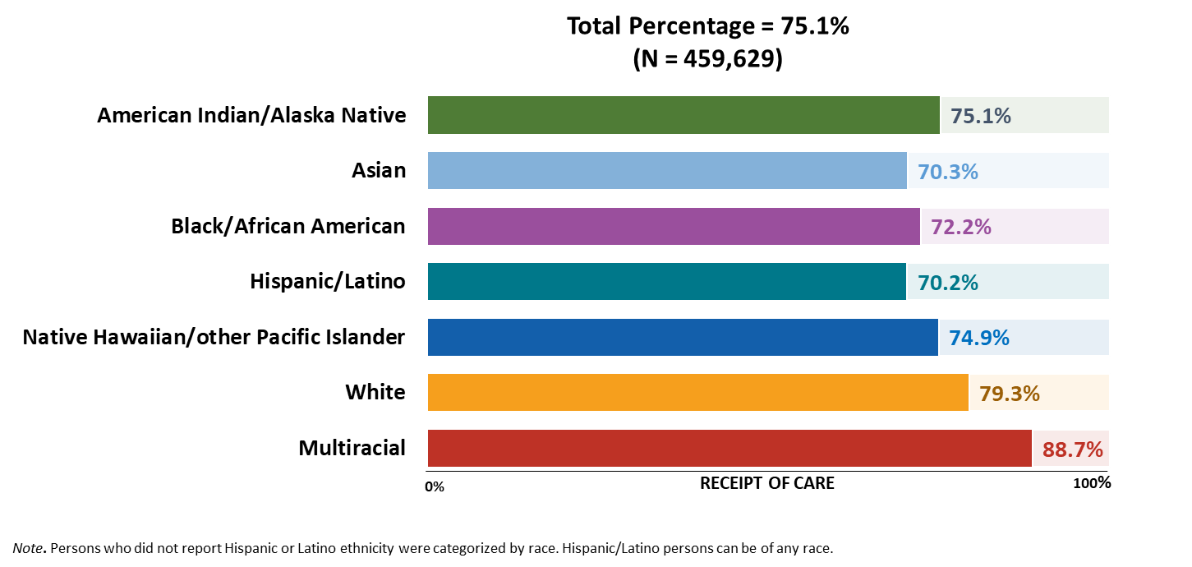
Receipt of HIV medical care among persons aged ≥ 55 years living with diagnosed HIV, by race/ethnicity, 2024—United States
Notes:
Key findings
Of 459,629 persons aged ≥ 55 years living with diagnosed HIV at year-end 2024 in the United States, 75.1% received HIV medical care in 2024.
For receipt of HIV medical care, lowest percentages among persons aged ≥ 55 years by race/ethnicity were among Asian (70.3%) and Hispanic/Latino (70.2%) persons.
Data notes and sources
For additional data, see Table 3c in the 2024 HIV Monitoring Data Release.
Use caution when interpreting data for American Indian/Alaska Native and Native Hawaiian/other Pacific Islander persons due to small numbers.
For more information on data sources, data collection and reporting practices, and case definitions, see the National HIV Surveillance System (NHSS) Technical Notes, available at https://www.cdc.gov/hiv-data/nhss/index.html.
Data for all figures are available in 2024 HIV Monitoring Data Release or NCHHSTP AtlasPlus.

Slide 42
Viral suppression among persons living with diagnosed HIV
Notes:
Viral suppression was measured among persons with HIV diagnosed by the end of the calendar year prior to the specified year who were alive at the end of that specified year. Viral suppression was defined as a viral load result of < 200 copies/mL at the most recent viral load test during the specified year. Virologic failure may indicate lack of adherence to antiretroviral therapy (ART). If multiple viral load tests were performed on the same day and could qualify as “most recent,” a viral load result of < 200 copies/mL was selected. If the numerical viral load result was missing or reported as a logarithmic value, the interpretation of the result (e.g., below limit, not detected) was used to determine viral suppression.

Slide 43
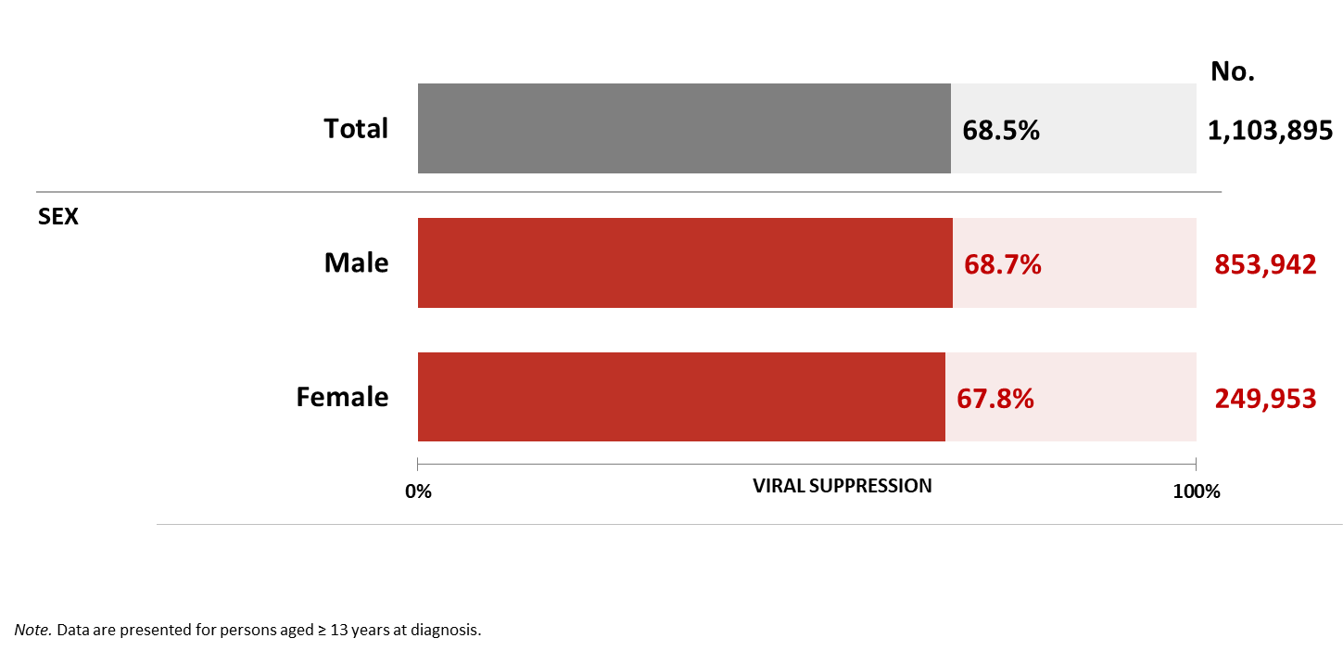
Viral suppression among persons living with diagnosed HIV, by sex, 2024—United States
Notes:
Key findings
During 2024 in the United States, 68.5% of 1,103,895 persons aged ≥ 13 years living with diagnosed HIV and alive at year-end 2024 were virally suppressed at their most recent test. By sex, 67.8% of females and 68.7% of males were virally suppressed.
Data notes and sources
For additional data, see Table 3a in the 2024 HIV Monitoring Data Release.
For more information on data sources, data collection and reporting practices, and case definitions, see the National HIV Surveillance System (NHSS) Technical Notes, available at https://www.cdc.gov/hiv-data/nhss/index.html.
Data for all figures are available in 2024 HIV Monitoring Data Release or NCHHSTP AtlasPlus.

Slide 44
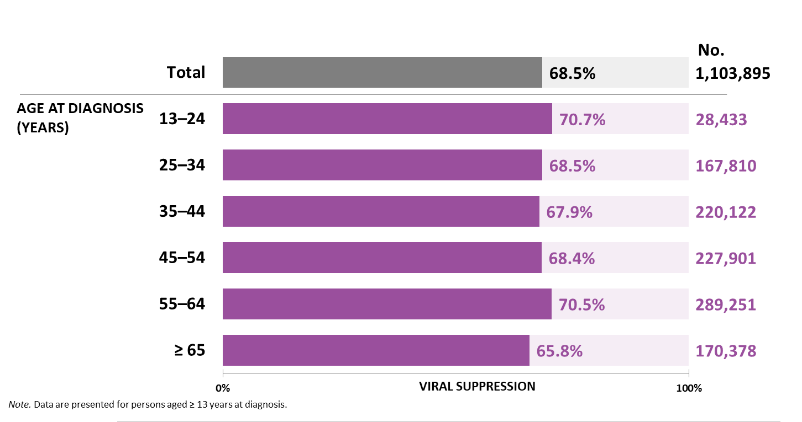
Viral suppression among persons living with diagnosed HIV, by age, 2024—United States
Notes:
Key findings
During 2024 in the United States, 68.5% of 1,103,895 persons aged ≥ 13 years living with diagnosed HIV and alive at year-end 2024 were virally suppressed at their most recent test. By age group at year-end 2023, viral suppression was the lowest among persons aged ≥ 65 years (65.8%).
Data notes and sources
For additional data, see Table 3a in the 2024 HIV Monitoring Data Release.
For more information on data sources, data collection and reporting practices, and case definitions, see the National HIV Surveillance System (NHSS) Technical Notes, available at https://www.cdc.gov/hiv-data/nhss/index.html.
Data for all figures are available in 2024 HIV Monitoring Data Release or NCHHSTP AtlasPlus.

Slide 45
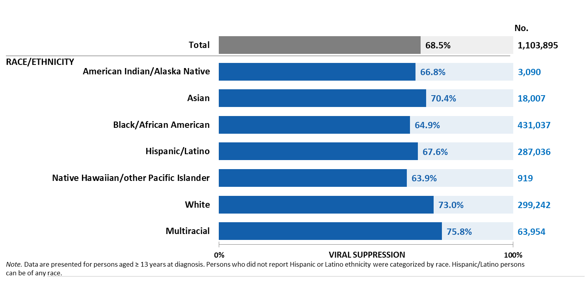
Viral suppression among persons living with diagnosed HIV, by race/ethnicity, 2024—United States
Notes:
Key findings
During 2024 in the United States, 68.5% of 1,103,895 persons aged ≥ 13 years living with diagnosed HIV and alive at year-end 2024 were virally suppressed at their most recent test. By race/ethnicity, viral suppression was the lowest among Native Hawaiian/other Pacific Islander persons (63.9%).
Data notes and sources
For additional data, see Table 3a in the 2024 HIV Monitoring Data Release.
Use caution when interpreting data for American Indian/Alaska Native and Native Hawaiian/other Pacific Islander persons due to small numbers.
For more information on data sources, data collection and reporting practices, and case definitions, see the National HIV Surveillance System (NHSS) Technical Notes, available at https://www.cdc.gov/hiv-data/nhss/index.html.
Data for all figures are available in 2024 HIV Monitoring Data Release or NCHHSTP AtlasPlus.

Slide 46
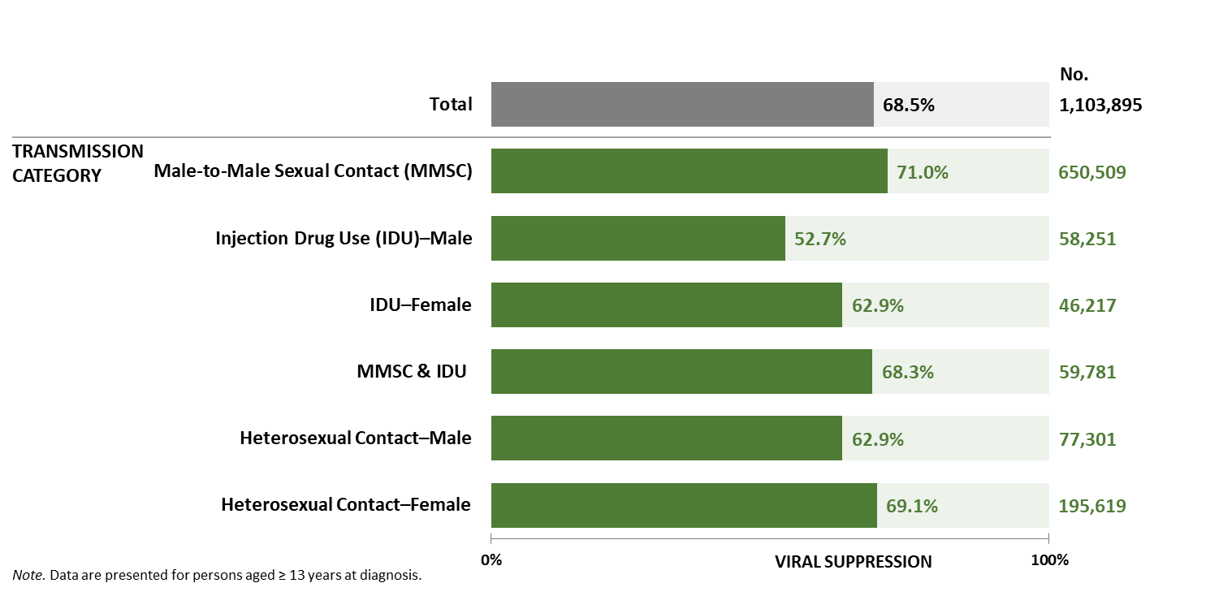
Viral suppression among persons living with diagnosed HIV, by transmission category and sex, 2024—United States
Notes:
Key findings
During 2024 in the United States, 68.5% of 1,103,895 persons aged ≥ 13 years living with diagnosed HIV and alive at year-end 2024 were virally suppressed at their most recent test.
By transmission category, viral suppression was the lowest among males with HIV attributed to injection drug use (52.7%).
Data notes and sources
For additional data, see Table 3a in the 2024 HIV Monitoring Data Release.
Data have been statistically adjusted to account for missing transmission category.
For more information on data sources, data collection and reporting practices, and case definitions, see the National HIV Surveillance System (NHSS) Technical Notes, available at https://www.cdc.gov/hiv-data/nhss/index.html.
Data for all figures are available in 2024 HIV Monitoring Data Release or NCHHSTP AtlasPlus.

Slide 47
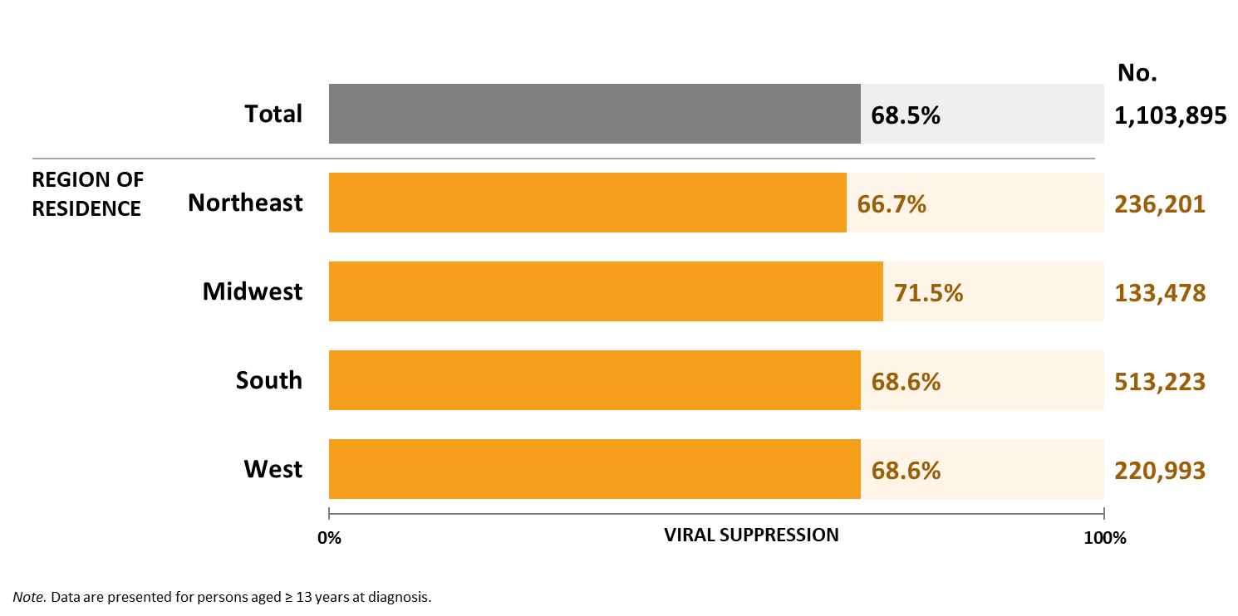
Viral suppression among persons living with diagnosed HIV, by region of residence, 2024—United States
Notes:
Key findings
During 2024 in the United States, 68.5% of 1,103,895 persons aged ≥ 13 years living with diagnosed HIV and alive at year-end 2024 were virally suppressed at their most recent test. By region of residence, viral suppression was the lowest among persons who resided in the Northeast (66.7%).
Data notes and sources
For additional data, see Table 3a in the 2024 HIV Monitoring Data Release.
For more information on data sources, data collection and reporting practices, and case definitions, see the National HIV Surveillance System (NHSS) Technical Notes, available at https://www.cdc.gov/hiv-data/nhss/index.html.
Data for all figures are available in 2024 HIV Monitoring Data Release or NCHHSTP AtlasPlus.

Slide 48
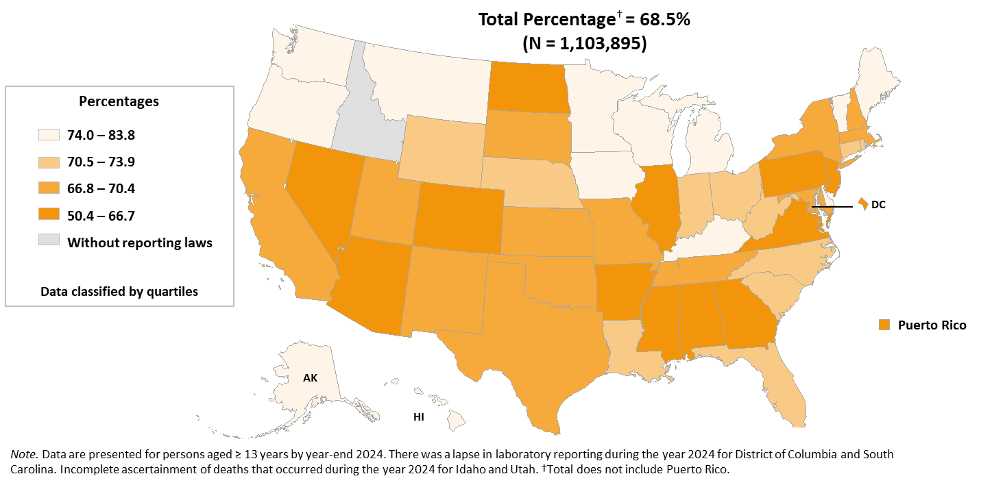
Viral suppression among persons living with diagnosed HIV, 2024—United States and Puerto Rico
Notes:
Key findings
During 2024 in the United States, 68.5% of 1,103,895 persons aged ≥ 13 years living with diagnosed HIV and alive at year-end 2024 were virally suppressed at their most recent test.
Jurisdictions in the lowest quartile (Alabama, Arizona, Arkansas, Colorado, District of Columbia, Georgia, Illinois, Mississippi, Nevada, New Jersey, North Dakota, Pennsylvania, Puerto Rico, and Virginia) had ≤66.7% of persons were virally suppressed.
Data notes and sources
For additional data, see Table 4b in the 2024 HIV Monitoring Data Release.
For more information on data sources, data collection and reporting practices, and case definitions, see the National HIV Surveillance System (NHSS) Technical Notes, available at https://www.cdc.gov/hiv-data/nhss/index.html.
Data for all figures are available in 2024 HIV Monitoring Data Release or NCHHSTP AtlasPlus.

Slide 49
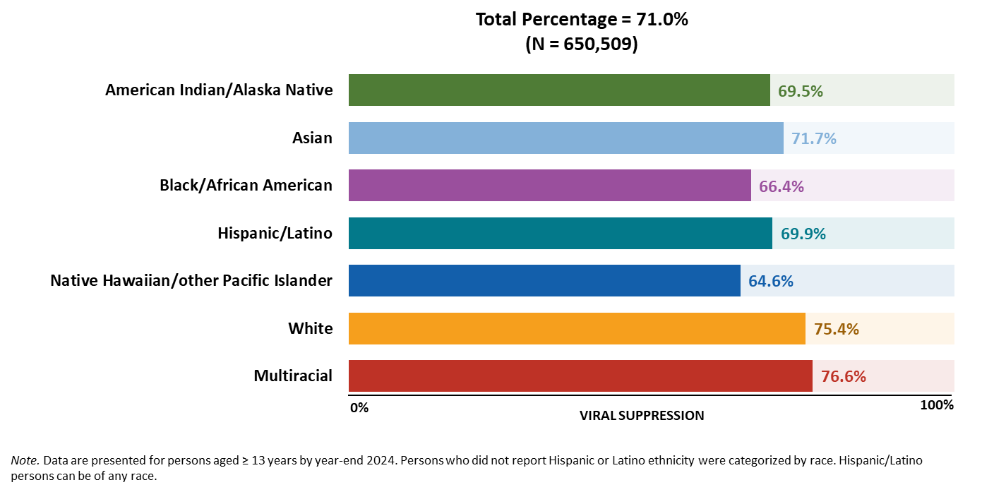
Viral suppression among males living with diagnosed HIV attributed to male-to-male sexual contact, by race/ethnicity, 2024—United States
Notes:
Key findings
Of 650,509 males aged ≥ 13 years living with diagnosed HIV attributed to male-to-male sexual contact at year-end 2024 in the United States, 71.0% were virally suppressed at their most recent test in 2024. By race/ethnicity among males with HIV attributed to male-to-male sexual contact, the lowest percentage of viral suppression was among Native Hawaiian/other Pacific Islander persons (64.6%).
Data notes and sources
For additional data, see Table 3d in the 2024 HIV Monitoring Data Release.
Data have been statistically adjusted to account for missing transmission category. Use caution when interpreting data for American Indian/Alaska Native and Native Hawaiian/other Pacific Islander persons due to small numbers.
For more information on data sources, data collection and reporting practices, and case definitions, see the National HIV Surveillance System (NHSS) Technical Notes, available at https://www.cdc.gov/hiv-data/nhss/index.html.
Data for all figures are available in 2024 HIV Monitoring Data Release or NCHHSTP AtlasPlus.

Slide 50
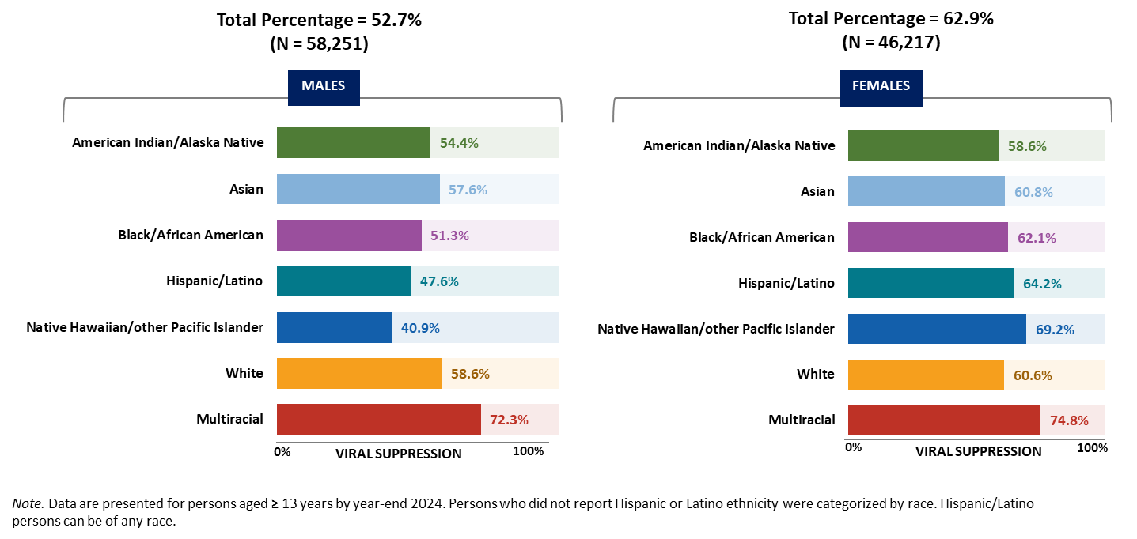
Viral suppression among persons living with diagnosed HIV attributed to injection drug use, by race/ethnicity and sex, 2024—United States
Notes:
Key findings
Of 58,251 males aged ≥ 13 years living with diagnosed HIV attributed to injection drug use at year-end 2024 in the United States, 52.7% were virally suppressed at their most recent test in 2024. Of 46,217 females aged ≥ 13 years living with diagnosed HIV attributed to injection drug use at year-end 2024 in the United States, 62.9% were virally suppressed at their most recent test in 2024.
Lowest percentages of viral suppression among persons with HIV attributed to injection drug use, by sex and race/ethnicity, were as follows:
• Male—Native Hawaiian/other Pacific Islander persons (40.9%)
• Female—American Indian/Alaska Native persons (58.6%)
Data notes and sources
For additional data, see Table 3c in the 2024 HIV Monitoring Data Release.
Data have been statistically adjusted to account for missing transmission category. Use caution when interpreting data for American Indian/Alaska Native and Native Hawaiian/other Pacific Islander persons due to small numbers.
For more information on data sources, data collection and reporting practices, and case definitions, see the National HIV Surveillance System (NHSS) Technical Notes, available at https://www.cdc.gov/hiv-data/nhss/index.html.
Data for all figures are available in 2024 HIV Monitoring Data Release or NCHHSTP AtlasPlus.

Slide 51
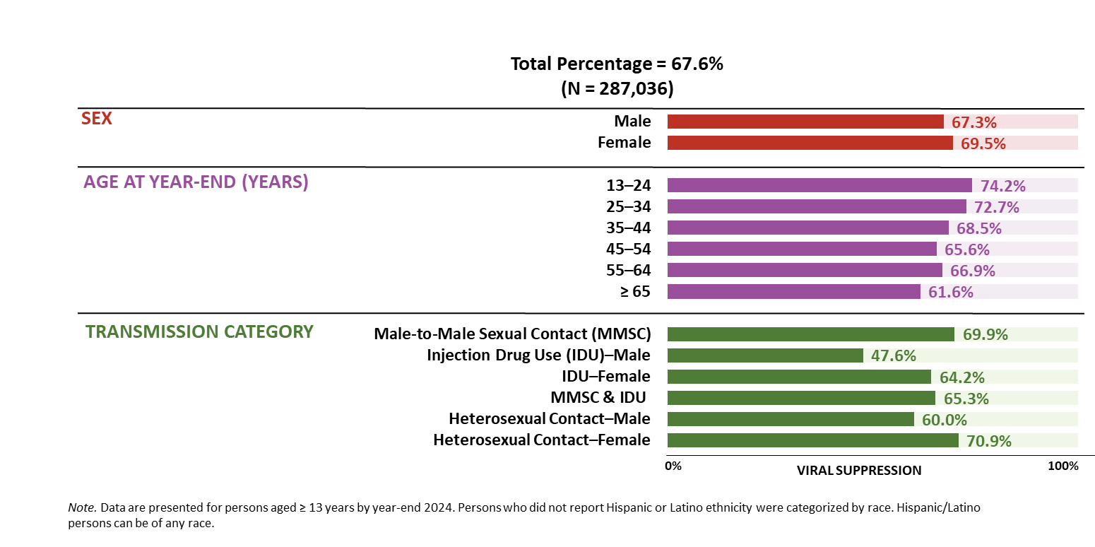
Viral suppression among Hispanic/Latino persons living with diagnosed HIV, by selected characteristics, 2024—United States
Notes:
Key findings
Among 287,036 Hispanic/Latino persons aged ≥ 13 years living with diagnosed HIV at year-end 2024, 67.6% were virally suppressed at their most recent test in 2024.
For viral suppression, lowest percentages among Hispanic/Latino persons:
• By sex—males (67.3%)
• By age at year-end 2023—persons aged ≥ 65 years (61.6%)
• By transmission category and sex—males with HIV attributed to injection drug use (47.6%)
Data notes and sources
For additional data, see Table 3c in the 2024 HIV Monitoring Data Release.
Data have been statistically adjusted to account for missing transmission category.
For more information on data sources, data collection and reporting practices, and case definitions, see the National HIV Surveillance System (NHSS) Technical Notes, available at https://www.cdc.gov/hiv-data/nhss/index.html.
Data for all figures are available in 2024 HIV Monitoring Data Release or NCHHSTP AtlasPlus.

Slide 52
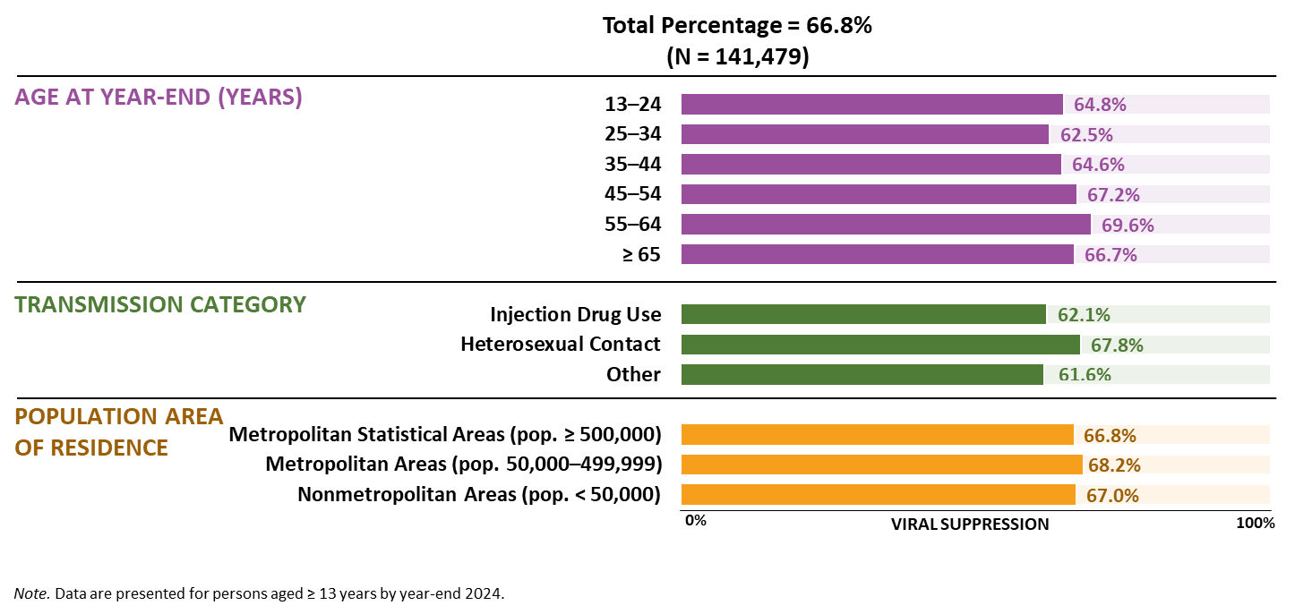
Viral suppression among Black/African American females living with diagnosed HIV, by selected characteristics, 2024—United States
Notes:
Key findings
In the United States, among 141,479 Black/African American females aged ≥ 13 years living with diagnosed HIV at year-end 2024, 66.8% were virally suppressed at their most recent test in 2024.
For viral suppression, lowest percentages among Black/African American females:
• By age at year-end 2023—persons aged 25–34 years (62.5%)
• By transmission category—persons with HIV attributed to other transmission category (61.6%)
• By population area of residence—persons who resided in metropolitan areas of population ≥ 500,000 (66.8%) and persons who resided in nonmetropolitan areas of population <50,000 (67.0%)
Data notes and sources
For additional data, see Table 3c in the 2024 HIV Monitoring Data Release.
Data have been statistically adjusted to account for missing transmission category.
For more information on data sources, data collection and reporting practices, and case definitions, see the National HIV Surveillance System (NHSS) Technical Notes, available at https://www.cdc.gov/hiv-data/nhss/index.html.
Data for all figures are available in 2024 HIV Monitoring Data Release or NCHHSTP AtlasPlus.

Slide 53
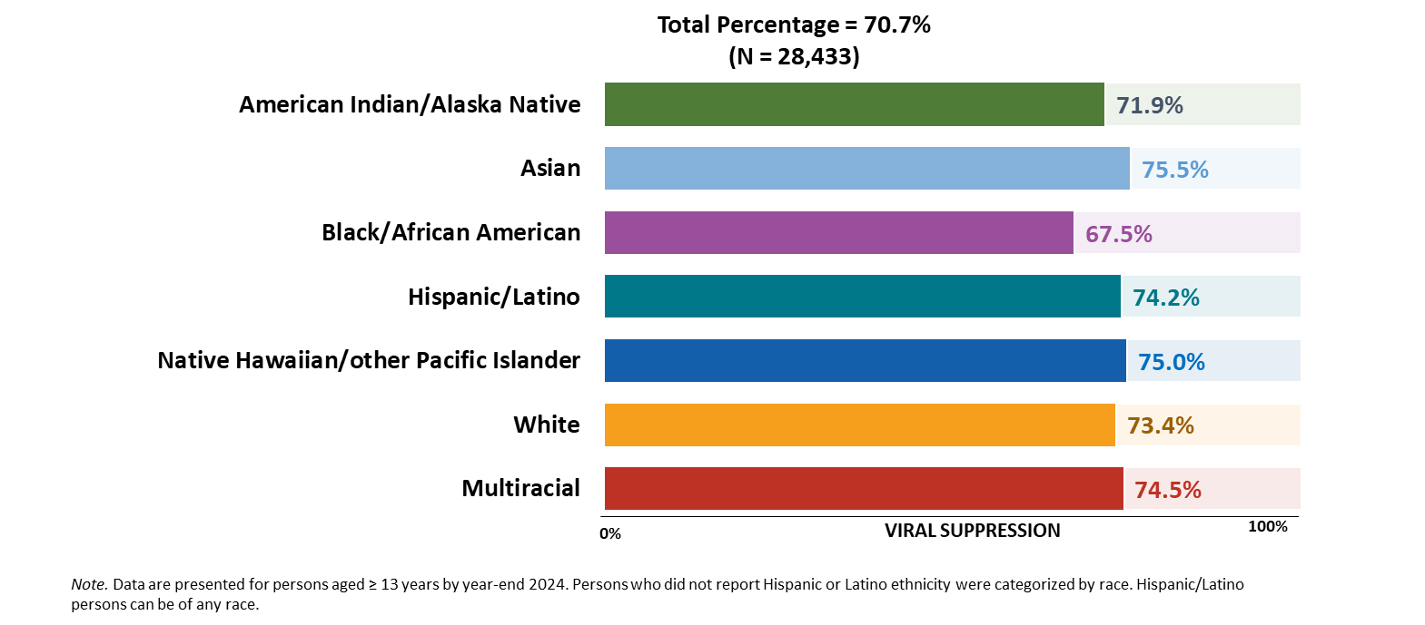
Viral suppression among persons aged 13–24 years living with diagnosed HIV, by race/ethnicity, 2024—United States
Notes:
Key findings
Of 28,433 persons aged 13–24 years living with diagnosed HIV at year-end 2024 in the United States, 70.7% were virally suppressed at their most recent test in 2024. The lowest percentage of viral suppression among persons aged 13–24 years by race/ethnicity was among Black/African American persons (67.5%).
Data notes and sources
For additional data, see Table 3c in the 2024 HIV Monitoring Data Release.
For more information on data sources, data collection and reporting practices, and case definitions, see the National HIV Surveillance System (NHSS) Technical Notes, available at https://www.cdc.gov/hiv-data/nhss/index.html.
Data for all figures are available in 2024 HIV Monitoring Data Release or NCHHSTP AtlasPlus.

Slide 54

Viral suppression among persons aged ≥ 55 years living with diagnosed HIV, by race/ethnicity, 2024—United States
Notes:
Key findings
Of 459,629 persons aged ≥ 55 years living with diagnosed HIV at year-end 2024 in the United States, 68.8% were virally suppressed at their most recent test in 2024. The lowest percentages of viral suppression among persons aged ≥ 55 years by race/ethnicity were among Black/African American (64.2%) and Hispanic/Latino (65.1%) persons.
Data notes and sources
For additional data, see Table 3c in the 2024 HIV Monitoring Data Release.
For more information on data sources, data collection and reporting practices, and case definitions, see the National HIV Surveillance System (NHSS) Technical Notes, available at https://www.cdc.gov/hiv-data/nhss/index.html.
Data for all figures are available in 2024 HIV Monitoring Data Release or NCHHSTP AtlasPlus.

Slide 55

HIV care continuum, 2024—U.S. Southern Region
Notes:
Key findings
In 2024, of the 513,223 (46%) persons aged ≥ 13 years living with diagnosed HIV in the U.S. Southern Region:
• 78% received HIV medical care
• 58% were retained in HIV medical care
• 69% were virally suppressed
Data notes and sources
For additional data, see Table 3a in the 2024 HIV Monitoring Data Release.
For more information on data sources, data collection and reporting practices, and case definitions, see the National HIV Surveillance System (NHSS) Technical Notes, available at https://www.cdc.gov/hiv-data/nhss/index.html.
Data for all figures are available in 2024 HIV Monitoring Data Release or NCHHSTP AtlasPlus.

Slide 56
Perinatally Acquired HIV
Notes:
To inform decisions about antiretroviral therapy and reduce perinatal transmission of HIV, pregnant women should know their HIV infection status. In 1995, recommendations for HIV counseling and voluntary testing of pregnant women were first published. In 2006, CDC issued revised HIV testing recommendations specifying that opt-out HIV screening be included in the routine panel of prenatal screening tests for all pregnant women.
Because of delays in reporting births and diagnoses of HIV infection attributed to perinatal exposure to the National HIV Surveillance System (NHSS), and due to the dynamic nature of surveillance case reporting and investigation, these data are subject to change. Perinatally acquired HIV infection numbers should be interpreted with caution. Additionally, small numbers (fewer than 12) and rates based on these numbers, should be interpreted with caution.

Slide 57

Rates of perinatally acquired HIV diagnoses among persons born in the United States, by year of birth and biological mother's race/ethnicity, 2020–2024—United States
Notes:
Key findings
In 2024, the overall annual rate of perinatally acquired HIV in the United States was 0.8 per 100,000 live births. By race/ethnicity, the highest rate of perinatally acquired HIV was among births for Black/African American persons (3.8 diagnoses per 100,000 live births).
Data notes and sources
For additional data, see Table 8b in the 2024 HIV Monitoring Data Release.
Live-birth data reflect race/ethnicity of the infant’s biological mother.
Race/ethnicity category for Other includes American Indian/Alaska Native, Asian, Native Hawaiian/other Pacific Islander, and multiracial persons. Because of delays in the reporting of births and diagnoses of HIV attributed to perinatal exposure, these numbers may be subject to change.
The data for 2020, which coincided with the onset of the COVID-19 pandemic, should be interpreted with caution. The pandemic had a significant impact on access to HIV testing, care, and related services, and case surveillance activities in state and local jurisdictions. Therefore, readers should also consider the potential influence of COVID-19 on HIV data for subsequent years.
Data for all figures are available in 2024 HIV Monitoring Data Release or NCHHSTP AtlasPlus.

Slide 58

Perinatally acquired HIV diagnoses among children born in 2024—United States and 7 territories and freely associated states
Notes:
Key findings
In the United States and 7 territories and freely associated states, a total of 30 children born during 2024 received an HIV diagnosis attributed to perinatal transmission.
Data notes and sources
The 2024 HIV Monitoring Data Release marks the first inclusion of data from the Republic of the Marshall Islands in numbers and rates of HIV diagnoses, deaths, and persons living with diagnosed HIV.
Because of delays in the reporting of births and diagnoses of HIV attributed to perinatal exposure, numbers may be subject to change.

Slide 59

Timing of biological mother’s HIV testing among children with perinatally acquired HIV or HIV exposure, birth years 2020–2023—United States and Puerto Rico
Notes:
Key findings
Among the 162 children who were born and perinatally acquired HIV during 2020–2023 in the United States and Puerto Rico, the timing of their biological mother’s HIV testing was as follows:
• Highest percentage—mothers were tested before pregnancy (48.8%)
• Lowest percentage—mothers were tested at the time of birth (3.1%)
Among the 11,595 children who were born and were exposed to, but not perinatally infected with, HIV during 2020–2023 in the United States and Puerto Rico, the timing of their biological mother’s HIV testing was as follows:
• Highest percentage—mothers were tested before pregnancy (83.3%)
• Lowest percentage—mothers were tested after birth (< 1%)
Data notes and sources
There were no perinatally acquired HIV diagnoses for American Samoa, Commonwealth of the Northern Mariana Islands, Guam, Republic of the Marshall Islands, Republic of Palau, or U.S. Virgin Islands from 2020–2023.
The data for 2020, which coincided with the onset of the COVID-19 pandemic, should be interpreted with caution. The pandemic had a significant impact on access to HIV testing, care, and related services, and case surveillance activities in state and local jurisdictions. As the COVID-19 pandemic lasted beyond 2020, readers should also consider the potential influence of these pandemic effects on U.S. public health systems when interpreting HIV data for 2021–2023.

Slide 60

Acknowledgments
Project Logo
Data Analysis and Dissemination Team, HIV Surveillance Branch, Division of HIV Prevention, National Center for HIV, Viral Hepatitis, STD, and TB Prevention, Centers for Disease Control and Prevention
State, territorial, and freely associated state health departments and the HIV surveillance programs that provided surveillance data to CDC

