Slide 1
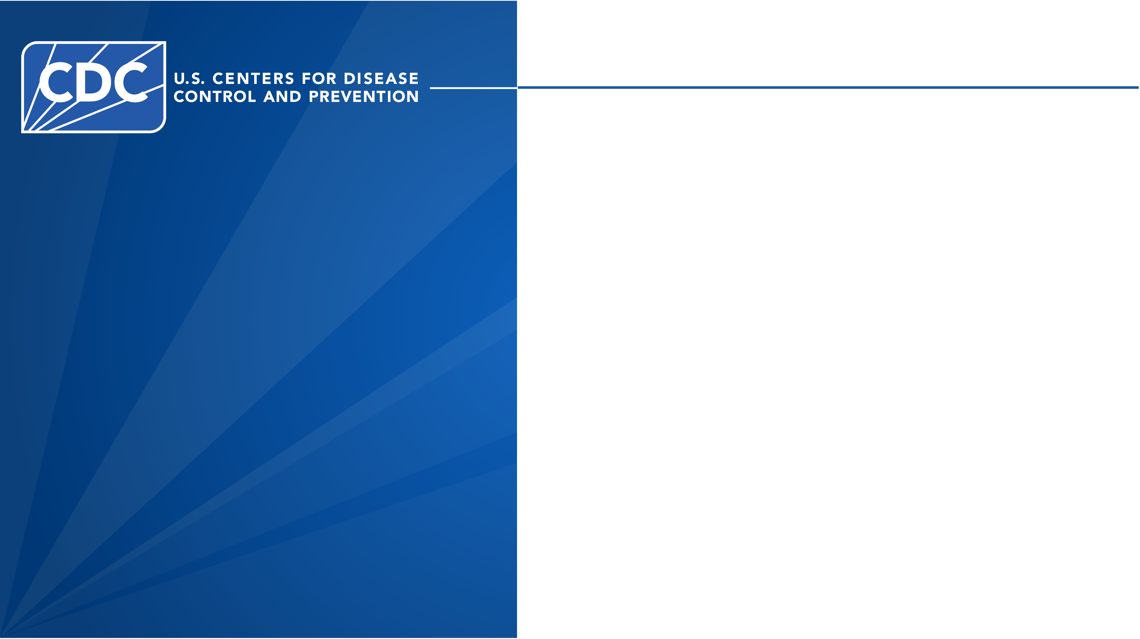
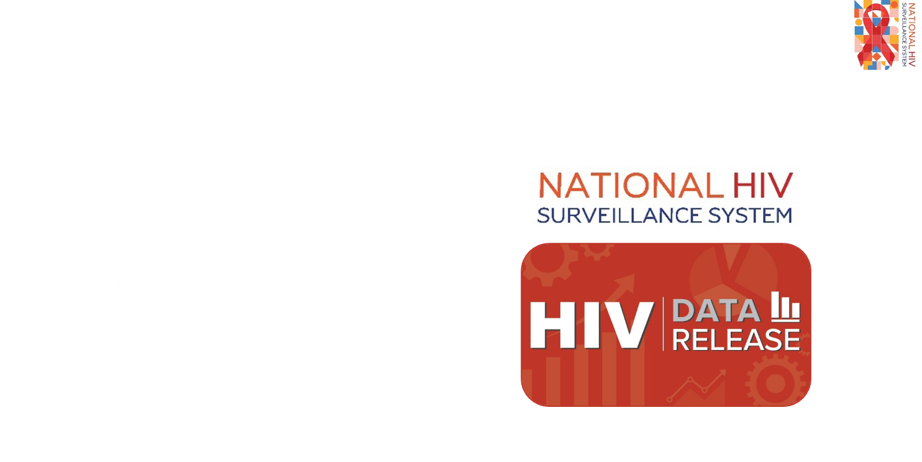
Notes:
These slides were prepared by the Division of HIV Prevention, National Center for HIV, Viral Hepatitis, STD, and TB Prevention (NCHHSTP), Centers for Disease Control and Prevention (CDC). These slides present data on persons with HIV in the United States based on cases of HIV infection reported to CDC’s National HIV Surveillance System (NHSS) through December 2025.
Data are based on case reports from 50 states, the District of Columbia, and the U.S. territories and freely associated states. Confidential, name-based reporting is required by law or regulation.
Note. This slide set is in the public domain. You may reproduce these slides without permission; however, citation as to source is appreciated.
Centers for Disease Control and Prevention. Diagnoses, Deaths and Prevalence of HIV in the United States and 7 Territories and Freely Associated States 2024. Atlanta: U.S. Department of Health and Human Services; 2026.
You are also free to adapt and revise these slides; however, you must remove the CDC name and logo if changes are made.

Slide 2
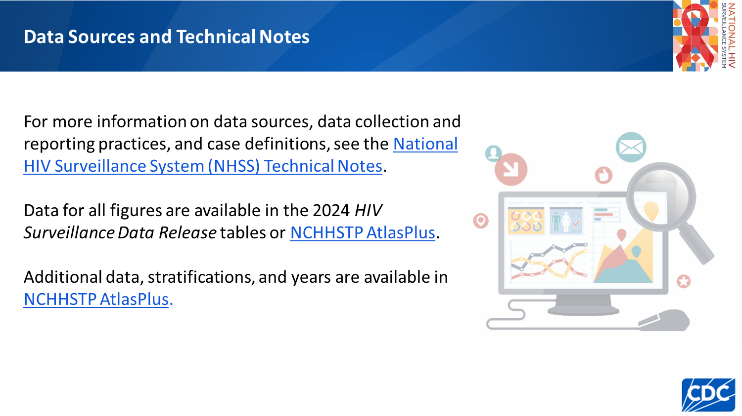
Notes:
For more information on data sources, data collection and reporting practices, and case definitions, see the National HIV Surveillance System (NHSS) Technical Notes, available at https://www.cdc.gov/hiv-data/nhss/index.html.
Data for all figures are available in the 2024 HIV Surveillance Data Release tables or NCHHSTP AtlasPlus, available at https://www.cdc.gov/nchhstp/about/atlasplus.html.
Additional data, stratifications, and years are available via NCHHSTP AtlasPlus, available at https://www.cdc.gov/nchhstp/about/atlasplus.html.

Slide 3
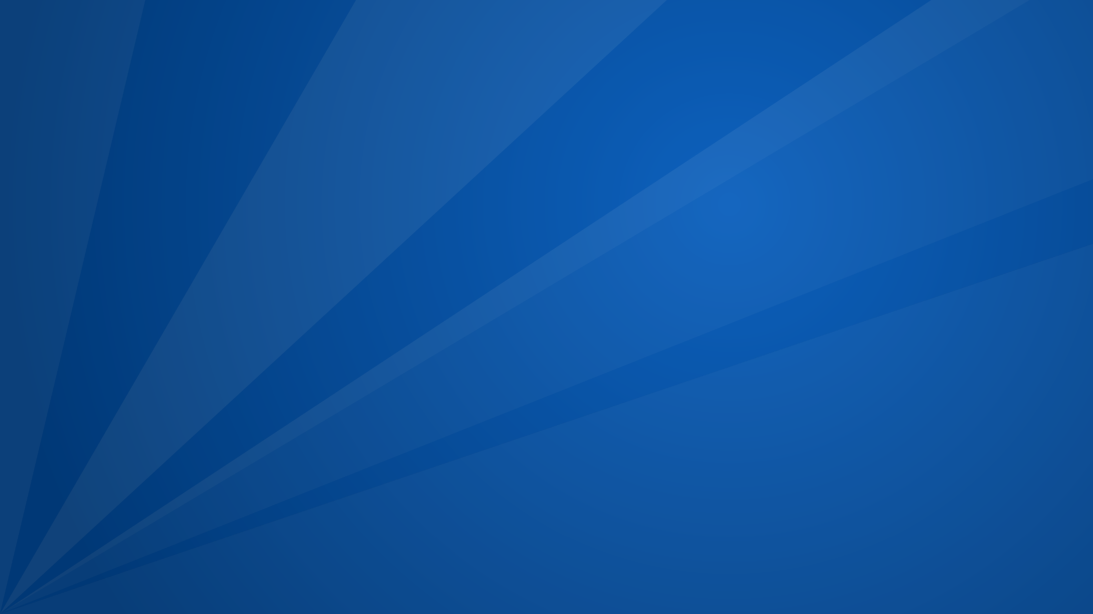
HIV Diagnoses
Notes:
In this data release , the term HIV diagnosis is defined as an HIV diagnosis regardless of the stage of disease (stage 0, 1, 2, 3 [acquired immunodeficiency syndrome (AIDS)], or unknown) and refers to all persons with an HIV diagnosis.
The data on HIV diagnoses reflect the date of diagnosis, not the date of report to NHSS.
Because of reporting delays, the number of diagnoses reported for a given year may be lower than numbers presented in later reports; however, fluctuations in the number of diagnoses for a given year typically subside after 2–3 years of reporting.
An evaluation of surveillance data for diagnoses during 2020–2024, found that, on average, approximately 81% of HIV diagnoses were reported to CDC during the year of diagnosis and approximately 98% were reported by the end of the following year.

Slide 4
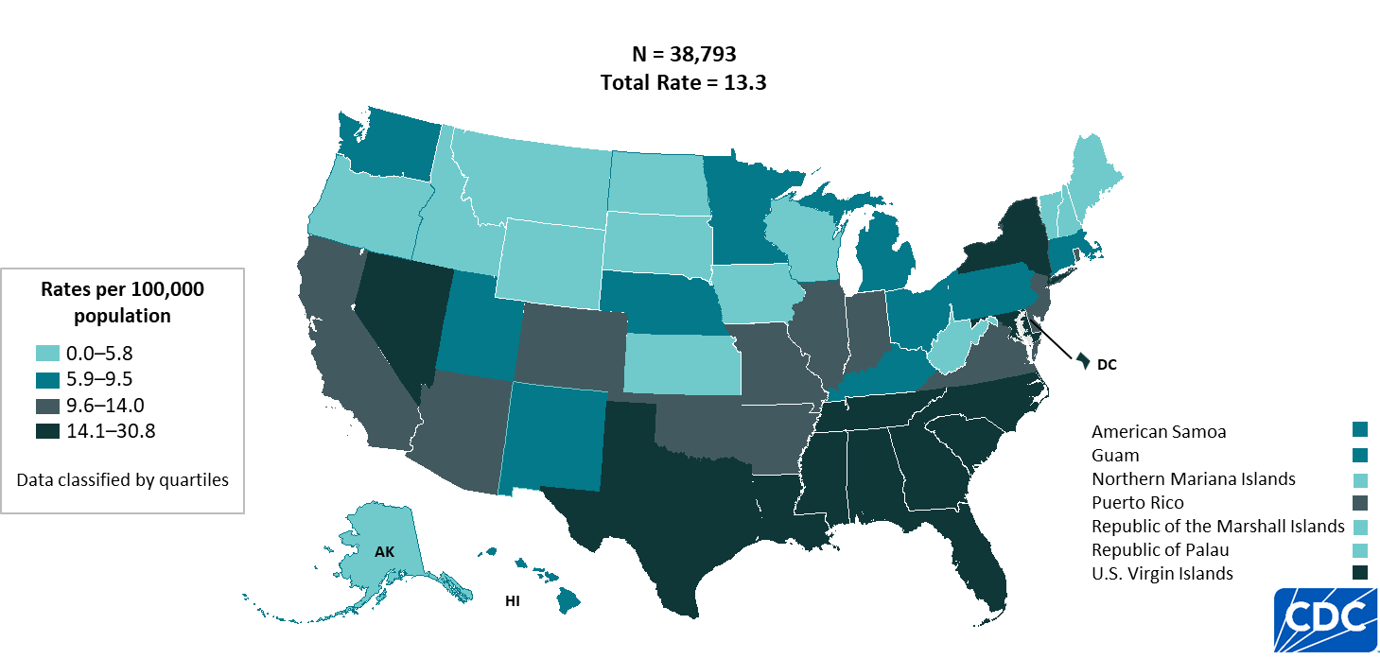
HIV diagnoses rates, 2024—United States and 7 territories and freely associated states
Note. Data are presented for persons aged ≥ 13 years at diagnosis.
Note. Data are presented for persons aged ≥ 13 years at diagnosis.
Notes:
Key findings
In 2024, in the United States and 7 territories and freely associated states, the highest HIV diagnoses rates among persons aged ≥ 13 years by residence at diagnosis were as follows:
District of Columbia (30.8), U.S. Virgin Islands (27.6), Georgia (26.0), Nevada (22.5), Louisiana (22.0), and Florida (21.4).
Data notes and sources
The 2024 HIV Surveillance Data Release marks the first inclusion of data from the Republic of the Marshall Islands in numbers and rates of HIV diagnoses, deaths, and persons living with diagnosed HIV.
For additional data, see Table 16 in the 2024 HIV Surveillance Data Release.
Use caution when comparing the rates of diagnoses for the District of Columbia and U.S. Virgin Islands to the rates for states due to the size of the populations.
Rates per 100,000 population were calculated for HIV diagnoses by dividing the number of diagnoses by the population for the calendar year and multiplying by 100,000. Population denominators were derived from vintage 2024 Census estimates for the 50 states, DC, and Puerto Rico, and from the U.S. Census Bureau’s International Database for American Samoa, the Commonwealth of the Northern Mariana Islands, Guam, the Republic of the Marshall Islands, the Republic of Palau, and the U.S. Virgin Islands.
Data for all figures are available in the 2024 HIV Surveillance Data Release tables or NCHHSTP AtlasPlus.

Slide 5
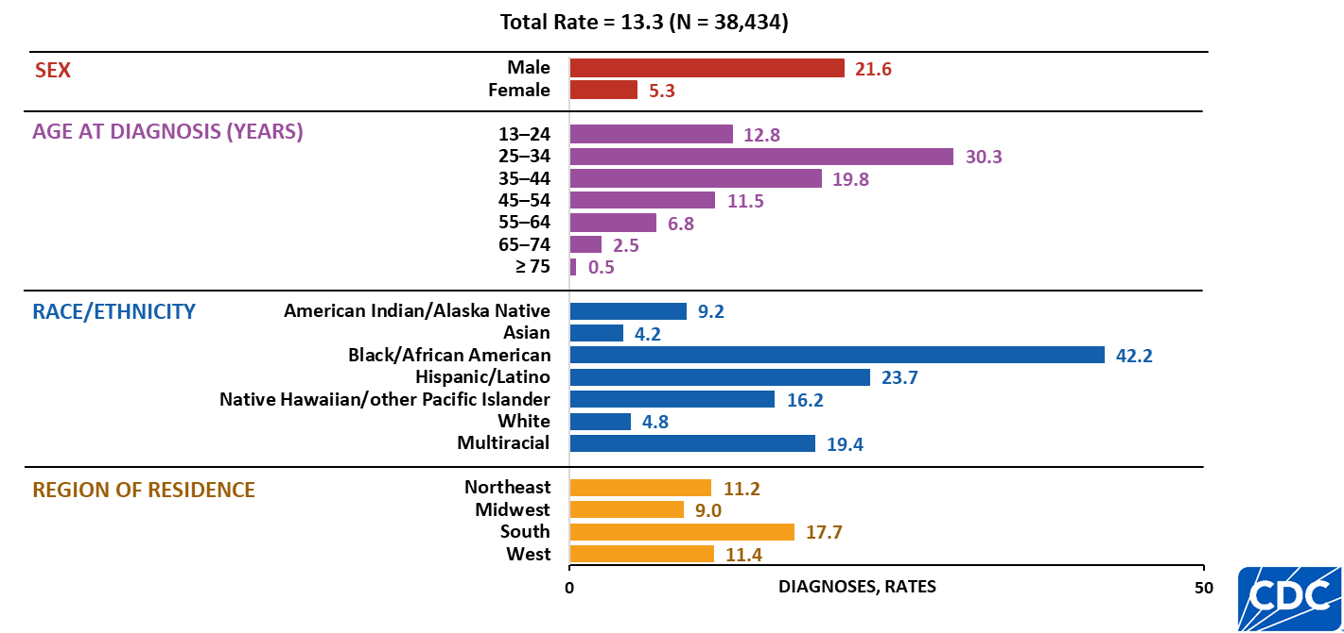
HIV diagnoses rates, by selected characteristics, 2024—United States
Note. Data are presented for persons aged ≥ 13 years at diagnosis. Rates are per 100,000. Persons who did not report Hispanic or Latino ethnicity were categorized by race. Hispanic/Latino persons can be of any race.
Notes:
Key findings
In 2024, in the United States, the highest rates of HIV diagnoses among persons aged ≥ 13 years by sex, age group, race/ethnicity, and region of residence were as follows:
Males (21.6)
Persons aged 25–34 years (30.3)
Black/African American persons (42.2)
Persons residing in the South (17.7)
Data notes and sources
For additional data, see Table 3a in the 2024 HIV Surveillance Data Release.
Use caution when interpreting data for American Indian/Alaska Native and Native Hawaiian/other Pacific Islander persons as rates are based on small numbers.
Rates per 100,000 population were calculated for HIV diagnoses by dividing the number of diagnoses by the population for the calendar year and multiplying by 100,000. Population denominators were derived from vintage 2024 Census estimates for the 50 states, DC, and Puerto Rico, and from the U.S. Census Bureau’s International Database for American Samoa, the Commonwealth of the Northern Mariana Islands, Guam, the Republic of the Marshall Islands, the Republic of Palau, and the U.S. Virgin Islands.
For more information on data sources, data collection and reporting practices, and case definitions, see the National HIV Surveillance System (NHSS) Technical Notes, available at https://www.cdc.gov/hiv-data/nhss/index.html.
Data for all figures are available in the 2024 HIV Surveillance Data Release tables or NCHHSTP AtlasPlus.

Slide 6
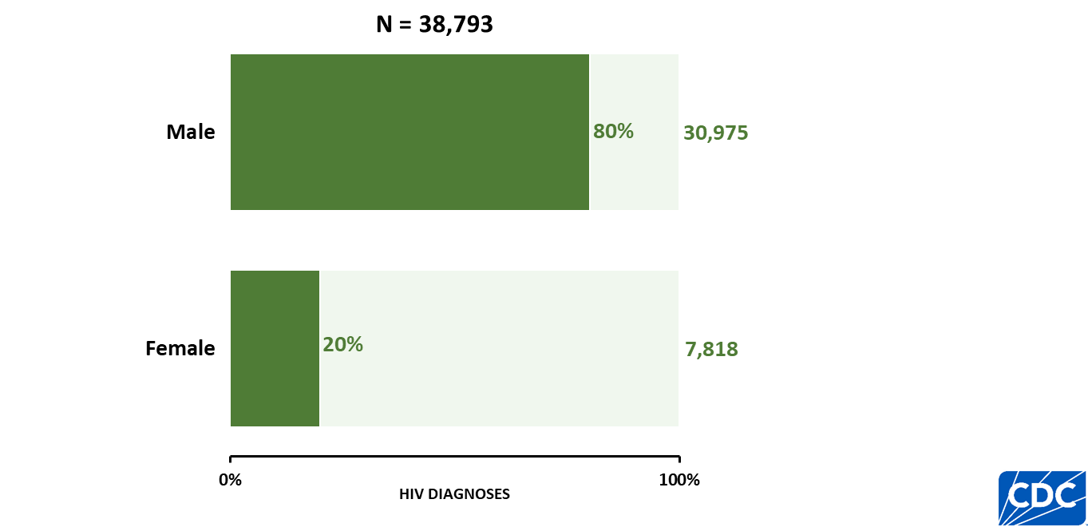
HIV diagnoses, by sex, 2024—United States and 7 territories and freely associated states
Note. Data are presented for persons aged ≥ 13 years at diagnosis.
Notes:
Key findings
In 2024, in the United States and 7 territories and freely associated states, males accounted for the highest percentage of HIV diagnoses (80%) among persons aged ≥ 13 years.
Data notes and sources
The 2024 HIV Surveillance Data Release marks the first inclusion of data from the Republic of the Marshall Islands in numbers and rates of HIV diagnoses, deaths, and persons living with diagnosed HIV.
For additional data, see Table 1b in the 2024 HIV Surveillance Data Release.
For more information on data sources, data collection and reporting practices, and case definitions, see the National HIV Surveillance System (NHSS) Technical Notes, available at https://www.cdc.gov/hiv-data/nhss/index.html.
Data for all figures are available in the 2024 HIV Surveillance Data Release tables or NCHHSTP AtlasPlus.

Slide 7
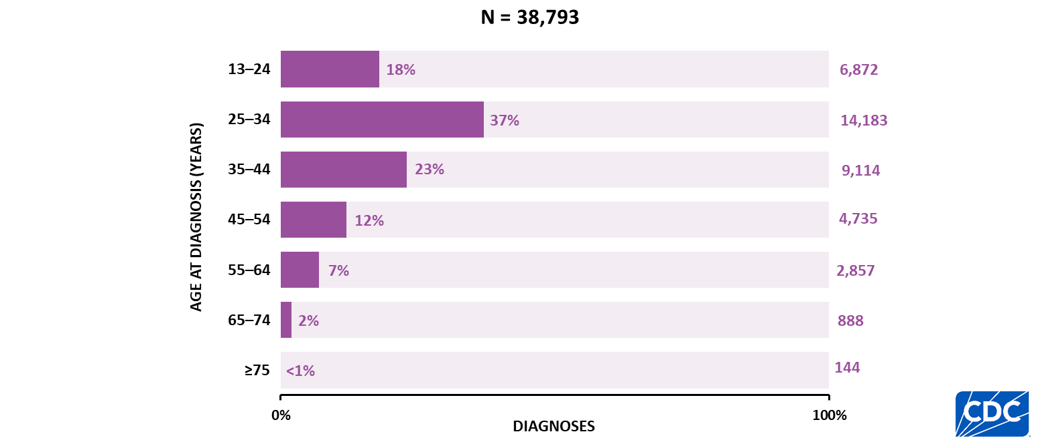
HIV diagnoses, by age, 2024—United States and 7 territories and freely associated states
Notes:
Key findings
In 2024, in the United States and 7 territories and freely associated states, the highest percentages of HIV diagnoses among persons aged ≥ 13 years by age group were as follows:
Persons aged 25‒34 and 35‒44 years accounted for 60% of HIV diagnoses, 37% and 23%, respectively.
Data notes and sources
The 2024 HIV Surveillance Data Release marks the first inclusion of data from the Republic of the Marshall Islands in numbers and rates of HIV diagnoses, deaths, and persons living with diagnosed HIV.
For additional data, see Table 1b in the 2024 HIV Surveillance Data Release.
For more information on data sources, data collection and reporting practices, and case definitions, see the National HIV Surveillance System (NHSS) Technical Notes, available at https://www.cdc.gov/hiv-data/nhss/index.html.
Data for all figures are available in the 2024 HIV Surveillance Data Release tables or NCHHSTP AtlasPlus.

Slide 8
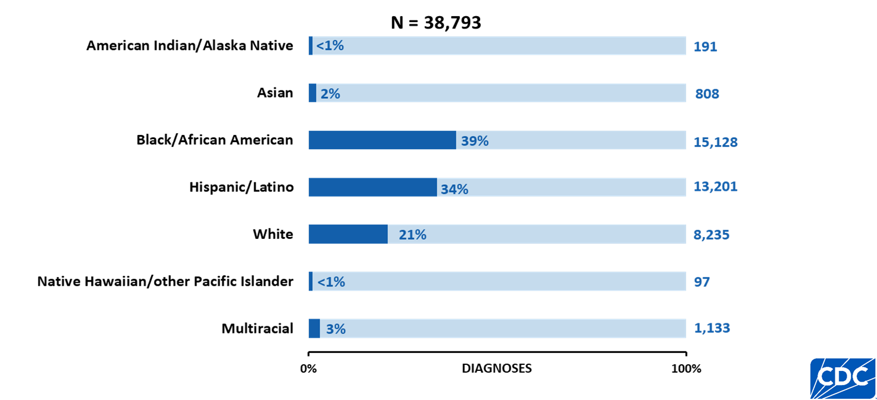
HIV diagnoses, by race/ethnicity, 2024—United States and 7 territories and freely associated states
Note. Data are presented for persons aged ≥ 13 years at diagnosis. Persons who did not report Hispanic or Latino ethnicity were categorized by race. Hispanic/Latino persons can be of any race.
Notes:
Key findings
In 2024, in the United States and 7 territories and freely associated states, the highest percentages of HIV diagnoses among persons aged ≥ 13 years by race/ethnicity were as follows:
Black/African American (39%) and Hispanic/Latino (34%) persons.
Data notes and sources
The 2024 HIV Surveillance Data Release marks the first inclusion of data from the Republic of the Marshall Islands in numbers and rates of HIV diagnoses, deaths, and persons living with diagnosed HIV.
For additional data, see Table 2b in the 2024 HIV Surveillance Data Release.
Use caution when interpreting data for American Indian/Alaska Native and Native Hawaiian/other Pacific Islander persons due to small numbers.
For more information on data sources, data collection and reporting practices, and case definitions, see the National HIV Surveillance System (NHSS) Technical Notes, available at https://www.cdc.gov/hiv-data/nhss/index.html.
Data for all figures are available in the 2024 HIV Surveillance Data Release tables or NCHHSTP AtlasPlus.

Slide 9
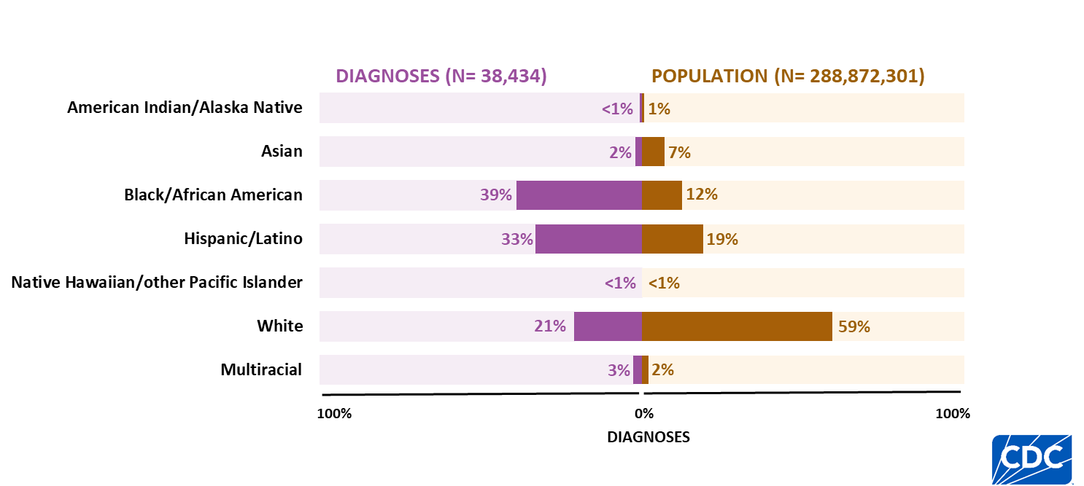
HIV diagnoses and population, by race/ethnicity, 2024—United States
Note. Data are presented for persons aged ≥ 13 years at diagnosis. Persons who did not report Hispanic or Latino ethnicity were categorized by race. Hispanic/Latino persons can be of any race.
Notes:
Key findings
In 2024, in the United States, the population and HIV diagnoses among persons aged ≥ 13 years by race/ethnicity were as follows:
Black/African American persons made up 12% of the population, but this group accounted for 39% of HIV diagnoses.
Hispanic/Latino persons made up 19% of the population, but this group accounted for 33% of HIV diagnoses.
Data notes and sources
For additional data, see Table 3a in the 2024 HIV Surveillance Data Release.
Use caution when interpreting data for American Indian/Alaska Native and Native Hawaiian/other Pacific Islander persons due to small numbers.
Population denominators used to calculate rates for the United States are based on the U.S. Census Bureau’s 2024 Vintage postcensal estimates.
For more information on data sources, data collection and reporting practices, and case definitions, see the National HIV Surveillance System (NHSS) Technical Notes, available at https://www.cdc.gov/hiv-data/nhss/index.html.
Data for all figures are available in the 2024 HIV Surveillance Data Release tables or NCHHSTP AtlasPlus.

Slide 10
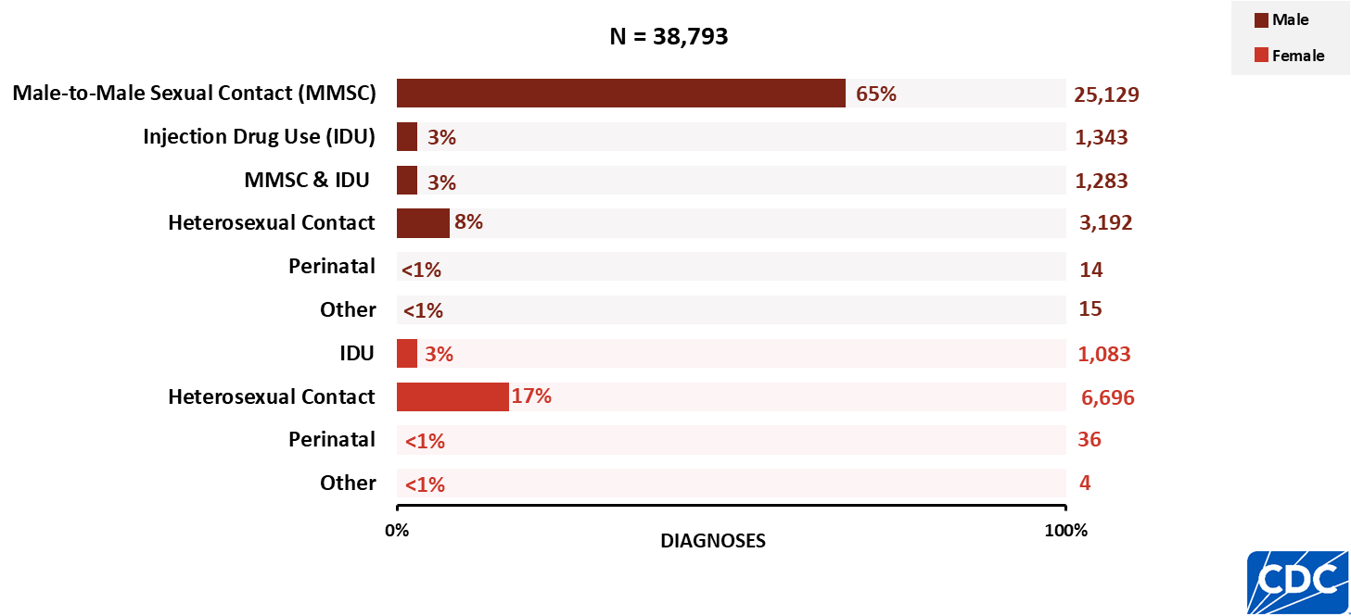
HIV diagnoses, by transmission category and sex, 2024—United States and 7 territories and freely associated states
Note. Data are presented for persons aged ≥ 13 years at diagnosis.
Notes:
Key findings
In 2024, in the United States and 7 territories and freely associated states, the highest percentages of HIV diagnoses among persons aged ≥ 13 years by transmission category and sex were as follows:
Male: male-to-male sexual contact (65%)
Female: heterosexual contact (17%)
Data notes and sources
The 2024 HIV Surveillance Report marks the first inclusion of data from the Republic of the Marshall Islands in numbers and rates of HIV diagnoses, deaths, and persons living with diagnosed HIV.
For additional data, see Table 1b in the 2024 HIV Surveillance Data Release.
Data have been statistically adjusted to account for missing transmission category.
For more information on data sources, data collection and reporting practices, and case definitions, see the National HIV Surveillance System (NHSS) Technical Notes, available at https://www.cdc.gov/hiv-data/nhss/index.html.
Data for all figures are available in the 2024 HIV Surveillance Data Release tables or NCHHSTP AtlasPlus.

Slide 11
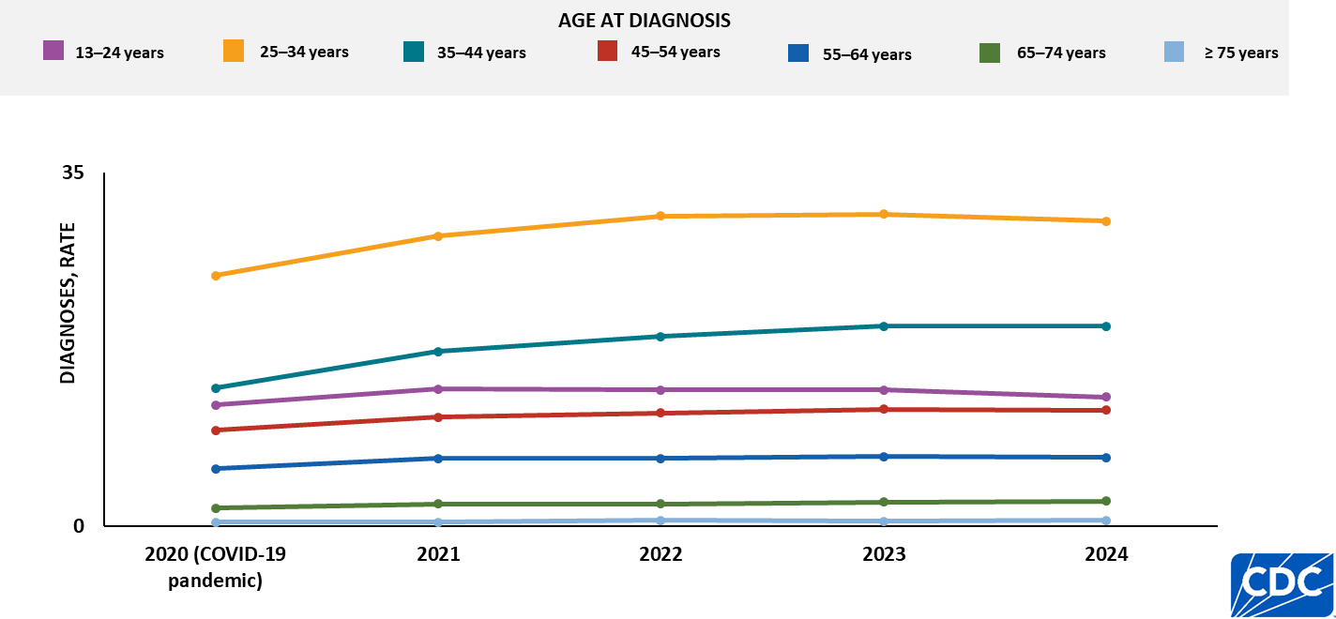
HIV diagnoses, by age, 2020–2024—United States and 7 territories and freely associated states
Note. Rates are per 100,000.
Notes:
Key findings
From 2020–2024, in the United States and 7 territories and freely associated states, the highest rates of HIV diagnoses among persons aged ≥ 13 years by age group were among:
persons aged 25–34 years
persons aged 35–44 years
Data notes and sources
The 2024 HIV Surveillance Data Release marks the first inclusion of data from the Republic of the Marshall Islands in numbers and rates of HIV diagnoses, deaths, and persons living with diagnosed HIV.
Rates per 100,000 population were calculated for HIV diagnoses by dividing the number of diagnoses by the population for the calendar year and multiplying by 100,000. Population denominators were derived from vintage 2024 Census estimates for the 50 states, DC, and Puerto Rico, and from the U.S. Census Bureau’s International Database for American Samoa, the Commonwealth of the Northern Mariana Islands, Guam, the Republic of the Marshall Islands, the Republic of Palau, and the U.S. Virgin Islands.
The data for 2020, which coincided with the onset of the COVID-19 pandemic, should be interpreted with caution. The pandemic substantially affected access to HIV testing, care, and related services, as well as case surveillance activities in state and local jurisdictions. Because these disruptions extended beyond 2020, readers should also consider the potential influence of COVID-19 on HIV data for subsequent years.
For additional data, see Table 1b in the 2024 HIV Surveillance Data Release.
For more information on data sources, data collection and reporting practices, and case definitions, see the National HIV Surveillance System (NHSS) Technical Notes, available at https://www.cdc.gov/hiv-data/nhss/index.html.
Data for all figures are available in the 2024 HIV Surveillance Data Release tables or NCHHSTP AtlasPlus.

Slide 12
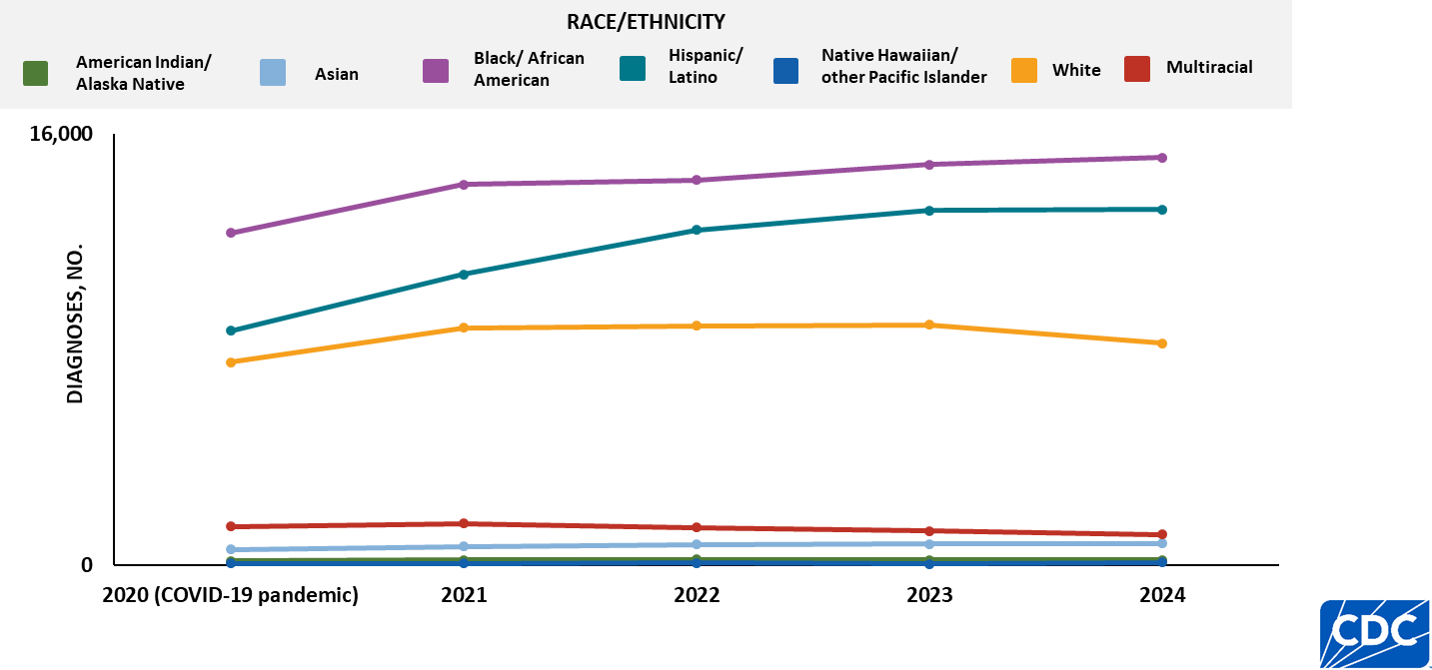
HIV diagnoses, by race/ethnicity, 2020–2024—United States and 7 territories and freely associated states
Note. Data are presented for persons aged ≥ 13 years at diagnosis. Persons who did not report Hispanic or Latino ethnicity were categorized by race. Hispanic/Latino persons can be of any race.
Notes:
Key findings
From 2020–2024, in the United States and 7 territories and freely associated states, the highest numbers of HIV diagnoses among persons aged ≥ 13 years by race/ethnicity were among:
Black/African American persons
Hispanic/Latino persons
Data notes and sources
The 2024 HIV Surveillance Data Release marks the first inclusion of data from the Republic of the Marshall Islands in numbers and rates of HIV diagnoses, deaths, and persons living with diagnosed HIV.
The data for 2020, which coincided with the onset of the COVID-19 pandemic, should be interpreted with caution. The pandemic substantially affected access to HIV testing, care, and related services, as well as case surveillance activities in state and local jurisdictions. Because these disruptions extended beyond 2020, readers should also consider the potential influence of COVID-19 on HIV data for subsequent years.
For additional data, see Tables 3b in the 2024 HIV Surveillance Data Release.
Use caution when interpreting data for American Indian/Alaska Native and Native Hawaiian/other Pacific Islander persons due to small numbers.
For more information on data sources, data collection and reporting practices, and case definitions, see the National HIV Surveillance System (NHSS) Technical Notes, available at https://www.cdc.gov/hiv-data/nhss/index.html.
Data for all figures are available in the 2024 HIV Surveillance Data Release tables or NCHHSTP AtlasPlus.

Slide 13
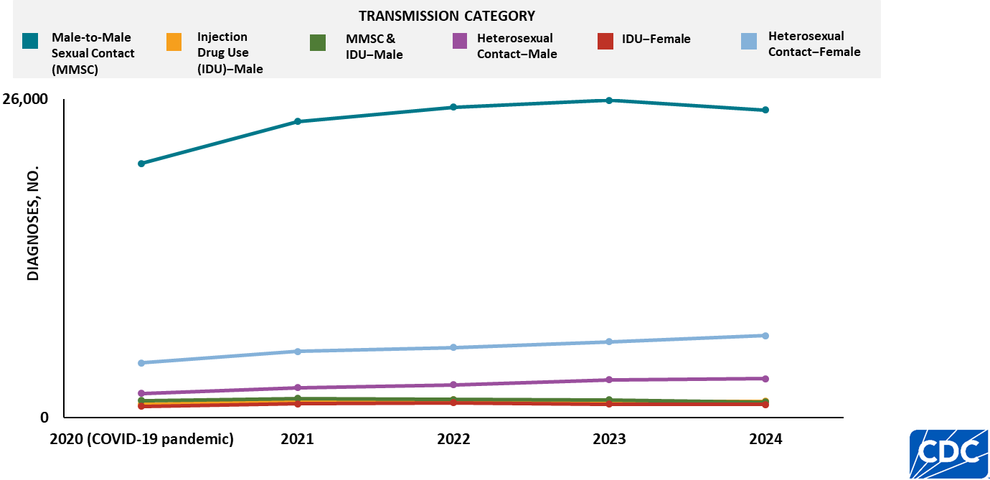
HIV diagnoses, by transmission category and sex, 2020–2024—United States and 7 territories and freely associated states
Note. Data are presented for persons aged ≥ 13 years at diagnosis.
Notes:
Key findings
From 2020–2024, in the United States and 7 territories and freely associated states, the highest numbers of HIV diagnoses among persons aged ≥ 13 years by transmission category and sex was among:
Male-to-male sexual contact (MMSC)
Data notes and sources
The 2024 HIV Surveillance Data Release marks the first inclusion of data from the Republic of the Marshall Islands in numbers and rates of HIV diagnoses, deaths, and persons living with diagnosed HIV.
The data for 2020, which coincided with the onset of the COVID-19 pandemic, should be interpreted with caution. The pandemic substantially affected access to HIV testing, care, and related services, as well as case surveillance activities in state and local jurisdictions. Because these disruptions extended beyond 2020, readers should also consider the potential influence of COVID-19 on HIV data for subsequent years.
For additional data, see Table 1b in the 2024 HIV Surveillance Data Release.
Data have been statistically adjusted to account for missing transmission category.
For more information on data sources, data collection and reporting practices, and case definitions, see the National HIV Surveillance System (NHSS) Technical Notes, available at https://www.cdc.gov/hiv-data/nhss/index.html.
Data for all figures are available in the 2024 HIV Surveillance Data Release tables or NCHHSTP AtlasPlus.

Slide 14
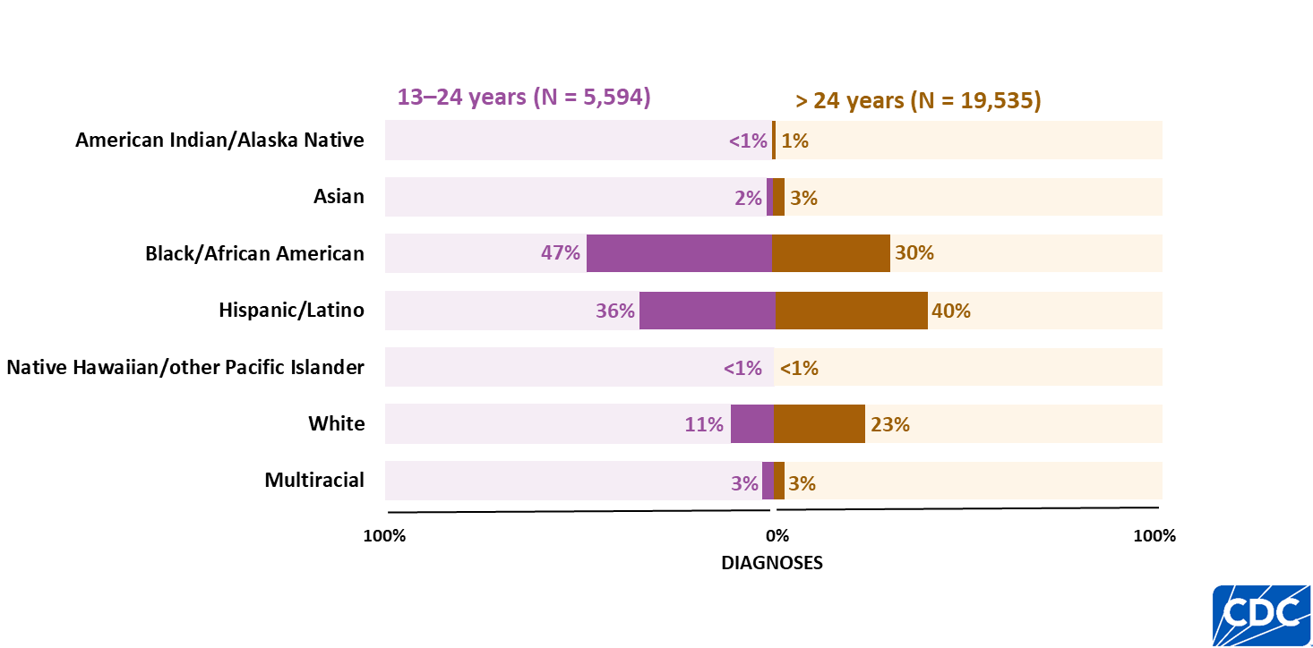
HIV diagnoses among males, attributed to male-to-male sexual contact, by race/ethnicity and age, 2024—United States and 7 territories and freely associated states
Note. Persons who did not report Hispanic or Latino ethnicity were categorized by race. Hispanic/Latino persons can be of any race.
Notes:
Key findings
In 2024, in the United States and 7 territories and freely associated states, the highest percentages of HIV diagnoses among males aged ≥ 13 years with HIV attributed to male-to-male sexual contact by age and race/ethnicity were as follows:
Aged 13–24 years—Black/African American males (47%)
Aged > 24 years—Hispanic/Latino males (40%)
Data notes and sources
The 2024 HIV Surveillance Data Release marks the first inclusion of data from the Republic of the Marshall Islands in numbers and rates of HIV diagnoses, deaths, and persons living with diagnosed HIV.
For additional data, see Table 4b in the 2024 HIV Surveillance Data Release.
Use caution when interpreting data for American Indian/Alaska Native and Native Hawaiian/other Pacific Islander persons due to small numbers
Data have been statistically adjusted to account for missing transmission category.
For more information on data sources, data collection and reporting practices, and case definitions, see the National HIV Surveillance System (NHSS) Technical Notes, available at https://www.cdc.gov/hiv-data/nhss/index.html.
Data for all figures are available in the 2024 HIV Surveillance Data Release tables or NCHHSTP AtlasPlus.

Slide 15
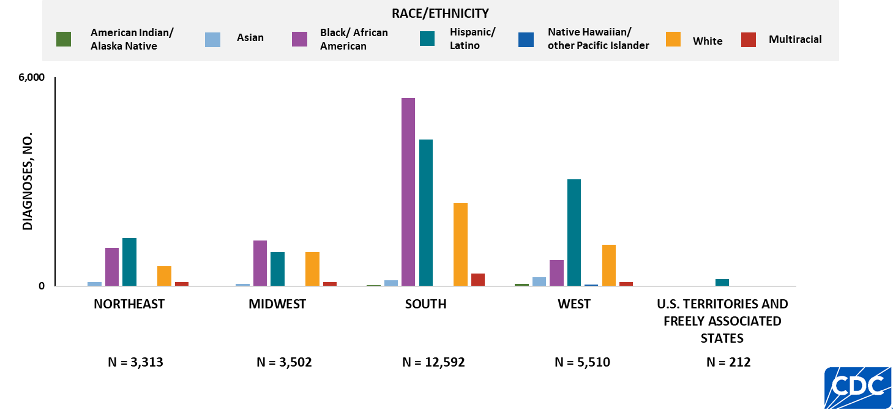
HIV diagnoses among males, attributed to male-to-male sexual contact, by region and race/ethnicity, 2024—United States and 7 territories and freely associated states
Note. Data are presented for persons aged ≥ 13 years at diagnosis. Persons who did not report Hispanic or Latino ethnicity were categorized by race. Hispanic/Latino persons can be of any race.
Notes:
Key findings
In 2024, in the United States and 7 territories and freely associated states, the highest numbers of HIV diagnoses among males aged ≥ 13 years with HIV attributed to male-to-male sexual contact by region and race/ethnicity were as follows:
Northeast—Hispanic/Latino males (1,382)
Midwest—Black/African American males (1,321)
South—Black/African American males (5,407)
West—Hispanic/Latino males (3,076)
U.S. territories and freely associated states—Hispanic/Latino males (203)
Data notes and sources
The 2024 HIV Surveillance Data Release marks the first inclusion of data from the Republic of the Marshall Islands in numbers and rates of HIV diagnoses, deaths, and persons living with diagnosed HIV.
For additional data, see Table 4b in the 2024 HIV Surveillance Data Release.
Use caution when interpreting data for American Indian/Alaska Native and Native Hawaiian/other Pacific Islander persons due to small numbers.
Data have been statistically adjusted to account for missing transmission category.
For more information on data sources, data collection and reporting practices, and case definitions, see the National HIV Surveillance System (NHSS) Technical Notes, available at https://www.cdc.gov/hiv-data/nhss/index.html.
Data for all figures are available in the 2024 HIV Surveillance Data Release tables or NCHHSTP AtlasPlus.

Slide 16
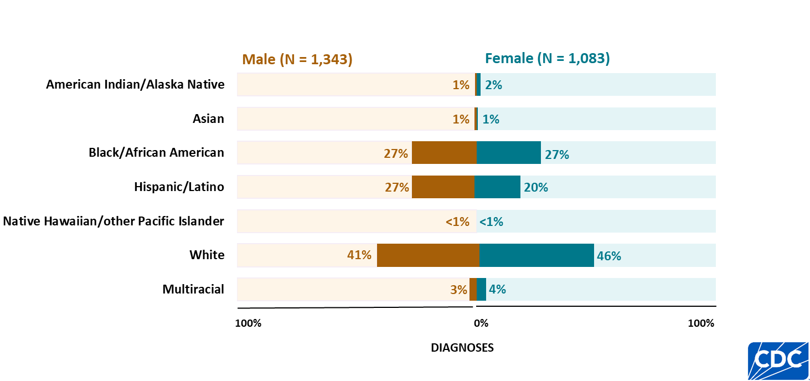
HIV diagnoses attributed to injection drug use, by race/ethnicity and sex, 2024—United States and 7 territories and freely associated states
Note. Data are presented for persons aged ≥ 13 years at diagnosis. Persons who did not report Hispanic or Latino ethnicity were categorized by race. Hispanic/Latino persons can be of any race.
Notes:
Key findings
In 2024, in the United States and 7 territories and freely associated states among persons aged ≥ 13 years, the highest percentages of HIV diagnoses attributed to injection drug use by race/ethnicity and sex were as follows:
Male—White persons (41%)
Female—White persons (46%)
Data notes and sources
The 2024 HIV Surveillance Data Release marks the first inclusion of data from the Republic of the Marshall Islands in numbers and rates of HIV diagnoses, deaths, and persons living with diagnosed HIV.
For additional data, see Table 5b in the 2024 HIV Surveillance Data Release.
Use caution when interpreting data for American Indian/Alaska Native and Native Hawaiian/other Pacific Islander persons due to small numbers.
Data have been statistically adjusted to account for missing transmission category.
For more information on data sources, data collection and reporting practices, and case definitions, see the National HIV Surveillance System (NHSS) Technical Notes, available at https://www.cdc.gov/hiv-data/nhss/index.html.
Data for all figures are available in the 2024 HIV Surveillance Data Release tables or NCHHSTP AtlasPlus.

Slide 17
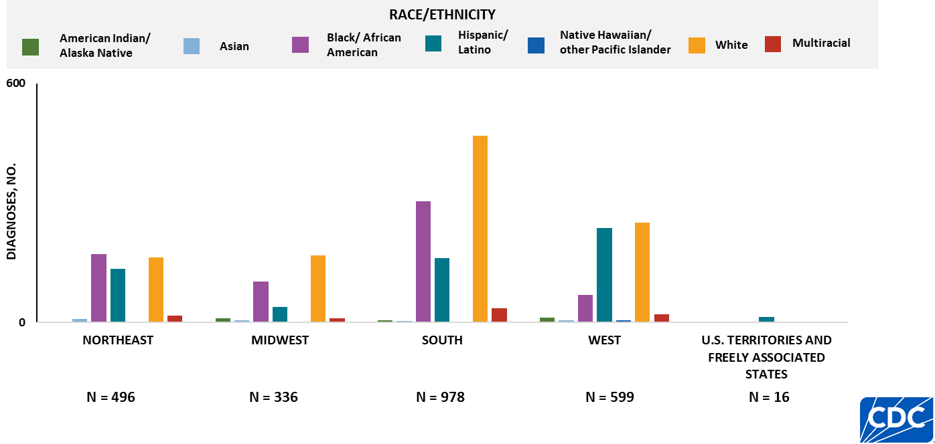
HIV diagnoses attributed to injection drug use, by region and race/ethnicity, 2024—United States and 7 territories and freely associated states
Note. Data are presented for persons aged ≥ 13 years at diagnosis. Persons who did not report Hispanic or Latino ethnicity were categorized by race. Hispanic/Latino persons can be of any race.
Notes:
Key findings
In 2024, in the United States and 7 territories and freely associated states among persons aged ≥ 13 years, the highest numbers of HIV diagnoses attributed to injection drug use by region and race/ethnicity were as follows:
Northeast—Black/African American persons (172)
Midwest—White persons (168)
South—White persons (469)
West—White persons (250)
U.S. territories and freely associated states—Hispanic/Latino persons (14)
Data notes and sources
The 2024 HIV Surveillance Data Release marks the first inclusion of data from the Republic of the Marshall Islands in numbers and rates of HIV diagnoses, deaths, and persons living with diagnosed HIV.
For additional data, see Table 5b in the 2024 HIV Surveillance Data Release.
Use caution when interpreting data for American Indian/Alaska Native, Asian, and Native Hawaiian/other Pacific Islander persons due to small numbers.
Data have been statistically adjusted to account for missing transmission category.
For more information on data sources, data collection and reporting practices, and case definitions, see the National HIV Surveillance System (NHSS) Technical Notes, available at https://www.cdc.gov/hiv-data/nhss/index.html.
Data for all figures are available in the 2024 HIV Surveillance Data Release tables or NCHHSTP AtlasPlus.

Slide 18
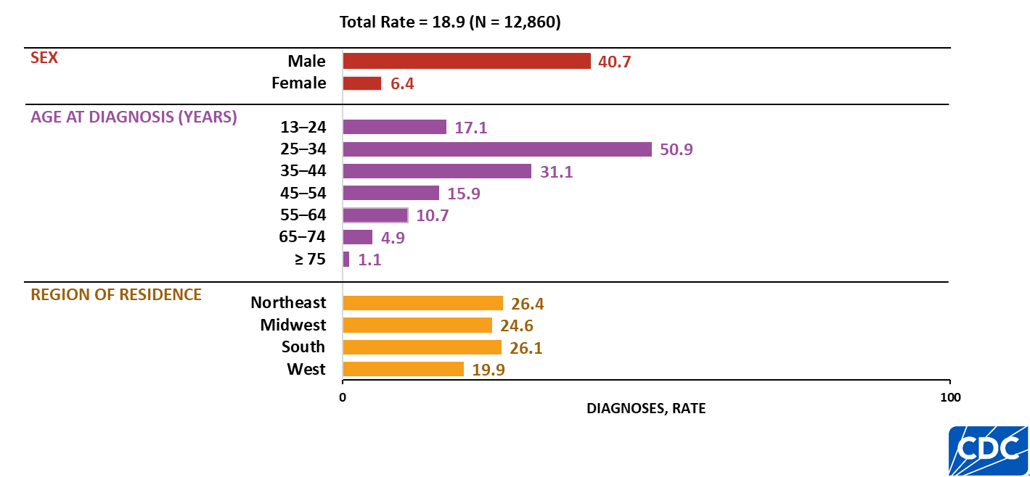
HIV diagnoses rates among Hispanic/Latino persons, by selected characteristics, 2024—United States
Note. Data are presented for persons aged ≥ 13 years at diagnosis. Rates are per 100,000. Persons who did not report Hispanic or Latino ethnicity were categorized by race. Hispanic/Latino persons can be of any race.
Notes:
Key findings
In 2024, in the United States, the highest rates of HIV diagnoses among Hispanic/Latino persons aged ≥ 13 years by sex, age group, and region were as follows:
Males (40.7)
Persons aged 25–34 years (50.9)
Persons residing in the Northeast (26.4)
Data notes and sources
Rates per 100,000 population were calculated for HIV diagnoses by dividing the number of diagnoses by the population for the calendar year and multiplying by 100,000. Population denominators were derived from vintage 2024 Census estimates for the 50 states, DC, and Puerto Rico, and from the U.S. Census Bureau’s International Database for American Samoa, the Commonwealth of the Northern Mariana Islands, Guam, the Republic of the Marshall Islands, the Republic of Palau, and the U.S. Virgin Islands.
For additional data, see NCHHSTP AtlasPlus.
For more information on data sources, data collection and reporting practices, and case definitions, see the National HIV Surveillance System (NHSS) Technical Notes, available at https://www.cdc.gov/hiv-data/nhss/index.html.
Data for all figures are available in the 2024 HIV Surveillance Data Release tables or NCHHSTP AtlasPlus.

Slide 19
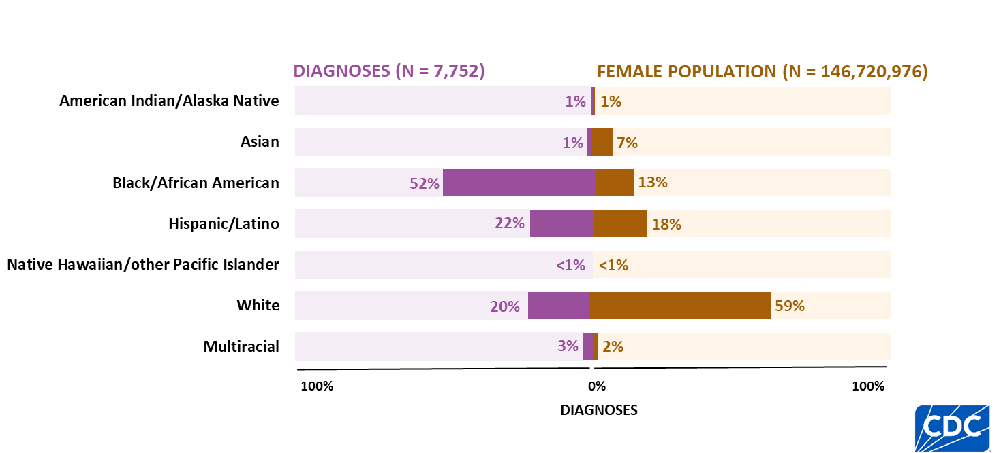
HIV diagnoses and population among females, by race/ethnicity, 2024—United States
Note. Data are presented for persons aged ≥ 13 years at diagnosis. Persons who did not report Hispanic or Latino ethnicity were categorized by race. Hispanic/Latino persons can be of any race.
Notes:
Key findings
In 2024, in the United States, the highest percentage of HIV diagnoses among females aged ≥ 13 years by race/ethnicity and U.S. population was among Black/African American females who accounted for more than half (52%) of HIV diagnoses but accounted for 13% of the female population.
Data notes and sources
For additional data, see NCHHSTP AtlasPlus.
Use caution when interpreting data for American Indian/Alaska Native and Native Hawaiian/other Pacific Islander females due to small numbers.
Population denominators used to calculate rates for the United States are based on the U.S. Census Bureau’s 2024 Vintage postcensal estimates.
For more information on data sources, data collection and reporting practices, and case definitions, see the National HIV Surveillance System (NHSS) Technical Notes, available at https://www.cdc.gov/hiv-data/nhss/index.html.
Data for all figures are available in the 2024 HIV Surveillance Data Release tables or NCHHSTP AtlasPlus.

Slide 20
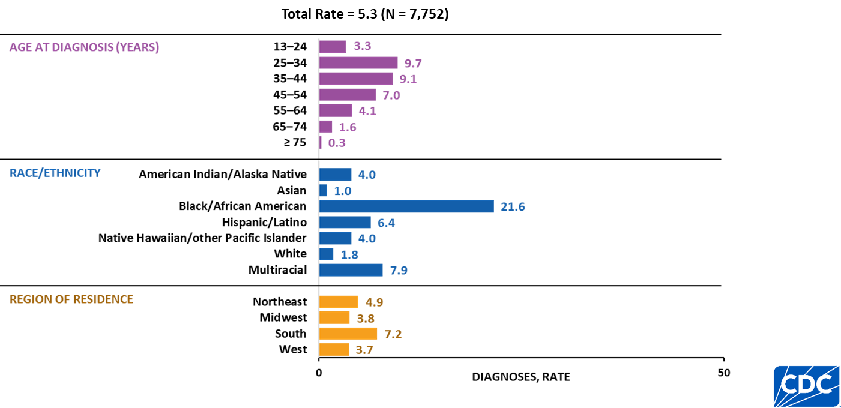
HIV diagnoses rates among females, by selected characteristics, 2024—United States
Note. Data are presented for persons aged ≥ 13 years at diagnosis. Rates are per 100,000. Persons who did not report Hispanic or Latino ethnicity were categorized by race. Hispanic/Latino persons can be of any race.
Notes:
Key findings
In 2024, in the United States, the highest rates of HIV diagnoses among females aged ≥ 13 years by age group, race/ethnicity, and region of residence were as follows:
Females aged 25–34 years (9.7)
Black/African American females (21.6)
Females residing in the South (7.2)
Data notes and sources
Rates per 100,000 population were calculated for HIV diagnoses by dividing the number of diagnoses by the population for the calendar year and multiplying by 100,000. Population denominators were derived from vintage 2024 Census estimates for the 50 states, DC, and Puerto Rico, and from the U.S. Census Bureau’s International Database for American Samoa, the Commonwealth of the Northern Mariana Islands, Guam, the Republic of the Marshall Islands, the Republic of Palau, and the U.S. Virgin Islands.
For additional data, see NCHHSTP AtlasPlus.
Use caution when interpreting data for American Indian/Alaska Native and Native Hawaiian/other Pacific Islander females due to small numbers.
For more information on data sources, data collection and reporting practices, and case definitions, see the National HIV Surveillance System (NHSS) Technical Notes, available at https://www.cdc.gov/hiv-data/nhss/index.html.
Data for all figures are available in the 2024 HIV Surveillance Data Release tables or NCHHSTP AtlasPlus.

Slide 21
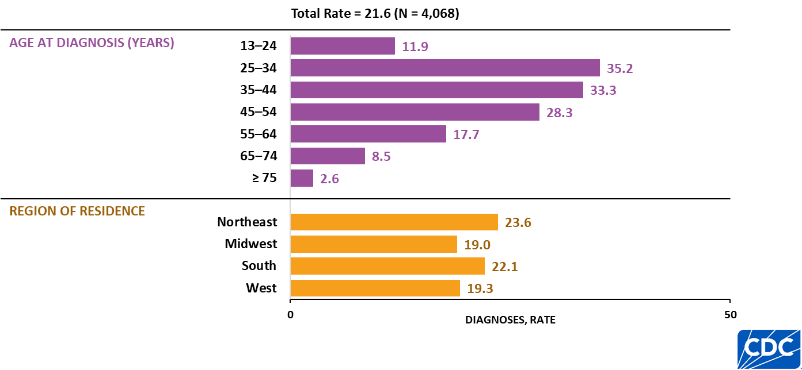
HIV diagnoses rates among Black females, by selected characteristics, 2024—United States
Note. Data are presented for persons aged ≥ 13 years at diagnosis. Rates are per 100,000.
Notes:
Key findings
In 2024, in the United States, the highest rates of HIV diagnoses among Black/African American females aged ≥ 13 years by age group and region were as follows:
Females aged 25–34 years (35.2)
Females residing in the Northeast (23.6)
Data notes and sources
Rates per 100,000 population were calculated for HIV diagnoses by dividing the number of diagnoses by the population for the calendar year and multiplying by 100,000. Population denominators were derived from vintage 2024 Census estimates for the 50 states, DC, and Puerto Rico, and from the U.S. Census Bureau’s International Database for American Samoa, the Commonwealth of the Northern Mariana Islands, Guam, the Republic of the Marshall Islands, the Republic of Palau, and the U.S. Virgin Islands.
For additional data, see NCHHSTP AtlasPlus.
For more information on data sources, data collection and reporting practices, and case definitions, see the National HIV Surveillance System (NHSS) Technical Notes, available at https://www.cdc.gov/hiv-data/nhss/index.html.
Data for all figures are available in the 2024 HIV Surveillance Data Release tables or NCHHSTP AtlasPlus.

Slide 22
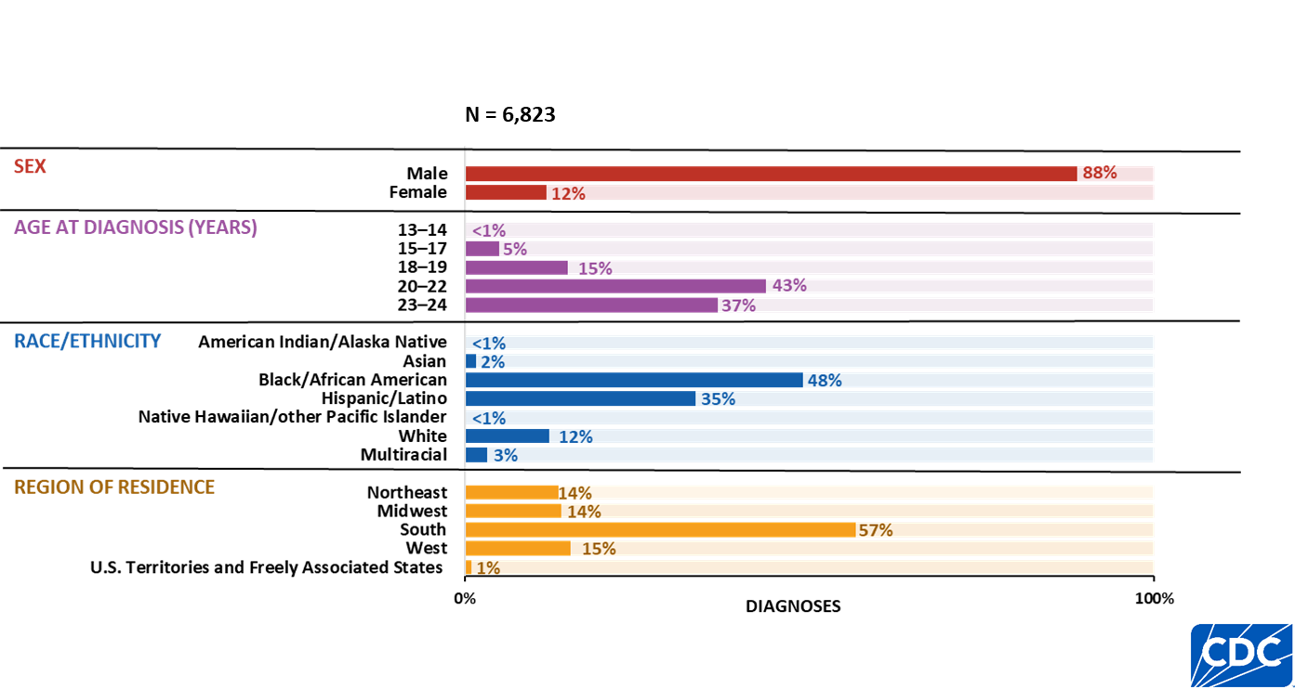
HIV diagnoses among persons aged 13–24 years, by selected characteristics, 2024—United States and 7 territories and freely associated states
Note. Persons who did not report Hispanic or Latino ethnicity were categorized by race. Hispanic/Latino persons can be of any race.
Notes:
Key findings
In 2024, in the United States and 7 territories and freely associated states, the highest percentages of HIV diagnoses among persons aged 13–24 years by sex, age group, race/ethnicity, and region were as follows:
Males (6,015; 88%)
20–22 years (2,929; 43%)
Black/African American persons (3,291; 48%)
Persons residing in the South (3,892; 57%)
Data notes and sources
The 2024 HIV Surveillance Report marks the first inclusion of data from the Republic of the Marshall Islands in numbers and rates of HIV diagnoses, deaths, and persons living with diagnosed HIV.
For additional data, see Table 7b in the 2024 HIV Surveillance Data Release.
Use caution when interpreting data for American Indian/Alaska Native, and Native Hawaiian/other Pacific Islander persons due to small numbers.
For more information on data sources, data collection and reporting practices, and case definitions, see the National HIV Surveillance System (NHSS) Technical Notes, available at https://www.cdc.gov/hiv-data/nhss/index.html.
Data for all figures are available in the 2024 HIV Surveillance Data Release tables or NCHHSTP AtlasPlus.

Slide 23
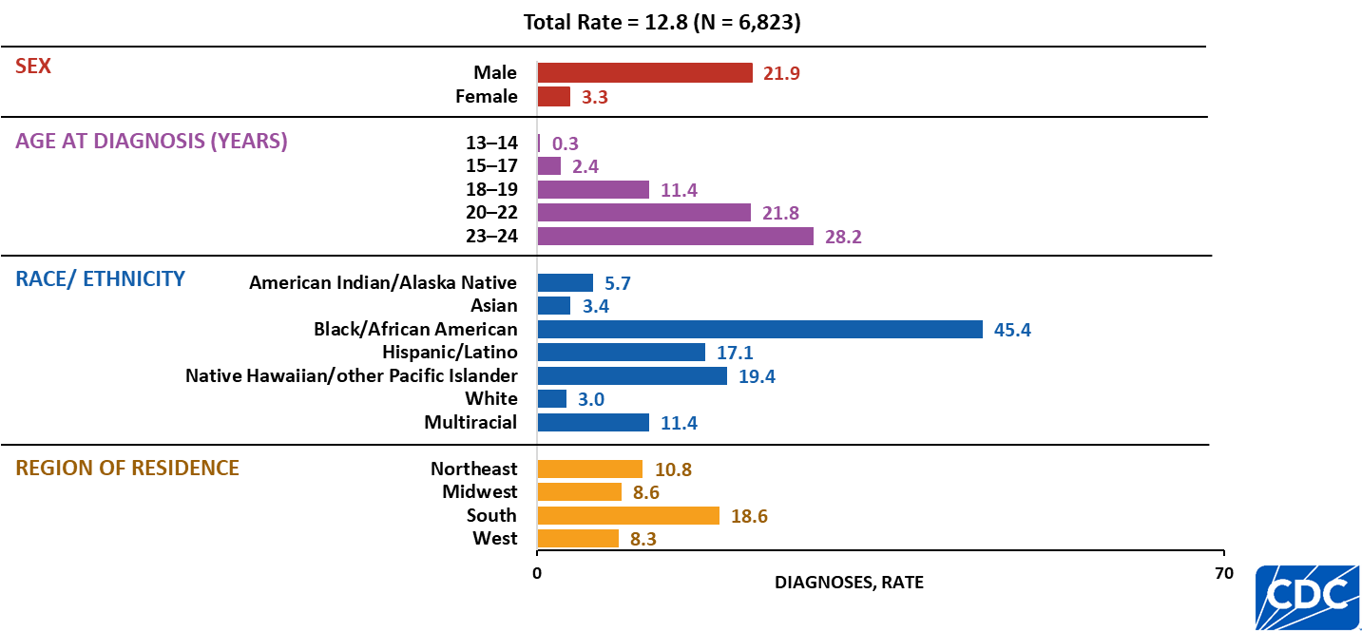
HIV diagnoses rates among persons aged 13–24 years, 2024—United States
Note. Rates are per 100,000. Persons who did not report Hispanic or Latino ethnicity were categorized by race. Hispanic/Latino persons can be of any race.
Notes:
Key findings
In 2024, in the United States, HIV diagnoses among persons aged 13–24 years by sex, age at diagnosis, race/ethnicity, and region were as follows:
Males (21.9)
Persons aged 23–24 years (28.2)
Black/African American persons (45.4)
Persons residing in the South (18.6)
Data notes and sources
Rates per 100,000 population were calculated for HIV diagnoses by dividing the number of diagnoses by the population for the calendar year and multiplying by 100,000. Population denominators were derived from vintage 2024 Census estimates for the 50 states, DC, and Puerto Rico, and from the U.S. Census Bureau’s International Database for American Samoa, the Commonwealth of the Northern Mariana Islands, Guam, the Republic of the Marshall Islands, the Republic of Palau, and the U.S. Virgin Islands.
For additional data, see Table 7a in the 2024 HIV Surveillance Data Release at https://www.cdc.gov/hiv-data/nhss/hiv-diagnoses-deaths-prevalence.html.
Use caution when interpreting data for American Indian/Alaska Native, and Native Hawaiian/other Pacific Islander persons due to small numbers.
For more information on data sources, data collection and reporting practices, and case definitions, see the National HIV Surveillance System (NHSS) Technical Notes, available at https://www.cdc.gov/hiv-data/nhss/index.html.
Data for all figures are available in the 2024 HIV Surveillance Data Release tables or NCHHSTP AtlasPlus.

Slide 24
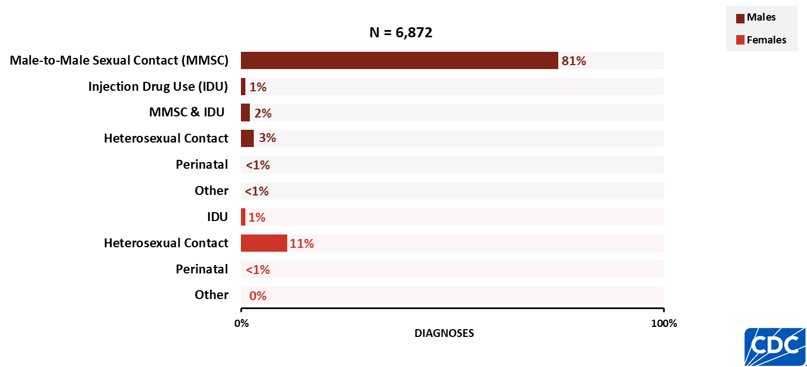
HIV diagnoses among persons aged 13–24 years, by transmission category and sex, 2024—United States and 7 territories and freely associated states
Notes:
Key findings
In 2024, in the United States and 7 territories and freely associated states, the highest percentages of HIV diagnoses among persons aged 13–24 years by sex and transmission category and sex were as follows:
Male—male-to-male sexual contact (5,594; 81%)
Female—heterosexual contact (760; 11%)
Data notes and sources
The 2024 HIV Surveillance Data Release marks the first inclusion of data from the Republic of the Marshall Islands in numbers and rates of HIV diagnoses, deaths, and persons living with diagnosed HIV.
For additional data, see Table 7b in the 2024 HIV Surveillance Data Release.
Data have been statistically adjusted to account for missing transmission category.
For more information on data sources, data collection and reporting practices, and case definitions, see the National HIV Surveillance System (NHSS) Technical Notes, available at https://www.cdc.gov/hiv-data/nhss/index.html.
Data for all figures are available in the 2024 HIV Surveillance Data Release tables or NCHHSTP AtlasPlus.

Slide 25
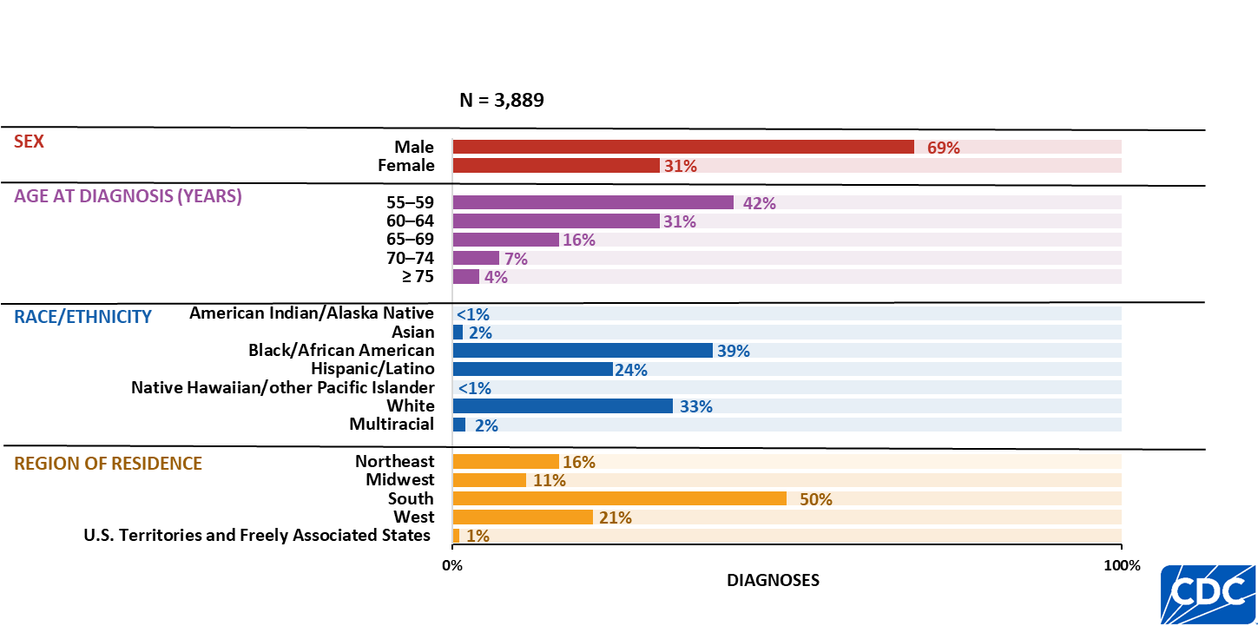
HIV diagnoses among persons aged ≥ 55 years, by selected characteristics, 2024—United States and 7 territories and freely associated states
Note. Persons who did not report Hispanic or Latino ethnicity were categorized by race. Hispanic/Latino persons can be of any race.
Notes:
Key findings
In 2024, in the United States and 7 territories and freely associated states, the highest percentages of HIV diagnoses among persons aged ≥ 55 years by sex, age group, race/ethnicity, and region were as follows:
Males (2,666; 69%)
55–59 years (1,647; 42%)
Black/African American persons (1,512; 39%)
Persons residing in the South (1,936; 50%)
Data notes and sources
The 2024 HIV Surveillance Data Release marks the first inclusion of data from the Republic of the Marshall Islands in numbers and rates of HIV diagnoses, deaths, and persons living with diagnosed HIV.
For additional data, see NCHHSTP AtlasPlus.
Use caution when interpreting data for American Indian/Alaska Native and Native Hawaiian/other Pacific Islander persons due to small numbers.
For more information on data sources, data collection and reporting practices, and case definitions, see the National HIV Surveillance System (NHSS) Technical Notes, available at https://www.cdc.gov/hiv-data/nhss/index.html.
Data for all figures are available in the 2024 HIV Surveillance Data Release tables or NCHHSTP AtlasPlus.

Slide 26
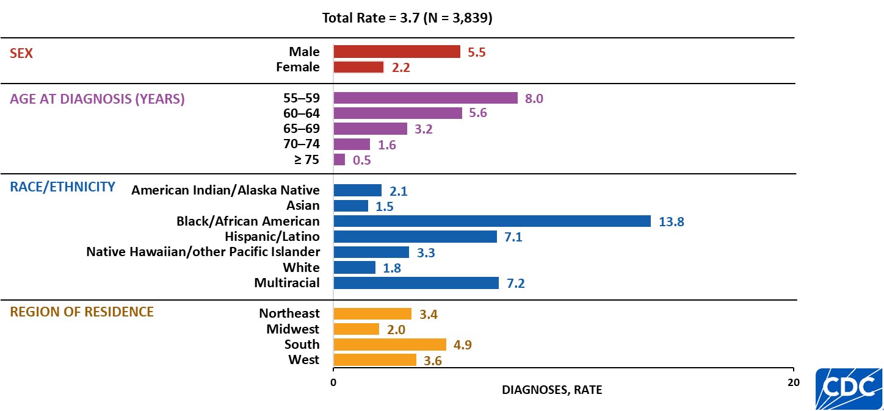
HIV diagnoses rates among persons aged ≥ 55 years, by selected characteristics, 2024—United States
Note. Rates are per 100,000. Persons who did not report Hispanic or Latino ethnicity were categorized by race. Hispanic/Latino persons can be of any race.
Notes:
Key findings
In 2024, in the United States, the highest rates of HIV diagnoses among persons aged ≥ 55 years by sex, age group, race/ethnicity, and region were as follows:
Males (5.5)
Persons aged 55–59 years (8.0)
Black/African American persons (13.8)
Persons residing in the South (4.9)
Data notes and sources
Rates per 100,000 population were calculated for HIV diagnoses by dividing the number of diagnoses by the population for the calendar year and multiplying by 100,000. Population denominators were derived from vintage 2024 Census estimates for the 50 states, DC, and Puerto Rico, and from the U.S. Census Bureau’s International Database for American Samoa, the Commonwealth of the Northern Mariana Islands, Guam, the Republic of the Marshall Islands, the Republic of Palau, and the U.S. Virgin Islands.
For additional data, see NCHHSTP AtlasPlus.
Use caution when interpreting data for American Indian/Alaska Native and Native Hawaiian/other Pacific Islander persons due to small numbers.
For more information on data sources, data collection and reporting practices, and case definitions, see the National HIV Surveillance System (NHSS) Technical Notes, available at https://www.cdc.gov/hiv-data/nhss/index.html.
Data for all figures are available in the 2024 HIV Surveillance Data Release tables or NCHHSTP AtlasPlus.

Slide 27
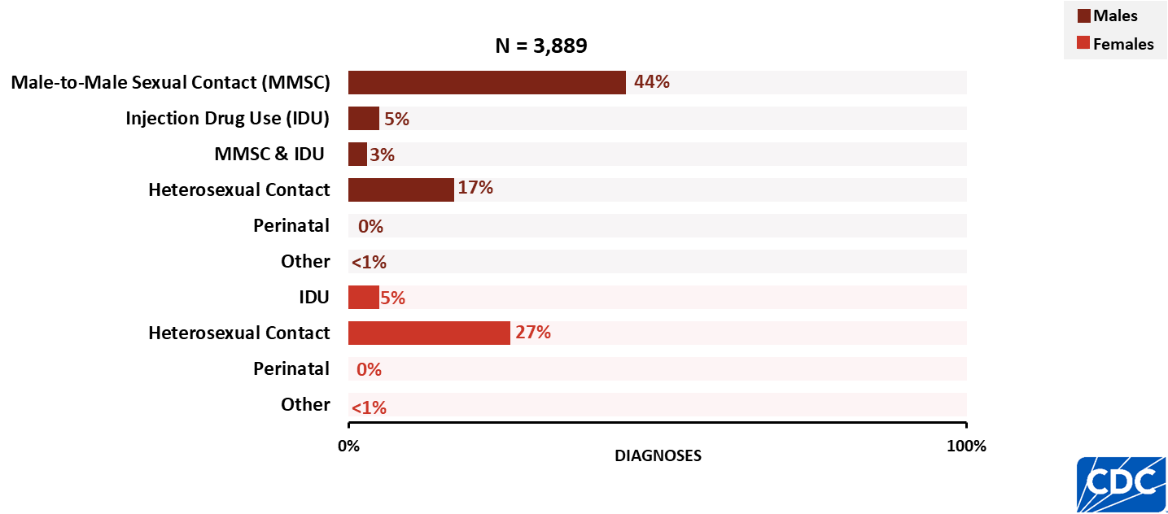
HIV diagnoses among persons aged ≥ 55 years, by transmission category and sex, 2024—United States and 7 territories and freely associated states
Notes:
Key findings
In 2024, in the United States and 7 territories and freely associated states, the highest numbers and percentages of HIV diagnoses among persons aged ≥ 55 years by transmission category and sex were as follows:
Male—male-to-male sexual contact (1,698; 44%)
Female—heterosexual contact (1,045; 27%)
Data notes and sources
The 2024 HIV Surveillance Report marks the first inclusion of data from the Republic of the Marshall Islands in numbers and rates of HIV diagnoses, deaths, and persons living with diagnosed HIV.
For additional data, see NCHHSTP AtlasPlus.
Data have been statistically adjusted to account for missing transmission category.
For more information on data sources, data collection and reporting practices, and case definitions, see the National HIV Surveillance System (NHSS) Technical Notes, available at https://www.cdc.gov/hiv-data/nhss/index.html.
Data for all figures are available in the 2024 HIV Surveillance Data Release tables or NCHHSTP AtlasPlus.

Slide 28
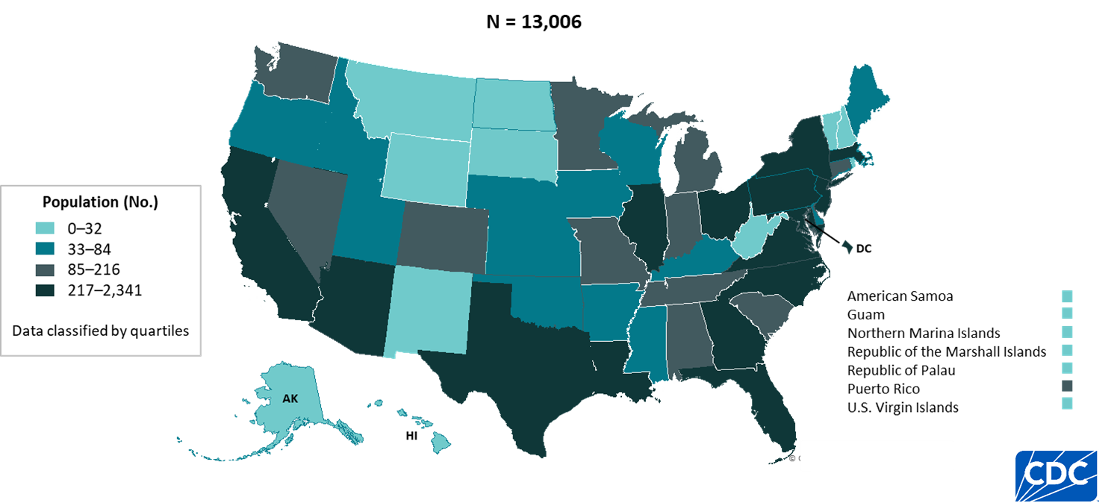
Persons living with diagnosed perinatally acquired HIV, year-end 2024—United States and 7 territories and freely associated states
Note. Prevalence data should be interpreted with caution due to use of preliminary death data for the year 2024 reported to CDC as of December 2025.
Notes:
Key findings
At year-end 2024, in the United States and 7 territories and freely associated states, the highest numbers of persons living with perinatally acquired HIV by area of residence were as follows:
New York (2,341), Florida (1,535), Texas (863), California (742), and Pennsylvania (591)
Data notes and sources
The 2024 HIV Surveillance Report marks the first inclusion of data from the Republic of the Marshall Islands in numbers and rates of HIV diagnoses, deaths, and persons living with diagnosed HIV.
For additional data, see Table 13b in the 2024 HIV Surveillance Data Release.
Data reflects persons (i.e., children, adolescents, and adults) with diagnosed, perinatally acquired HIV who were alive at year-end 2024, regardless of their age at year-end 2024.
For more information on data sources, data collection and reporting practices, and case definitions, see the National HIV Surveillance System (NHSS) Technical Notes, available at https://www.cdc.gov/hiv-data/nhss/index.html.
Data for all figures are available in the 2024 HIV Surveillance Data Release tables.

Slide 29
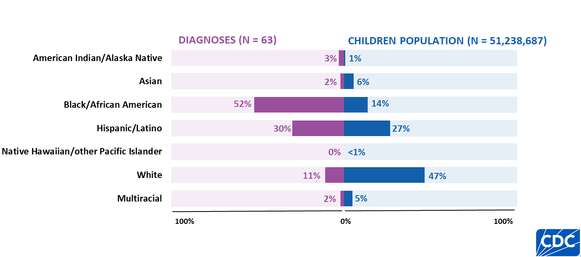
HIV diagnoses and population among children aged < 13 years, by race/ethnicity, 2024—United States
Note. Persons who did not report Hispanic or Latino ethnicity were categorized by race. Hispanic/Latino persons can be of any race.
Notes:
Key findings
In 2024, in the United States, the highest percentage of HIV diagnoses among children aged <13 years was among Black/African American children who accounted for 52% of HIV diagnoses but 14% of the children population.
Data notes and sources
For additional data, see Table 2a in the 2024 HIV Surveillance Data Release.
Use caution when interpreting data for American Indian/Alaska Native and Native Hawaiian/other Pacific Islander persons due to small numbers.
Population denominators used to calculate rates for the United States are based on the U.S. Census Bureau’s 2024 Vintage postcensal estimates.
For more information on data sources, data collection and reporting practices, and case definitions, see the National HIV Surveillance System (NHSS) Technical Notes, available at https://www.cdc.gov/hiv-data/nhss/index.html.
Data for all figures are available in the 2024 HIV Surveillance Data Release tables or NCHHSTP AtlasPlus.

Slide 30
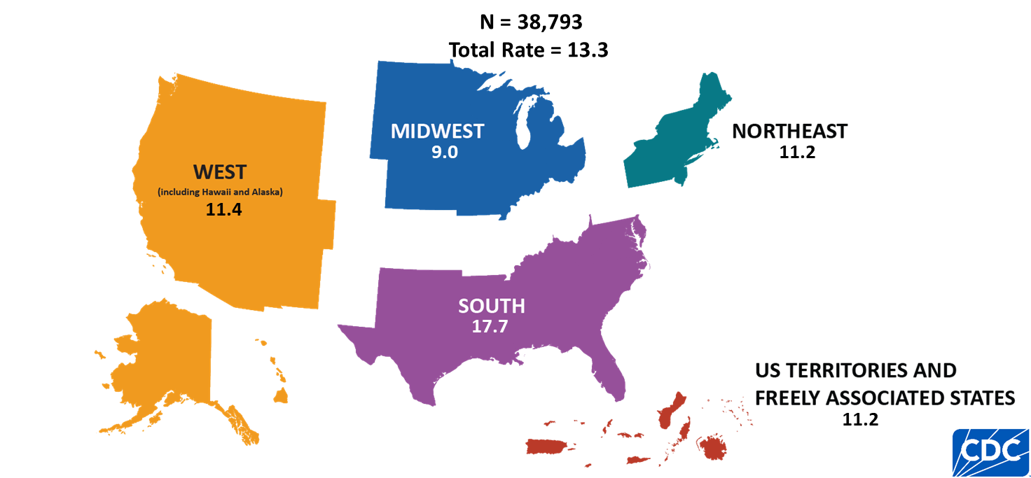
HIV diagnoses rates, by region, 2024—United States and 7 territories and freely associated states
Note. Rates are per 100,000. Data are presented for persons aged ≥ 13 years at diagnosis.
Notes:
Key findings
In 2024, among the four main regions in the United States (the Northeast, Midwest, South, and West) and 7 territories and freely associated states, the South had the highest rate (17.7) of HIV diagnoses among persons aged ≥ 13 years.
Data notes and sources
The 2024 HIV Surveillance Data Release marks the first inclusion of data from the Republic of the Marshall Islands in numbers and rates of HIV diagnoses, deaths, and persons living with diagnosed HIV.
Rates per 100,000 population were calculated for HIV diagnoses by dividing the number of diagnoses by the population for the calendar year and multiplying by 100,000. Population denominators were derived from vintage 2024 Census estimates for the 50 states, DC, and Puerto Rico, and from the U.S. Census Bureau’s International Database for American Samoa, the Commonwealth of the Northern Mariana Islands, Guam, the Republic of the Marshall Islands, the Republic of Palau, and the U.S. Virgin Islands.
For additional data, see Table 16 in the 2024 HIV Surveillance Data Release.
For more information on data sources, data collection and reporting practices, and case definitions, see the National HIV Surveillance System (NHSS) Technical Notes, available at https://www.cdc.gov/hiv-data/nhss/index.html.
Data for all figures are available in the 2024 HIV Surveillance Data Release tables or NCHHSTP AtlasPlus.

Slide 31
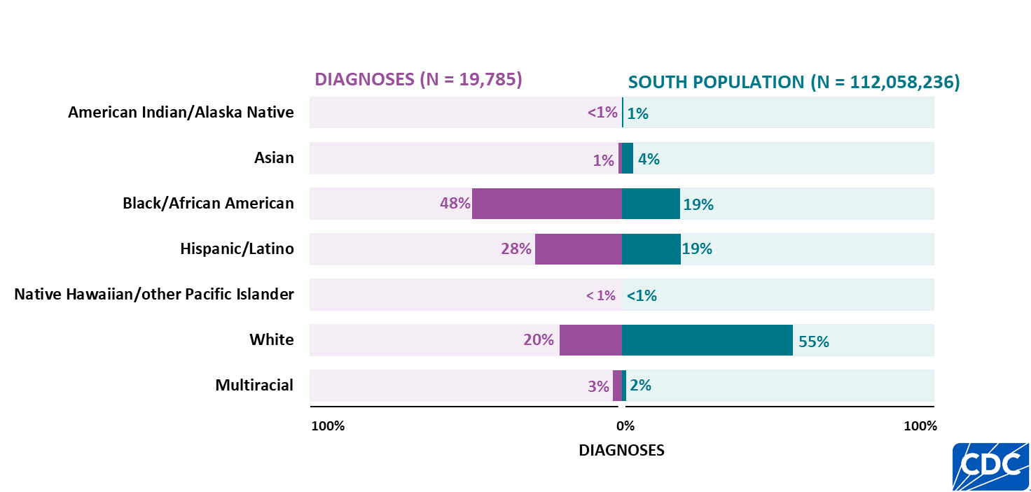
HIV diagnoses and population, by race/ethnicity, 2024—U.S. Southern Region
Note. Data are presented for persons aged ≥ 13 years at diagnosis. Persons who did not report Hispanic or Latino ethnicity were categorized by race. Hispanic/Latino persons can be of any race.
Notes:
Key findings
In 2024, in the U.S. Southern Region, the highest percentage of HIV diagnoses among persons aged ≥ 13 years was among Black/African American persons who accounted for 48% of HIV diagnoses but made up 19% of persons aged ≥ 13 years.
Data notes and sources
For additional data, see Table 3a in the 2024 HIV Surveillance Data Release.
Use caution when interpreting data for American Indian/Alaska Native and Native Hawaiian/other Pacific Islander persons as percentages are based on small numbers.
Population denominators used to calculate rates for the United States are based on the U.S. Census Bureau’s 2024 Vintage postcensal estimates.
For more information on data sources, data collection and reporting practices, and case definitions, see the National HIV Surveillance System (NHSS) Technical Notes, available at https://www.cdc.gov/hiv-data/nhss/index.html.
Data for all figures are available in the 2024 HIV Surveillance Data Release tables or NCHHSTP AtlasPlus.

Slide 32
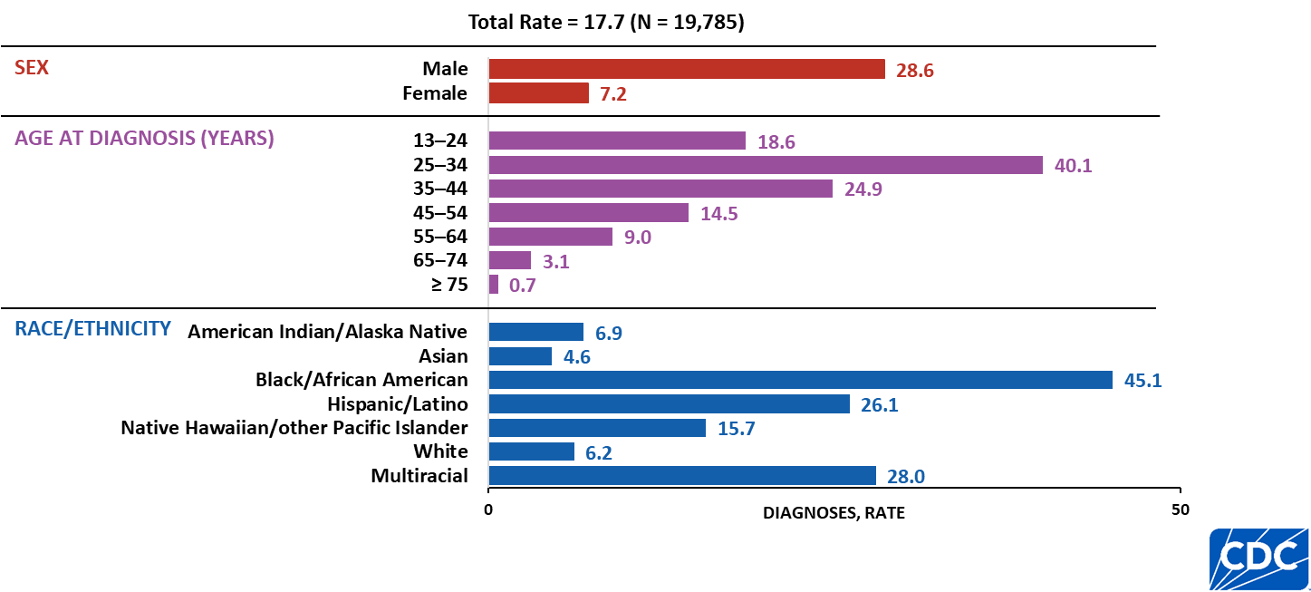
HIV diagnoses rates, by selected characteristics, 2024—U.S. Southern Region
Note. Data are presented for persons aged ≥ 13 years at diagnosis. Rates are per 100,000. Persons who did not report Hispanic or Latino ethnicity were categorized by race. Hispanic/Latino persons can be of any race.
Notes:
Key findings
In 2024, in the U.S. Southern Region, the highest rates of HIV diagnoses among persons aged ≥ 13 years by sex, age group, and race/ethnicity were as follows:
Males (28.6)
Persons aged 25–34 years (40.1)
Black/African American persons (45.1)
Data notes and sources
Rates per 100,000 population were calculated for HIV diagnoses by dividing the number of diagnoses by the population for the calendar year and multiplying by 100,000. Population denominators were derived from vintage 2024 Census estimates for the 50 states, DC, and Puerto Rico, and from the U.S. Census Bureau’s International Database for American Samoa, the Commonwealth of the Northern Mariana Islands, Guam, the Republic of the Marshall Islands, the Republic of Palau, and the U.S. Virgin Islands.
For additional data, see NCHHSTP AtlasPlus.
Use caution when interpreting data for American Indian/Alaska Native and Native Hawaiian/other Pacific Islander persons due to small numbers.
For more information on data sources, data collection and reporting practices, and case definitions, see the National HIV Surveillance System (NHSS) Technical Notes, available at https://www.cdc.gov/hiv-data/nhss/index.html.
Data for all figures are available in the 2024 HIV Surveillance Data Release tables or NCHHSTP AtlasPlus.

Slide 33
HIV Deaths
Notes:
Persons reported to NHSS are assumed alive unless their deaths have been reported to CDC.
Data for the most recent year should be interpreted with caution due to the use of preliminary death data that are based on a 12-month reporting delay to allow data to be reported to CDC. Data on deaths of persons with diagnosed HIV labeled as "any cause" may not be due to HIV and includes deaths with an unknown underlying cause.
Data on HIV-related deaths of persons with diagnosed HIV include deaths with an underlying cause with an International Classification of Diseases, Tenth Revision code of B20–B24, O98.7, or R75. Non–HIV-related deaths include all other deaths with a known underlying cause. HIV-related deaths and non–HIV-related deaths numbers and percentages exclude deaths with an unknown underlying cause.
Death data by region or area of residence is based on residence at death; when information on residence at death is not available, the state where a person's death occurred is used; when both residence at death and state where a person's death occurred are not available, the most recent known address on or before the date of death is used.
Rates per 100,000 population were calculated for deaths of persons with diagnosed HIV by dividing the number of deaths by the population for the calendar year and multiplying by 100,000. Population denominators were derived from vintage 2024 Census estimates for the 50 states, DC, and Puerto Rico, and from the U.S. Census Bureau’s International Database for American Samoa, the Commonwealth of the Northern Mariana Islands, Guam, the Republic of the Marshall Islands, the Republic of Palau, and the U.S. Virgin Islands.

Slide 34
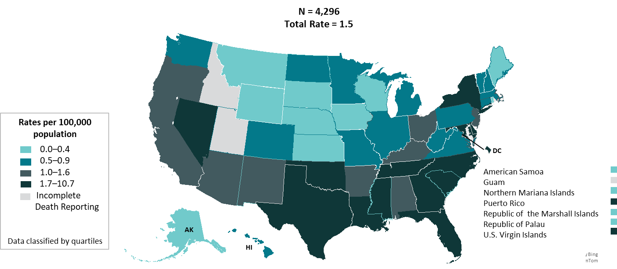

HIV-related death rates of persons with diagnosed HIV, 2024—United States and 7 territories and freely associated states
Note. Data are presented for persons aged ≥ 13 years at death. Rates are per 100,000. Deaths of persons with diagnosed HIV infection are based on residence at death.
Notes:
Key findings
In 2024, in the United States and 7 territories and freely associated states, the highest rates of HIV related deaths among persons aged ≥ 13 years with diagnosed HIV by residence at the time of death were as follows:
U.S. Virgin Islands (10.7), District of Columbia (7.8), Mississippi (3.3), Maryland (3.0), and Florida (2.8)
Data notes and sources
The 2024 HIV Surveillance Data Release marks the first inclusion of data from the Republic of the Marshall Islands in numbers and rates of HIV diagnoses, deaths, and persons living with diagnosed HIV.
Rates per 100,000 population were calculated for deaths of persons with diagnosed HIV by dividing the number of deaths by the population for the calendar year and multiplying by 100,000. Population denominators were derived from vintage 2024 Census estimates for the 50 states, DC, and Puerto Rico, and from the U.S. Census Bureau’s International Database for American Samoa, the Commonwealth of the Northern Mariana Islands, Guam, the Republic of the Marshall Islands, the Republic of Palau, and the U.S. Virgin Islands.
For additional data, see Table 9b in the 2024 HIV Surveillance Data Release.
HIV-related deaths include deaths with an underlying cause with an International Classification of Diseases, Tenth Revision code of B20–B24, O98.7, or R75. Data for the year 2023 are preliminary and based on death data received by CDC as of December 2025.
Use caution when comparing the rates of diagnoses for the U.S. Virgin Islands and District of Columbia to the rates for states due to the size of the populations.
For more information on data sources, data collection and reporting practices, and case definitions, see the National HIV Surveillance System (NHSS) Technical Notes, available at https://www.cdc.gov/hiv-data/nhss/index.html.
Data for all figures are available in the 2024 HIV Surveillance Data Release tables or NCHHSTP AtlasPlus.

Slide 35
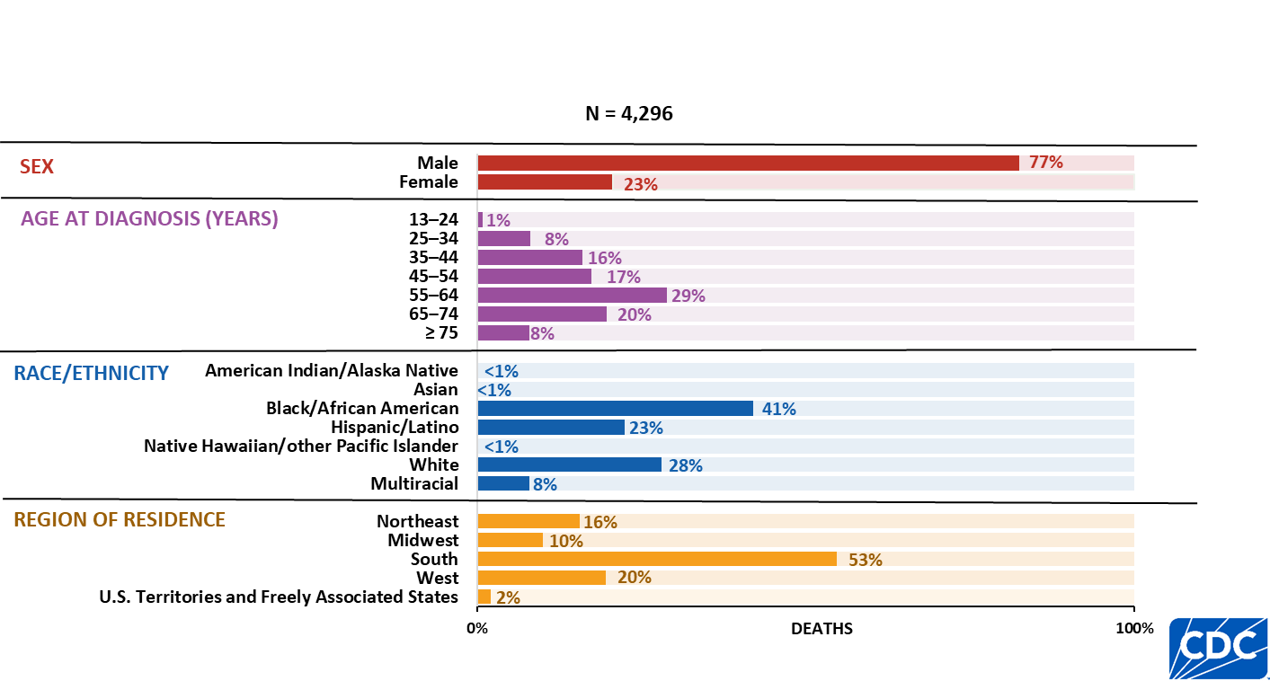
HIV-related deaths of persons with diagnosed HIV, by selected characteristics, 2024—United States and 7 territories and freely associated states
Note. Data are presented for persons aged ≥ 13 years at death. Persons who did not report Hispanic or Latino ethnicity were categorized by race. Hispanic/Latino persons can be of any race.
Notes:
Key findings
In 2024, in the United States and 7 territories and freely associated states, the highest numbers and percentages of HIV-related deaths of persons aged ≥ 13 years with diagnosed HIV by sex, age group, race/ethnicity, and region of residence at the time of death were as follows:
Males (3,306; 77%)
55–64 years (1,251; 29%)
Black/African American persons (1,741; 41%)
Persons residing in the South (2,261; 53%)
Data notes and sources
The 2024 HIV Surveillance Data Release marks the first inclusion of data from the Republic of the Marshall Islands in numbers and rates of HIV diagnoses, deaths, and persons living with diagnosed HIV.
For additional data, see Table 9b in the 2024 HIV Surveillance Data Release.
HIV-related deaths include deaths with an underlying cause with an International Classification of Diseases, Tenth Revision code of B20–B24, O98.7, or R75. Data for the year 2023 are preliminary and based on death data received by CDC as of December 2024.
Use caution when interpreting data for American Indian/Alaska Native, Asian, and Native Hawaiian/other Pacific Islander persons due to small numbers.
For more information on data sources, data collection and reporting practices, and case definitions, see the National HIV Surveillance System (NHSS) Technical Notes, available at https://www.cdc.gov/hiv-data/nhss/index.html.
Data for all figures are available in the 2024 HIV Surveillance Data Release tables or NCHHSTP AtlasPlus.

Slide 36
Persons Living with Diagnosed HIV (Diagnosed Prevalence)
Notes:
Prevalence data reflect persons living with diagnosed HIV, regardless of stage of disease, at the end of the most recent year.
Data for the most recent year should be interpreted with caution due to the use of preliminary death data that are based on a 12-month reporting delay to allow data to be reported to CDC.
For tables presenting prevalence data, region or area of residence is based on most recent known address at the end of the specified year.
Due to incomplete reporting of deaths for the most recent year, prevalence data for Guam, Idaho, and Utah should be interpreted with caution.
Rates per 100,000 population were calculated for persons living with diagnosed HIV by dividing the number living with diagnosed HIV by the population for the calendar year and multiplying by 100,000. Population denominators were derived from vintage 2024 Census estimates for the 50 states, DC, and Puerto Rico, and from the U.S. Census Bureau’s International Database for American Samoa, the Commonwealth of the Northern Mariana Islands, Guam, the Republic of the Marshall Islands, the Republic of Palau, and the U.S. Virgin Islands.

Slide 37
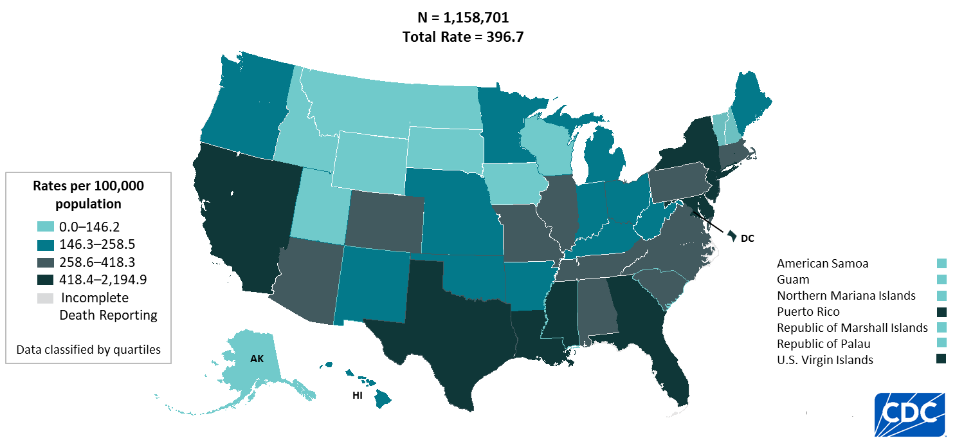
Persons living with diagnosed HIV (Prevalence), 2024—United States and 7 territories and freely associated states
Note. Data are presented for persons aged ≥ 13 years at year-end 2024. Prevalence data should be interpreted with caution due to use of preliminary death data for the year 2024 reported to CDC as of December 2025.
Notes:
Key findings
At year-end 2024, in the United States and 7 territories and freely associated states, the highest rates of persons aged ≥ 13 years living with diagnosed HIV by area of residence were as follows:
District of Columbia (2,194.9), U.S. Virgin Islands (832.0), New York (748.9), Georgia (671.4), Maryland (653.2), and Florida (624.8)
Data notes and sources
The 2024 HIV Surveillance Data Release marks the first inclusion of data from the Republic of the Marshall Islands in numbers and rates of HIV diagnoses, deaths, and persons living with diagnosed HIV.
Rates per 100,000 population were calculated for HIV persons living with diagnosed HIV by dividing the number living with diagnosed HIV by the population for the calendar year and multiplying by 100,000. Population denominators were derived from vintage 2024 Census estimates for the 50 states, DC, and Puerto Rico, and from the U.S. Census Bureau’s International Database for American Samoa, the Commonwealth of the Northern Mariana Islands, Guam, the Republic of the Marshall Islands, the Republic of Palau, and the U.S. Virgin Islands.
For additional data, see Table 12b in the 2024 HIV Surveillance Data Release.
Prevalence data for 2024 should be interpreted with caution due to the use of preliminary death data for that year reported to CDC as of December 2025.
Use caution when comparing the rates of diagnoses for the District of Columbia and U.S. Virgin Islands to the rates for states due to the size of the populations.
For more information on data sources, data collection and reporting practices, and case definitions, see the National HIV Surveillance System (NHSS) Technical Notes, available at https://www.cdc.gov/hiv-data/nhss/index.html.
Data for all figures are available in the 2024 HIV Surveillance Data Release tables or NCHHSTP AtlasPlus.

Slide 38
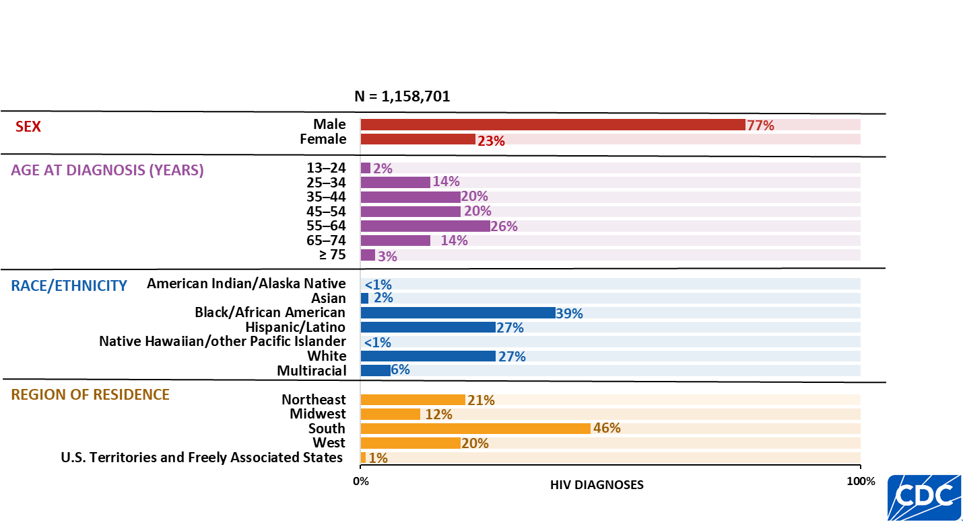
Persons living with diagnosed HIV (Prevalence), by selected characteristics, 2024—United States and 7 territories and freely associated states
Note. Data are presented for persons aged ≥ 13 years at year-end 2024. Persons who did not report Hispanic or Latino ethnicity were categorized by race. Hispanic/Latino persons can be of any race.
Notes:
Key findings
In 2024 in the United States and 7 territories and freely associated states, the highest numbers and percentages of persons aged ≥ 13 years living with diagnosed HIV by sex, age group, race/ethnicity, and region of residence were as follows:
Males (896,231; 77%)
55–64 years (300,819; 26%)
Black/African American persons (446,585; 39%)
Persons residing in the South (532,812; 46%)
Data notes and sources
The 2024 HIV Surveillance Data Release marks the first inclusion of data from the Republic of the Marshall Islands in numbers and rates of HIV diagnoses, deaths, and persons living with diagnosed HIV.
For additional data, see Table 12b in the 2024 HIV Surveillance Data Release.
Prevalence data for 2024 should be interpreted with caution due to the use of preliminary death data for that year reported to CDC as of December 2025.
Use caution when interpreting data for American Indian/Alaska Native and Native Hawaiian/other Pacific Islander persons due to small numbers.
For more information on data sources, data collection and reporting practices, and case definitions, see the National HIV Surveillance System (NHSS) Technical Notes, available at https://www.cdc.gov/hiv-data/nhss/index.html.
Data for all figures are available in the 2024 HIV Surveillance Data Release tables or NCHHSTP AtlasPlus.

Slide 39
