Slide 1
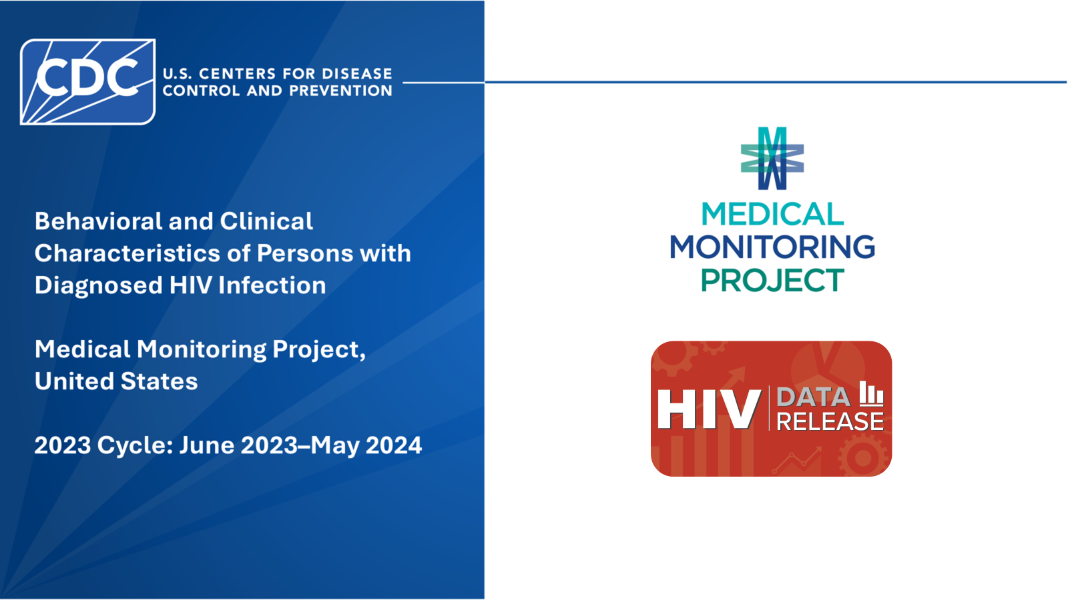
Notes:
The report provides the latest nationally representative data on behavioral and clinical characteristics of adults with diagnosed HIV in the United States. The data were collected by the Medical Monitoring Project (MMP), a cross-sectional complex sample survey that is the only source of locally and nationally representative information on behavioral and clinical factors that affect HIV treatment success and risk of HIV transmission among U.S. adults with HIV. These data are used to monitor progress towards national and local HIV prevention and treatment goals and inform planning and resources to improve the health and well-being of persons with HIV.
All percentages reported are weighted and might not sum to 100 because of rounding.
All material contained in this report is the public domain and may be used and reprinted without special permission; however, citation as to source is appreciated.
Behavioral and Clinical Characteristics of Persons with Diagnosed HIV Infection—Medical Monitoring Project, United States, 2023 Cycle (June 2023–May 2024). Centers for Disease Control and Prevention. Published [date]. Accessed [date]. Web link
You are also free to adapt and revise these slides; however, you must remove the CDC name and logo if changes are made.
This report is also available in CDC Stacks at https://stacks.cdc.gov/view/cdc/253408

Slide 2
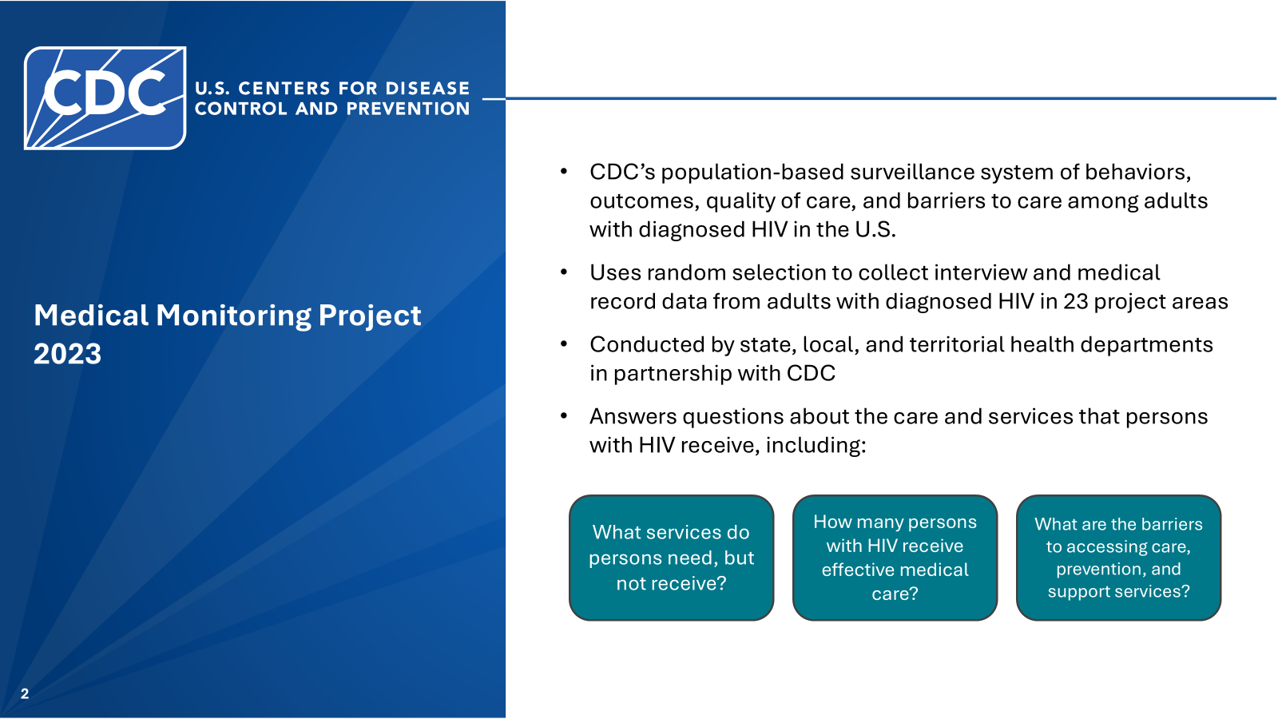
Notes:
MMP is CDC’s population-based surveillance system for collecting information about behaviors, outcomes, quality of life, and barriers to care among adults with diagnosed HIV in the U.S. It uses random selection to collect interview and medical record data from adults with diagnosed HIV in 23 project areas. MMP is conducted by state, local, and territorial health departments in partnership with CDC and answers questions about the care and services that persons with HIV receive, including: what services do persons need but not receive, how many persons with HIV receive effective medical care, and what are the barriers to accessing care, prevention, and support services.

Slide 3
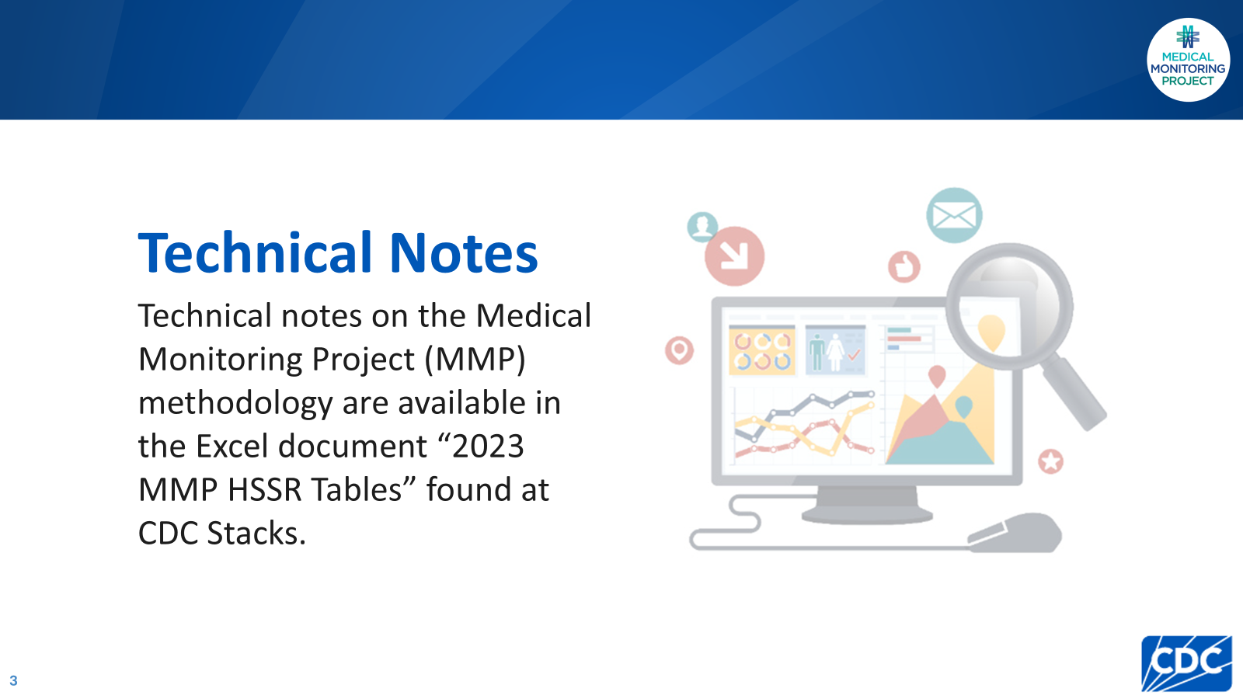
https://stacks.cdc.gov/view/cdc/253409
Notes:
Technical notes on MMP’s methodology, including data definitions and sampling methodology, are available in the Excel document “2023 MMP HSSR Tables” found at CDC Stacks at https://stacks.cdc.gov/view/cdc/253409.

Slide 4
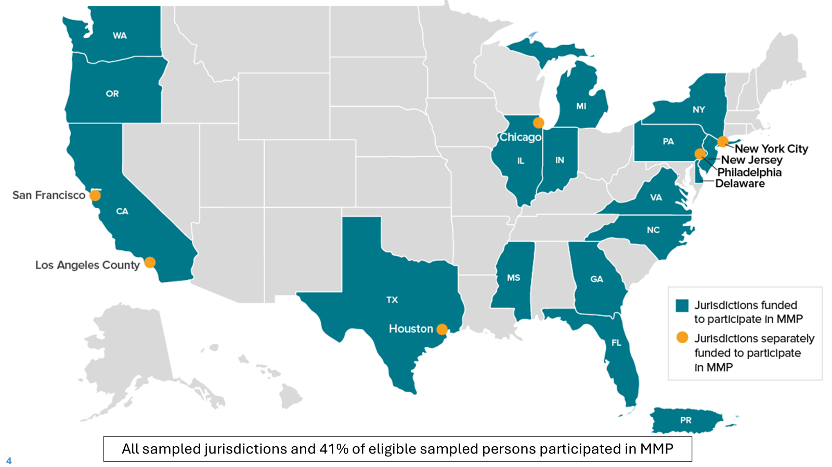
Notes:
All 16 states, including 6 separately funded jurisdictions within those states, and the 1 territory sampled for MMP participated. In total, 9,700 persons were sampled from NHSS and 3,711 participated. Adjusted for eligibility, the response rate was 41%.

Slide 5


Slide 6
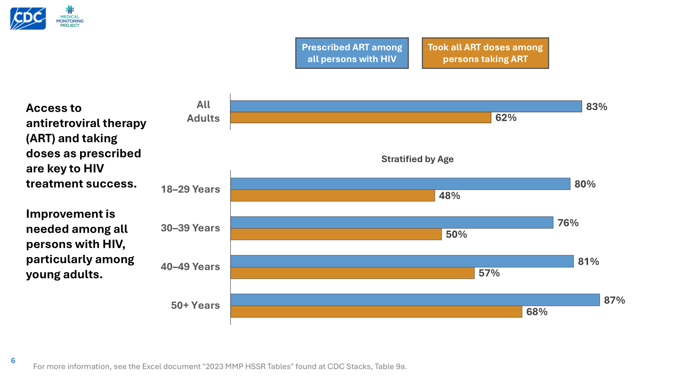
Notes:
Being prescribed antiretroviral therapy and taking all prescribed doses are essential precursors to optimal health among persons with HIV. Prescription of ART during the past 12 months was highest among those 50 years and over (87%), as was adherence to all ART doses during the past 30 days (68%). Those aged 30-39 had the lowest prescription of ART (76%). The 18-29 age group reported the lowest adherence to ART (48%). These data illustrate substantial need for improvement among all age groups, but particularly among younger persons with HIV.

Slide 7
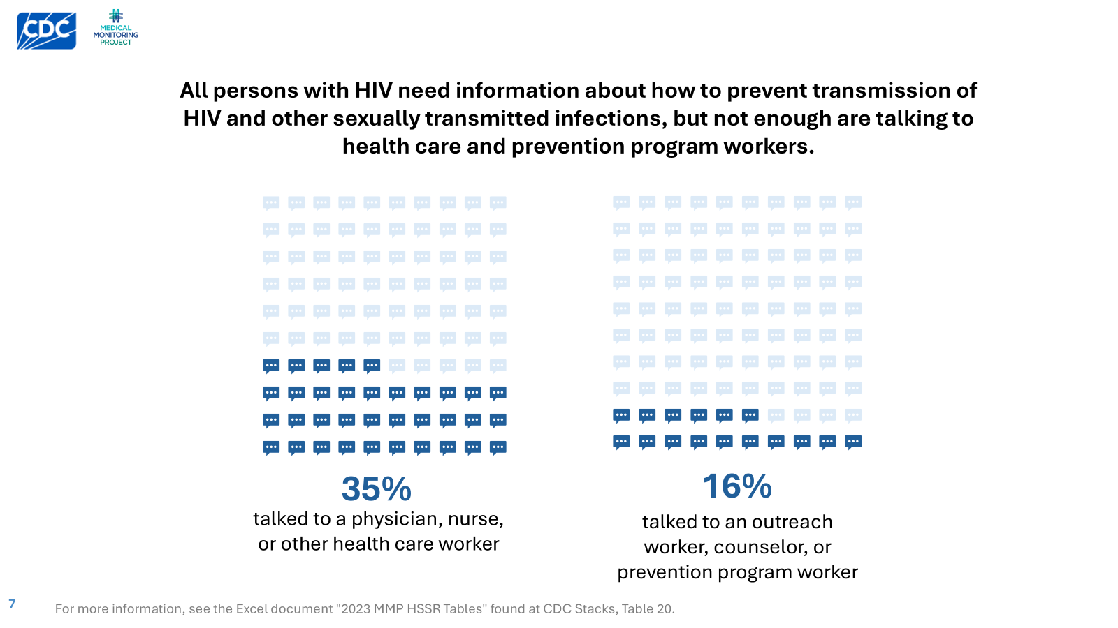
Notes:
Health care providers and prevention program researchers can be a trusted source of information for persons with HIV about how to prevent transmission of HIV and other sexually transmitted infections, and can therefore help reduce new infections. However, MMP data show that not enough persons are having these discussions.

Slide 8
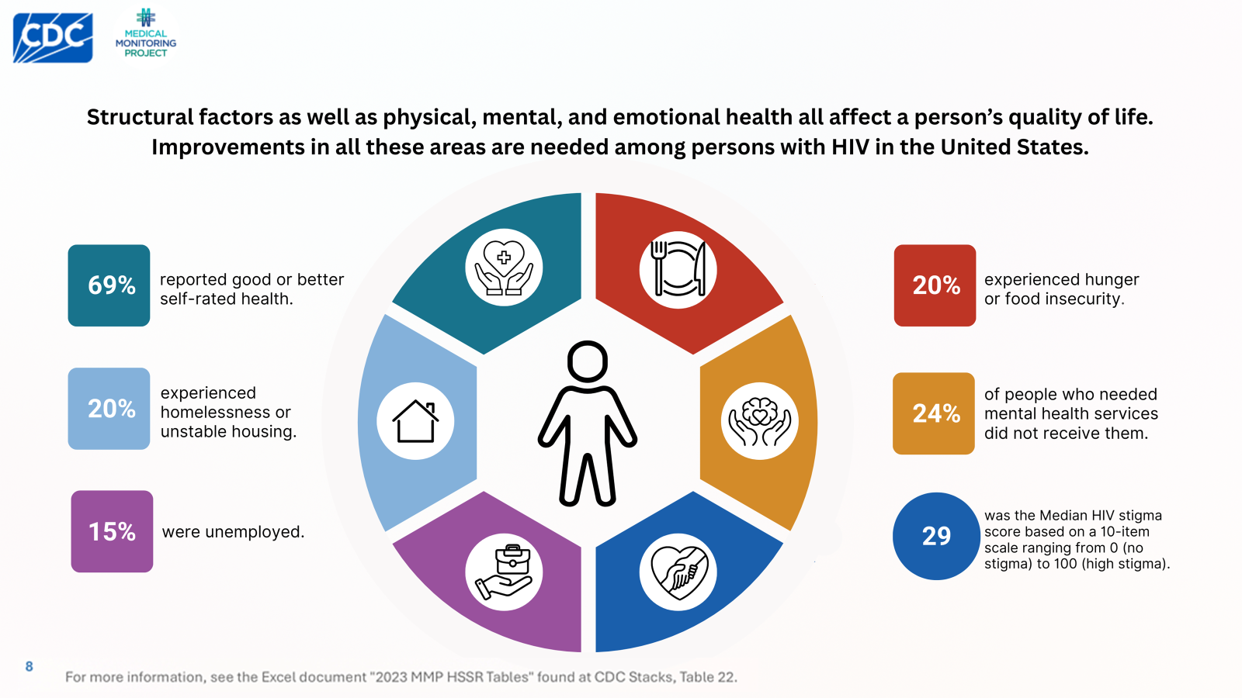
Notes:
Structural factors as well as physical, mental, and emotional health all affect a person’s quality of life. MMP data show that improvement in all of these areas are needed among persons with HIV, who experience particular challenges related to housing, hunger, and mental health.

Slide 9


Slide 10
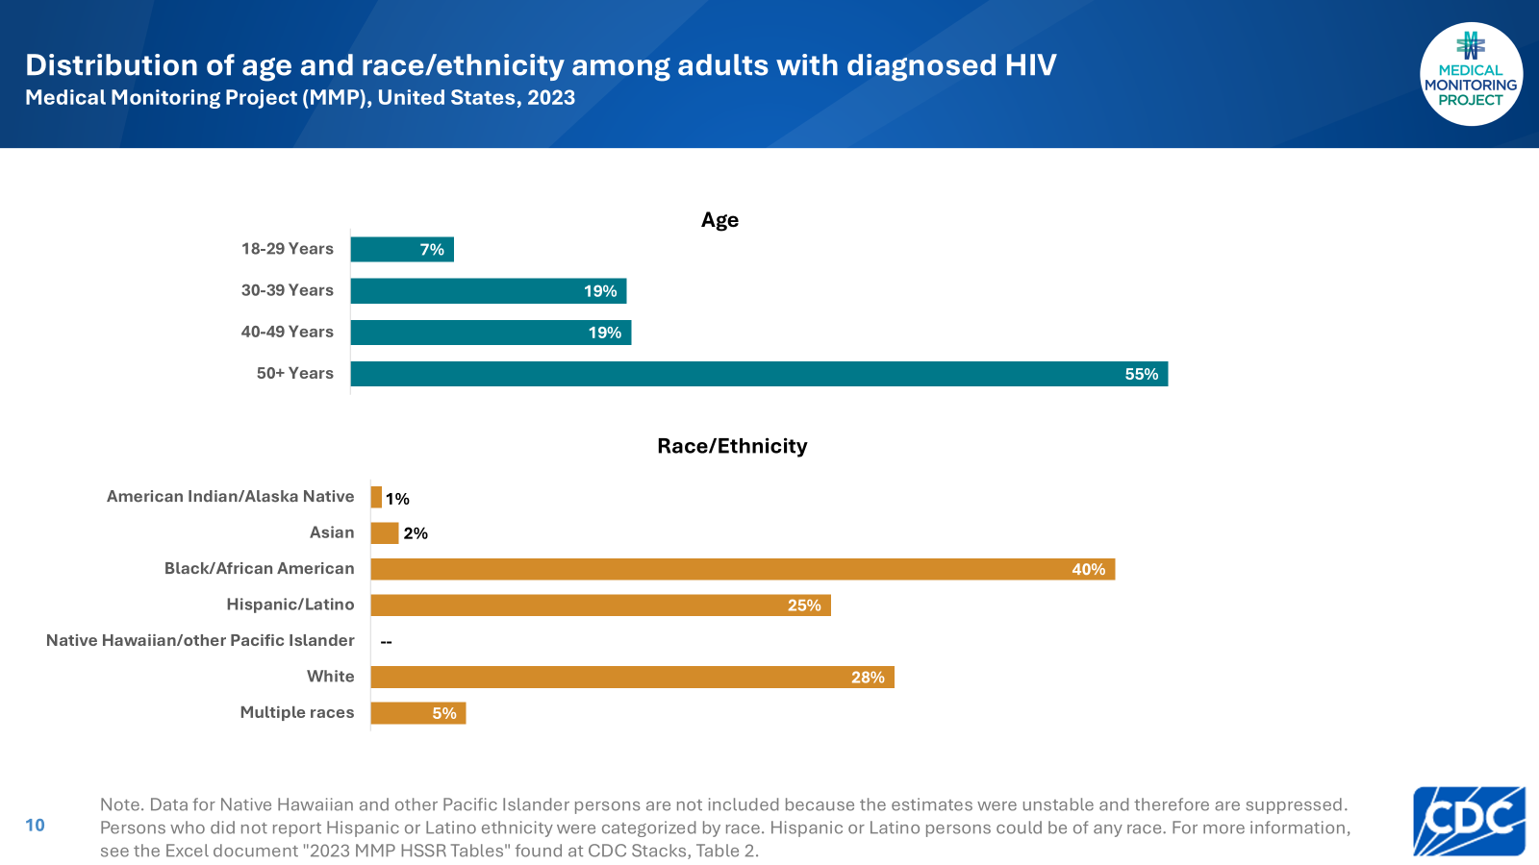
Notes:
Nearly three-quarters (74%) of persons were aged at least 40 years.
An estimated 40% identified as Black or African American, 28% identified as White, 25% identified as Hispanic or Latino, 5% identified as multiracial, 2% identified as Asian, and 1% identified as American Indian/Alaska Native.

Slide 11
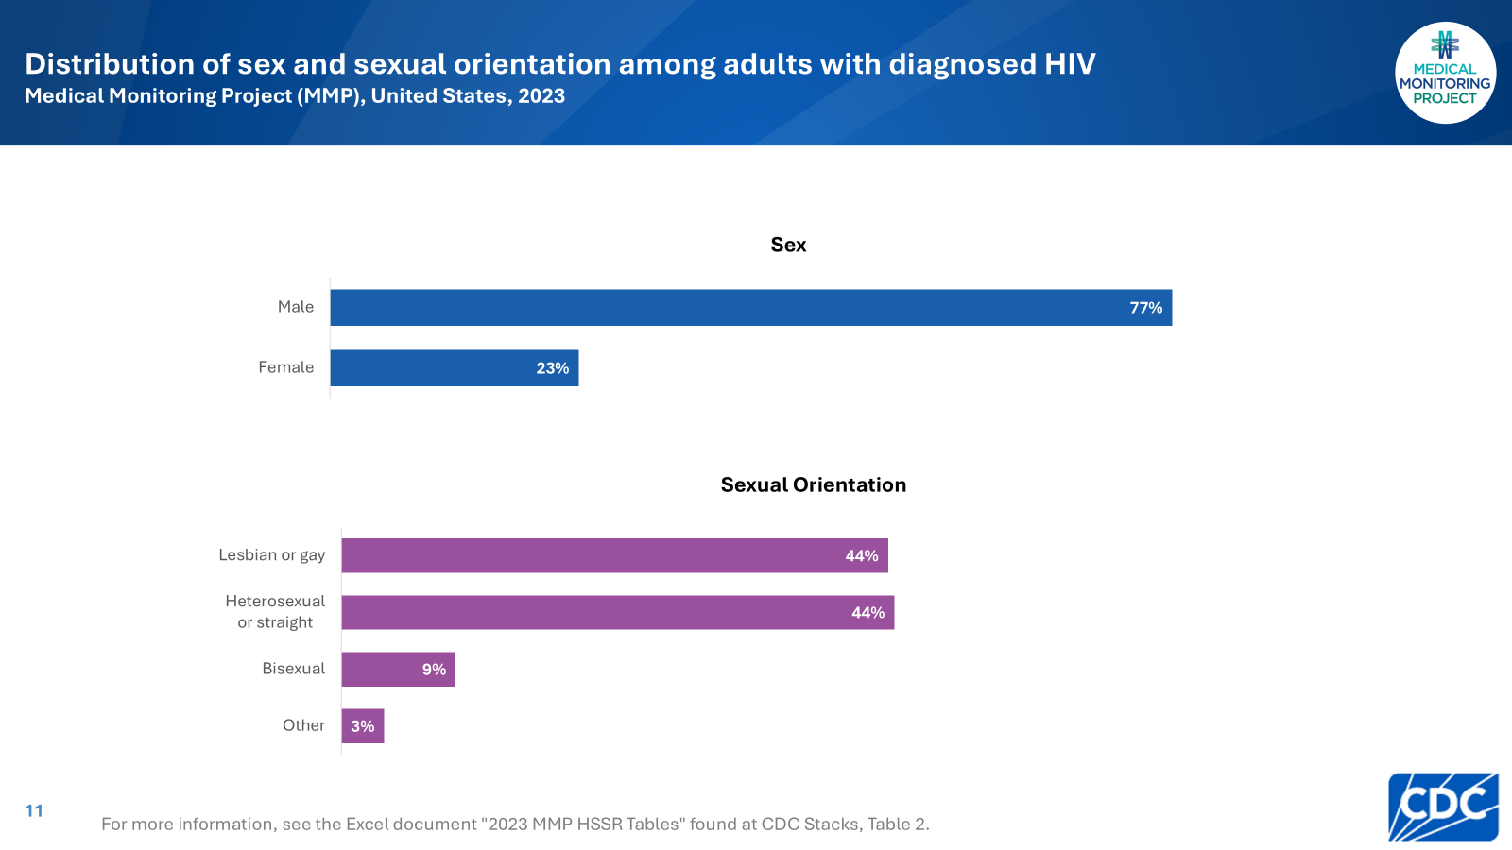
Notes:
An estimated 77% of persons were male and 23% were female.
An estimated 44% identified as lesbian or gay; 44% as heterosexual or straight; 9% as bisexual; and 3% as another sexual orientation (i.e., not lesbian or gay, straight, or bisexual).

Slide 12
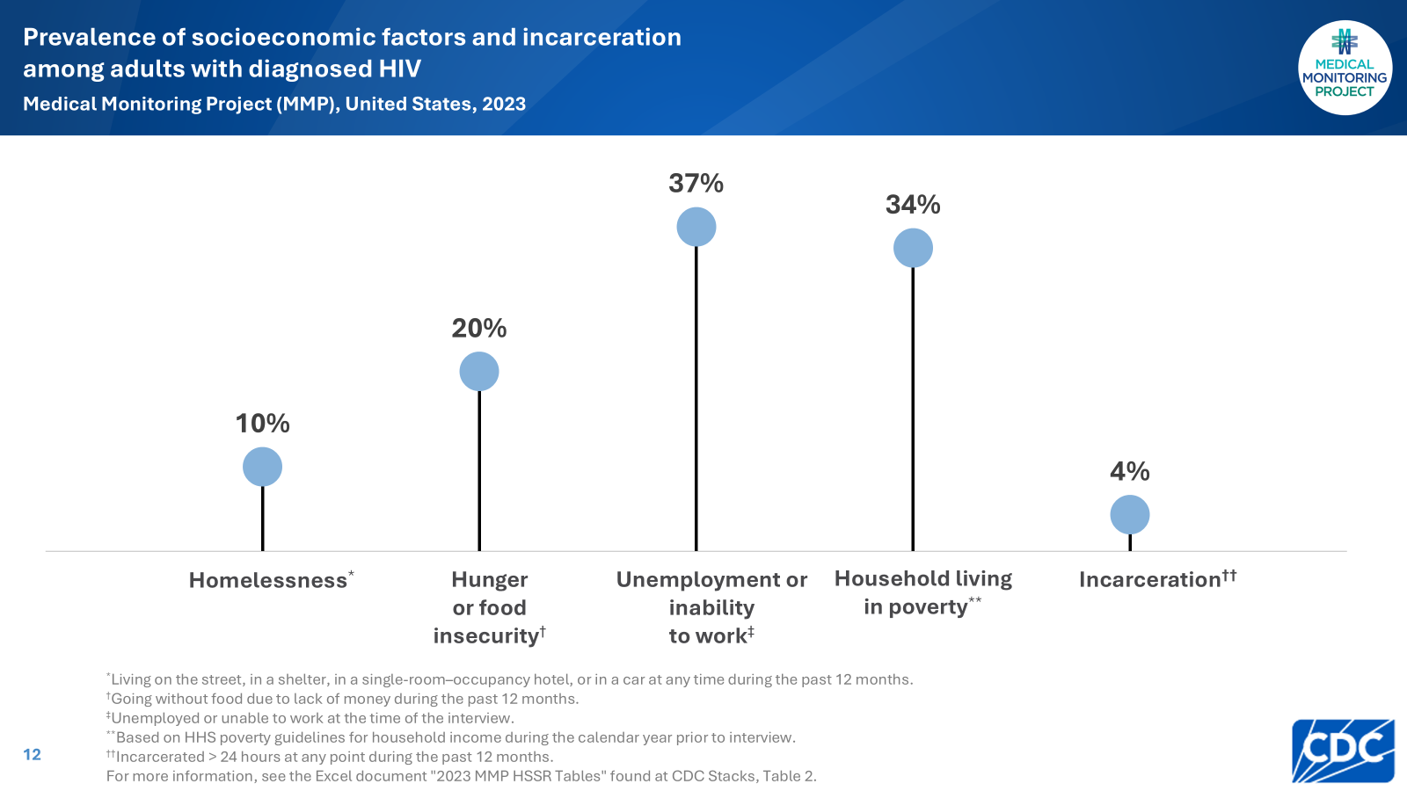
Notes:
The estimated prevalence of homelessness among all persons with diagnosed HIV was 10%. Approximately 20% experienced hunger or food insecurity, 37% were unemployed or unable to work, 34% had household incomes below the federal poverty threshold, and 4% were recently incarcerated.

Slide 13
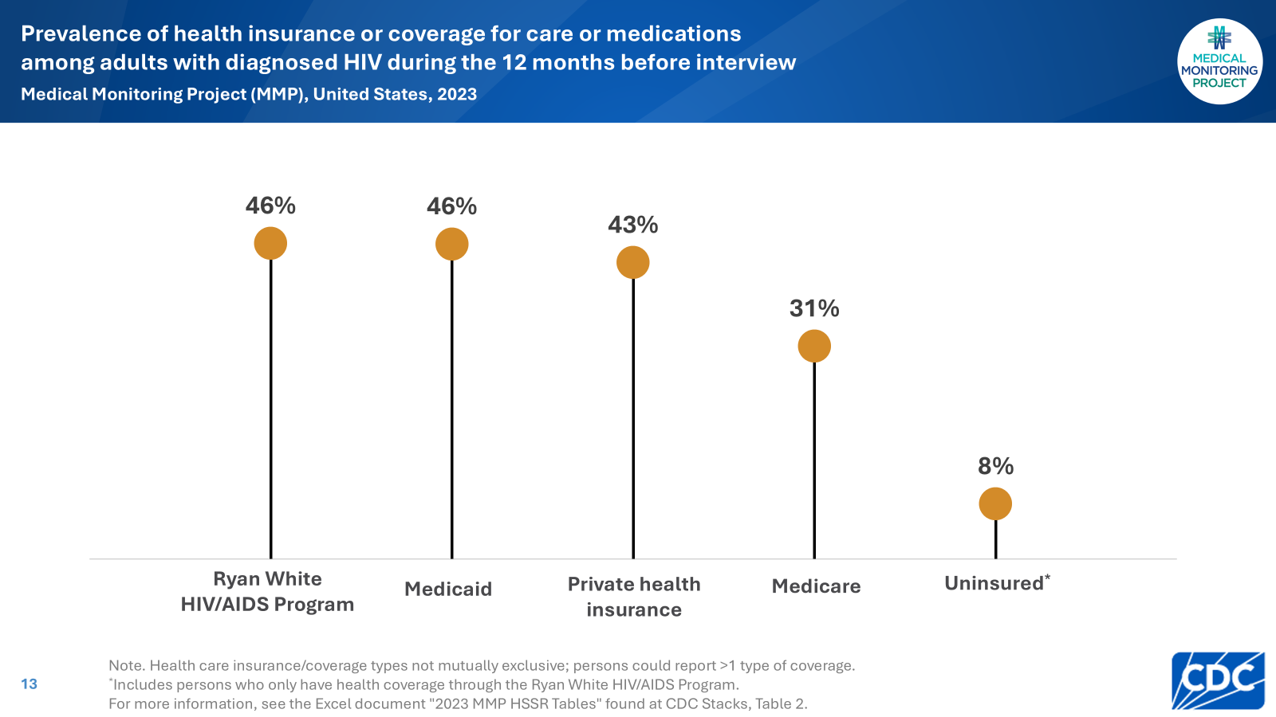
Notes:
An estimated 46% had coverage through the Ryan White HIV/AIDS Program (RWHAP), 46% had Medicaid, 43% had private health insurance, and 31% had Medicare. An estimated 8% were uninsured, including those who received RWHAP assistance only.

Slide 14
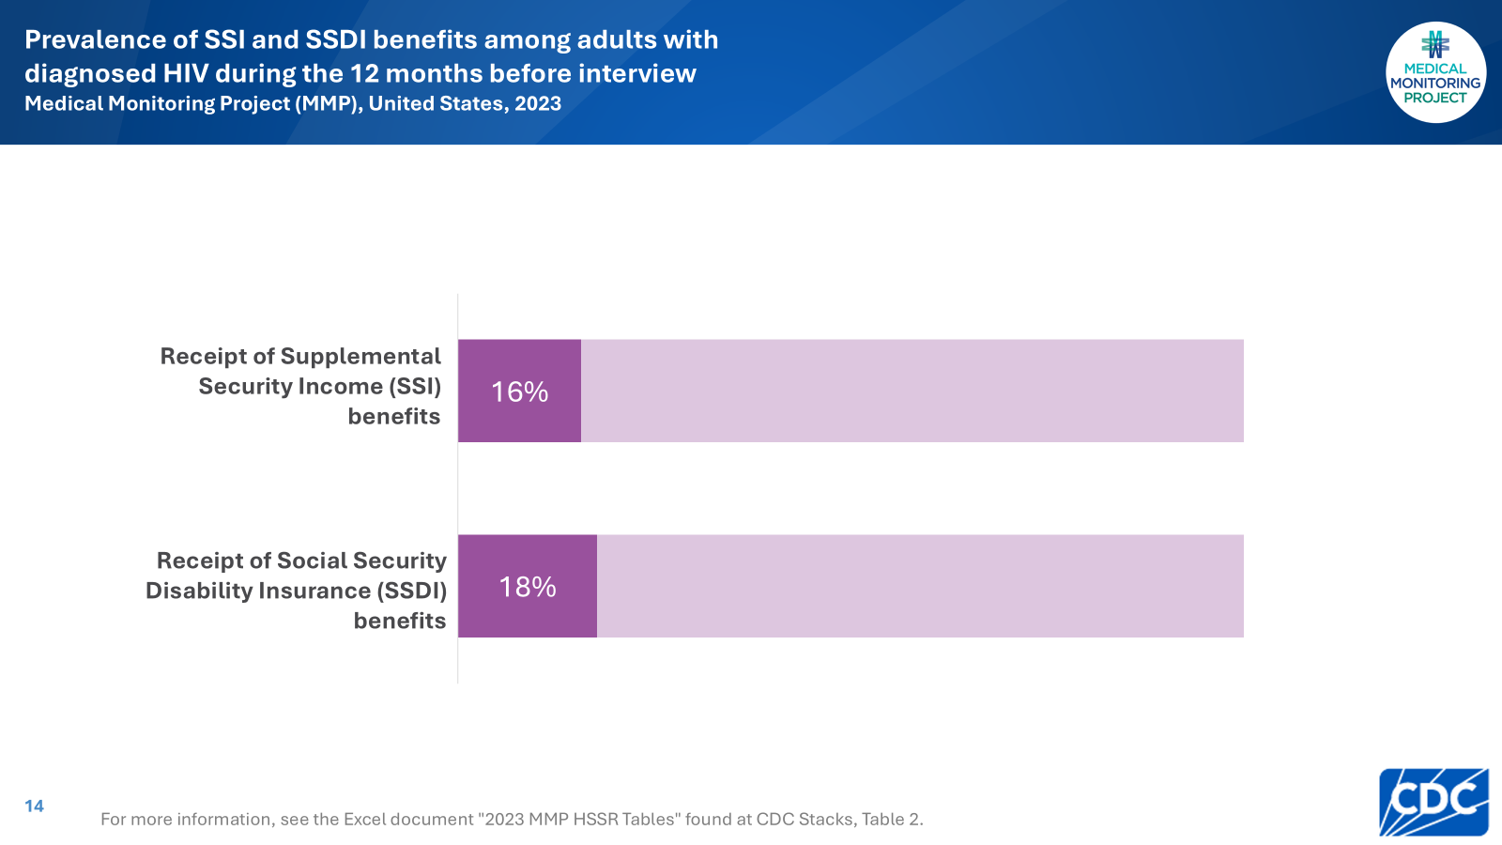
Notes:
An estimated 16% received Supplemental Security Income (SSI), and 18% received Social Security Disability Insurance (SSDI).

Slide 15
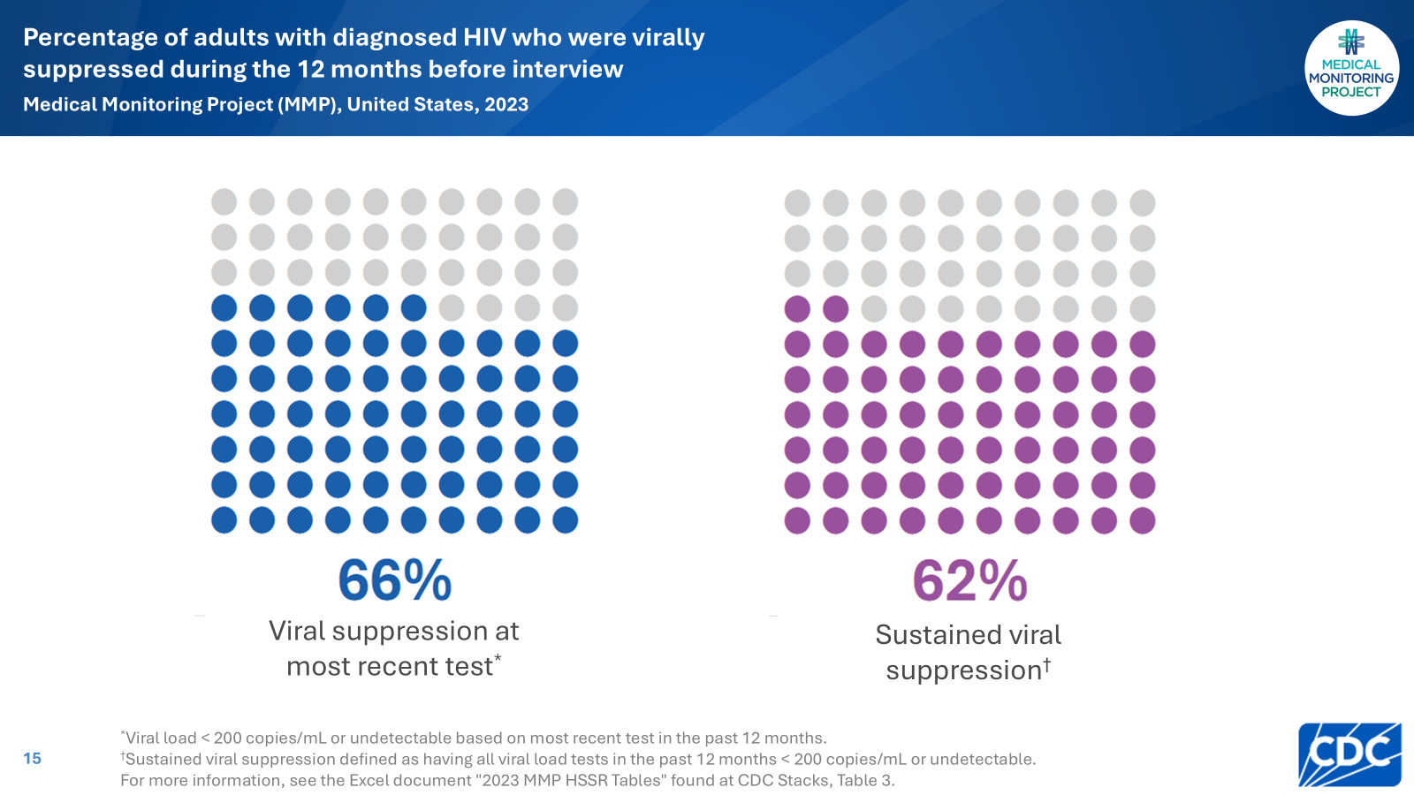
Notes:
An estimated 66% of persons had a viral load that was undetectable or < 200 copies/mL at the most recent measurement, while 62% had viral loads that were undetectable or < 200 copies/mL at all measurements during the past 12 months (sustained viral suppression).

Slide 16
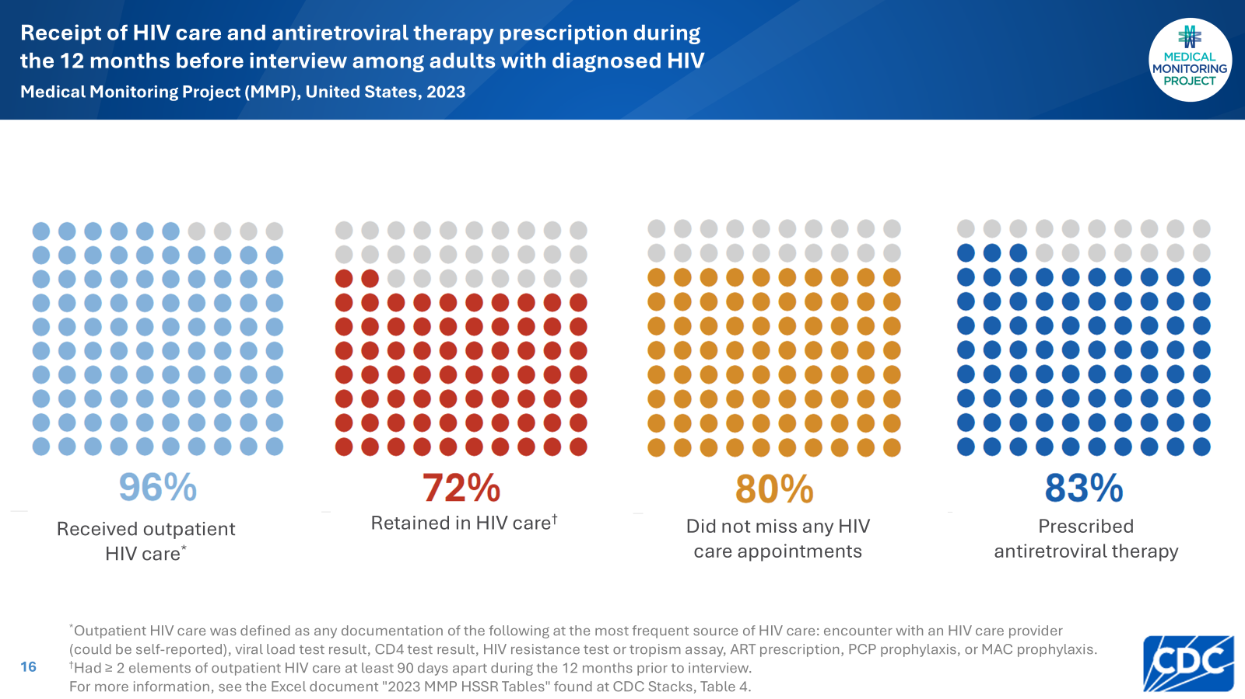
Notes:
Overall, 96% had received outpatient HIV care during the past 12 months. An estimated 72% were retained in care during the past 12 months. Approximately 80% did not miss any HIV appointments during the past 12 months. An estimated 83% of persons had an ART prescription documented in the medical record during the 12 months before interview.

Slide 17
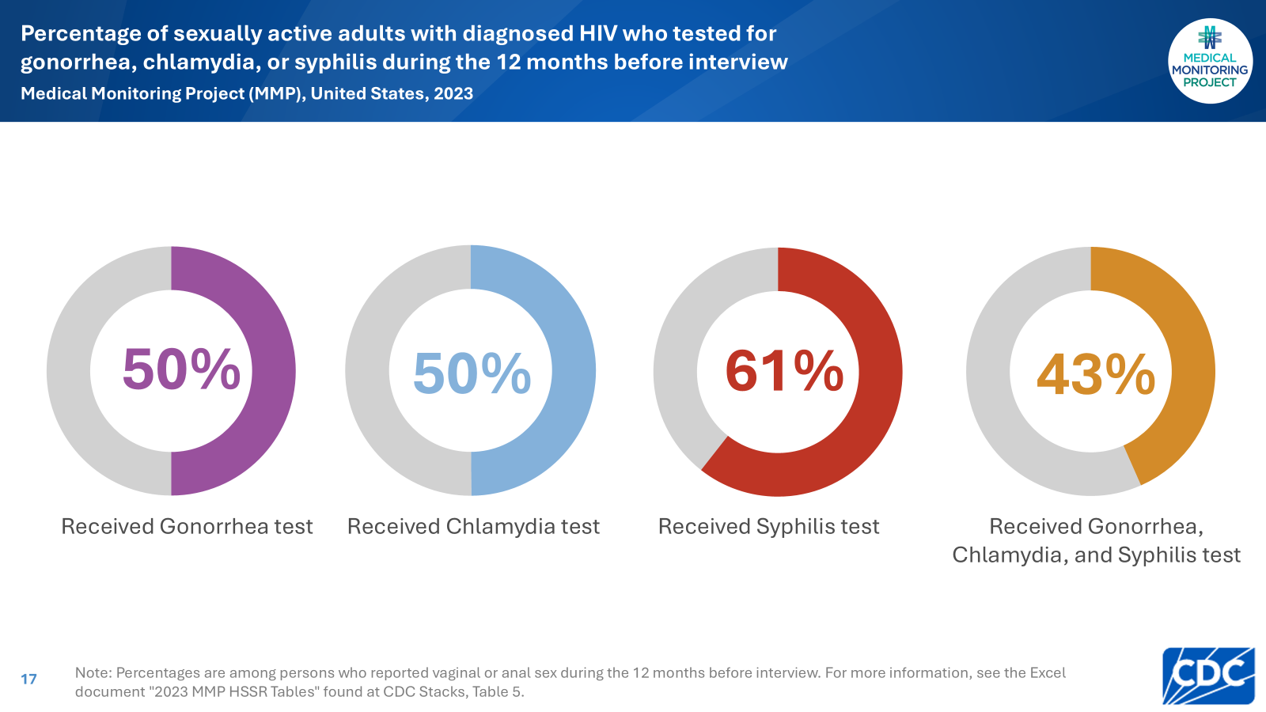
Notes:
Among persons who are sexually active, an estimated 50% were tested for gonorrhea, 50% for chlamydia, 61% for syphilis, and 43% for all 3 sexually transmitted infections (STIs).

Slide 18
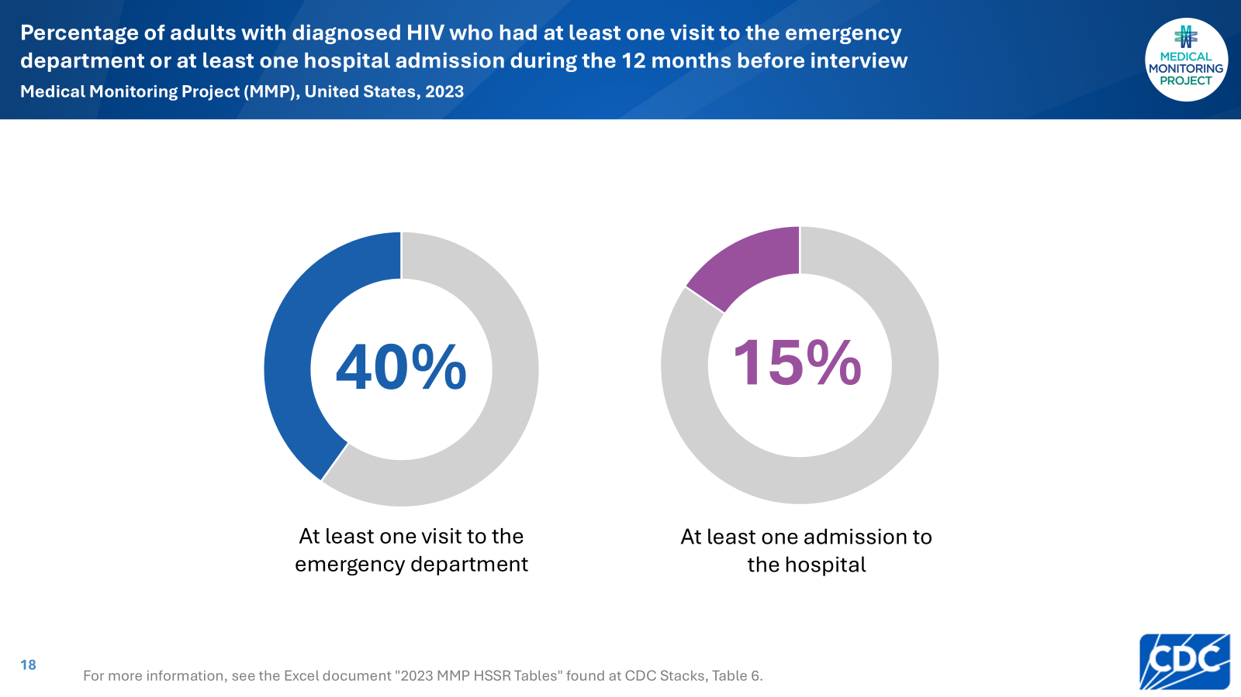
Notes:
An estimated 40% of persons were seen in an emergency department at least once during the past 12 months. An estimated 15% of persons were admitted to a hospital for an illness at least once during the past 12 months.

Slide 19
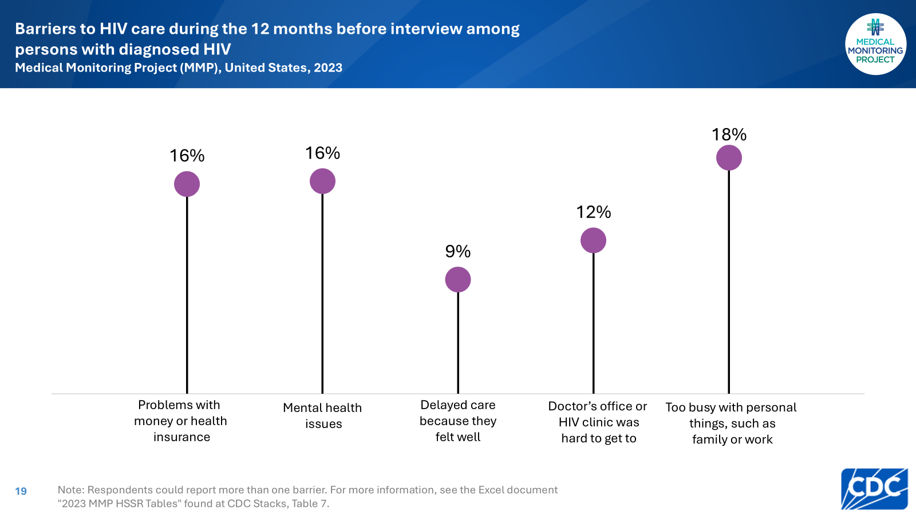
Notes:
The most frequently reported barriers to accessing HIV care were being too busy with personal things (18%), problems with money or health insurance (16%), mental health issues (16%), and having a doctor’s office or clinic that was hard to get to (12%). An estimated 9% reported delaying care because they felt well.

Slide 20
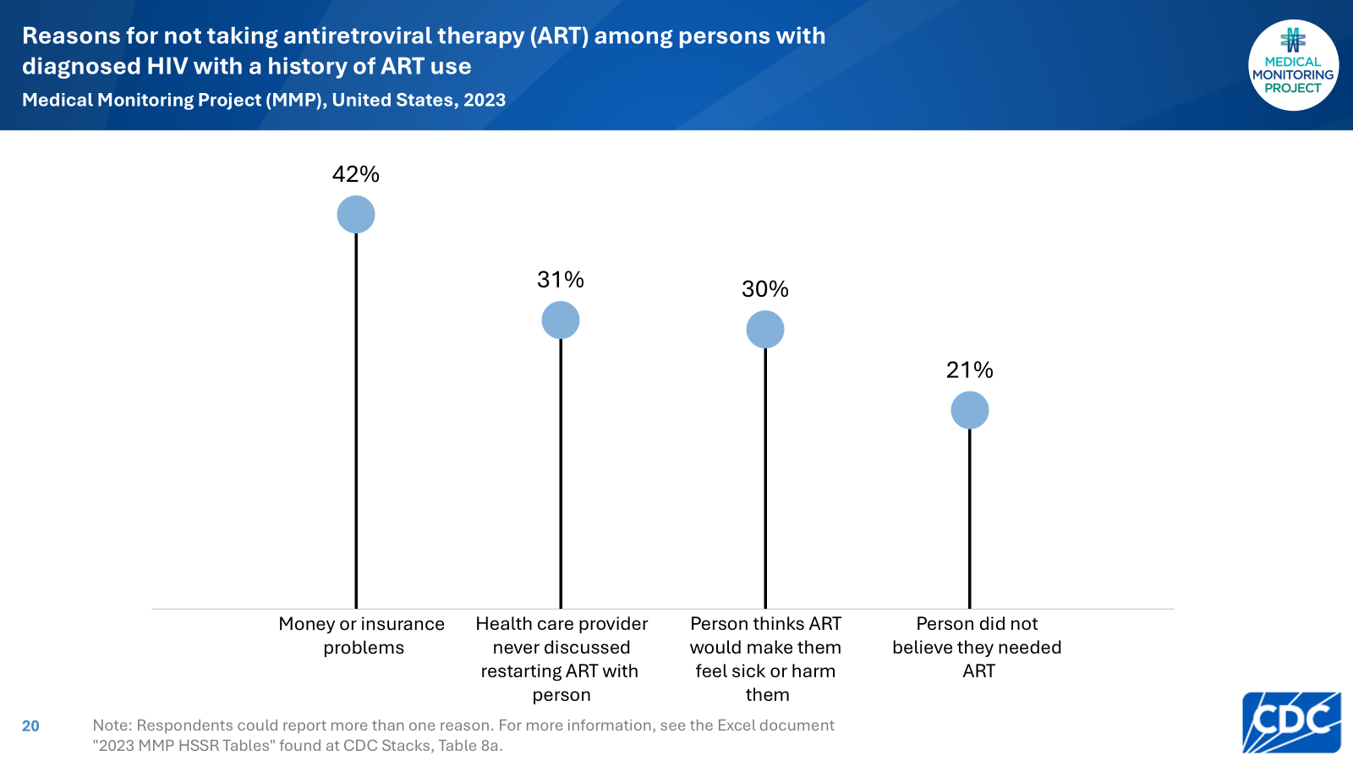
Notes:
Among those with a history of ART use but who were not currently taking ART, 42% were not taking ART due to money or insurance problems, 31% were not taking ART because the health care provider never discussed restarting ART with the person, 30% because the person thought ART would make them feel sick or harm them, and 21% because the person did not believe they needed ART.

Slide 21
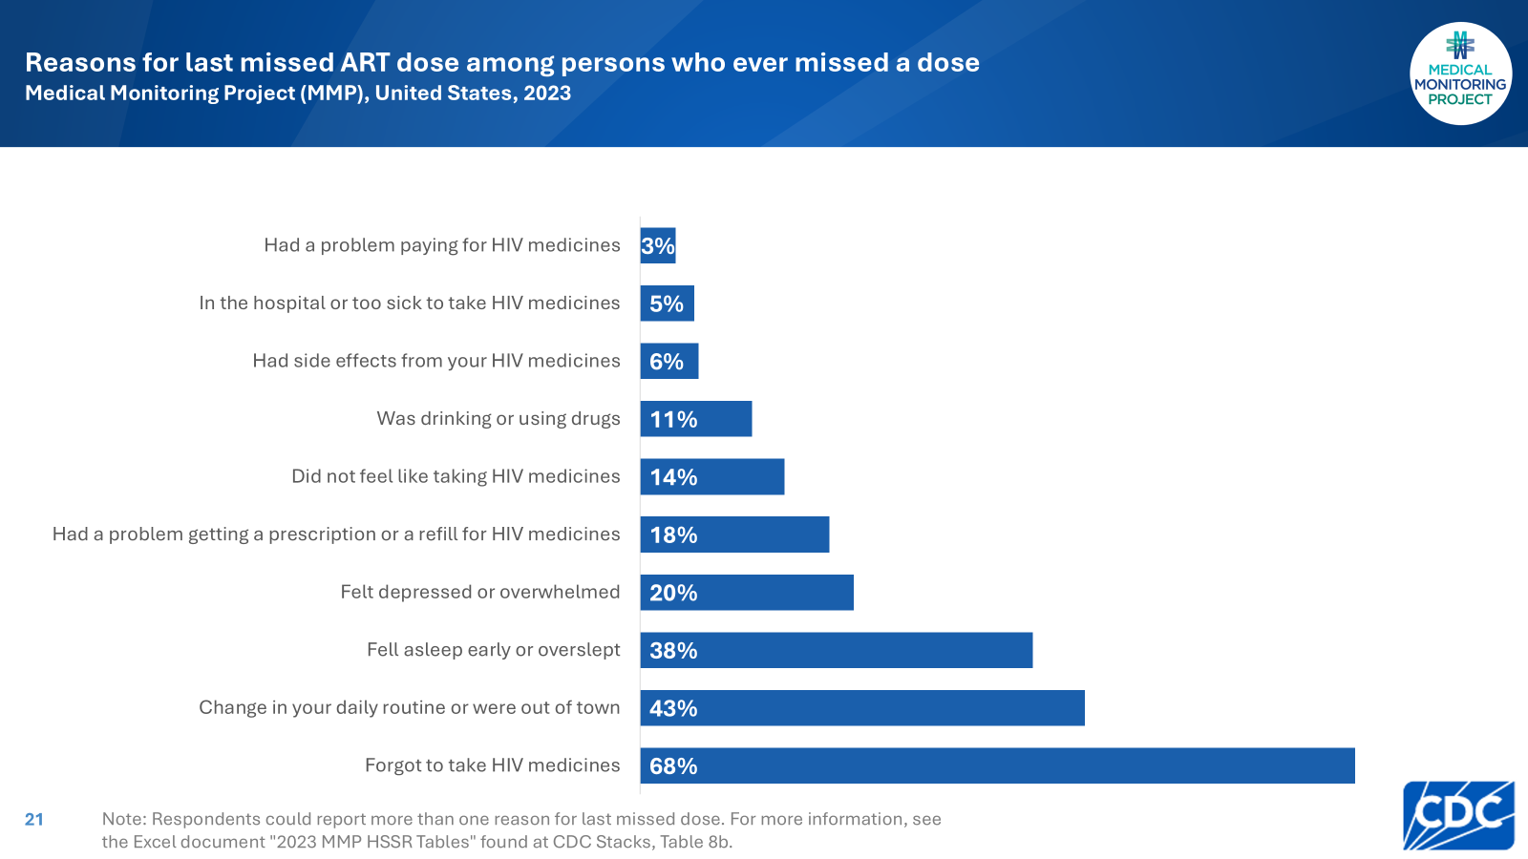
Notes:
Among persons who had ever missed a dose, the most common reasons given for not taking one’s most recently missed ART dose were forgetting (68%), a change in one’s daily routine or being out of town (43%), or falling asleep early or oversleeping (38%).

Slide 22
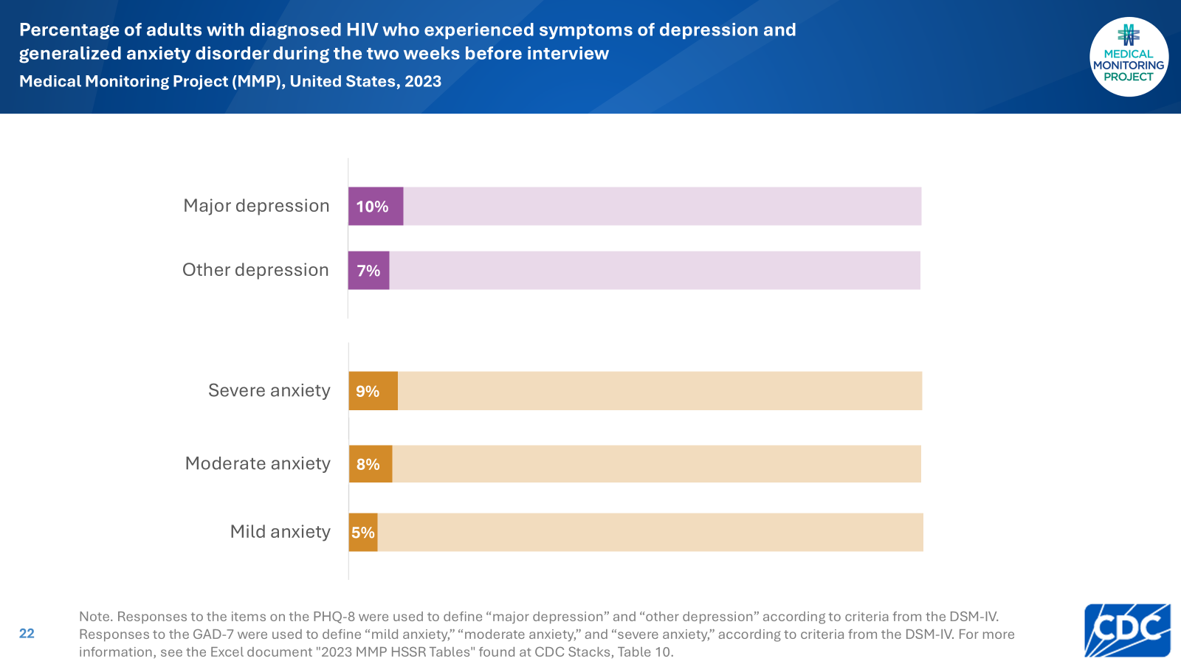
Notes:
The estimated prevalence of symptoms indicative of major or other depression during the 2 weeks before interview based on the Patient Health Questionnaire (PHQ-8) algorithm was 17%, including 10% with major depression. The estimated prevalence of mild, moderate, or severe symptoms of generalized anxiety disorder during the 2 weeks before interview based on the Generalized Anxiety Disorder Scale (GAD-7) was 22%, including 9% with severe anxiety.

Slide 23
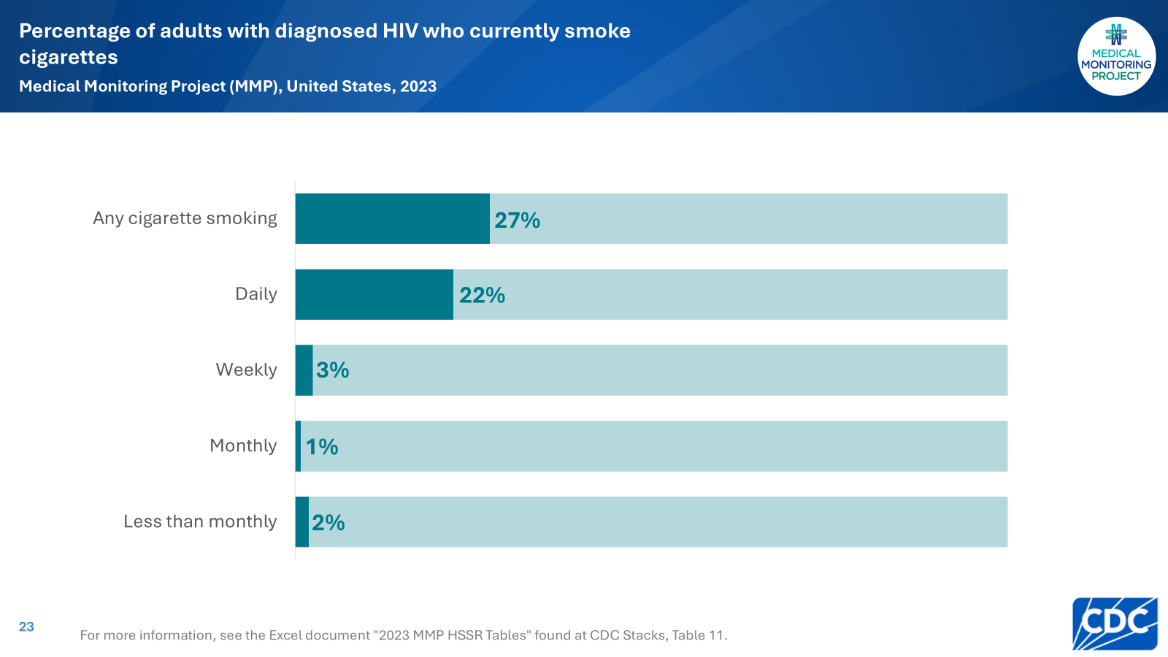
Notes:
The estimated prevalence of current smoking was 27%: 22% of persons smoked daily, 3% weekly, 1% monthly, and 2% less than monthly.

Slide 24
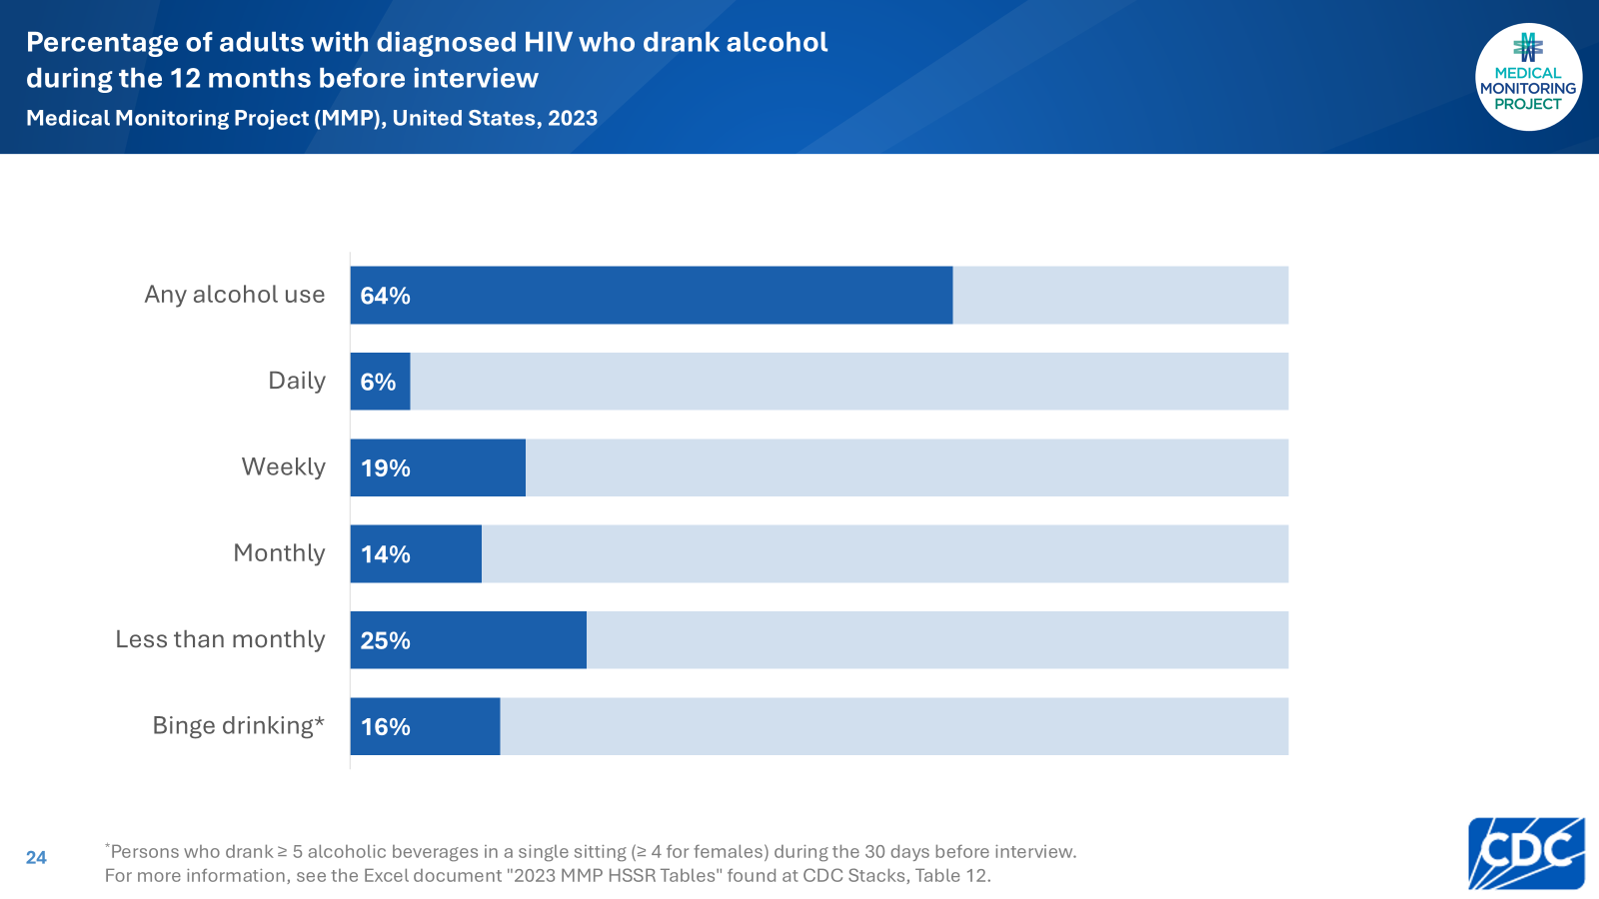
Notes:
The estimated prevalence of alcohol use in the past 12 months was 64%: 6% of persons drank alcohol daily, 19% weekly, 14% monthly, and 25% less than monthly. An estimated 16% of persons engaged in binge drinking during the past 30 days.

Slide 25
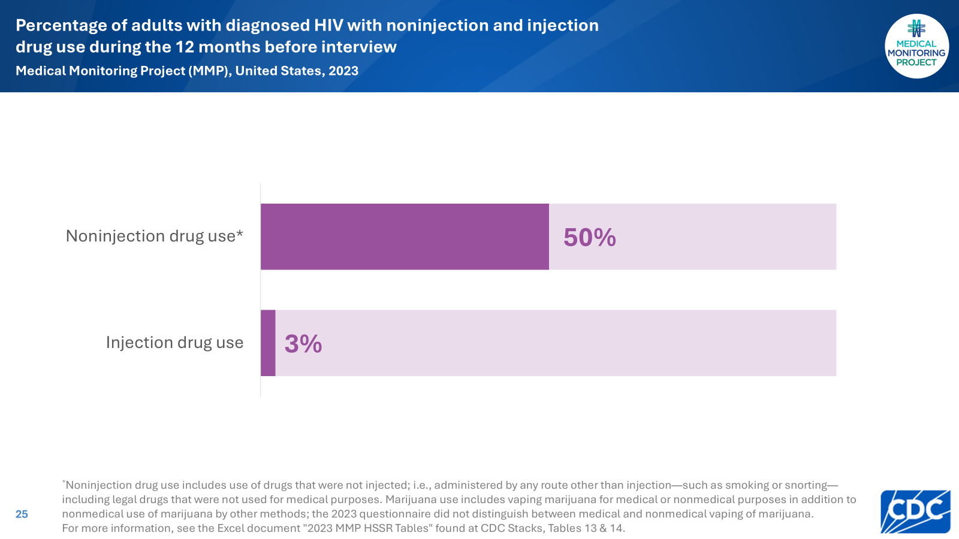
Notes:
An estimated 50% of persons used noninjection drugs for nonmedical purposes. An estimated 3% of persons used injection drugs for nonmedical purposes.

Slide 26
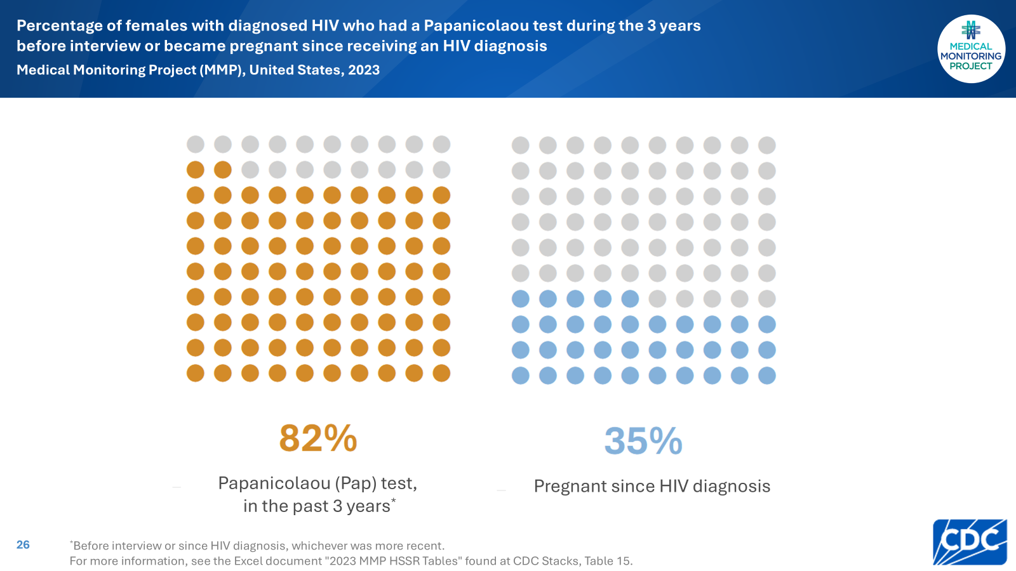
Notes:
Among women, 82% reported receiving a Papanicolaou (Pap) test in the past 3 years, or since HIV diagnosis for women with a diagnosis within the past 3 years. An estimated 35% of females reported being pregnant at least once since receiving an HIV diagnosis.

Slide 27
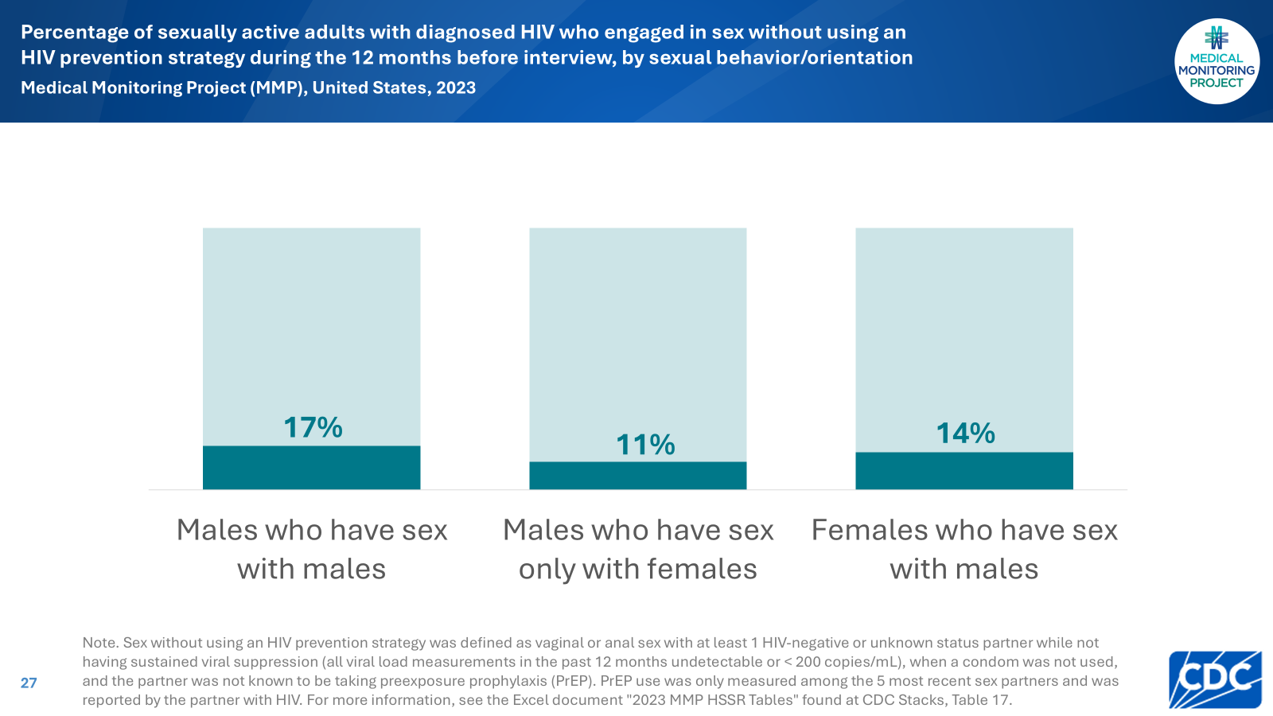
Notes:
Among those who were sexually active, 17% of males who had sex with males, 11% of males who had sex only with females, and 14% of females who had sex with males engaged in sex without the use of an HIV prevention strategy.

Slide 28
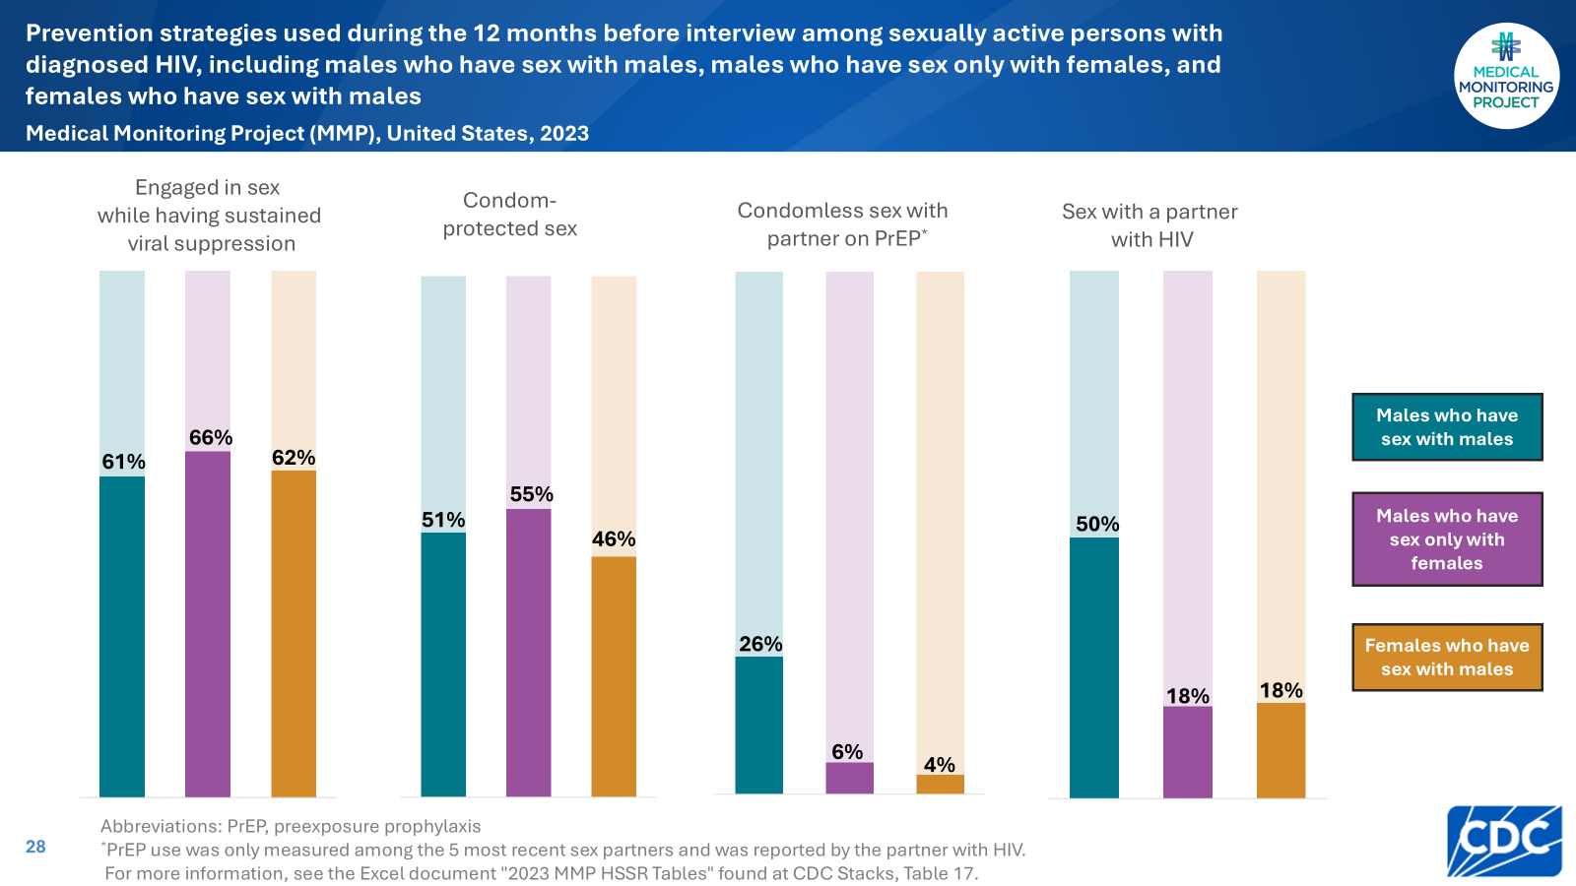
Notes:
Persons who were sexually active used a variety of HIV prevention strategies. For instance, an estimated 61% of sexually active MSM engaged in sex while having sustained viral suppression, 51% had condom-protected sex, 26% had condomless sex with a partner taking preexposure prophylaxis (PrEP), and 50% had sex with a person with HIV.

Slide 29
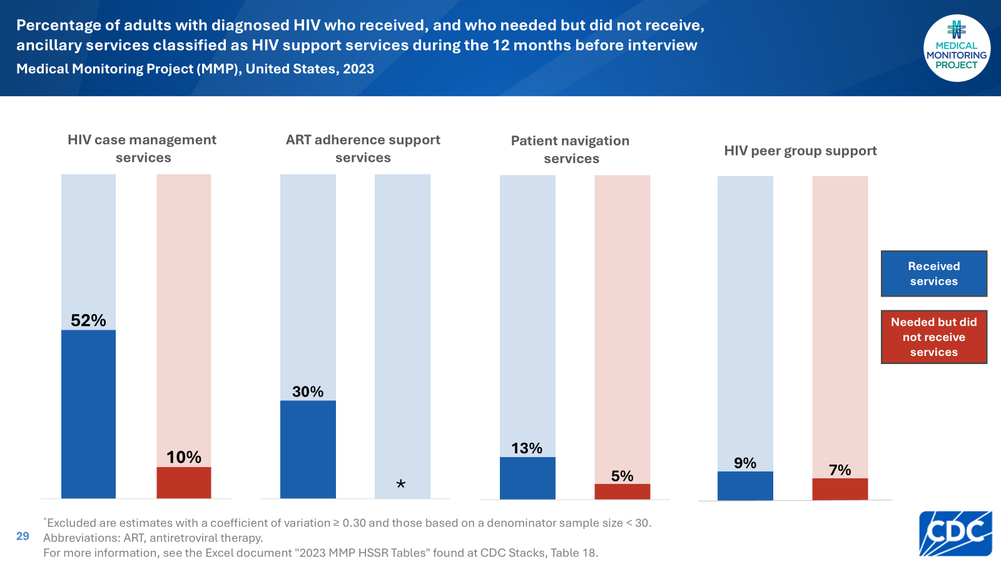
Notes:
Among all HIV support services, the most commonly reported service received in the 12 months before interview was HIV case management (52%). HIV case management was also the most commonly needed but not received service (10%).

Slide 30
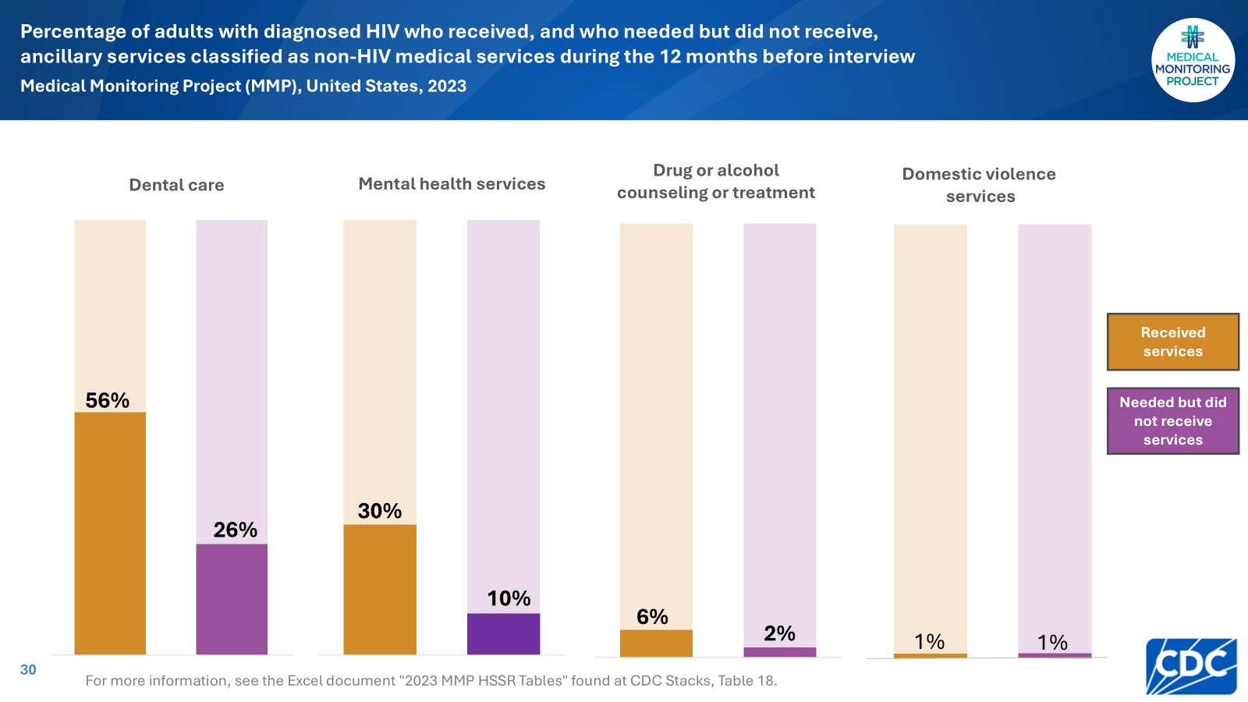
Notes:
Among all non-HIV medical services, the most commonly reported service received in the 12 months before interview was dental care (56%). Dental care was also the most commonly needed but not received service (26%).

Slide 31
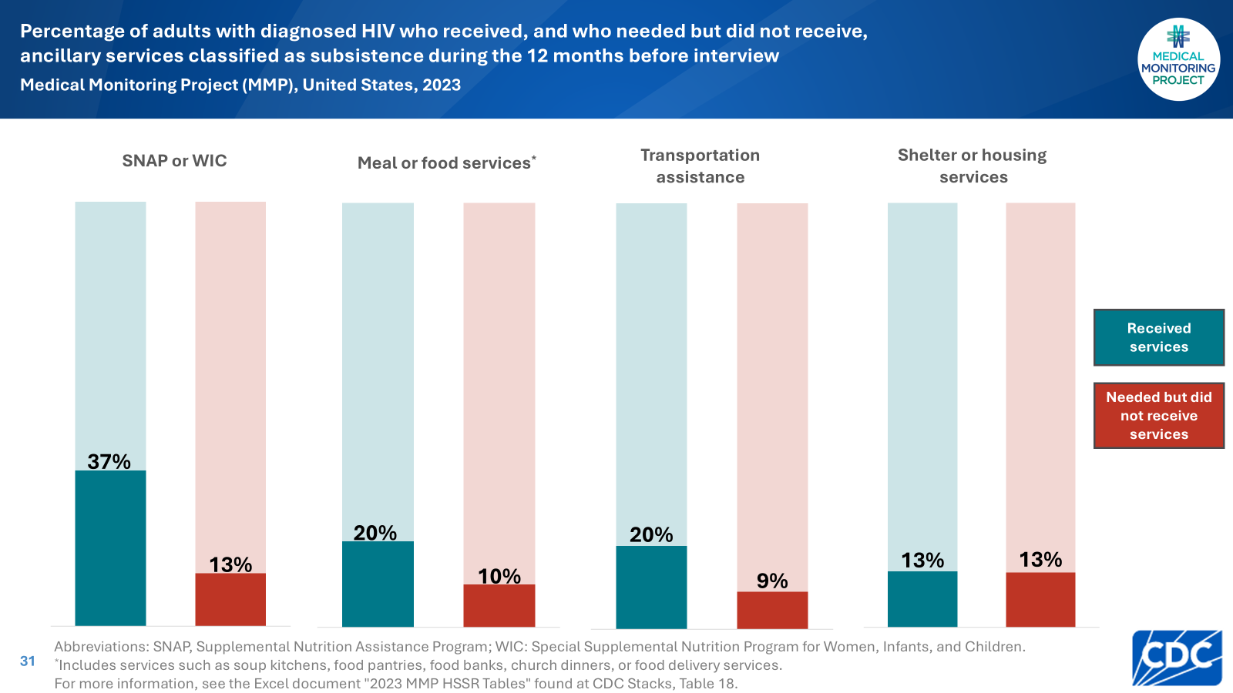
Notes:
Among all services related to subsistence, the most commonly reported service received in the 12 months before interview was SNAP or WIC (37%). The most commonly needed but not received service was also SNAP or WIC (13%) as well as shelter or housing services (13%).

Slide 32
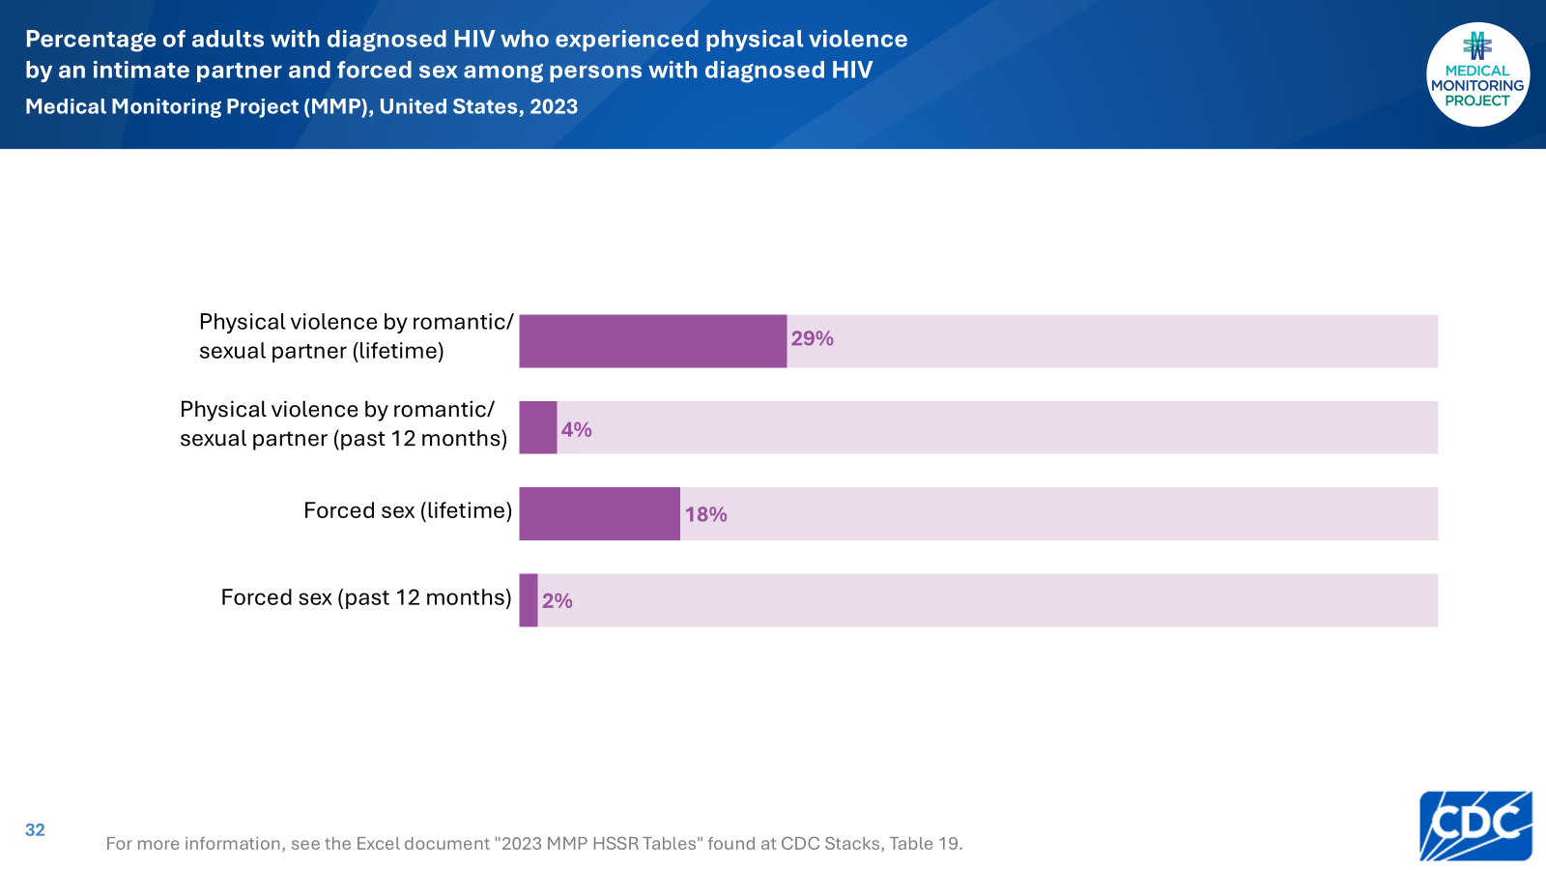
Notes:
An estimated 29% of persons had ever been physically hurt by a romantic or sexual partner, including 4% who experienced this in the past 12 months. An estimated 18% of persons had ever been threatened with harm or physically forced to have unwanted sex, including 2% who experienced this in the past 12 months.

Slide 33
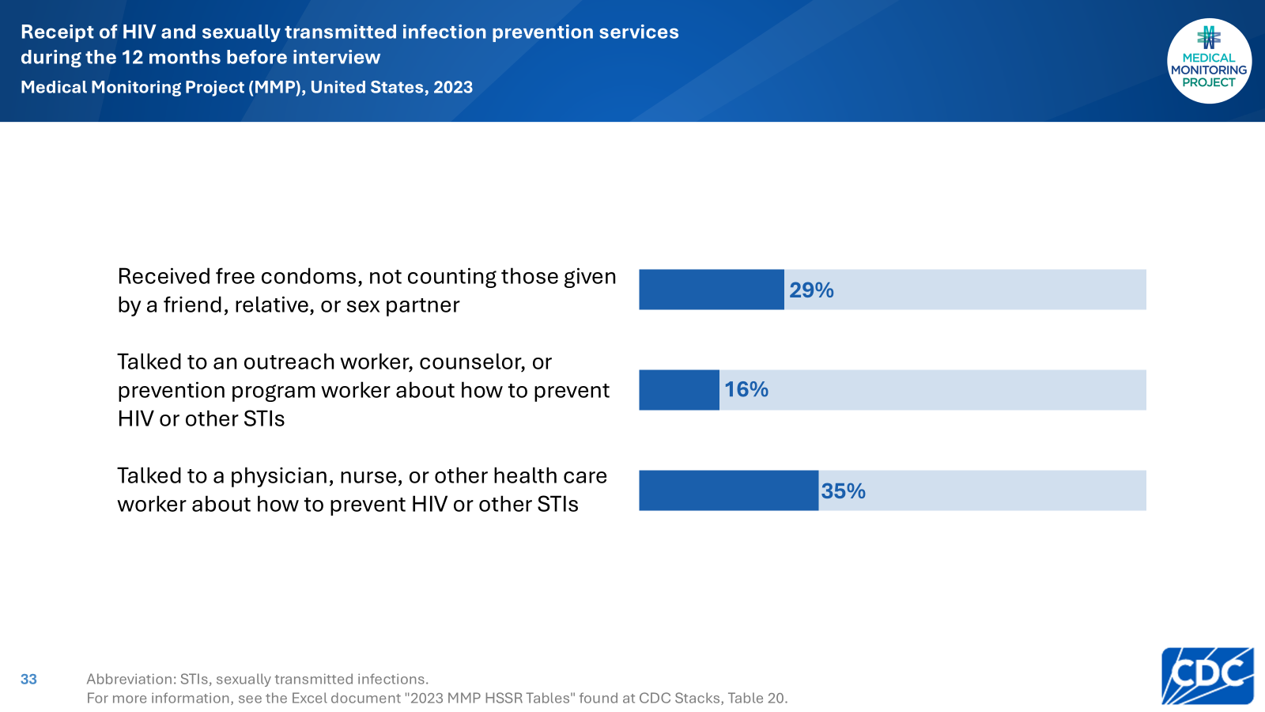
Notes:
An estimated 29% of persons received free condoms, excluding those given by a friend, relative, or sex partner; 16% talked to an outreach worker, counselor, or prevention program worker about how to prevent HIV or other sexually transmitted infections (STIs). An estimated 35% of persons talked with a physician, nurse, or other health care worker about how to prevent HIV or other STIs.

Slide 34
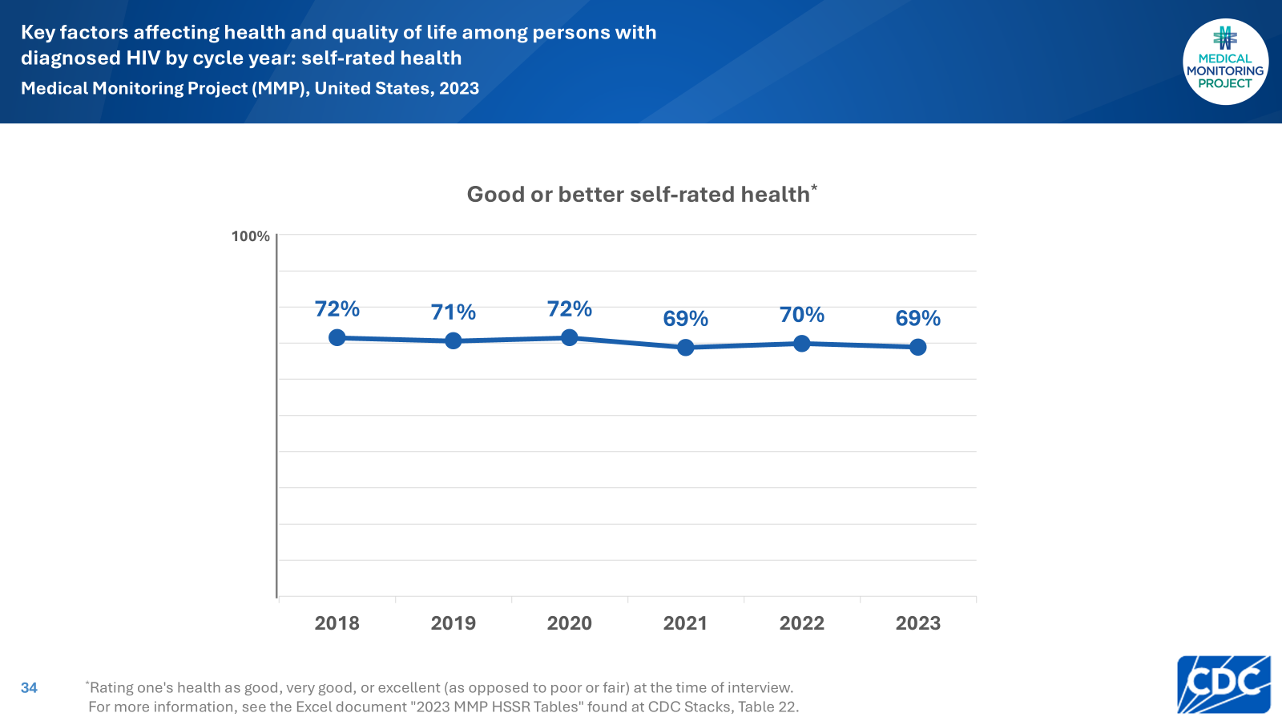
Notes:
In the 2023 cycle, an estimated 69% reported having good or better self-rated health.

Slide 35
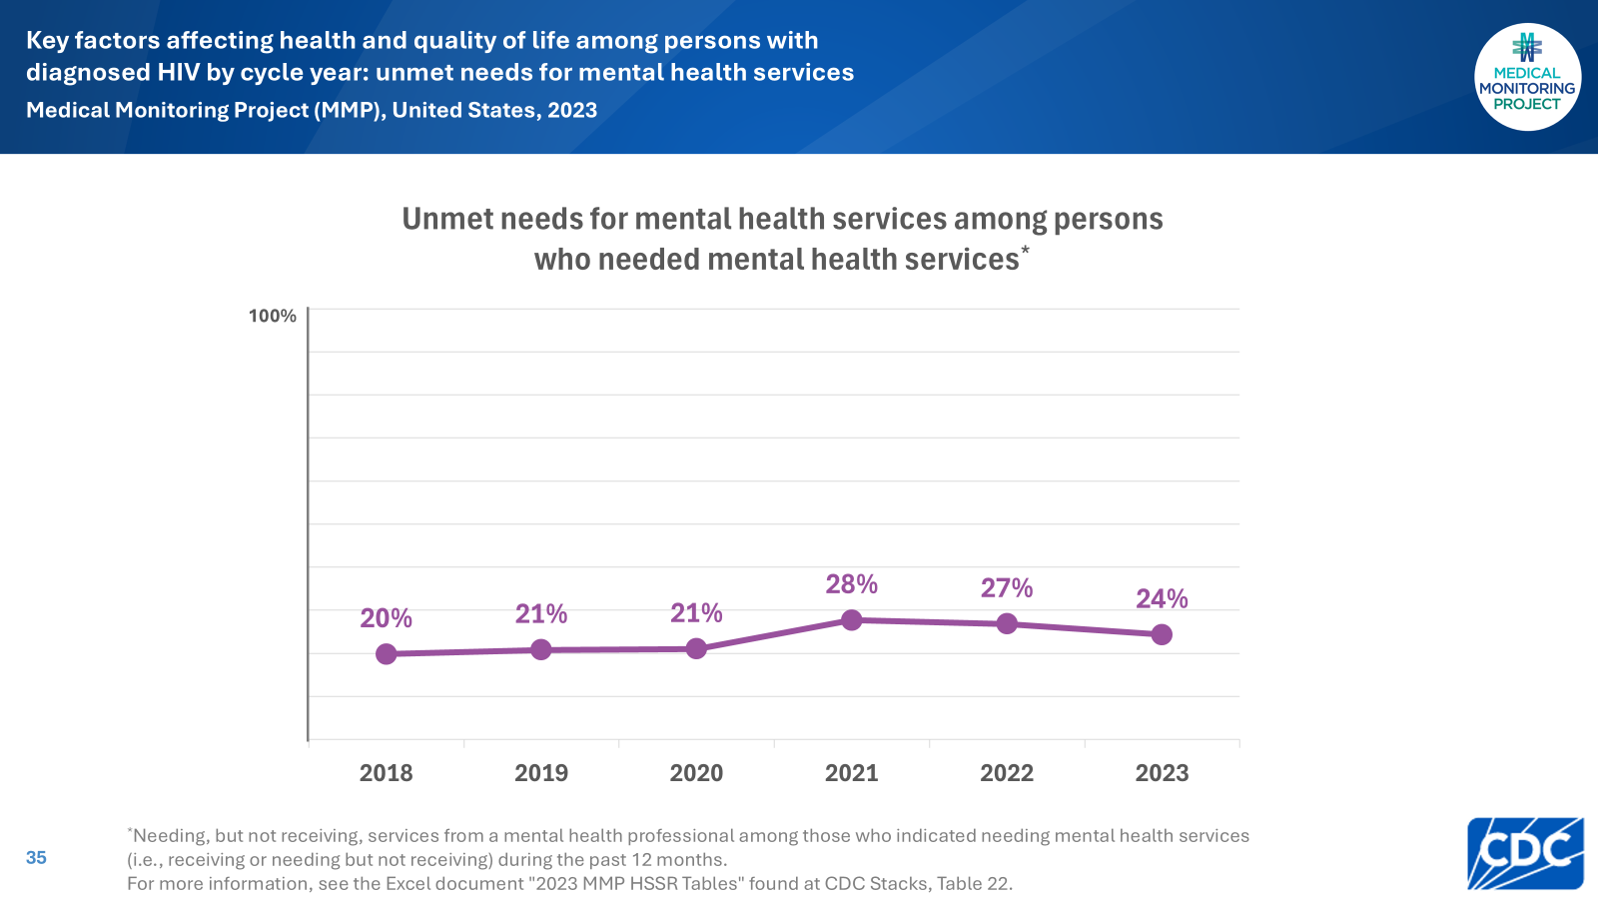
Notes:
Among those who needed mental health services, 24% reported unmet needs during the 2023 cycle.

Slide 36
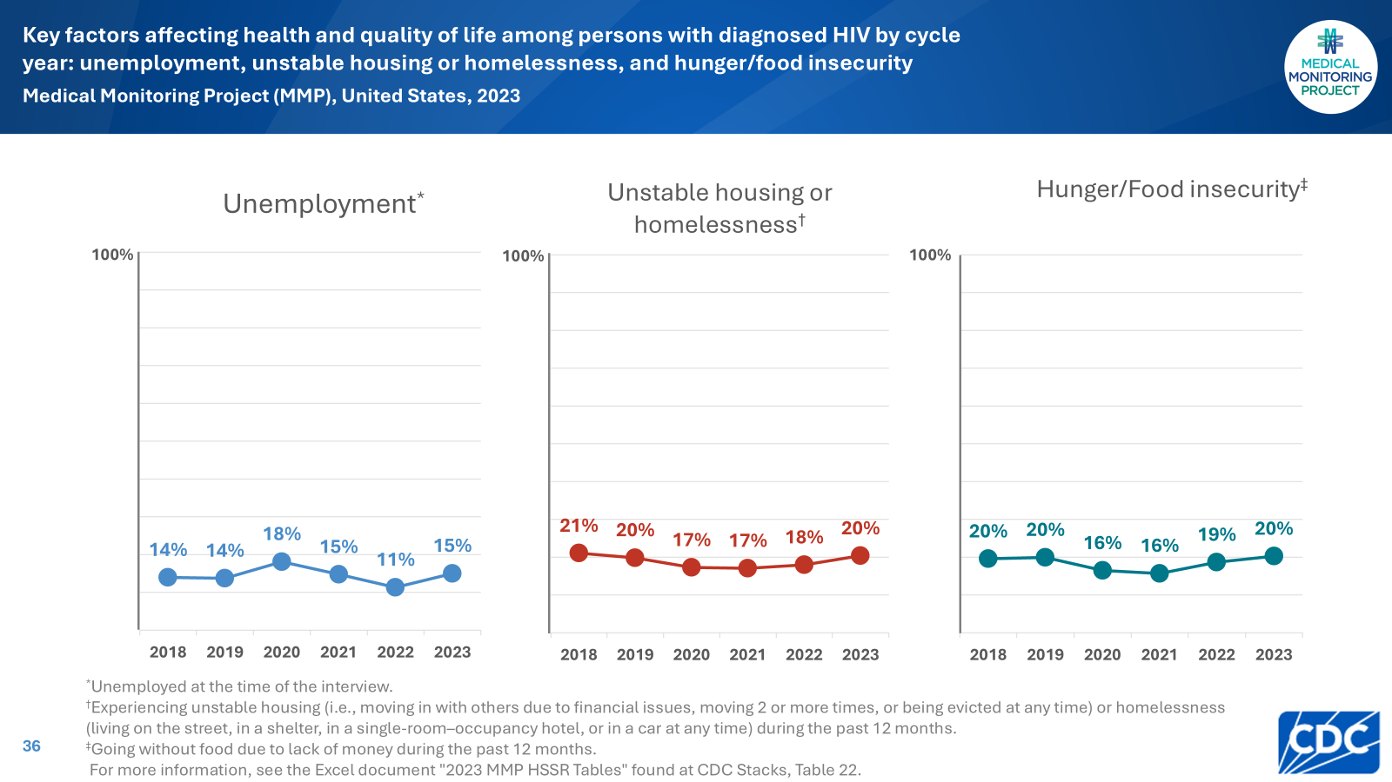
Notes:
In the 2023 cycle, 15% reported current unemployment, 20% reported unstable housing or homelessness, and 20% reported hunger/food insecurity.

Slide 37
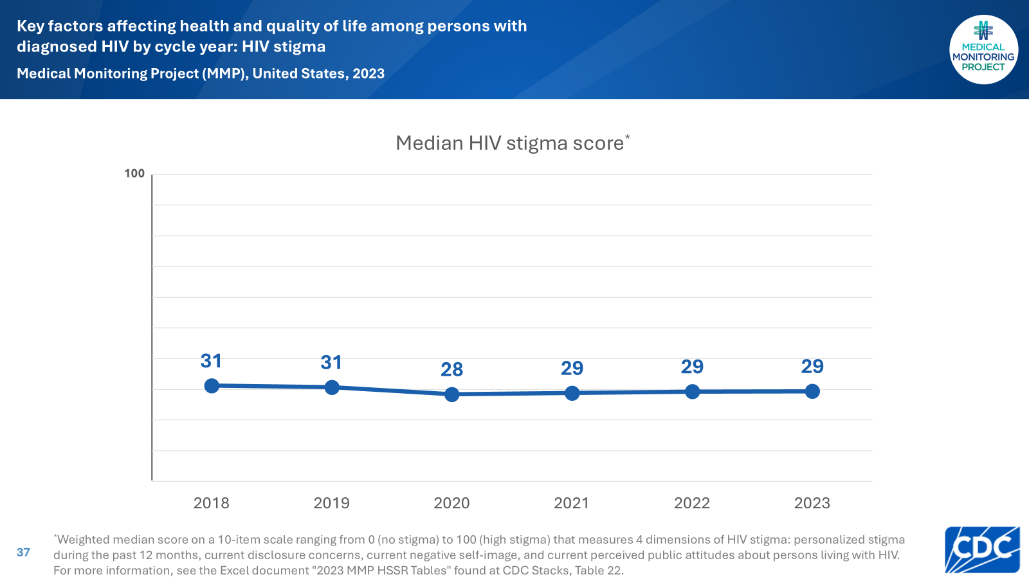
Notes:
During the 2023 cycle, the median HIV stigma score was 29.

Slide 38
