Slide 1

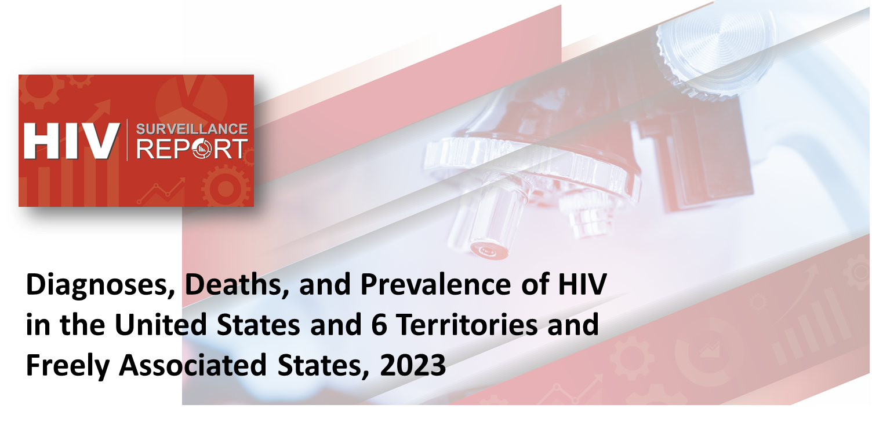
U.S. Centers for Disease Control and Prevention
U.S. Centers for Disease Control and Prevention
Notes:
These slides were prepared by the Division of HIV Prevention, National Center for HIV, Viral Hepatitis, STD, and TB Prevention (NCHHSTP), Centers for Disease Control and Prevention (CDC). These slides present data on persons with HIV in the United States based on cases of HIV infection reported to CDC’s National HIV Surveillance System (NHSS) through December 2024.
Note. This slide set is in the public domain. You may reproduce these slides without permission; however, citation as to source is appreciated.
Centers for Disease Control and Prevention. Diagnoses, Deaths and Prevalence of HIV in the United States and 6 Territories and Freely Associated States 2023. Atlanta: U.S. Department of Health and Human Services; 2025.
You are also free to adapt and revise these slides; however, you must remove the CDC name and logo if changes are made.

Slide 2
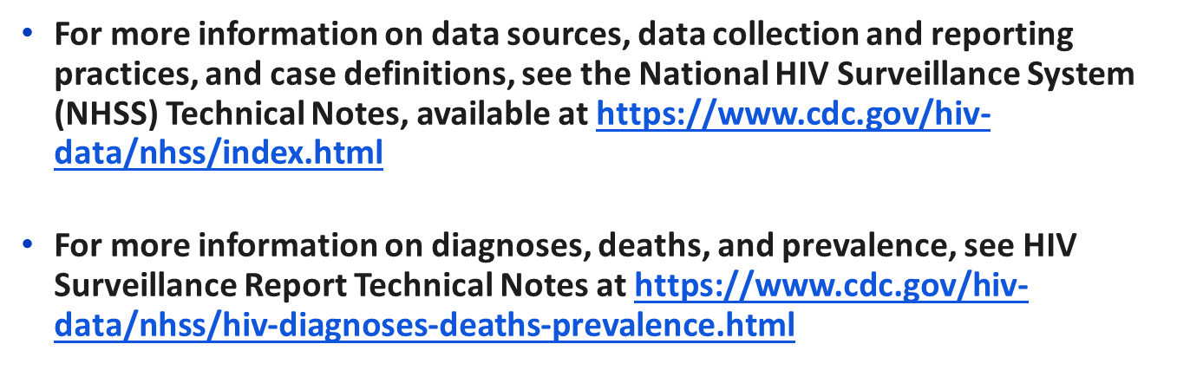

Data Sources and Technical Notes
Notes:
For more information on data sources, data collection and reporting practices, and case definitions, see the National HIV Surveillance System (NHSS) Technical Notes, available at https://www.cdc.gov/hiv-data/nhss/index.html.
For more information on diagnoses, deaths, and prevalence; see HIV Surveillance Report Technical Notes at https://www.cdc.gov/hiv-data/nhss/hiv-diagnoses-deaths-prevalence.html.

Slide 3
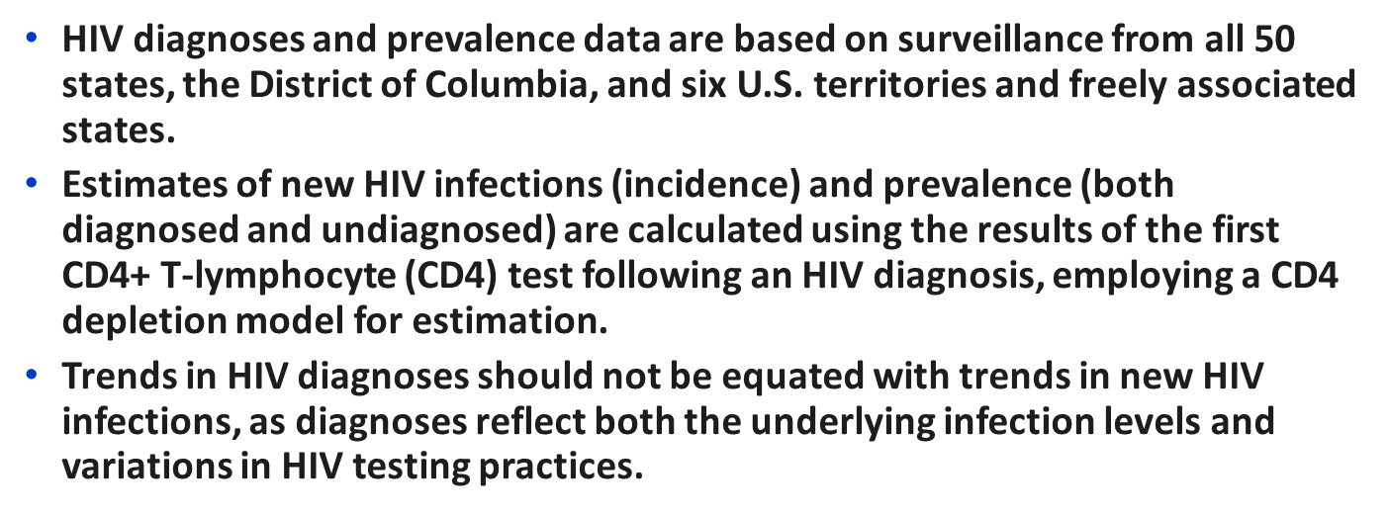
Understanding HIV Data: Diagnoses vs. New Infections
Notes:
For more information on diagnoses, deaths, and prevalence; see HIV Surveillance Report Technical Notes at https://www.cdc.gov/hiv-data/nhss/hiv-diagnoses-deaths-prevalence.html.
For more information on methods used to estimate HIV incidence and prevalence, see the Technical Notes, available at https://www.cdc.gov/hiv-data/nhss/estimated-hiv-incidence-and-prevalence.html.

Slide 4


Slide 5
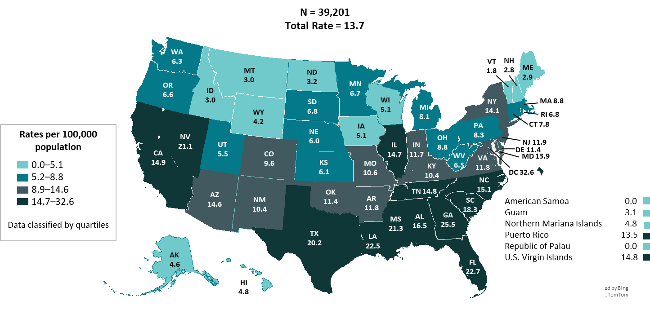
HIV diagnoses, 2023—United States and 6 territories and freely associated states
Note. Data are presented for persons aged ≥ 13 years at diagnosis.
Notes:
In 2023 in the United States and 6 territories and freely associated states, the highest HIV diagnoses rates among persons aged ≥ 13 years by residence at diagnosis were as follows:
District of Columbia (32.6), Georgia (25.5), Florida (22.7), Louisiana (22.5), and Mississippi (21.3).
Note.
Use caution when comparing the rates of diagnoses for the District of Columbia to the rates for states.
For additional data, see Table 16 in the report Diagnoses, Deaths and Prevalence of HIV in the United States and 6 Territories and Freely Associated States 2023 at https://www.cdc.gov/hiv-data/nhss/hiv-diagnoses-deaths-prevalence.html.
For more information on data sources, data collection and reporting practices, and case definitions, see the National HIV Surveillance System (NHSS) Technical Notes, available at https://www.cdc.gov/hiv-data/nhss/index.html.
For more information on diagnoses, see HIV Surveillance Report Technical Notes at https://www.cdc.gov/hiv-data/nhss/hiv-diagnoses-deaths-prevalence.html.

Slide 6
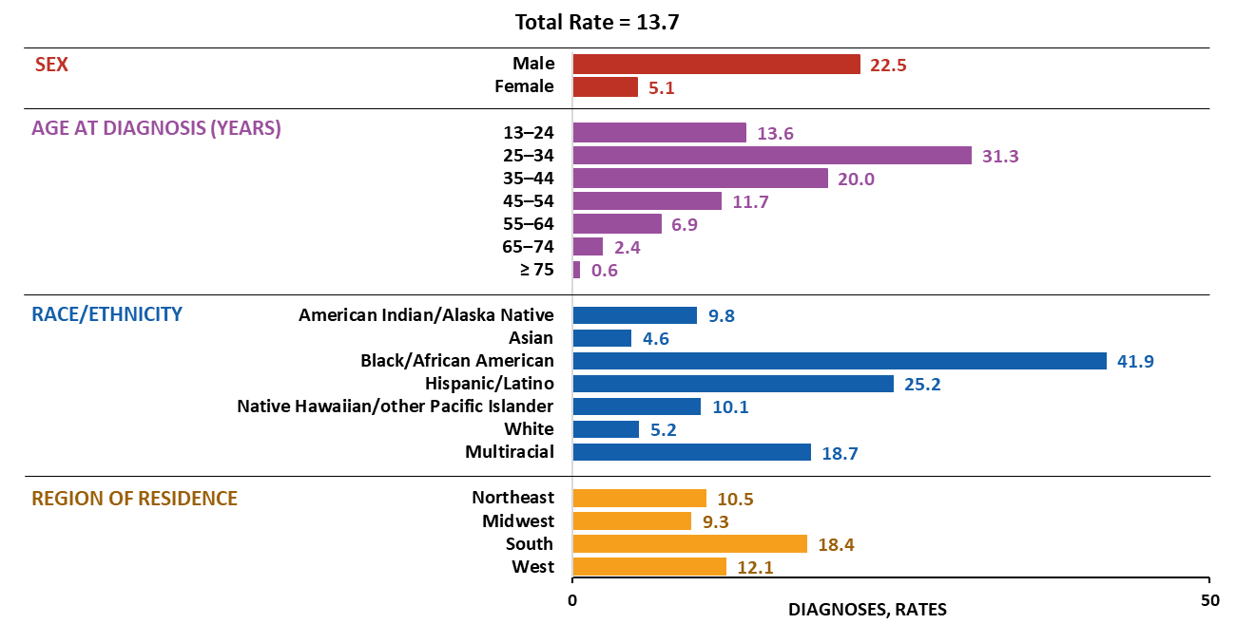
HIV diagnoses, by selected characteristics, 2023—United States
Note. Data are presented for persons aged ≥ 13 years at diagnosis. Rates are per 100,000. Hispanic/Latino persons can be of any race.
Notes:
In 2023 in the United States, the highest rates of HIV diagnoses among persons aged ≥ 13 years by sex, age, race/ethnicity, and region of residence were as follows:
Males (22.5)
Persons aged 25–34 years (31.3)
Black/African American persons (41.9)
Persons residing in the South (18.4)
Note.
Use caution when interpreting data for American Indian/Alaska Native and Native Hawaiian/other Pacific Islander persons as rates are based on small numbers.
For more information on data sources, data collection and reporting practices, and case definitions, see the National HIV Surveillance System (NHSS) Technical Notes, available at https://www.cdc.gov/hiv-data/nhss/index.html.
For more information on diagnoses, see HIV Surveillance Report Technical Notes at https://www.cdc.gov/hiv-data/nhss/hiv-diagnoses-deaths-prevalence.html.

Slide 7
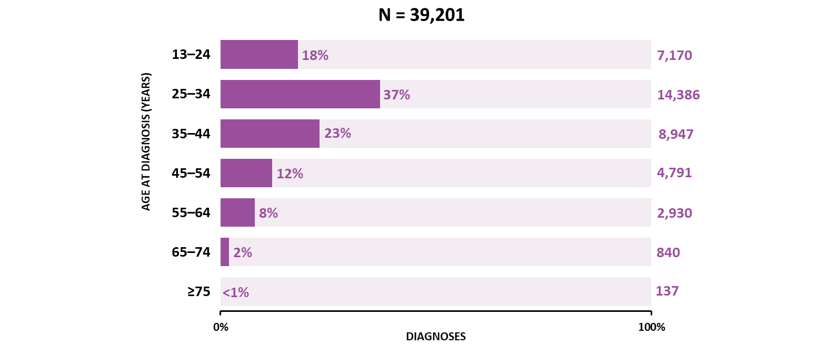
HIV diagnoses, by age, 2023—United States and 6 territories and freely associated states
Notes:
In 2023 in the United States and 6 territories and freely associated states, the highest percentages of HIV diagnoses among persons aged ≥ 13 years by age group were as follows:
Persons aged 25‒34 and 35‒44 years accounted for 60% of HIV diagnoses, 37% and 23%, respectively.
Note.
For additional data, see Table 1b in the report Diagnoses, Deaths and Prevalence of HIV in the United States and 6 Territories and Freely Associated States 2023 at https://www.cdc.gov/hiv-data/nhss/hiv-diagnoses-deaths-prevalence.html.
For more information on data sources, data collection and reporting practices, and case definitions, see the National HIV Surveillance System (NHSS) Technical Notes, available at https://www.cdc.gov/hiv-data/nhss/index.html.

Slide 8
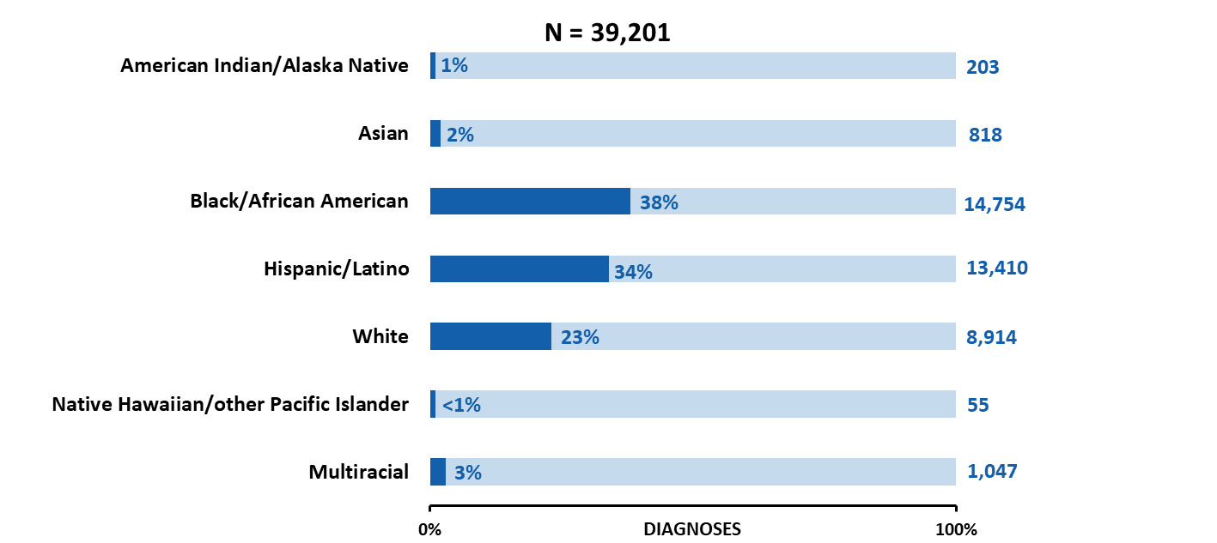
HIV diagnoses, by race/ethnicity, 2023—United States and 6 territories and freely associated states
Note. Data are presented for persons aged ≥ 13 years at diagnosis. Hispanic/Latino persons can be of any race.
Notes:
In 2023 in the United States and 6 territories and freely associated states, the highest percentages of HIV diagnoses among persons aged ≥ 13 years by race/ethnicity were as follows:
Black/African American (38%) and Hispanic/Latino (34%) persons.
Note.
For additional data, see Table 2b in the report Diagnoses, Deaths and Prevalence of HIV in the United States and 6 Territories and Freely Associated States 2023 at https://www.cdc.gov/hiv-data/nhss/hiv-diagnoses-deaths-prevalence.html.
Use caution when interpreting data for American Indian/Alaska Native and Native Hawaiian/other Pacific Islander persons as rates are based on small numbers.
For more information on data sources, data collection and reporting practices, and case definitions, see the National HIV Surveillance System (NHSS) Technical Notes, available at https://www.cdc.gov/hiv-data/nhss/index.html.

Slide 9
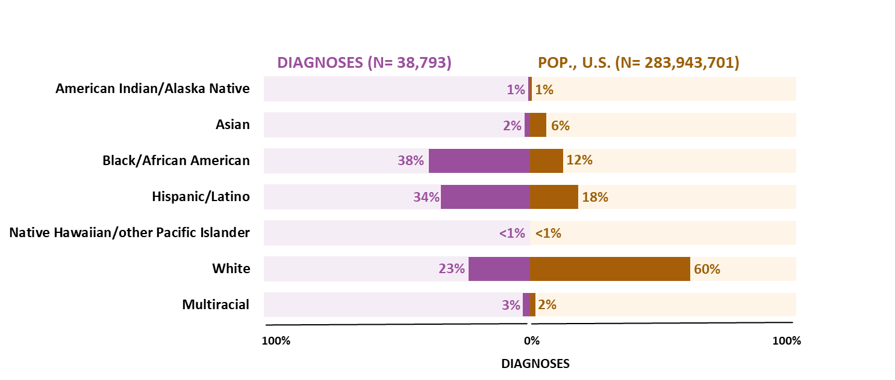
HIV diagnoses and population, by race/ethnicity, 2023—United States
Note. Data are presented for persons aged ≥ 13 years at diagnosis. Hispanic/Latino persons can be of any race.
Notes:
In 2023 in the United States, population and HIV diagnoses among persons aged ≥ 13 years by race/ethnicity were as follows:
Black/African American persons aged ≥ 13 years made up 12% of the population, but HIV among this group accounted for 38% of diagnoses.
Hispanic/Latino persons aged ≥ 13 years made up 18% of the population, but HIV among this group accounted for 34% of diagnoses.
Note.
Use caution when interpreting data for American Indian/Alaska Native and Native Hawaiian/other Pacific Islander persons due to small numbers.
For more information on data sources, data collection and reporting practices, and case definitions, see the National HIV Surveillance System (NHSS) Technical Notes, available at https://www.cdc.gov/hiv-data/nhss/index.html.
For more information on diagnoses, see HIV Surveillance Report Technical Notes at https://www.cdc.gov/hiv-data/nhss/hiv-diagnoses-deaths-prevalence.html.

Slide 10
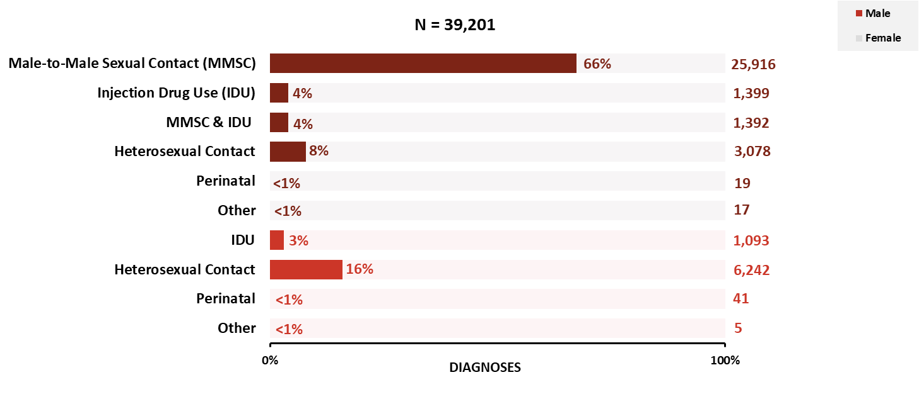
HIV diagnoses, by sex and transmission category, 2023—United States and 6 territories and freely associated states
Note. Data are presented for persons aged ≥ 13 years at diagnosis.
Notes:
In 2023 in the United States and 6 territories and freely associated states, the highest percentages of HIV diagnoses among persons aged ≥ 13 years by sex and transmission category were as follows:
Male: male-to-male sexual contact (66%)
Female: heterosexual contact (16%)
Note.
For additional data, see Table 1b in the report Diagnoses, Deaths and Prevalence of HIV in the United States and 6 Territories and Freely Associated States 2023 at https://www.cdc.gov/hiv-data/nhss/hiv-diagnoses-deaths-prevalence.html.
Data have been statistically adjusted to account for missing transmission category.
For more information on data sources, data collection and reporting practices, and case definitions, see the National HIV Surveillance System (NHSS) Technical Notes, available at https://www.cdc.gov/hiv-data/nhss/index.html.

Slide 11
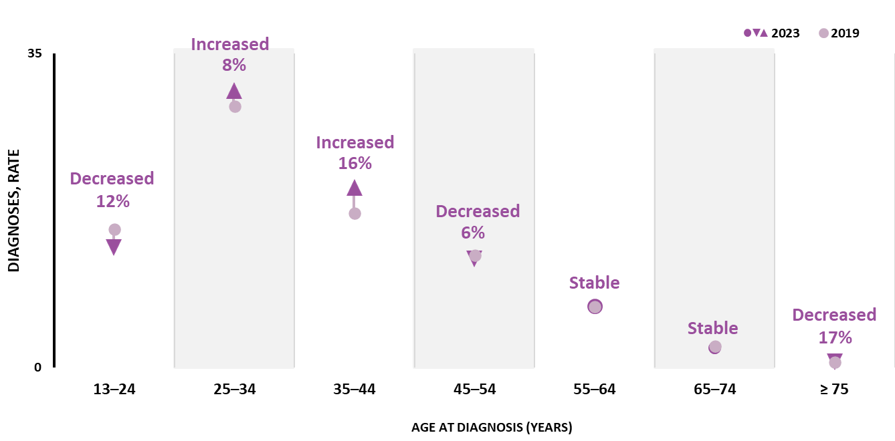
HIV diagnoses, by age, 2019–2023—United States and 6 territories and freely associated states
Note. Rates are per 100,000.
Notes:
In 2023, compared with 2019, in the United States and 6 territories and freely associated states changes in the rate of HIV diagnoses by age group were as follows:
Increase—persons aged 25–34 (8%) and 35–44 years (16%)
Decrease—persons aged 13–24 (12%), 45–54 (6%), and ≥ 75 years (17%)
Stable—persons aged 55–64 and 65–74 years
Note.
Trends in HIV diagnoses should not be equated with trends in new HIV infections, as diagnoses reflect both the underlying infection levels and variations in HIV testing practices.
For additional data, see Table 1b in the report Diagnoses, Deaths and Prevalence of HIV in the United States and 6 Territories and Freely Associated States 2023 at https://www.cdc.gov/hiv-data/nhss/hiv-diagnoses-deaths-prevalence.html.
For more information on data sources, data collection and reporting practices, and case definitions, see the National HIV Surveillance System (NHSS) Technical Notes, available at https://www.cdc.gov/hiv-data/nhss/index.html.

Slide 12
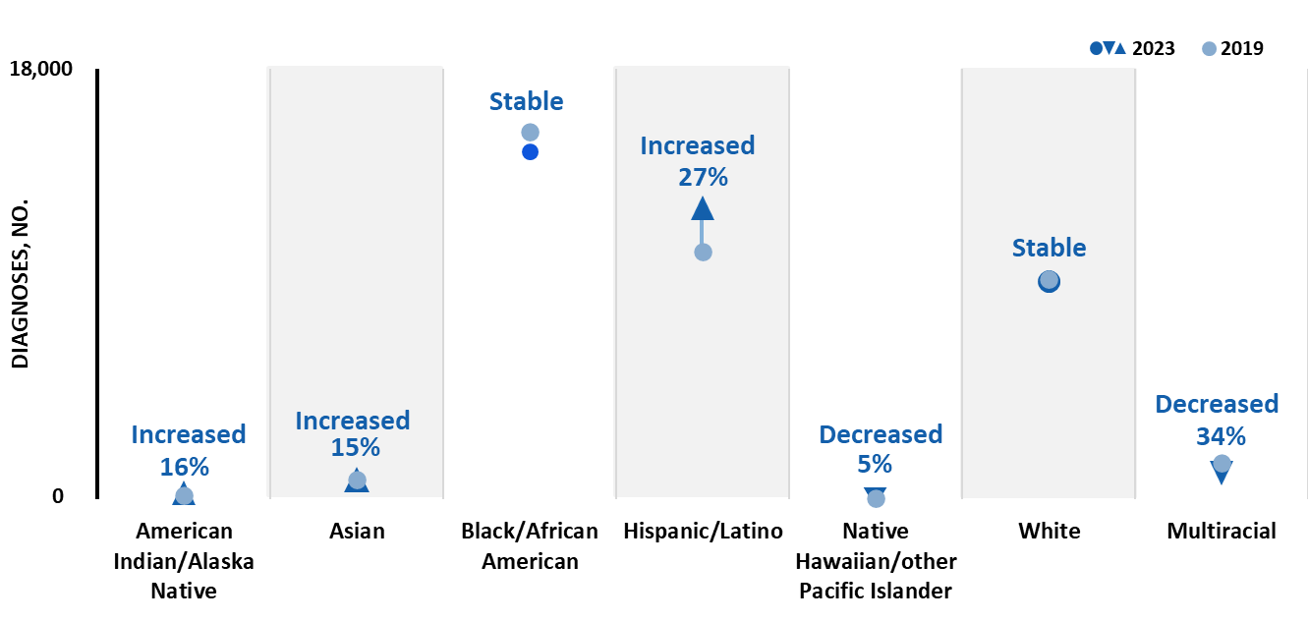
HIV diagnoses, by race/ethnicity, 2019–2023—United States and 6 territories and freely associated states
Note. Data are presented for persons aged ≥ 13 years at diagnosis. Hispanic/Latino persons can be of any race.
Notes:
In 2023, compared with 2019, in the United States and 6 territories and freely associated states changes in the numbers of HIV diagnoses among persons aged ≥ 13 years by race/ethnicity were as follows:
Increase—American Indian/Alaska Native (16%), Asian (15%), and Hispanic/Latino persons (27%)
Decrease—Native Hawaiian/other Pacific Islander (5%) and Multiracial persons (34%)
Stable—Black/African American and White persons
Note.
Trends in HIV diagnoses should not be equated with trends in new HIV infections, as diagnoses reflect both the underlying infection levels and variations in HIV testing practices.
For additional data, see Tables 3b in the report Diagnoses, Deaths and Prevalence of HIV in the United States and 6 Territories and Freely Associated States 2023 at https://www.cdc.gov/hiv-data/nhss/hiv-diagnoses-deaths-prevalence.html.
Use caution when interpreting data for American Indian/Alaska Native and Native Hawaiian/other Pacific Islander persons as percentages are based on small numbers.
For more information on data sources, data collection and reporting practices, and case definitions, see the National HIV Surveillance System (NHSS) Technical Notes, available at https://www.cdc.gov/hiv-data/nhss/index.html.

Slide 13
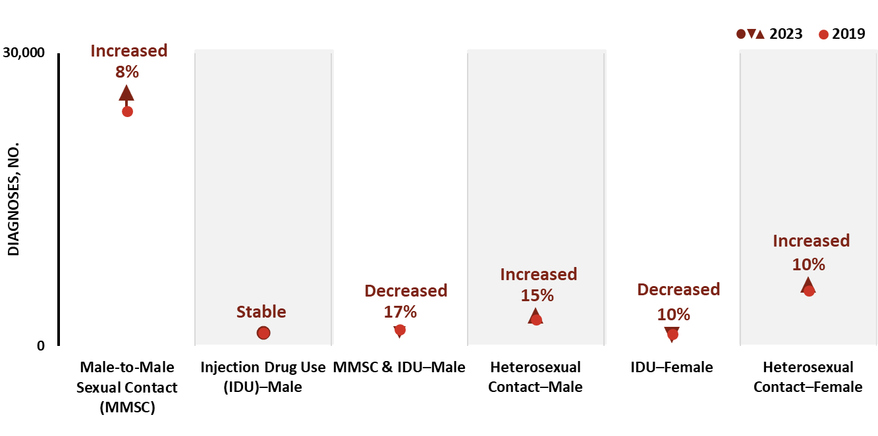
HIV diagnoses, by sex and transmission category, 2019–2023—United States and 6 territories and freely associated states
Note. Data are presented for persons aged ≥ 13 years at diagnosis.
Notes:
In 2023, compared with 2019, in the United States and 6 territories and freely associated states changes in the numbers of HIV diagnoses among persons aged ≥ 13 years by sex and transmission category were as follows:
Increase—Male-to-male sexual contact (MMSC) (8%), male heterosexual contact (15%), and female heterosexual contact (10%)
Decrease—MMSC and injection drug use (IDU) (17%) and female IDU (10%)
Stable—Male IDU
Note.
Trends in HIV diagnoses should not be equated with trends in new HIV infections, as diagnoses reflect both the underlying infection levels and variations in HIV testing practices.
For additional data, see Table 1b in the report Diagnoses, Deaths and Prevalence of HIV in the United States and 6 Territories and Freely Associated States 2023 at https://www.cdc.gov/hiv-data/nhss/hiv-diagnoses-deaths-prevalence.html.
For more information on data sources, data collection and reporting practices, and case definitions, see the National HIV Surveillance System (NHSS) Technical Notes, available at https://www.cdc.gov/hiv-data/nhss/index.html.

Slide 14
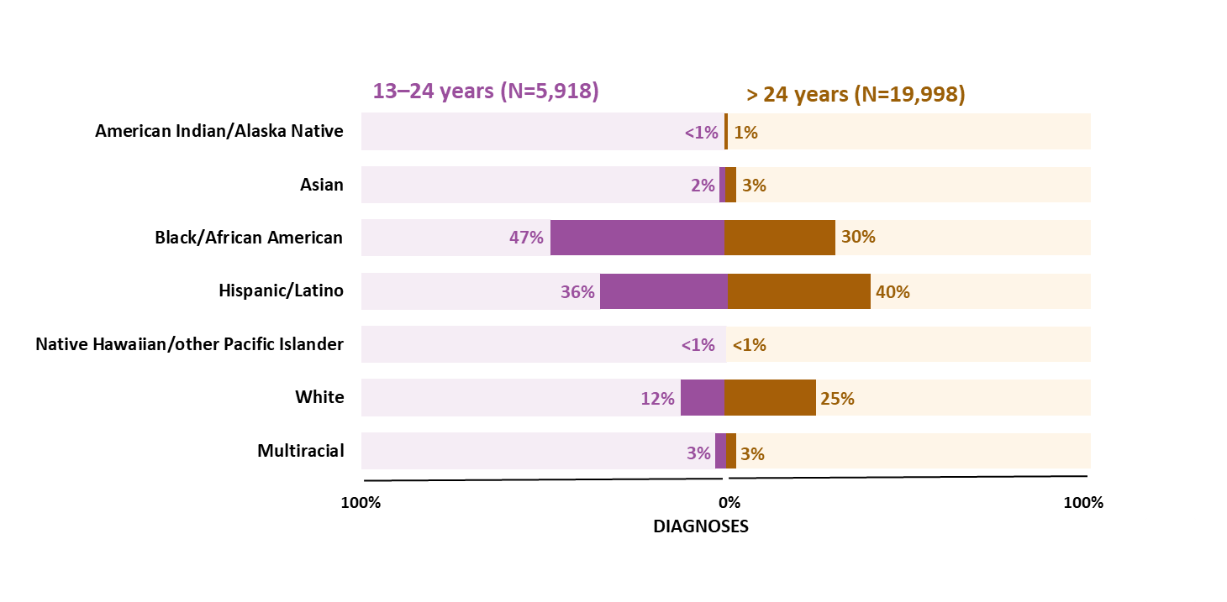
HIV diagnoses among males, attributed to male-to-male sexual contact, by age and race/ethnicity, 2023—United States and 6 territories and freely associated states
Note. Hispanic/Latino persons can be of any race.
Notes:
In 2023 in the United States and 6 territories and freely associated states, the highest percentages of HIV diagnoses among males with HIV attributed to male-to-male sexual contact by age and race/ethnicity were as follows:
Aged 13–24 years—Black/African American males (47%)
Aged > 24 years—Hispanic/Latino males (40%)
Note.
For additional data, see Table 4b in the report Diagnoses, Deaths and Prevalence of HIV in the United States and 6 Territories and Freely Associated States 2023 at https://www.cdc.gov/hiv-data/nhss/hiv-diagnoses-deaths-prevalence.html.
Use caution when interpreting data for American Indian/Alaska Native and Native Hawaiian/other Pacific Islander persons due to small numbers
Data have been statistically adjusted to account for missing transmission category.
For more information on data sources, data collection and reporting practices, and case definitions, see the National HIV Surveillance System (NHSS) Technical Notes, available at https://www.cdc.gov/hiv-data/nhss/index.html.

Slide 15
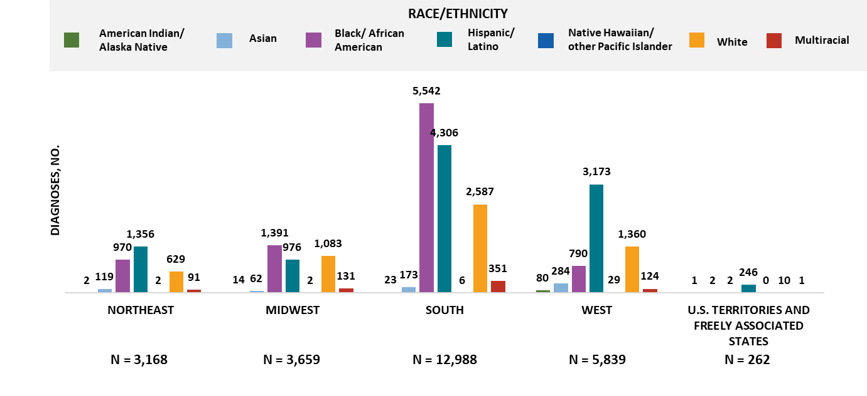
HIV diagnoses among males, attributed to male-to-male sexual contact, by region and race/ethnicity, 2023—United States and 6 territories and freely associated states
Note. Data are presented for persons aged ≥ 13 years at diagnosis. Hispanic/Latino persons can be of any race.
Notes:
In 2023 in the United States and 6 territories and freely associated states, the highest numbers and percentages of HIV diagnoses among males with HIV attributed to male-to-male sexual contact by region and race/ethnicity were as follows:
Northeast—Hispanic/Latino males (1,356; 43%)
Midwest—Black/African American males (1,391; 38%)
South—Black/African American males (5,542; 43%)
West—Hispanic/Latino males (3,173; 54%)
U.S. territories and freely associated states—Hispanic/Latino males (246; 94%)
Note.
For additional data, see Table 4b in the report Diagnoses, Deaths and Prevalence of HIV in the United States and 6 Territories and Freely Associated States 2023 at https://www.cdc.gov/hiv-data/nhss/hiv-diagnoses-deaths-prevalence.html.
Use caution when interpreting data for American Indian/Alaska Native and Native Hawaiian/other Pacific Islander persons due to small numbers.
Data have been statistically adjusted to account for missing transmission category.
For more information on data sources, data collection and reporting practices, and case definitions, see the National HIV Surveillance System (NHSS) Technical Notes, available at https://www.cdc.gov/hiv-data/nhss/index.html.

Slide 16
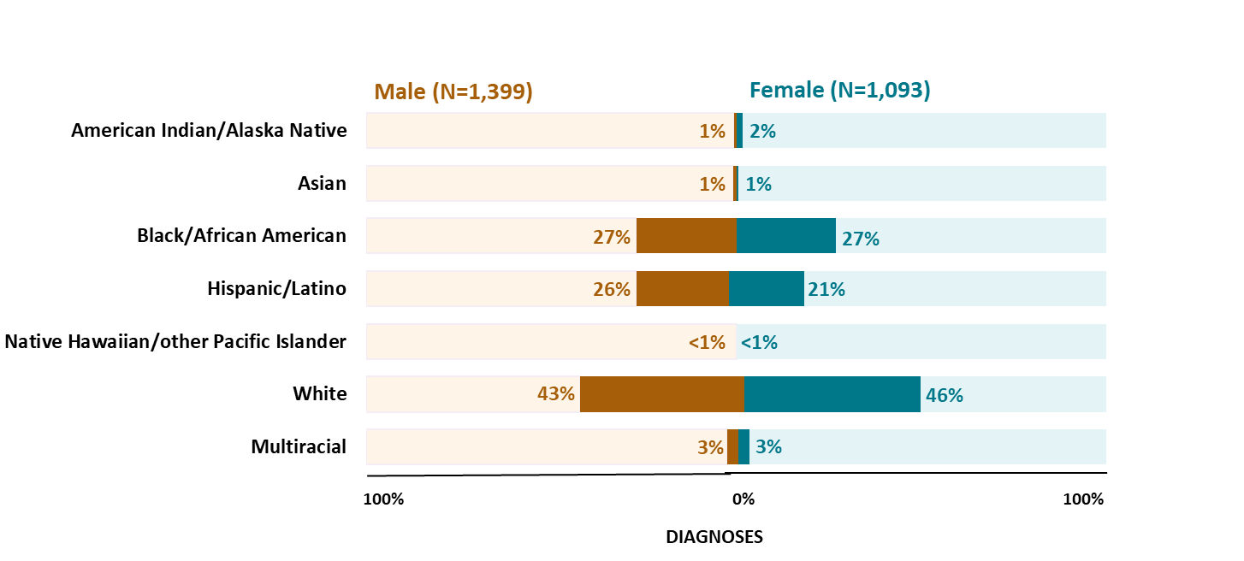
HIV diagnoses attributed to injection drug use, by sex and race/ethnicity, 2023—United States and 6 territories and freely associated states
Note. Data are presented for persons aged ≥ 13 years at diagnosis. Hispanic/Latino persons can be of any race.
Notes:
In 2023 in the United States and 6 territories and freely associated states, the highest percentages of HIV diagnoses attributed to injection drug use by sex and race/ethnicity were as follows:
Male—White persons (43%)
Female—White persons (46%)
Note.
For additional data, see Table 5b in the report Diagnoses, Deaths and Prevalence of HIV in the United States and 6 Territories and Freely Associated States 2023 at https://www.cdc.gov/hiv-data/nhss/hiv-diagnoses-deaths-prevalence.html.
Use caution when interpreting data for American Indian/Alaska Native and Native Hawaiian/other Pacific Islander persons due to small numbers.
Data have been statistically adjusted to account for missing transmission category.
For more information on data sources, data collection and reporting practices, and case definitions, see the National HIV Surveillance System (NHSS) Technical Notes, available at https://www.cdc.gov/hiv-data/nhss/index.html.

Slide 17
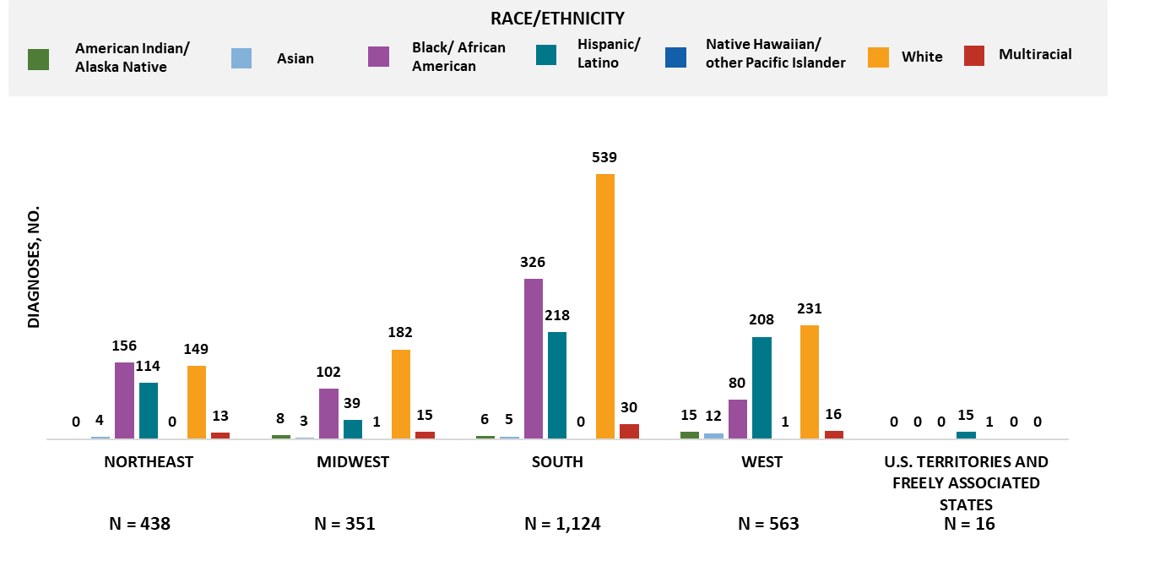
HIV diagnoses attributed to injection drug use, by region and race/ethnicity, 2023—United States and 6 territories and freely associated states
Note. Data are presented for persons aged ≥ 13 years at diagnosis. Hispanic/Latino persons can be of any race.
Notes:
In 2023 in the United States and 6 territories and freely associated states, the highest numbers and percentages of HIV diagnoses attributed to injection drug use by region and race/ethnicity were as follows:
Northeast—Black/African American persons (156; 36%)
Midwest—White persons (182; 52%)
South—White persons (539; 48%)
West—White persons (231; 41%)
U.S. territories and freely associated states—Hispanic/Latino (15; 94%)
Note.
For additional data, see Table 5b in the report Diagnoses, Deaths and Prevalence of HIV in the United States and 6 Territories and Freely Associated States 2023 at https://www.cdc.gov/hiv-data/nhss/hiv-diagnoses-deaths-prevalence.html.
Use caution when interpreting data for American Indian/Alaska Native, Asian, and Native Hawaiian/other Pacific Islander persons due to small numbers.
Data have been statistically adjusted to account for missing transmission category.
For more information on data sources, data collection and reporting practices, and case definitions, see the National HIV Surveillance System (NHSS) Technical Notes, available at https://www.cdc.gov/hiv-data/nhss/index.html.

Slide 18
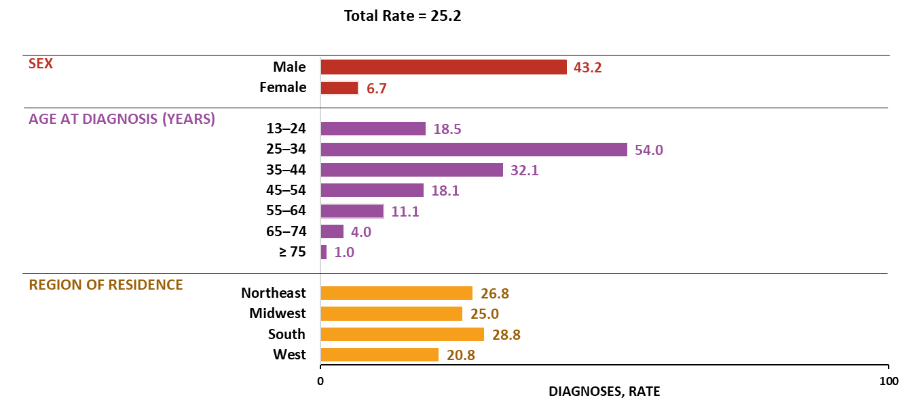
HIV diagnoses among Hispanic/Latino persons, by selected characteristics, 2023—United States
Note. Data are presented for persons aged ≥ 13 years at diagnosis. Rates are per 100,000. Hispanic/Latino persons can be of any race.
Notes:
In 2023 in the United States, the highest rates of HIV diagnoses among Hispanic/Latino persons aged ≥ 13 years by sex, age group, and region were as follows:
Males (43.2)
Persons aged 25–34 years (54.0)
Persons residing in the South (28.8)
Note.
For more information on data sources, data collection and reporting practices, and case definitions, see the National HIV Surveillance System (NHSS) Technical Notes, available at https://www.cdc.gov/hiv-data/nhss/index.html.
For more information on diagnoses, see HIV Surveillance Report Technical Notes at https://www.cdc.gov/hiv-data/nhss/hiv-diagnoses-deaths-prevalence.html.

Slide 19
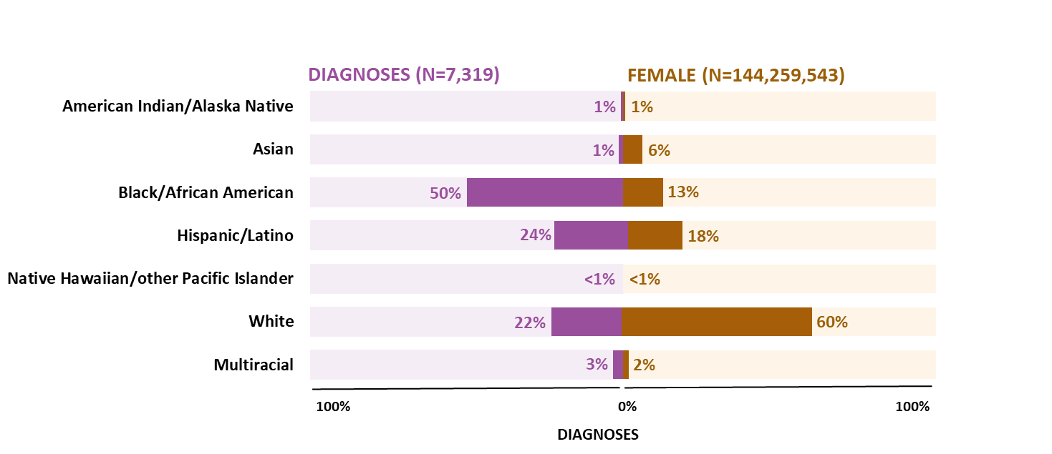
HIV diagnoses and population among females, by race/ethnicity, 2023—United States
Note. Data are presented for persons aged ≥ 13 years at diagnosis. Hispanic/Latino persons can be of any race.
Notes:
For 2023, the highest percentage of HIV diagnoses among females aged ≥ 13 years by race/ethnicity and U.S. population was among Black/African American females who accounted for half (50%) of HIV diagnoses but accounted for 13% of the female population.
Note.
Use caution when interpreting data for American Indian/Alaska Native and Native Hawaiian/other Pacific Islander females due to small numbers.
For more information on data sources, data collection and reporting practices, and case definitions, see the National HIV Surveillance System (NHSS) Technical Notes, available at https://www.cdc.gov/hiv-data/nhss/index.html.
For more information on diagnoses, see HIV Surveillance Report Technical Notes at https://www.cdc.gov/hiv-data/nhss/hiv-diagnoses-deaths-prevalence.html.

Slide 20
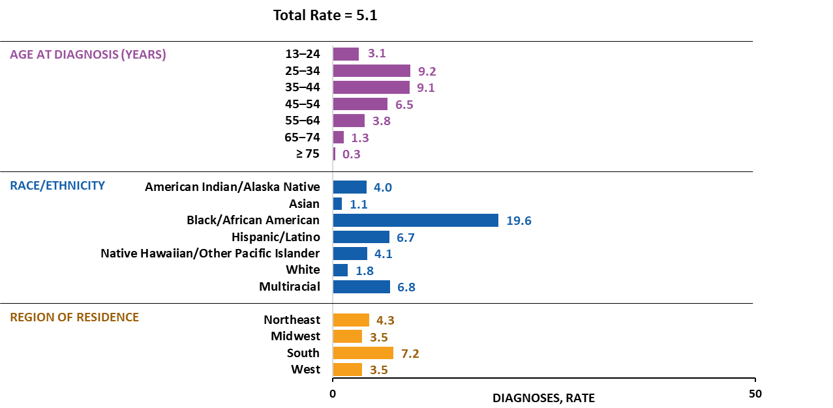
HIV diagnoses among females, by selected characteristics, 2023—United States
Note. Data are presented for persons aged ≥ 13 years at diagnosis. Rates are per 100,000. Hispanic/Latino persons can be of any race.
Notes:
In 2023 in the United States, the highest rates of HIV diagnoses among females aged ≥ 13 years by age group, race/ethnicity, and region of residence were as follows:
Females aged 25–34 years (9.2)
Black/African American females (19.6)
Females residing in the South (7.2)
Note.
Use caution when interpreting data for American Indian/Alaska Native and Native Hawaiian/other Pacific Islander females as rates are based on small numbers.
For more information on data sources, data collection and reporting practices, and case definitions, see the National HIV Surveillance System (NHSS) Technical Notes, available at https://www.cdc.gov/hiv-data/nhss/index.html.
For more information on diagnoses, see HIV Surveillance Report Technical Notes at https://www.cdc.gov/hiv-data/nhss/hiv-diagnoses-deaths-prevalence.html.

Slide 21
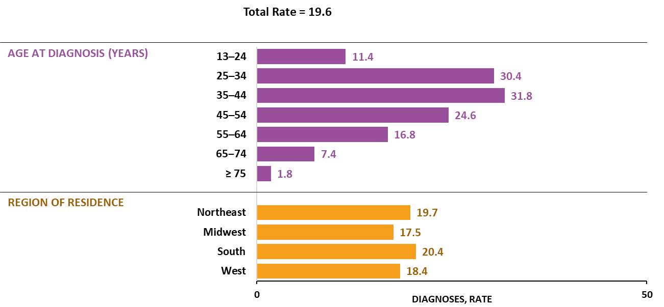
HIV diagnoses among Black females, by selected characteristics, 2023—United States
Note. Data are presented for persons aged ≥ 13 years at diagnosis. Rates are per 100,000.
Notes:
In 2023 in the United States, the highest rates of HIV diagnoses among Black/African American females aged ≥ 13 years by age group and region were as follows:
Females aged 35–44 years (31.8)
Females residing in the South (20.4)
Note.
For more information on data sources, data collection and reporting practices, and case definitions, see the National HIV Surveillance System (NHSS) Technical Notes, available at https://www.cdc.gov/hiv-data/nhss/index.html.
For more information on diagnoses, see HIV Surveillance Report Technical Notes at https://www.cdc.gov/hiv-data/nhss/hiv-diagnoses-deaths-prevalence.html.

Slide 22
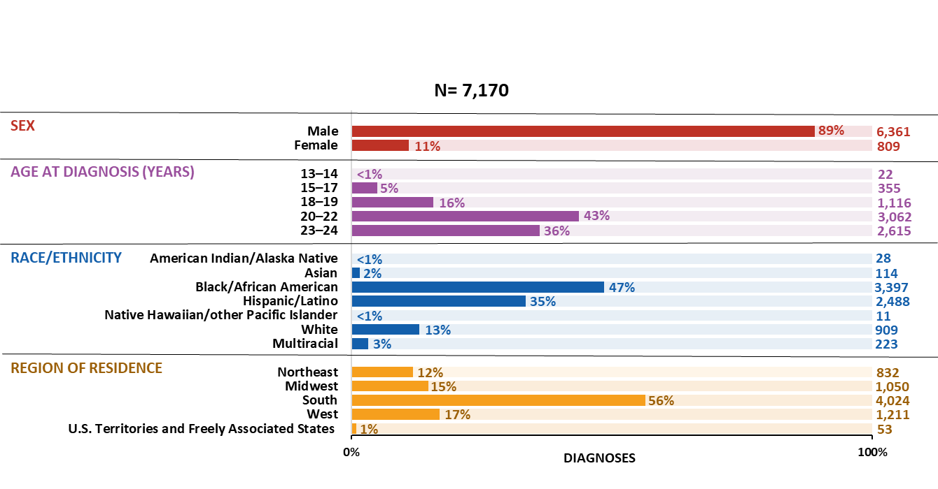
HIV diagnoses among persons aged 13–24 years, by selected characteristics, 2023—United States and 6 territories and freely associated states
Note. Hispanic/Latino persons can be of any race.
Notes:
In 2023 in the United States and 6 territories and freely associated states, the highest numbers and percentages of HIV diagnoses among persons aged 13–24 years by sex, age group, race/ethnicity, and region were as follows:
Males—6,361 (89%)
20–22 years—1,116 (43%)
Black/African American persons—3,397 (47%)
South—4,024 (56%)
Note.
For additional data, see Table 7b in the report Diagnoses, Deaths and Prevalence of HIV in the United States and 6 Territories and Freely Associated States 2023 at https://www.cdc.gov/hiv-data/nhss/hiv-diagnoses-deaths-prevalence.html.
Use caution when interpreting data for persons aged 13–14 years, American Indian/Alaska Native, and Native Hawaiian/other Pacific Islander persons due to small numbers.
For more information on data sources, data collection and reporting practices, and case definitions, see the National HIV Surveillance System (NHSS) Technical Notes, available at https://www.cdc.gov/hiv-data/nhss/index.html.

Slide 23
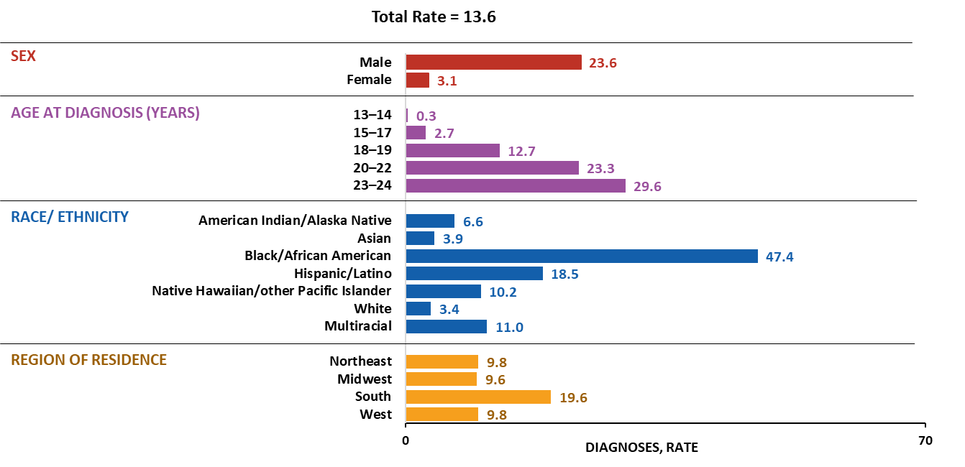
HIV diagnoses among persons aged 13–24 years, by selected characteristics, 2023—United States
Note. Rates are per 100,000. Hispanic/Latino persons can be of any race.
Notes:
In 2023 in the United States, HIV diagnoses among persons aged 13–24 years by sex, age at diagnosis, race/ethnicity, and region were as follows:
Males (23.6)
Persons aged 23–24 years (29.6)
Black/African American persons (47.4)
Persons residing in the South (19.6)
Note.
For additional data, see Table 7a in the report Diagnoses, Deaths and Prevalence of HIV in the United States and 6 Territories and Freely Associated States 2023 at https://www.cdc.gov/hiv-data/nhss/hiv-diagnoses-deaths-prevalence.html.
Use caution when interpreting data for persons aged 13‒14 years, American Indian/Alaska Native, and Native Hawaiian/other Pacific Islander persons due to small numbers.
For more information on data sources, data collection and reporting practices, and case definitions, see the National HIV Surveillance System (NHSS) Technical Notes, available at https://www.cdc.gov/hiv-data/nhss/index.html.

Slide 24
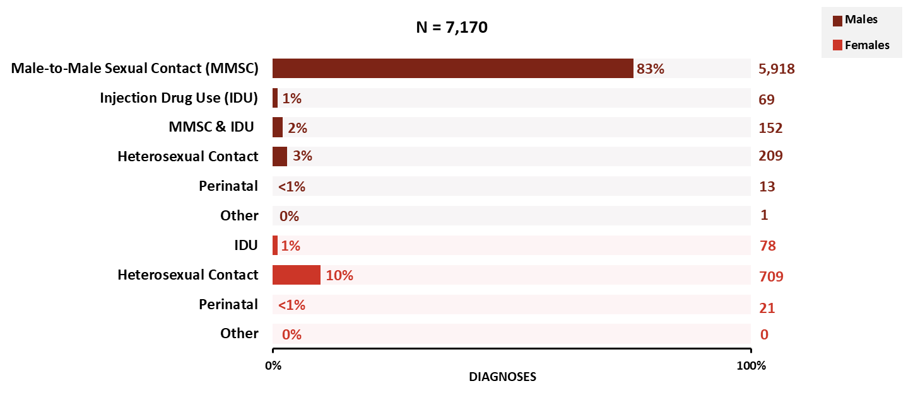
HIV diagnoses among persons aged 13–24 years, by sex and transmission category, 2023—United States and 6 territories and freely associated states
Notes:
In 2023 in the United States and 6 territories and freely associated states, the highest percentages of HIV diagnoses among persons aged 13–24 years by sex and transmission category were as follows:
Male—male-to-male sexual contact (83%)
Female—heterosexual contact (10%)
Note.
For additional data, see Table 7b in the report Diagnoses, Deaths and Prevalence of HIV in the United States and 6 Territories and Freely Associated States 2023 at https://www.cdc.gov/hiv-data/nhss/hiv-diagnoses-deaths-prevalence.html.
Data have been statistically adjusted to account for missing transmission category.
For more information on data sources, data collection and reporting practices, and case definitions, see the National HIV Surveillance System (NHSS) Technical Notes, available at https://www.cdc.gov/hiv-data/nhss/index.html.

Slide 25
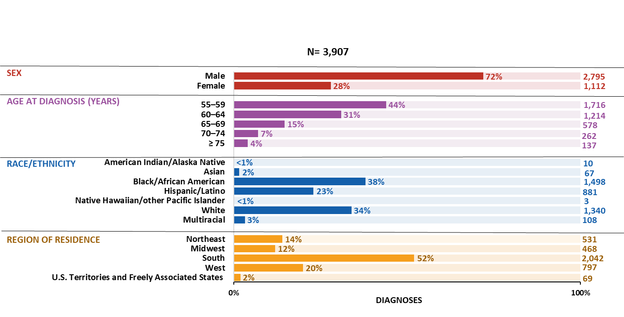
HIV diagnoses among persons aged ≥ 55 years, by selected characteristics, 2023—United States and 6 territories and freely associated states
Note. Hispanic/Latino persons can be of any race.
Notes:
In 2023, in the United States and 6 territories and freely associated states, the highest numbers and percentages of HIV diagnoses among persons aged ≥ 55 years by sex, age group, race/ethnicity, and region were as follows:
Males—2,795 (72%)
55–59 years—1,716 (44%)
Black/African American persons—1,498 (38%)
South—2,042 (52%)
Note.
Use caution when interpreting data for American Indian/Alaska Native and Native Hawaiian/other Pacific Islander persons due to small numbers.
For more information on data sources, data collection and reporting practices, and case definitions, see the National HIV Surveillance System (NHSS) Technical Notes, available at https://www.cdc.gov/hiv-data/nhss/index.html.
For more information on diagnoses, see HIV Surveillance Report Technical Notes at https://www.cdc.gov/hiv-data/nhss/hiv-diagnoses-deaths-prevalence.html.

Slide 26
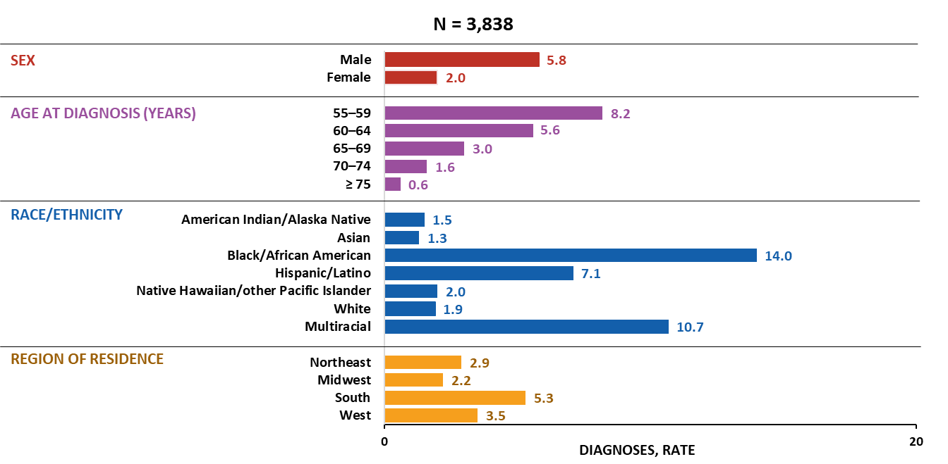
HIV diagnoses among persons aged ≥ 55 years, by selected characteristics, 2023—United States
Note. Rates are per 100,000. Hispanic/Latino persons can be of any race.
Notes:
In 2023 in the United States, the highest rates of HIV diagnoses among persons aged ≥ 55 years by sex, age group, race/ethnicity, and region were as follows:
Males (5.8), persons aged 55–59 years (8.2)
Black/African American persons (14.0)
Persons residing in the South (5.3)
Note.
Use caution when interpreting data for American Indian/Alaska Native and Native Hawaiian/other Pacific Islander persons due to small numbers.
For more information on data sources, data collection and reporting practices, and case definitions, see the National HIV Surveillance System (NHSS) Technical Notes, available at https://www.cdc.gov/hiv-data/nhss/index.html.
For more information on diagnoses, see HIV Surveillance Report Technical Notes at https://www.cdc.gov/hiv-data/nhss/hiv-diagnoses-deaths-prevalence.html.

Slide 27
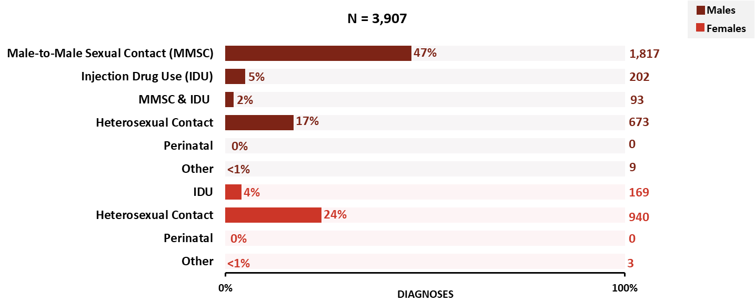
HIV diagnoses among persons aged ≥ 55 years, by sex and transmission category, 2023—United States and 6 territories and freely associated states
Notes:
In 2023 in the United States and 6 territories and freely associated states, the highest numbers and percentages of HIV diagnoses among persons aged ≥ 55 years by sex and transmission category were as follows:
Male—male-to-male sexual contact (1,817; 47%)
Female—heterosexual contact (940; 24%)
Note.
Data have been statistically adjusted to account for missing transmission category.
For more information on data sources, data collection and reporting practices, and case definitions, see the National HIV Surveillance System (NHSS) Technical Notes, available at https://www.cdc.gov/hiv-data/nhss/index.html.
For more information on diagnoses, see HIV Surveillance Report Technical Notes at https://www.cdc.gov/hiv-data/nhss/hiv-diagnoses-deaths-prevalence.html.

Slide 28
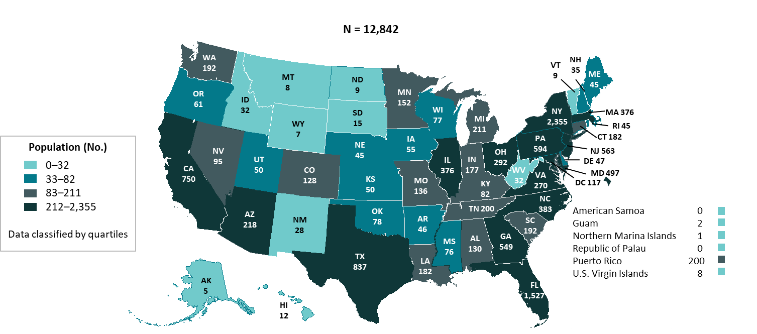
Persons living with diagnosed perinatally acquired HIV, year-end 2023—United States and 6 territories and freely associated states
Note. Prevalence data should be interpreted with caution due to use of preliminary death data for the year 2023 reported to CDC as of December 2024.
Notes:
At year-end 2023 in the United States and 6 territories and freely associated states, the highest numbers of persons living with perinatally acquired HIV by area of residence were as follows:
New York (2,355), Florida (1,527), Texas (837), Pennsylvania (594), and New Jersey (563)
Note.
Data reflects persons (i.e., children, adolescents, and adults) with diagnosed, perinatally acquired HIV who were alive at year-end 2023, regardless of their age at year-end 2023.
For more information on data sources, data collection and reporting practices, and case definitions, see the National HIV Surveillance System (NHSS) Technical Notes, available at https://www.cdc.gov/hiv-data/nhss/index.html.
For more information on prevalence, see HIV Surveillance Report Technical Notes at https://www.cdc.gov/hiv-data/nhss/hiv-diagnoses-deaths-prevalence.html.

Slide 29
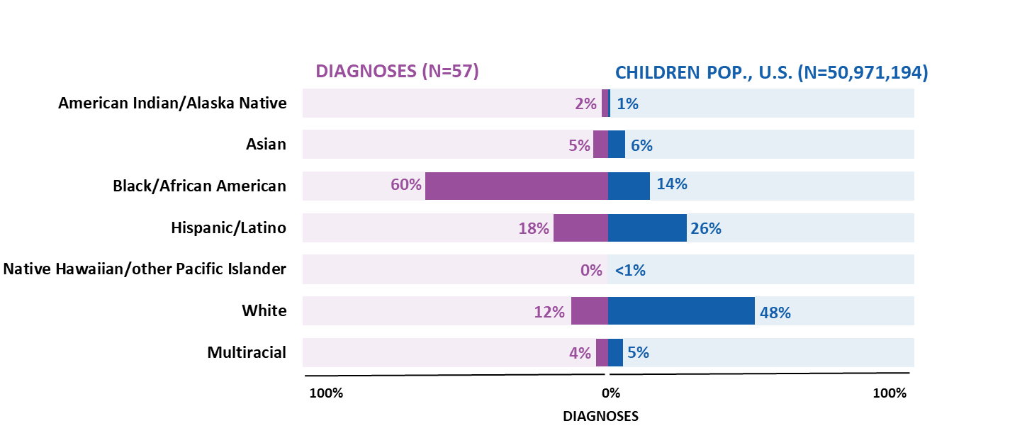
HIV diagnoses and population among children aged < 13 years, by race/ethnicity, 2023—United States
Note. Hispanic/Latino persons can be of any race.
Notes:
In 2023 in the United States, the highest percentage of HIV diagnoses among children aged <13 years was among Black/African American children aged < 13 years who accounted for 60% of HIV diagnoses but 14% of the children aged <13 years population.
Note.
Use caution when interpreting data for American Indian/Alaska Native and Native Hawaiian/other Pacific Islander persons as percentages are based on small numbers.
For more information on data sources, data collection and reporting practices, and case definitions, see the National HIV Surveillance System (NHSS) Technical Notes, available at https://www.cdc.gov/hiv-data/nhss/index.html.
For more information on diagnoses, see HIV Surveillance Report Technical Notes at https://www.cdc.gov/hiv-data/nhss/hiv-diagnoses-deaths-prevalence.html.

Slide 30
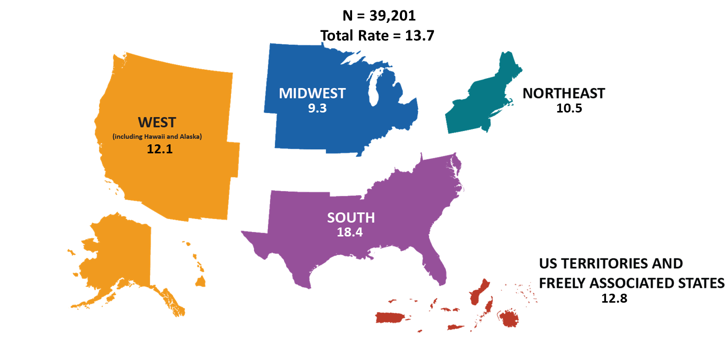
HIV diagnoses, by region, 2023—United States and 6 territories and freely associated states
Note. Rates are per 100,000. Data are presented for persons aged ≥ 13 years at diagnosis.
Notes:
In 2023, among the four main regions in the United States (the Northeast, Midwest, South, and West) and 6 territories and freely associated states; the South had the highest rate (18.4) of HIV diagnoses.
Note.
For additional data, see Table 16 in the report Diagnoses, Deaths and Prevalence of HIV in the United States and 6 Territories and Freely Associated States 2023 at https://www.cdc.gov/hiv-data/nhss/hiv-diagnoses-deaths-prevalence.html.
For more information on data sources, data collection and reporting practices, and case definitions, see the National HIV Surveillance System (NHSS) Technical Notes, available at https://www.cdc.gov/hiv-data/nhss/index.html.

Slide 31
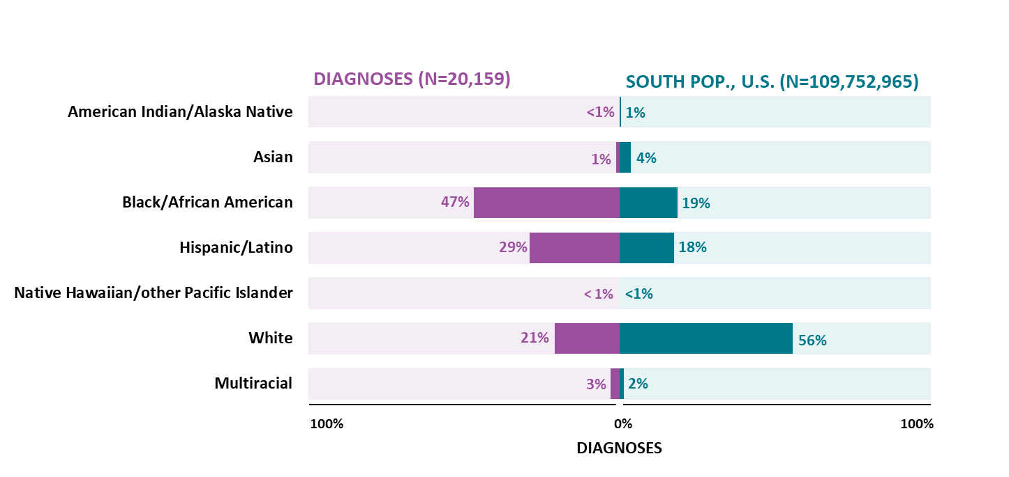
HIV diagnoses and population, by race/ethnicity, 2023—U.S. Southern Region
Note. Data are presented for persons aged ≥ 13 years at diagnosis. Hispanic/Latino persons can be of any race.
Notes:
In 2023, in the U.S. Southern Region, the highest percentage of HIV diagnoses among persons aged ≥ 13 years was among Black/African American persons who accounted for 47% of HIV diagnoses but made up 19% of persons aged ≥ 13 years.
Note.
Use caution when interpreting data for American Indian/Alaska Native and Native Hawaiian/other Pacific Islander persons as percentages are based on small numbers.
For more information on data sources, data collection and reporting practices, and case definitions, see the National HIV Surveillance System (NHSS) Technical Notes, available at https://www.cdc.gov/hiv-data/nhss/index.html.
For more information on diagnoses, see HIV Surveillance Report Technical Notes at https://www.cdc.gov/hiv-data/nhss/hiv-diagnoses-deaths-prevalence.html.

Slide 32
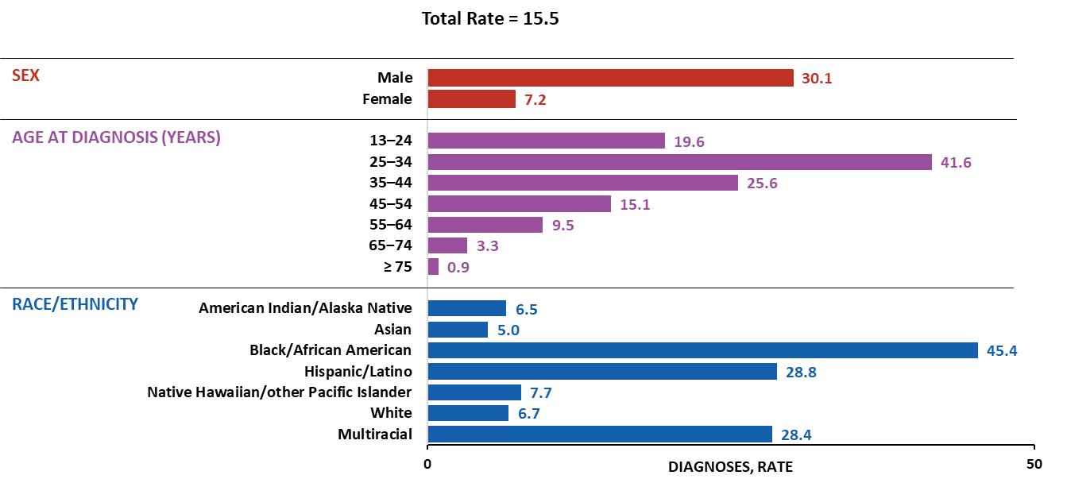
HIV diagnoses, by selected characteristics, 2023—U.S. Southern Region
Note. Data are presented for persons aged ≥ 13 years at diagnosis. Rates are per 100,000. Hispanic/Latino persons can be of any race.
Notes:
In 2023 in the U.S. Southern Region, the highest rates of HIV diagnoses among persons aged ≥ 13 years by sex, age group, and race/ethnicity were as follows:
Males (30.1)
Persons aged 25–34 years (41.6)
Black/African American persons (45.4)
Note.
Use caution when interpreting data for American Indian/Alaska Native and Native Hawaiian/other Pacific Islander persons as rates are based on small numbers.
For more information on data sources, data collection and reporting practices, and case definitions, see the National HIV Surveillance System (NHSS) Technical Notes, available at https://www.cdc.gov/hiv-data/nhss/index.html.
For more information on diagnoses, see HIV Surveillance Report Technical Notes at https://www.cdc.gov/hiv-data/nhss/hiv-diagnoses-deaths-prevalence.html.

Slide 33


Slide 34
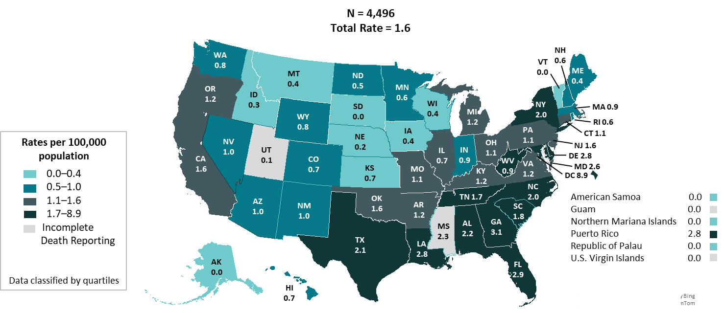
HIV-related deaths of persons with diagnosed HIV, 2023—United States and 6 territories and freely associated states
Note. Data are presented for persons aged ≥ 13 years at death. Rates are per 100,000. Deaths of persons with diagnosed HIV infection are based on residence at death.
Notes:
In 2023 in the United States and 6 territories and freely associated states, the highest rates of HIV related deaths among persons aged ≥ 13 years with diagnosed HIV by residence at the time of death were as follows:
District of Columbia (8.9), Georgia (3.1), Florida (2.9), Delaware (2.8), and Louisiana (2.8)
Note.
For additional data, see Table 9b in the report Diagnoses, Deaths and Prevalence of HIV in the United States and 6 Territories and Freely Associated States 2023 at https://www.cdc.gov/hiv-data/nhss/hiv-diagnoses-deaths-prevalence.html.
HIV-related deaths include deaths with an underlying cause with an International Classification of Diseases, Tenth Revision code of B20–B24, O98.7, or R75. Data for the year 2023 are preliminary and based on death data received by CDC as of December 2024.
Use caution when comparing the rates of diagnoses for the District of Columbia to the rates for states.
For more information on data sources, data collection and reporting practices, and case definitions, see the National HIV Surveillance System (NHSS) Technical Notes, available at https://www.cdc.gov/hiv-data/nhss/index.html.

Slide 35
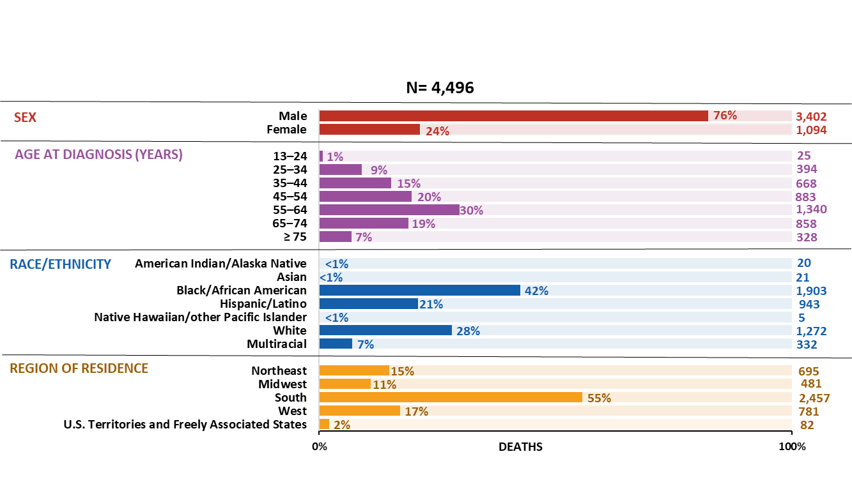
HIV-related deaths of persons with diagnosed HIV, by selected characteristics, 2023—United States and 6 territories and freely associated states
Note. Data are presented for persons aged ≥ 13 years at death. Hispanic/Latino persons can be of any race.
Notes:
In 2023 in the United States and 6 territories and freely associated states, the highest numbers and percentages of HIV-related deaths of persons aged ≥ 13 years with diagnosed HIV by sex, age group, race/ethnicity, and region of residence at the time of death were as follows:
Males―3,402 (76%)
55–64 years―1,340 (30%)
Black/African American persons―1,903 (43%)
South―2,457 (56%)
Note.
For additional data, see Table 9b in the report Diagnoses, Deaths and Prevalence of HIV in the United States and 6 Territories and Freely Associated States 2023 at https://www.cdc.gov/hiv-data/nhss/hiv-diagnoses-deaths-prevalence.html.
HIV-related deaths include deaths with an underlying cause with an International Classification of Diseases, Tenth Revision code of B20–B24, O98.7, or R75. Data for the year 2023 are preliminary and based on death data received by CDC as of December 2024.
Use caution when interpreting data for persons aged 13‒24 years, American Indian/Alaska Native, Asian, and Native Hawaiian/other Pacific Islander persons as percentages due to are based on small numbers.
For more information on data sources, data collection and reporting practices, and case definitions, see the National HIV Surveillance System (NHSS) Technical Notes, available at https://www.cdc.gov/hiv-data/nhss/index.html.

Slide 36


Slide 37
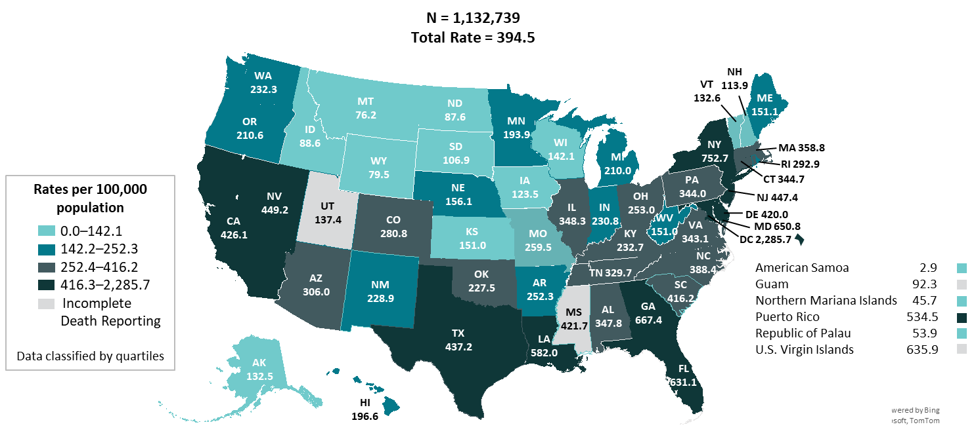
Persons living with diagnosed HIV (Prevalence), 2023—United States and 6 territories and freely associated states
Note. Data are presented for persons aged ≥ 13 years at year-end 2023. Prevalence data should be interpreted with caution due to use of preliminary death data for the year 2023 reported to CDC as of December 2024.
Notes:
At year-end 2023 in the United States and 6 territories and freely associated states, the highest rates of persons aged ≥ 13 years living with diagnosed HIV by area of residence were as follows:
District of Columbia (2,285.7), New York (752.7), Georgia (667.4), Maryland (650.8), U.S. Virgin Islands (635.9), and Florida (631.1)
Note.
For additional data, see Table 12b in the report Diagnoses, Deaths and Prevalence of HIV in the United States and 6 Territories and Freely Associated States 2023 at https://www.cdc.gov/hiv-data/nhss/hiv-diagnoses-deaths-prevalence.html.
Prevalence data for 2023 should be interpreted with caution due to the use of preliminary death data for that year reported to CDC as of December 2024.
Use caution when comparing the rates of diagnoses for the District of Columbia to the rates for states.
For more information on data sources, data collection and reporting practices, and case definitions, see the National HIV Surveillance System (NHSS) Technical Notes, available at https://www.cdc.gov/hiv-data/nhss/index.html.

Slide 38
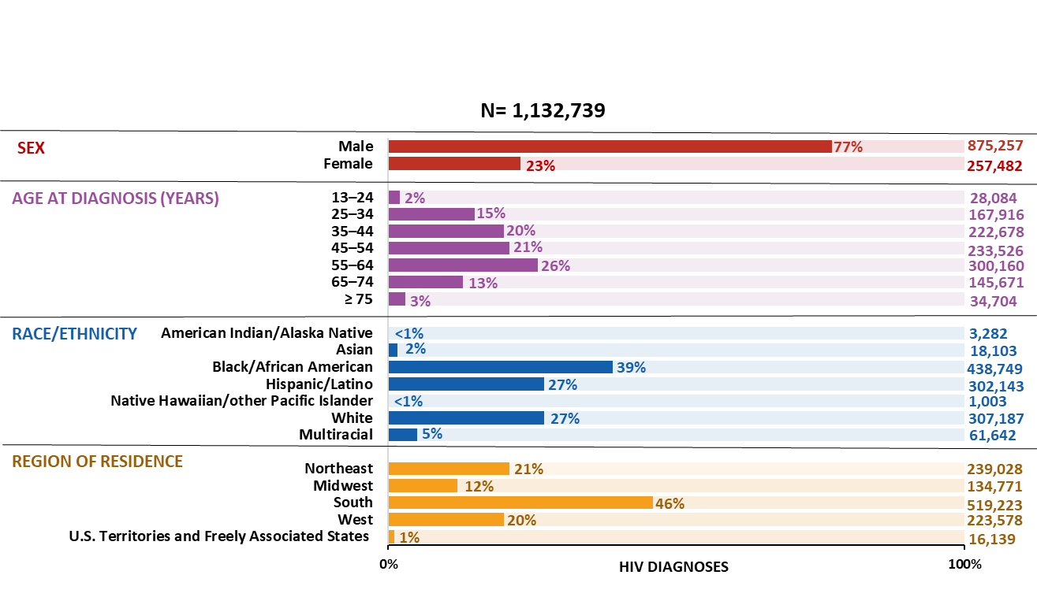
Persons living with diagnosed HIV (Prevalence), by selected characteristics, 2023—United States and 6 territories and freely associated states
Note. Data are presented for persons aged ≥ 13 years at year-end 2023. Hispanic/Latino persons can be of any race.
Notes:
In 2023 in the United States and 6 territories and freely associated states, the highest numbers and percentages of persons aged ≥ 13 years living with diagnosed HIV by sex, age group, race/ethnicity, and region of residence were as follows:
Males―875,257 (77%)
55–64 years―300,160 (26%)
Black/African American persons―438,749 (39%)
South―519,223 (46%)
Note.
For additional data, see Table 12b in the report Diagnoses, Deaths and Prevalence of HIV in the United States and 6 Territories and Freely Associated States 2023 at https://www.cdc.gov/hiv-data/nhss/hiv-diagnoses-deaths-prevalence.html.
Prevalence data for 2023 should be interpreted with caution due to the use of preliminary death data for that year reported to CDC as of December 2024.
Use caution when interpreting data for American Indian/Alaska Native and Native Hawaiian/other Pacific Islander persons due to small numbers.
For more information on data sources, data collection and reporting practices, and case definitions, see the National HIV Surveillance System (NHSS) Technical Notes, available at https://www.cdc.gov/hiv-data/nhss/index.html.

