Slide 1
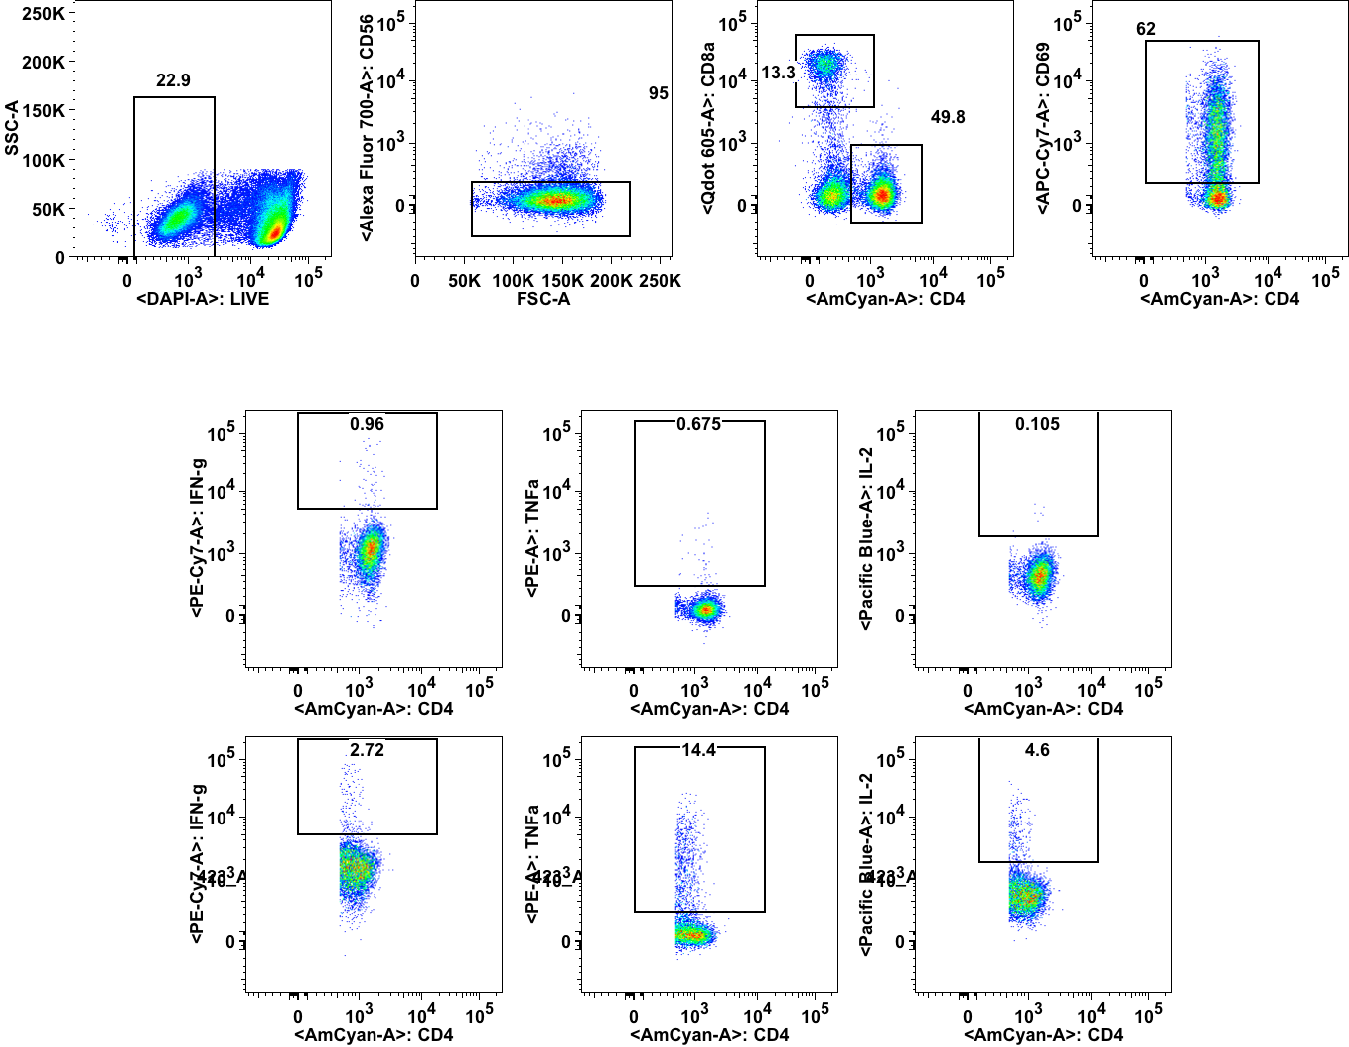
Figure S1.
Live cell Non-NK cell CD4/CD8 CD69+CD4+
IFN-γ TNF-α IL-2

