Slide 1
Topic 8: Ppe part 2 – gloves
[Date of training]
Notes:
Participants log in and get settled.

Slide 2
Agenda
Objectives
Discussion
Role of Gloves in Infection Control
“Dos and Don’ts” for Using Gloves at Work
Next Steps
Notes:
Facilitator Notes
Welcome the group and add a greeting to the chat box.
If this session is part of an ongoing series, you may choose to say “welcome back,” “thank you for joining us again,” etc.
Announce housekeeping notes, either orally or via chat.
If needed, provide additional notes specific to the platform you’re using (e.g., how to “raise your hand,” how to post questions).
Establish that the session focuses on gloves.
Provide an overview of the agenda.
Adapt this section of the session as needed: for instance, you may choose to spend additional time on introductions if there are new faces, or if participants do not know each other.
Sample Script
“Welcome to Project Firstline. Over the next 10 minutes, we’ll focus on one important piece of your PPE – your personal protective equipment – gloves. Please keep your videos on, to the extent possible, and keep your microphone muted when you are not contributing to the discussion. It’s great to see you all here today!”
“Today we’ll talk about the role of gloves in infection control, and we’ll also cover some ‘dos and don’ts’ for using them at work every day.”

Slide 3
Learning Objectives
Describe two (2) reasons why wearing gloves is important for infection control.
Discuss two (2) reasons why wearing more than one pair of gloves at once is not recommended for routine care.
Notes:
Facilitator Notes
Provide an overview of the session’s learning objectives.
Sample Script
“Here is what we expect to learn today. By the end of today’s training, you will be able to describe why it’s important to wear gloves, and how to wear them properly.”

Slide 4
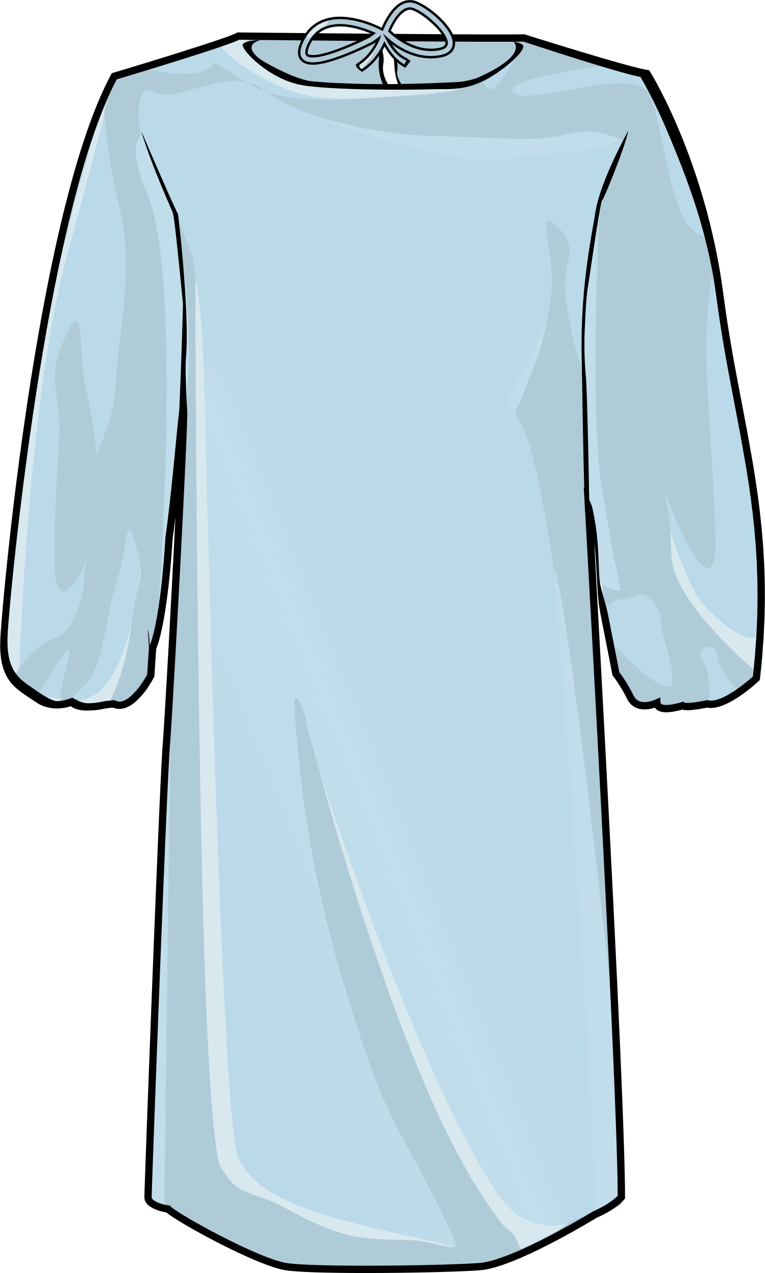
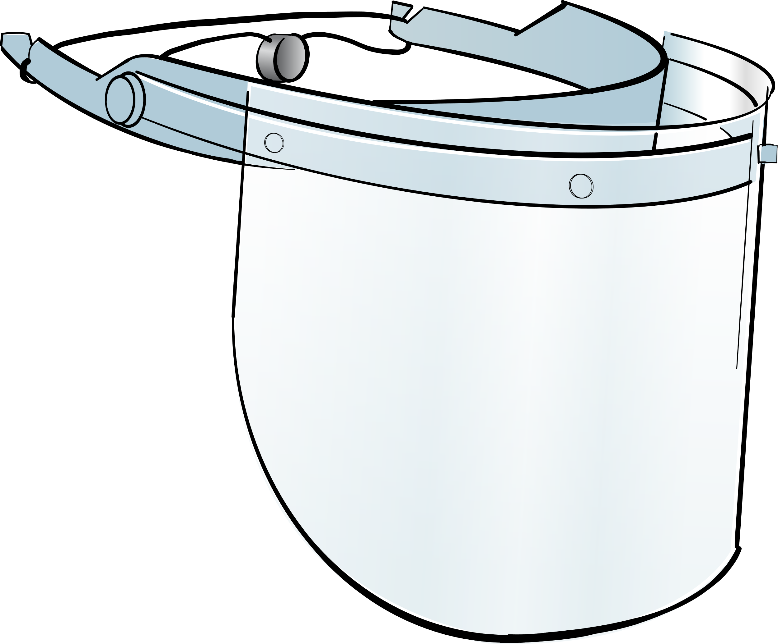
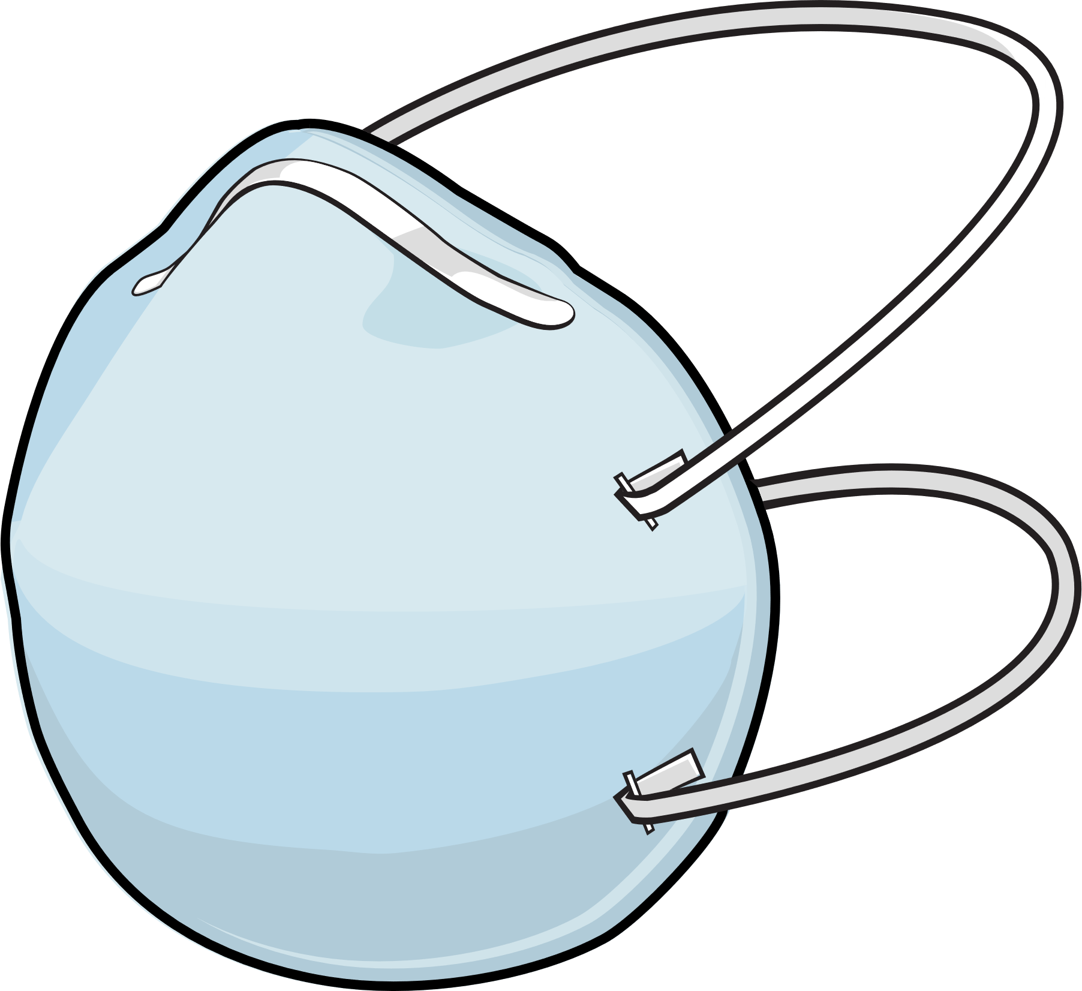
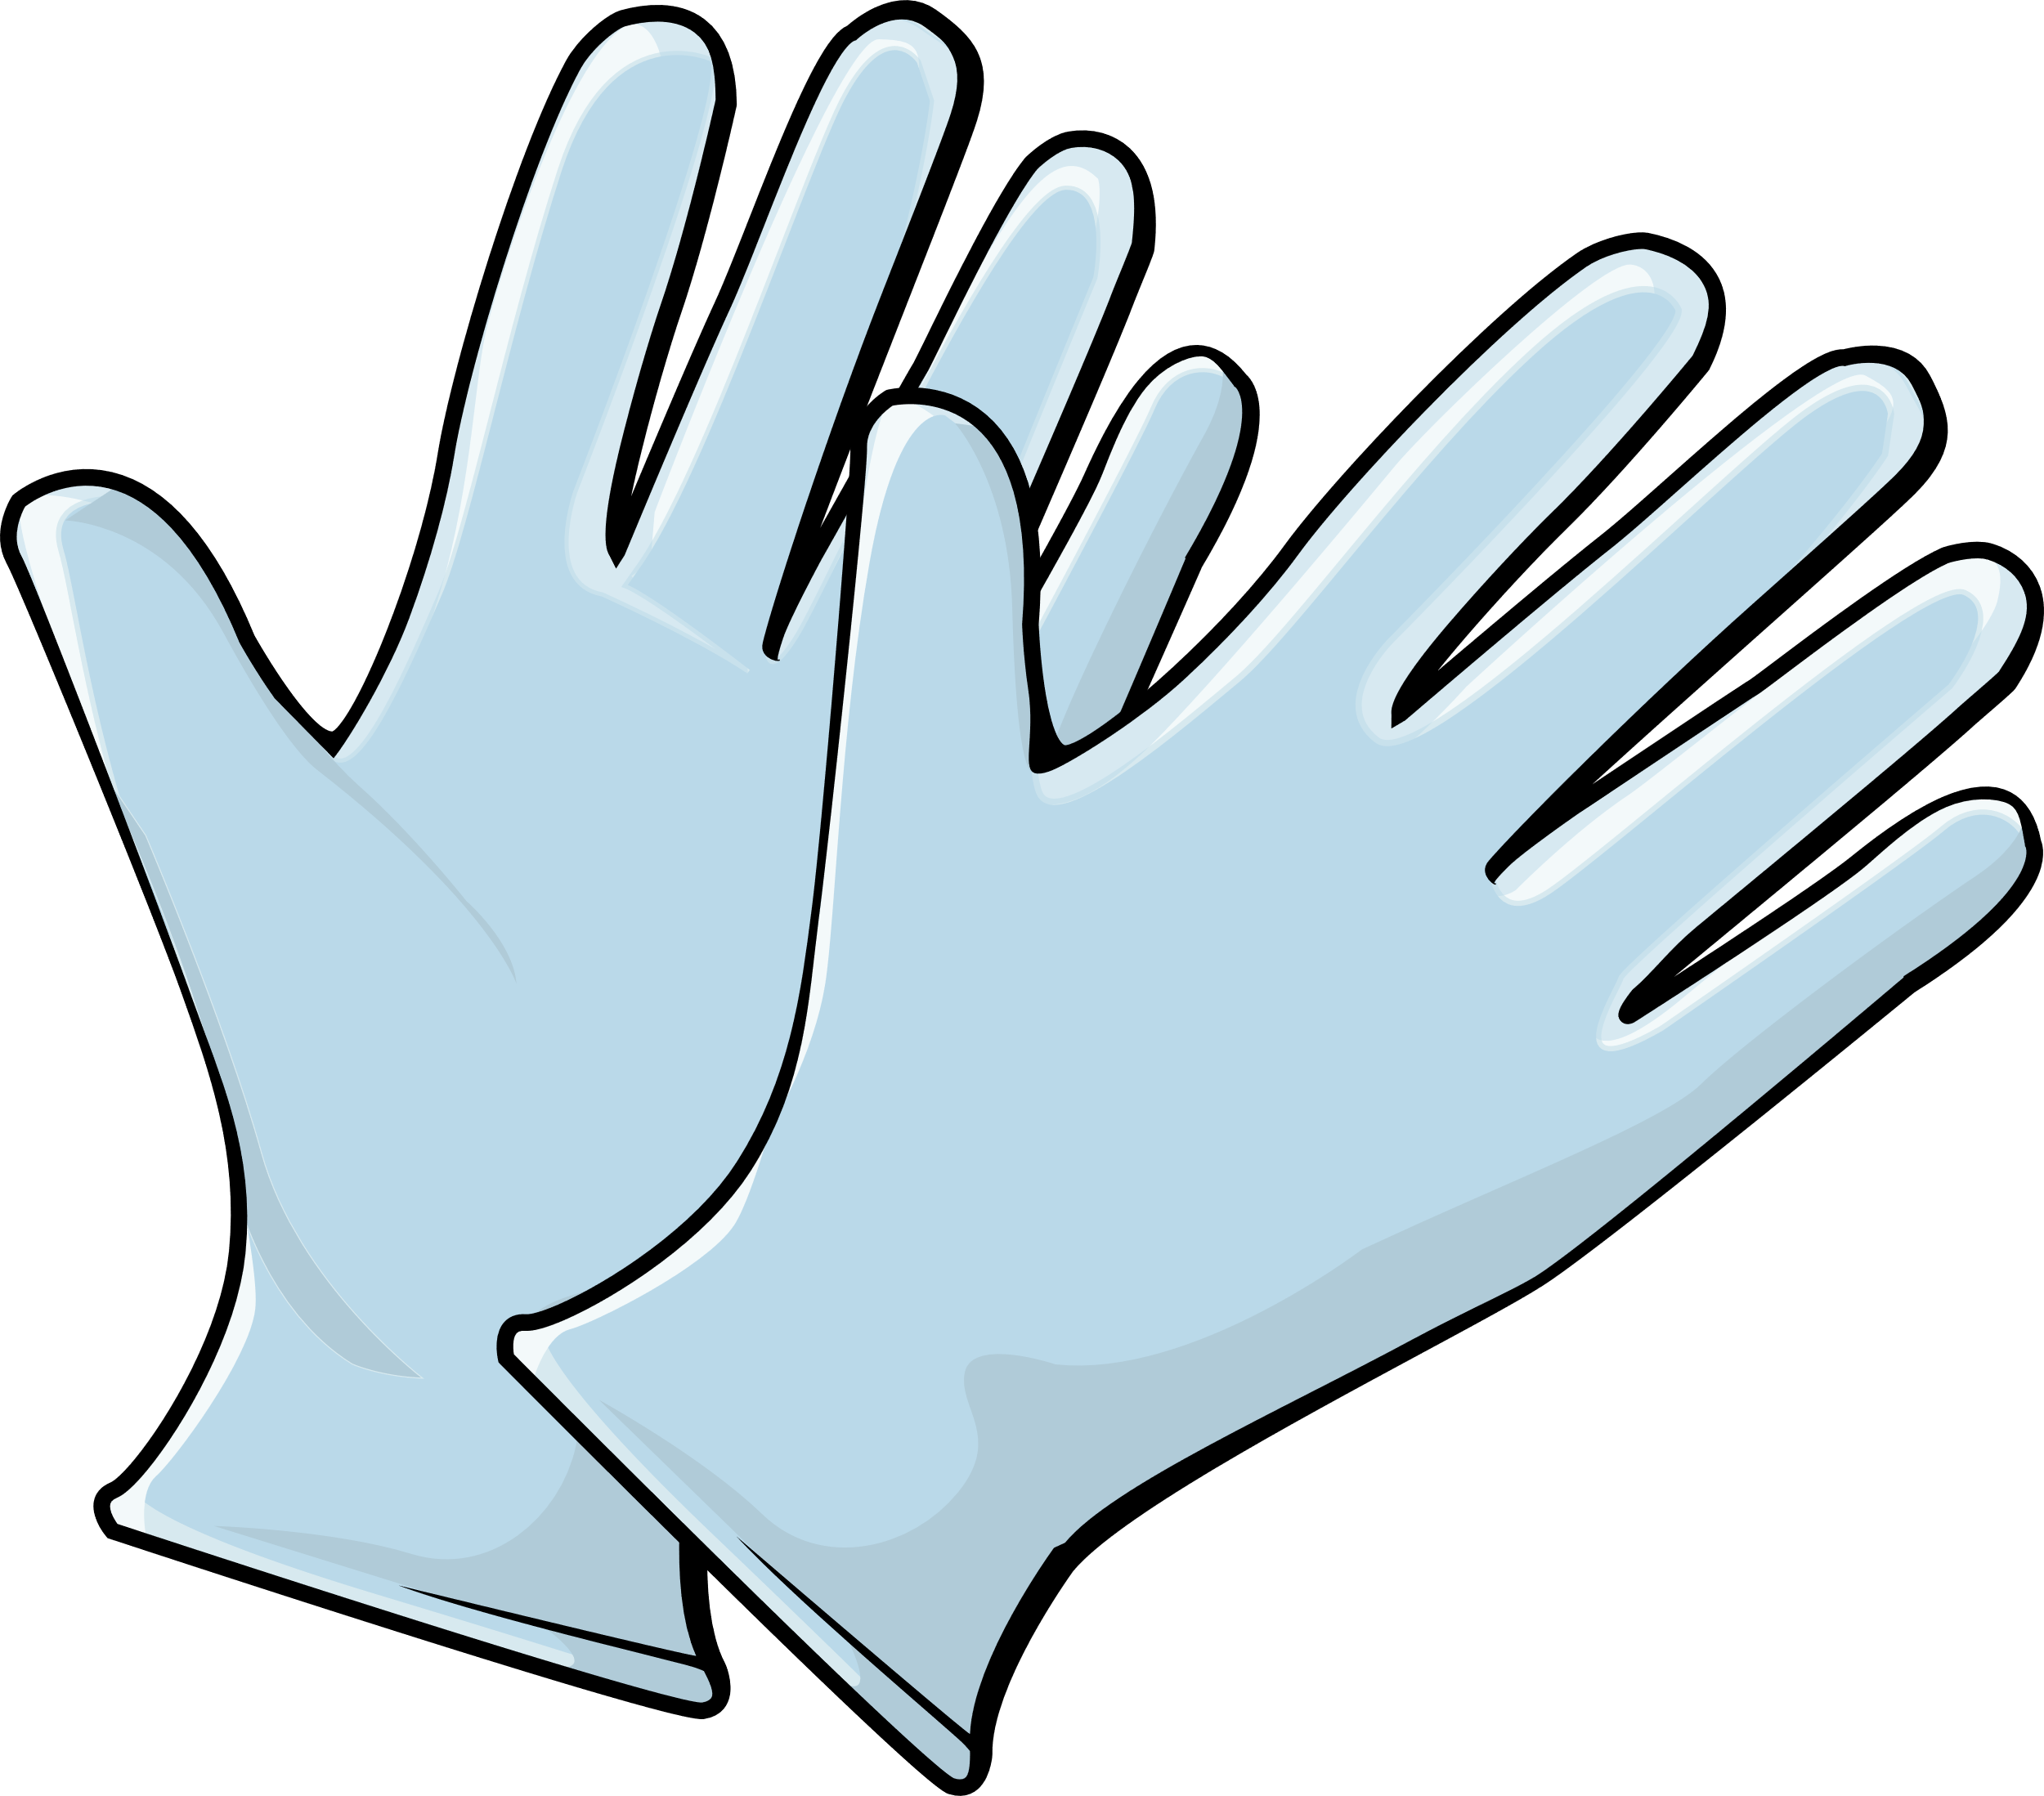
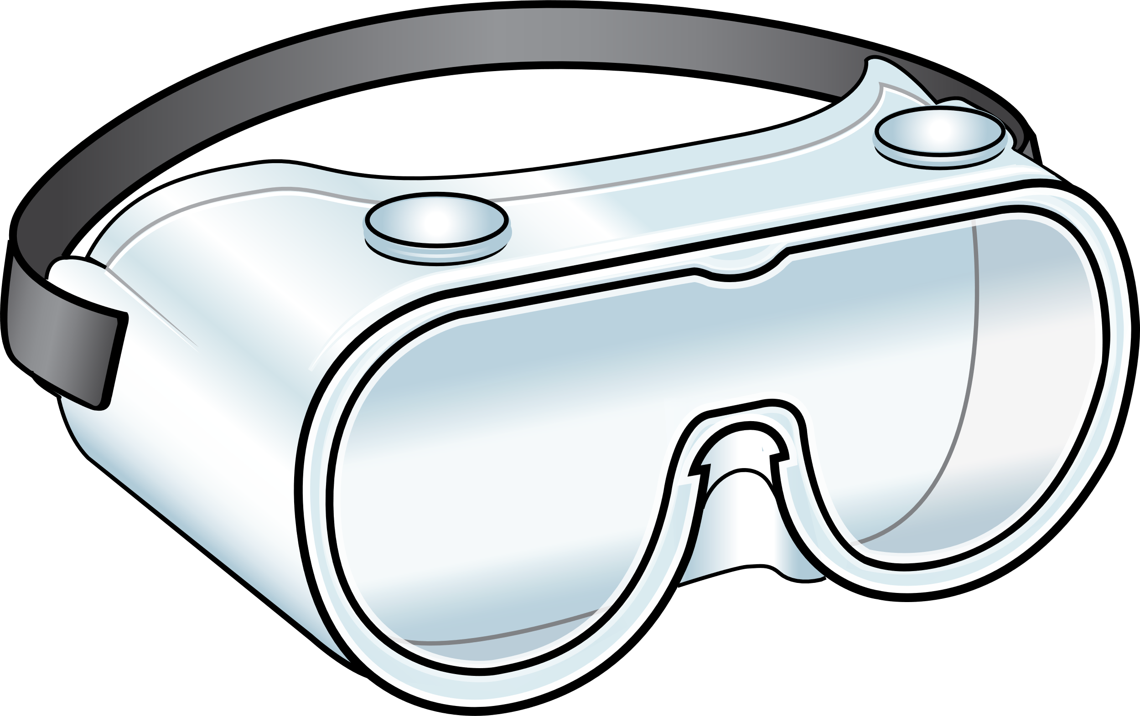
Recommended PPE for COVID-19
Eye Protection
Gloves & Gown
Respirator
Notes:
Facilitator Notes
Establish that the session will focus on gloves, which are part of the PPE recommended for COVID-19.
If this session is part of a series, you may choose to indicate that future sessions will focus on other pieces of PPE.
Sample Script
“Let’s start by thinking about the specific PPE recommended for COVID-19. Today, we’ll focus on gloves. In future sessions, we’ll examine other types of PPE.”

Slide 5
Gloves protect you and keep germs from spreading
How?
Gloves protect you and keep you from accidentally spreading germs into your work environment.
Gloves help stop germs from spreading from place to place while carried on your hands.
Gloves cover any breaks and cracks in your skin so that germs can’t get to them, and they keep germs from spreading from your broken skin to others, or the environment.
If you touch something with germs on it, the germs can get on your gloves.
Notes:
Facilitator Notes
The bullet points on slides 5 and 6 summarize content from Episode 11 of Inside Infection Control: Why are Gloves Recommended for COVID-19? For time reasons, the video is not shown during the 10-minute session. You may wish to refer to the Content Outline for Episode 11 for additional discussion points.
Note: This slide has animations for the second column. When you advance to the slide, only the first column will appear.
After you introduce the points, ask participants to share answers to the questions “Why?” or “How?” either orally or in the chat.
After they provide responses, use the animation to reveal the answers.
Sample Script
“Let’s break down some of the reasons why gloves are so important for infection control in healthcare. First, gloves protect you and also keep you from accidentally spreading germs into your work environment. How do they do that?”
(Pause for responses.)
“That’s right. Gloves cover any breaks and cracks in your skin so that germs can’t get to them, and also keep germs from spreading from your broken skin to others, or to the environment. Gloves also help stop germs from spreading from place to place while carried on your hands. How do they do that?”
(Pause for responses.)
“Yes! When you’re wearing gloves, if you touch something with germs on it, the germs can get on your gloves. That’s why, when you move from one patient or one task to another, you take those gloves off and throw them away and, if needed, put on clean ones, so you’ve removed whatever is on them and you don’t carry germs to your next patient or task.”

Slide 6
Gloves MUST be worn properly to be effective
Clean your hands
After you’ve taken your gloves off and before you put on a new pair
Before you reach into the box to pull out new gloves
Do not wear two pairs of gloves at once, which can
Add new risks, like making your fingers harder to move
Spread germs when removing and replacing the top layer
Notes:
Facilitator Notes
Note: This slide has animations for both sets of sub-bullets. When you advance to the slide, only the first level of bullets will appear.
After you have posed each question, ask for responses from participants.
After they provide responses, use the animation to have the sub-bullets appear.
Sample Script
“Gloves must be worn properly, or they won’t be effective. When you’ve been wearing gloves, when should you clean your hands?”
(Pause for responses.)
“That’s right. It’s important to clean your hands after you remove your used gloves, and before you pull a new pair out of the box. If you reach into the box with dirty hands, what happens? You’ve contaminated all of the gloves in the box!”
“What are some of the reasons why we shouldn’t wear two pairs of gloves at once for routine care?”
(Pause for responses.)
“That’s right. Wearing more than one pair of gloves can make it harder to move your hands and fingers while providing care, which can lead to mistakes. Also, removing and replacing the top layer of gloves between patients or tasks increases your risk of contaminating the bottom pair of gloves and spreading germs to yourself, others, and the environment.”

Slide 7
What questions do you still have about wearing gloves?
Notes:
Facilitator Notes
Invite additional, remaining questions.
You may choose to ask participants to respond orally, in the chat, or both.
If the answers are information that is already included in this session, please respond.
If the questions address content that is not covered in this session, please do not attempt to answer. Instead, take note of the questions and consult with CDC resources to follow up with answers after the session.
Sample Script
“Thank you all for your time! Please take a moment to reflect on today’s session and share any remaining questions you have. Does anyone have any questions still remaining?”
(Address questions as appropriate.)
“Thank you for sharing those questions. Project Firstline is actively collecting your questions to help inform more training resources as they’re developed. I’ve written them down, and I will get back to you with responses.”

Slide 8
Key takeaways
Wearing gloves is an important strategy for infection control.
They protect you and keep you from accidentally spreading germs into your environment.
Gloves must be worn properly to be effective.
Wearing two pairs of gloves at once is not recommended for routine care and can be an infection control risk.
Notes:
Facilitator Notes
Review key takeaways.
You may choose to revisit discussion points or questions that arose during the session.
Sample Script
“I hope this training gave you some good information about gloves, and why they are so important for infection control. I’ve captured some key takeaways here, which you can review at your leisure after the session today.”

Slide 9
Feedback Form
Notes:
Facilitator Notes
Explain how to access the Feedback Form.
Sample Script
“And, finally, please let us know how you enjoyed today’s session by completing the following feedback form. Thanks again for joining us today.”
After the Session
Send list of participant questions compiled during this session to ProjectFirstline@cdc.gov.

