Slide 1
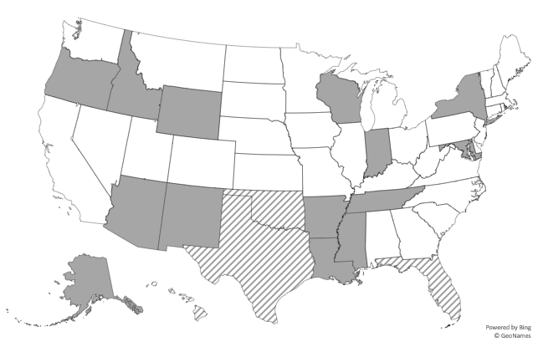
Supplemental Figure A: Chlamydia
Did not report gender identity
Reported gender identity; <70% of cases had a non-missing value
Reported gender identity; ≥70% of cases had a non-missing value

Slide 2
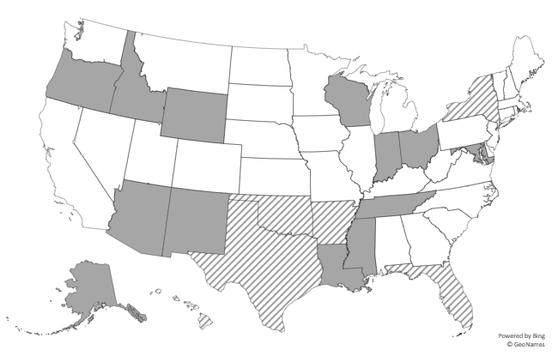
Supplemental Figure B
Did not report gender identity
Reported gender identity; <70% of cases had a non-missing value
Reported gender identity; ≥70% of cases had a non-missing value

Slide 3
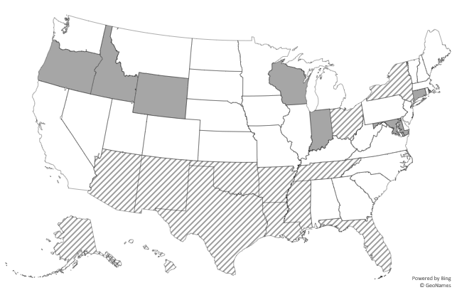
Supplemental Figure C
Did not report gender identity
Reported gender identity; <70% of cases had a non-missing value
Reported gender identity; ≥70% of cases had a non-missing value

