Slide 1
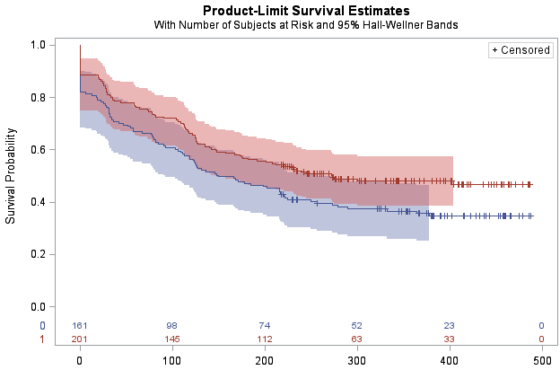
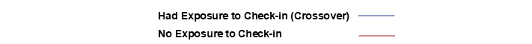
Supplemental Digital Content 1: Kaplan-Meier Survival Curves of Time to First PrEP Discontinuation (in days), by Exposure to Monthly Check-In Text Message*
Days
Days
Log rank test p-value: 0.0173
*Because the clinic classifies the PrEP stop date as the initial encounter date if the patient is lost to follow-up right after their initial prescription fill, some patients look like they were on PrEP for 0 days. This approach is conservative, since this assumes these patients did not end up taking any PrEP.

