Slide 1
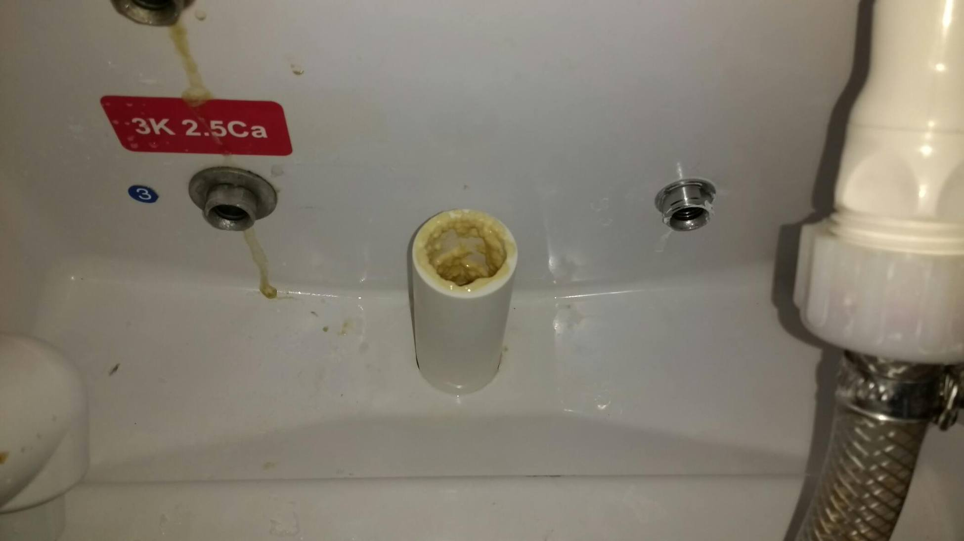
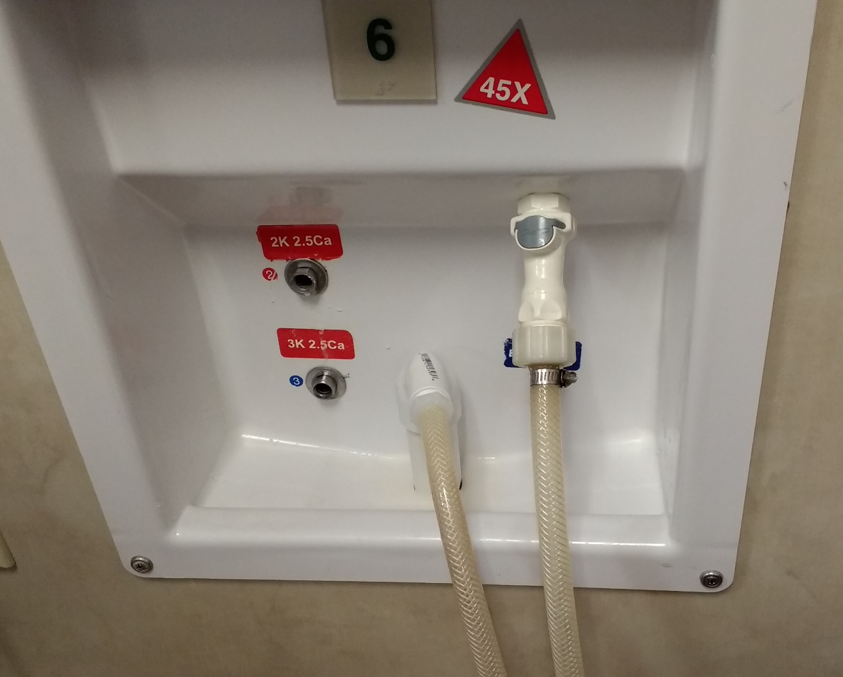
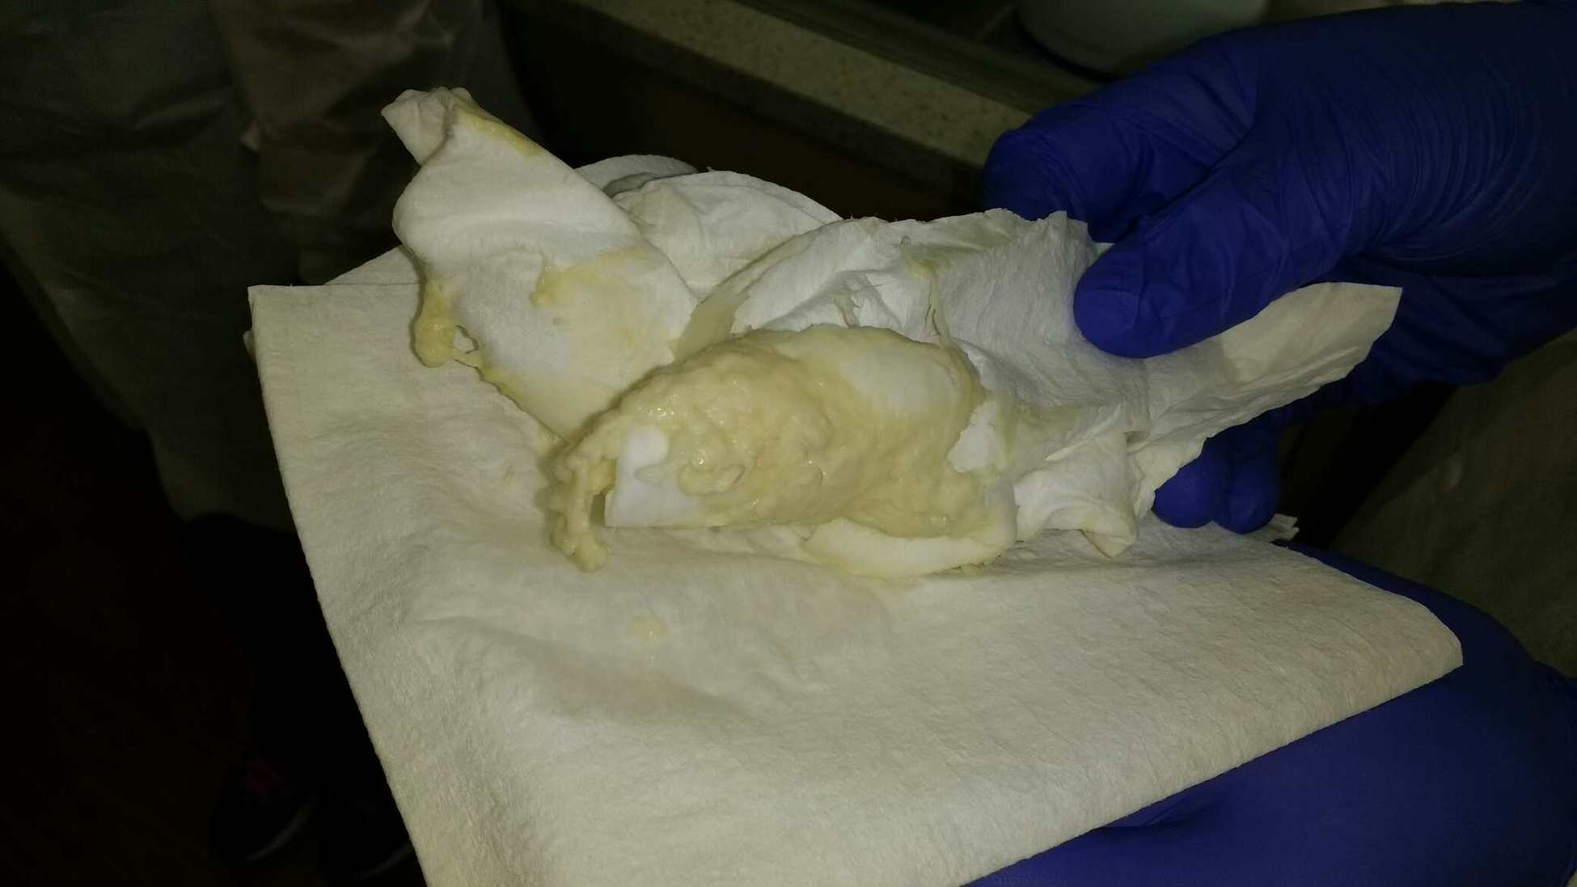
Figure S1 Photographs of Dialysis Station Wall Box Waste Lines and Drains at Facility A
b
a
Waste drain
Waste line and drain
c

Slide 2
a. Photograph of waste line and drain at wall box
b. Photograph of clogged wall box drain with drain line removed (different wall box than that depicted in photograph a)
c. Photograph of paper towel used to clear out clogged wall box drain (same wall box depicted in photograph b)

