Slide 1
Tuberculosis (TB) in the United States
1993–2021*
Division of Tuberculosis Elimination
National Tuberculosis Surveillance System
*Data updated as of July 8, 2022
Notes:
Tuberculosis in the United States—National Tuberculosis Surveillance System, Highlights from 2021. This slide set was prepared by the Division of Tuberculosis Elimination, National Center for HIV, Viral Hepatitis, STD, and TB Prevention (NCHHSTP), Centers for Disease Control and Prevention (CDC), U.S. Department of Health and Human Services (HHS). It provides recent trends and highlights of data collected through the National Tuberculosis Surveillance System (NTSS) for 2021.
Since 1953, through the cooperation of state and local health departments, CDC has collected information on newly reported cases of tuberculosis (TB) disease in the United States. Each individual TB case report (Report of Verified Case of Tuberculosis, or RVCT) is submitted electronically to CDC. The data for this slide set are based on TB case reports for 1993–2021 received by CDC as of July 8, 2022. All case counts and rates for years 1993–2020 have been updated, and data from 2021 have been added.

Slide 2
Progress Towards TB Elimination, United States, 1982–2021
26,673 TB cases in 1992
Incidence rate: 10.4 per 100,000
7,882 TB cases in 2021
Incidence rate: 2.4 per 100,000
Notes:
This graph shows the annual number of TB cases in the United States for each year during 1982–2021, and the TB elimination threshold goal of <1 case per 1,000,000 (1 million) population, which is approximately 330 cases per year for the current U.S. population. In 1992, 26,673 cases were reported in the United States, with an incidence rate of 10.4 cases per 100,000 population. TB cases and incidence rates have declined substantially since 1992, but the annual rate of decline has been inadequate to achieve TB elimination goals.
In 2021, 7,882 cases were reported, with an incidence rate of 2.4 cases per 100,000, representing a 9.9% increase in case count and 9.8% increase in incidence rate compared with 2020. This increase might be partially explained by delayed detection of cases with symptom onset during 2020 that were not diagnosed until 2021 because of delayed health care-seeking behavior, interruptions in health care access, or disrupted TB services related to the COVID-19 pandemic. Other factors associated with the pandemic, including changes in immigration, infection prevention strategies, and health service provision, likely had an effect on TB epidemiology in 2021 and ongoing effects will likely continue in the future.

Slide 3
TB Cases and Incidence Rates, United States, 1993–2021
Notes:
During 2021, the United States reported 7,882 TB cases, an incidence rate of 2.4 cases per 100,000 persons. Except for 2015, the U.S. TB case count and incidence rate have declined every year since 1993 until 2021, when an increase was seen. The annual incidence rate increased by 9.8% from 2020 to 2021.
This increase might be partially explained by delayed detection of cases with symptom onset during 2020 that were not diagnosed until 2021 because of delayed health care-seeking behavior, interruptions in health care access, or disrupted TB services related to the COVID-19 pandemic. Other factors associated with the pandemic, including changes in immigration, infection prevention strategies, and health service provision, likely had an effect on TB epidemiology in 2021 and ongoing effects will likely continue in the future.

Slide 4
TB Incidence Rates and Annual Percent Change in Rate,
United States, 2010–2021
*Annual percent change in rate based on unrounded data
Notes:
The top graph shows incidence rates (cases per 100,000 persons) since 2010. The bottom graph shows annual percentage change in incidence rate, with any value >0 representing an increase from the previous year and any value <0 representing a decrease from the previous year.
The incidence rate increased by 9.8% from 2020 (2.2 cases per 100,000) to 2021 (2.4 cases per 100,000). This increase might be partially explained by delayed detection of cases with symptom onset during 2020 that were not diagnosed until 2021 because of delayed health care-seeking behavior, interruptions in health care access, or disrupted TB services related to the COVID-19 pandemic. Other factors associated with the pandemic, including changes in immigration, infection prevention strategies, and health service provision, likely had an ongoing effect on TB epidemiology in 2021 and ongoing effects will likely continue in the future.

Slide 5
TB-Related Deaths* and Mortality Rates, United States, 1993–2020
600 TB-related deaths in 2020
*National Vital Statistics System Underlying Cause of Death (based on deaths reported through 2020)
Notes:
The National Vital Statistics System (NVSS) reported 600 TB-related deaths (0.2 deaths per 100,000 persons) where TB was the underlying cause of death for 2020, the most recent year for which data are available. This represents a 14.1% increase in deaths and a 13.0% increase in the mortality rate compared with 2019.
It is important to note that under current NVSS guidance, deaths caused by TB among persons with comorbid HIV infections are classified with HIV as the underlying cause of death, not TB, and are not included here.
National Vital Statistics System accessed from CDC WONDER as of July 12, 2022: https://wonder.cdc.gov/

Slide 6
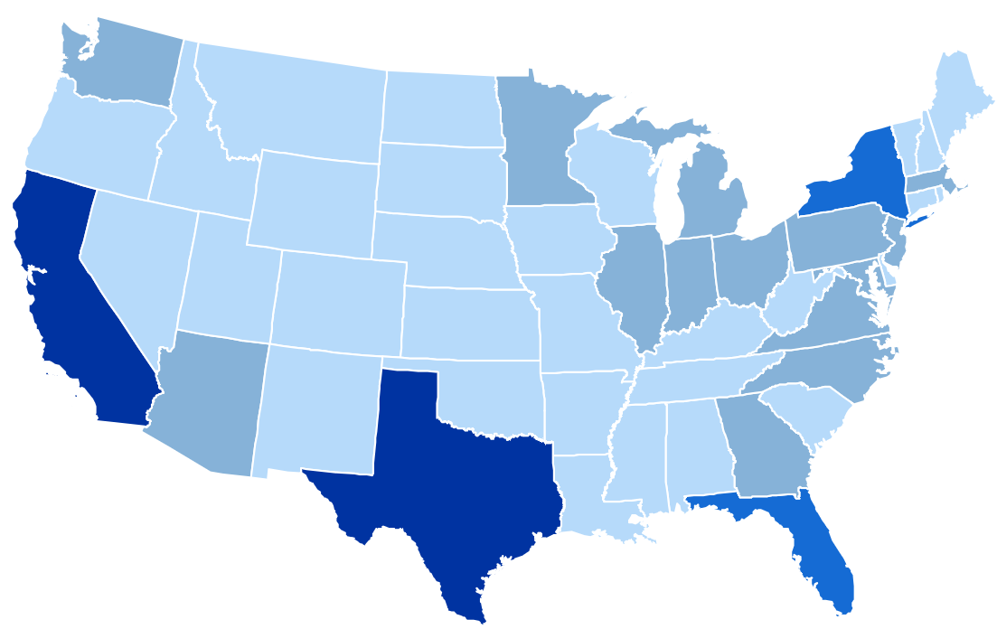
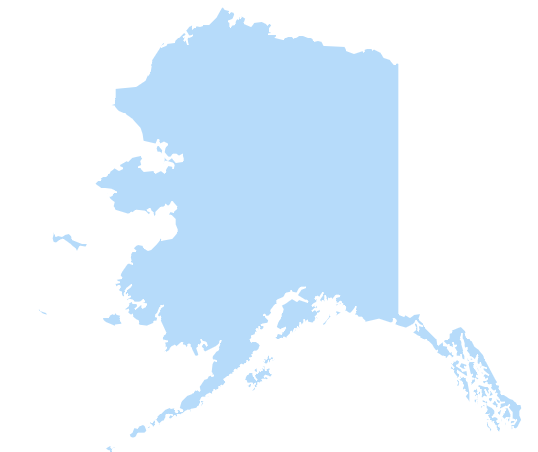
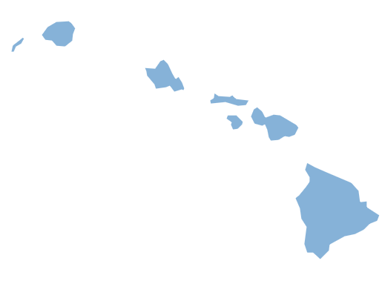
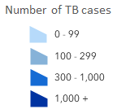
TB Cases by Reporting Area, United States, 2021
California 22%
New York*
9%
Florida
6%
Number of TB cases
≤99
Texas
13%
100–299
300–999
≥1000
* Includes New York City
Notes:
Among U.S. states, close to half (49.9%) of TB cases continue to be reported from 4 states: California (22.2%, n=1,752), Texas (12.7%, n=1,000), New York state (including New York City, 8.7%, n=683), and Florida (6.3%, n=500). These states are also the most populous states in the United States, but only represent about a third of the total U.S. population.
Note: ranges were determined based on the Jenks Natural Breaks method, then rounded to the nearest 100.

Slide 7
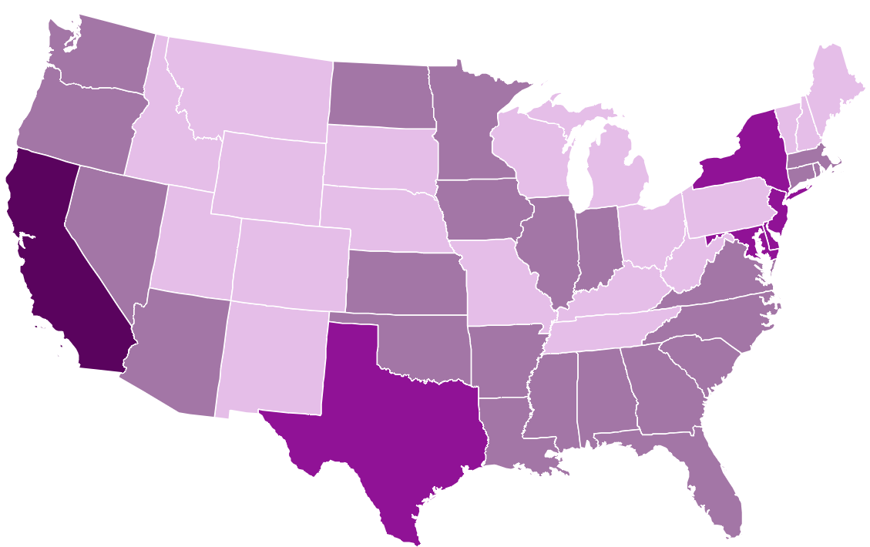
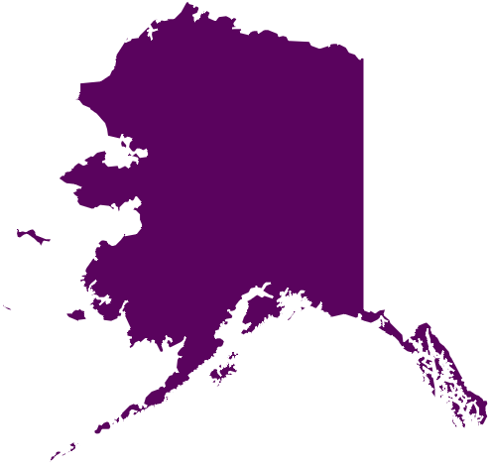
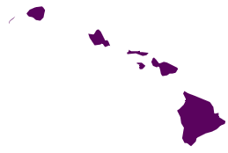
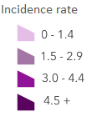
TB Incidence Rates* by Reporting Area, United States, 2021
Washington
2.6
New York
3.4†
New Jersey
3.2
California
4.5
Delaware
4.1
Alaska
7.9
Maryland
3.2
Hawaii
7.4
District of Columbia
2.7
Incidence rate
<1.5
1.5–<3.0
Texas
3.4
3.0–<4.5
*Cases per 100,000 persons
†Includes New York City
≥4.5
Notes:
Nine states and the District of Columbia had incidence rates higher than the national rate of 2.4 cases per 100,000 persons in 2021. Alaska had the highest rate (7.9), followed by Hawaii (7.4), California (4.5), Delaware (4.1), New York (including New York City, 3.4), Texas (3.4), New Jersey (3.2), Maryland (3.2), District of Columbia (2.7), and Washington (2.6). Other than Delaware, these reporting areas also had incidence rates greater than the national rate in 2020. Delaware’s incidence rate doubled from 1.7 in 2020 to 4.1 in 2021 and included several cases associated with an outbreak linked to a donor-derived bone allograft product which, in total, was associated with 113 cases in 18 states.
Note: New York City, which is a distinct reporting area, had an incidence rate of 6.2 cases per 100,000 persons. When New York City is analyzed separately, the remainder of New York state has an incidence rate of 1.4 cases per 100,000 persons.

Slide 8
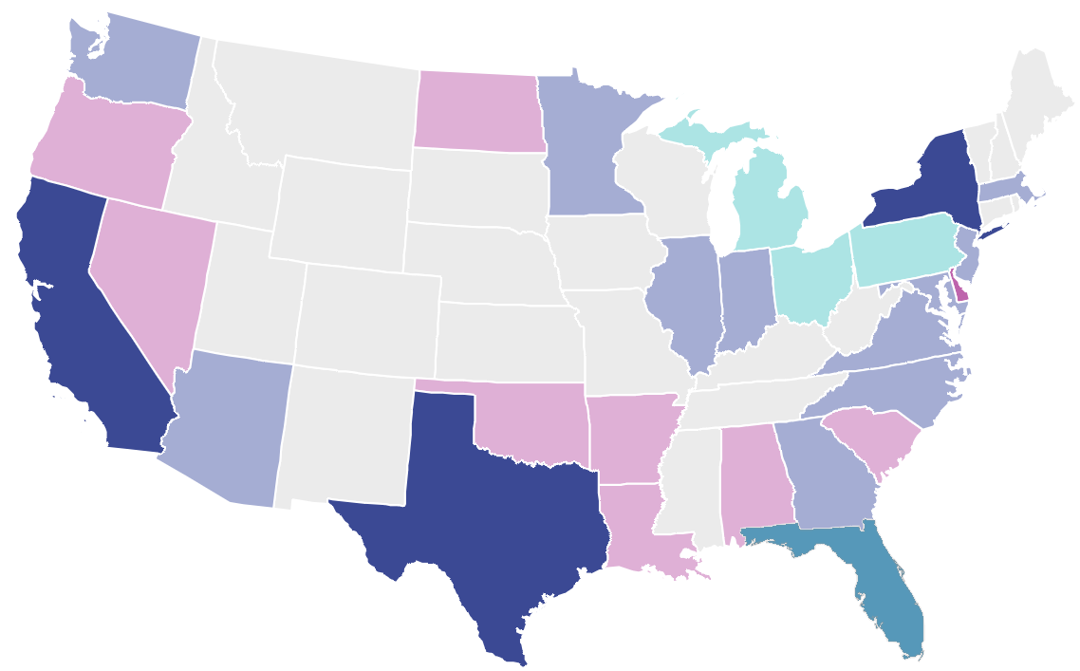
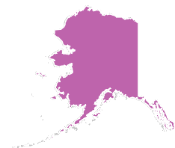

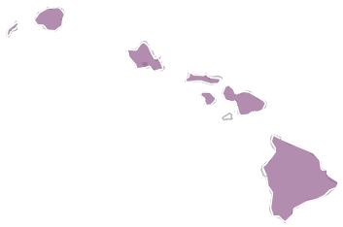
TB Cases and Incidence Rates*
by Reporting Area, United States, 2021
100–499
≤99
≥500
≥3.4
1.7–<3.4
<1.7
Incidence rate*
*Cases per 100,000 persons
0 states with low incidence and high case count
Case count
Notes:
This map shows each state shaded based on two scales, one representing TB case counts and one representing incidence rates, overlaid. Case counts reflect the overall burden of testing, treating, and preventing TB in each jurisdiction, but the incidence provides a clearer picture of epidemiologic risk by jurisdiction. The lighter shades represent low values and darker shades represent higher values on each measure.
States with low case count and low incidence rate are shown in light grey, such as Maine and Idaho.
States with low case count but medium incidence rate, such as Nevada, are shown in light pink.
States with low case count but high incidence rate, such as Alaska, are shown in medium pink.
States with a medium case count but low incidence rate are shown in light teal, such as Ohio.
States with medium case count and medium incidence rate are shown in light indigo (the middle of the color key), such as Georgia and Washington.
Hawaii was the only state with medium case count and high incidence rate, shown in the muted pink color.
None of the states had a high case count but low incidence rate, so the brightest teal color from the key is not found on the map.
Florida was the only state with high case count and medium incidence rate, shown in the muted blue.
States with high case count and high incidence rate are shown in dark indigo, such as California, Texas, and New York.

Slide 9


Top 10 TB Incidence Rates* by Metropolitan Statistical Areas (MSAs), United States, 2021
San Francisco
5.8
New York City
4.2
Stockton
5.2
Bakersfield
4.6
San Jose
6.9
Fresno
4.4
San Diego
6.1
Houston
4.2
Incidence rate*
Los Angeles
4.9
<1.5
Honolulu
8.6
1.5–<3.0
3.0–<4.5
≥4.5
*Cases per 100,000 persons
Notes:
Metropolitan statistical areas (MSAs) are geographic units of one or more counties used for conducting geographic analyses. They are useful because the counties within the MSAs are connected socioeconomically, so people within an MSA can be expected to interact more with one another than with those in different MSAs.
This map shows states color-coded by TB incidence rate. In addition, among MSAs with an estimated population size of at least 500,000, the 10 MSAs with the highest TB incidence rates are presented here: Honolulu with the highest incidence rate at 8.6 cases per 100,000, followed by San Jose at 6.9 cases per 100,000, San Diego at 6.1 cases per 100,000, San Francisco at 5.8 cases per 100,000, Stockton at 5.2 cases per 100,000, Los Angeles at 4.9 cases per 100,000, Bakersfield at 4.6 cases per 100,000, Fresno at 4.4 cases per 100,000, and both Houston and New York City at 4.2 cases per 100,000. The New York City MSA includes Newark and Jersey City, New Jersey.

Slide 10
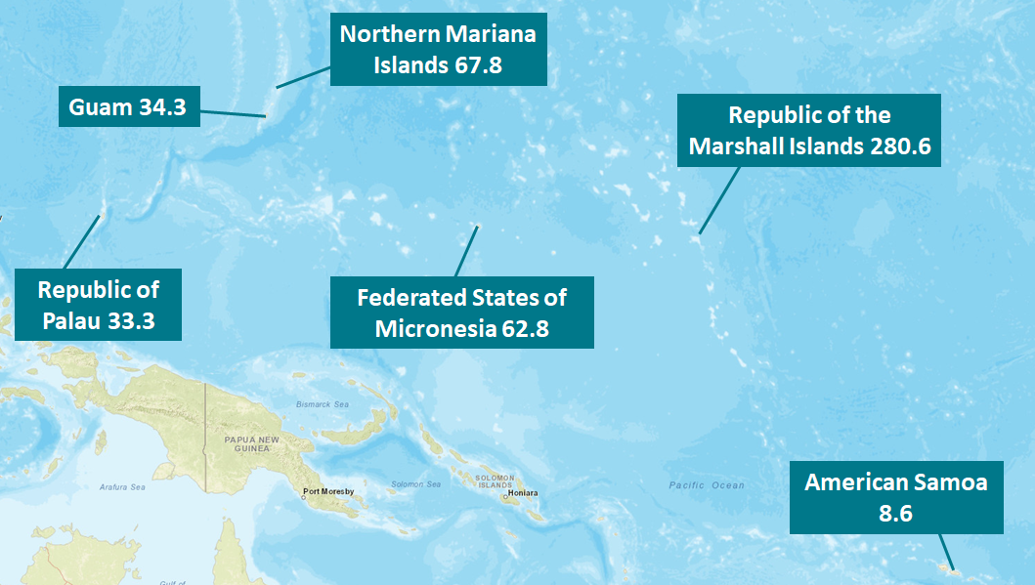

TB Incidence Rates* by U.S.-Affiliated Pacific Islands, 2021
*Cases per 100,000 persons
Notes:
Among the U.S.-Affiliated Pacific Islands, incidence rates (cases per 100,000 persons) ranged from 8.6 (American Samoa, n=4) to 280.6 (Republic of the Marshall Islands, n=118).

Slide 11
TB Cases and Incidence Rates by Origin of Birth,*
United States, 1993–2021
*Persons born in the United States, certain U.S. territories, or elsewhere to at least one U.S. citizen parent are categorized as U.S.-born. All other persons are categorized as non-U.S.–born.
Notes:
The distribution of the origin of birth for persons with TB remained similar in 2021 to previous years, with most reported TB cases occurring among non-U.S.–born persons (5,626 cases; 71.4%); 2,223 (28.2%) cases occurred among U.S.-born persons, and 33 (0.4%) had unknown origin of birth. The percentage of cases among non-U.S.–born persons has gradually increased over time in the past decade, from 62.6% in 2011 to 71.4% in 2021. In 2021, the incidence rates among both non-U.S.–born and U.S.–born persons increased to 12.5 cases per 100,000 persons and 0.8 cases per 100,000, respectively.

Slide 12
TB Incidence Rates by Origin of Birth,* United States, 2011–2021
7% increase from 2020 to 2021
11% increase from 2020 to 2021
*Persons born in the United States, certain U.S. territories, or elsewhere to at least one U.S. citizen parent are categorized as U.S.-born. All other persons are categorized as non-U.S.–born.
Notes:
Incidence rates for U.S.-born persons are shown in the left figure in purple, and incidence rates for non-U.S.–born persons are shown on the right figure in blue. Note that the scale of the y-axes for these figures are different.
TB incidence rates have been declining in both groups over the past ten years. In 2021, an increase in TB incidence rate was seen for both U.S.-born and non-U.S.–born persons. The increase in incidence rate from 2020 to 2021 was 11% among the U.S.-born population compared with 7% among the non-U.S.–born.

Slide 13
TB Incidence Rates and Percentages by Origin of Birth,*
United States, 2021 (N=7,849)
Origin of birth unknown, <1%
U.S.-born, 28%
(Rate: 0.8 per 100,000)
$$–$$
Non-U.S.–born 71%
(Rate: 12.5 per 100,000)
*Persons born in the United States, certain U.S. territories, or elsewhere to at least one U.S. citizen parent are categorized as U.S.-born. All other persons are categorized as non-U.S.–born.
Notes:
The TB incidence rate among non-U.S.–born persons of 12.5 per 100,000 persons was 16 times the rate of 0.8 per 100,000 among U.S.-born persons (using unrounded rates) in 2021. In 2021, 5,626 (71.4%) cases occurred among non-U.S.–born persons and 2,223 (28.2%) cases among U.S.-born persons.

Slide 14
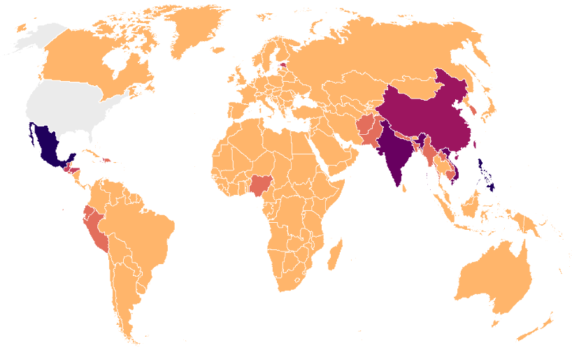

TB Cases by Countries of Birth Among Non-U.S.–Born* Persons with TB, United States, 2021 (N=5,626)
China
6%
Mexico
19%
Philippines
12%
India
10%
Vietnam
8%
N/A
0 - 49
50 - 99
100 - 249
250 - 399
400 - 599
600 +
*Persons born in the United States, certain U.S. territories, or elsewhere to at least one U.S. citizen parent are categorized as U.S.-born. All other persons are categorized as non-U.S.–born.
Notes:
In 2021, five countries of birth accounted for 54% of countries of birth origin among non-U.S.–born persons with reported TB in the United States.
The most common countries of birth among non-U.S.–born persons with TB disease remained similar to previous years, with Mexico (18.7%) as the most frequently reported country of birth, followed by the Philippines (12.3%), India (10.2%), Vietnam (7.5%), and China (5.6%). These countries of birth also have large populations that live in the United States.

Slide 15
Top 10 TB Incidence Rates* by Country of Birth,
United States, 2017–2021
* Cases per 100,000 persons
Notes:
The countries of birth with the highest U.S. incidence rates of TB disease (cases per 100,000 persons) in 2021 were the Republic of the Marshall Islands (169.6, average annual number of cases: 47), followed by the Republic of the Congo (101.0, average annual number of cases: 35), Mongolia (76.9, average annual number of cases: 9), and Bhutan (70.3, average annual number of cases: 38). These countries of birth were followed by Myanmar (70.0, average annual number of cases: 105), Somalia (69.6, average annual number of cases: 20), Nepal (60.8, average annual number of cases: 91), the Federated States of Micronesia (58.5, average annual number of cases: 20), Guinea (50.6, average annual number of cases: 9), and Ethiopia (47.3, average annual number of cases: 134).
U.S. population estimates by country of birth were used for the denominators and were obtained from the U.S. Census Bureau, American Community Survey (ACS) Public Use Microdata Sample data, 2016–2020, 5-year file (https://www.census.gov/programs-surveys/acs/microdata/access.html).

Slide 16
Percentage of TB Cases Among Non-U.S.–Born* Persons by Years Since Initial Arrival in the United States at Diagnosis,† 2021 (N=5,626)
*Persons born in the United States, certain U.S. territories, or elsewhere to at least one U.S. citizen parent are categorized as U.S.-born. All other persons are categorized as non-U.S.–born.
†The number of years since initial arrival in the United States at diagnosis was unknown or missing for 11% of non-U.S.–born persons. These persons were included in the denominator when calculating percentages.
Notes:
This slide shows the percentage of TB cases among the non-U.S.–born by number of years since initial arrival in the United States at diagnosis. One-quarter of TB cases (25.2%) reported among non-U.S.–born persons in 2021 were diagnosed within 5 years of arrival in the United States.

Slide 17
TB Cases by Race/Ethnicity,* United States, 2011–2021
Multiple Race
Native Hawaiian or Other Pacific Islander
American Indian or Alaska Native
White
Black or African American
Hispanic or Latino
Asian
*Persons who identified as Hispanic or Latino were categorized as "Hispanic or Latino," regardless of self-reported race. Persons who did not identify as Hispanic or Latino were categorized by self-reported race; if more than one race was reported, the person was categorized as "Multiple race."
Notes:
This graph shows overall TB case counts in the past decade by race/ethnicity. With the exception of a slight increase from 2014 (n=9,382) to 2015 (n=9,538), the overall number of TB cases decreased from 2011 through 2020. The decrease was largest among White and Black or African American persons. The number of TB cases increased from 7,171 in 2020 to 7,882 in 2021. Increases in case counts were seen in all race/ethnicity groups except Native Hawaiian or Other Pacific Islander persons (117 cases in 2020 and 115 cases in 2021).

Slide 18
Percentage of TB Cases by Race/Ethnicity,* United States, 2011–2021
Multiple Race
Native Hawaiian or Other Pacific Islander
American Indian or Alaska Native
White
Black or African American
Hispanic or Latino
Asian
*Persons who identified as Hispanic or Latino were categorized as "Hispanic or Latino," regardless of self-reported race. Persons who did not identify as Hispanic or Latino were categorized by self-reported race; if more than one race was reported, the person was categorized as "Multiple race."
Notes:
This 100% stacked bar chart shows percentage distributions over time by race/ethnicity. Despite the decline in overall number of TB cases in 2020 and the subsequent increase in 2021, the distribution of race/ethnicity among persons with TB disease has been relatively consistent since 2011.

Slide 19
Percentage of TB Cases by Race/Ethnicity,*
United States, 2021 (N=7,882)
*Persons who identified as Hispanic or Latino were categorized as "Hispanic or Latino," regardless of self-reported race. Persons who did not identify as Hispanic or Latino were categorized by self-reported race; if more than one race was reported, the person was categorized as "Multiple race."
Notes:
This bar chart shows the percentage of TB cases by race/ethnicity for 2021. Non-Hispanic Asian persons represented 36.0% of total cases in 2021, followed by Hispanic persons (30.6%), non-Hispanic Black or African American persons (18.0%), and non-Hispanic White persons (11.2%). All other race groups (American Indian or Alaska Native persons, Native Hawaiian or Other Pacific Islander persons, and non-Hispanic multiple race persons) represented approximately 1% of cases each. Persons with unknown or missing race/ethnicity information comprised less than 1% of all cases.

Slide 20
TB Incidence Rates by Race/Ethnicity,* United States, 2011–2021
Native Hawaiian or Other Pacific Islander
Asian
Hispanic or Latino
Black or African American
American Indian or Alaska Native
Multiple Race
White
*Persons who identified as Hispanic or Latino were categorized as "Hispanic or Latino," regardless of self-reported race. Persons who did not identify as Hispanic or Latino were categorized by self-reported race; if more than one race was reported, the person was categorized as "Multiple race."
Notes:
TB incidence rates (number of cases per 100,000 persons) vary by race/ethnicity groups. In 2021, Native Hawaiian or Other Pacific Islander persons had the highest rate (18.4), followed by Asian persons (14.4). Rates among Hispanic or Latino persons, Black or African American persons, and American Indian or Alaska Native persons were similar at 3.8, 3.4, and 3.5, respectively. Persons who identify with more than one race (1.0) and White persons (0.4) had the lowest rates. Based on unrounded numbers, rates increased in 2021 compared with 2020 for all race/ethnicity groups except for Native Hawaiian or Other Pacific Islander persons.

Slide 21
TB Cases Among U.S.-Born* Persons by Race/Ethnicity,†
United States, 2011–2021
Multiple Race
Native Hawaiian or Other Pacific Islander
American Indian or Alaska Native
White
Black or African American
Hispanic or Latino
Asian
*Persons born in the United States, certain U.S. territories, or elsewhere to at least one U.S. citizen parent are categorized as U.S.-born. All other persons are categorized as non-U.S.–born.
†Persons who identified as Hispanic or Latino were categorized as "Hispanic or Latino," regardless of self-reported race. Persons who did not identify as Hispanic or Latino were categorized by self-reported race; if more than one race was reported, the person was categorized as "Multiple race."
Notes:
The number of TB cases reported among U.S.-born persons has declined since 2011, though there was an increase of 216 cases from 2020 (n=2,007) to 2021 (n=2,223). In 2021, Black or African American persons (n=758) and White persons (n=639) had the greatest number of TB cases among U.S.-born persons. The distribution of race/ethnicity among U.S.-born persons has been relatively consistent since 2011.

Slide 22
TB Incidence Rates Among U.S.-Born* Persons by Race/Ethnicity,† United States, 2011–2021
Native Hawaiian or
Other Pacific Islander
American Indian or
Alaska Native
Black or African American
Asian
Hispanic or Latino
White
Multiple Race
*Persons born in the United States, certain U.S. territories, or elsewhere to at least one U.S. citizen parent are categorized as U.S.-born. All other persons are categorized as non-U.S.–born.
†Persons who identified as Hispanic or Latino were categorized as "Hispanic or Latino," regardless of self-reported race. Persons who did not identify as Hispanic or Latino were categorized by self-reported race; if more than one race was reported, the person was categorized as "Multiple race."
Notes:
In 2021, among U.S.-born persons, Native Hawaiian or Other Pacific Islander persons had the highest incidence rate (5.7 cases per 100,000 persons), followed by American Indian or Alaska Native persons (3.8 cases per 100,000 persons). Incidence rates among U.S.-born Black or African American persons, Hispanic or Latino persons, Asian persons, and White persons have all declined since 2011, followed by increases from 2020 to 2021. Native Hawaiian or Other Pacific Islander persons were the only race/ethnicity group with an observed decline in incidence rate from 2020 to 2021, but this population still had the highest incidence rate among U.S.-born persons in 2021. The rates among Native Hawaiian or Other Pacific Islander persons and American Indian or Alaska Native persons have greater year-to-year variability than all other groups because of low case counts and smaller population sizes. White persons and persons who identify with more than one race continue to have the lowest rates among all race groups.

Slide 23
TB Cases Among Non-U.S.–Born* Persons by Race/Ethnicity,†
United States, 2011–2021
Multiple Race
Native Hawaiian or Other Pacific Islander
American Indian or Alaska Native
White
Black or African American
Hispanic or Latino
Asian
*Persons born in the United States, certain U.S. territories, or elsewhere to at least one U.S. citizen parent are categorized as U.S.-born. All other persons are categorized as non-U.S.–born.
†Persons who identified as Hispanic or Latino were categorized as "Hispanic or Latino," regardless of self-reported race. Persons who did not identify as Hispanic or Latino were categorized by self-reported race; if more than one race was reported, the person was categorized as "Multiple race."
Notes:
The number of TB cases reported among non-U.S.–born persons increased from 2020 (n=5,145) to 2021 (n=5,626). Over 80% of non-U.S.–born cases occurred among Asian persons (n=2,706) and Hispanic or Latino (n=1,845) persons. Since 2011, the distribution of the number of TB cases by race/ethnicity among non-U.S.–born persons has been relatively consistent.

Slide 24
TB Incidence Rates Among Non-U.S.–Born* Persons by Race/Ethnicity,† United States, 2011–2021
Multiple Race
Asian
Native Hawaiian or Other Pacific Islander
Black or African American
Hispanic or Latino
White
American Indian or Alaska Native
*Persons born in the United States, certain U.S. territories, or elsewhere to at least one U.S. citizen parent are categorized as U.S.-born. All other persons are categorized as non-U.S.–born.
†Persons who identified as Hispanic or Latino were categorized as "Hispanic or Latino," regardless of self-reported race. Persons who did not identify as Hispanic or Latino were categorized by self-reported race; if more than one race was reported, the person was categorized as "Multiple race."
Notes:
In 2021, among non-U.S.–born persons, persons who identify with more than one race had the highest incidence rate (30.2 cases per 100,000 persons), followed by Asian persons (23.8 cases per 100,000 persons). The rates among Native Hawaiian or Other Pacific Islander persons and persons who identify with more than one race have greater year-to-year variability than all other groups because of low case counts and smaller populations. White persons and American Indian or Alaska Native persons have the lowest incidence rates among all race/ethnicity groups of non-U.S.–born persons.

Slide 25
TB Incidence Rates Among Non-U.S.–Born and U.S.-Born* Persons by Race/Ethnicity,† United States, 2011–2021
Non-U.S.–born§
U.S.–born
*Persons born in the United States, certain U.S. territories, or elsewhere to at least one U.S. citizen parent are categorized as U.S.-born. All other persons are categorized as non-U.S.–born.
†Persons who identified as Hispanic or Latino were categorized as "Hispanic or Latino," regardless of self-reported race. Persons who did not identify as Hispanic or Latino were categorized by self-reported race; if more than one race was reported, the person was categorized as "Multiple race."
§Non-U.S-born American Indian/Alaska Native are not displayed because some years have zero cases, which cannot be displayed in a log-scale graph.
Notes:
These figures show TB incidence rates by race/ethnicity among non-U.S.–born persons and U.S.-born persons, separately on the log scale. Non-U.S.–born American Indian or Alaska Native persons did not have any reported TB cases in years 2014, 2016, and 2020; therefore, their data are not presented in the non-U.S.–born graph since zeros cannot be displayed on the log scale.
For all race/ethnicity groups, incidence rates are higher among non-U.S.–born persons compared with U.S.-born persons.
Compared with 2020, TB incidence rates remained steady or increased for all race/ethnicity groups except among Native Hawaiian or Other Pacific Islander persons (6.2 in 2020 and 5.7 in 2021 for U.S.-born persons; 35.4 in 2020 and 22.0 in 2021 for non-U.S.–born persons) and non-U.S.–born Black or African American persons (15.6 in 2020 and 15.2 in 2021).

Slide 26
Percentage* of TB Cases by Origin† and Race/Ethnicity,§
United States, 2021
Non-U.S.–born persons
(N=5,626)
U.S.-born persons
(N=2,223)
Asian
Hispanic or Latino
Black or
African American
White
Native Hawaiian or
Other Pacific Islander
Multiple Race
0%
American Indian or
Alaska Native
*Percentages are rounded. Percentages of unknowns/missing are <1% and are not displayed in graphs.
†Persons born in the United States, certain U.S. territories, or elsewhere to at least one U.S. citizen parent are categorized as U.S.-born. All other persons are categorized as non-U.S.–born.
§Persons who identified as Hispanic or Latino were categorized as "Hispanic or Latino," regardless of self-reported race. Persons who did not identify as Hispanic or Latino were categorized by self-reported race; if more than one race was reported, the person was categorized as "Multiple race.
Notes:
The distribution of race/ethnicity among persons with TB disease continued to differ markedly by origin of birth in 2021. Approximately half of the TB cases reported among non-U.S.–born persons occurred among Asian persons (48.1%), followed by Hispanic or Latino persons (32.8%), Black or African American persons (11.8%), and White persons (4.3%). Among U.S.-born persons with TB disease, Black or African American persons represented the largest percentage of cases (34.1%), followed by White persons (28.7%), Hispanic or Latino persons (24.4%), and Asian persons (5.6%).

Slide 27
TB Incidence Rates* by Origin† and Race/Ethnicity,§
United States, 2021
Non-U.S.–born persons
(N=5,626)
U.S.-born persons
(N=2,223)
Asian
Asian
Hispanic or Latino
Black African or American
White
Native Hawaiian or
Other Pacific Islander
Multiple Race
American Indian or Alaska Native
*Cases per 100,000 persons
†Persons born in the United States, certain U.S. territories, or elsewhere to at least one U.S. citizen parent are categorized as U.S.-born. All other persons are categorized as non-U.S.–born.
§Persons who identified as Hispanic or Latino were categorized as "Hispanic or Latino," regardless of self-reported race. Persons who did not identify as Hispanic or Latino were categorized by self-reported race; if more than one race was reported, the person was categorized as "Multiple race."
Notes:
This slide shows TB incidence rates (cases per 100,000 persons) by race/ethnicity among non-U.S.–born persons compared with U.S.-born persons in 2021. Among non-U.S.–born persons with TB disease, persons who identify with more than one race had the highest rate (30.2) followed by Asian persons (23.8), Native Hawaiian or Other Pacific Islander persons (22.0), Black or African American persons (15.2), Hispanic or Latino persons (8.9), White persons (3.1), and American Indian or Alaska Native persons (1.3).
Among U.S.-born persons with TB disease, Native Hawaiian or Other Pacific Islander persons had the highest incidence rate (5.7 per 100,000 persons), followed by American Indian or Alaska Native persons (3.8), Black or African American persons (2.1), Asian persons (1.5), and Hispanic or Latino persons (1.3). White persons and persons who identify with more than one race had the lowest rates (0.3).

Slide 28
TB Cases by Age Group, United States, 1993–2021
Notes:
The distribution of TB cases by age group in 2021 remained similar to past years with most cases occurring among persons aged 45 to 64 years (30.6%), followed closely by persons aged 25 to 44 years (28.7%) and persons 65 years or older (28.1%). In contrast, only 12.6% of reported TB cases occurred among children and young adults less than 25 years.

Slide 29
TB Incidence Rates by Age Group, United States, 1993–2021
Notes:
TB incidence rates are higher among adults than among children, and among persons 15 years and older, the incidence rates increase with age. In 2021, persons 65 years or older had the highest TB incidence rate (cases per 100,000 persons) (4.0), and children aged 5 to 14 years had the lowest rate (0.4). Incidence rates were steady or increased in 2021 compared with 2020 for all age groups except children 0 to 4 years, which changed from 0.9 in 2020 to 0.8 in 2021.

Slide 30
TB Cases Among U.S.-Born* Persons by Age Group,
United States, 1994–2021
*Persons born in the United States, certain U.S. territories, or elsewhere to at least one U.S. citizen parent are categorized as U.S.-born. All other persons are categorized as non-U.S.–born.
Notes:
The change in number of cases among U.S.-born persons by age from 1994 to 2021 is shown in this graph with 16,170 cases reported in 1994 and 2,223 in 2021. Among U.S.-born persons, all age groups experienced an increase in cases in 2021 except the 5 to 14 years age group, with 102 cases in 2021 compared with 103 cases in 2020.

Slide 31
TB Incidence Rates* Among U.S.-Born† Persons by Age Group,
United States, 1994–2021
*Population Source: U.S. Census Bureau, Current Population Survey Basic Monthly: https://data.census.gov/mdat/
†Persons born in the United States, certain U.S. territories, or elsewhere to at least one U.S. citizen parent are categorized as U.S.-born. All other persons are categorized as non-U.S.–born.
Notes:
Since 1994, each age group among U.S.-born persons has experienced a 72% or greater decline in incidence rate (cases per 100,000 persons), with the 65 years or older age group experiencing the biggest decline at more than 92% (14.2 in 1994 and 1.1 in 2021). All age groups except for the 5 to 14 years age group experienced an increase in incidence rate from 2020 to 2021, with the 45 to 64 years age group experiencing the largest increase at 13.0%.

Slide 32
TB Cases Among Non-U.S.–Born* Persons by
Age Group, United States, 1994–2021
*Persons born in the United States, certain U.S. territories, or elsewhere to at least one U.S. citizen parent are categorized as U.S.-born. All other persons are categorized as non-U.S.–born.
Notes:
The percentage of TB cases by age group among non-U.S.–born persons remained relatively the same from 2020 to 2021. The number of cases increased from 2020 to 2021 for all age groups except the 0 to 4 years age group (13 in 2020 and 7 in 2021) and the 15 to 24 years age group (477 in 2020 and 441 in 2021).

Slide 33
TB Incidence Rates* Among Non-U.S.–Born† Persons by
Age Group, United States, 1994–2021
*Population Source: U.S. Census Bureau, Current Population Survey Basic Monthly: https://data.census.gov/mdat/
†Persons born in the United States, certain U.S. territories, or elsewhere to at least one U.S. citizen parent are categorized as U.S.-born. All other persons are categorized as non-U.S.–born.
Notes:
From 1994 through 2020, each age group among non-U.S.–born persons has experienced a 50% or greater decline in incidence rate, with the 0 to 4 years age group experiencing the biggest decline at more than 89% (57.3 in 1994 and 6.0 in 2020). In 2021, the incidence rate for non-U.S.–born persons aged 0 to 4 years was 3.2, a 46% decrease compared with 6.0 in 2020. The incidence rate for non-U.S.–born persons aged 15 to 24 years was 14.2 in 2021, 13% lower than the incidence rate of 16.3 in 2020. Incidence rates increased or remained steady from 2020 to 2021 among all other age groups of non-U.S.–born persons. Non-U.S.–born persons 65 years and older experienced the greatest increase, a 14% increase from 19.5 in 2020 to 22.2 in 2021.

Slide 34
Percentage of TB Cases by Birth Decade Among U.S.-Born* Persons,
United States, 1993–2021
*Persons born in the United States, certain U.S. territories, or elsewhere to at least one U.S. citizen parent are categorized as U.S.-born. All other persons are categorized as non-U.S.–born.
Notes:
This slide examines the percentage of TB cases by birth decade cohort (cases among persons born in the same decade) among U.S.-born persons over time. Persons born in the United States during the same decade share similar exposures to and risk factors for TB disease. In 1993, the most common birth decade cohort of cases among U.S.-born persons was the 1950s (21.5%), followed by the 1940s (16.2%), and the 1960s (13.8%). Fewer than 7% of cases were born in the 1970s and 1980s. In 2021, the most common birth decade of cases among U.S.-born persons was the 1960s (17.1%), followed by the 1950s (14.9%), and the 1990s (13.3%).

Slide 35
Percentage of TB Cases by Birth Decade Among Non-U.S.–Born* Persons, United States, 1993–2021
*Persons born in the United States, certain U.S. territories, or elsewhere to at least one U.S. citizen parent are categorized as U.S.-born. All other persons are categorized as non-U.S.–born.
Notes:
This slide examines the percentage of TB cases by birth decade cohort (cases among persons born in the same decade) among non-U.S.–born persons over time. In 1993, almost half of TB cases were among persons born in the 1950s (19.1%) and 1960s (22.9%). The percentages of birth cohorts prior to the 1950s ranged from 10.3% to 11.9%. In 2021, 88% of TB cases among non-U.S.–born persons were born between the 1940s and the 1990s. The percentage of cases born in each birth cohort ranged from 13.1% (1940s) to 15.6% (1950s).
Birth decade cohort may not be as relevant for non-U.S.–born persons because those born in the same decade, but in a variety of countries, did not necessarily share the same exposures to and risk factors for TB disease.

Slide 36
Percentage of TB Cases by Sex and Age Group, United States, 2021
Males (N=4,827)
Age group
Females (N=3,052)
0–4 years (N=160)
5–14 years (N=157)
15–24 years (N=675)
25–44 years (N=2,266)
45–64 years (N=2,409)
≥65 years (N=2,215)
Notes:
Males continued to represent the majority (61.3%) of persons with TB disease overall. The percentage was greater for males compared with females for each age group, except for children 5 to 14 years old (46% males and 54% females).

Slide 37
Pediatric TB Cases by Origin of Birth,* United States, 1993–2021
*Persons born in the United States, certain U.S. territories, or elsewhere to at least one U.S. citizen parent are categorized as U.S.-born. All other persons are categorized as non-U.S.–born.
Notes:
In contrast to overall U.S. TB cases, for which over two-thirds of cases were among non-U.S.–born persons, only 62 (19.6%) of 317 cases in children less than 15 years old occurred among non-U.S.–born persons in 2021. The percentage of non-U.S.–born persons among pediatric cases has fluctuated between 20 and 30% since 1993.

Slide 38
Pediatric TB Incidence Rates* by Origin of Birth,†
United States, 1994–2021
*Population Source: U.S. Census Bureau, Current Population Survey Basic Monthly: https://data.census.gov/mdat/
†Persons born in the United States, certain U.S. territories, or elsewhere to at least one U.S. citizen parent are categorized as U.S.-born. All other persons are categorized as non-U.S.–born.
Notes:
In 2021, the majority (80%) of children less than 15 years old with TB disease were U.S.-born, however, the incidence rate (cases per 100,000 persons) was higher among non-U.S.–born children compared with U.S.-born children. For children aged 0 to 4 years old, the incidence rate among non-U.S.–born children (3.2) was four times the rate among U.S.-born children (0.8). For children aged 5 to 14 years, the incidence rate among non-U.S.–born children (3.3) was 11 times the rate among U.S.-born children (0.3).

Slide 39
TB Cases by Case Verification Criteria, United States, 1993–2021
Positive NAA* test
*NAA=nucleic acid amplification
Notes:
Most TB cases continue to be verified through positive culture, with other laboratory-confirmation methods (i.e., nucleic acid amplification or smear microscopy) only representing a limited percentage of verified cases. In the absence of laboratory confirmation, cases can also be confirmed by meeting the clinical criteria for a verified TB case or diagnosed by a provider. Cases verified by culture may also be positive on NAA or smear microscopy as culture confirmation supersedes NAA or smear result in the case verification criteria classification.
From 2009 to 2021, the overall percentage of cases verified by a positive culture (77.1% in 2009 and 79.2% in 2021) and positive NAA test (0.5% in 2009 and 3.0% in 2021) has increased, while the percentage verified by positive smear (0.6% in 2009 and 0.3% in 2021), as a clinical case (15.4% in 2009 and 13.1% in 2021), and by provider diagnosis (6.3% in 2009 and 4.4% in 2021) has decreased.

Slide 40
Percentage TB Cases by Case Verification Criteria,
United States, 2021 (N=7,882)
*NAA=nucleic acid amplification
Notes:
In 2021, most TB cases continued to be verified by positive culture at 79.2% (n=6,244), with other laboratory-confirmation methods (i.e., nucleic acid amplification or smear microscopy) representing a combined 3.3% (n=258) of verified cases. In addition, 13.1% (n=1,035) were confirmed by clinical criteria and 4.4% (n=345) by provider diagnosis. Cases verified by culture may also be positive on NAA or smear microscopy as culture confirmation supersedes NAA or smear result in the case verification criteria classification.

Slide 41
Percentage of TB Cases by Site of Disease,* United States, 2021
*Patients may have more than one disease site but are counted in mutually exclusive categories for surveillance purposes.
†Any pulmonary involvement which includes cases that are pulmonary only and both pulmonary and extrapulmonary.
Notes:
The vast majority of TB cases had pulmonary involvement (78.8%). Among the 21.2% of TB cases with only extrapulmonary involvement, TB of the lymphatic system remained most common (30.6%), followed by TB of the pleura (15.2%). Bone and joint TB increased from 143 (8.9%) cases in 2020 to 243 (13.7%) cases in 2021, including 113 cases associated with a large outbreak linked to a bone allograft product.
TB meningitis, a particularly serious form of the disease involving the meninges, made up 3.5% of extrapulmonary only cases. “Other” includes all other extrapulmonary sites of disease (e.g., ocular, hepatic).

Slide 42
Percentage of TB Cases* by Initial Drug Regimen,
United States, 1993–2021
HRZE†
Other 4+ drug regimen§
*Persons alive at diagnosis with initial drug regimen information.
†H, isoniazid; R, rifampin; Z, pyrazinamide; E, ethambutol.
§A drug regimen with at least four drugs, other than HRZE.
Notes:
Since the early 2000s, the percentage of patients started on the standard initial four-drug regimen of isoniazid, rifampin, pyrazinamide, and ethambutol has remained above 80%. In some situations, including known or suspected drug resistance or a clinical contraindication to the standard initial therapy, a different four-drug regimen could be clinically appropriate. The percentage of patients on an initial drug regimen of four or more drugs other than the standard four-drug regimen has increased from 4.9% in 2004 to 10.4% in 2021. Use of initial regimens with fewer than four drugs has represented <7% of reported cases in the past decade.

Slide 43
Percentage* of TB Cases† by Initial Drug Regimen, United States, 2021 (N=7,604)
Other 4+ drug regimen§, 10%
*Percentages do not total to 100% due to rounding.
†Persons alive at diagnosis with initial drug regimen information.
§A drug regimen with at least four drugs, other than HRZE.
¶H, isoniazid; R, rifampin; Z, pyrazinamide; E, ethambutol.
Notes:
Of TB patients who were on therapy in 2021, 83.2% started on isoniazid, rifampin, pyrazinamide, and ethambutol (HRZE), 10.4% started on a different 4-drug regimen and 6.3% started on a regimen of less than four drugs.

Slide 44
Percentage of TB Cases by Mode of Treatment Administration,* United States, 1993–2019†
DOT§ only
DOT and SAT§
*Persons on an initial drug therapy with at least one drug.
†Most recent year for which data are complete.
§DOT=directly observed therapy; SAT=self-administered therapy.
Notes:
The percentage of people with TB disease receiving at least a portion of their medication by directly observed therapy (DOT) has risen from 36% in 1993 to 95% in 2019, the most recent year with complete data.

Slide 45
Percentage of TB Cases* by Mode of Treatment Administration, United States, 2019† (N=8,632)
*Persons alive at diagnosis with initial drug regimen information
†Most recent year for which data are complete.
Notes:
During 2019, the most recent year for which treatment completion data are available, 62.2% of patients were administered treatment exclusively by directly observed therapy (DOT), 4.8% solely by self-administered therapy (SAT), and 33.0% by both DOT and SAT.

Slide 46
Percentage of TB Cases* by Completion of TB Therapy,
United States, 1993–2019†
National Goal§:
95%
*Persons alive at diagnosis who started TB therapy and for whom therapy <1 year was indicated.
†Most recent year for which data are complete.
§National goal: for 95% of patients with newly diagnosed TB disease for whom ≤12 months of treatment is indicated to complete treatment within 12 months.
Notes:
The national goal for treatment completion is for 95% of patients for whom ≤12 months of treatment is indicated to complete treatment within 12 months. Although the percentage of eligible patients completing therapy in 1 year has risen from 63.4% in 1993 to 89.9% in 2019, the nation is still short of the 95% goal, and the percentage has been relatively level since 2009.

Slide 47
Percentage of TB Cases* by Reason Therapy Stopped,
United States, 2019† (N=8,632)
Reasons therapy stopped
Other§
*Persons alive at diagnosis taking one or more TB drugs.
†Most recent year for which data are complete
§Reason therapy stopped reported as other, unknown, or missing.
Notes:
Successful therapy completion for people with TB disease is a major performance indicator for TB programs. Among patients during 2019 who were alive at diagnosis and started on TB treatment, 86.8% completed TB treatment successfully. Among patients who did not complete therapy, 57% died before completing TB treatment; 11% were lost to follow-up before completing treatment; 8% refused treatment; and 21% did not complete treatment for other or unknown reasons. Twenty-eight patients (2%) had to permanently stop TB treatment prior to completion because of an adverse treatment event.

Slide 48
TB Cases Resistant to Isoniazid* by Origin of Birth,†
United States, 1993–2021
*Persons with isolates resistant to at least isoniazid among persons with isolates tested with at least isoniazid and rifampin.
†Persons born in the United States, certain U.S. territories, or elsewhere to at least one U.S. citizen parent are categorized as U.S.-born. All other persons are categorized as non-U.S.–born.
Notes:
In 2021, among persons with a known origin of birth, 535 isoniazid-resistant TB cases were reported in the United States, an increase from 461 cases during 2020. The increase in isoniazid-resistant TB cases from 2020 to 2021 occurred in both U.S.-born and non-U.S.–born persons.

Slide 49
Number and Percentage of Multidrug-Resistant (MDR)* TB Cases by History of TB, United States, 1993–2021
*Resistant to at least isoniazid and rifampin.
Notes:
Since 1996, the percentage of all multidrug-resistant (MDR) cases occurring among persons with no previous history of TB disease (i.e., primary MDR TB) has remained below 1.5%. The overall MDR case count was 77 in 2021 compared with 58 in 2020.

Slide 50
Percentage of HIV Coinfection by Age Among Persons with TB,* United States, 2011–2021
*Persons alive at diagnosis with HIV test results
Notes:
Coinfection with HIV is a major risk factor for progression of latent TB infection to TB disease. The percentage of HIV coinfection among persons with reported TB and HIV test results has decreased since 2011 from 7.4% in 2011 to 4.2% in 2021 for all ages, from 10.9% in 2011 to 6.3% in 2021 for persons aged 25 to 44 years, and from 9.7% in 2011 to 5.6% in 2021 for persons aged 45 to 64 years. Among 7,621 persons who were alive at TB diagnosis in 2021, HIV status was known for 90.5% (n=6,897), and 4.2% (n=293) of persons with TB and known HIV status were coinfected with HIV.

Slide 51
Percentage of Selected Risk Factors Among Persons with TB by Origin of Birth,* United States, 2021
*Persons born in the United States, certain U.S. territories, or elsewhere to at least one U.S. citizen parent are categorized as U.S.-born. All other persons are categorized as non-U.S.–born.
Notes:
Among all reported risk factors for TB disease, diabetes mellitus (23.9%) was the most commonly reported factor by all persons with TB, followed non-HIV immunosuppression (8.6%) and close contact of a person with infectious TB (6.1%). Diabetes mellitus was more common among non-U.S.–born persons (26.7%), compared with U.S.-born persons (16.8%), while close contact was more common among U.S.-born persons (12.0%), compared with non-U.S.–born persons (3.7%).

Slide 52
Percentage of Social and Behavioral Risk Factors Among Persons
Aged ≥15 Years with TB, United States, 2021
Excess alcohol use*
Noninjecting drug use*
Experiencing homelessness*
Residing in correctional facility†
Residing in long-term care facility†
Injecting drug use*
*Within past 12 months prior to TB diagnosis
†At the time of TB diagnosis
Notes:
Among persons who had risk factor information available and were at least 15 years of age, the most common social risk factor reported was excess alcohol use (8.2%) in the past 12 months, followed by noninjecting drug use (7.0%), experiencing homelessness (4.5%), and injecting drug use (1.1%). At the time of TB diagnosis, 4.5% of cases reported residing in a correctional facility and 1.5% reported residing in a long-term care facility. Persons residing in congregate settings are at higher risk of being infected with TB than the general population.

Slide 53
Number and Percentage of Correctional Facility* Residents Among Persons Aged ≥15 Years with TB, United States, 1993–2021
*Correctional facilities include federal prisons, state prisons, local jails, juvenile correctional facilities, other correctional facilities, and unknown or missing types of correctional facility.
Notes:
The percentage of cases among persons aged 15 years or older who reported residing in a correctional facility at the time of TB diagnosis has been decreasing since 2010 (4.7%). In 2021, the percentage was 2.4% (n=179) compared with 2.6% (n=178) in 2020.

Slide 54
TB Cases Among Correctional Facility Residents Aged ≥15 Years by Type of Facility, United States, 1993–2021
Other*
*Includes Immigration and Customs Enforcement (ICE) detention centers, Indian reservation facilities (e.g., tribal jails), military stockades and jails, federal park police facilities, police lockups (temporary holding facilities for persons who have not been formally charged in court), or other correctional facilities that are not included in the other specific choices
Notes:
In 2021, 179 TB cases were reported among persons aged 15 years or older who were residing in a correctional facility at the time of TB diagnosis. The percentage in local jails increased from 23.0% in 2020 to 31.3% in 2021, the percentage in state prisons increased from 26.4% in 2020 to 27.9% in 2021, the percentage in federal prisons increased from 10.7% in 2020 to 12.3%, and the percentage in other correctional facilities decreased from 38.2% in 2020 to 27.4% in 2021.

Slide 55
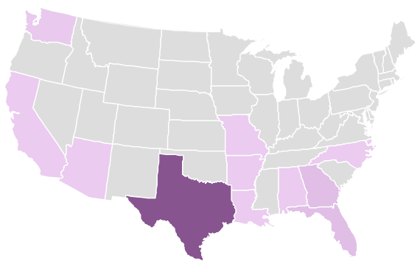
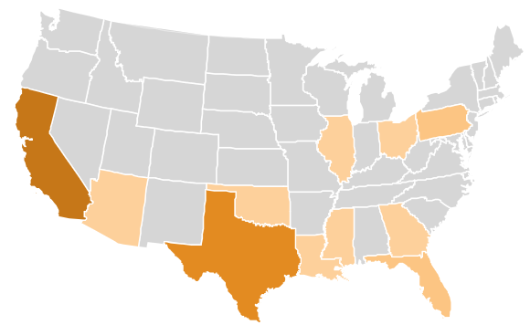


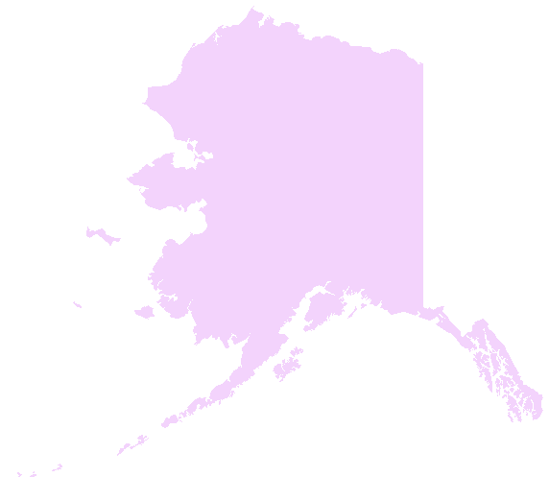
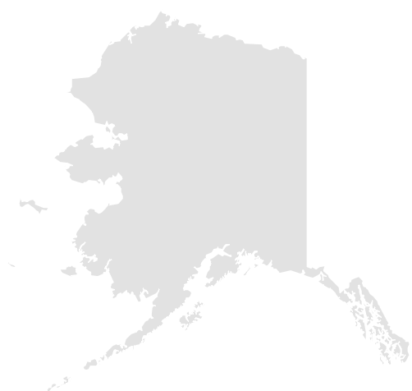
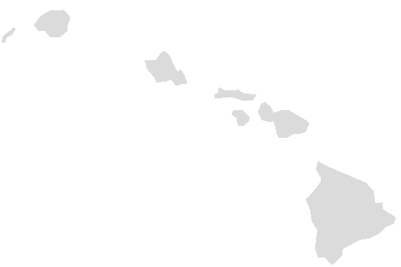
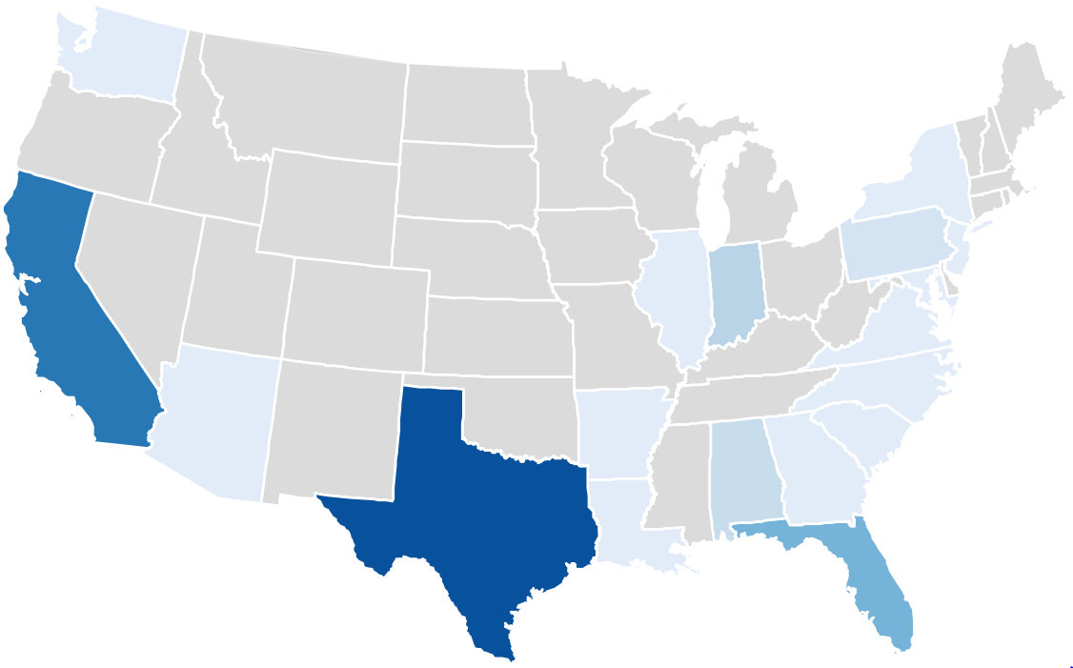
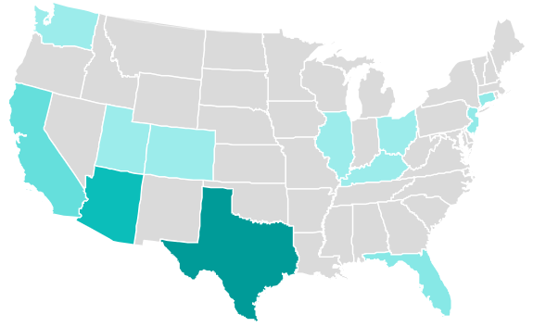


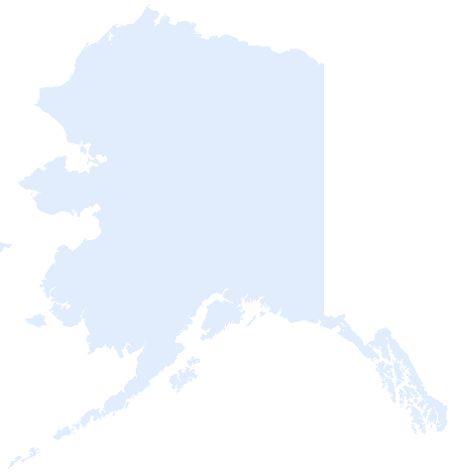
TB Cases Among Correctional Facility Residents Aged ≥15 Years by Type of Facility, United States, 2021
State Prisons
Federal Prisons
Number
of cases
Number
of cases
28
6
1
1
Local Jails
Other Facilities
Number
of cases
Number
of cases
15
21
1
1
Notes:
This slide displays the number of TB cases diagnosed among residents of state prisons, federal prisons, local jails, and other facilities in 2021 as four separate maps. Each map is color-coded so that as the number of TB cases increases, the color becomes darker. Texas had the greatest number of cases among persons who resided in state prisons (n=28), local jails (n=15), and other facilities (n=21) at the time of diagnosis. California had the greatest number of TB cases (n=6) among persons who resided in federal prisons. Other facilities include Immigration and Customs Enforcement (ICE) detention centers, Indian reservation facilities (e.g., tribal jails), military stockades and jails, federal park police facilities, police lockups (i.e., temporary holding facilities for persons who have not been formally charged in court), or other correctional facilities that are not included in the other specific choices.

Slide 56
Percentage of TB Cases by Primary Occupation*
Among Persons Aged ≥15 Years, United States, 2021 (N=5,795)
*Within past 12 months prior to TB diagnosis.
Notes:
Historically, healthcare workers, migrant workers, and correctional employees have been considered to be at increased risk of developing TB disease. In 2021, the percentages of persons reporting these occupations were 4.2%, 1.4%, and 0.1% respectively. Unemployed persons comprised 21% of TB cases, and 35% were either retired or not seeking employment.

Slide 57
Percentage of TB Cases by Status and Cause of Death, United States, 2019* (N=8,898)
Dead at diagnosis
(N=221)
Died after diagnosis
(N=671)
TB cause of death
TB not cause
of death
Unknown cause of death
*Most recent year for which data are complete
Notes:
In 2019, the most recent year for which complete data are available, of the 892 (10.0%) persons with TB, 221 (24.8%) were dead at the time of TB diagnosis and 671 (75.2%) died after diagnosis (i.e., during treatment). TB was reported as the cause of death for 29% of persons who were dead at diagnosis and 37% of persons who died after diagnosis. The percentage who died among persons with TB disease has remained consistent with previous years.

Slide 58
Sputum Culture Conversions, United States, 2019* (N=5,047)
Reasons sputum culture conversion not documented
*Most recent year for which data are complete
Notes:
Conversion of a patient’s positive sputum culture to negative is a key indicator of treatment effectiveness. Among 5,047 cases during 2019 with positive sputum cultures, 4,394 (87.1%) had documented sputum culture conversion; 612 (12.1%) did not have a sputum culture conversion documented. The most common reason for a sputum culture conversion not to be documented was that the patient had died (40.8%), followed by sputum not collected (21.1%), and could not produce sputum (10.0%).

Slide 59
National TB Genotyping Surveillance Coverage,*
United States, 2004–2021
National Goal:
100%
*Culture-confirmed TB cases with at least one genotyped isolate.
Notes:
This slide shows genotyping surveillance coverage from 2004 to 2021. The national goal for genotyping surveillance coverage is 100%. In 2004, the percentage of culture confirmed TB cases with at least one genotyped isolate was 52.6%. Since 2015, the percentage of culture confirmed TB cases with a genotyped isolate has been at least 97%; in 2021, it was 97.3%.

Slide 60
Definitions for TB Genotyping in the United States
Spoligotype: 000000000003771
Initial 12-locus MIRU-VNTR:*
223325173533
Sequentially assigned for each unique spoligotype and initial 12-locus MIRU-VNTR combination
Additional 12-locus MIRU-VNTR (MIRU2):†
444534423428
PCRType:
PCR00002
+
Sequentially assigned for each unique spoligotype and 24-locus MIRU-VNTR combination
GENType:
G00010
* MIRU-VNTR=Mycobacterial interspersed repetitive unit–variable number tandem repeat.
† The complete set of 24 loci is referred to as 24-locus MIRU-VNTR and is used for U.S. GENType designations.
Notes:
This slide depicts the assignment of PCRType using unique spoligotype and initial 12-locus MIRU-VNTR combination and GENType using the 24-locus MIRU-VNTR combination.

Slide 61
Number of County-based TB Genotype Clusters* by Cluster Size, United States, 2019–2021
* Clusters have two or more cases with matching spoligotype and 24-locus locus mycobacterial interspersed repetitive unit-variable number tandem repeat type (GENType) within a county during the specified 3-year time period.
Notes:
This slide shows the number of county-based TB genotype clusters by the size of the clusters. A genotype cluster has two or more cases with matching spoligotype and 24-locus MIRU-VNTR (GENType) within a county during the specified 3-year time period. During 2019 to 2021, there were 836 two-case clusters, 206 three-case clusters, 95 four-case clusters, 30 five-case clusters, 18 six-case clusters, 12 seven-case clusters, 11 eight-case clusters, 4 nine-case clusters, and 29 clusters with 10 or more TB cases. The total number of clusters during 2018 to 2020 (n=1,280) declined during 2019 to 2021 (n=1,241). The number of clusters with 6 or more cases declined during 2019 to 2021 (n=74) compared with 2018 to 2020 (n=79).

Slide 62
TB Genotype Clusters by TB GIMS* Alert Levels,† United States, 2019–2021 (N=1,241)
* TB GIMS=Tuberculosis Genotyping Information Management System
† Alert levels are based on a log-likelihood ratio, which calculates the geographical concentration of a genotype in a county compared to the rest of the country during a 3-year period. TB GIMS generates alert level notifications based on this statistic: “No alert” is indicated if LLR is between 0–<5, “medium” is for LLR of 5–<10 and “high” alert is for clusters with LLR ≥10.
Notes:
Clusters are classified into alert levels based on a log-likelihood ratio (LLR) calculation. Clusters with an LLR of 5–<10 are classified as a medium alert level, and clusters with an LLR ≥10 are classified as a high alert level. At the individual case level, clustered cases were often part of medium- (23.5%) or high-level alerts (14.8%). At the cluster level, 335 (27.0%) of 1,241 clusters identified nationally during 2019 to 2021 were either medium- (n=279) or high-level alerts (n=56). The distribution of alerts has remained stable compared with 2016 to 2018, when clustered cases were often medium- (22.6%) or high-level alerts (18.6%) and 392 (29.1%) of 1,349 clusters were medium- or high-level alerts.

Slide 63
Genotyped TB Cases Estimated to be Attributed to Recent Transmission, United States, 2020–2021 (N=11,404)
Recent transmission,* 12%
Not recent transmission,§ 88%
Limited recent transmission
Extensive recent transmission†
* A TB case is designated as attributed to recent transmission if a plausible source case can be identified in a person who i) has the same M. tuberculosis genotype, ii) has an infectious form of TB disease, iii) resides within 10 miles of the TB case, iv) is 10 years of age or older, and v) was diagnosed within 2 years before the TB case.
† A TB case is designated as attributed to extensive recent transmission when the criteria above for recent transmission are met, and furthermore the case belongs to a plausible transmission chain of six or more cases. Otherwise, the case is designated as attributed to limited recent transmission.
§ Cases not attributed to recent transmission may be misclassified in children <5 years old or indeterminate in persons with a recent U.S. arrival due to limitations of the plausible-source case method.
Notes:
Nationally, of 11,404 genotyped cases evaluated for recent transmission and reported during 2020 to 2021, CDC attributed 1,400 (12.3%) to recent transmission.
Note: 8.3% (n=944) were attributed to limited recent transmission and 4.0% (n=456) were attributed to extensive recent transmission. 87.7% (n=10,004) were not attributed to recent transmission.

Slide 64
Genotyped Cases Estimated to be Attributed to Limited and Extensive Recent Transmission,* United States, 2018–2021
N=1,400
Limited recent transmission
Extensive recent transmission†
* A TB case is designated as attributed to recent transmission if a plausible source case can be identified in a person who i) has the same M. tuberculosis genotype, ii) has an infectious form of TB disease, iii) resides within 10 miles of the TB case, iv) is 10 years of age or older, and v) was diagnosed within 2 years before the TB case.
† A TB case is designated as attributed to extensive recent transmission when the criteria above for recent transmission are met, and furthermore the case belongs to a plausible transmission chain of six or more cases. Otherwise, the case is designated as attributed to limited recent transmission.
Notes:
CDC has provided national estimates of recent transmission and extensive recent transmission throughout a 2-year period since the publication of Reported Tuberculosis in the United States, 2016. Although the number of cases attributed to both limited and extensive recent transmission declined during 2018 to 2019 (n=1,703) compared with during 2020 to 2021 (n=1,400), the relative percentages attributed to both recent transmission and extensive recent transmission remained similar during 2018 to 2019 (12.5% and 4.1% versus 12.3% and 4.0% during 2020 to 2021).

Slide 65
Percentages of TB Cases Estimated to be Attributed and Not Attributed to Recent Transmission* by Origin of Birth,† 2020–2021
Non-U.S.–born
U.S.-born
Recent transmission
Recent transmission
Not recent transmission,§
Not recent transmission,§
* Cases with unknown origin of birth not shown (n=40).
† A TB case is designated as attributed to recent transmission if a plausible source case can be identified in a person who i) has the same M. tuberculosis genotype, ii) has an infectious form of TB disease, iii) resides within 10 miles of the TB case, iv) is 10 years of age or older, and v) was diagnosed within 2 years before the TB case.
§ Cases not attributed to recent transmission may be misclassified in children <5 years old or indeterminate in persons with a recent U.S. arrival due to limitations of the plausible-source case method.
Notes:
A greater percentage of genotyped cases were attributed to recent transmission among U.S.-born persons (24.8%, n=750) than among non-U.S.–born persons (7.7%, n=644). Among U.S.-born persons, 75.2% (n=2,270) were not attributed to recent transmission, and among non-U.S.–born persons, 92.3% (n=7,700) were not attributed to recent transmission.

Slide 66
Percentage of TB Cases Estimated to be Attributed to Recent Transmission* by Race/Ethnicity,† United States, 2018–2021
2018–2019
2020–2021
American Indian or Alaska Native
Native Hawaiian or
Other Pacific Islander
Black or
African American
White
Hispanic or Latino
Asian
*A TB case is designated as attributed to recent transmission if a plausible source case can be identified in a person who i) has the same M. tuberculosis genotype, ii) has an infectious form of TB disease, iii) resides within 10 miles of the TB case, iv) is 10 years of age or older, and v) was diagnosed within 2 years before the TB case.
†Persons who identified as Hispanic or Latino were categorized as "Hispanic or Latino," regardless of self-reported race. Persons who did not identify as Hispanic or Latino were categorized by self-reported race; if more than one race was reported, the person was categorized as "Multiple race."
Notes:
Greater percentages of cases attributed to recent transmission were identified among American Indian or Alaska Native persons [2018 to 2019: n=60 (40%), 2020 to 2021: n=52 (42%)], Native Hawaiian or Other Pacific Islander persons [2018 to 2019: n=50 (32%), 2020 to 2021: n=58 (35%)], and Black or African American persons [2018 to 2019: n=521 (20%), 2020 to 2021: n=403 (20%)], compared with national average estimates [50 states and Washington DC; 2018 to 2019: n=1,703 (13%), 2020 to 2021: n=1,400 (12%)].

Slide 67
Percentage of TB Cases Estimated to be Attributed to Extensive Recent Transmission* by Race/Ethnicity,† United States, 2018–2021
2018–2019
2020–2021
American Indian or Alaska Native
Native Hawaiian or
Other Pacific Islander
Black or
African American
White
Hispanic or Latino
Asian
*A TB case is attributed to extensive recent transmission when the criteria for recent transmission are met and furthermore the case belongs to plausible transmission chain of 6 or more cases.
†Persons who identified as Hispanic or Latino were categorized as "Hispanic or Latino," regardless of self-reported race. Persons who did not identify as Hispanic or Latino were categorized by self-reported race; if more than one race was reported, the person was categorized as "Multiple race."
Notes:
Greater percentages of cases attributed to extensive recent transmission were identified among American Indian or Alaska Native persons [2018 to 2019: n=30 (20%), 2020 to 2021: n=23 (18%)], Native Hawaiian or Other Pacific Islander persons [2018 to 2019: n=19 (12%), 2020 to 2021: n=28 (17%)], and Black or African American persons [2018 to 2019: n=190 (7.2%), 2020 to 2021: n=155 (7.5%)], compared with national average estimates [50 states and Washington, DC; 2018 to 2019: n=557 (4.1%), 2020 to 2021: n=456 (4.0%)].

Slide 68
Division of Tuberculosis Elimination
National Center for HIV, Viral Hepatitis, STD, and TB Prevention
Centers for Disease Control and Prevention
1600 Clifton Road NE, US 12-4
Atlanta, GA 30329
Phone: 404-639-8120
Internet Address: http://www.cdc.gov/tb/
Notes:
For more information, please contact Division of Tuberculosis Elimination at http://www.cdc.gov/tb/.

