Slide 1
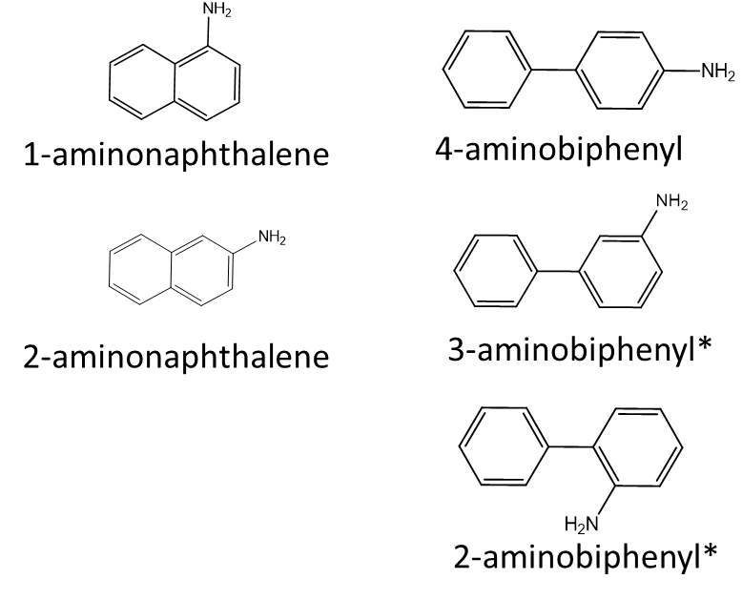
Supplementary Figure S1.
Supplementary Figure S1. Chemical structures of five AAs. Analytes that were monitored for isomeric separation but not quantified are indicated with an asterisk.

