Slide 1
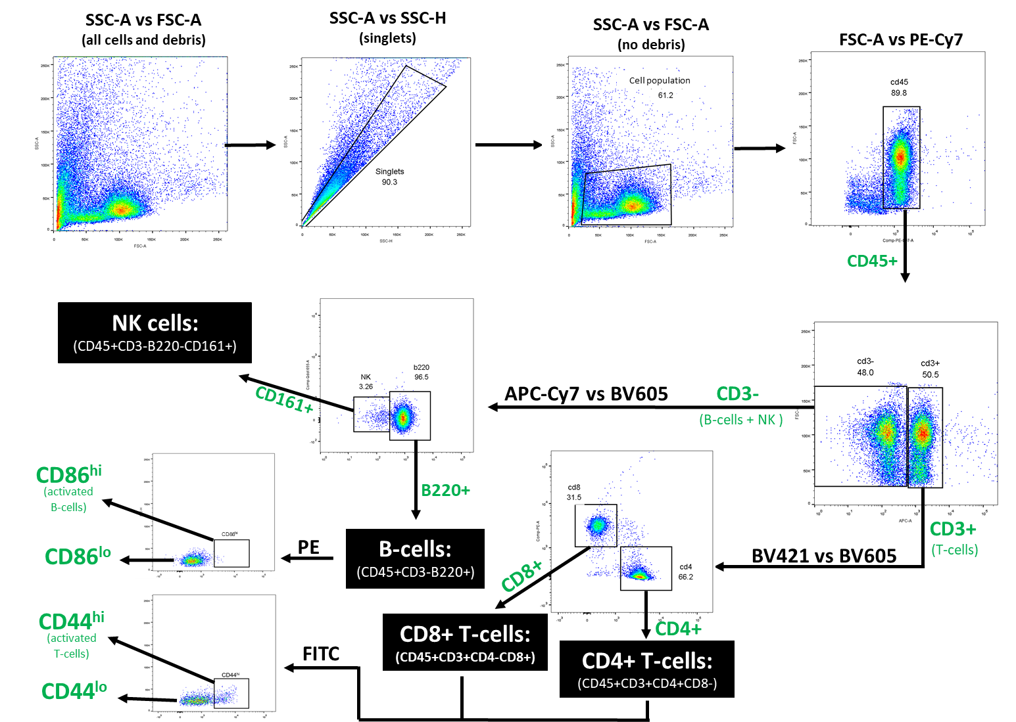
Supplemental
Flow cytometry gating strategy used to discriminate between lymphocyte subsets and evaluate activation status in bronchoalveolar lavage (BAL), lymph node, and spleen samples. Following exclusion of debris and doublets, T-cells were identified by their CD45+/CD3+ expression profile. This population was subsequently differentiated into subpopulations of CD4+/CD8- and CD4-/CD8+ cells for determination of helper and cytotoxic T-cells, respectively. Concurrently, the CD45+CD3- population was used to identify B-cells and NK cells based on expression of B220 and CD161. The CD4+ and CD8+ T-cell populations were then evaluated for CD44 expression to determine the frequency of cellular activation within each subpopulation. CD44^{hi/lo} populations were established according to the gates illustrated in the terminal step of the scheme above. B-cell populations were similarly interrogated for activation status by assessing CD86 expression level. The proportion of cells bearing a CD86^{hi} phenotype was determined according to the population shift illustrated above.

