Slide 1
Name | Forward Sequence | Reverse Sequence
Tslp | GCAAATCGAGGACTGTGAGAGC | TGAGGGCTTCTCTTGTTCTCCG
IL13 | AACGGCAGCATGGTATGGAGTG | TGGGTCCTGTAGATGGCATTGC
IL33 | CTACTGCATGAGACTCCGTTCTG | AGAATCCCGTGGATAGGCAGAG
18s | GGTGGAGTCATACGCATTCTGG | ACAGCATTCCCAGTGCCTTGGA
IL6 | TACCACTTCACAAGTCGGAGGC | CTGCAAGTGCATCATCGTTGTTC
Kc | TCCAGAGCTTGAAGGTGTTGCC | AACCAAGGGAGCTTCAGGGTCA
Muc5ac | CCACTTTCTCCTTCTCCACACC | GGTTGTCGATGCAGCCTTGCTT
Muc5B | CTGAAGACCTGTCGGAACCCAA | GCCACACACTTCATCTGGTCCT
IL1β | TGGACCTTCCAGGATGAGGACA | GTTCATCTCGGAGCCTGTAGTG
Ym1 | TACTCACTTCCACAGGAGCAGG | CTCCAGTGTAGCCATCCTTAGG
IL13ra1 | TGTTCTTGCCGACGCTGTCTAC | GTGTAGAAGGTGGAGTTTTGCTC
IL13ra2 | TGGTCTGCTCTTGGAAACCTGG | GCTGGAGGTAATCAGCACACTG
Arg1 | TCATCTGGGTGGATGCTCACAC | GAGAATCCTGGCACATCGGGAA
Tnf-α | GGTGCCTATGTCTCAGCCTCTT | GCCATAGAACTGATGAGAGGGAG
Hmox1 | CACTCTGGAGATGACACCTGAG | GTGTTCCTCTGTCAGCATCACC
Tgf-β | TGATACGCCTGAGTGGCTGTCT | CACAAGAGCAGTGAGCGCTGAA
Nrf2 | CAGCATAGAGCAGGACATGGAG | GAACAGCGGTAGTATCAGCCAG
Supplemental Table 1: Primer sequence

Slide 2
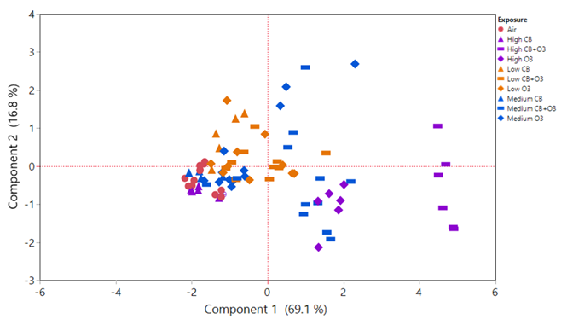
Supplemental Figure 1. PCA analyses of all the study groups.

Slide 3
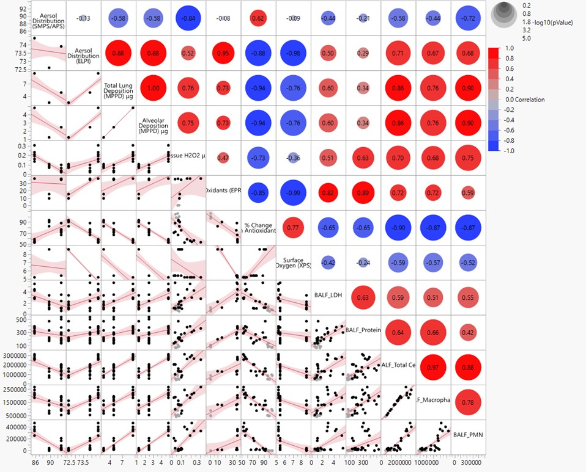
Supplemental Figure 2. Scatter plot showing correlation of various variables and Pearson correlation coefficient (r) of these variables on the top right of the matrix. Blue indicates a negative correlation between the variables while red indicates a positive correlation between the variables.

Slide 4
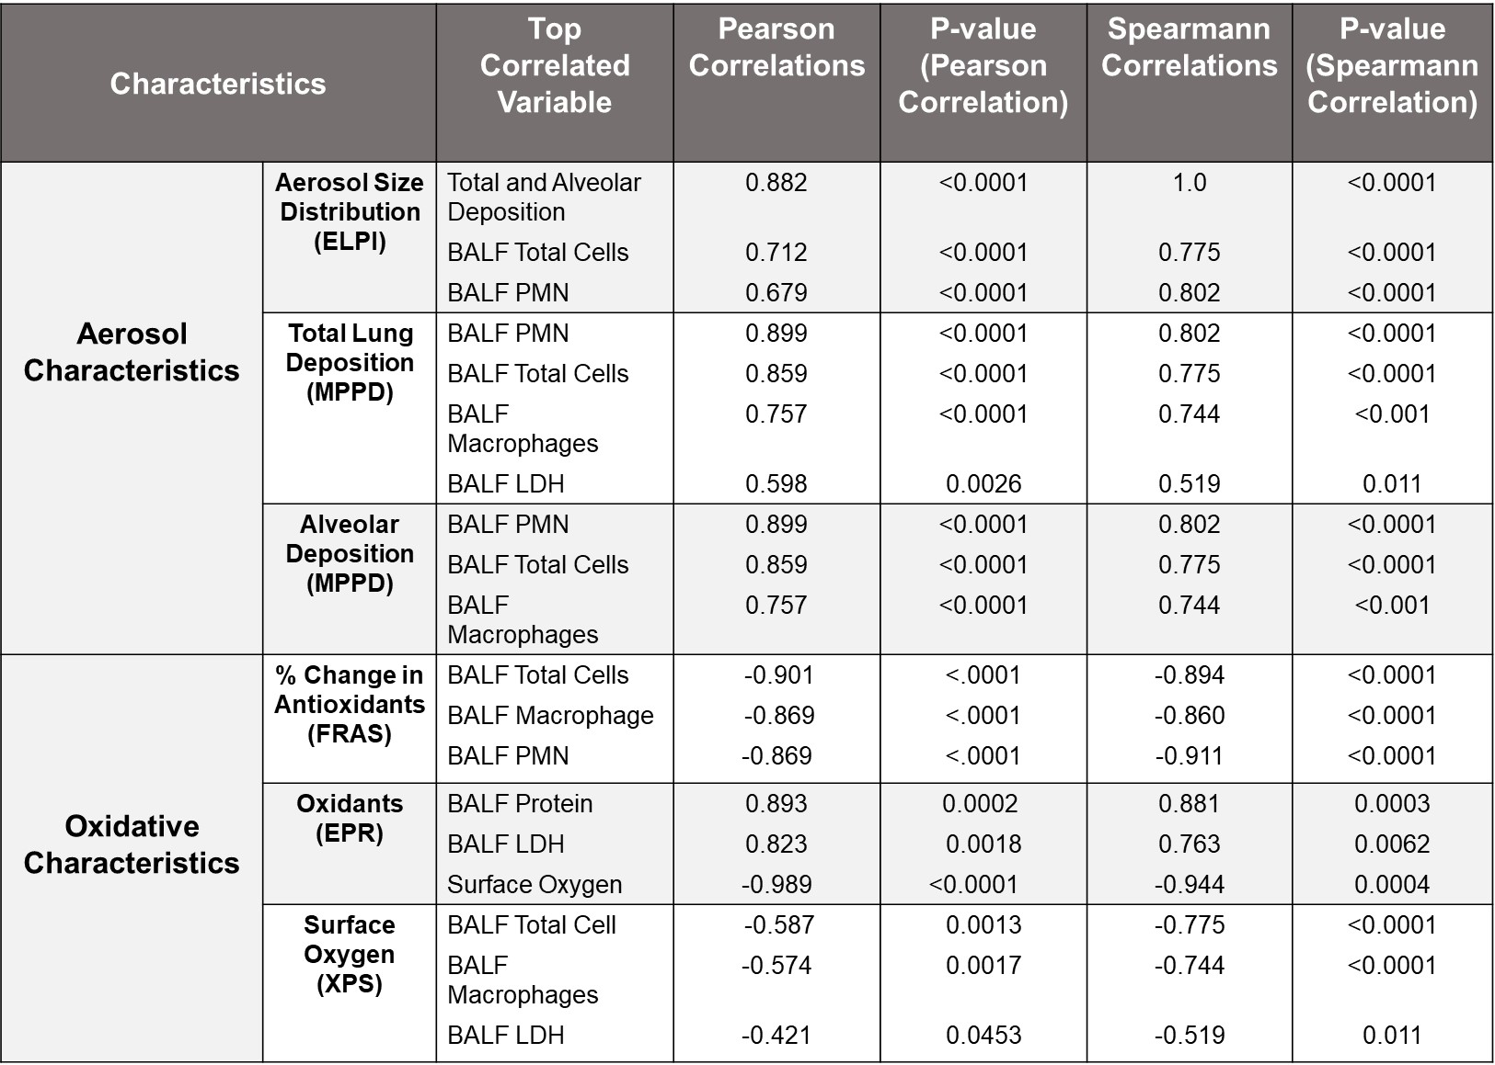
Supplemental Table 2. Spearman Correlation vs Pearson Correlation

