Slide 1
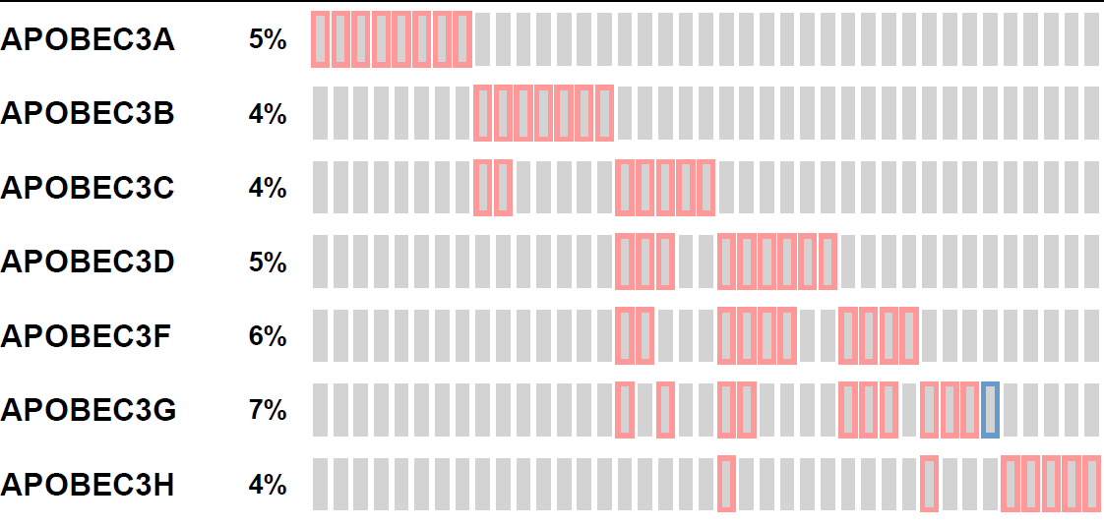
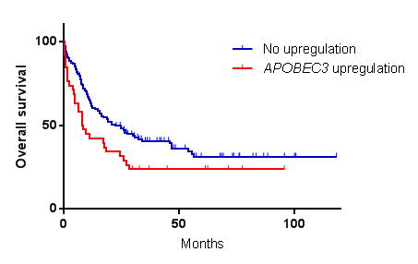
A
B
No upregulation
APOBEC3 upregulation
Hazard ratio 1.614 (95%CI; 1.072, 2.829)
p=0.0256 logrank-test
Supplementary Figure 1. Expression of APOBEC3 mRNA in patients with AML. (A) mRNA plot for APOBEC3 genes. Each column indicates a unique patient, showing each gene upregulated (red) or downregulated (blue) in a combined total of 200 AML samples from TCGA obtained through cBioPortal. Patients who did not have upregulation or downregulation of APOBEC3 gene were not shown. (B) Kaplan-Meier curves for overall survival of AML patients with or without upregulation of APOBEC3 genes.
Takei et al. Supplementary Figure S1

