Slide 1
Sexually Transmitted Disease
Surveillance 2019
Notes:
This slide set was prepared by the Division of STD Prevention, National Center for HIV/AIDS, Viral Hepatitis, STD, and TB Prevention (NCHHSTP), Centers for Disease Control and Prevention (CDC). These slides display trends for STDs in the United States through 2019. Data presented include case reports provided to CDC through the National Notifiable Diseases Surveillance System (NNDSS) and data collected through projects and programs that monitor STDs in various settings, including the National Job Training Program (NJTP), the STD Surveillance Network (SSuN), and the Gonococcal Isolate Surveillance Project (GISP).
For more information on data sources, data collection and reporting practices, and case definitions, please see the Technical Note, available at www.cdc.gov/std/statistics/2019/Technicalnotes.
All data points for figures presented in these slides are available at www.cdc.gov/std/statistics/2019/data.zip
NOTE: This slide set is in the public domain. You may reproduce these slides without permission; however, citation as to source is appreciated.
Centers for Disease Control and Prevention. Sexually Transmitted Disease Surveillance 2019. Atlanta: U.S. Department of Health and Human Services; 2021.
You are also free to adapt and revise these slides; however, you must remove the CDC name and logo if changes are made.

Slide 2
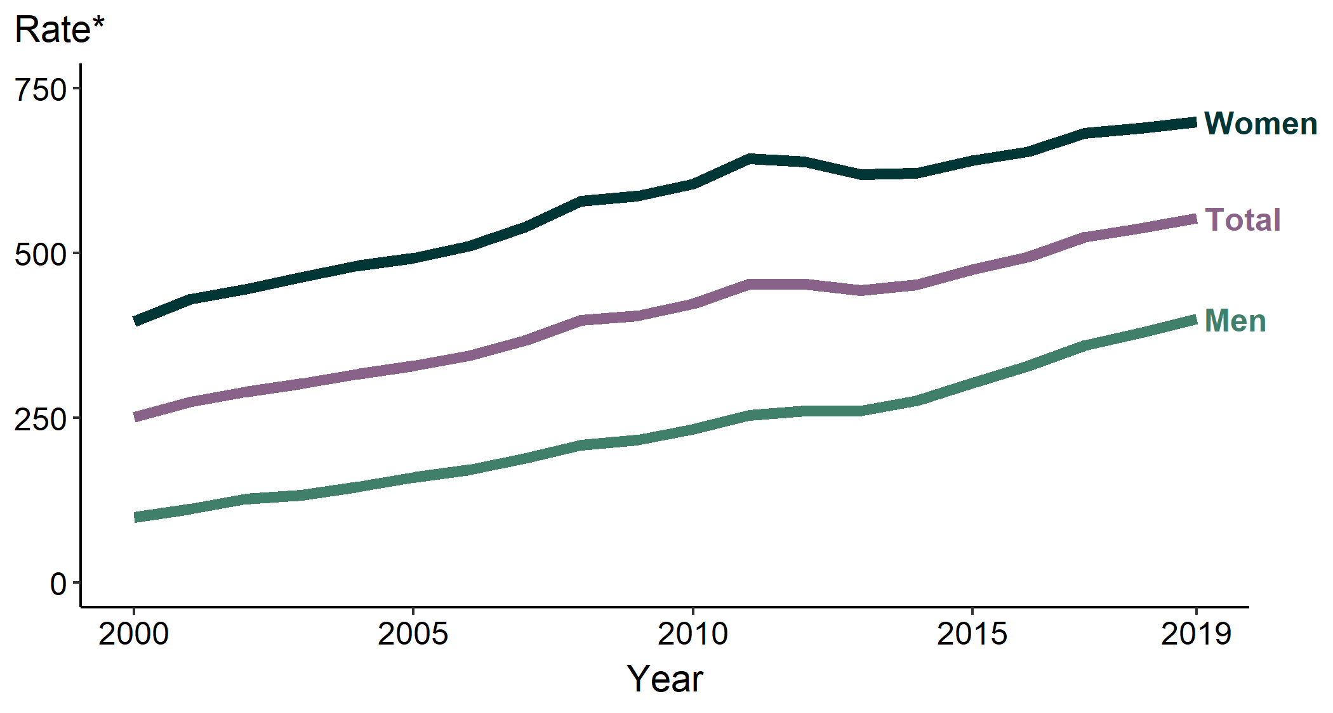
Chlamydia — Rates of Reported Cases by Sex, United States, 2000–2019
* Per 100,000
Notes:
In 2019, 1,808,703 chlamydial infections were reported to CDC in 50 states and the District of Columbia. This case count corresponds to a rate of 552.8 cases per 100,000 population, an increase of 2.8% from 2018. During 2018–2019, the rate of reported chlamydia among males increased 5.5% (from 378.9 to 399.9 cases per 100,000 males) and the rate among females increased 1.3% (from 689.6 to 698.9 cases per 100,000 females).
See Technical Notes (www.cdc.gov/std/statistics/2019/Technicalnotes) for information on chlamydia case reporting.
Data points are available at www.cdc.gov/std/statistics/2019/data.zip

Slide 3
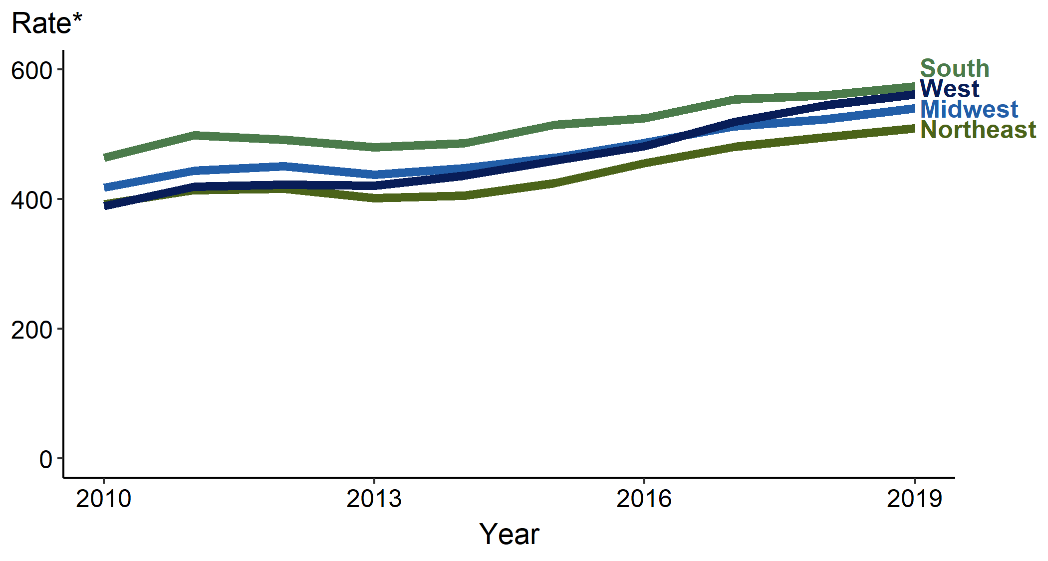
Chlamydia — Rates of Reported Cases by Region, United States, 2010–2019
* Per 100,000
Notes:
In 2019, rates of reported cases of chlamydia were highest in the South (573.9 cases per 100,000; 2.4% increase from 2018), followed by the West (561.6 per 100,000; 3.2% increase from 2018), Midwest (540.1 per 100,000; 3.3% increase from 2018), and Northeast (509.4 per 100,000; 2.8% increase from 2018).
See Technical Notes (www.cdc.gov/std/statistics/2019/Technicalnotes) for information on chlamydia case reporting.
Data points are available at www.cdc.gov/std/statistics/2019/data.zip

Slide 4
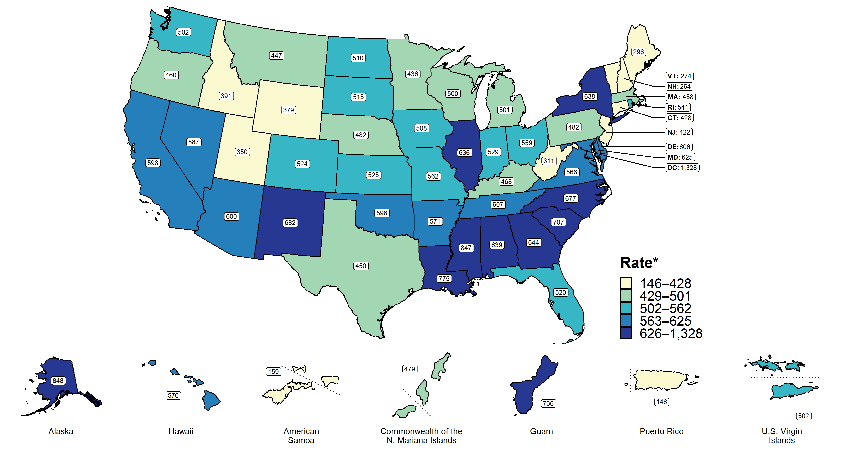
Chlamydia — Rates of Reported Cases by State, United States and Territories, 2019
* Per 100,000
Notes:
In 2019, rates of reported cases of chlamydia by state ranged from 263.7 cases per 100,000 population in New Hampshire to 848.1 cases per 100,000 population in Alaska; the rate for the District of Columbia was 1,327.8 cases per 100,000 population.
See Technical Notes (www.cdc.gov/std/statistics/2019/Technicalnotes) for information on chlamydia case reporting and on interpreting reported rates in US territories.
Data points are available at www.cdc.gov/std/statistics/2019/data.zip

Slide 5
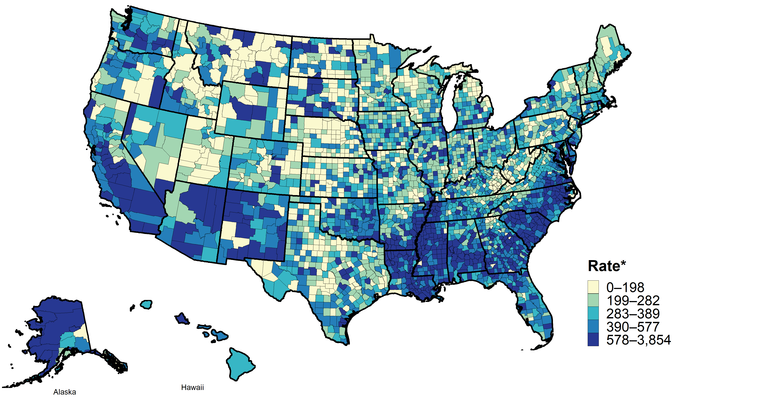
Chlamydia — Rates of Reported Cases by County, United States, 2019
* Per 100,000
Notes:
In 2019, 98.8% of all counties in the United States reported at least one case of chlamydia. Out of 3,142 counties and independent cities, 96 made up approximately 50% of all reported cases of chlamydia.
See Technical Notes (www.cdc.gov/std/statistics/2019/Technicalnotes) for information on chlamydia case reporting.
Data points are available at www.cdc.gov/std/statistics/2019/data.zip

Slide 6
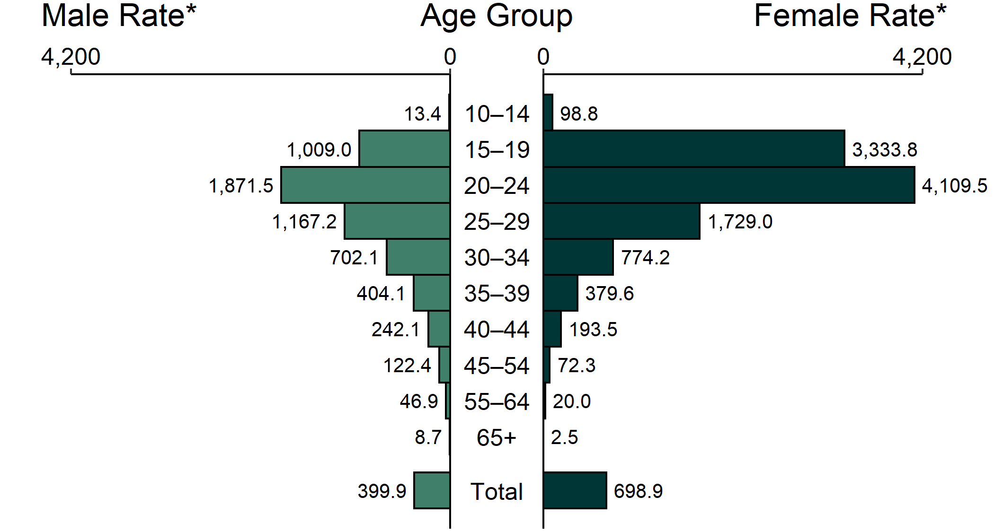
Chlamydia — Rates of Reported Cases by Age Group and Sex, United States, 2019
* Per 100,000
NOTE: Total includes all ages.
Notes:
The highest age-specific rates of reported cases of chlamydia in 2019 were among females aged 15–19 years (3,333.8 cases per 100,000 females) and 20–24 years (4,109.5 cases per 100,000 females). The age-specific rates of reported cases of chlamydia among males, although substantially lower than rates among females, were highest in those aged 20–24 years (1,871.5 cases per 100,000 males).
See Technical Notes (www.cdc.gov/std/statistics/2019/Technicalnotes) for information on chlamydia case reporting.
Data points are available at www.cdc.gov/std/statistics/2019/data.zip

Slide 7
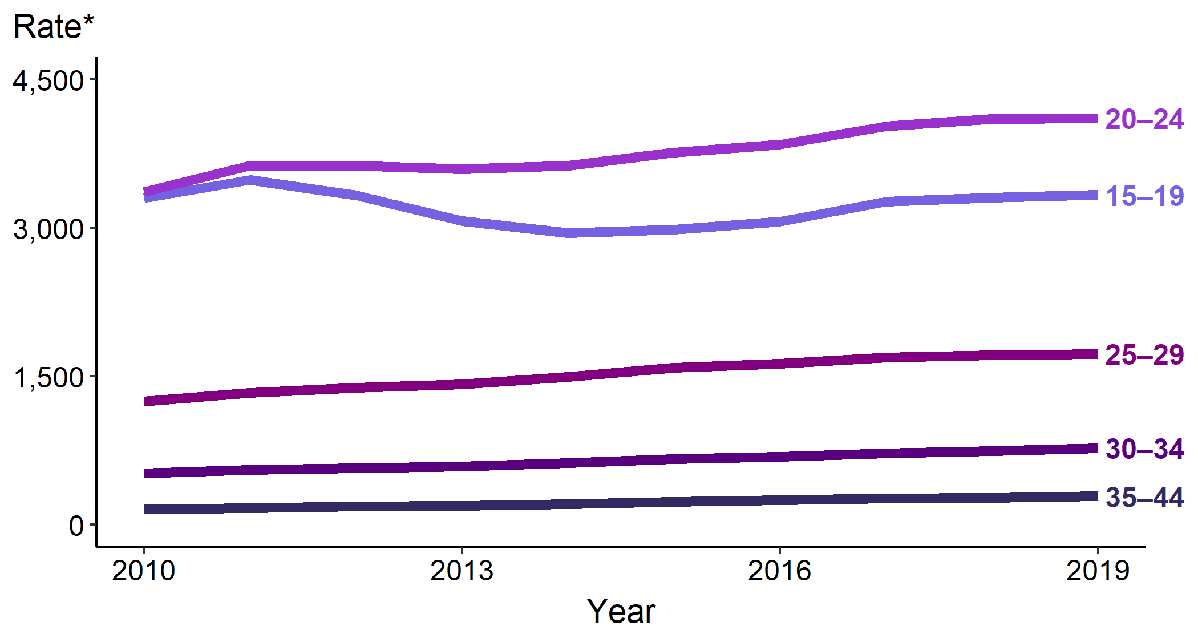
Chlamydia — Rates of Reported Cases Among Females Aged 15–44 Years by Age Group, United States, 2010–2019
* Per 100,000
Notes:
The rate of reported chlamydia among 15–19-year-old females increased 0.7% during 2018–2019, with a total increase of 11.6% during 2015–2019 (2,986.5 to 3,333.8 cases per 100,000 females). The rate among 20–24-year-old females increased 0.2% during 2018–2019, with a total increase of 9.2% during 2015–2019 (3,764.4 to 4,109.5 cases per 100,000 females).
See Technical Notes (www.cdc.gov/std/statistics/2019/Technicalnotes) for information on chlamydia case reporting.
Data points are available at www.cdc.gov/std/statistics/2019/data.zip

Slide 8
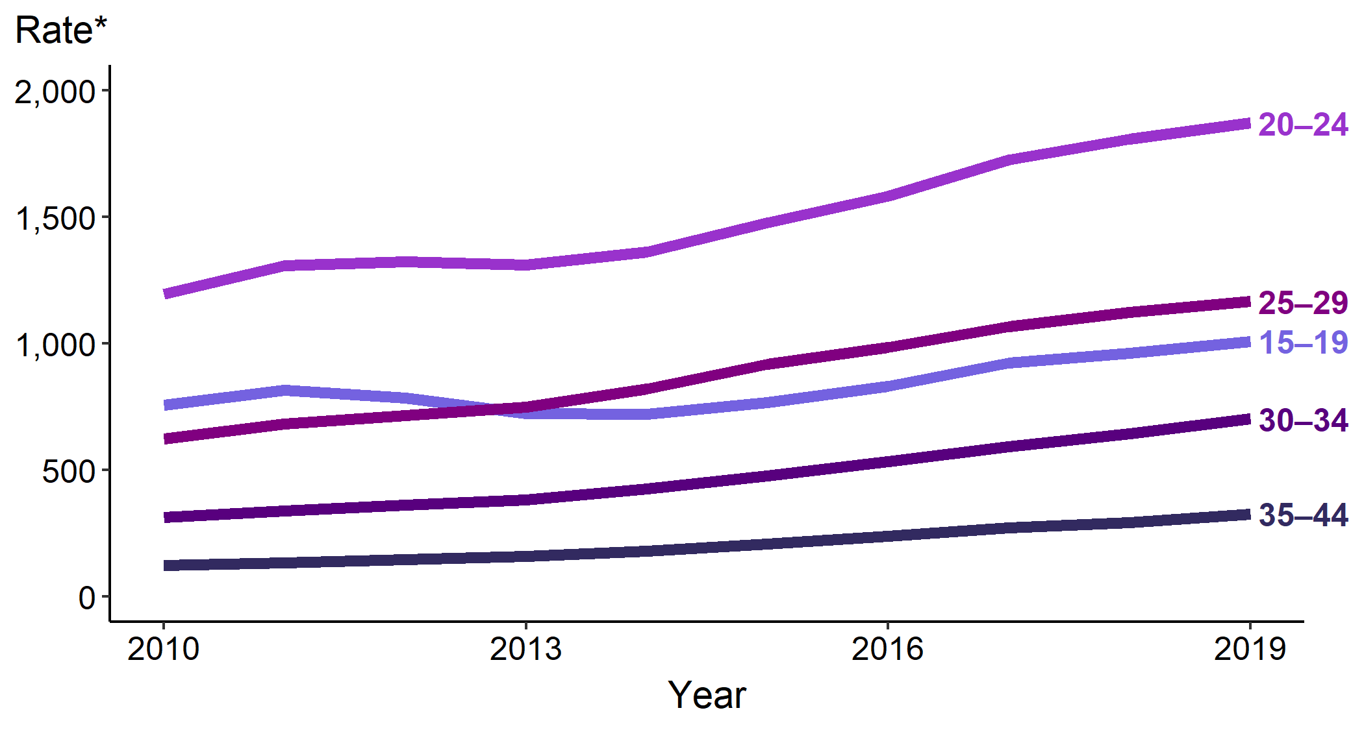
Chlamydia — Rates of Reported Cases Among Males Aged 15–44 Years by Age Group, United States, 2010–2019
* Per 100,000
Notes:
The rate of reported chlamydia among 15–19-year-old males increased 5.0% during 2018–2019, with a total increase of 31.6% during 2015–2019 (from 766.6 to 1,009.0 cases per 100,000 males). The rate among 20–24-year-old males increased 3.5% during 2018–2019, with a total increase of 26.7% during 2015–2019 (1,476.8 to 1,871.5 cases per 100,000 males).
See Technical Notes (www.cdc.gov/std/statistics/2019/Technicalnotes) for information on chlamydia case reporting.
Data points are available at www.cdc.gov/std/statistics/2019/data.zip

Slide 9
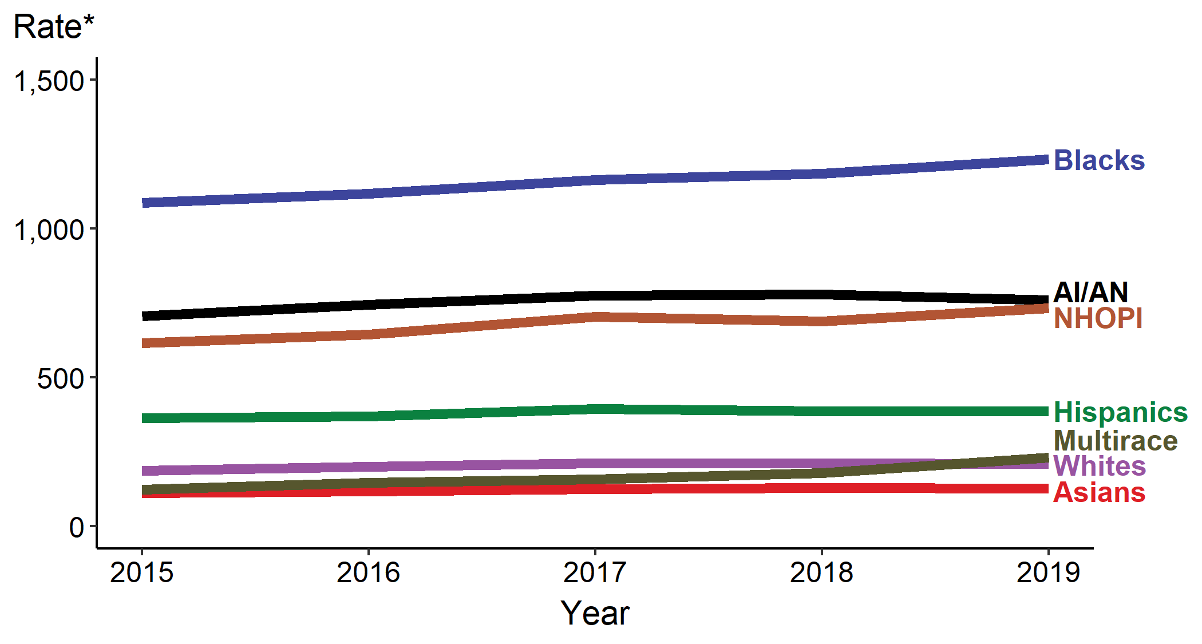
Chlamydia — Rates of Reported Cases by Race/Hispanic Ethnicity, United States, 2015–2019
* Per 100,000
ACRONYMS: AI/AN = American Indians/Alaska Natives; NHOPI = Native Hawaiians/Other Pacific Islanders
Notes:
In 2019, rates of reported cases of chlamydia were highest among Blacks (1,233.2 per 100,000), followed by American Indians/Alaska Natives (760.0 per 100,000) and Native Hawaiians/Other Pacific Islanders (733.4 per 100,000). During 2015–2019, rates of reported chlamydia cases increased among all racial/Hispanic ethnicity groups, with American Indians/Alaska Natives increasing 7.5%, Hispanics 6.3%, Blacks 13.5%, Whites 11.8%, Native Hawaiians/Other Pacific Islanders 18.9%, Asians 15.4%, and Multirace 87.2%.
Not all US jurisdictions reported cases in Office of Management and Budget compliant race categories in 2019. This may minimally under- or overestimate rates for Asians, NHOPI, or Multirace individuals. For completeness, data in this figure include cases reported from all jurisdictions.
See Technical Notes (www.cdc.gov/std/statistics/2019/Technicalnotes) for information on gonorrhea case reporting and reporting STD case data for race/Hispanic ethnicity.
Data points are available at www.cdc.gov/std/statistics/2019/data.zip

Slide 10
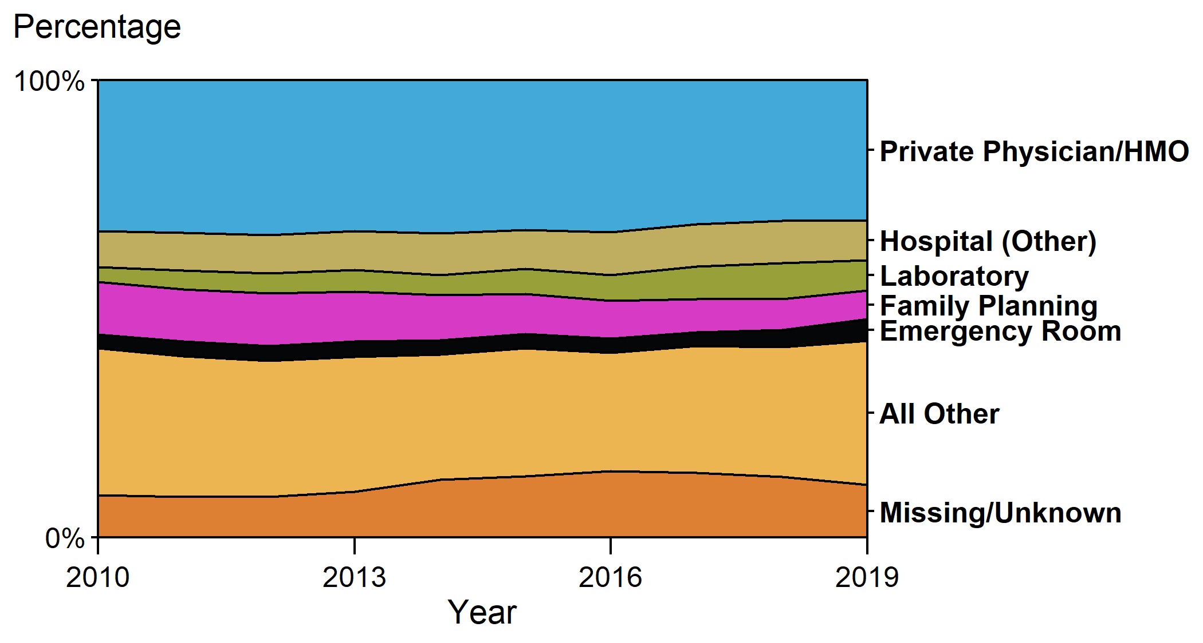
Chlamydia — Percentage of Reported Cases Among Females by Reporting Source, United States, 2010–2019
ACRONYMS: HMO = health maintenance organization
Notes:
In 2019, 30.7% of chlamydia cases among females were reported from a private physician/health maintenance organization. Only 6.3% of cases were reported from Family Planning clinics and only 3.9% from STD clinics.
See Technical Notes (www.cdc.gov/std/statistics/2019/Technicalnotes) for information on chlamydia case reporting and on classification of reporting sources and a full list of reporting sources.
Data points are available at www.cdc.gov/std/statistics/2019/data.zip

Slide 11
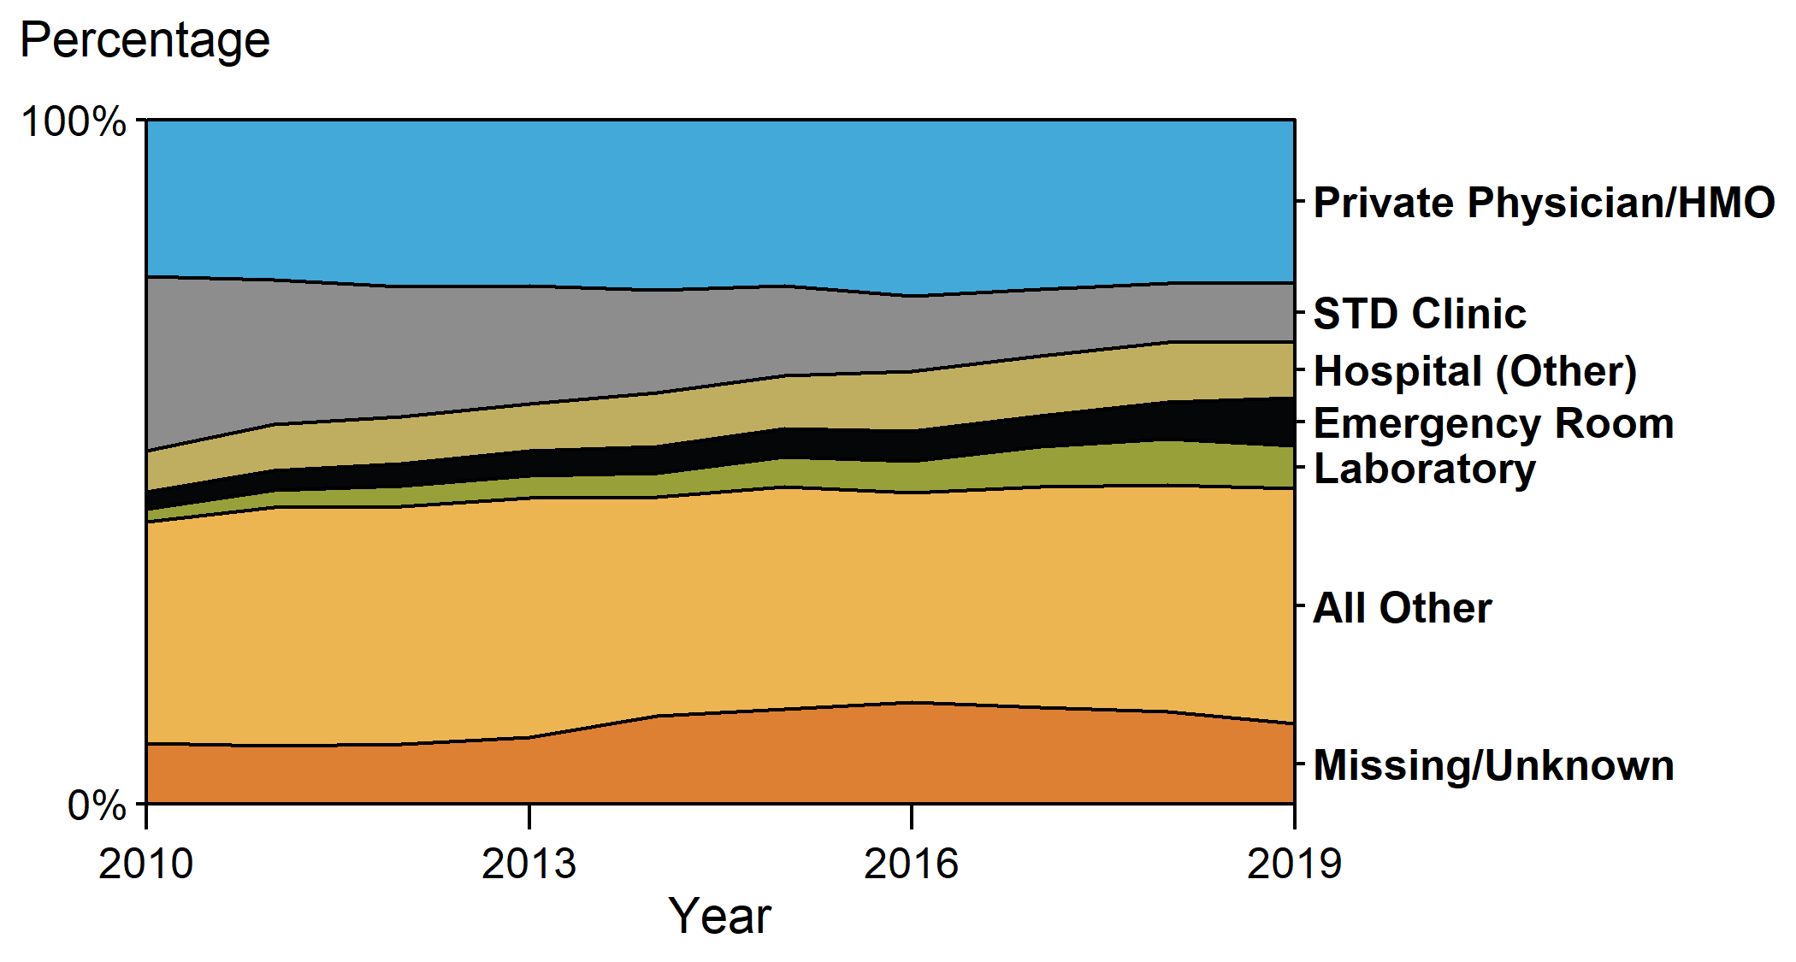
Chlamydia — Percentage of Reported Cases Among Males by Reporting Source, United States, 2010–2019
ACRONYMS: HMO = health maintenance organization
Notes:
In 2019, 23.8% of male chlamydia cases were reported from a private physician/health maintenance organization. The proportion of male cases reported from STD clinic sites has decreased substantially over time, from 25.5% in 2010 to 8.6% in 2019.
See Technical Notes (www.cdc.gov/std/statistics/2019/Technicalnotes) for information on chlamydia case reporting and on classification of reporting sources and a full list of reporting sources.
Data points are available at www.cdc.gov/std/statistics/2019/data.zip

Slide 12
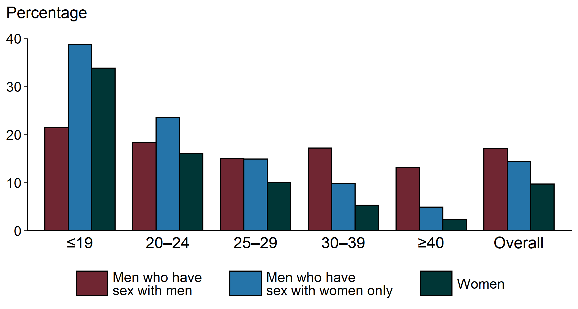
Chlamydia — Proportion of STD Clinic Patients Testing Positive by Age Group, Sex, and Sex of Sex Partners, STD Surveillance Network (SSuN), 2019
NOTE: Results are based on unique patients with known sex of sex partners (n=89,448) attending SSuN STD clinics who were tested ≥1 time for chlamydia in 2019.
Notes:
Among patients accessing care in STD clinics in jurisdictions participating in the STD Surveillance Network (SSuN) who were tested for chlamydia in 2019, 17.1% of men who have sex with men, 14.4% of men who have sex with women only, and 9.7% of women were found to be positive. The proportion testing positive for chlamydia varied by sex and sex of sex partners, as well as age. Women and men who have sex with women only aged 19 years or younger had the highest positivity at 33.8% and 38.8%, respectively.
See Technical Notes (www.cdc.gov/std/statistics/2019/Technicalnotes) for information on SSuN methodology.
Data points are available at www.cdc.gov/std/statistics/2019/data.zip

Slide 13
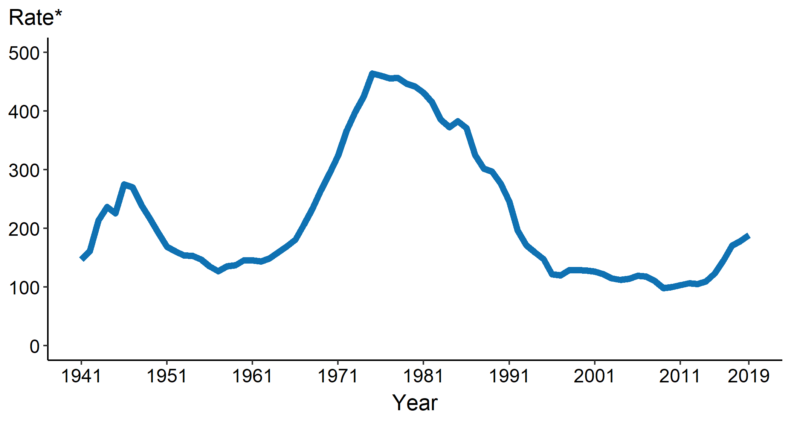
Gonorrhea — Rates of Reported Cases by Year, United States, 1941–2019
* Per 100,000
Notes:
In 2019, 616,392 cases of gonorrhea were reported to CDC in 50 states and the District of Columbia, yielding a rate of 188.4 cases per 100,000 population. The rate of reported gonorrhea cases increased 5.7% from 2018 and increased 53.2% since 2015.
See Technical Notes (www.cdc.gov/std/statistics/2019/Technicalnotes) for information on gonorrhea case reporting.
Data points are available at www.cdc.gov/std/statistics/2019/data.zip

Slide 14
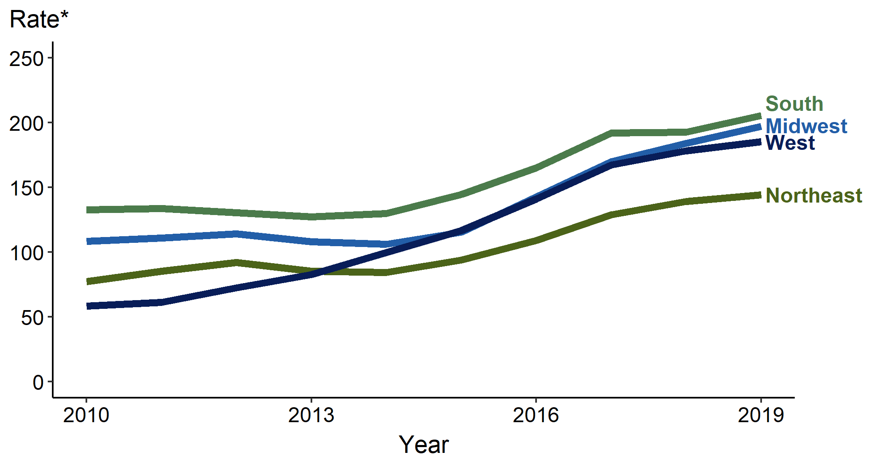
Gonorrhea — Rates of Reported Cases by Region, United States, 2010–2019
* Per 100,000
Notes:
In 2019, the South had the highest rate of reported gonorrhea cases (205.4 cases per 100,000; 6.6% increase from 2018) followed by the Midwest (197.2 per 100,000; 7.1% increase from 2018), the West (185.2 per 100,000; 3.9% increase from 2018), and the Northeast (144.4 per 100,000; 3.7% increase from 2018). During 2015–2019, the largest increase occurred in the Midwest (from 115.4 to 197.2 cases per 100,000; 70.9% increase).
See Technical Notes (www.cdc.gov/std/statistics/2019/Technicalnotes) for information on gonorrhea case reporting.
Data points are available at www.cdc.gov/std/statistics/2019/data.zip

Slide 15
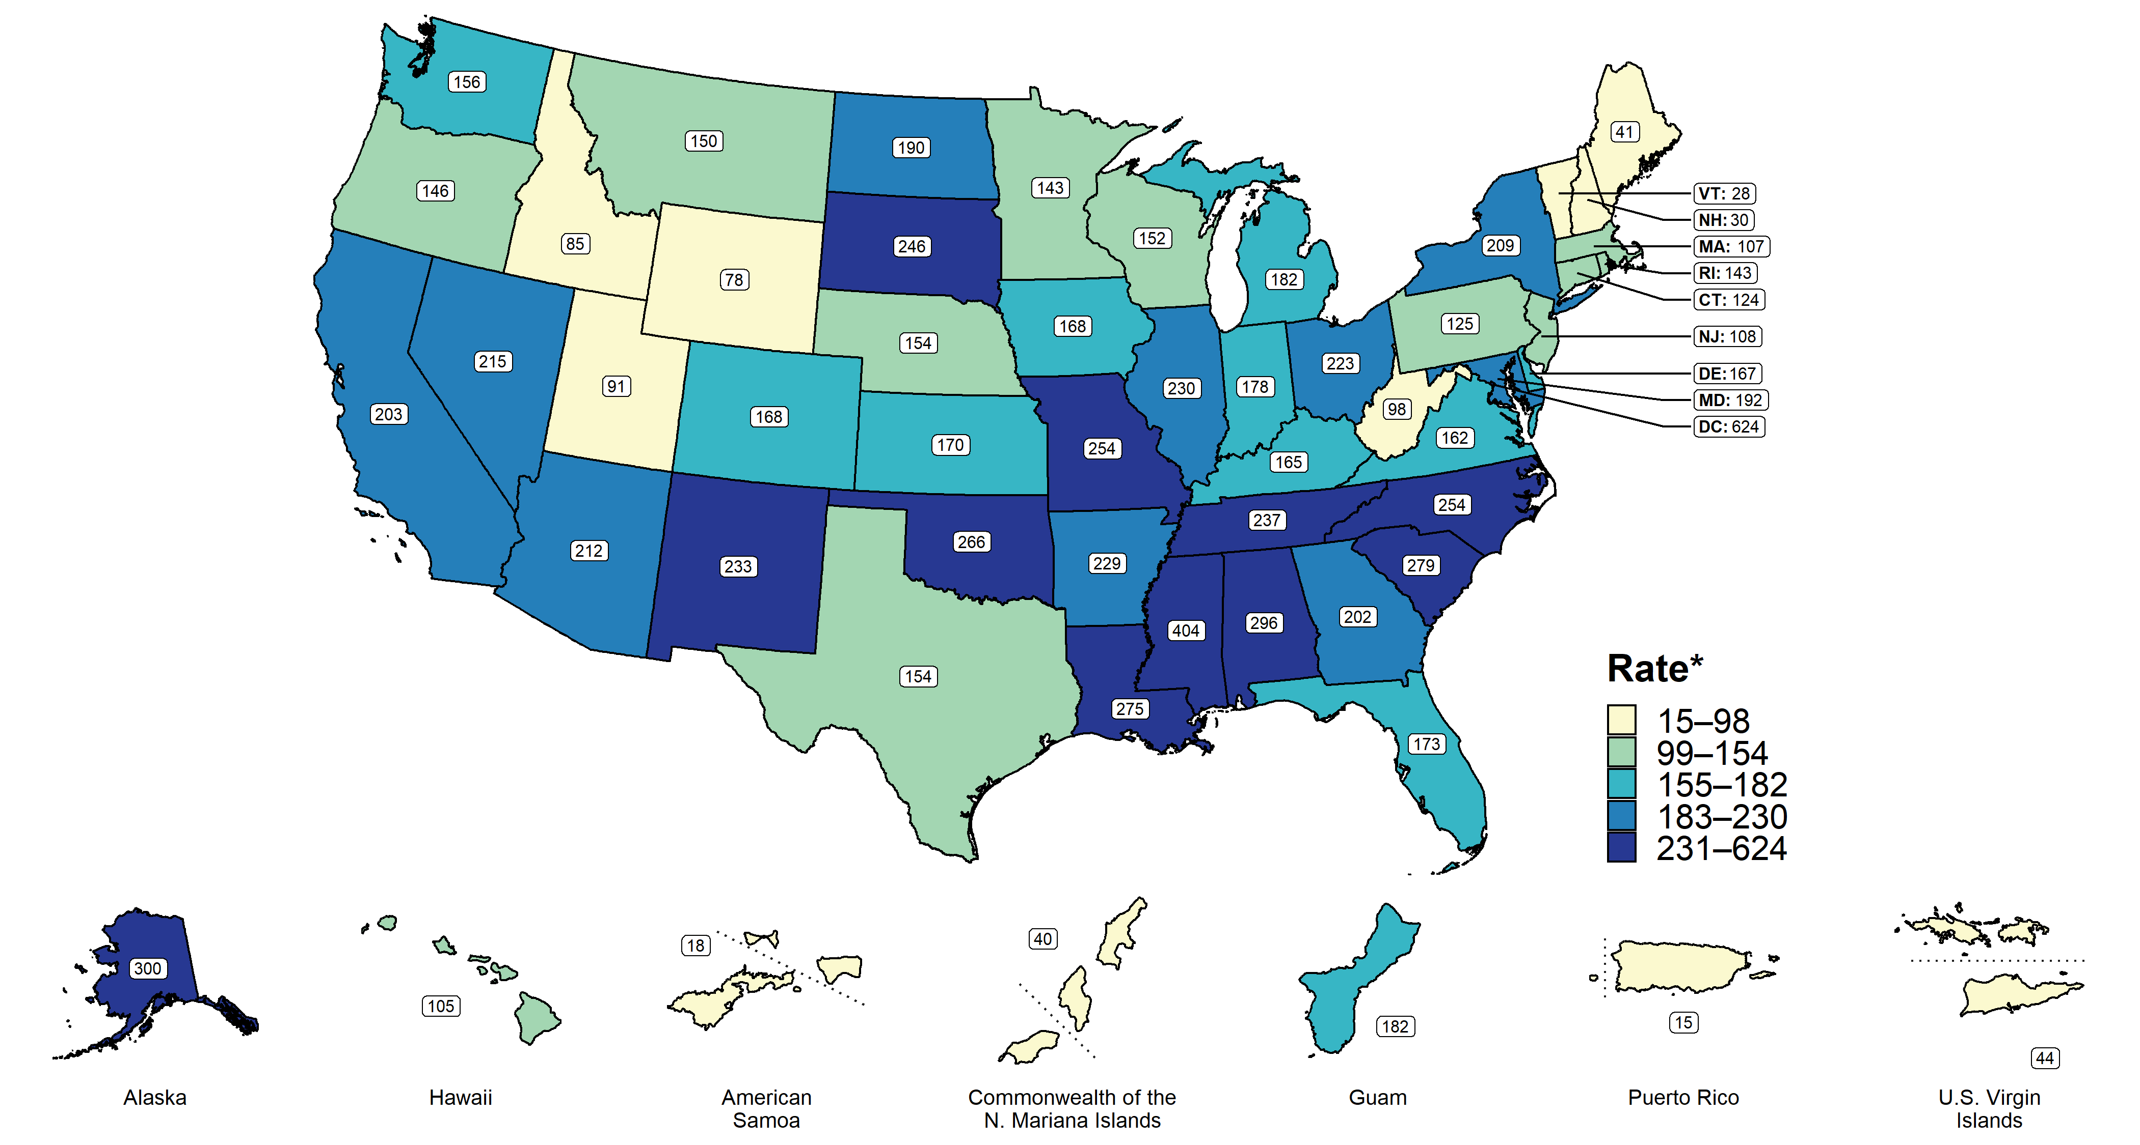
Gonorrhea — Rates of Reported Cases by State, United States and Territories, 2019
* Per 100,000
Notes:
In 2019, rates of reported gonorrhea cases per 100,000 population ranged by state from 27.9 in Vermont to 404.1 in Mississippi; the gonorrhea rate in the District of Columbia was 623.8 cases per 100,000 population.
See Technical Notes (www.cdc.gov/std/statistics/2019/Technicalnotes) for information on gonorrhea case reporting and on interpreting reported rates in US territories.
Data points are available at www.cdc.gov/std/statistics/2019/data.zip

Slide 16
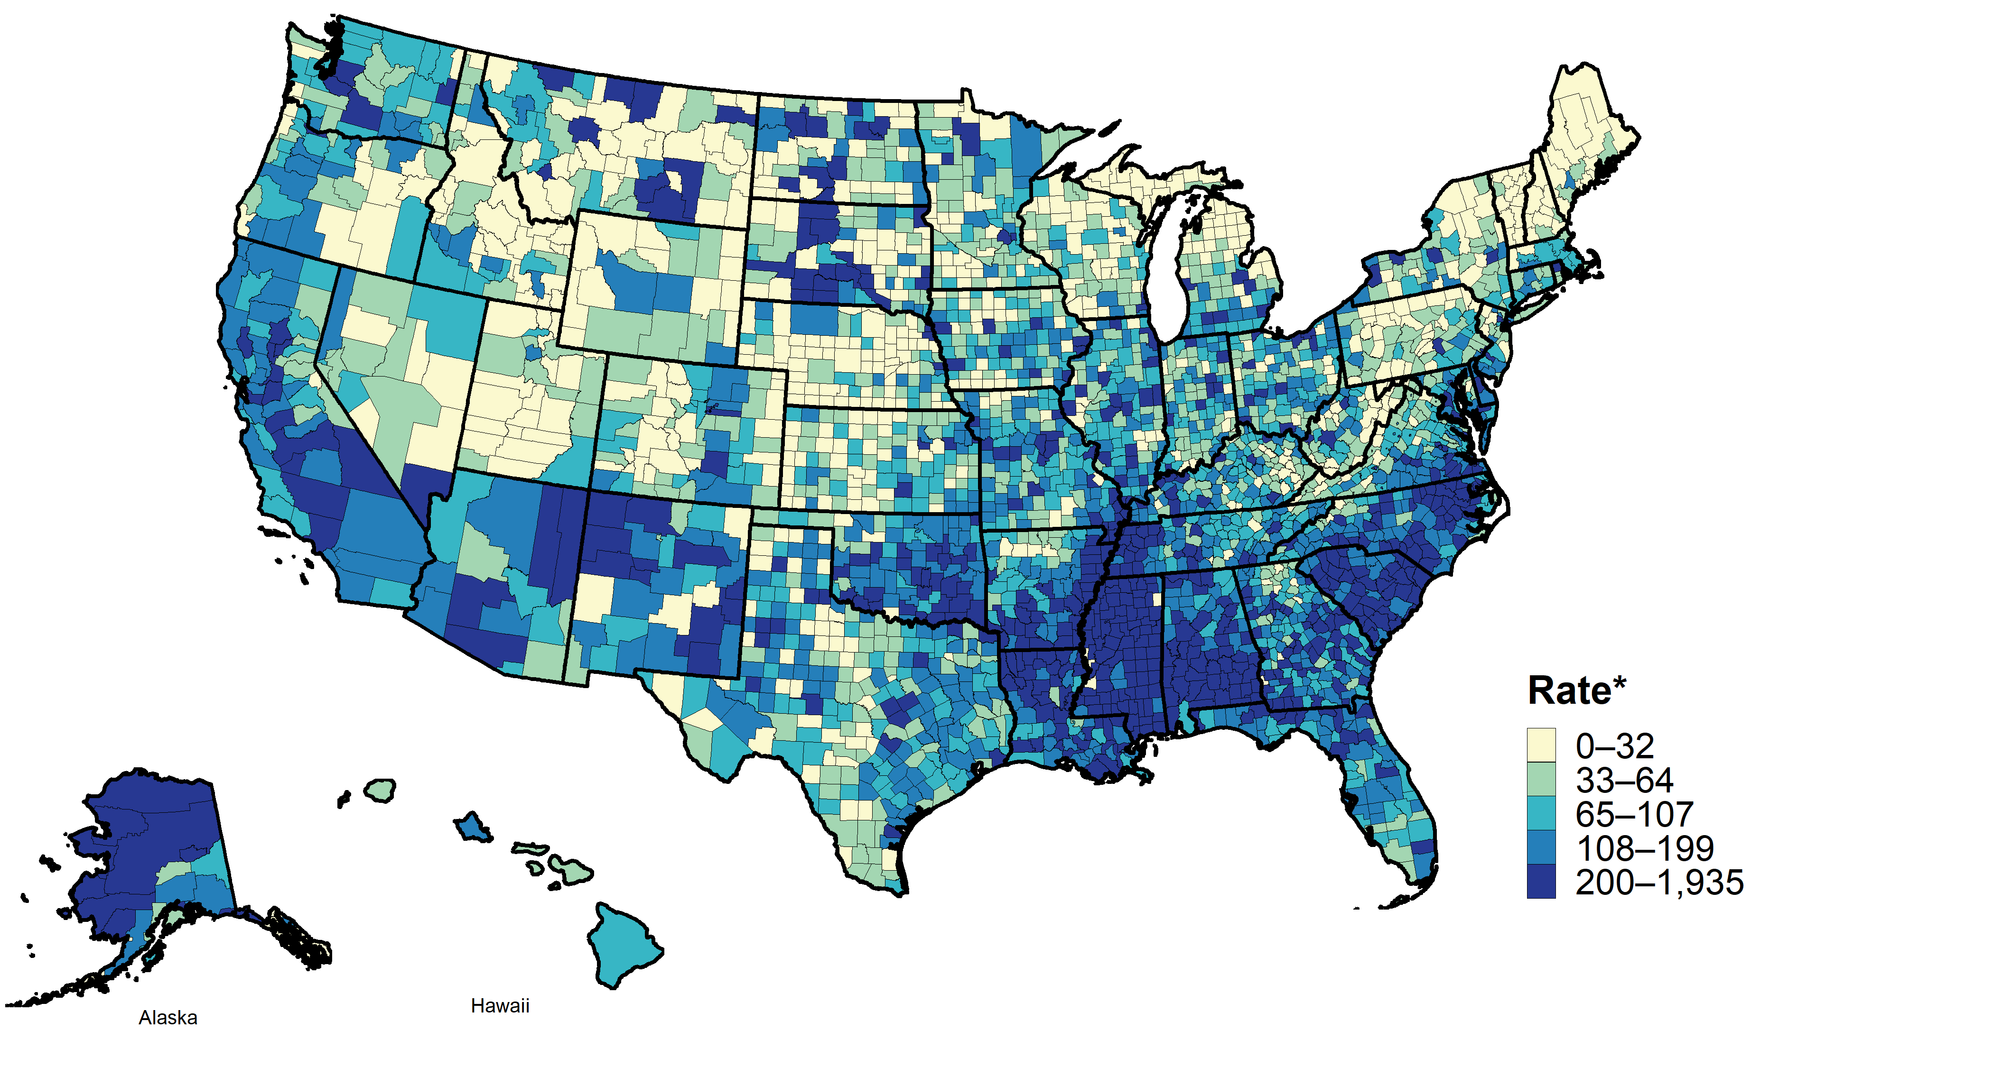
Gonorrhea — Rates of Reported Cases by County, United States, 2019
* Per 100,000
Notes:
In 2019, 94.3% of all counties in the United States reported at least one case of gonorrhea. Out of 3,142 counties and independent cities, 73 made up approximately 50% of all reported cases of gonorrhea.
See Technical Notes (www.cdc.gov/std/statistics/2019/Technicalnotes) for information on gonorrhea case reporting.
Data points are available at www.cdc.gov/std/statistics/2019/data.zip

Slide 17
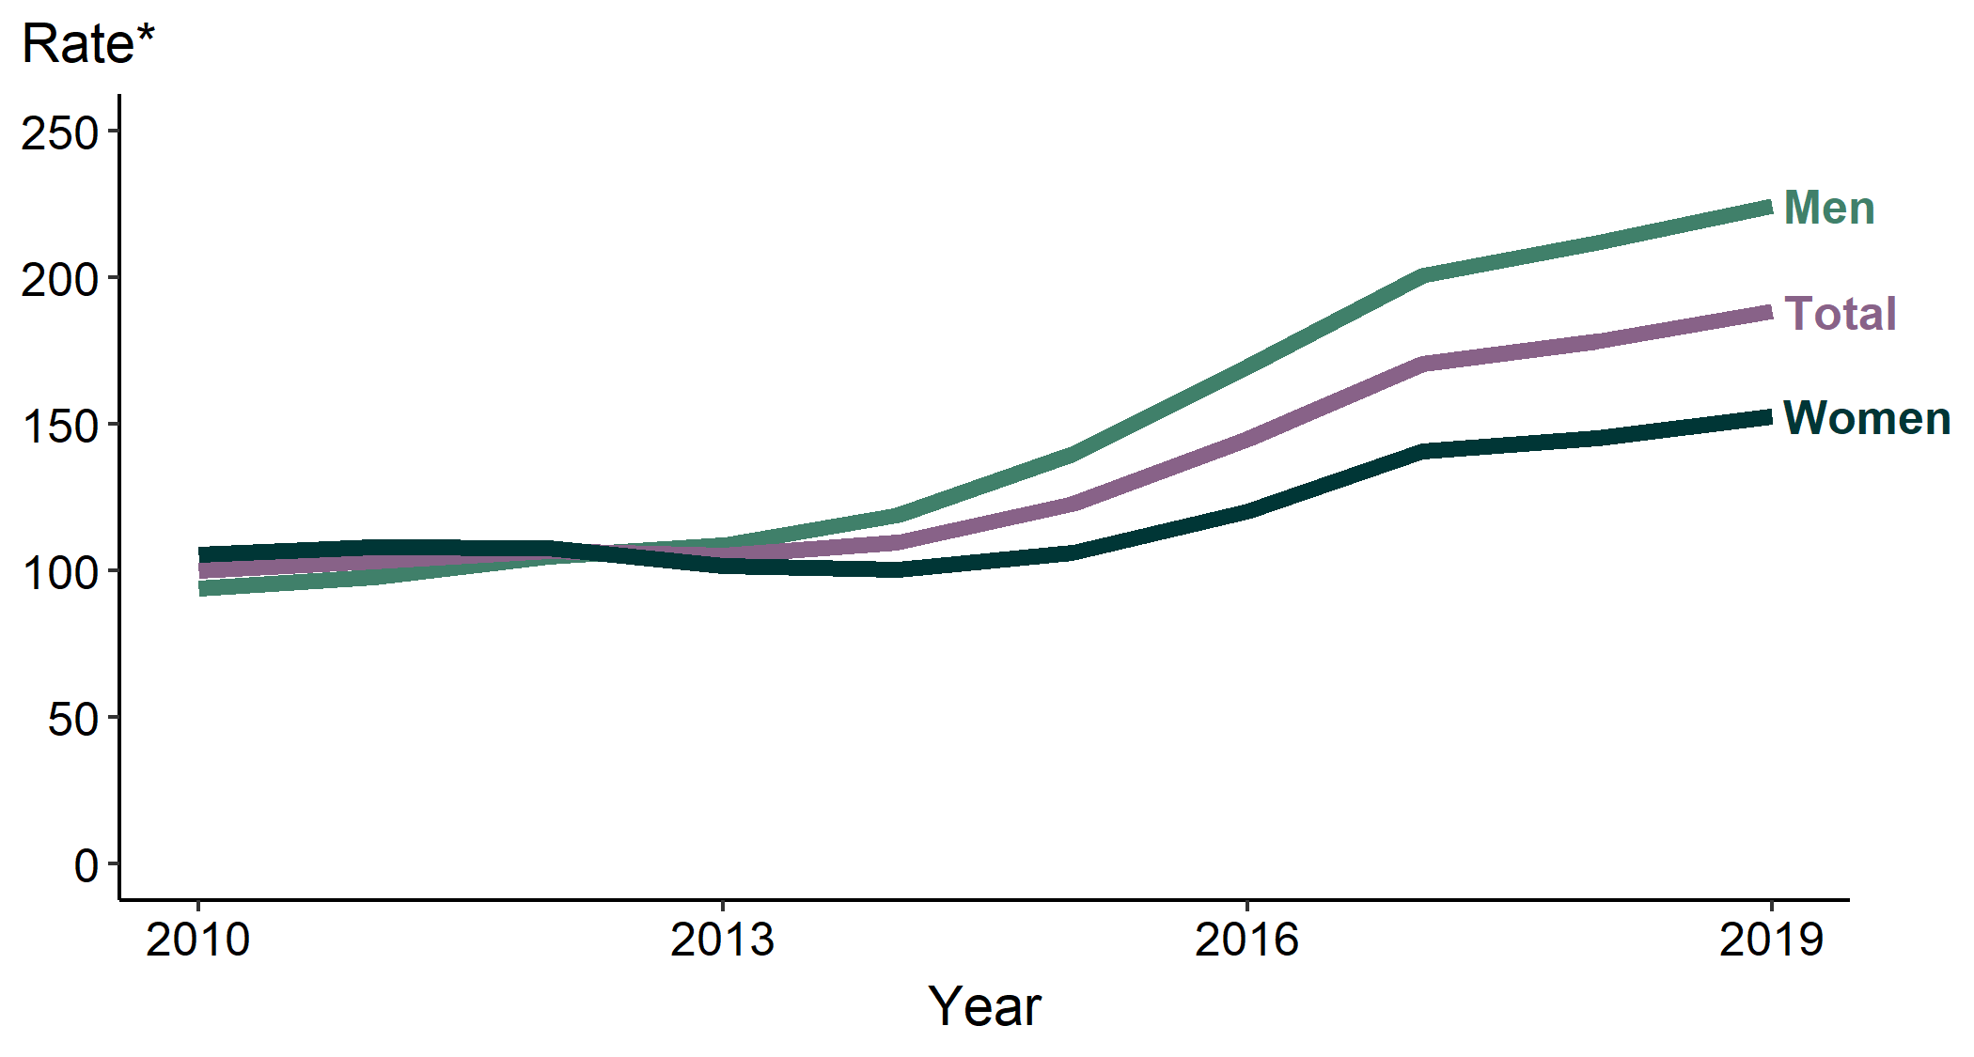
Gonorrhea — Rates of Reported Cases by Sex, United States, 2010–2019
* Per 100,000
Notes:
During 2018–2019, the gonorrhea rate among males increased 5.9% (from 211.9 to 224.4 cases per 100,000 males) and the rate among females increased 5.1% (from 145.2 to 152.6 cases per 100,000 females). During 2015–2019, the rate among males increased 60.6% (from 139.7 to 224.4 cases per 100,000 males) and the rate among females increased 43.6% (from 106.3 to 152.6 cases per 100,000 females).
See Technical Notes (www.cdc.gov/std/statistics/2019/Technicalnotes) for information on gonorrhea case reporting.
Data points are available at www.cdc.gov/std/statistics/2019/data.zip

Slide 18
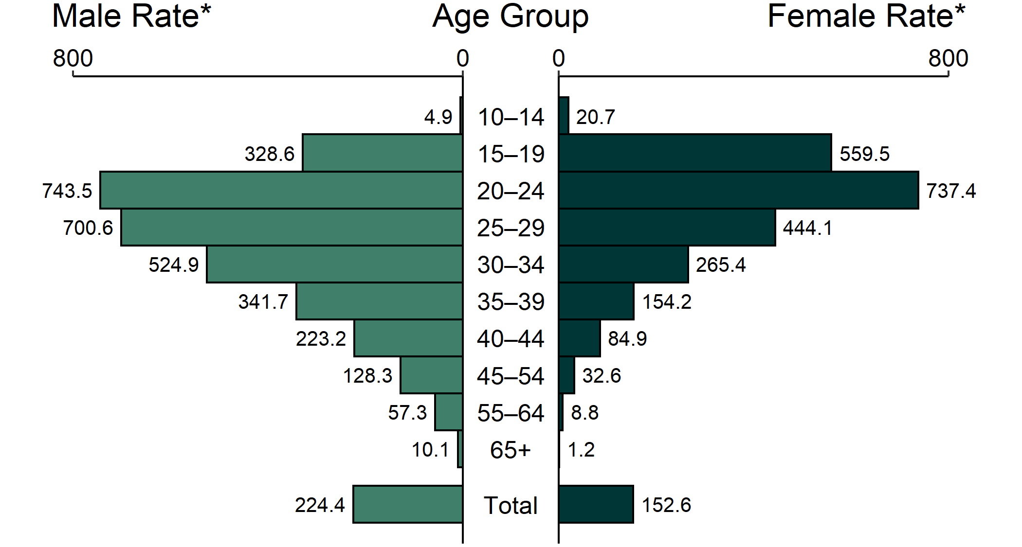
Gonorrhea — Rates of Reported Cases by Age Group and Sex, United States, 2019
* Per 100,000
NOTE: Total includes all ages.
Notes:
In 2019, rates of reported gonorrhea cases were the highest among adolescents and young adults. In 2019, the highest rates among females were observed among those aged 20–24 years (737.4 cases per 100,000 females) and 15–19 years (559.5 cases per 100,000 females). Among males, the rate was highest among those aged 20–24 years (743.5 cases per 100,000 males) and 25–29 years (700.6 cases per 100,000 males).
See Technical Notes (www.cdc.gov/std/statistics/2019/Technicalnotes) for information on gonorrhea case reporting.
Data points are available at www.cdc.gov/std/statistics/2019/data.zip

Slide 19
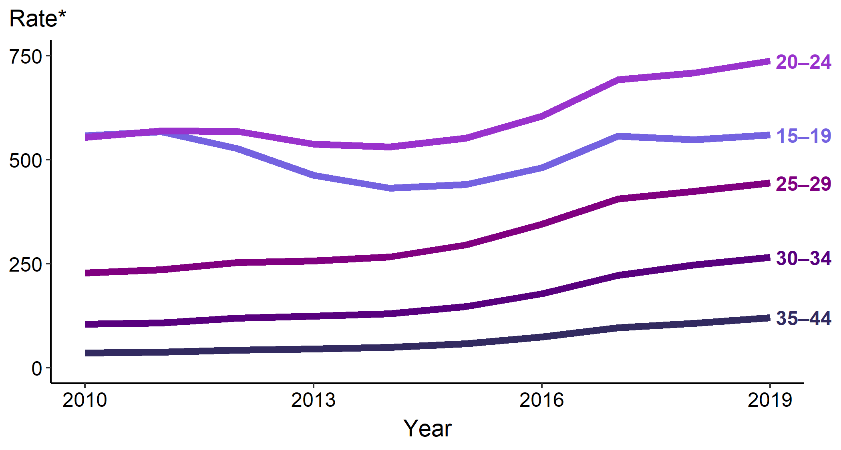
Gonorrhea — Rates of Reported Cases Among Females Aged 15–44 Years by Age Group, United States, 2010–2019
* Per 100,000
Notes:
The rate of reported gonorrhea among 15–19-year-old females increased 2.0% during 2018–2019, with a total increase of 26.8% during 2015–2019 (441.1 to 559.5 cases per 100,000 females). The rate among 20–24-year-old females increased 4.0% during 2018–2019, with a total increase of 33.6% during 2015–2019 (551.9 to 737.4 cases per 100,000 females).
See Technical Notes (www.cdc.gov/std/statistics/2019/Technicalnotes) for information on gonorrhea case reporting.
Data points are available at www.cdc.gov/std/statistics/2019/data.zip

Slide 20
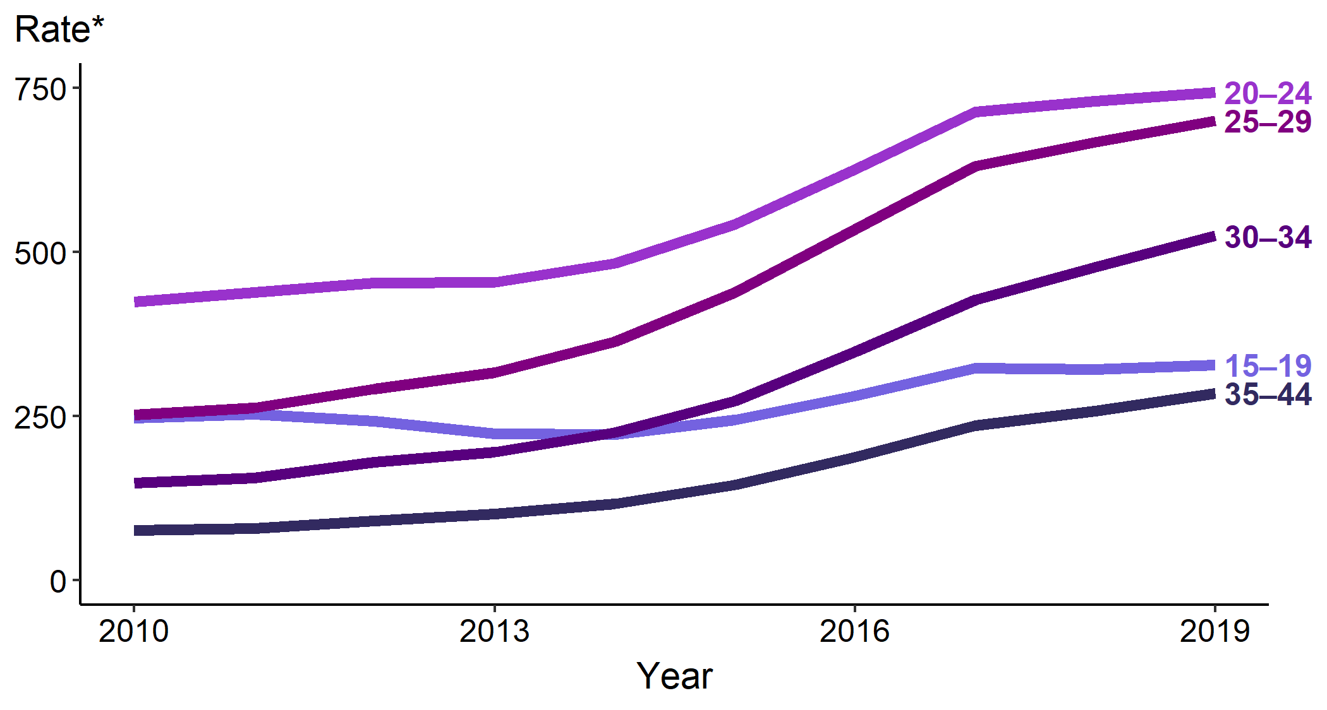
Gonorrhea — Rates of Reported Cases Among Males Aged 15–44 Years by Age Group, United States, 2010–2019
* Per 100,000
Notes:
The rate of reported gonorrhea among 20–24-year-old males increased 1.8% during 2018–2019, with a total increase of 37.1% during 2015–2019 (542.4 to 743.5 cases per 100,000 males). The rate among 25-29-year-old males increased 5.0% during 2018–2019, with a total increase of 59.6% during 2015–2019 (439.0 to 700.6 cases per 100,000 males).
See Technical Notes (www.cdc.gov/std/statistics/2019/Technicalnotes) for information on gonorrhea case reporting.
Data points are available at www.cdc.gov/std/statistics/2019/data.zip

Slide 21
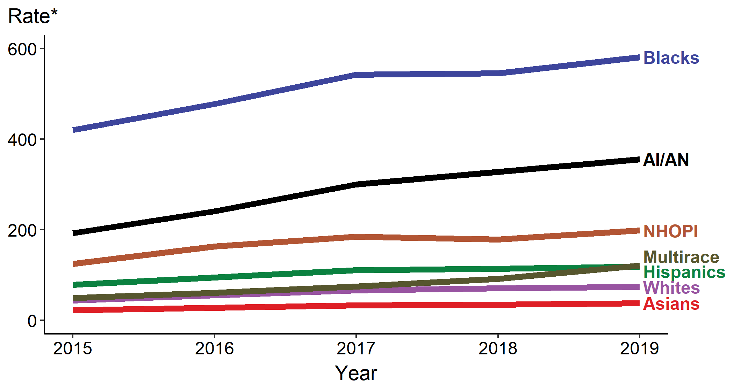
Gonorrhea — Rates of Reported Cases by Race/Hispanic Ethnicity, United States, 2015–2019
* Per 100,000
ACRONYMS: AI/AN = American Indians/Alaska Natives; NHOPI = Native Hawaiians/Other Pacific Islanders
Notes:
In 2019, the rate of reported gonorrhea cases was highest among Blacks (581.0 cases per 100,000 population), followed by American Indians/Alaska Natives (355.8 per 100,000). During 2015–2019, the rate of reported gonorrhea increased among all race/Hispanic ethnicity groups: 143.7% among Multirace persons, 70.5% among Asians, 59.0% among Native Hawaiians/Other Pacific Islanders, 66.1% among Whites, 85.1% among American Indians/Alaska Natives, 50.3% among Hispanics, and 38.3% among Blacks.
Not all US jurisdictions reported cases in Office of Management and Budget compliant race categories in 2019. This may minimally under- or overestimate rates for Asians, NHOPI, or Multirace individuals. For completeness, data in this figure include cases reported from all jurisdictions.
See Technical Notes (www.cdc.gov/std/statistics/2019/Technicalnotes) for information on gonorrhea case reporting and reporting STD case data for race/Hispanic ethnicity.
Data points are available at www.cdc.gov/std/statistics/2019/data.zip

Slide 22
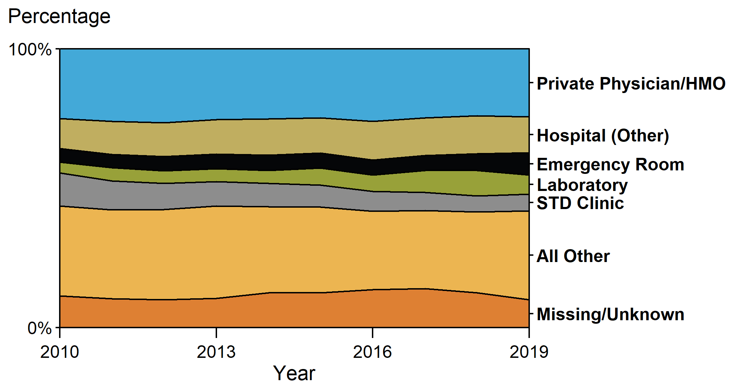
Gonorrhea — Percentage of Reported Cases Among Females by Reporting Source, United States, 2010–2019
ACRONYMS: HMO = health maintenance organization
Notes:
In 2019, among females, only 6.0% of gonorrhea cases were reported from an STD clinic, with a large proportion of cases (24.4%) being reported from a private physician/health maintenance organization.
See Technical Notes (www.cdc.gov/std/statistics/2019/Technicalnotes) for information on gonorrhea case reporting and on classification of reporting sources and a full list of reporting sources.
Data points are available at www.cdc.gov/std/statistics/2019/data.zip

Slide 23
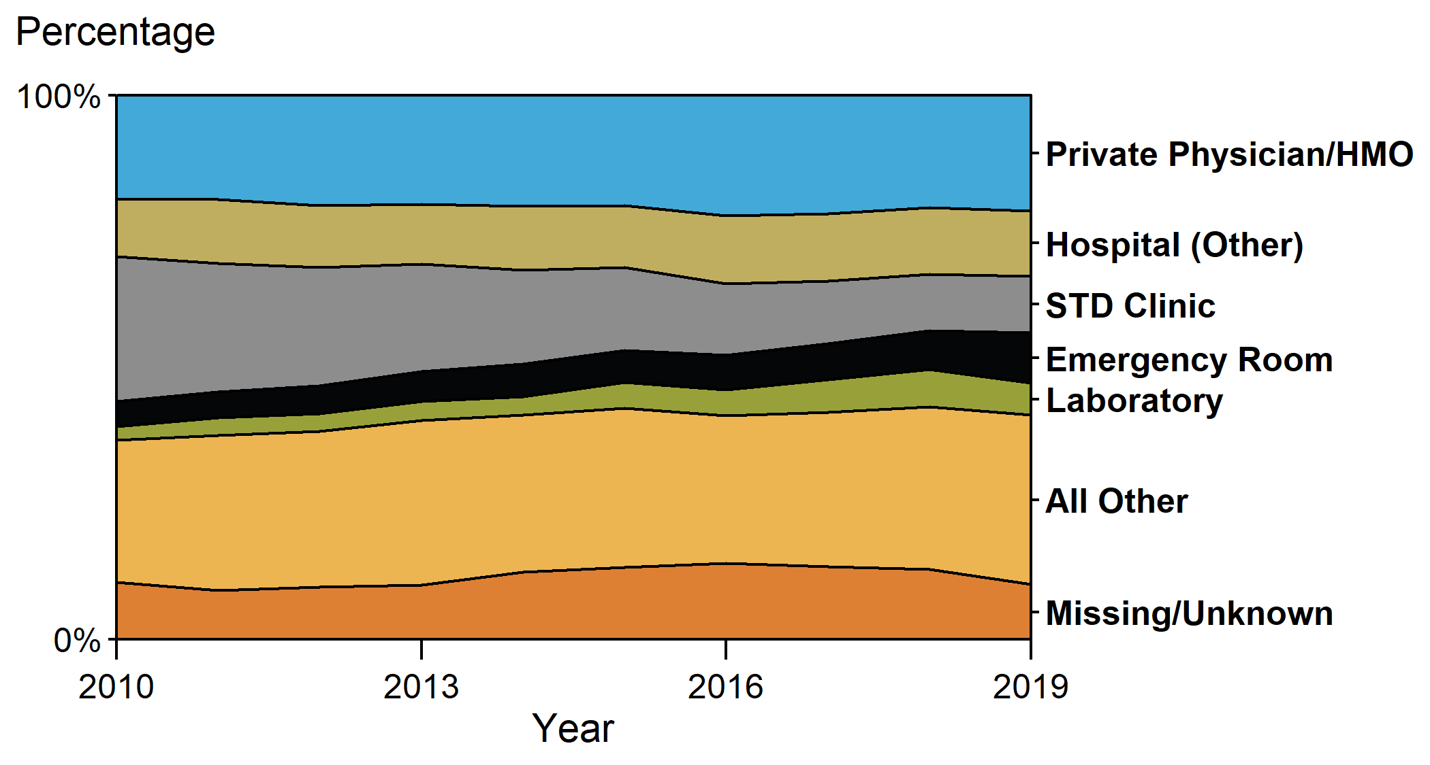
Gonorrhea — Percentage of Reported Cases Among Males by Reporting Source, United States, 2010–2019
ACRONYMS: HMO = health maintenance organization
Notes:
In 2019, among males, only 10.5% of gonorrhea cases were reported through an STD clinic, with a large proportion of cases (21.3%) being reported from a private physician/health maintenance organization.
See Technical Notes (www.cdc.gov/std/statistics/2019/Technicalnotes) for information on gonorrhea case reporting and on classification of reporting sources and a full list of reporting sources.
Data points are available at www.cdc.gov/std/statistics/2019/data.zip

Slide 24
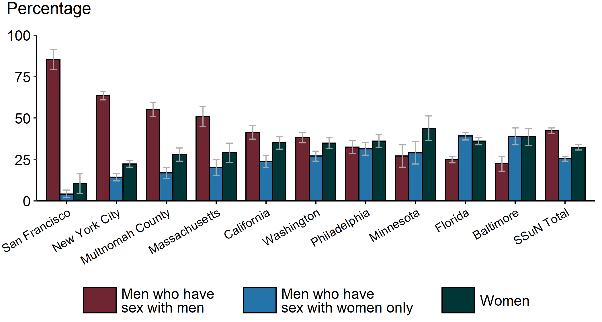
Gonorrhea – Estimated Proportion of Cases Treated with Recommended Regimen by Jurisdiction, STD Surveillance Network (SSuN), 2019
NOTE: Estimate based on weighted analysis of data obtained from interviews (n= 7,044) conducted among a random sample of reported gonorrhea cases. California data exclude San Francisco (shown separately).
ACRONYMS: MSM = Gay, bisexual, and other men who have sex with men; MSW = Men who have sex with women only
Notes:
Based on enhanced data collected on a random sample of gonorrhea cases reported in jurisdictions participating in the STD Surveillance Network (SSuN), the estimated burden of disease (and 95% confidence intervals) represented by men who have sex with men, men who have sex with women only, and women varied substantially across collaborating sites based on weighted analysis. San Francisco had the highest proportion of gonorrhea cases estimated to be among men who have sex with men (85.3%), while Baltimore had the lowest proportion of cases among men who have sex with men (22.4%). In total, across all SSuN sites, 42.3% of gonorrhea cases were estimated to be among men who have sex with men, 25.4% among men who have sex with women only, and 32.3% among women.
See Technical Notes (www.cdc.gov/std/statistics/2019/Technicalnotes) for information on SSuN methodology.
Data points are available at www.cdc.gov/std/statistics/2019/data.zip

Slide 25
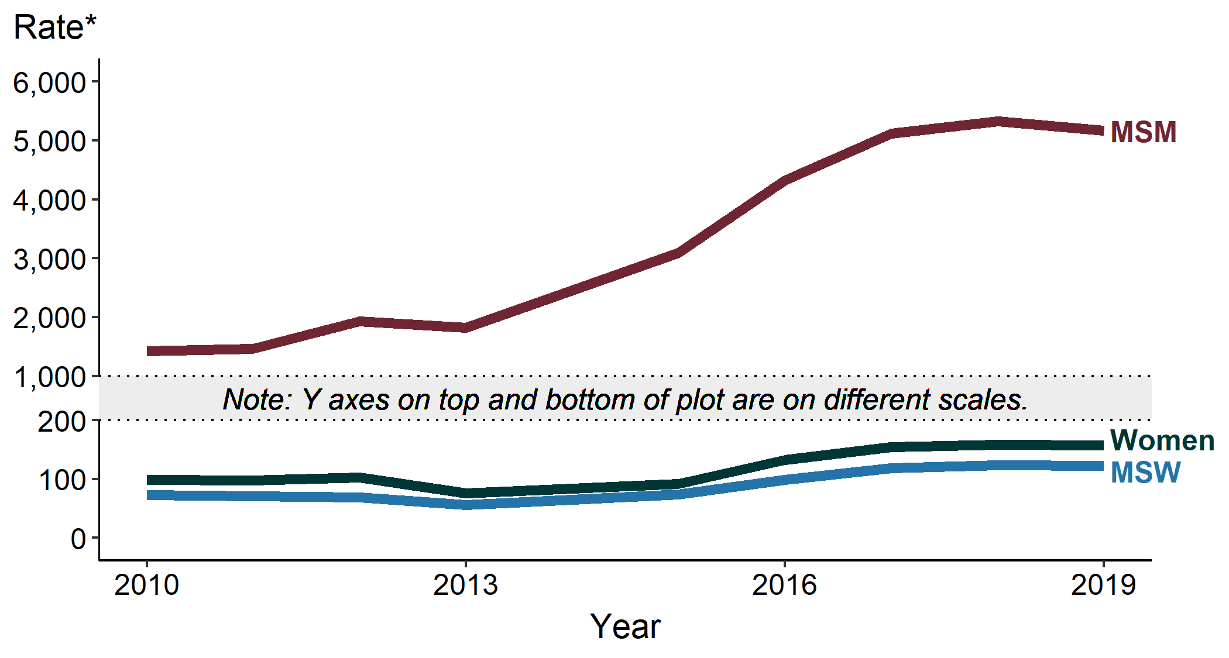
Gonorrhea — Estimated Rates of Reported Gonorrhea Cases by MSM, MSW, and Women, STD Surveillance Network (SSuN), 2010–2019
* Per 100,000 population
NOTE: Estimate based on weighted analysis of data obtained from interviews (n=28,979) conducted among a random sample of reported gonorrhea cases. Sites include Baltimore, Philadelphia, New York City, Washington State, San Francisco, and California (excluding San Francisco).
ACRONYMS: MSM = Gay, bisexual, and other men who have sex with men; MSW = Men who have sex with women only
Notes:
Among 6 jurisdictions participating in the STD Surveillance Network (SSuN) continuously since 2010, the estimated gonorrhea case rate among men who have sex with men increased 263.4% during 2010–2019, from 1,421.5 cases per 100,000 men who have sex with men (MSM) in 2010 to 5,165.6 cases per 100,000 MSM in 2019. Over the same time period, case rates among women and men who have sex with women only (MSW) also increased by 59.8% and 69.5%, respectively.
See Technical Notes (www.cdc.gov/std/statistics/2019/Technicalnotes) for information on SSuN methodology.
Data points are available at www.cdc.gov/std/statistics/2019/data.zip
ADAPTED FROM: Stenger M, Pathela P, Anschuetz G, et al. Increases in the rate of Neisseria gonorrhoeae among gay, bisexual and other men who have sex with men (MSM) — findings from the STD Surveillance Network 2010–2015. Sex Transm Dis. 2017;44(7):393–397.

Slide 26
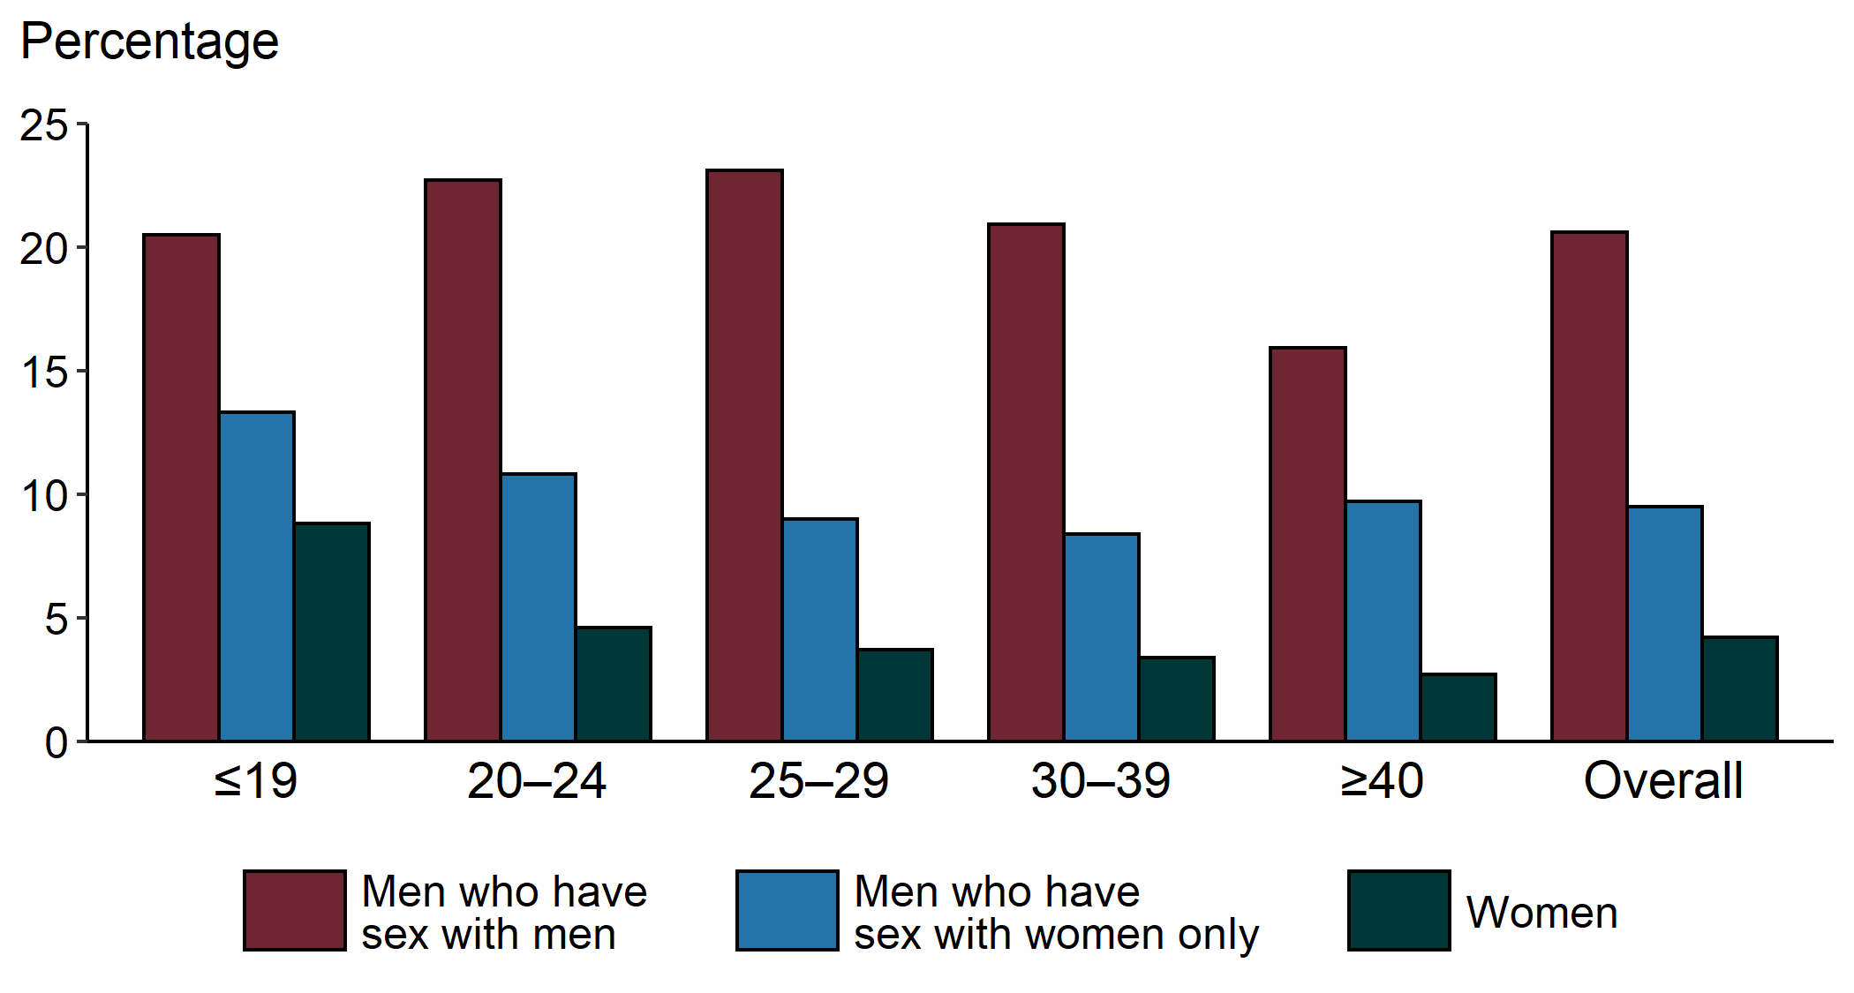
Gonorrhea — Proportion of STD Clinic Patients Testing Positive by Age Group, Sex, and Sex of Sex Partners, STD Surveillance Network (SSuN), 2019
NOTE: Results are based on data obtained from unique patients with known sex of sex partners (n=81,812) attending SSuN STD clinics who were tested ≥1 times for gonorrhea in 2019.
Notes:
Among patients accessing care in STD clinics in jurisdictions participating in the STD Surveillance Network (SSuN) who were tested for gonorrhea in 2019, 20.6% of men who have sex with men, 9.5% of men who have sex with women only, and 4.2% of women were positive. The proportion of STD clinic patients who tested positive for gonorrhea varied by sex and sex of sex partners, as well as age group, with highest proportions among men who have sex with men in all age groups.
See Technical Notes (www.cdc.gov/std/statistics/2019/Technicalnotes) for information on SSuN methodology.
Data points are available at www.cdc.gov/std/statistics/2019/data.zip

Slide 27
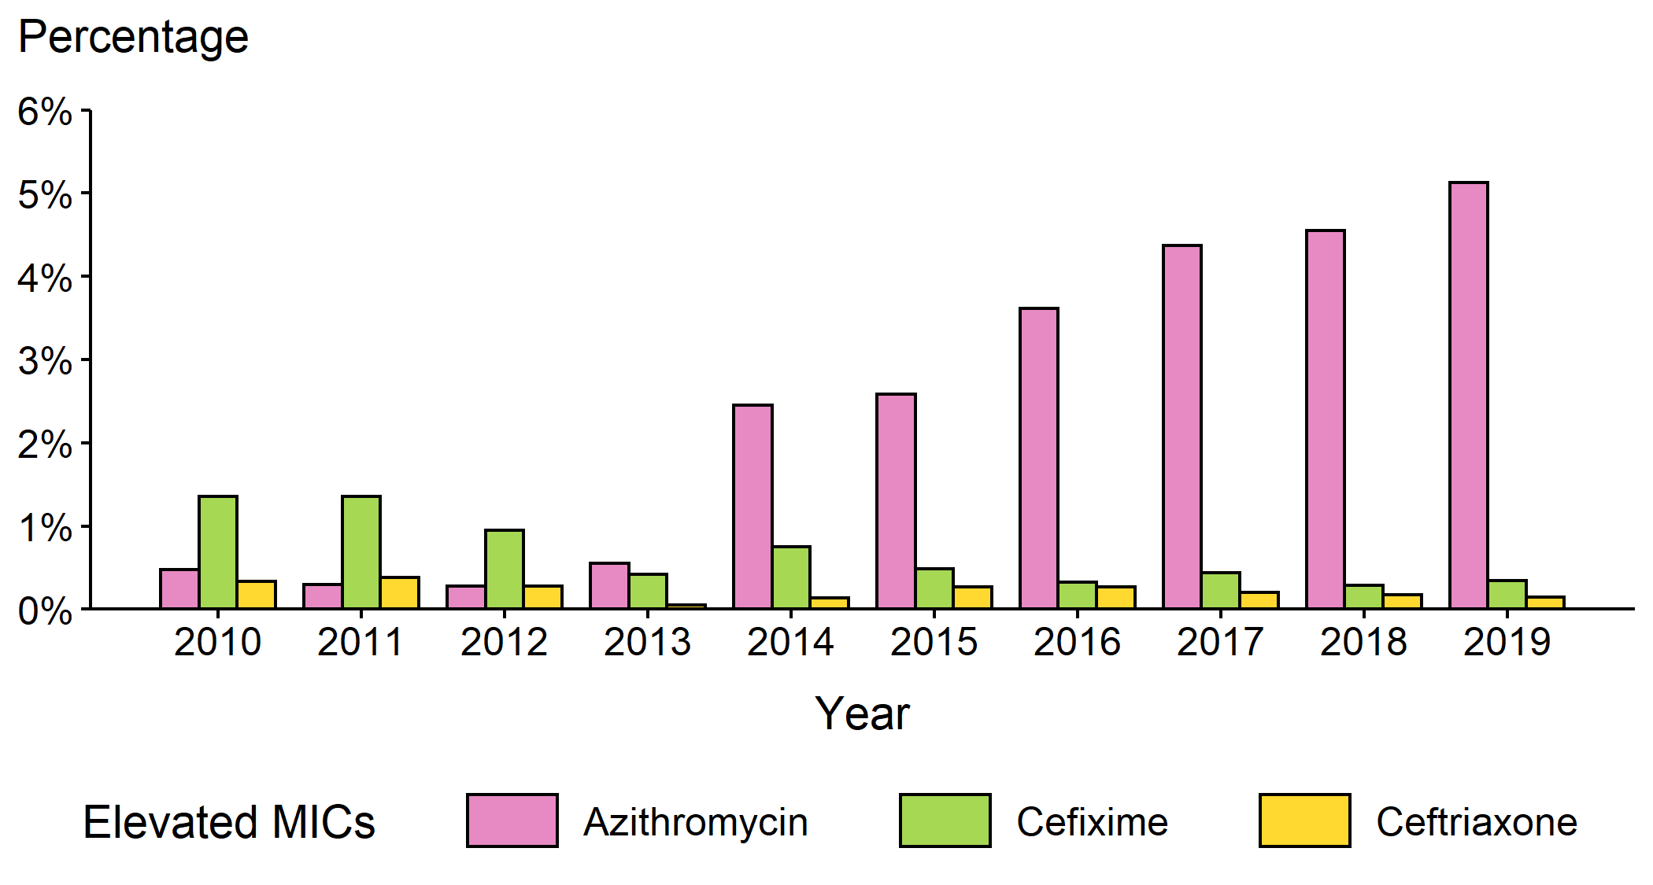
Neisseria gonorrhoeae — Percentage of Isolates with Elevated Minimum Inhibitory Concentrations (MICs) to Azithromycin, Cefixime, and Ceftriaxone, Gonococcal Isolate Surveillance Project (GISP), 2010–2019
NOTE: Elevated MIC = Azithromycin: ≥ 2.0 µg/mL; Cefixime: ≥ 0.25 µg/mL; Ceftriaxone: ≥ 0.125 µg/mL
Notes:
During 2010–2019, the percentage of Neisseria gonorrhoeae isolates that exhibited elevated ceftriaxone minimum inhibitory concentrations, defined as ≥ 0.125 µg/mL, fluctuated between 0.1% and 0.4%. In 2019, 0.1% of isolates had elevated ceftriaxone minimum inhibitory concentrations. The percentage of isolates with elevated cefixime minimum inhibitory concentrations (≥ 0.25 µg/mL) declined from 1.4% in 2011 to 0.3% in 2019. During 2012–2014, the percentage of isolates with elevated azithromycin minimum inhibitory concentrations (≥ 2 µg/mL) ranged from 0.3% to 2.5% with a sharp increase during 2013–2014 (0.6% to 2.5%); during 2014–2019, the percentage increased from 2.5% to 5.1%.
See Technical Notes (www.cdc.gov/std/statistics/2019/Technicalnotes) for information on GISP methodology.
Data points are available at www.cdc.gov/std/statistics/2019/data.zip

Slide 28
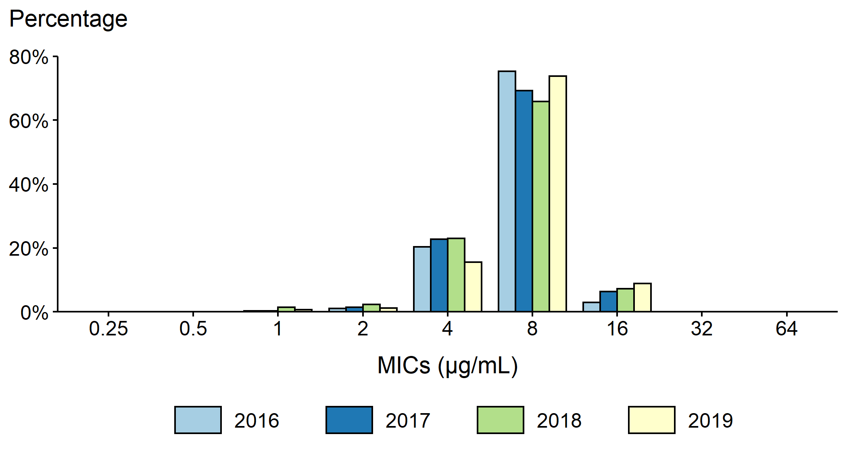
Neisseria gonorrhoeae — Distribution of Gentamicin Minimum Inhibitory Concentrations (MICs) by Year, Gonococcal Isolate Surveillance Project (GISP), 2016–2019
NOTE: Beginning in 2018, the antibiotic susceptibility testing range for gentamicin was expanded from MICs of 1 µg/mL–32 µg/mL in previous years to 0.25 µg/mL–64 µg/mL.
Notes:
During 2016 to 2019, 65.0–75.3% of all tested Neisseria gonorrhoeae isolates had a gentamycin minimum inhibitory concentration value of 8 µg/mL. In 2019, 0.02% of all tested Neisseria gonorrhoeae isolates had a gentamycin minimum inhibitory concentration above 16 µg/mL.
See Technical Notes (www.cdc.gov/std/statistics/2019/Technicalnotes) for information on GISP methodology.
Data points are available at www.cdc.gov/std/statistics/2019/data.zip

Slide 29
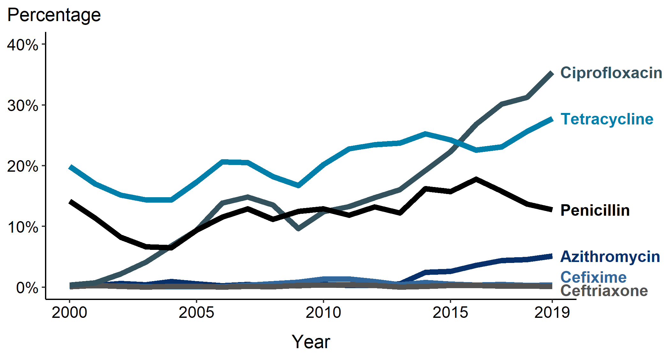
Neisseria gonorrhoeae — Prevalence of Tetracycline, Penicillin, or Ciprofloxacin Resistance* or Elevated Cefixime, Ceftriaxone, or Azithromycin Minimum Inhibitory Concentrations (MICs)†, by Year — Gonococcal Isolate Surveillance Project (GISP), 2000–2019
* Resistance: Ciprofloxacin = MIC ≥ 1.0 µg/mL; Penicillin = MIC ≥ 2.0 µg/mL or Beta-lactamase positive; Tetracycline = MIC ≥ 2.0 µg/mL
† Elevated MICs: Azithromycin = MIC ≥ 1.0 µg/mL 29 (2000–2004); ≥ 2.0 µg/mL (2005–2019); Ceftriaxone = MIC ≥ 0.125 µg/mL; Cefixime = MIC ≥ 0.25 µg/mL
NOTE: Cefixime susceptibility was not tested in 2007 and 2008.
Notes:
In 2019, 35.4% of Neisseria gonorrhoeae isolates collected from GISP sites were resistant to ciprofloxacin, 27.8% to tetracycline, and 12.8% to penicillin.
See Technical Notes (www.cdc.gov/std/statistics/2019/Technicalnotes) for information on GISP methodology.
Data points are available at www.cdc.gov/std/statistics/2019/data.zip

Slide 30
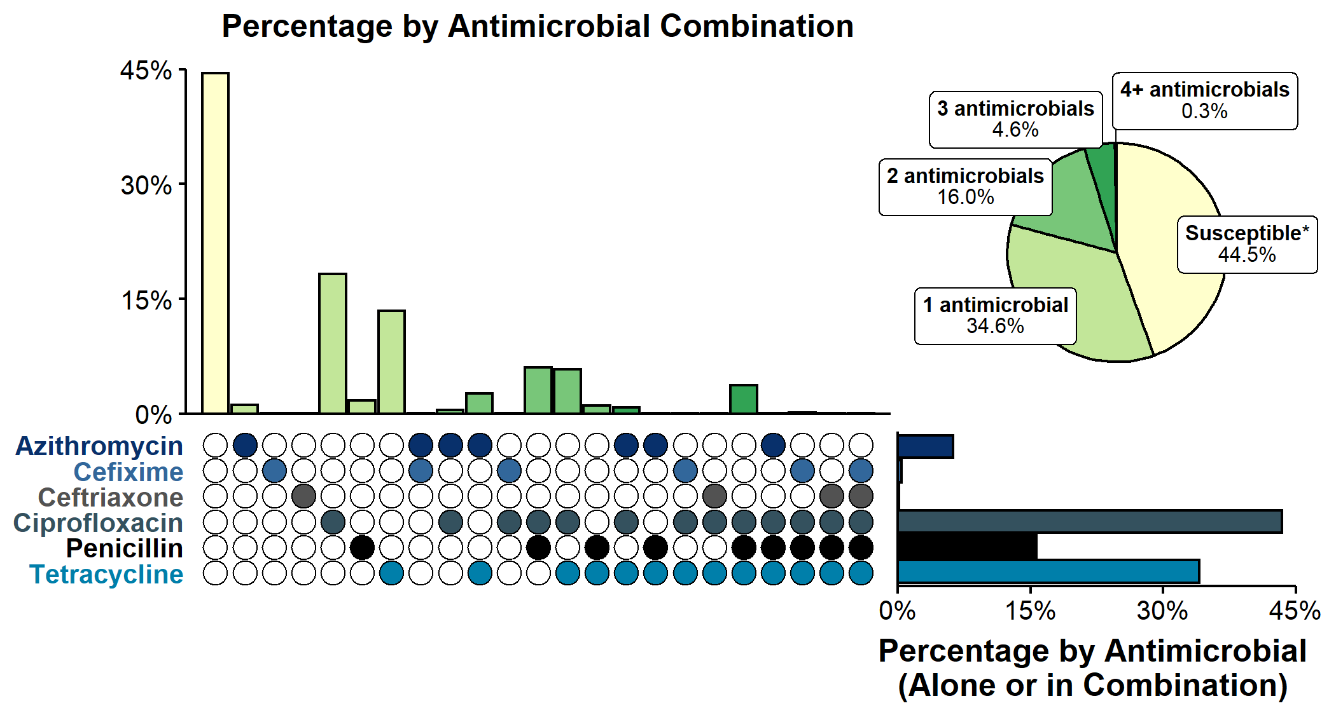
Resistance or Elevated Minimum Inhibitory Concentration (MIC) Patterns of Neisseria gonorrhoeae Isolates to Antimicrobials, Gonococcal Isolate Surveillance Project (GISP), 2019
* Susceptible category only includes isolates with penicillin, tetracycline, and ciprofloxacin MIC values that are considered susceptible and isolates with ceftriaxone, cefixime, and azithromycin MIC values that are not considered elevated.
NOTE: Elevated MIC = Ceftriaxone: MIC ≥ 0.125 µg/mL; Cefixime: MIC ≥ 0.25 µg/mL; Azithromycin: MIC ≥ 2.0 µg/mL. Resistance = Tetracycline: MIC ≥ 2.0 µg/mL; Ciprofloxacin: MIC ≥ 1.0 µg/mL; Penicillin: MIC ≥ 2.0 µg/mL or Beta-lactamase positive. In Panel B, a filled circle reflects resistance or elevated MIC to a specific antimicrobial; only antimicrobial combinations with non-zero percentages are shown.
Notes:
In 2019, 44.5% of Neisseria gonorrhoeae isolates collected through GISP were susceptible to the six antimicrobials tested. More than half (54.3%) were resistant to at least one of three antimicrobials (tetracycline, penicillin, or ciprofloxacin). An additional 1.2% of isolates were susceptible to those antimicrobials, but had elevated minimum inhibitory concentrations to ceftriaxone, cefixime, or azithromycin. Overall, 16.0% of isolates demonstrated resistance or elevated minimum inhibitory concentrations to two antimicrobials tested; 4.6% demonstrated resistance or elevated minimum inhibitory concentrations to three antimicrobials tested. No isolates with elevated azithromycin minimum inhibitory concentrations also had elevated ceftriaxone minimum inhibitory concentrations.
See Technical Notes (www.cdc.gov/std/statistics/2019/Technicalnotes) for information on GISP methodology.
Data points are available at www.cdc.gov/std/statistics/2019/data.zip

Slide 31
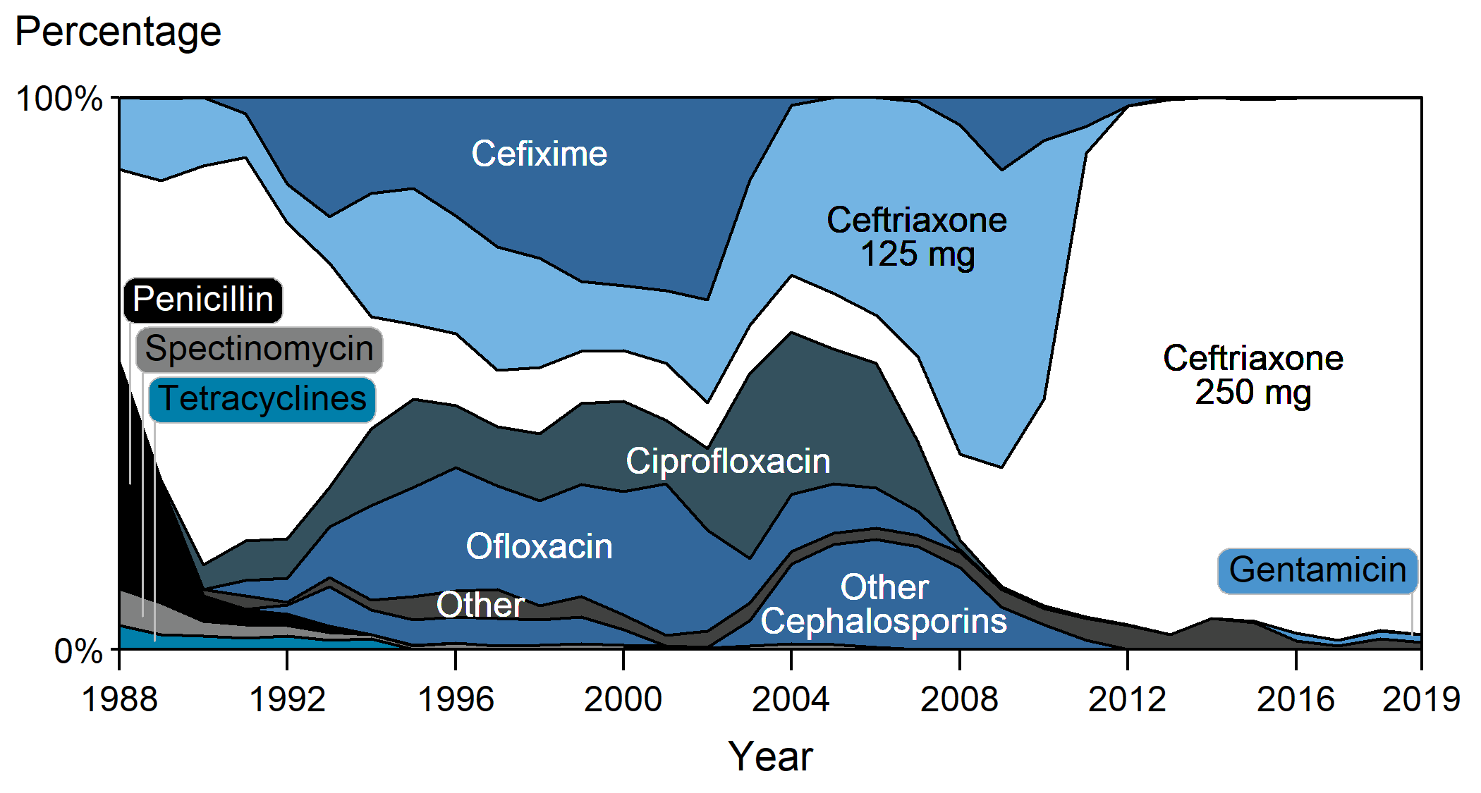
Distribution of Primary Antimicrobial Drugs Used to Treat Gonorrhea Among Participants, Gonococcal Isolate Surveillance Project (GISP), 1988–2019
Notes:
In 2019, 97.0% of GISP participants were treated with ceftriaxone 250 mg. Participants treated with gentamicin 240 mg increased from 0.2% in 2015 to 1.5% in 2019.
See Technical Notes (www.cdc.gov/std/statistics/2019/Technicalnotes) for information on GISP methodology.
Data points are available at www.cdc.gov/std/statistics/2019/data.zip

Slide 32
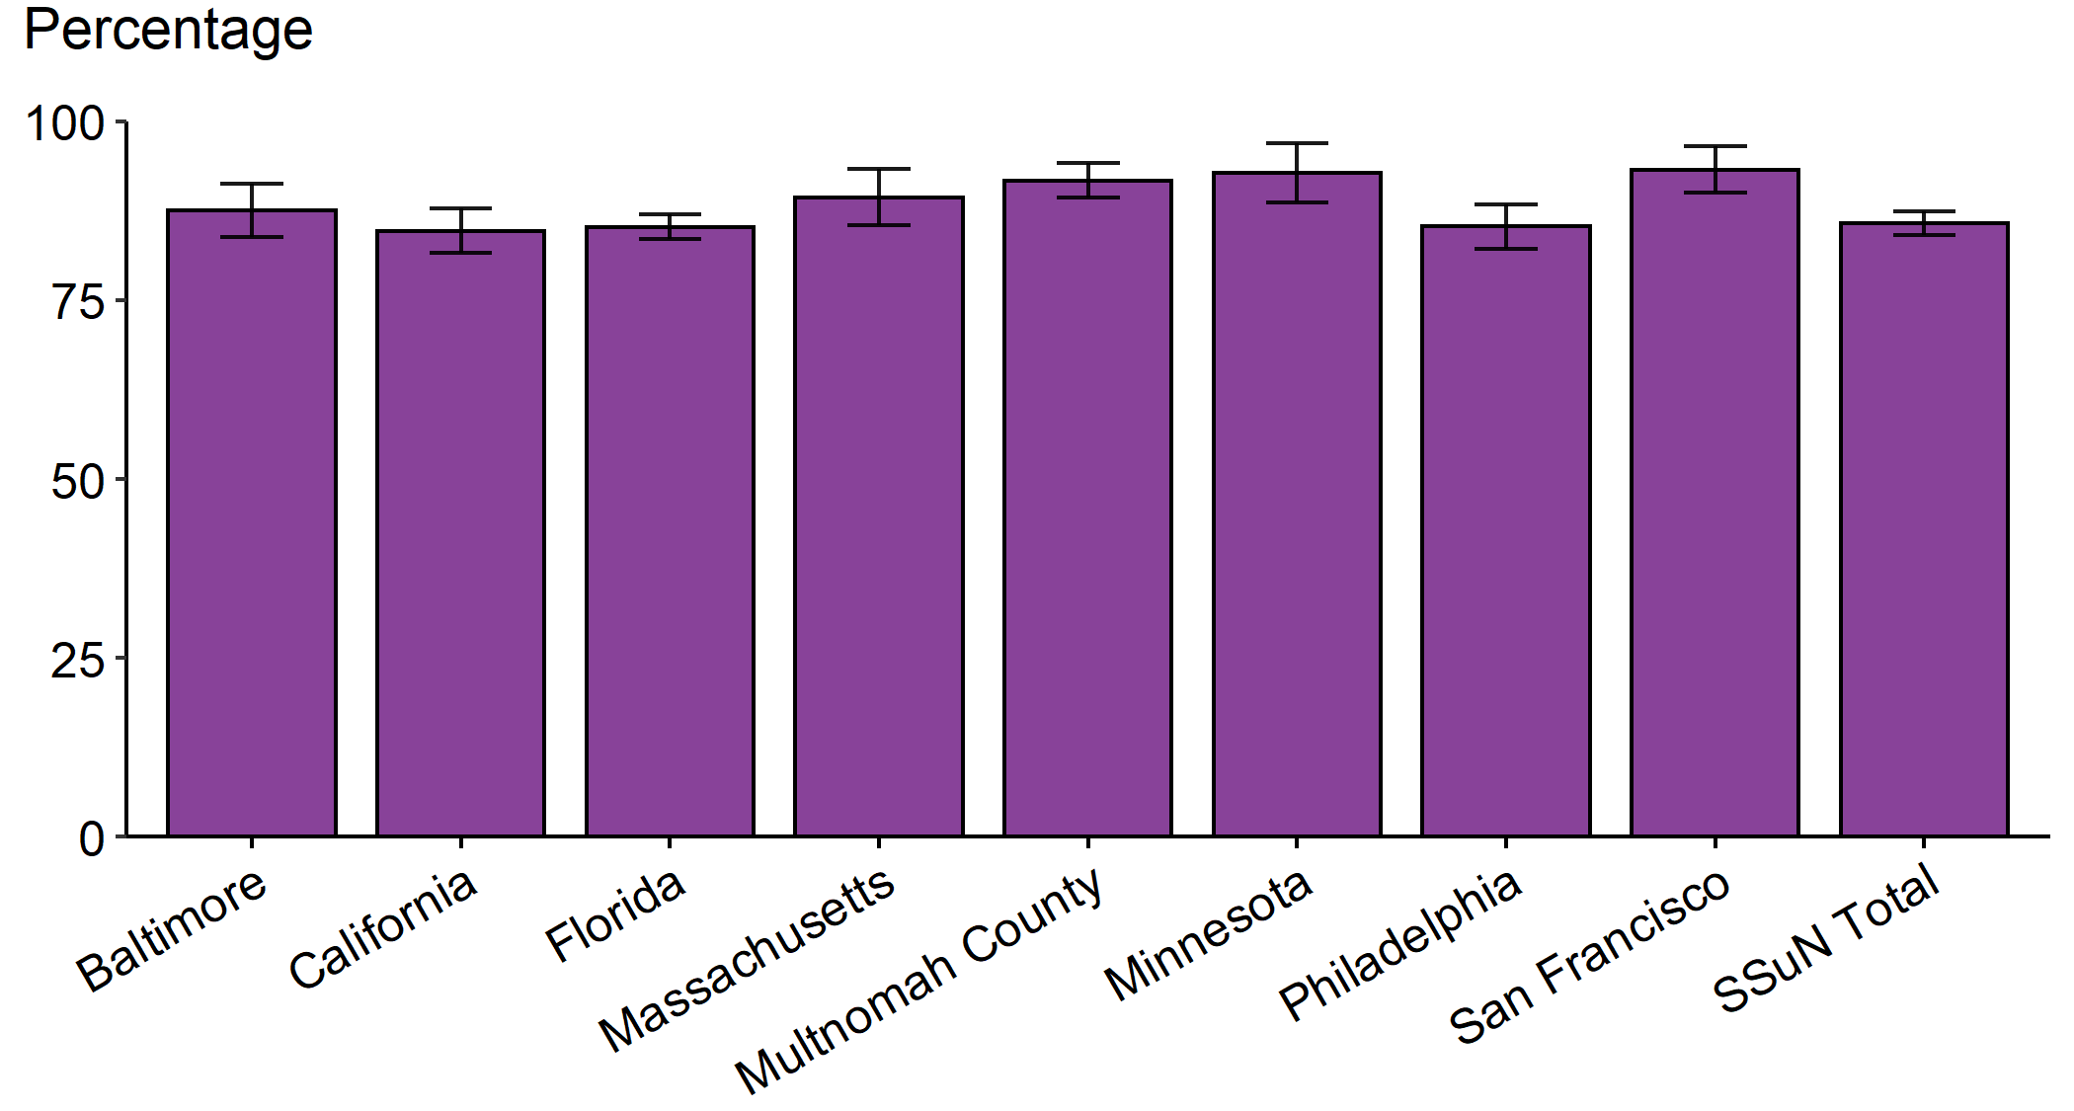
Gonorrhea – Estimated Proportion of Cases Treated with Recommended Regimen by Jurisdiction, STD Surveillance Network (SSuN), 2019
NOTE: Includes SSuN jurisdictions with documented treatment information (antimicrobials and dosages) for ≥80% of cases with complete investigations. California data exclude San Francisco (shown separately).
Notes:
In 2019, based on weighted analysis of randomly sampled cases reported in SSuN jurisdictions with documented treatment information (i.e., antimicrobials and dosages) for 80% or more of cases, 85.8% (95% CI = 84.1–87.4) of reported patients with gonorrhea in SSuN jurisdictions received the recommended treatment for uncomplicated gonorrhea. The proportion of reported patients that received the recommended dual treatment ranged from 84.7% (95% CI = 81.6–87.8) in the state of California to 93.2% (95% CI = 90.0–96.5) in the city of San Francisco, California.
See Technical Notes (www.cdc.gov/std/statistics/2019/Technicalnotes) for information on SSuN methodology. In 2019, the recommended treatment for uncomplicated gonorrhea was treatment with 250 mg dose of ceftriaxone plus 1 g dose of azithromycin.
Data points are available at www.cdc.gov/std/statistics/2019/data.zip
ADAPTED FROM: Weston EJ, Workowski K, Torrone E, et al. Adherence to CDC recommendations for the treatment of uncomplicated gonorrhea – STD Surveillance Network (SSuN), United States, 2016. MMWR Morb Mortal Wkly Rep. 2018;67:473–76.

Slide 33
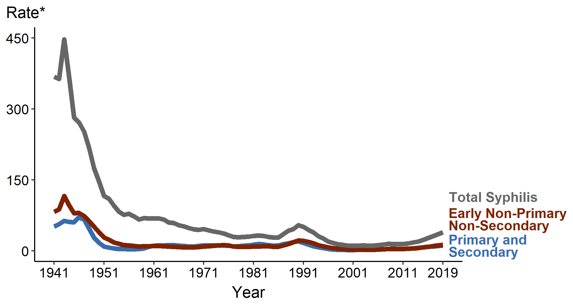
Syphilis — Rates of Reported Cases by Stage of Infection, United States, 1941–2019
* Per 100,000
Notes:
In 2019, 129,813 total cases of syphilis representing all stages of disease were reported in the United States. The 2019 case count for total syphilis reflects a 12.8% increase from 2018 when there were 115,062 cases. Reports of primary and secondary syphilis and early non-primary non-secondary syphilis cases—incident stages of infection—increased as well during 2018–2019.
See Technical Notes (www.cdc.gov/std/statistics/2019/Technicalnotes) for information on syphilis case reporting.
Data points are available at www.cdc.gov/std/statistics/2019/data.zip

Slide 34
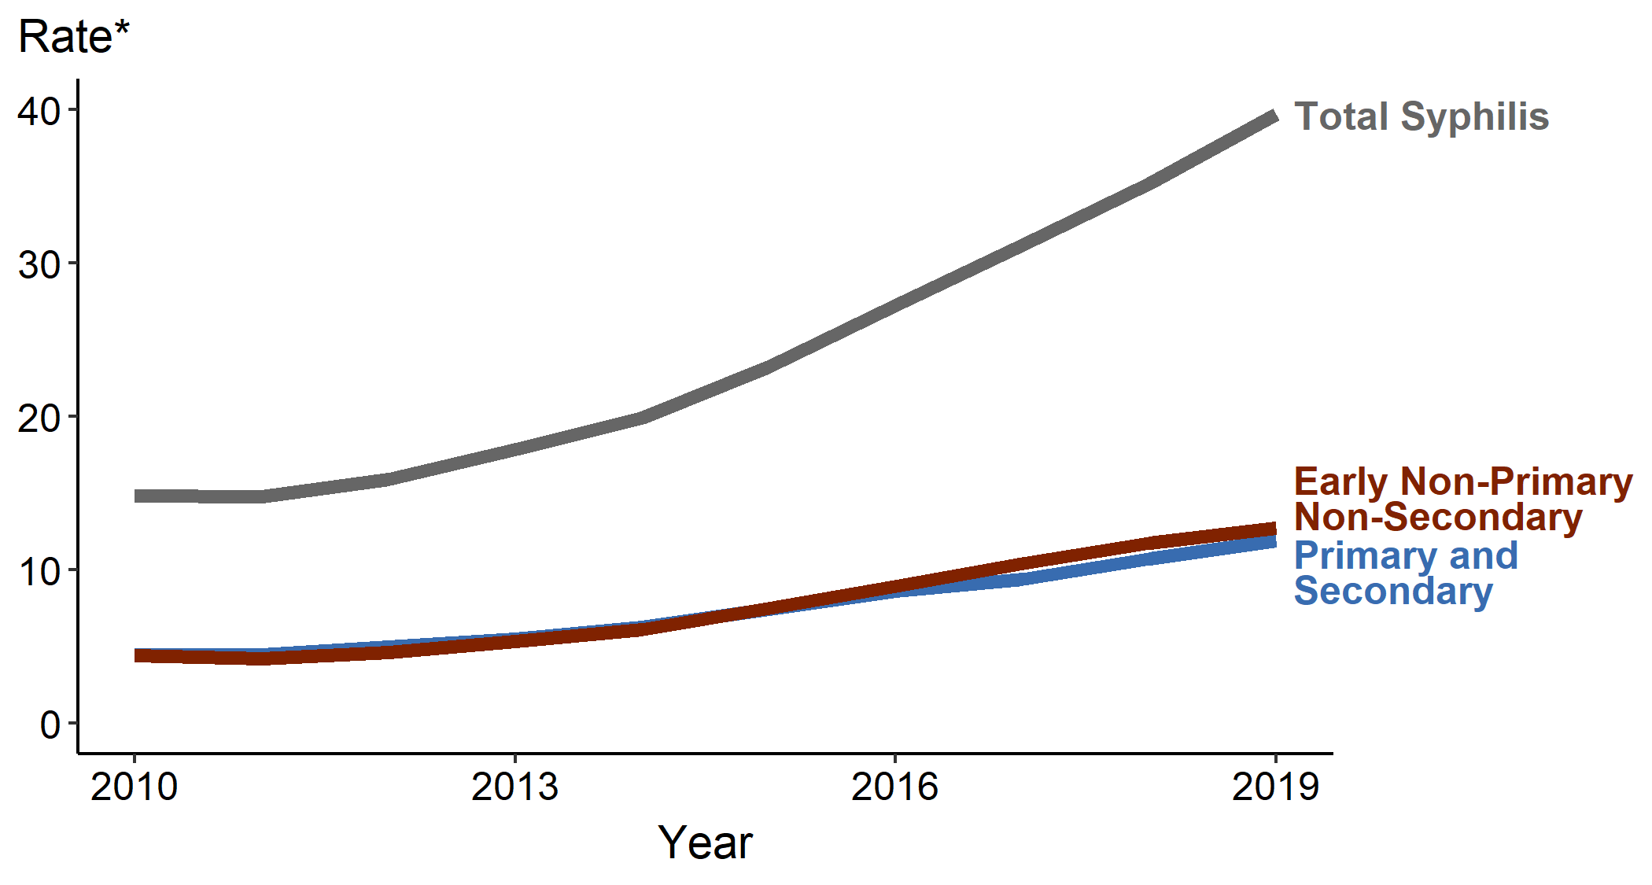
Syphilis — Rates of Reported Cases by Stage of Infection, United States, 2010–2019
* Per 100,000
Notes:
During 2010–2019, the rate of total syphilis increased 167.2% (14.8 to 39.7 per 100,000), the rate of early non-primary non-secondary syphilis increased 189.0% (4.4 to 12.7 per 100,000), and the rate of primary and secondary syphilis increased 167.2% (4.5 to 11.9 per 100,000).
See Technical Notes (www.cdc.gov/std/statistics/2019/Technicalnotes) for information on syphilis case reporting.
Data points are available at www.cdc.gov/std/statistics/2019/data.zip

Slide 35
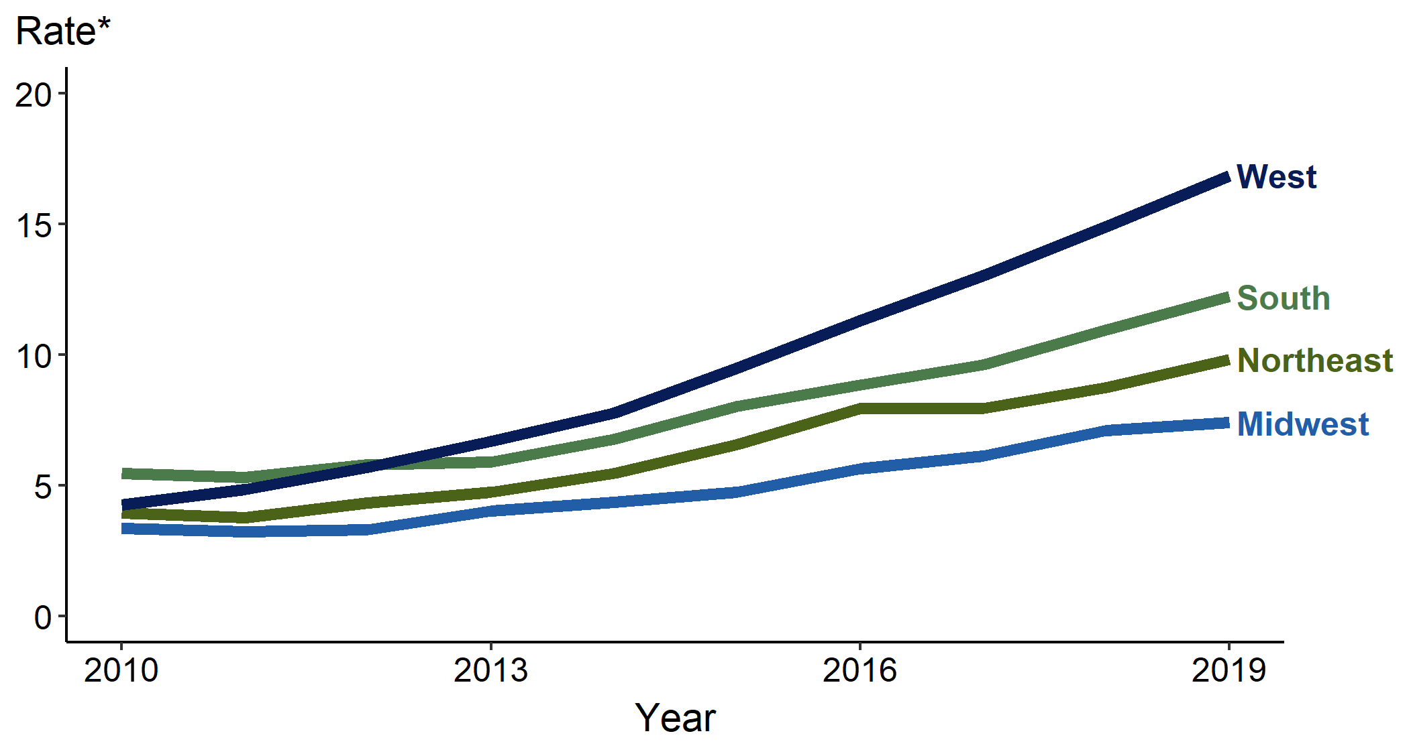
Primary and Secondary Syphilis — Rates of Reported Cases by Region, United States, 2010–2019
* Per 100,000
Notes:
In 2019, rates of reported cases of primary and secondary syphilis were highest in the West (16.9 cases per 100,000 population; 13.4% per 100,000 increase from 2018), followed by the South (12.2 per 100,000; 10.9% increase from 2018), Northeast (9.8 per 100,000; 12.6% increase from 2018), and Midwest (7.4 per 100,000; 4.2% increase from 2018). During 2015–2019, the largest increase occurred in the West (9.5 to 16.9 cases per 100,000 population; 77.9% increase).
See Technical Notes (www.cdc.gov/std/statistics/2019/Technicalnotes) for information on syphilis case reporting.
Data points are available at www.cdc.gov/std/statistics/2019/data.zip

Slide 36
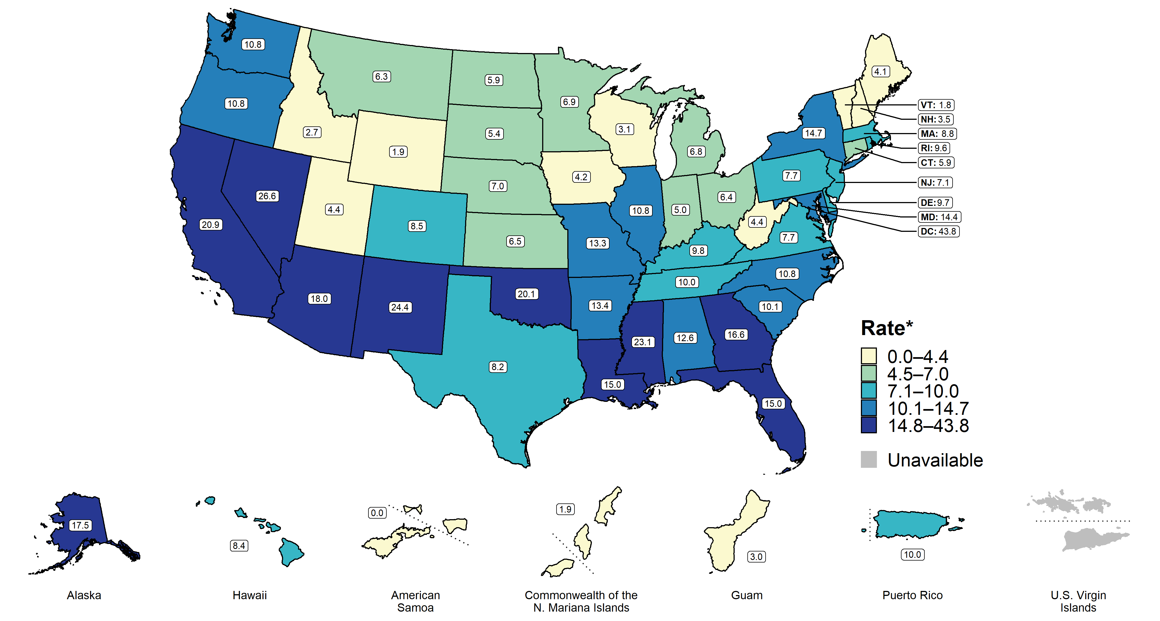
Primary and Secondary Syphilis — Rates of Reported Cases by State, United States and Territories, 2019
* Per 100,000
Notes:
Rates of reported cases of primary and secondary syphilis per 100,000 population ranged by state from 1.8 in Vermont to 26.6 in Nevada. The rate of reported cases of primary and secondary syphilis cases in the District of Columbia was 43.8 cases per 100,000 population.
See Technical Notes (www.cdc.gov/std/statistics/2019/Technicalnotes) for information on syphilis case reporting and on interpreting reported rates in US territories.
Data points are available at www.cdc.gov/std/statistics/2019/data.zip

Slide 37
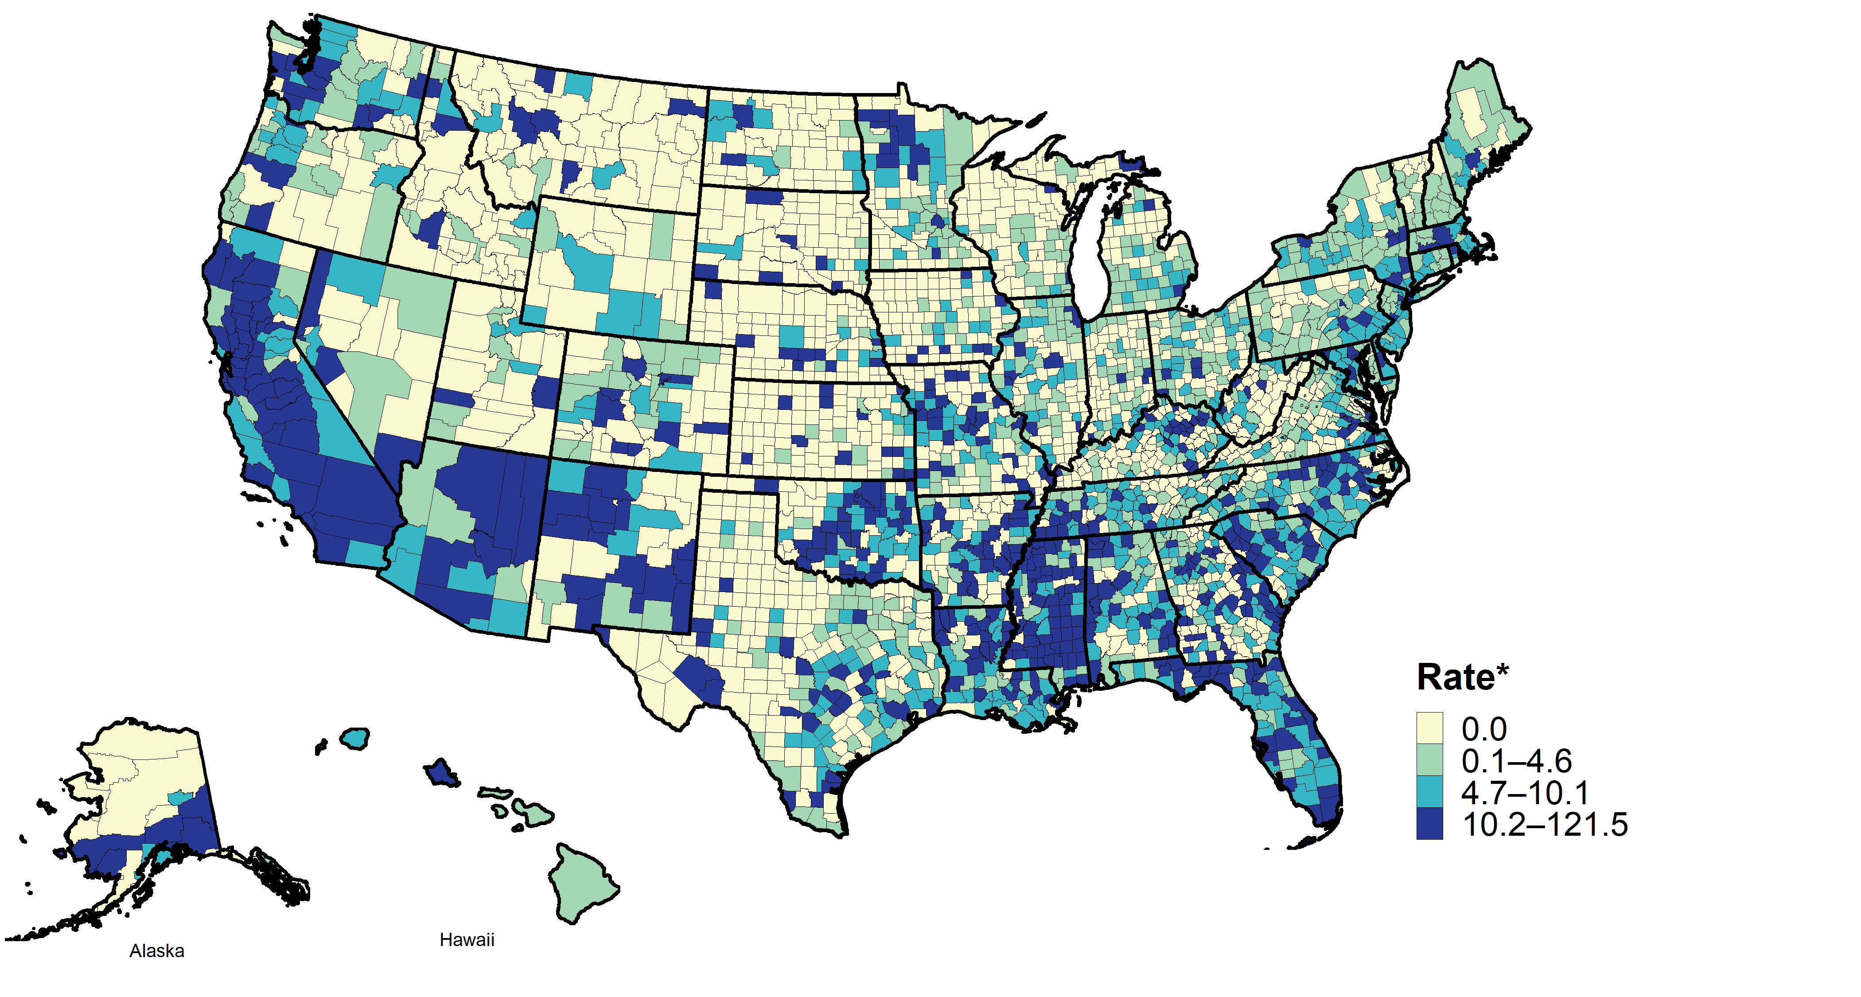
Primary and Secondary Syphilis — Rates of Reported Cases by County, United States, 2019
* Per 100,000
Notes:
In 2019, 45 (1.4%) of the 3,142 U.S. counties and independent cities accounted for half of all reported cases of primary and secondary syphilis. In 2019, 1,413 (45.0%) counties reported no cases of primary and secondary syphilis.
See Technical Notes (www.cdc.gov/std/statistics/2019/Technicalnotes) for information on syphilis case reporting.
Data points are available at www.cdc.gov/std/statistics/2019/data.zip

Slide 38
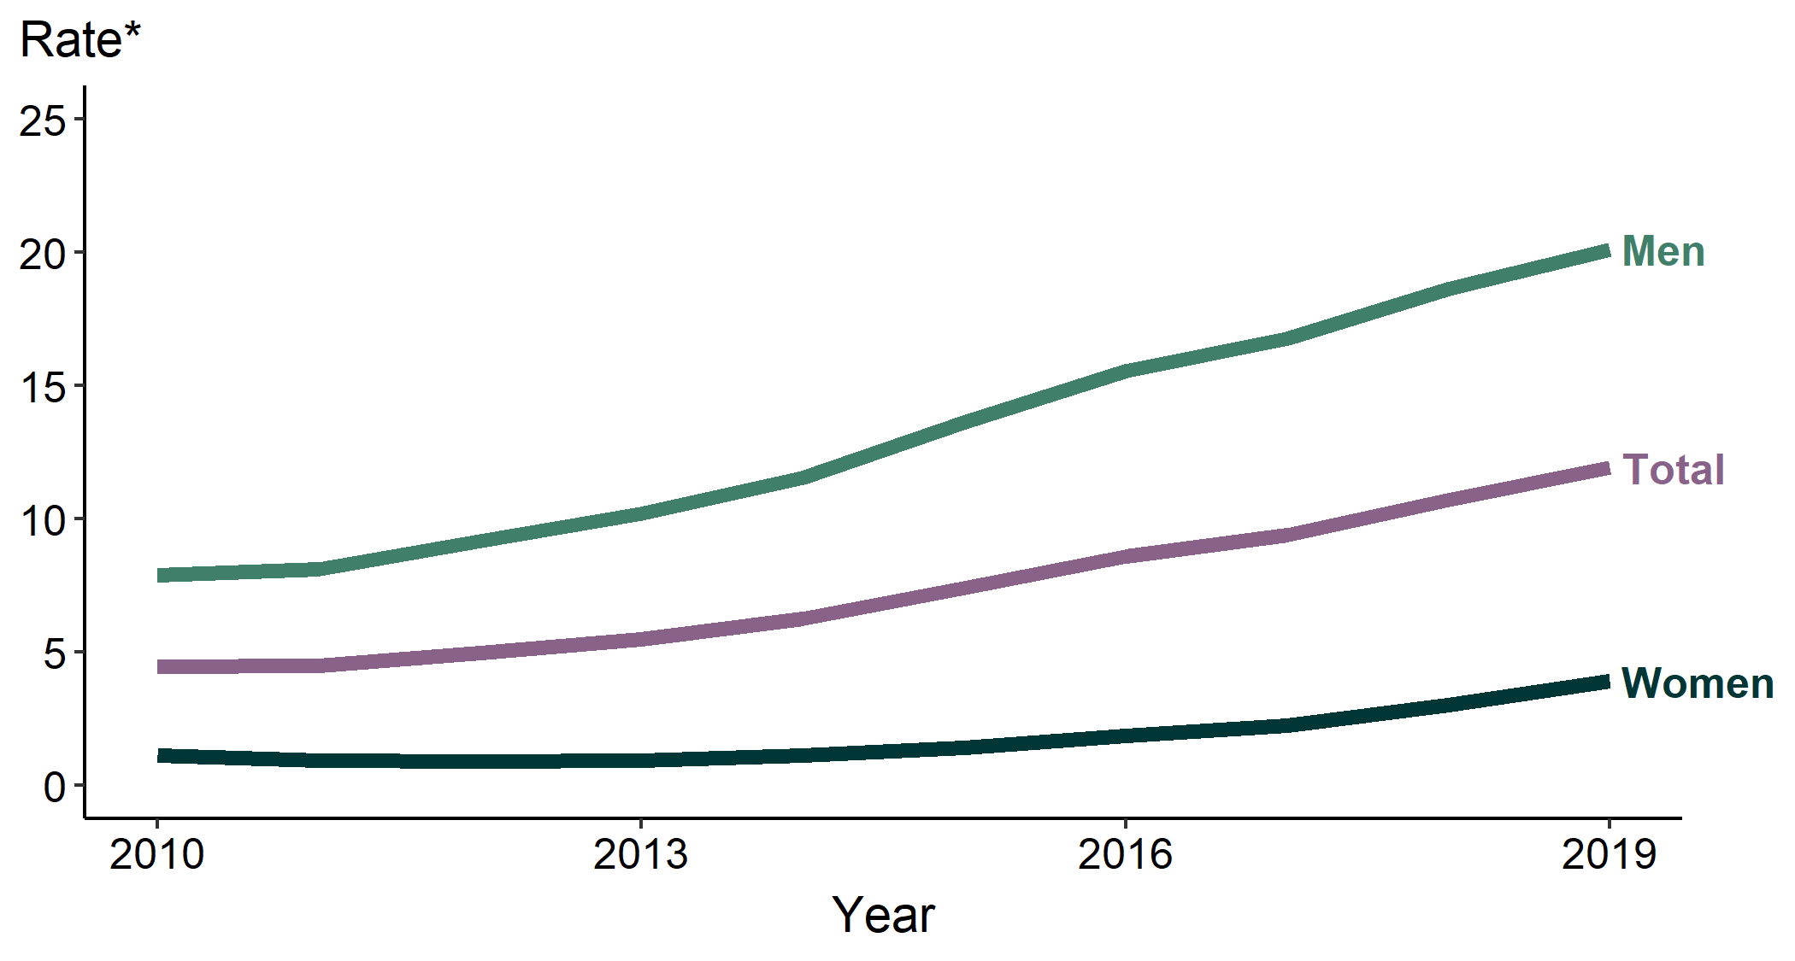
Primary and Secondary Syphilis — Rates of Reported Cases by Sex, United States, 2010–2019
* Per 100,000
Notes:
During 2018–2019, the primary and secondary syphilis rate among males increased 8.1% (from 18.6 to 20.1 cases per 100,000 males) and the rate among females increased 30.0% (from 3.0 to 3.9 cases per 100,000 females). During 2015–2019, the rate among males increased 47.8% (from 13.6 to 20.1 cases per 100,000 males) and the rate among females increased 178.6% (from 1.4 to 3.9 cases per 100,000 females).
See Technical Notes (www.cdc.gov/std/statistics/2019/Technicalnotes) for information on syphilis case reporting.
Data points are available at www.cdc.gov/std/statistics/2019/data.zip

Slide 39
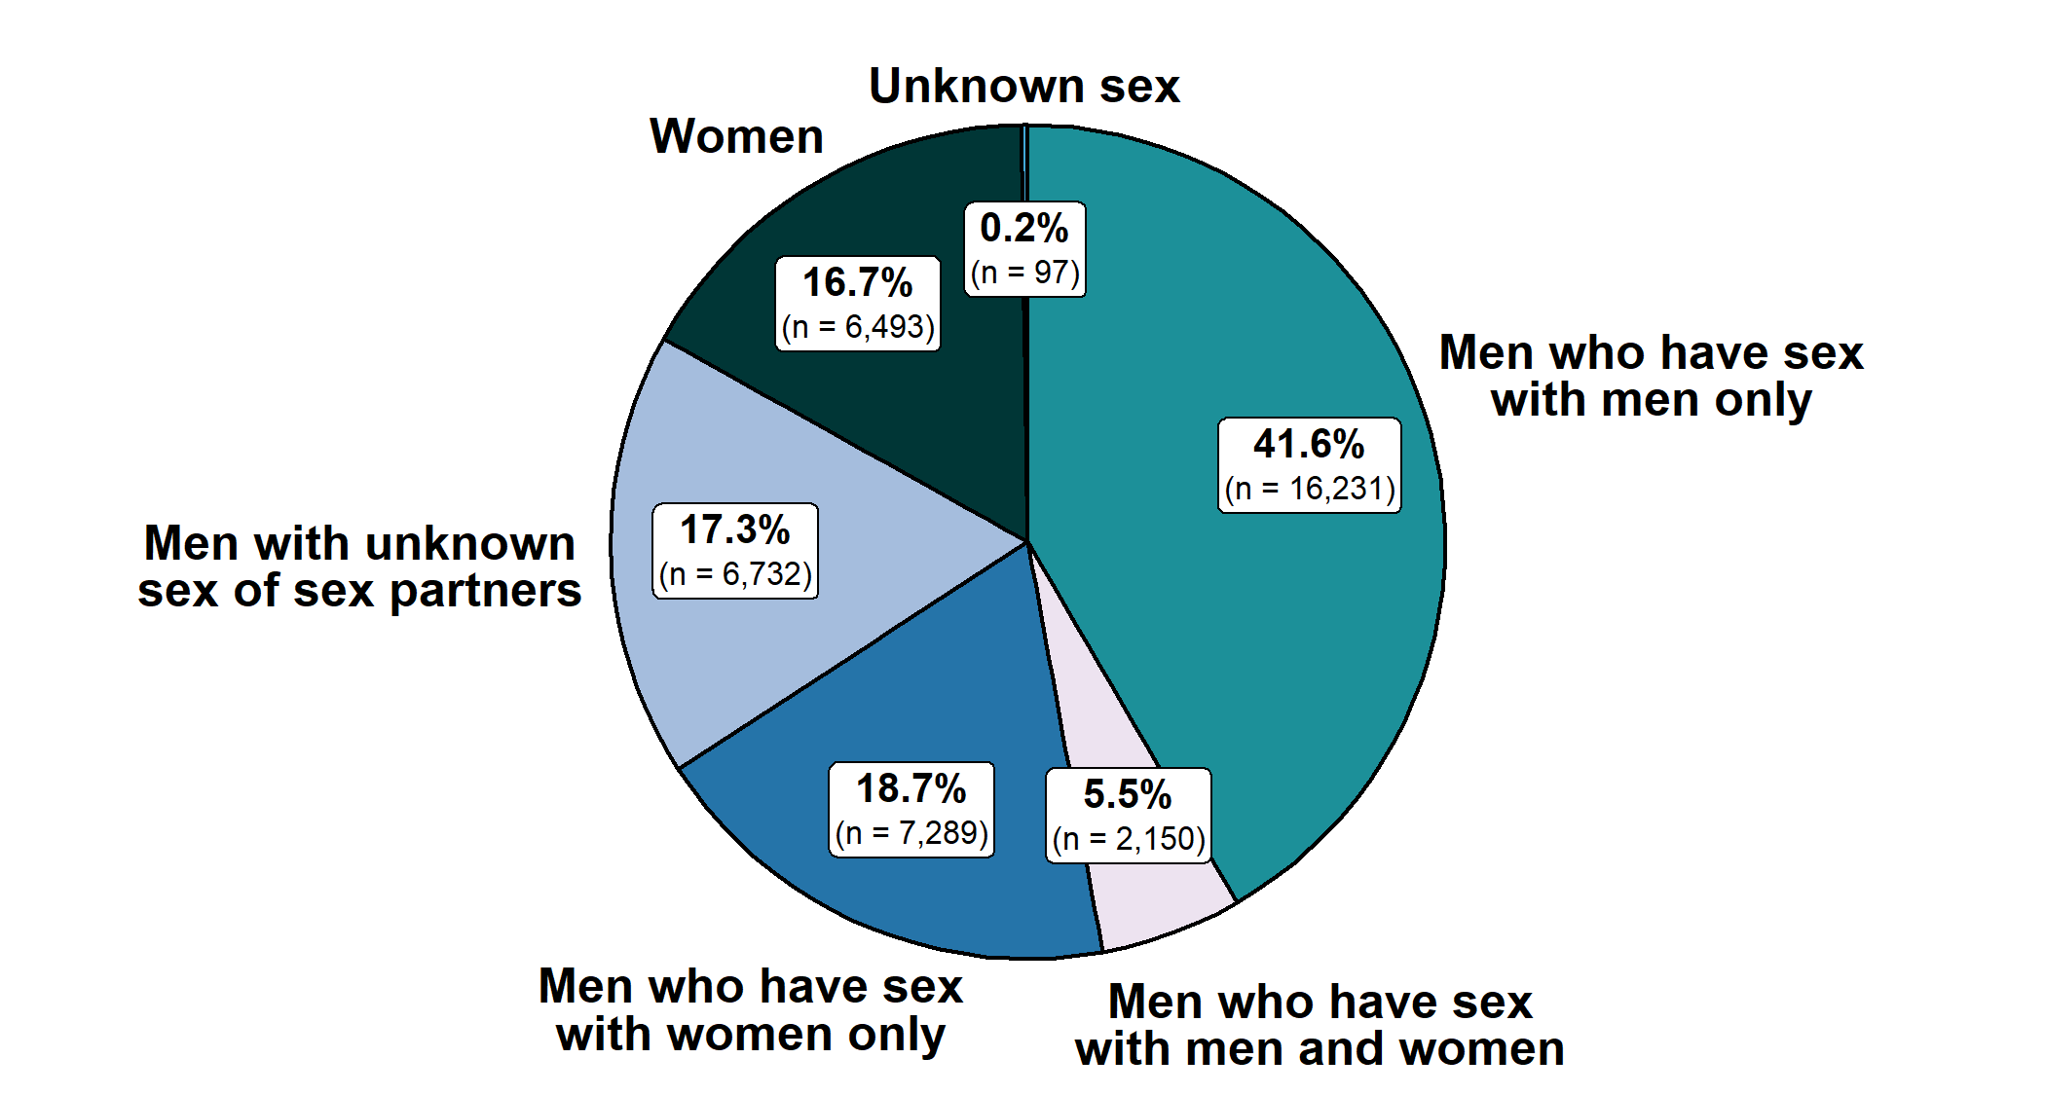
Primary and Secondary Syphilis — Distribution of Cases by Sex and Sex of Sex Partners, United States, 2019
Notes:
Of 38,992 reported primary and secondary syphilis cases in 2019, 41.6% were among men who have sex with men only. Men who have sex with men only combined with men who have sex with both men and women accounted for 47.1% of all primary and secondary syphilis cases and for 56.7% of all male primary and secondary syphilis cases.
See Technical Notes (www.cdc.gov/std/statistics/2019/Technicalnotes) for information on syphilis case reporting.
Data points are available at www.cdc.gov/std/statistics/2019/data.zip

Slide 40
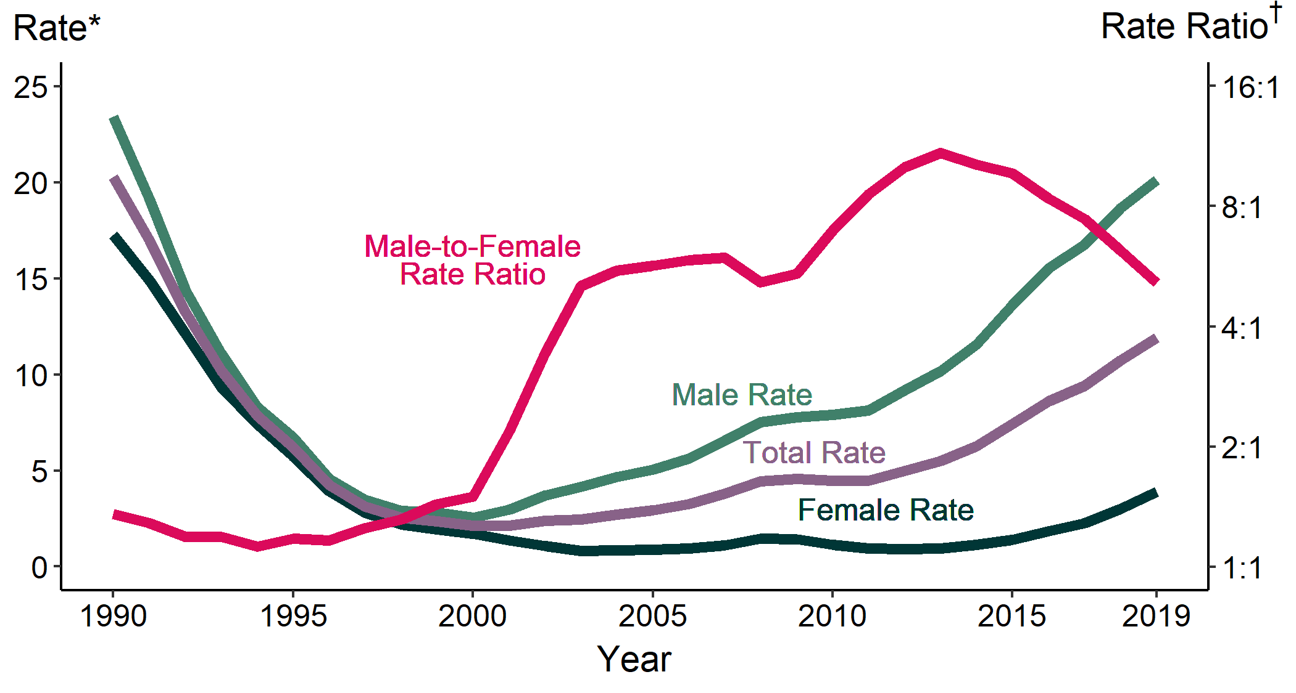
Primary and Secondary Syphilis — Rates of Reported Cases by Sex and Male-to-Female Rate Ratios, United States, 1990–2019
* Per 100,000
† Log scale
Notes:
Although the male-to-female rate ratio for primary and secondary syphilis increased from 1990 to 2013, the rate ratio is now declining due to the increasing rate of female syphilis. During 2015–2019, the rate of primary and secondary syphilis among women more than doubled (178.6% increase).
See Technical Notes (www.cdc.gov/std/statistics/2019/Technicalnotes) for information on syphilis case reporting.
Data points are available at www.cdc.gov/std/statistics/2019/data.zip

Slide 41
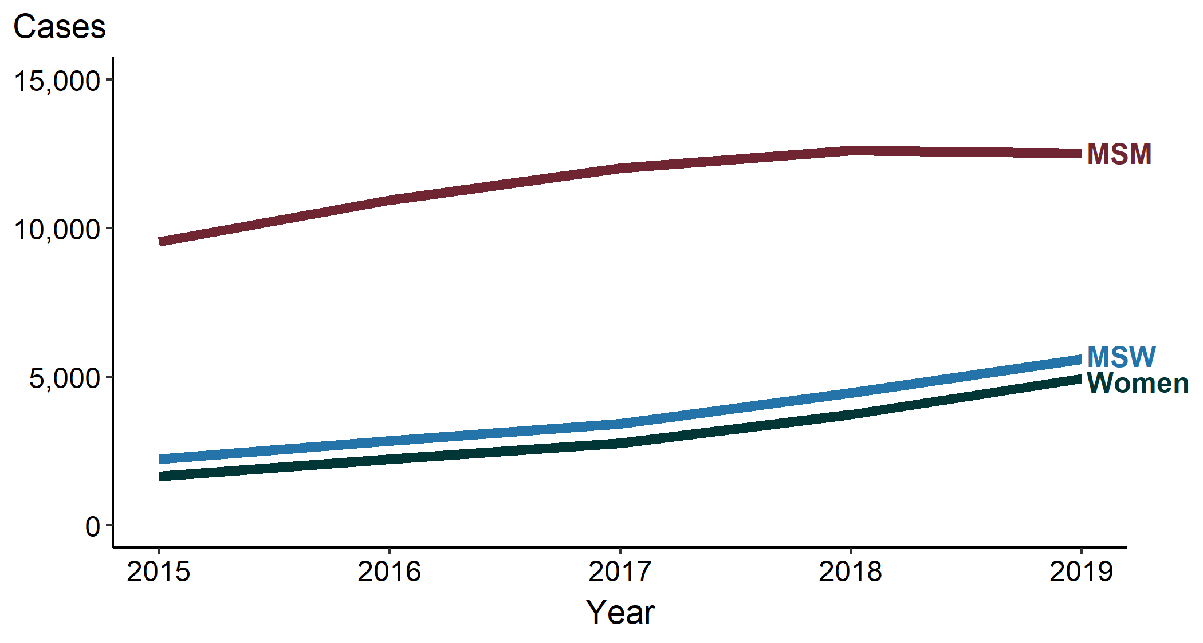
Primary and Secondary Syphilis — Reported Cases by Sex and Sex of Sex Partners, 31 States*, 2015–2019
*31 states were able to classify ≥70% of reported cases of primary and secondary syphilis among males as either MSM or MSW for each year during 2015–2019.
ACRONYMS: MSM = Gay, bisexual, and other men who have sex with men; MSW = Men who have sex with women only
Notes:
In 31 states with complete information on sex of sex partners for male cases, most primary and secondary syphilis cases were among men who have sex with men in 2019. During 2018–2019, the number of reported primary and secondary cases decreased among men who have sex with men slightly (12,614 cases in 2018 to 12,532 in 2019), while reported cases among men who have sex with women only (4,473 cases in 2018 to 5,601 in 2019) and women (3,735 cases in 2018 to 4,952 in 2019) increased.
See Technical Notes (www.cdc.gov/std/statistics/2019/Technicalnotes) for information on syphilis case reporting.
Data points are available at www.cdc.gov/std/statistics/2019/data.zip

Slide 42
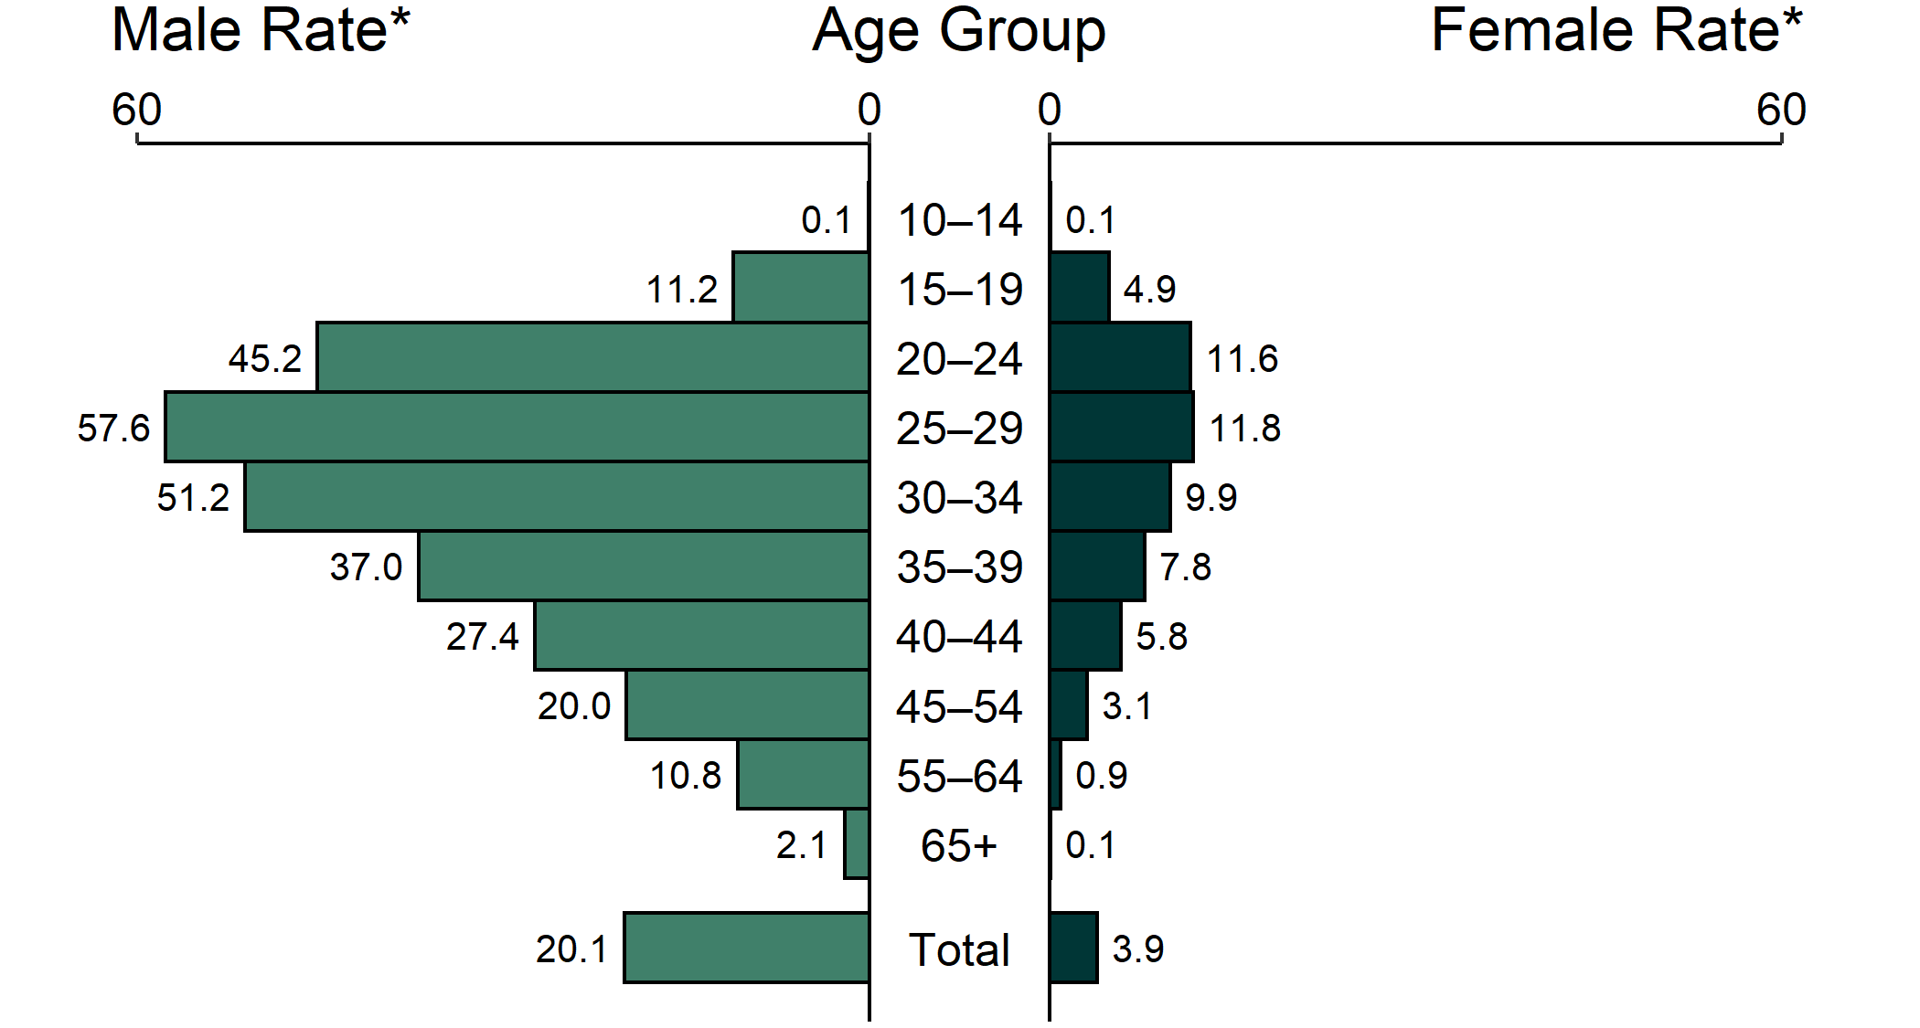
Primary and Secondary Syphilis — Rates of Reported Cases by Age Group and Sex, United States, 2019
* Per 100,000
NOTE: Total includes all ages.
Notes:
The highest rates of primary and secondary syphilis were among men aged 25–29 years (57.6 cases per 100,000 males), men aged 30–34 years (51.2 cases per 100,000 males), and men aged 20–24 years (45.2 cases per 100,000 males). The highest rates among females were among those aged 25–29 years (11.8 cases per 100,000 females) and those aged 20–24 years (11.6 cases per 100,000 females).
See Technical Notes (www.cdc.gov/std/statistics/2019/Technicalnotes) for information on syphilis case reporting.
Data points are available at www.cdc.gov/std/statistics/2019/data.zip

Slide 43
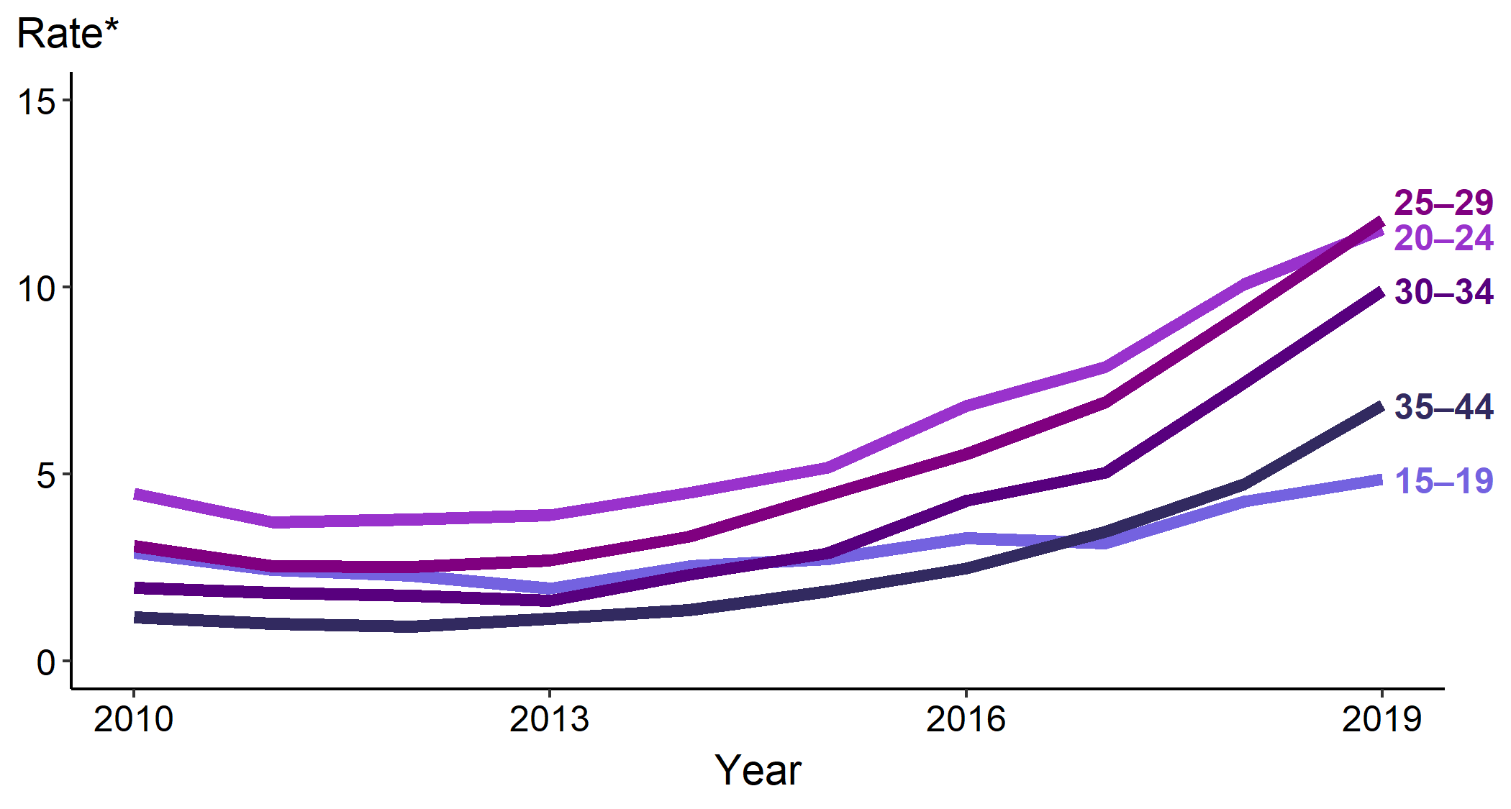
Primary and Secondary Syphilis — Rates of Reported Cases Among Females Aged 15–44 Years by Age Group, United States, 2010–2019
* Per 100,000
Notes:
The highest rate of primary and secondary syphilis was among 25–29-year-old females, increasing 26.9% during 2018–2019 (9.3 to 11.8 per 100,000 females), with a total increase of 168.2% during 2015–2019 (4.4 to 11.8 cases per 100,000 females). The second highest rate, among 20–24-year-old females, increased 14.9% during 2018–2019 (10.1 to 11.6 per 100,000 females) with a total increase of 123.1% during 2015–2019 (5.2 to 11.6 cases per 100,000 females).
See Technical Notes (www.cdc.gov/std/statistics/2019/Technicalnotes) for information on syphilis case reporting.
Data points are available at www.cdc.gov/std/statistics/2019/data.zip

Slide 44
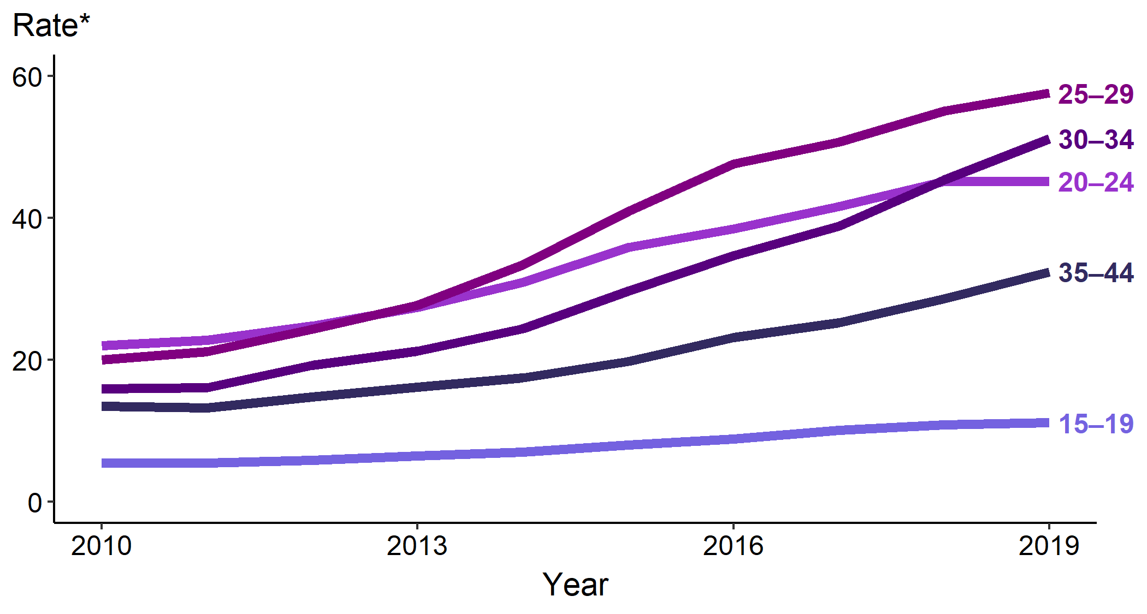
Primary and Secondary Syphilis — Rates of Reported Cases Among Males Aged 15–44 Years by Age Group, United States, 2010–2019
* Per 100,000
Notes:
During 2018–2019, the rate of reported primary and secondary syphilis cases among males aged 15–44 years increased in all age groups except 20-24 which did not change from the previous year. The rate of primary and secondary syphilis among was highest among 25-29-year-old males, increasing 4.5% during 2018–2019, with a total increase of 40.8% during 2015–2019 (40.9 to 57.6 cases per 100,000 males).
See Technical Notes (www.cdc.gov/std/statistics/2019/Technicalnotes) for information on syphilis case reporting.
Data points are available at www.cdc.gov/std/statistics/2019/data.zip

Slide 45
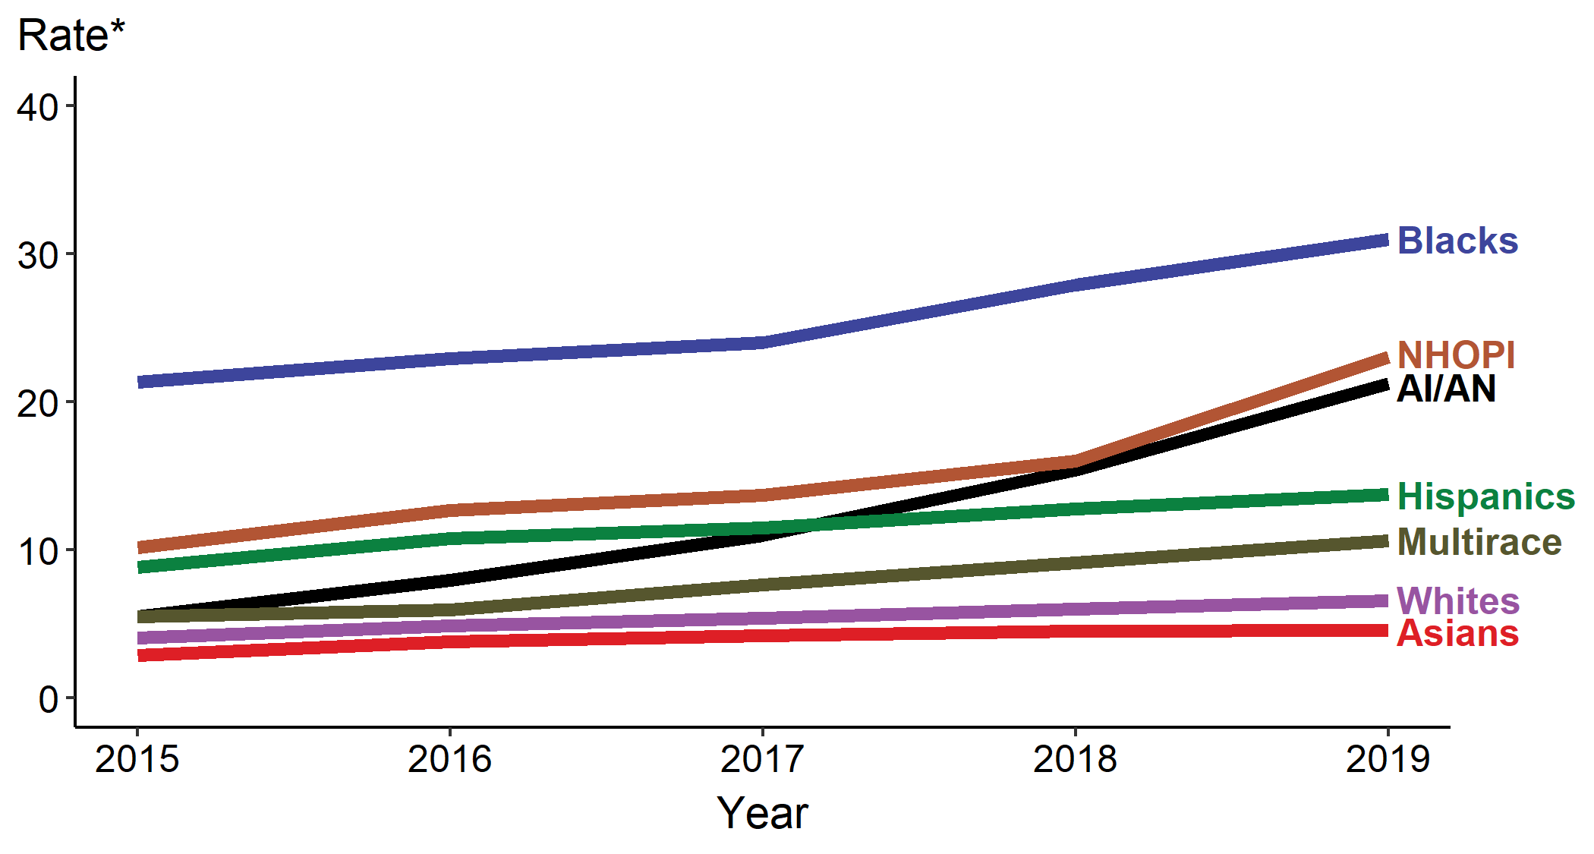
Primary and Secondary Syphilis — Rates of Reported Cases by Race/Hispanic Ethnicity, United States, 2015–2019
* Per 100,000
ACRONYMS: AI/AN = American Indians/Alaska Natives; NHOPI = Native Hawaiians/Other Pacific Islanders
Notes:
In 2019, the rate of reported cases of primary and secondary syphilis remained highest among Blacks (31.0 cases per 100,000), followed by Native Hawaiians/Other Pacific Islanders (23.0 per 100,000) and American Indians/Alaska Natives (21.2 per 100,00). During 2015–2019, the primary and secondary syphilis rate increased among all race/Hispanic ethnicity groups: American Indians/Alaska Natives increased 285.5%, Native Hawaiians/Other Pacific Islanders increased 125.5%, those who identified as Multirace increased 92.7%, Whites increased 61.0%, Asians increased 58.6%, and Blacks increased 44.9%.
Not all US jurisdictions reported cases in Office of Management and Budget compliant race categories in 2019. This may minimally under- or overestimate rates for Asians, NHOPI, or Multirace individuals. For completeness, data in this figure include cases reported from all jurisdictions.
See Technical Notes (www.cdc.gov/std/statistics/2019/Technicalnotes) for information on syphilis case reporting and reporting STD case data for race/Hispanic ethnicity.
Data points are available at www.cdc.gov/std/statistics/2019/data.zip

Slide 46
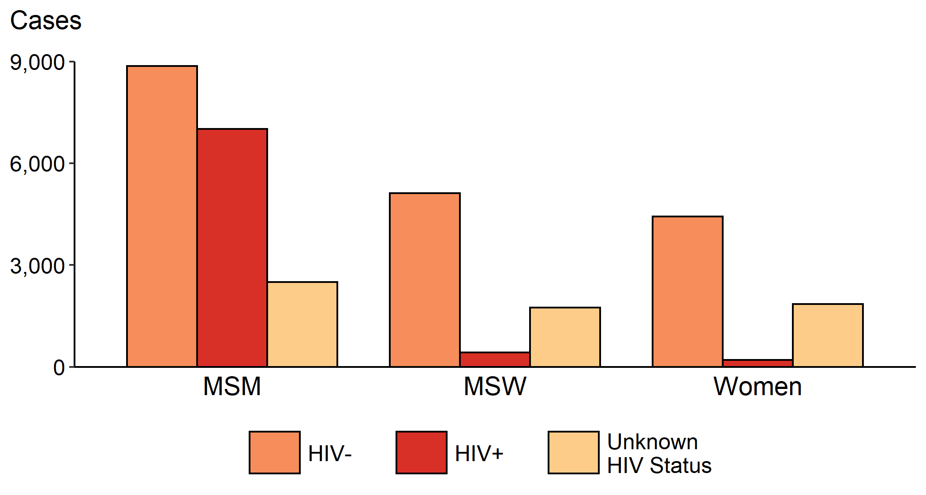
Primary and Secondary Syphilis — Reported Cases by Sex, Sex of Sex Partners, and HIV Status, United States, 2019
ACRONYMS: MSM = Gay, bisexual, and other men who have sex with men; MSW = Men who have sex with women only
Notes:
Among primary and secondary syphilis cases with reported HIV status, 44.2% (7,013/15,880) of cases among men who have sex with men were HIV-positive, compared with 7.6% (419/5,535) of cases among men who have sex with women only, and 4.3% (200/4,636) of cases among women.
Note: HIV status is categorized as reported by jurisdictions. Jurisdictions determine HIV status using multiple sources, including self-report, match with HIV registry, and available test results. Cases reported with a missing or unknown status are categorized as having an unknown HIV status.
See Technical Notes (www.cdc.gov/std/statistics/2019/Technicalnotes) for information on syphilis case reporting.
Data points are available at www.cdc.gov/std/statistics/2019/data.zip

Slide 47
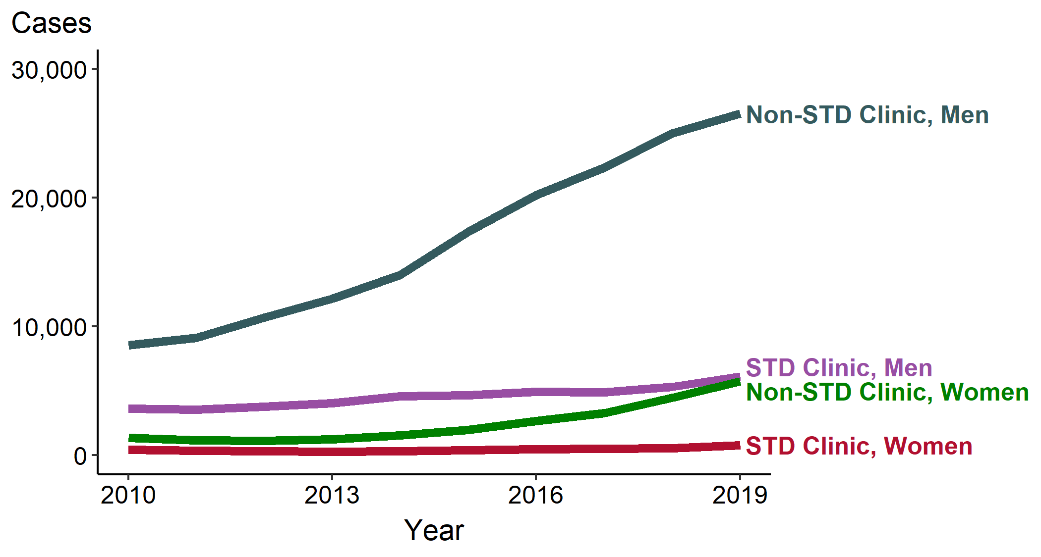
Primary and Secondary Syphilis — Reported Cases by Reporting Source and Sex, United States, 2010–2019
Notes:
During 2010–2019, the number of primary and secondary syphilis cases reported from STD clinics has remained relatively stable for males and females while the number of cases reported from non-STD clinics increased 210% among males and 326% among females.
See Technical Notes (www.cdc.gov/std/statistics/2019/Technicalnotes) for information on syphilis case reporting.
Data points are available at www.cdc.gov/std/statistics/2019/data.zip

Slide 48
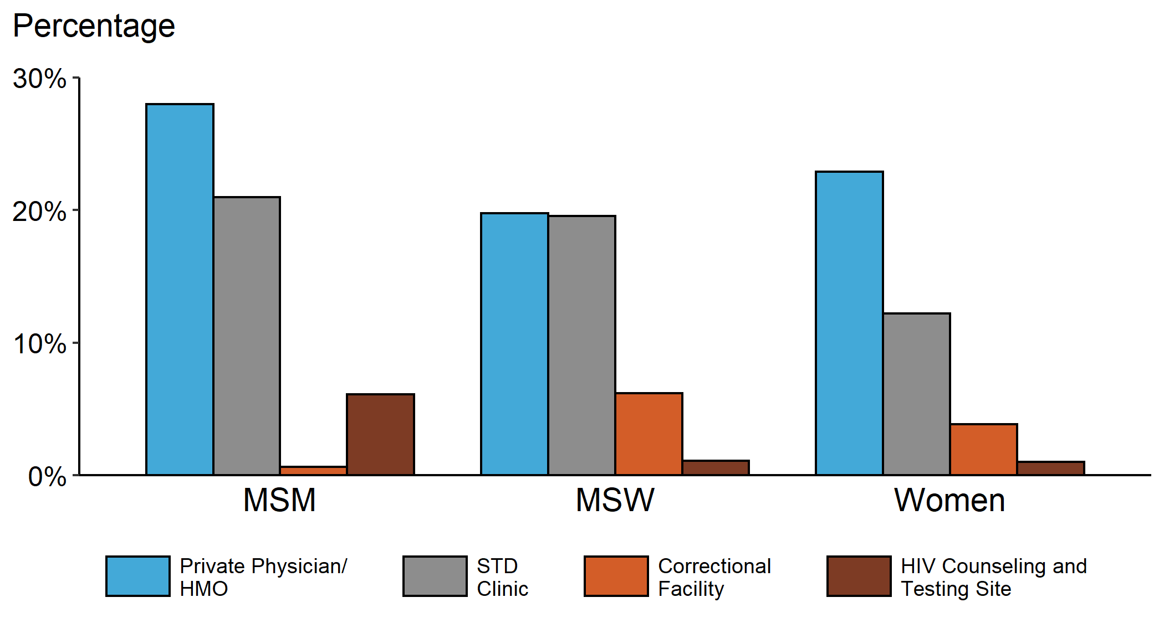
Primary and Secondary Syphilis — Percentage of Reported Cases by Sex, Sex of Sex Partners, and Selected Reporting Sources, United States, 2019
ACRONYMS: HMO = health maintenance organization; MSM = Gay, bisexual, and other men who have sex with men; MSW = Men who have sex with women only
Notes:
Of cases reported among men who have sex with men, private physicians/health maintenance organizations and STD clinics reported the highest proportion of cases. Although private physicians/health maintenance organizations and STD clinics are also the most common reporting sources for women and men who have sex with women only, correctional facilities make up a more significant reporting source in these two groups.
See Technical Notes (www.cdc.gov/std/statistics/2019/Technicalnotes) for information on syphilis case reporting.
Data points are available at www.cdc.gov/std/statistics/2019/data.zip

Slide 49
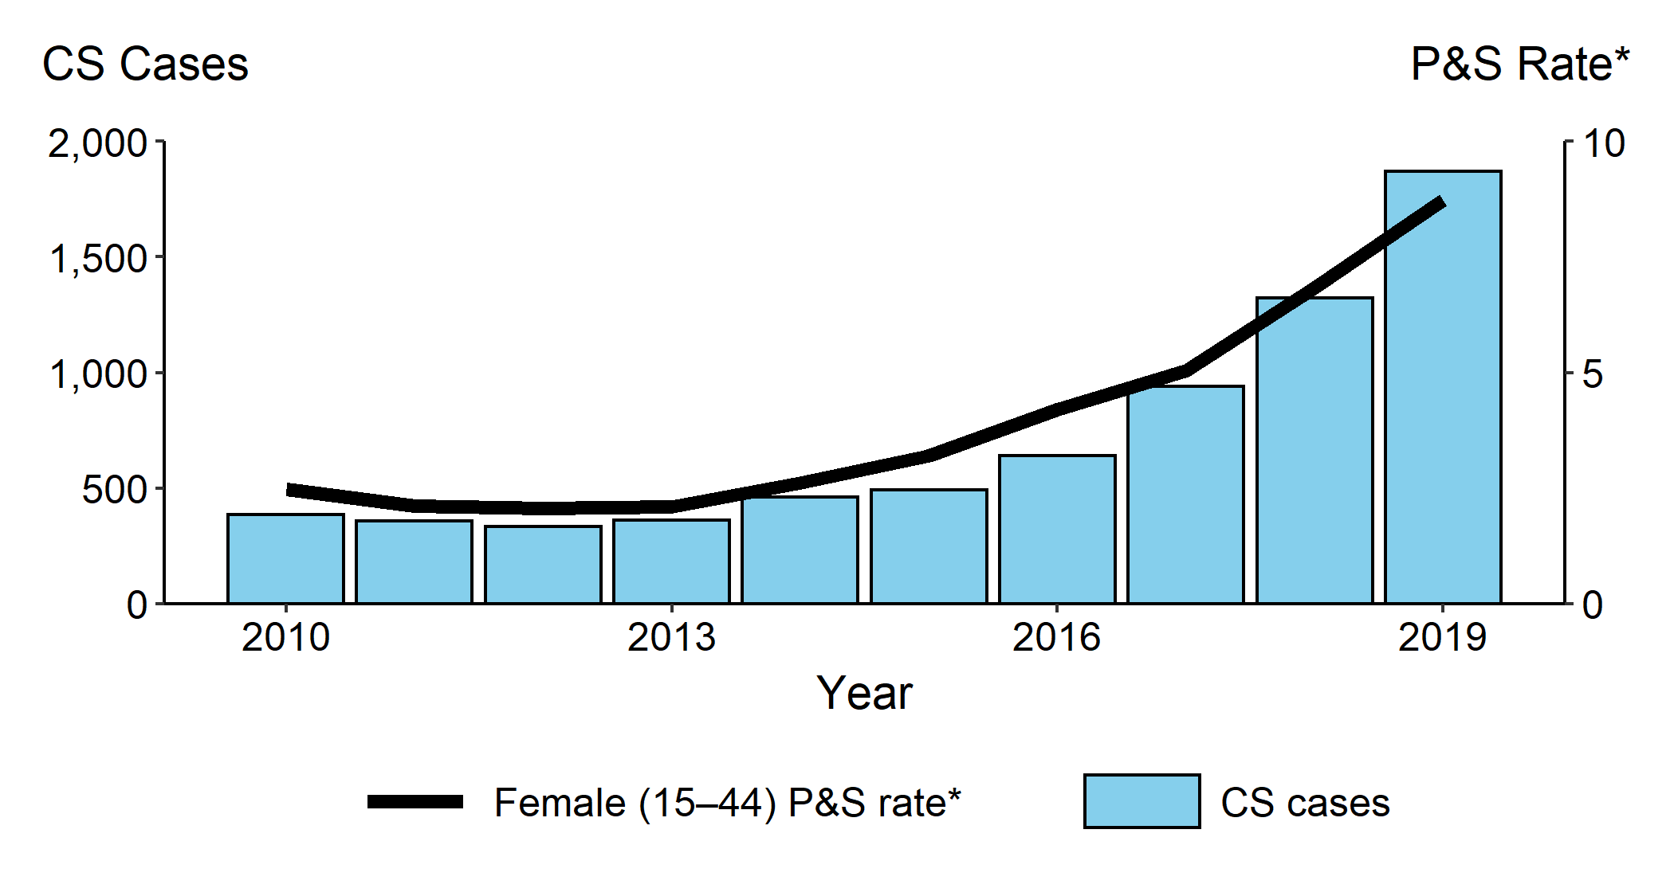
Congenital Syphilis — Reported Cases by Year of Birth and Rates of Reported Cases of Primary and Secondary Syphilis Among Females Aged 15–44 Years, United States, 2010–2019
* Per 100,000
ACRONYMS: CS = Congenital syphilis; P&S = Primary and secondary syphilis
Notes:
In 2019, there were a total of 1,870 cases of congenital syphilis reported for a rate of 48.5 cases per 100,000 live births. During 2018–2019, the rate of congenital syphilis increased 41.4% (34.3 to 48.5 per 100,000 live births), concurrent with a 27.9% (6.8 to 8.7 per 100,000 females) increase in the rate of primary and secondary syphilis among women aged 15-44 years. During 2015–2019, the rate of congenital syphilis increased 291.1% (12.4 to 48.5 per 100,000 live births) and the rate of primary and secondary syphilis among women aged 15-44 years increased 171.9% (3.2 to 8.7 per 100,000 females).
See Technical Notes (www.cdc.gov/std/statistics/2019/Technicalnotes) for information on syphilis case reporting.
Data points are available at www.cdc.gov/std/statistics/2019/data.zip

Slide 50
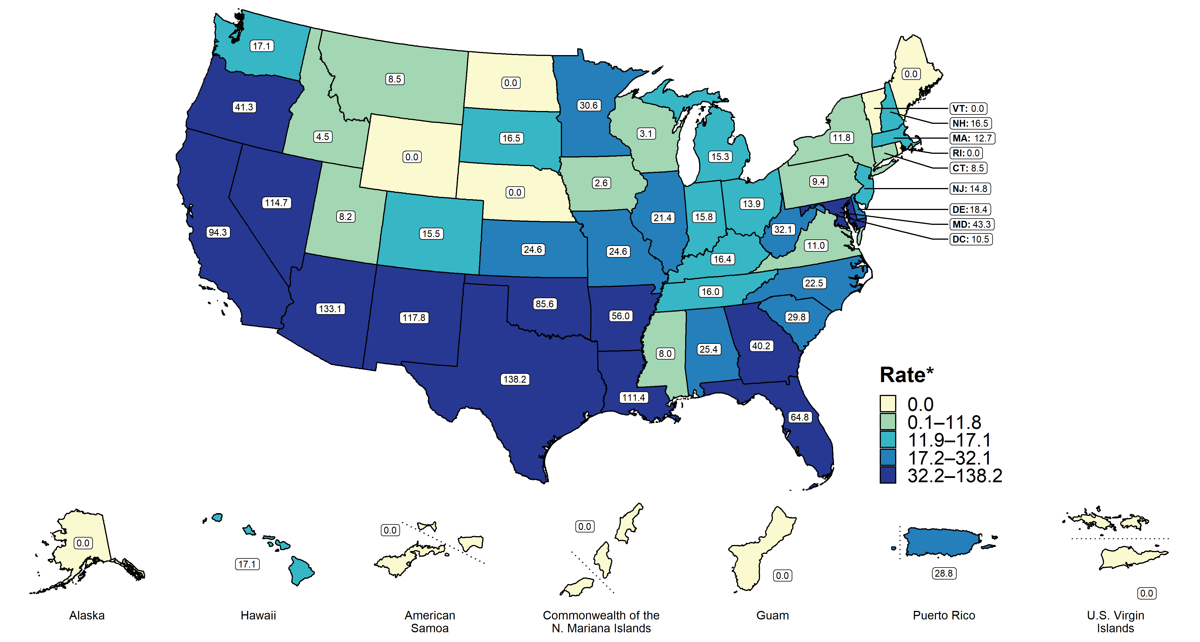
Congenital Syphilis — Rates of Reported Cases by Year of Birth and State, United States and Territories, 2019
* Per 100,000 live births
Notes:
In 2019, 43 states plus the District of Columbia reported at least one case of congenital syphilis. Rates of reported congenital syphilis per 100,000 live births ranged by state from 2.6 in Iowa to 138.2 in Texas; the congenital syphilis rate in the District of Columbia was 10.5 cases per 100,000 live births.
See Technical Notes (www.cdc.gov/std/statistics/2019/Technicalnotes) for information on syphilis case reporting and on interpreting reported rates in US territories.
Data points are available at www.cdc.gov/std/statistics/2019/data.zip

Slide 51
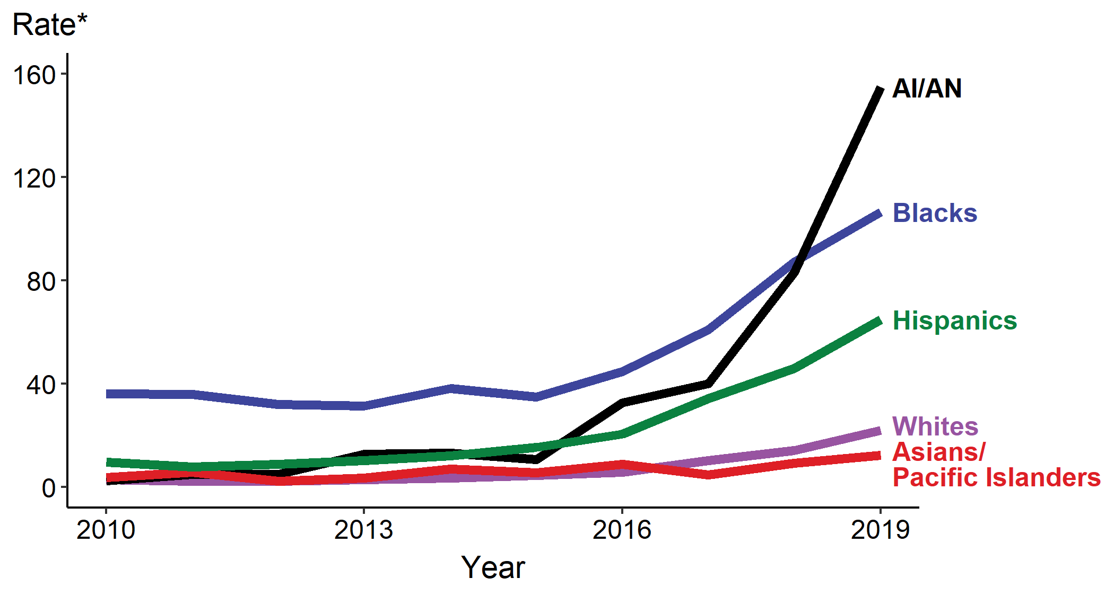
Congenital Syphilis — Rates of Reported Cases by Year of Birth, Race, and Hispanic Ethnicity of Mother, United States, 2010–2019
* Per 100,000 live births
ACRONYMS: AI/AN = American Indians/Alaska Natives
Notes:
Rates of reported congenital syphilis cases increased for all race/Hispanic ethnicity groups during 2015–2019, including a 1,347.7% increase among American Indians/Alaska Natives (from 10.7 to 154.9 cases per 100,000 live births), a 391.1% increase among Whites (from 4.5 to 22.1 cases per 100,000 live births), a 318.7% among Hispanics (from 15.5 to 64.9 cases per 100,000 live births), a 204.0% increase among Blacks (from 35.0 to 106.4 cases per 100,000 live births), and a 123.6% increase among Asian/Pacific Islanders (from 5.5 to 12.3 cases per 100,000 live births).
National Center for Health Statistics bridged race categories are presented to allow the display of data across several years.
See Technical Notes (www.cdc.gov/std/statistics/2019/Technicalnotes) for information on syphilis case reporting and reporting STD case data for race/Hispanic ethnicity.
Data points are available at www.cdc.gov/std/statistics/2019/data.zip

Slide 52
Congenital Syphilis — Reported Cases by Vital Status and Clinical Signs and Symptoms* of Infection, United States, 2015–2019
*Infants with signs/symptoms of congenital syphilis have documentation of at least one of the following: long bone changes consistent with congenital syphilis, snuffles, condyloma lata, syphilitic skin rash, pseudoparalysis, hepatosplenomegaly, edema, jaundice due to syphilitic hepatitis, reactive CSF-VDRL, elevated CSF WBC or protein, or evidence of direct detection of T. Pallidum.
NOTE: Of the 5,269 congenital syphilis cases reported during 2015–2019, 22 (0.4%) did not have sufficient information to be categorized
Notes:
In 2019, there were 128 congenital syphilis-related deaths (94 stillbirths and 34 infant deaths), and an increase of 36.2% from 2018 (94 to 128 deaths) and of 255.6% from 2015 (36 to 128 deaths).
See Technical Notes (www.cdc.gov/std/statistics/2019/Technicalnotes) for information on syphilis case reporting.
Data points are available at www.cdc.gov/std/statistics/2019/data.zip

Slide 53
Congenital Syphilis — Missed Prevention Opportunities among Mothers Delivering Infants with Congenital Syphilis, United States, 2015–2019
NOTE: Of the 5,269 congenital syphilis cases reported during 2015–2019, 912 (17.3%) were not able to have the primary missed prevention opportunity identified due to insufficient information submitted to CDC related to maternal prenatal care, testing, or treatment.
Notes:
During 2015–2019, the majority of missed prevention opportunities among mothers of infants with congenital syphilis were no adequate maternal treatment despite receipt of timely syphilis diagnosis and no timely prenatal care/no timely syphilis testing. In 2019, the most common missed congenital syphilis prevention opportunity was a lack of adequate maternal syphilis treatment despite receipt of a timely syphilis diagnosis (40.2%). The second most common missed congenital syphilis prevention opportunity in 2019 was a lack of timely prenatal care and subsequent lack of timely syphilis testing (36.3%).
See Technical Notes (www.cdc.gov/std/statistics/2019/Technicalnotes) for information on missed prevention opportunity classification
Data points are available at www.cdc.gov/std/statistics/2019/data.zip
ADAPTED FROM: Kimball A, Torrone E, Miele K, et al. Missed Opportunities for Prevention of Congenital Syphilis - United States, 2018. MMWR Morb Mortal Wkly Rep. 2020 Jun 5;69(22):661-665.

Slide 54
Chlamydia — Rates of Reported Cases Among Females by State, United States and Territories, 2019
* Per 100,000
Notes:
In 2019, the overall rate of reported cases of chlamydia among females was 698.9 per 100,000 females. Rates of reported chlamydia cases among females per 100,000 population ranged by state from 333 in New Hampshire to 1,137 in Alaska. The rate of reported chlamydia cases among females in the District of Columbia was 1,362 cases per 100,000 population.
See Technical Notes (www.cdc.gov/std/statistics/2019/Technicalnotes) for information on chlamydia case reporting and on interpreting reported rates in US territories.
Data points are available at www.cdc.gov/std/statistics/2019/data.zip

Slide 55
Gonorrhea — Rates of Reported Cases Among Females by State, United States and Territories, 2019
* Per 100,000
Notes:
In 2019, the overall rate of reported cases of gonorrhea among females was 152.6 per 100,000 females. Rates of reported gonorrhea cases among females per 100,000 population ranged by state from 20 in New Hampshire to 404 in Mississippi. The rate of reported gonorrhea cases among females in the District of Columbia was 348 cases per 100,000 population.
See Technical Notes (www.cdc.gov/std/statistics/2019/Technicalnotes) for information on gonorrhea case reporting and on interpreting reported rates in US territories.
Data points are available at www.cdc.gov/std/statistics/2019/data.zip

Slide 56
Chlamydia and Gonorrhea — Rates of Reported Cases Among Infants <1 Year of Age by Year and Specimen Source, United States, 2015–2019
* Per 100,000 live births
ACRONYMS: CT = Chlamydia; GC = Gonorrhea
Notes:
During 2015–2019, 448 chlamydia or gonorrhea cases among infants aged less than one year with a specimen source of either ‘eye’ or ‘conjunctiva’ (conjunctivitis infections) were reported to CDC. The overall reported rate of chlamydial conjunctivitis in infants was relatively stable during 2015–2019, ranging from 1.5 to 2.3 cases per 100,000 live births. Similarly, the rate of gonococcal conjunctivitis in infants remained relatively constant and low during 2015–2019, ranging from 0.3–0.4 cases per 100,000 live births. An additional 1,609 chlamydia or gonorrhea cases among infants aged less than one year with a specimen source of other, unknown, or missing were reported during 2015–2019.
See Technical Notes (www.cdc.gov/std/statistics/2019/Technicalnotes) for information on chlamydia and gonorrhea case reporting.
Data points are available at www.cdc.gov/std/statistics/2019/data.zip
ADAPTED FROM: Kreisel K, Weston E, Braxton J, et al. Keeping an eye on chlamydia and gonorrhea conjunctivitis in infants in the United States, 2010–2015. Sex Transm Dis. 2017; 44(6): 356–358.

Slide 57
Primary and Secondary Syphilis — Rates of Reported Cases Among Females by State, United States and Territories, 2019
* Per 100,000
Notes:
In 2019, the overall rate of reported primary and secondary syphilis cases among females was 3.9 cases per 100,000 females. Rates of reported primary and secondary syphilis cases among females per 100,000 population ranged by state from 0.3 in Vermont to 16.8 in Mississippi. The rate of reported primary and secondary syphilis cases among females in the District of Columbia was 5.7 cases per 100,000 population.
See Technical Notes (www.cdc.gov/std/statistics/2019/Technicalnotes) for information on syphilis case reporting and on interpreting reported rates in US territories.
Data points are available at www.cdc.gov/std/statistics/2019/data.zip

Slide 58
Chlamydia — Rates of Reported Cases Among Females Aged 15–24 Years by State, United States and Territories, 2019
* Per 100,000
Notes:
Among females aged 15–24 years, the population targeted for chlamydia screening, the overall rate of reported cases of chlamydia in 2019 was 3,728.1 cases per 100,000 females. Rates of reported chlamydia cases varied by state for females aged 15–24 years, with the majority of states having the highest reported case rates in the South.
See Technical Notes (www.cdc.gov/std/statistics/2019/Technicalnotes) for information on chlamydia case reporting and on interpreting reported rates in US territories.
Data points are available at www.cdc.gov/std/statistics/2019/data.zip

Slide 59
Chlamydia — Rates of Reported Cases Among Males Aged 15–24 Years by State, United States and Territories, 2019
* Per 100,000
Notes:
Among males aged 15–24 years, the overall rate of reported cases of chlamydia in 2019 was 1,448.6 cases per 100,000 males. Rates of reported chlamydia cases varied by state for males aged 15–24 years, with the majority of states having the highest reported case rates in the South.
See Technical Notes (www.cdc.gov/std/statistics/2019/Technicalnotes) for information on chlamydia case reporting and on interpreting reported rates in US territories.
Data points are available at www.cdc.gov/std/statistics/2019/data.zip

Slide 60
Gonorrhea — Rates of Reported Cases Among Females Aged 15–24 Years by State, United States and Territories, 2019
* Per 100,000
Notes:
In 2019, among females aged 15–24 years, the rate of reported gonorrhea was 650.0 cases per 100,000 females. Rates of reported gonorrhea cases varied by state for females aged 15–24 years, with the majority of states having the highest reported case rates in the South.
See Technical Notes (www.cdc.gov/std/statistics/2019/Technicalnotes) for information on gonorrhea case reporting and on interpreting reported rates in US territories.
Data points are available at www.cdc.gov/std/statistics/2019/data.zip

Slide 61
Gonorrhea — Rates of Reported Cases Among Males Aged 15–24 Years by State, United States and Territories, 2019
* Per 100,000
Notes:
Among males aged 15–24 years, the rate of reported gonorrhea was 540.0 cases per 100,000 males in 2019. Rates of reported gonorrhea cases varied by state for males aged 15–24 years, with the majority of states having the highest reported case rates in the South.
See Technical Notes (www.cdc.gov/std/statistics/2019/Technicalnotes) for information on gonorrhea case reporting and on interpreting reported rates in US territories.
Data points are available at www.cdc.gov/std/statistics/2019/data.zip

Slide 62
Chlamydia — Prevalence Among Females Aged 16–24 Years Entering the National Job Training Program by State of Residence, United States and Territories, 2019
* Fewer than 100 females who resided in these states/areas and entered the National Job Training Program were screened for chlamydia in 2019.
Notes:
Among females aged 16–24 years entering the National Job Training Program in 2019 in 41 states and the District of Columbia, the median state-specific chlamydia prevalence was 11.9% (range: 5.1% to 21.2%).
See Technical Notes (www.cdc.gov/std/statistics/2019/Technicalnotes) for information on the National Job Training Program methodology.
Data points are available at www.cdc.gov/std/statistics/2019/data.zip

Slide 63
Chlamydia — Prevalence Among Males Aged 16–24 Years Entering the National Job Training Program by State of Residence, United States and Territories, 2019
* Fewer than 100 males who resided in these states/areas and entered the NJTP were screened for chlamydia in 2019.
Notes:
Among males aged 16–24 years entering the National Job Training Program in 2019 in all 50 states, the District of Columbia, and Puerto Rico, the median state-specific chlamydia prevalence was 6.6% (range: 1.6% to 11.3%).
See Technical Notes (www.cdc.gov/std/statistics/2019/Technicalnotes) for information on the National Job Training Program methodology.
Data points are available at www.cdc.gov/std/statistics/2019/data.zip

Slide 64
Gonorrhea — Prevalence Among Females Aged 16–24 Years Entering the National Job Training Program by State of Residence, United States and Territories, 2019
* Fewer than 100 females who resided in these states/areas and entered the National Job Training Program were screened for gonorrhea in 2019.
Notes:
Among females aged 16–24 years entering the National Job Training Program in 41 states and the District of Columbia, the median state-specific gonorrhea prevalence in 2019 was 2.4% (range: 0.3% to 9.5%).
See Technical Notes (www.cdc.gov/std/statistics/2019/Technicalnotes) for information on the National Job Training Program methodology.
Data points are available at www.cdc.gov/std/statistics/2019/data.zip

Slide 65
Gonorrhea — Prevalence Among Males Aged 16–24 Years Entering the National Job Training Program by State of Residence, United States and Territories, 2019
* Fewer than 100 males who resided in these states/areas and entered the National Job Training Program were screened for gonorrhea in 2019.
Notes:
Among males aged 16–24 years entering the National Job Training Program in 46 states, the District of Columbia, and Puerto Rico, the median state-specific gonorrhea prevalence in 2019 was 0.7% (range: 0.0% to 2.6%).
See Technical Notes (www.cdc.gov/std/statistics/2019/Technicalnotes) for information on the National Job Training Program methodology.
Data points are available at www.cdc.gov/std/statistics/2019/data.zip

Slide 66
Chlamydia — Rates of Reported Cases by Race/Hispanic Ethnicity and Sex, United States, 2019
* Per 100,000
ACRONYMS: AI/AN = American Indians/Alaska Natives; NHOPI = Native Hawaiians/Other Pacific Islanders
NOTE: Total includes all cases including those with unknown race/Hispanic ethnicity.
Notes:
In 2019, the rate of reported chlamydia cases among Black females was 5.2 times the rate among White females (1,435.7 and 274.7 cases per 100,000 population, respectively). The rate of reported chlamydia cases among Black males was 7.1 times the rate among White males (1,010.2 and 142.5 cases per 100,000 population, respectively). The rate of reported chlamydia cases among American Indian/Alaska Natives females was 4.0 times the rate among White females (1,102.3 and 274.7 cases per 100,000 population, respectively). The rate of reported gonorrhea cases among American Indian/Alaska Natives males was 3.2 times the rate among White males (406.3 and 142.5 cases per 100,000 population, respectively).
Not all US jurisdictions reported cases in Office of Management and Budget compliant race categories in 2019. This may minimally under- or overestimate rates for Asians, NHOPI, or Multirace individuals. For completeness, data in this figure include cases reported from all jurisdictions.
See Technical Notes (www.cdc.gov/std/statistics/2019/Technicalnotes) for information on chlamydia case reporting and reporting STD case data for race/Hispanic ethnicity.
Data points are available at www.cdc.gov/std/statistics/2019/data.zip

Slide 67
Chlamydia — Rate Ratios Among Females Aged 15–24 Years by Race/Hispanic Ethnicity and Region, United States, 2019
* For the rate ratios, Whites are the reference population. Y-axis is log scale.
ACRONYMS: AI/AN = American Indians/Alaska Natives; NHOPI = Native Hawaiians/Other Pacific Islanders
Notes:
Among females aged 15–24 years, the population targeted for chlamydia screening, rate ratios (using Whites as the reference population) varied by region in 2019. Differences were greatest in the Northeast where the rate of chlamydia among Black females was 6.0 times the rate among White females.
Not all US jurisdictions reported cases in Office of Management and Budget compliant race categories in 2019. This may minimally under- or overestimate rates for Asians, NHOPI, or Multirace individuals. For completeness, data in this figure include cases reported from all jurisdictions.
See Technical Notes (www.cdc.gov/std/statistics/2019/Technicalnotes) for information on chlamydia case reporting and reporting STD case data for race/Hispanic ethnicity.
Data points are available at www.cdc.gov/std/statistics/2019/data.zip

Slide 68
Gonorrhea — Rate of Reported Cases by Race/Hispanic Ethnicity and Sex, United States, 2019
* Per 100,000
ACRONYMS: AI/AN = American Indians/Alaska Natives; NHOPI = Native Hawaiians/Other Pacific Islanders
NOTE: Total includes all cases including those with unknown race/Hispanic ethnicity.
Notes:
In 2019, the rate of reported gonorrhea cases among Black females was 6.8 times the rate among White females (448.9 and 65.5 cases per 100,000 population, respectively). The rate of reported gonorrhea cases among Black males was 8.8 times the rate among White males (724.0 and 82.2 cases per 100,000 population, respectively). The rate of reported gonorrhea cases among American Indian/Alaska Natives females was 6.6 times the rate among White females (429.9 and 65.5 cases per 100,000 population, respectively). The rate of reported gonorrhea cases among American Indian/Alaska Natives males was 3.4 times the rate among White males (278.8 and 82.2 cases per 100,000 population, respectively).
Not all US jurisdictions reported cases in Office of Management and Budget compliant race categories in 2019. This may minimally under- or overestimate rates for Asians, NHOPI, or Multirace individuals. For completeness, data in this figure include cases reported from all jurisdictions.
See Technical Notes (www.cdc.gov/std/statistics/2019/Technicalnotes) for information on gonorrhea case reporting and reporting STD case data for race/Hispanic ethnicity.
Data points are available at www.cdc.gov/std/statistics/2019/data.zip

Slide 69
Gonorrhea — Rate Ratios by Race/Hispanic Ethnicity and Region, United States, 2019
* For the rate ratios, Whites are the reference population. Y-axis is log scale.
ACRONYMS: AI/AN = American Indians/Alaska Natives; NHOPI = Native Hawaiians/Other Pacific Islanders
Notes:
Rate ratios of reported rates of gonorrhea (using Whites as the reference population) varied by region in 2019. Differences were greatest in the Midwest where the rate of gonorrhea among Blacks was 11.7 times the rate among White females.
Not all US jurisdictions reported cases in Office of Management and Budget compliant race categories in 2019. This may minimally under- or overestimate rates for Asians, NHOPI, or Multirace individuals. For completeness, data in this figure include cases reported from all jurisdictions.
See Technical Notes (www.cdc.gov/std/statistics/2019/Technicalnotes) for information on gonorrhea case reporting and reporting STD case data for race/Hispanic ethnicity.
Data points are available at www.cdc.gov/std/statistics/2019/data.zip

Slide 70
Primary and Secondary Syphilis — Rates of Reported Cases by Race/Hispanic Ethnicity and Sex, United States, 2019
* Per 100,000
ACRONYMS: AI/AN = American Indians/Alaska Natives; NHOPI = Native Hawaiians/Other Pacific Islanders
NOTE: Total includes all cases including those with unknown race/Hispanic ethnicity.
Notes:
In 2019, the highest rates of primary and secondary syphilis were observed among Black men with 53.5 cases per 100,000 males and Native Hawaiian Other Pacific Islander men with 35.9 cases per 100,000 males. Among women, the highest rates were among American Indian/Alaska Natives with 15.4 cases per 100,000 females and Blacks with 10.2 cases per 100,000 females.
Not all US jurisdictions reported cases in Office of Management and Budget compliant race categories in 2019. This may minimally under- or overestimate rates for Asians, NHOPI, or Multirace individuals. For completeness, data in this figure include cases reported from all jurisdictions.
See Technical Notes (www.cdc.gov/std/statistics/2019/Technicalnotes) for information on syphilis case reporting and reporting STD case data for race/Hispanic ethnicity.
Data points are available at www.cdc.gov/std/statistics/2019/data.zip

Slide 71
Primary and Secondary Syphilis — Rate Ratios by Sex, Race/Hispanic Ethnicity, and Region, United States, 2019
* For the rate ratios, Whites are the reference population. Y-axis is log scale.
ACRONYMS: AI/AN = American Indians/Alaska Natives; NHOPI = Native Hawaiians/Other Pacific Islanders
Notes:
Across both sexes, the rates of reported primary and secondary syphilis cases among American Indians/Alaska Natives, Blacks, Hispanics, and Native Hawaiians/Other Pacific Islanders were higher than the rate among Whites in 2019. Similar disparities were seen in all regions of the United States.
Not all US jurisdictions reported cases in Office of Management and Budget compliant race categories in 2019. This may minimally under- or overestimate rates for Asians, NHOPI, or Multirace individuals. For completeness, data in this figure include cases reported from all jurisdictions.
See Technical Notes (www.cdc.gov/std/statistics/2019/Technicalnotes) for information on syphilis case reporting and reporting STD case data for race/Hispanic ethnicity.
Data points are available at www.cdc.gov/std/statistics/2019/data.zip

Slide 72
Primary and Secondary Syphilis — Reported Cases by Sex, Sex of Sex Partners, Race, and Hispanic Ethnicity, United States, 2019
NOTE: Of all reported cases of primary and secondary syphilis, 17.3% were among men without data on sex of sex partners, and 0.3% were cases with unknown sex; 5.4% of all cases had missing or unknown race/Hispanic ethnicity. Cases with missing or unknown race/Hispanic ethnicity are included in the “Other” category.
Notes:
Across the four race/Hispanic ethnicity groups displayed, men who have sex with men accounted for the highest proportion of primary and secondary syphilis cases. Of primary and secondary syphilis cases among men who have sex with men, 35.2% were White, 28.8% were Black, and 23.7% were Hispanic.
For completeness, data in this figure includes cases reported from all jurisdictions.
See Technical Notes (www.cdc.gov/std/statistics/2019/Technicalnotes) for information on syphilis case reporting and reporting STD case data for race/Hispanic ethnicity.
Data points are available at www.cdc.gov/std/statistics/2019/data.zip

Slide 73
Primary and Secondary Syphilis — Estimated Rates of Reported Cases Among MSM by State, United States, 2019
* Per 100,000
NOTE: States reporting <70% of male cases identified as MSM or MSW in 2019 are suppressed.
ACRONYMS: MSM = Gay, bisexual, and other men who have sex with men; MSW = Men who have sex with women only
Notes:
In 2019, 37 states provided data to classify at least 70% of male primary and secondary syphilis cases as men who have sex with men (MSM) or men who have sex with women only. Among these areas, estimated rates of primary and secondary syphilis cases in MSM ranged from 172.7 cases per 100,000 MSM in West Virginia to 1071.7 cases per 100,000 MSM in Mississippi.
See Technical Notes (www.cdc.gov/std/statistics/2019/Technicalnotes) for information on syphilis case reporting and information on estimating MSM population sizes for rate denominators.
Data points are available at www.cdc.gov/std/statistics/2019/data.zip

Slide 74
Neisseria gonorrhoeae — Percentage of Urethral Isolates Obtained from MSM Attending STD Clinics, Gonococcal Isolate Surveillance Project (GISP), 1989–2019
ACRONYMS: MSM = Gay, bisexual, and other men who have sex with men
Notes:
Overall, the proportion of Neisseria gonorrhoeae isolates collected in selected STD clinics participating in GISP that were from men who have sex with men increased steadily from 3.9% in 1989 to a high of 38.5% in 2017. In 2019, this proportion was 32.4%.
See Technical Notes (www.cdc.gov/std/statistics/2019/Technicalnotes) for information on GISP methodology.
Data points are available at www.cdc.gov/std/statistics/2019/data.zip

Slide 75
Neisseria gonorrhoeae — Percentage of Urethral Isolates with Elevated Minimum Inhibitory Concentrations (MICs) to Azithromycin* and Ceftriaxone† by Sex and Sex of Sex Partners, Gonococcal Isolate Surveillance Project (GISP), 2010–2019
* Elevated Azithromycin MIC: ≥2.0 µg/mL
† Elevated Ceftriaxone MIC: ≥0.125 µg/mL
Notes:
In 2019, the proportion of Neisseria gonorrhoeae isolates with elevated azithromycin minimum inhibitory concentrations (≥2.0 µg/mL) and elevated ceftriaxone minimum inhibitory concentrations (≥0.125 µg/mL) was higher in isolates from men who have sex with men (MSM) than from men who have sex with women (MSW) only. For azithromycin, 8.8% of isolates from men who have sex with men had elevated minimum inhibitory concentrations compared to 3.3% in men who have sex with women only. For ceftriaxone, the proportion was slightly higher at 0.2% in men who have sex with men compared to 0.1% in men who have sex with women only.
See Technical Notes (www.cdc.gov/std/statistics/2019/Technicalnotes) for information on GISP methodology.
Data points are available at www.cdc.gov/std/statistics/2019/data.zip

Slide 76
Proportion of HIV negative compared to HIV positive MSM with Primary and Secondary Syphilis*, Urogenital Gonorrhea, or Urogenital Chlamydia, STD Surveillance Network (SSuN), 2019
* Includes SSuN jurisdictions that reported data on ≥20 patients with a diagnosis of primary and secondary syphilis in 2019
ACRONYMS: MSM = Gay, bisexual, and other men who have sex with men
Notes:
Among HIV-positive men who have sex with men attending STD clinics in participating SSuN jurisdictions in 2019, urogenital chlamydia positivity was 6.3% and urogenital gonorrhea positivity was 12.5% (compared to 6.3% and 7.3%, respectively, among HIV-negative men who have sex with men). Among HIV-positive men who have sex with men, 7.1% were diagnosed with primary and secondary syphilis compared to 3.4% of HIV-negative men who have sex with men.
Note: HIV status is categorized as documented in the clinic records based on most the recent HIV test result.
See Technical Notes (www.cdc.gov/std/statistics/2019/Technicalnotes) for information on SSuN methodology.
Data points are available at www.cdc.gov/std/statistics/2019/data.zip

Slide 77
Reference Map of U.S. Census Regions

